Slide 1
FastSlides Platform Guide
2026-08-19 • https://slides.fastsme.com
**FastSlides** is an open-source **presentation builder** built with — a server-side, HTMX-driven port of the core of . Python-first, no JavaScript framework: a deck library, a slide editor with a live themed canvas, a full-screen present mode, and **AI deck generation from a prompt**.

Slide 2
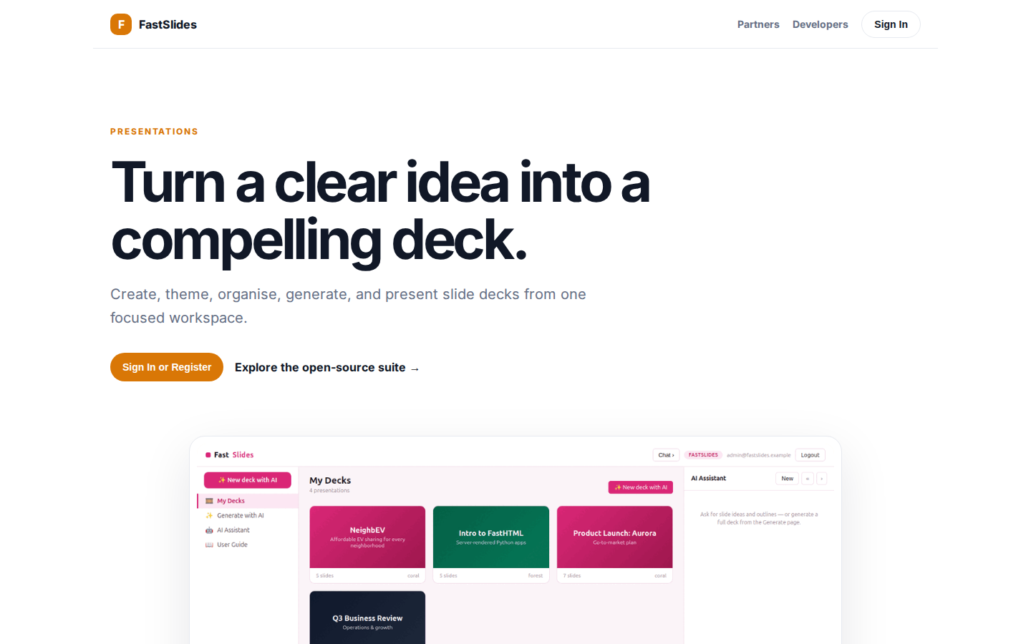
Turn a clear idea into a compelling deck.
PRESENTATIONS Turn a clear idea into a compelling deck. Create, theme, organise, generate, and present slide decks from one focused workspace. Sign In or Register Explore the open-source suite → Product tour · see the workspace in action 01 Deck and slide edit
https://slides.fastsme.com/

Slide 3
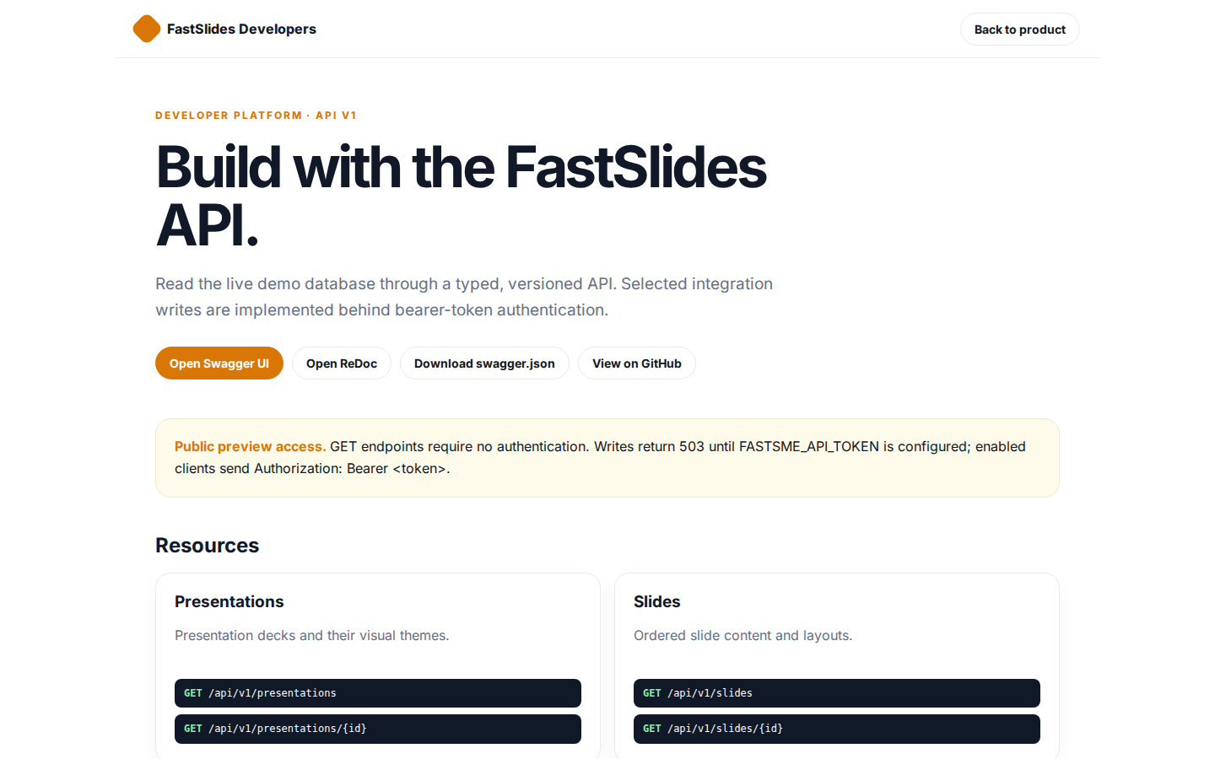
Build with the FastSlides API.
FastSlides Developers Back to product DEVELOPER PLATFORM · API V1 Build with the FastSlides API. Read the live demo database through a typed, versioned API. Selected integration writes are implemented behind bearer-token authentication. Open Swagger UI Open Re
https://slides.fastsme.com/developers

Slide 4
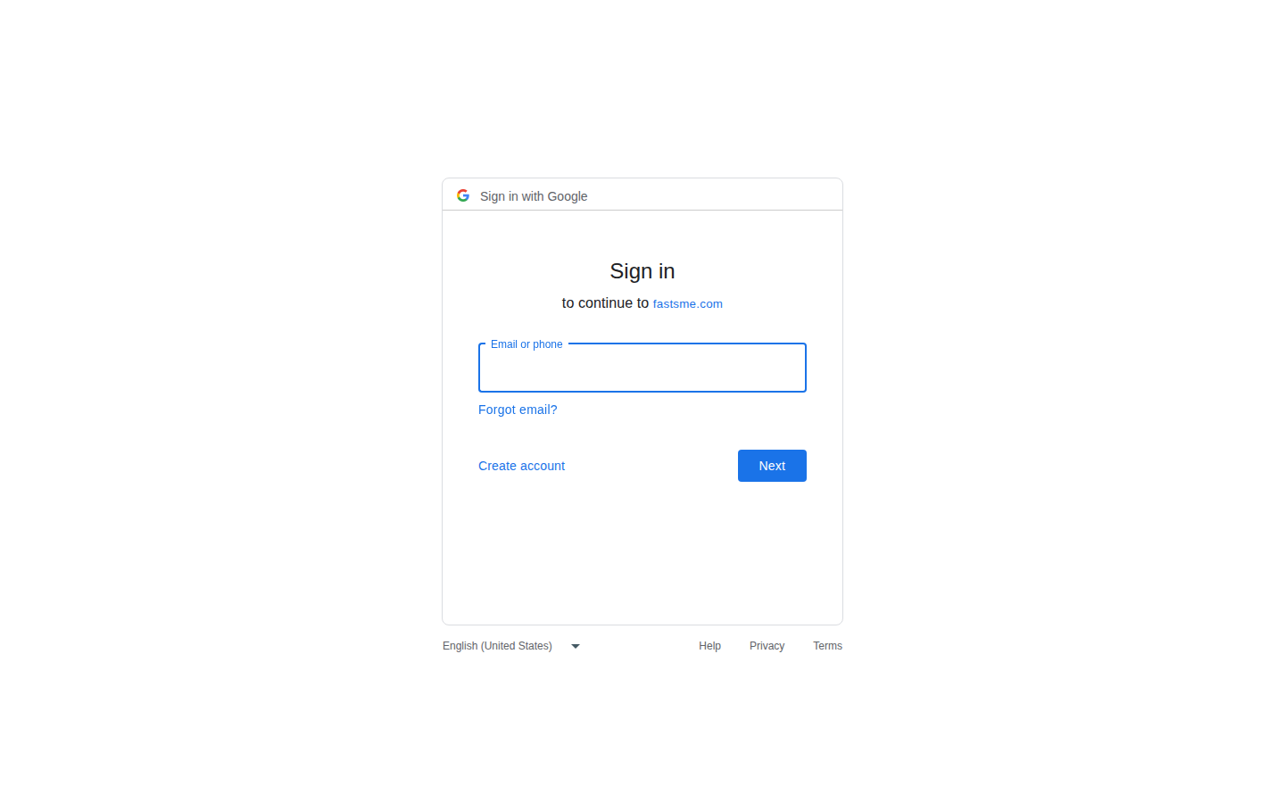
Sign in
Sign in with Google Sign in to continue to fastsme.com Email or phone Forgot email? Next Create account Afrikaans azərbaycan bosanski català Čeština Cymraeg Dansk Deutsch eesti English (United Kingdom) English (United States) Español (España) Español (Latinoam
https://accounts.google.com/v3/signin/identifier?opparams=%253F&dsh=S-536623146%3A1787122859054161&access_type=online&client_id=887059023987-2a7spj1m82eivobdbt1itb3cqca6tpt1.apps.googleusercontent.com&o2v=2&prompt=select_account&redirect_uri=https%3A%2F%2Fslides.fastsme.com%2Fauth%2Fgoogle%2Fcallback&response_type=code&scope=openid+email+profile&service=lso&state=9dTz4OaAs2nPQj3i4aQ_vsj---SrrtvD6fvEQCm9DRs&flowName=GeneralOAuthLite&continue=https%3A%2F%2Faccounts.google.com%2Fsignin%2Foauth%2Flegacy%2Fconsent%3Fauthuser%3Dunknown%26part%3DAJi8hAOLGaPJkUTGYvLciSjqB8yjJyBXy5DV8u8NHz5DDfYyadYE9g-F1symIWDOVBBplBQKA8worU9iPT5VHyeqFB9bxX_X-cAR-fmc3uUNDCubMa0uISYBq7v2kCybG42q9wyssfT8AviCMa1-2ulw60-7VW7UVficsSp8GehCaJkX4Oyy9ShP8S2UtCEC8L_3Eif19M16iY1zUufSbaydPNbtu8AfeuUqNXbPSze9fMKUafzckcIUX0cKTuS6JPv2JpWQlN7TC8b9otil6FbPySBDVXGsEopIiPO6Wb2JNYw-FXfEhDPjuDfjZTg69cjeBit71FiL-Uka0zrZMSn-ICn1xqaVARLxe2xva_GPUOV6OA6_fbsip7JlClL1H7Z30snZC_tOcroS8Z06CSyzNaMQYP4xtjcjv2KiH4fRvW9yOA7ziEOZtL08FeC7yYOTHBMFIEUDGV9Ya0JLp1DZdCnkvGUN4Q%26flowName%3DGeneralOAuthFlow%26as%3DS-536623146%253A1787122859054161%26client_id%3D887059023987-2a7spj1m82eivobdbt1itb3cqca6tpt1.apps.googleusercontent.com%23&app_domain=https%3A%2F%2Fslides.fastsme.com&rart=ANgoxccjjL_rvSfCMaT6DsEXEXdqktgJGTNElx3MiFGOFPg4BKxaH2-RkxHUTOAfumSvRIV3RsCU8hM3plF1_XSXESxizTBHRd184FH5g_2v2CFWD4g_umA

