Slide 1
FastVC Platform Guide
2026-08-19 • https://vc.fastsme.com
FastVC is an AI workspace for venture investment teams. It adapts the proven PEHero workflow to a narrower startup-investing domain: thesis-led discovery, founder and fundraising signals, screening, round construction, diligence, investment committee, LP relations and portfolio support.

Slide 2
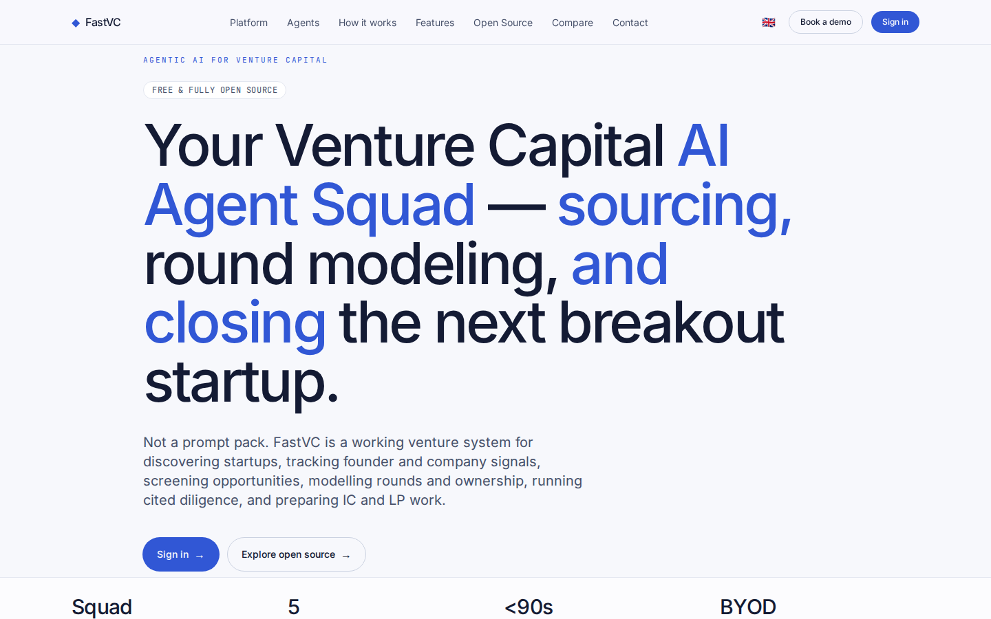
Your Venture Capital AI Agent Squad — sourcing, round modeling, and closing the next break
AGENTIC AI FOR VENTURE CAPITAL FREE & FULLY OPEN SOURCE Your Venture Capital AI Agent Squad — sourcing, round modeling, and closing the next breakout startup. Not a prompt pack. FastVC is a working venture system for discovering startups, tracking founder and
https://vc.fastsme.com/

Slide 3
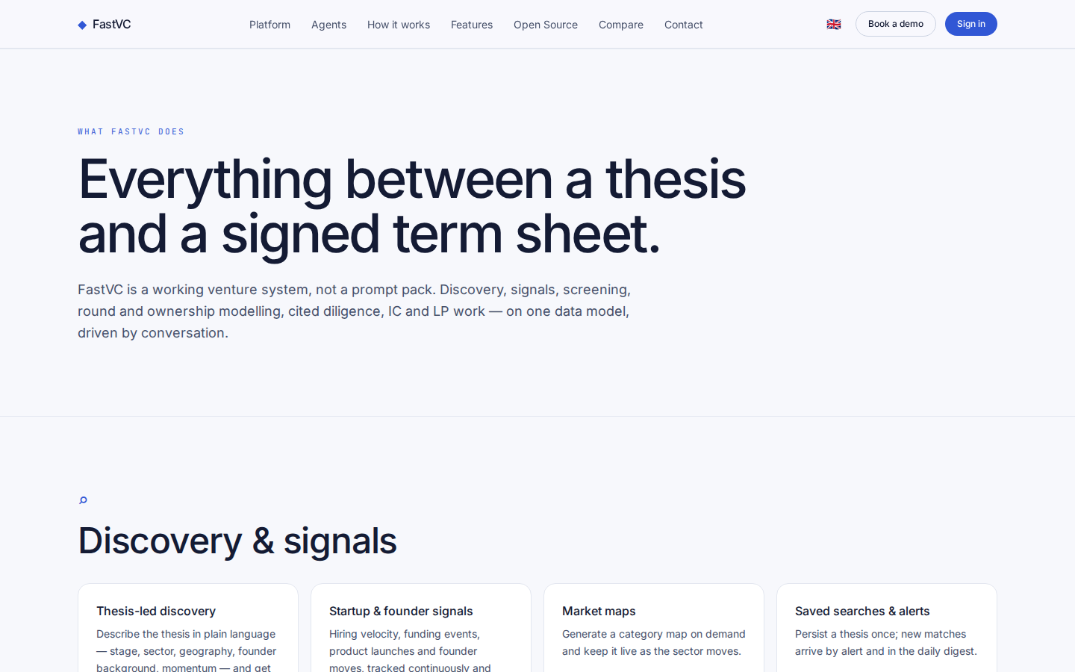
Everything between a thesis and a signed term sheet.
WHAT FASTVC DOES Everything between a thesis and a signed term sheet. FastVC is a working venture system, not a prompt pack. Discovery, signals, screening, round and ownership modelling, cited diligence, IC and LP work — on one data model, driven by conversati
https://vc.fastsme.com/features

Slide 4
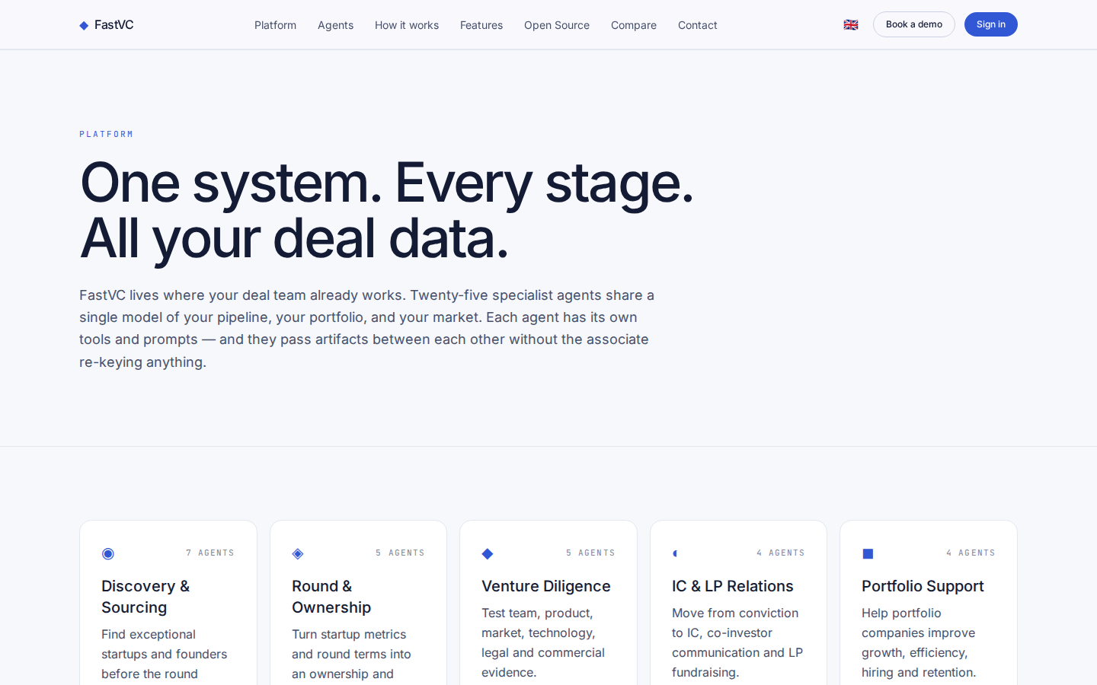
One system. Every stage. All your deal data.
PLATFORM One system. Every stage. All your deal data. FastVC lives where your deal team already works. Twenty-five specialist agents share a single model of your pipeline, your portfolio, and your market. Each agent has its own tools and prompts — and they pas
https://vc.fastsme.com/platform

Slide 5
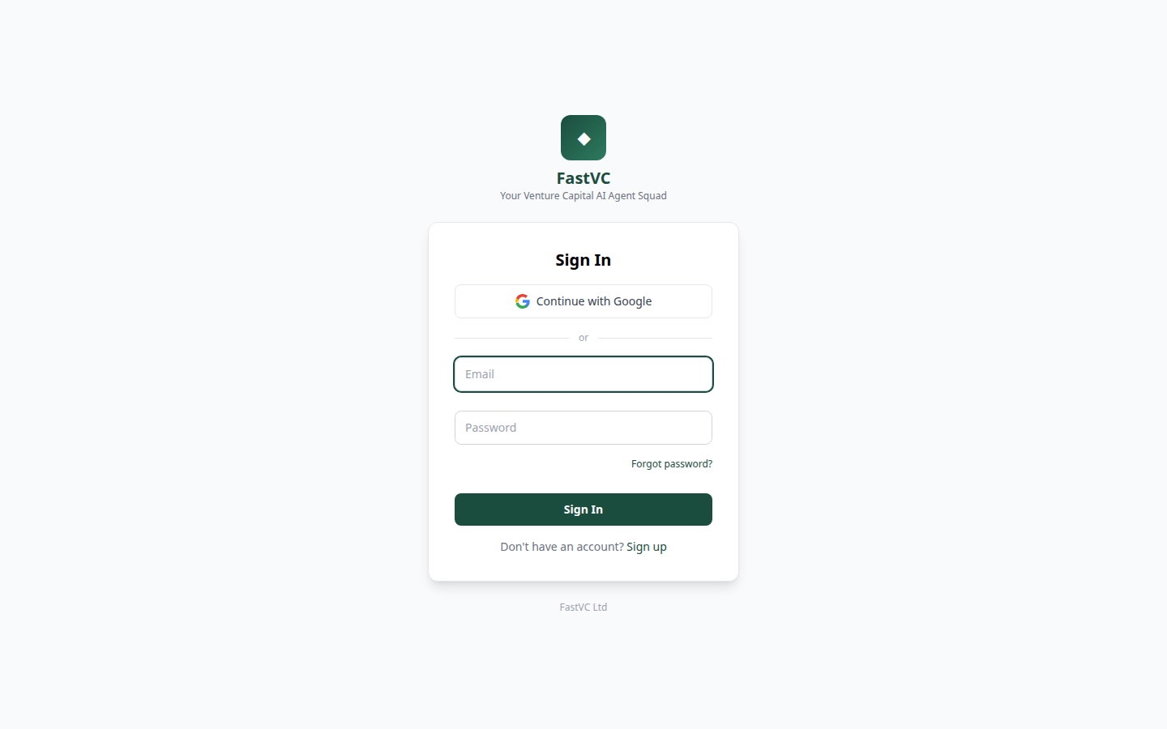
Sign In — FastVC
◆ FastVC Your Venture Capital AI Agent Squad Sign In Continue with Google or Forgot password? Sign In Don't have an account? Sign up FastVC Ltd
https://vc.fastsme.com/signin

