Slide 1
FastVoice Platform Guide
2026-08-19 • https://voice.fastsme.com
FastVoice is a self-hosted voice-agent platform built with Python, FastHTML, HTMX, and browser-native JavaScript. It combines a visual workflow editor, live browser testing, outbound campaigns, telephony, knowledge retrieval, tools, recordings, model configuration, REST APIs, MCP, and a typed Python SDK in one deployab

Slide 2
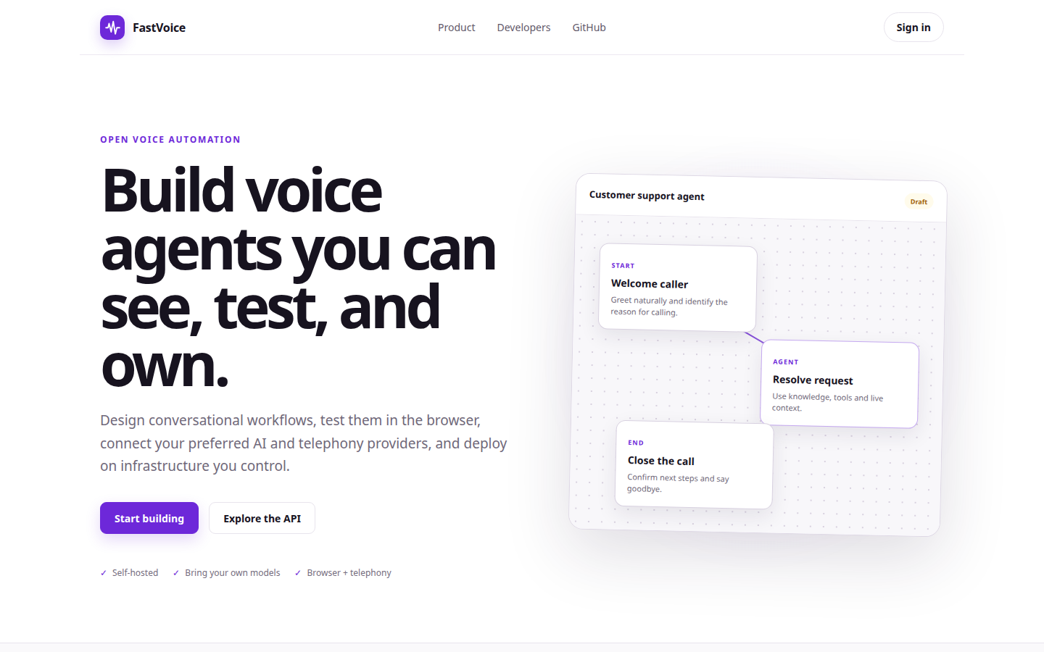
Build voice agents you can see, test, and own.
OPEN VOICE AUTOMATION Build voice agents you can see, test, and own. Design conversational workflows, test them in the browser, connect your preferred AI and telephony providers, and deploy on infrastructure you control. Start building Explore the API Self-hos
https://voice.fastsme.com/

Slide 3
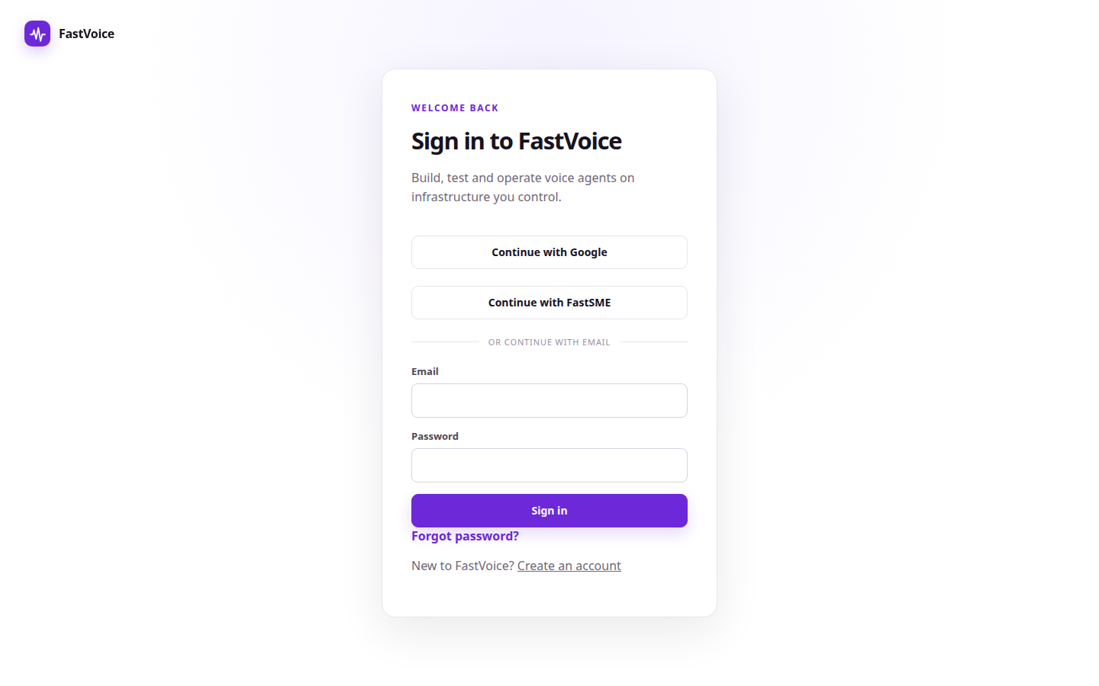
Sign in to FastVoice
FastVoice WELCOME BACK Sign in to FastVoice Build, test and operate voice agents on infrastructure you control. Continue with GoogleContinue with FastSME OR CONTINUE WITH EMAIL Email Password Sign in Forgot password? New to FastVoice? Create an account
https://voice.fastsme.com/login

Slide 4
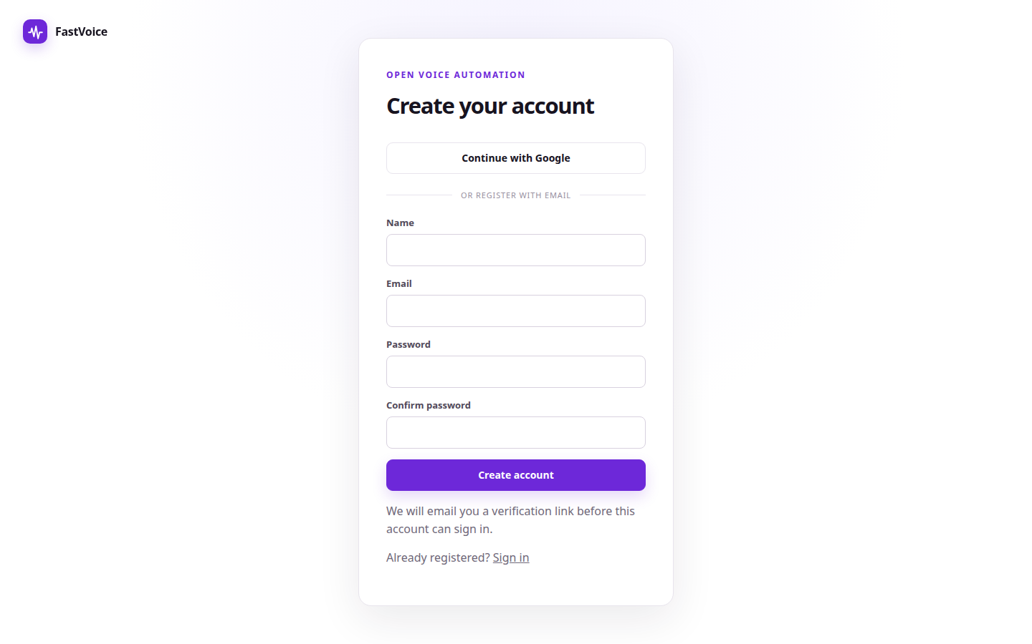
Create your account
FastVoice OPEN VOICE AUTOMATION Create your account Continue with Google OR REGISTER WITH EMAIL Name Email Password Confirm password Create account We will email you a verification link before this account can sign in. Already registered? Sign in
https://voice.fastsme.com/signup

Slide 5
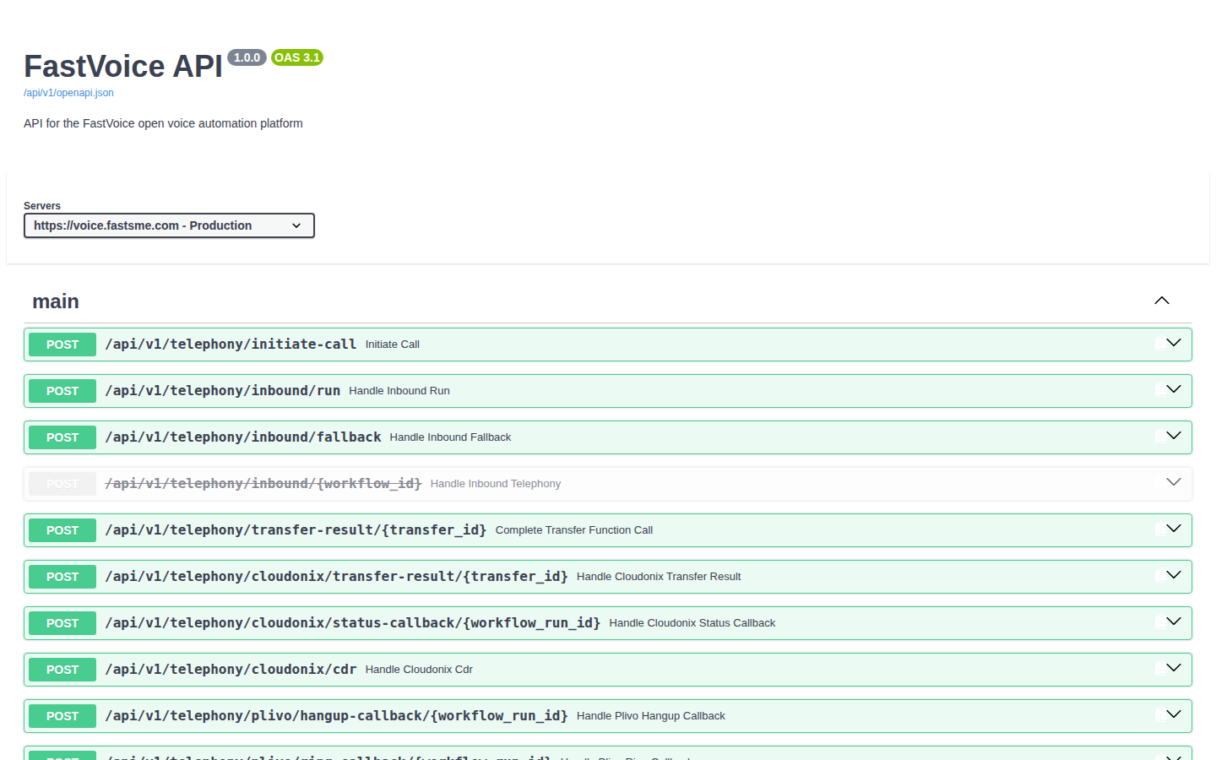
FastVoice API 1.0.0 OAS 3.1
main POST /api/v1/telephony/initiate-call Initiate Call POST /api/v1/telephony/inbound/run Handle Inbound Run POST /api/v1/telephony/inbound/fallback Handle Inbound Fallback POST /api/v1/telephony/inbound/{workflow_id} Handle Inbound Telephony POST /api/v1/tel
https://voice.fastsme.com/api/v1/docs

