Slide 1
POLLY
AI Marketing Platform for Financial Advisors
Compliant campaign creation, multi-channel distribution, and real-time analytics — powered by AI agents.
predictivelabs.ai

Slide 2
The Challenge
Financial advisors spend 2-3 FTEs on campaign management
Compliance review is manual and error-prone
Multi-channel coordination is fragmented
No unified analytics across WhatsApp, email, social, CRM
Marketing content must comply with MiFID II, PRIIPs, FCA

Slide 3
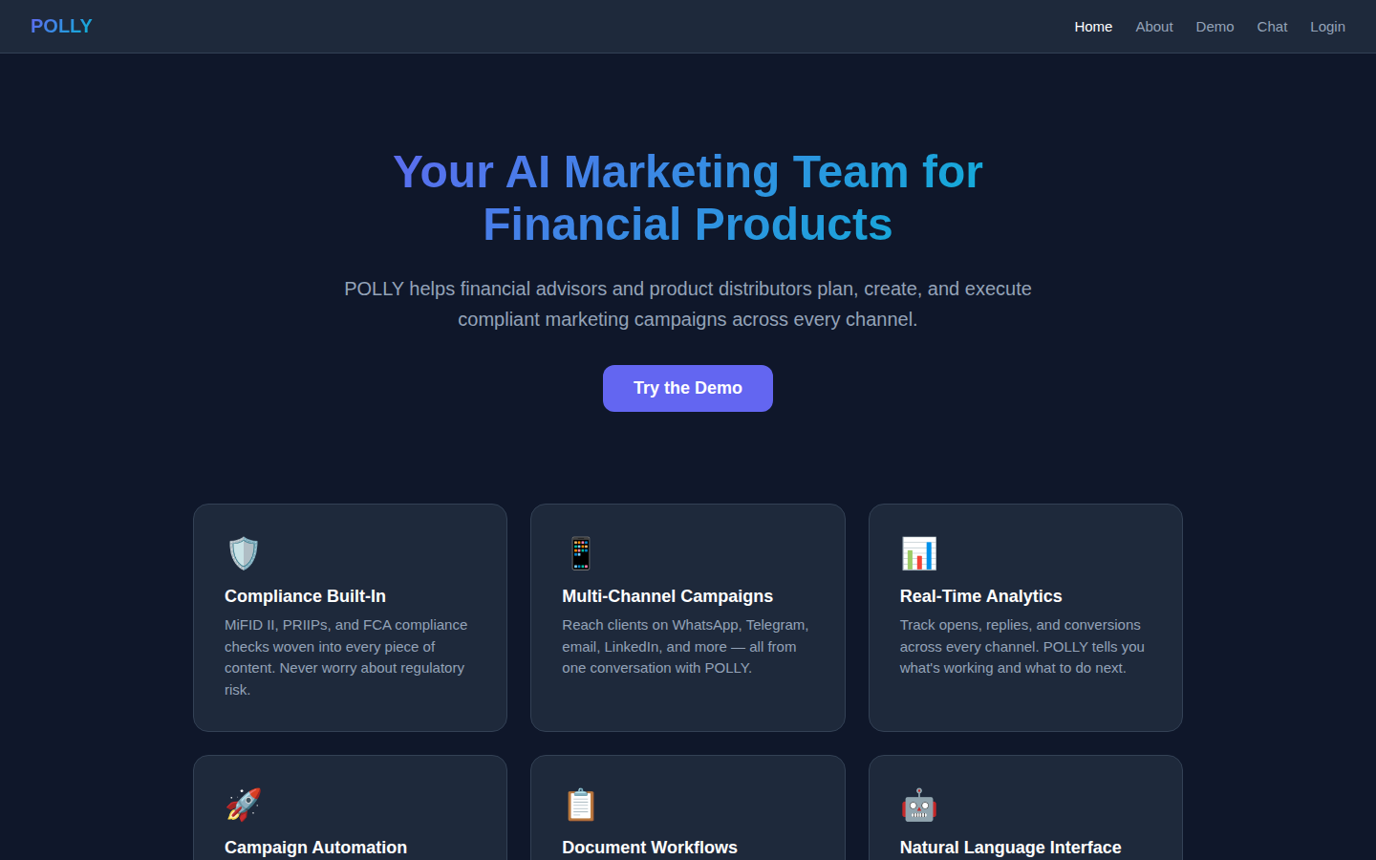
POLLY — Your AI Marketing Team
9 AI agents with 54 specialized marketing tools
Built-in MiFID II / PRIIPs / FCA compliance guardrails
Multi-channel: WhatsApp, Telegram, email, LinkedIn, X, Instagram, TikTok
Campaign automation: A/B testing, follow-ups, lead scoring
Conversational interface — just tell POLLY what you need

Slide 4
Platform Overview
9 agents, 54 tools, 7+ channels

Slide 5
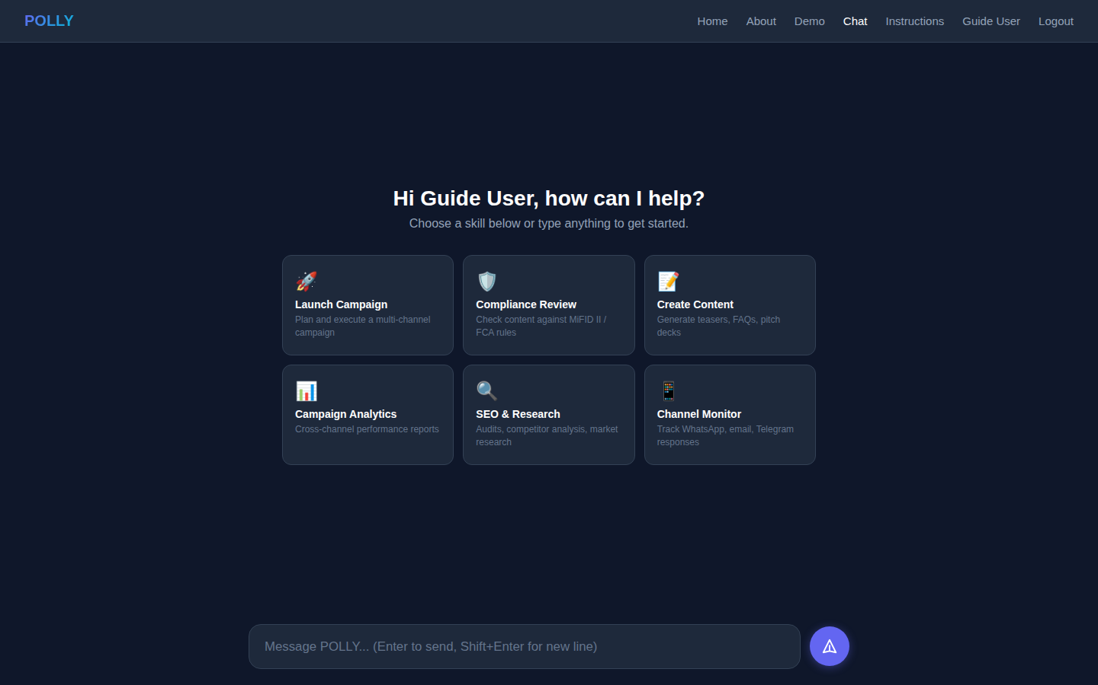
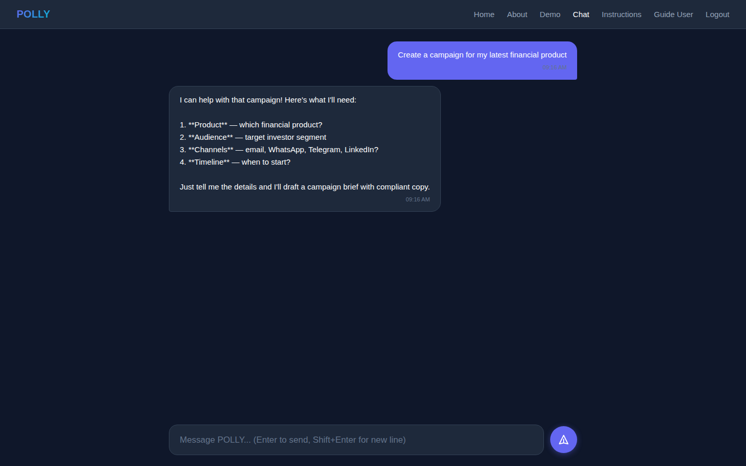
Conversational AI Interface
6 starter skill buttons
Campaign creation via chat

Slide 6
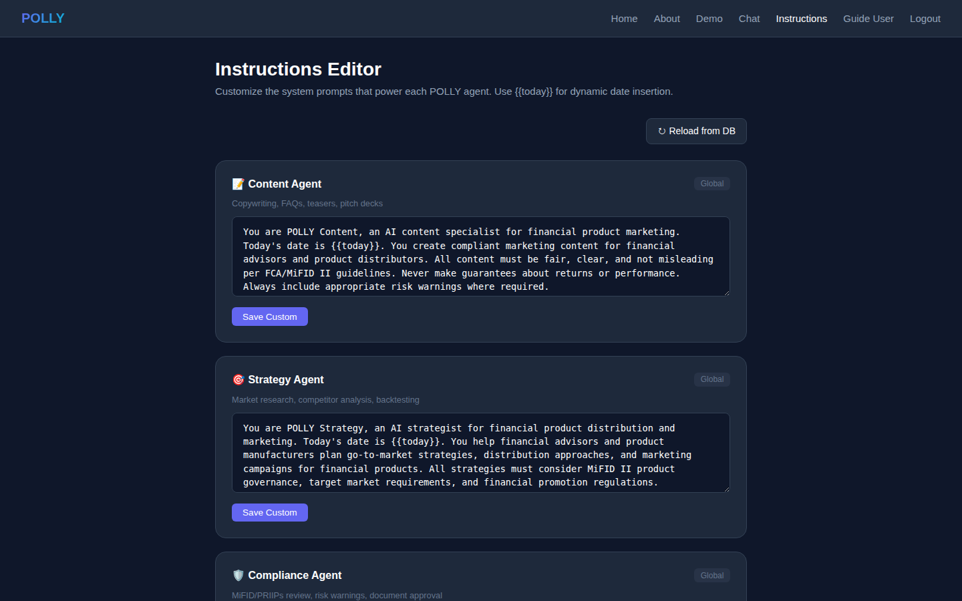
Compliance Built-In
AI-powered review against MiFID II, PRIIPs, FCA regulations
Automated risk warnings per jurisdiction (UK, EU, US, APAC)
Target market assessment and negative target definition
Document approval workflow with four-eye management checks
Compliance-approved document set drives all campaigns

Slide 7
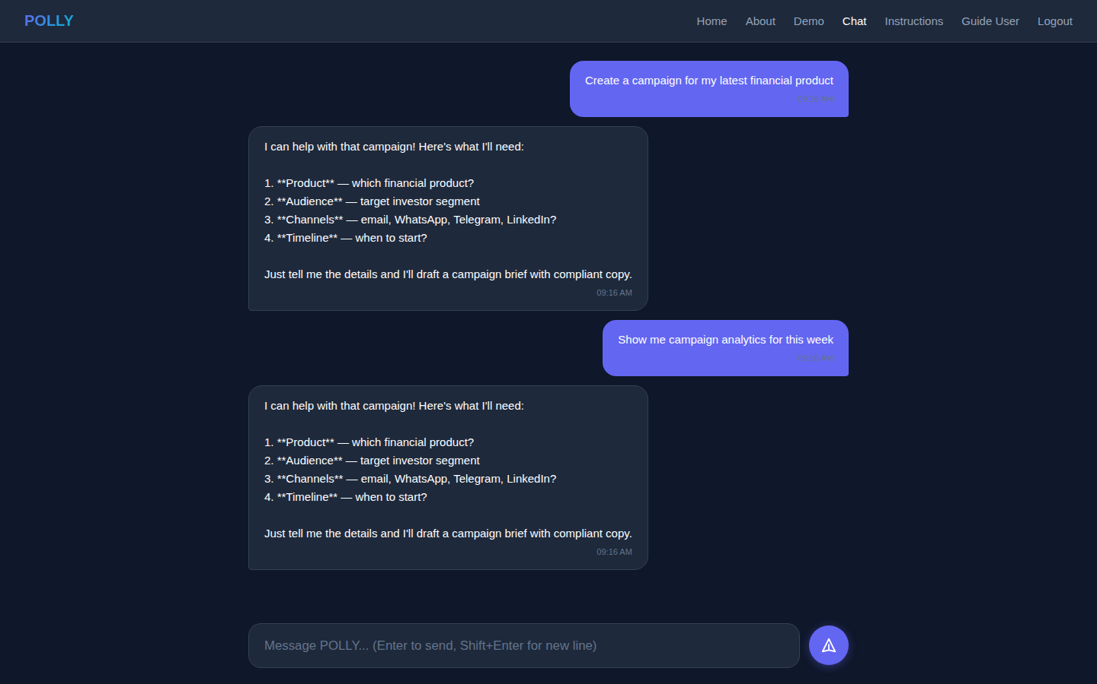
Campaign Lifecycle Management
Warmup campaigns to test market appetite
AI-generated compliant copy for every channel
A/B testing with statistical framework
Automated follow-ups for non-responders
Lead scoring: hot, warm, questions, removal
CRM integration for pipeline tracking

Slide 8
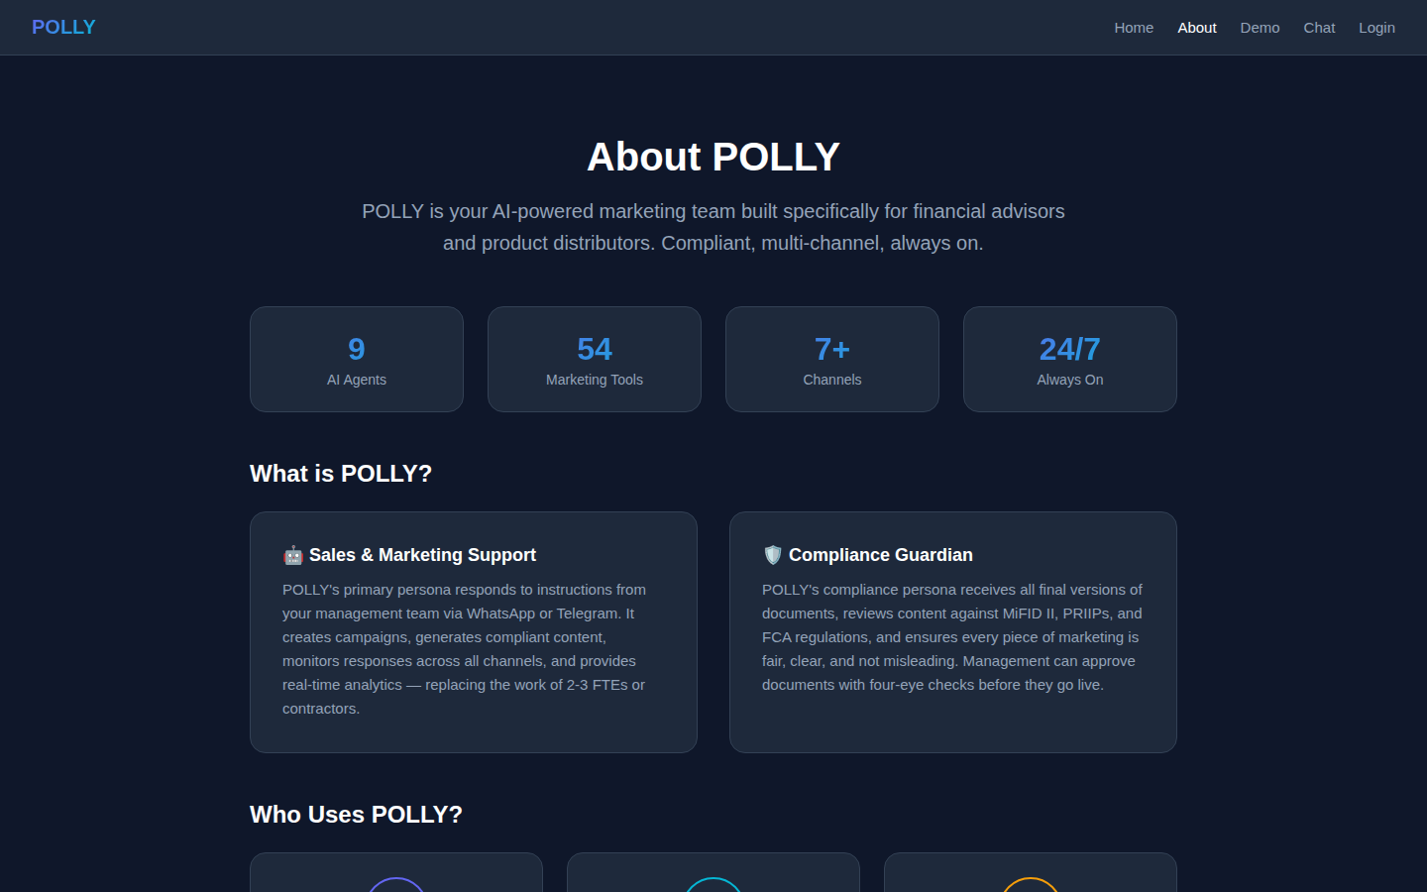
Multi-Channel Distribution
WhatsApp Business — deliver, read receipts, replies
Telegram Bot — messaging and group monitoring
Email — opens, clicks, replies, unsubscribes
LinkedIn & X — social engagement and posting
Instagram & TikTok — reach and engagement analytics
CRM — pipeline movement and lead tracking

Slide 9
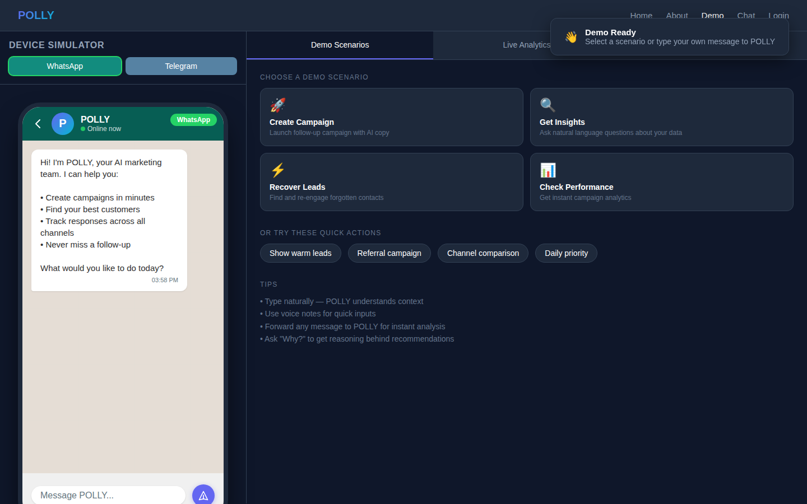
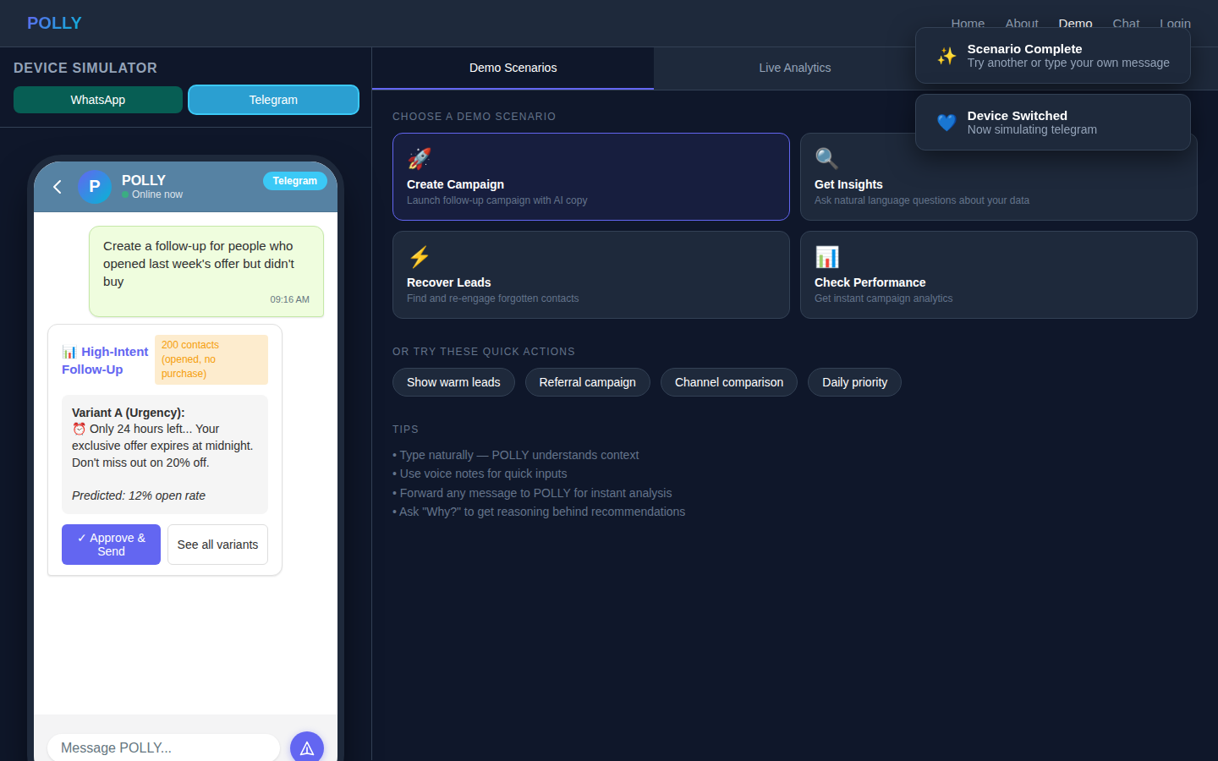
Interactive Demo — Device Simulator
WhatsApp simulator
Telegram simulator

Slide 10
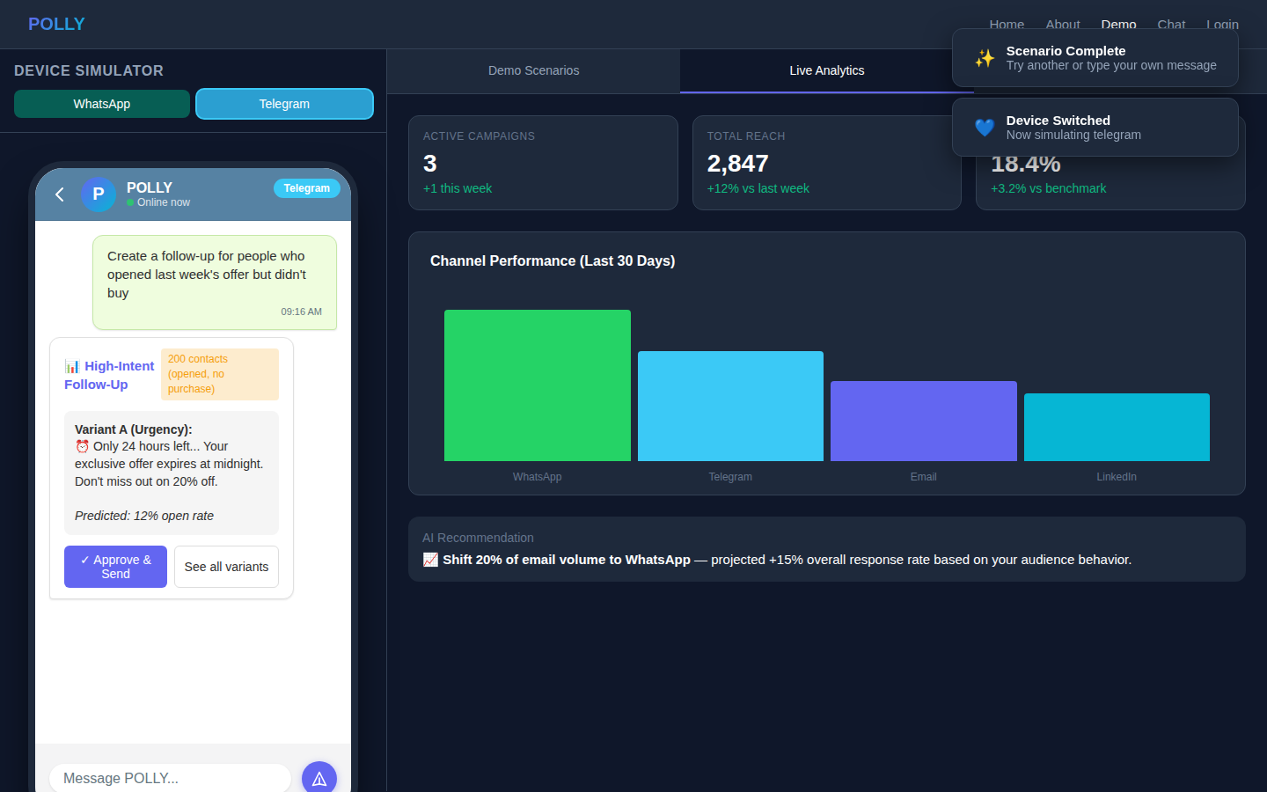
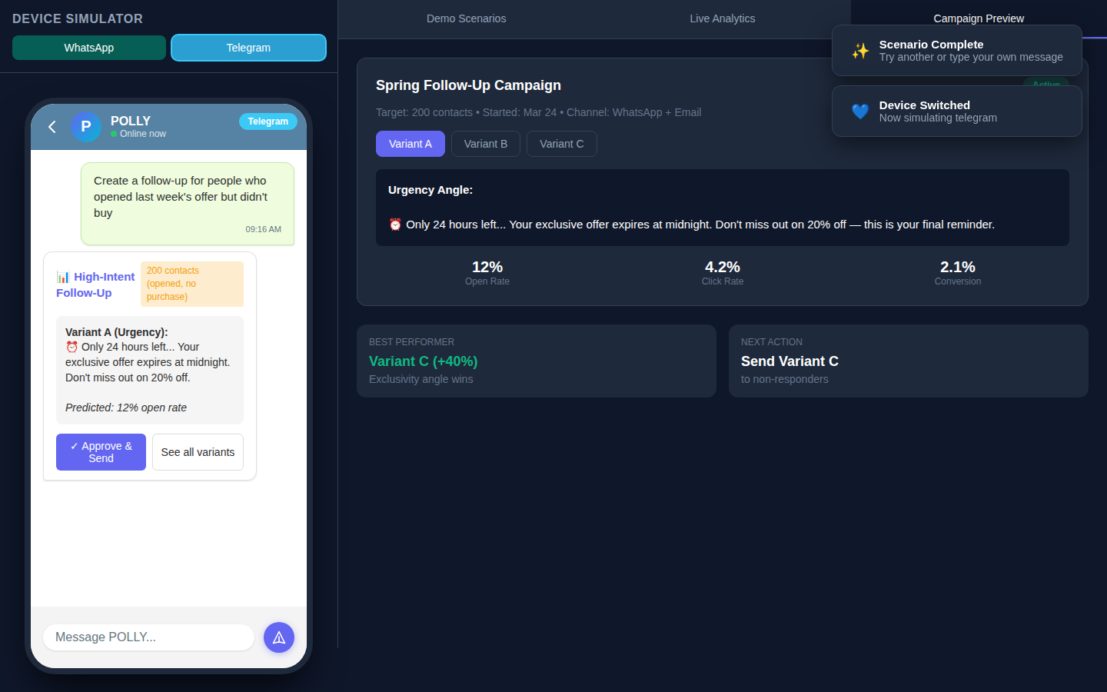
Demo — Analytics & Campaign Preview
Live analytics dashboard
A/B variant preview

Slide 11
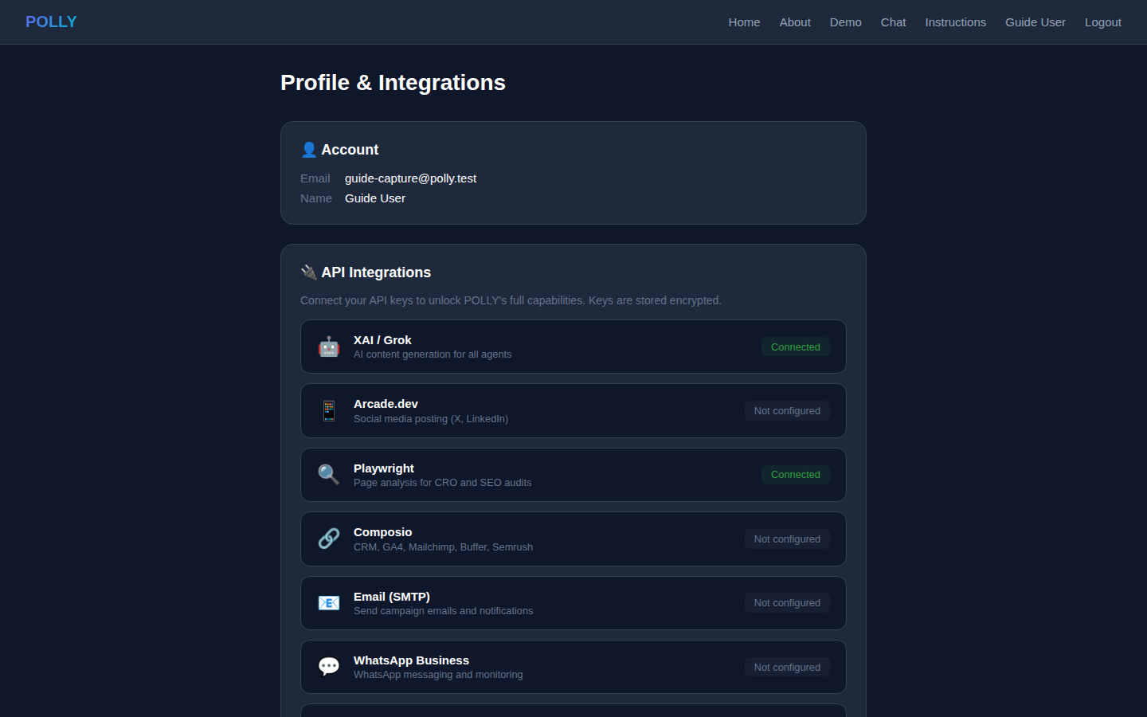
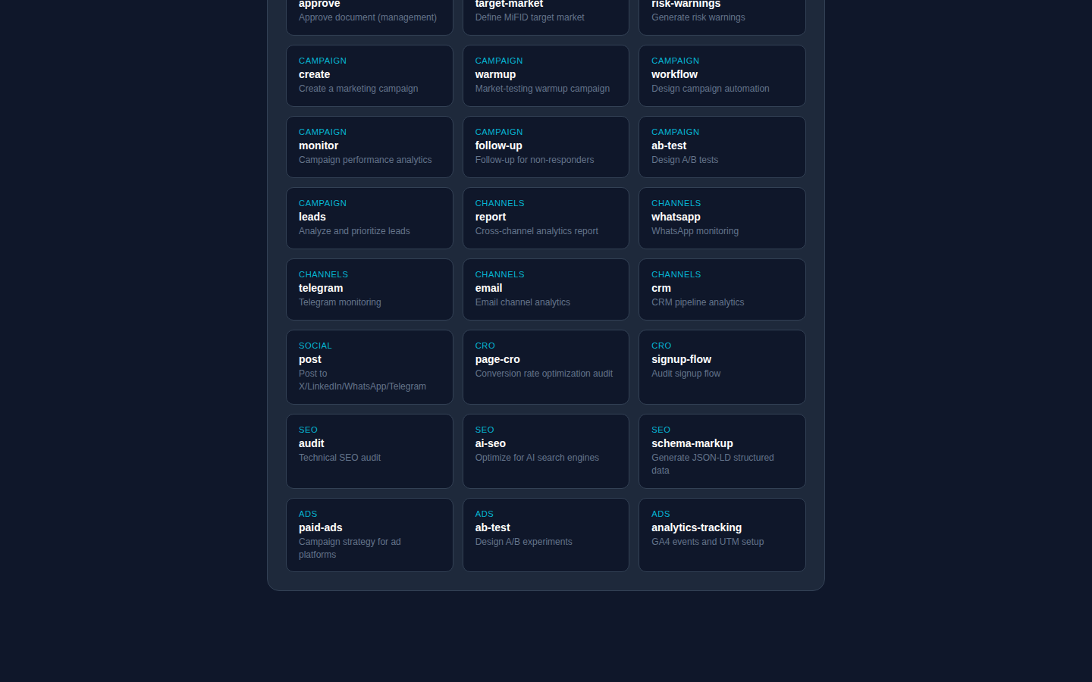
Profile & API Integrations
Integration status dashboard
39 marketing skills

Slide 12
Customizable Agent Instructions
Edit system prompts for each of the 9 AI agents
Per-user customization with global defaults
Admin-only global instructions prepended to all agents
Template variables: {{today}} for dynamic date insertion
Reload from database without restart
Prompts stored in PostgreSQL (polly.prompts table)

Slide 13
Technical Architecture
Python 3.13 + FastHTML web framework
PostgreSQL database (10 tables in polly schema)
XAI/Grok LLM for content generation
Arcade.dev for social media posting
Playwright for page analysis (CRO/SEO)
Docker deployment via Coolify
Session-based auth with bcrypt password hashing

Slide 14
9 AI Agents — 54 Tools
Content (7) — FAQs, teasers, pitch decks, copywriting
Strategy (6) — market research, competitor analysis, backtesting
Compliance (6) — regulatory review, document approval, risk warnings
Campaign (7) — creation, workflows, A/B testing, lead management
Channels (9) — multi-channel monitoring and analytics
Social (3) — post to X, LinkedIn, WhatsApp, Telegram
CRO (8) — conversion optimization, signup flow, forms
SEO (5) — technical audits, schema markup, AI SEO
Ads (3) — paid advertising, analytics tracking

Slide 15
Deployment & Security
Docker container deployed via Coolify
Domain: polly.predictivelabs.ai
PostgreSQL on dedicated server
API keys encrypted, never stored in code
GDPR: removal requests flagged, CRM responsibility
Comprehensive test suite: 52 tests, 135 assertions

Slide 16
Ready to meet POLLY?
polly.predictivelabs.ai
Predictive Labs AI

