Slide 1

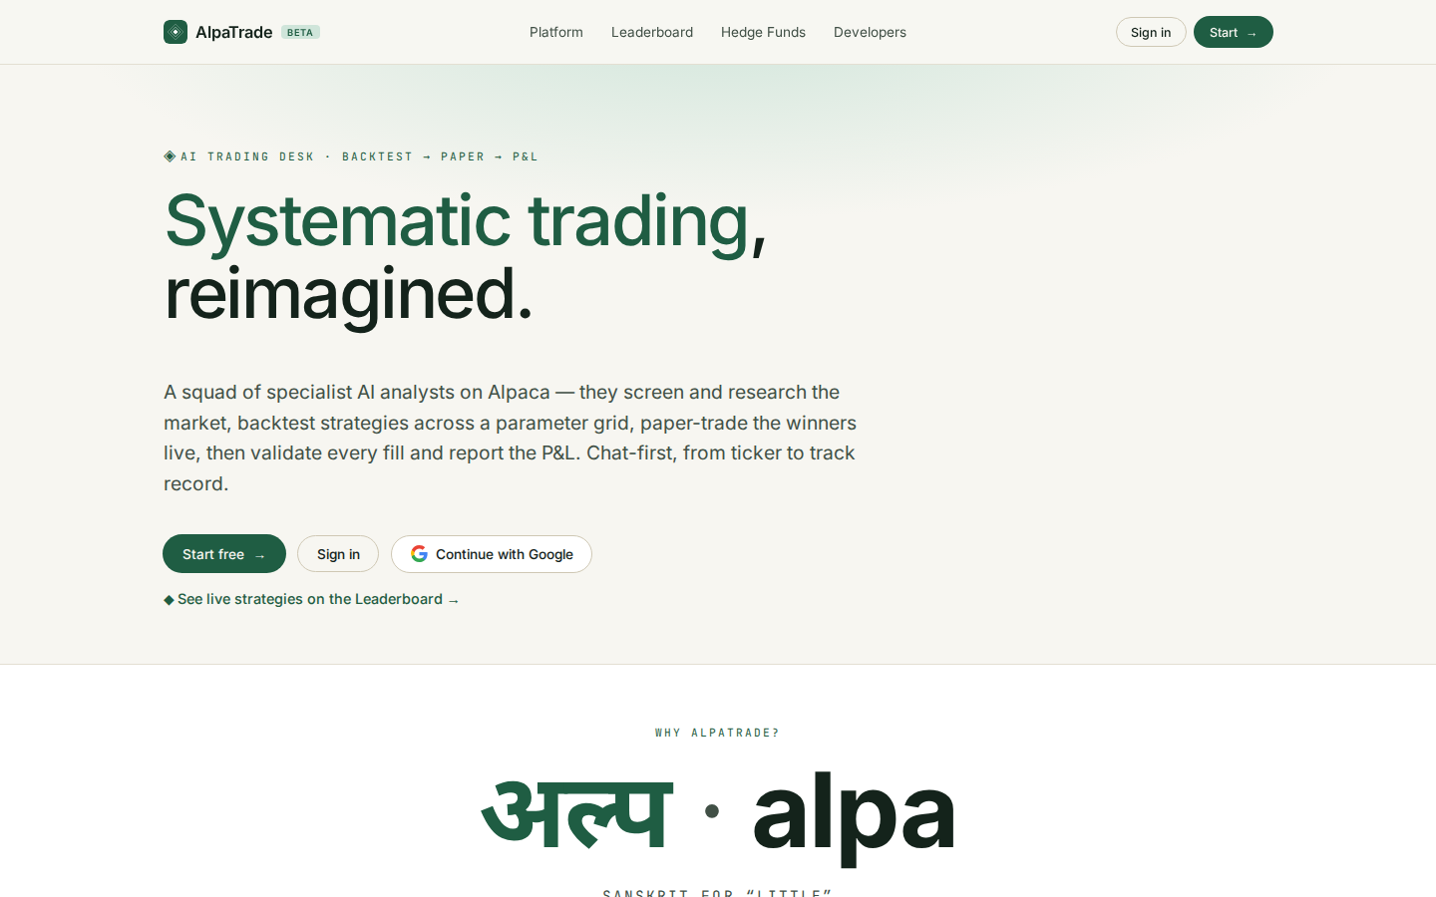
AlpaTrade
AlpaTrade user guide
The chat-first AI trading desk on Alpaca, from sign-in to your first live strategy
• Part 1 · Getting started: sign in, connect Alpaca from the chat, clone the Mag-7 buy-the-dip strategy, backtest it and activate it
• Part 2 · Advanced features: every other menu, from the Leaderboard and Hedge Funds to the Dashboard, Settings, News and Profile
• Version 0.40.1 · 12 October 2026 · Predictive Labs Ltd
AlpaTrade user guide · v0.40.1 · 12 October 2026 · © Predictive Labs Ltd 2026
1

Slide 2
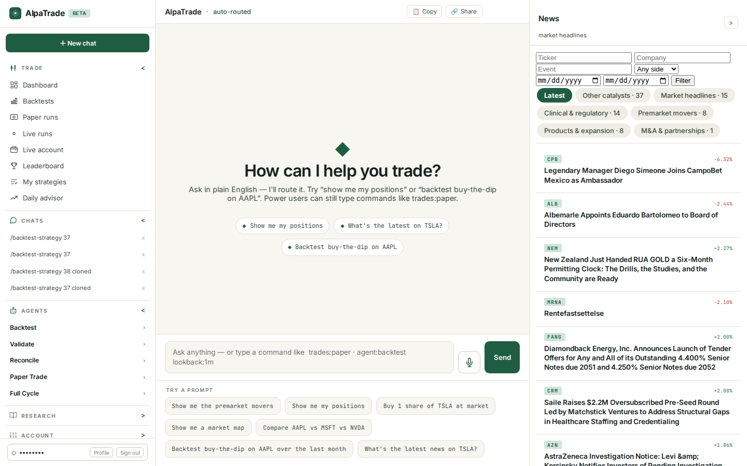
AlpaTrade
PART 1 · GETTING STARTED
1. Sign in and open the chat
• Go to alpatrade.chat and choose Sign in, or Start to create a free account.
• Sign in with Google, or with your email and password.
• You land in the chat. The left menu holds Trade, Chats, Agents, Research and Account. Market news is on the right.
• Type a request in plain English, or tap one of the Try a prompt ideas below the box.
AlpaTrade user guide · v0.40.1 · 12 October 2026 · © Predictive Labs Ltd 2026
2

Slide 3
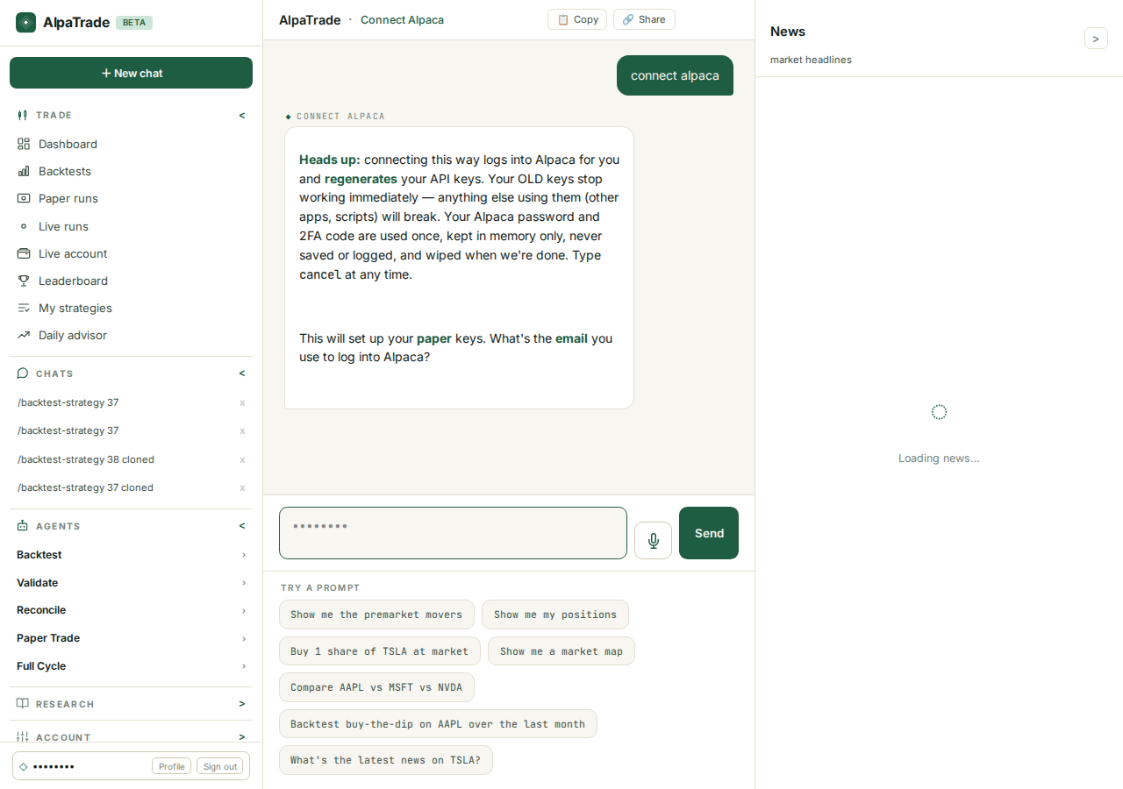
AlpaTrade
PART 1 · GETTING STARTED
2. Connect Alpaca from the chat
• In the chat box, type connect alpaca. Type connect alpaca live to set up your live keys as well.
• Read the heads-up first. AlpaTrade logs in to Alpaca for you and creates new API keys, so your old keys stop working at once.
• Enter the email you use for Alpaca, then your Alpaca password. The box hides what you type. The password is used once and never saved.
• Type cancel at any time to stop.
AlpaTrade user guide · v0.40.1 · 12 October 2026 · © Predictive Labs Ltd 2026
3

Slide 4
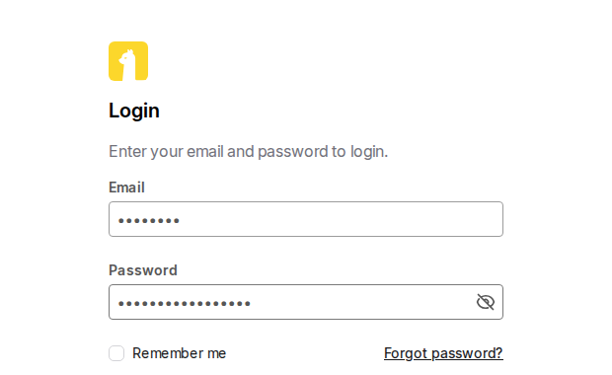
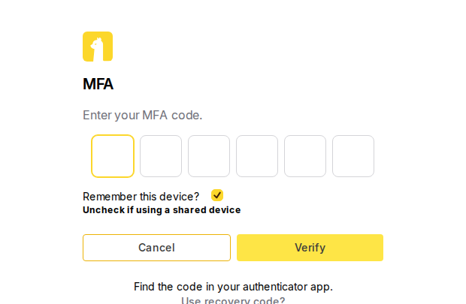
AlpaTrade
PART 1 · GETTING STARTED
You only type the 2FA code
• AlpaTrade opens Alpaca's login page in a secure browser on its server and fills in your email and password for you (masked in these pictures).
• Alpaca then asks for the 6-digit code from your authenticator app.
• Type that code into the AlpaTrade chat straight away, because codes expire in about 30 seconds. It is hidden and never stored.
• You don't open Alpaca yourself. The 2FA code is the only thing you type.
AlpaTrade user guide · v0.40.1 · 12 October 2026 · © Predictive Labs Ltd 2026
4

Slide 5
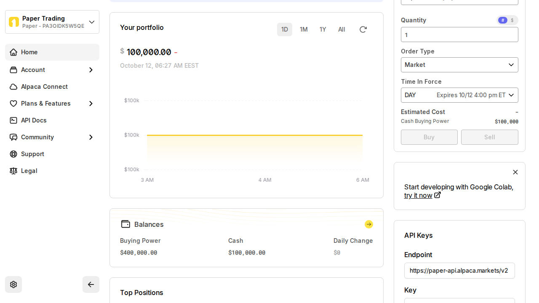
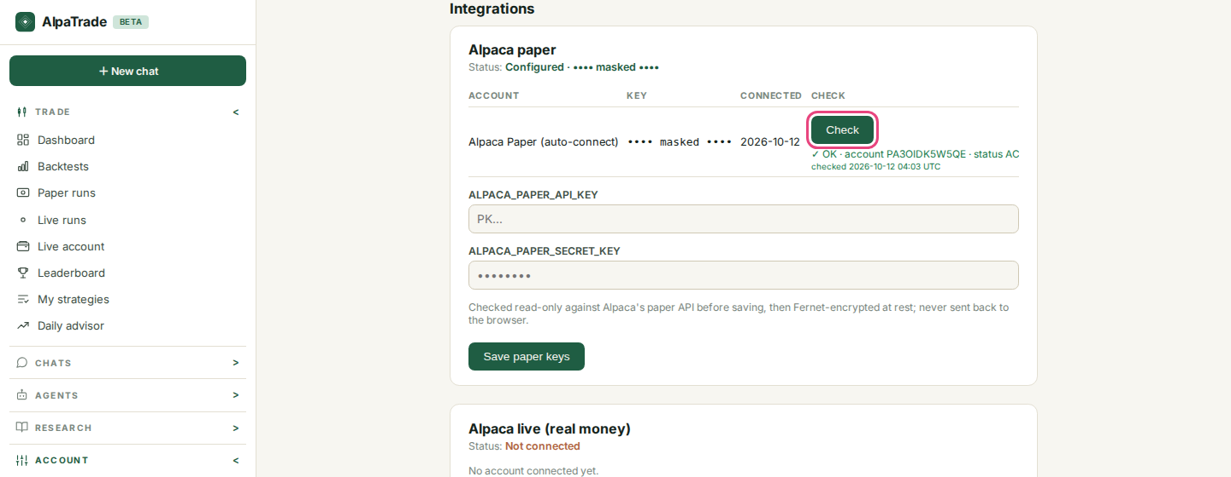
AlpaTrade
PART 1 · GETTING STARTED
New keys created, saved and checked
• AlpaTrade creates a fresh paper key pair on your Alpaca dashboard. The key and secret are masked here.
• The keys are checked read-only with Alpaca and then stored encrypted. The secret is never sent back to your browser.
• The chat confirms: Done! Alpaca is connected.
• Settings > Integrations now shows Alpaca paper as Configured. Press Check at any time: a green OK shows your account and its status.
• Prefer to do it by hand? Paste your keys into the same Settings form.
AlpaTrade user guide · v0.40.1 · 12 October 2026 · © Predictive Labs Ltd 2026
5

Slide 6
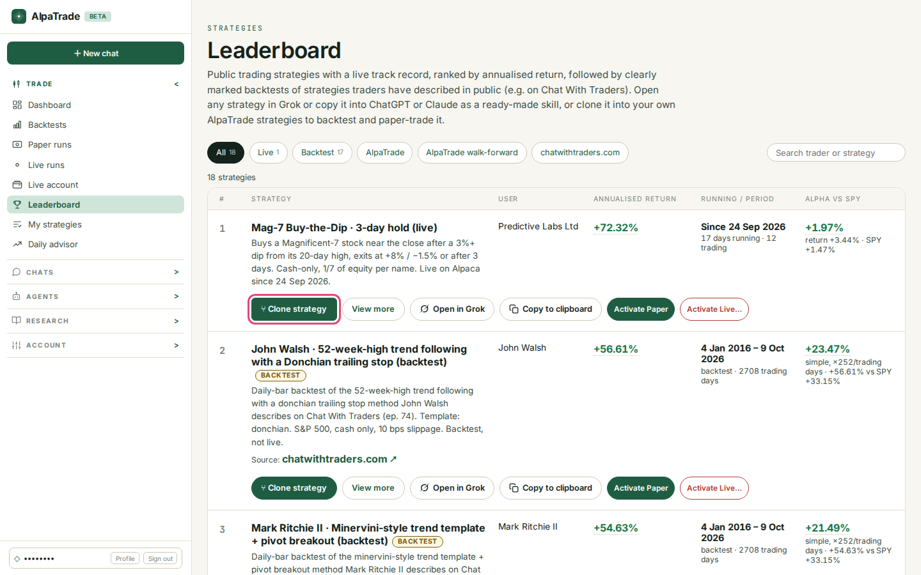
AlpaTrade
PART 1 · GETTING STARTED
3. Pick Mag-7 Buy-the-Dip and clone it
• Open Leaderboard from the left menu.
• Mag-7 Buy-the-Dip · 3-day hold (live) is the live strategy run by Predictive Labs Ltd. It buys a Magnificent-7 stock after a dip of 3% or more from its 20-day high. It sells at +8%, at −1.5% or after 3 days.
• Each row shows the annualised return, how long the strategy has run, and its alpha vs SPY.
• Press Clone strategy. You get your own private copy, and a backtest starts in a new chat. If you clone the same strategy again, AlpaTrade reuses your copy.
AlpaTrade user guide · v0.40.1 · 12 October 2026 · © Predictive Labs Ltd 2026
6

Slide 7
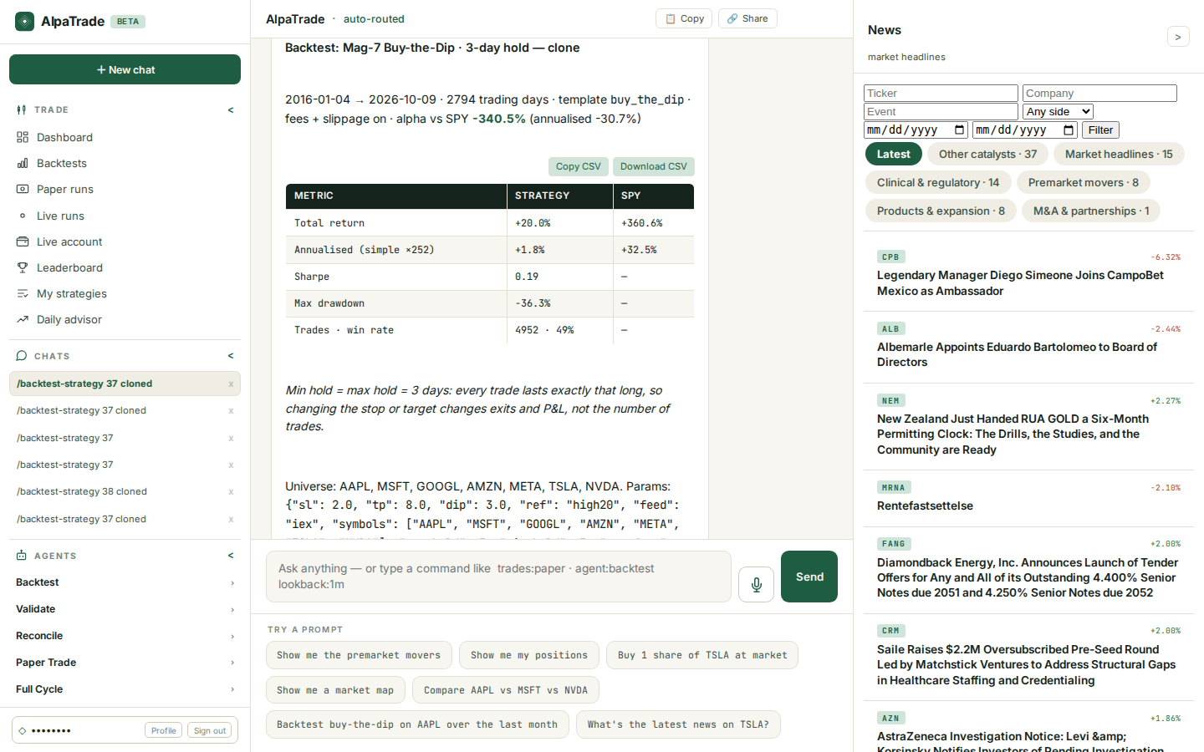
AlpaTrade
PART 1 · GETTING STARTED
4. Backtest your copy in the chat
• The backtest uses daily data from January 2016 to today, with fees and slippage included.
• The table compares your strategy with SPY: total return, annualised return, Sharpe ratio, maximum drawdown, number of trades and win rate.
• In this run the strategy made +20.0% in total (+1.8% a year), against +360.6% for SPY. Sharpe was 0.19, the worst drawdown −36.3%, with 4,952 trades and 49% of them winners.
• Copy CSV and Download CSV export the figures.
• A backtest is hypothetical. It is not investment advice.
AlpaTrade user guide · v0.40.1 · 12 October 2026 · © Predictive Labs Ltd 2026
7

Slide 8
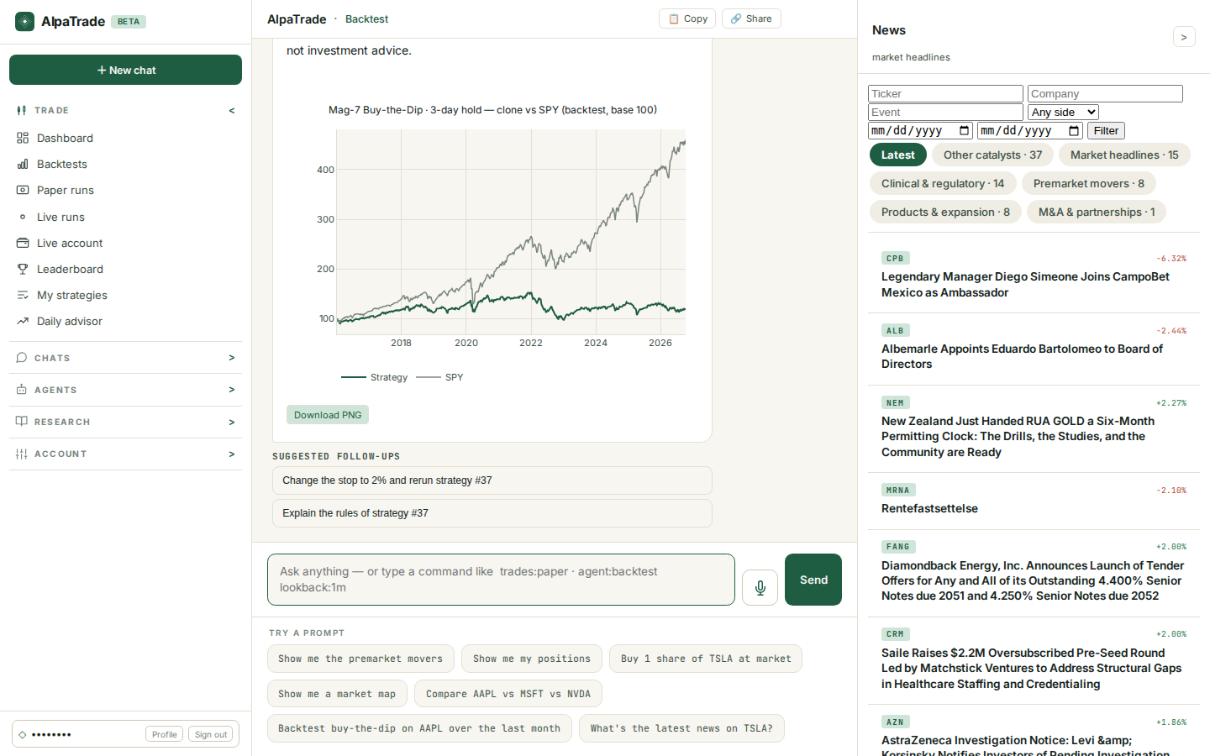
AlpaTrade
PART 1 · GETTING STARTED
The equity curve vs SPY
• Below the table, a chart shows your strategy and SPY. Both lines start at 100.
• Download PNG saves the chart.
• To try a change, ask in plain English, for example: change the stop to 2% and rerun strategy #37. You can also tap a suggested follow-up.
• Open the strategy page to read the full rules or to rerun the backtest.
AlpaTrade user guide · v0.40.1 · 12 October 2026 · © Predictive Labs Ltd 2026
8

Slide 9
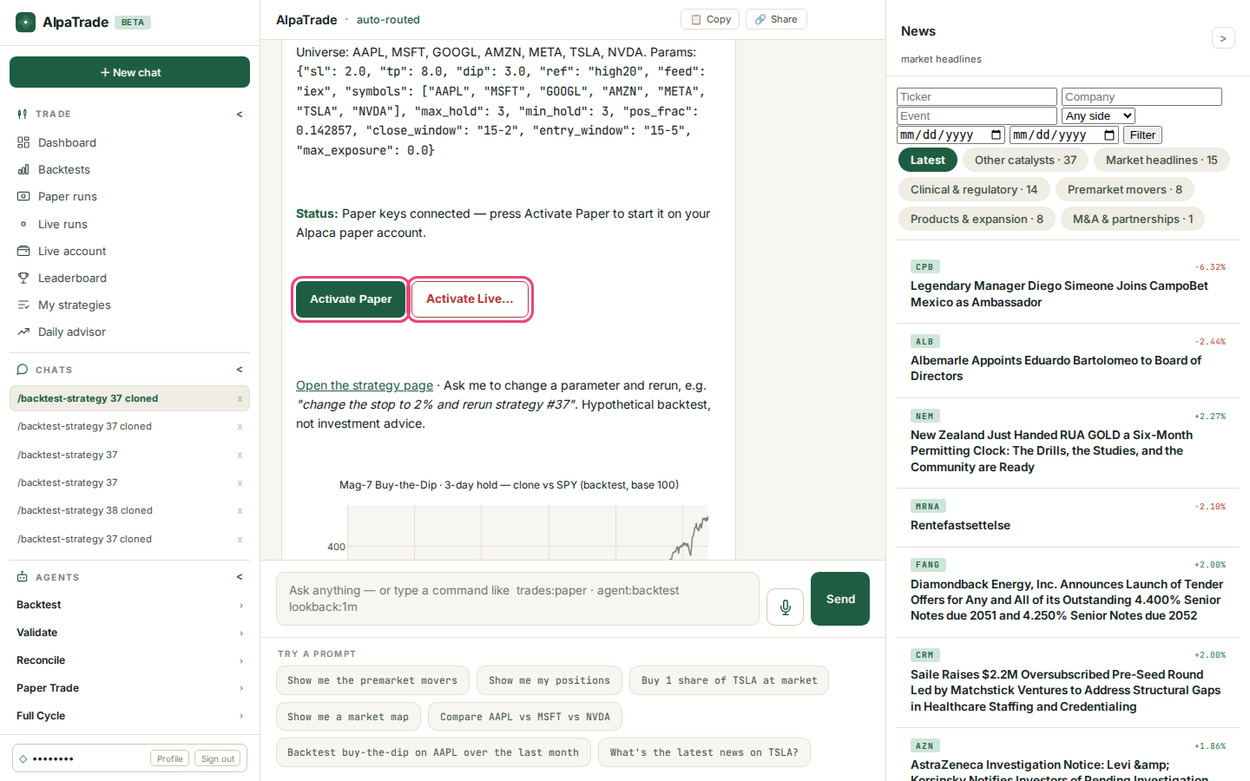
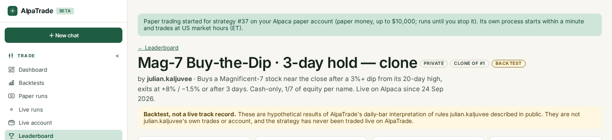
AlpaTrade
PART 1 · GETTING STARTED
5. Activate on paper or live
• Under the backtest, the chat shows your status and two buttons.
• Activate Paper trades with paper money (up to $10,000) on your Alpaca paper account until you stop it. It starts within a minute and trades during US market hours (ET).
• Activate Live… always opens a confirmation page first. One click never starts live trading.
• The same buttons appear on the Leaderboard and under My strategies.
AlpaTrade user guide · v0.40.1 · 12 October 2026 · © Predictive Labs Ltd 2026
9

Slide 10
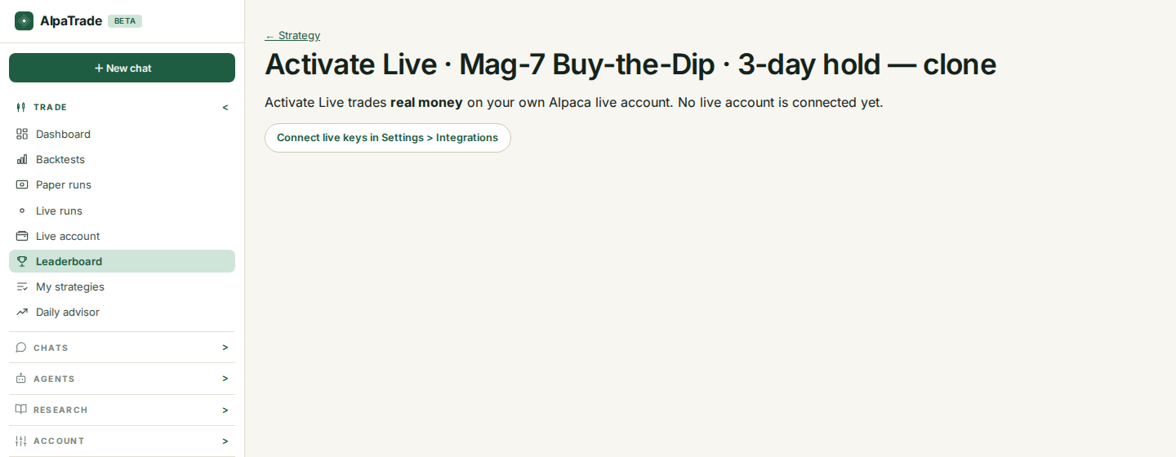
AlpaTrade
PART 1 · GETTING STARTED
Activate Live: you confirm first
• Activate Live trades real money on your own Alpaca live account, using cash only.
• If no live account is connected, you see this page. Follow the link to Settings > Integrations, or type connect alpaca live in the chat.
• With a live account connected, the page shows the amount the strategy may use and asks you to confirm. The strategy starts only after you confirm.
• Later you can Pause it (no new buys; open trades still exit) or Deactivate it.
AlpaTrade user guide · v0.40.1 · 12 October 2026 · © Predictive Labs Ltd 2026
10

Slide 11
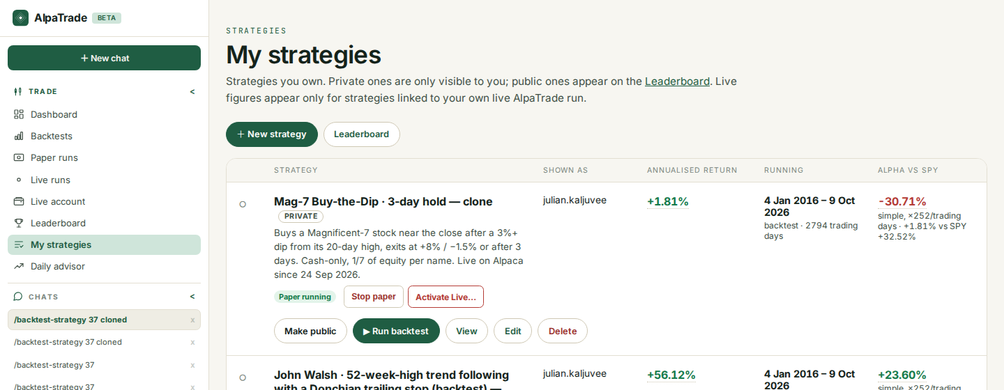
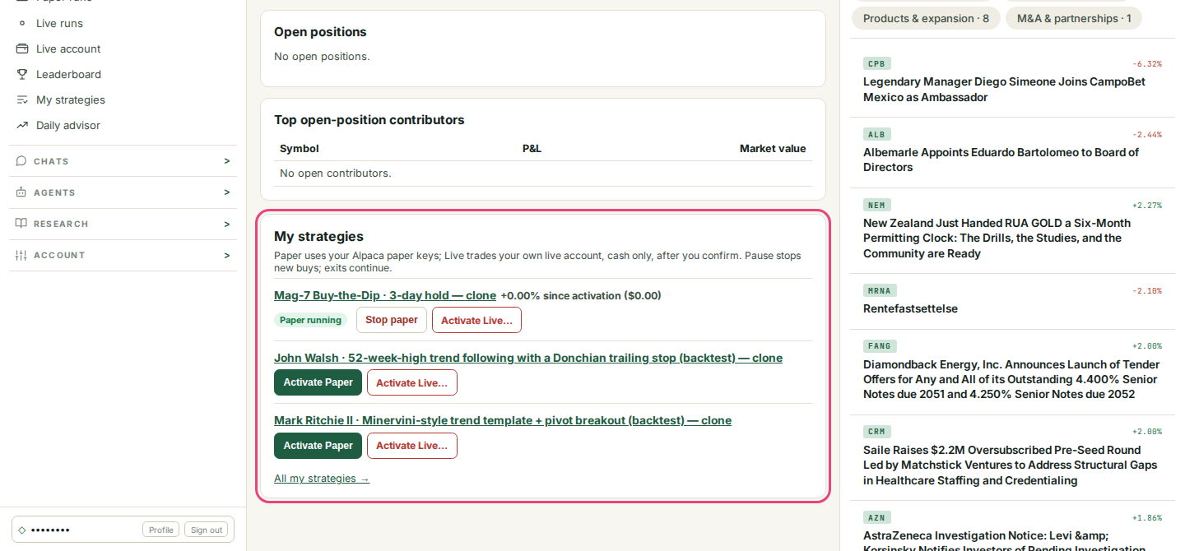
AlpaTrade
PART 1 · GETTING STARTED
My strategies and the Dashboard card
• My strategies lists every strategy you own, private ones included, with Shown as, annualised return, running period and alpha vs SPY.
• A strategy that is trading shows Paper running, with a Stop paper button next to it.
• The Dashboard has a My strategies card with the same controls and the return since you activated it.
• Make public lists your strategy on the Leaderboard. Edit and Delete sit beside it.
AlpaTrade user guide · v0.40.1 · 12 October 2026 · © Predictive Labs Ltd 2026
11

Slide 12
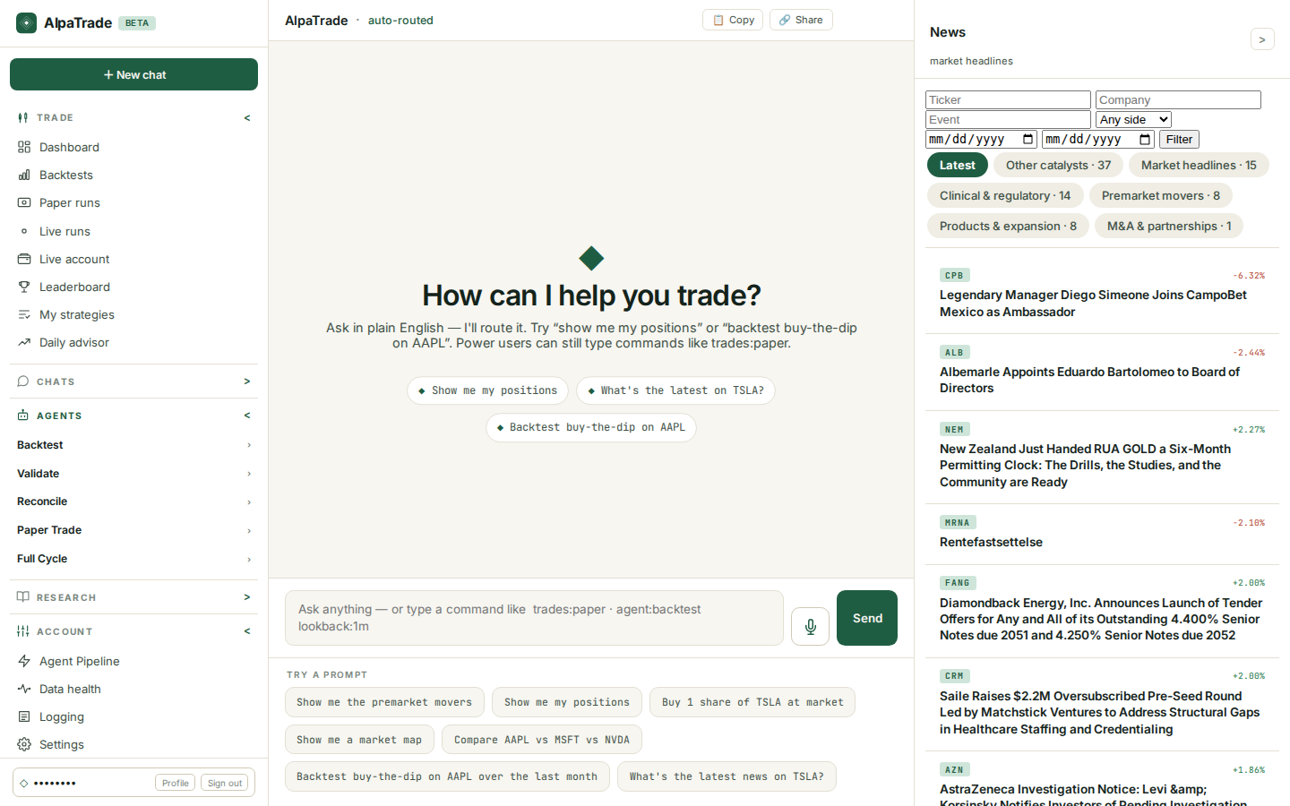
AlpaTrade
PART 2 · ADVANCED FEATURES
Part 2 · Advanced features
Everything beyond your first strategy
• Public site: Platform, Leaderboard, Hedge Funds and Developers.
• Trade: Dashboard, Backtests, Paper runs, Live runs, Live account, Leaderboard, My strategies and Daily advisor.
• Agents: Backtest, Validate, Reconcile, Paper Trade and Full Cycle.
• Research: Market Map, Charts, Premarket, Model Analytics, News, Hedge Funds and more.
• Account: Agent Pipeline, Data health, Logging, Settings and Help. Profile is at the bottom of the menu.
AlpaTrade user guide · v0.40.1 · 12 October 2026 · © Predictive Labs Ltd 2026
12

Slide 13
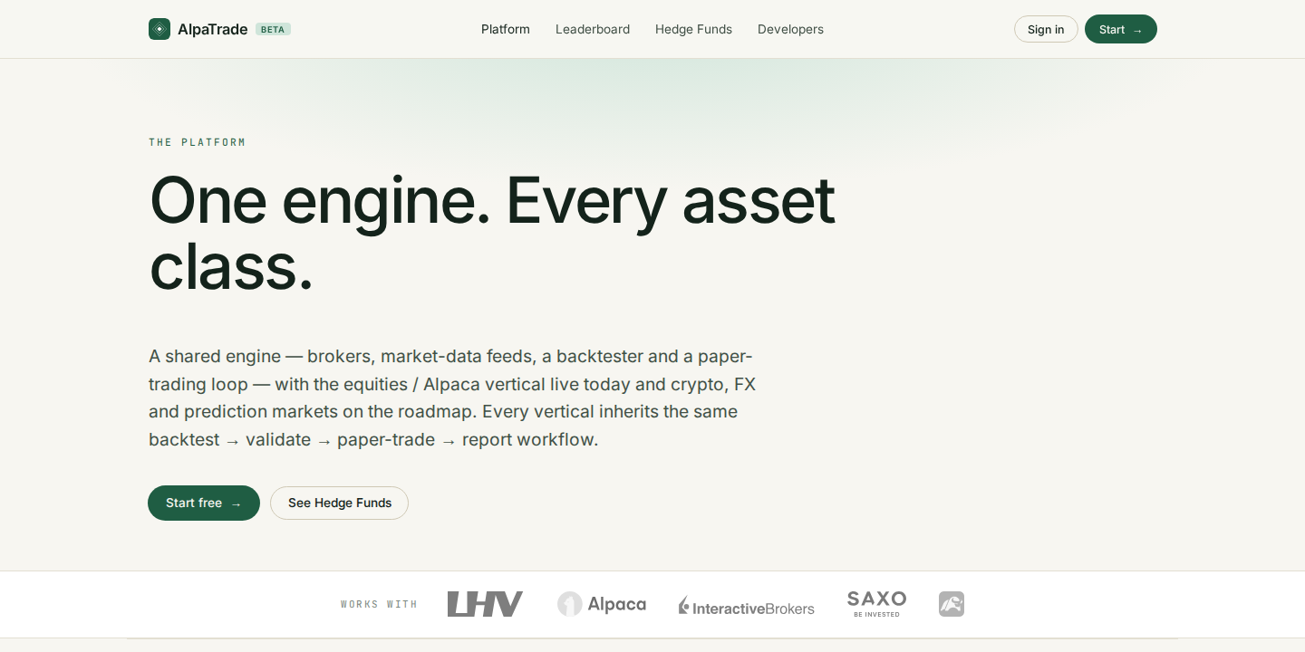
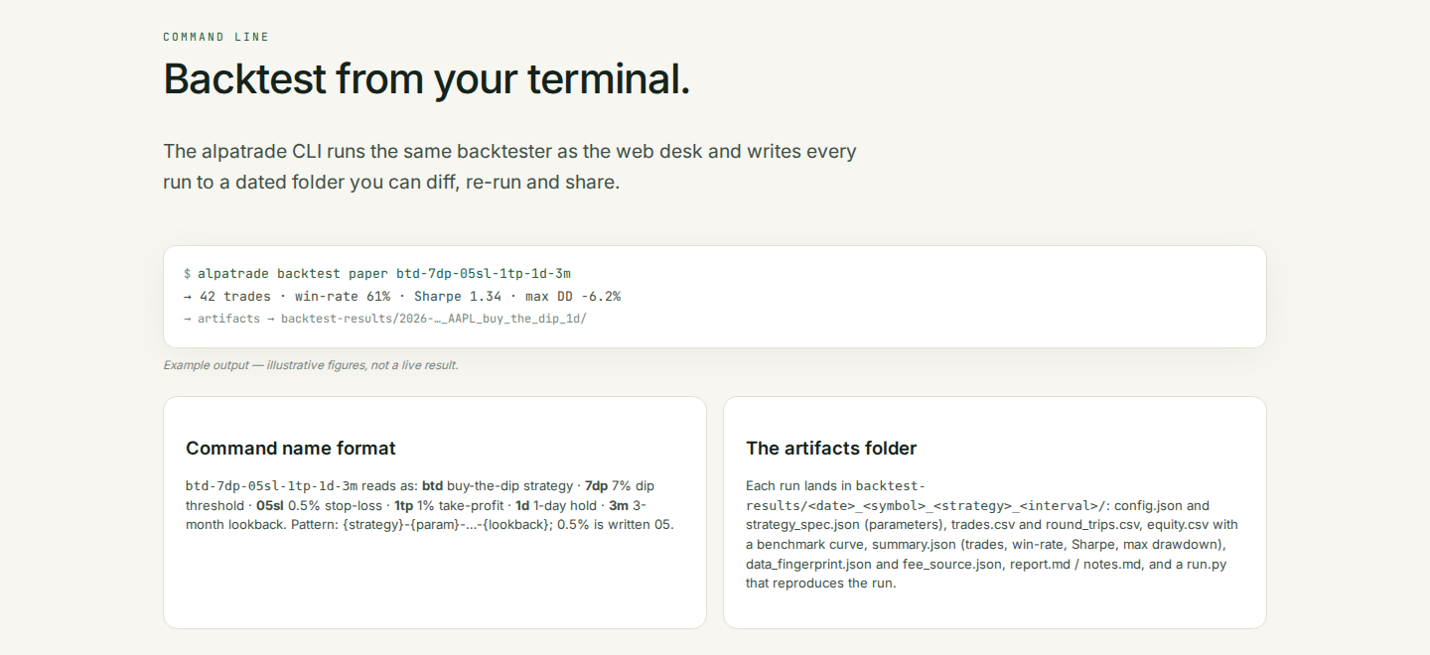
AlpaTrade
PART 2 · ADVANCED FEATURES
Platform and Developers
• Platform explains the engine behind AlpaTrade: broker links, market data, a backtester and a paper-trading loop.
• US equities on Alpaca are live today. Crypto, FX and prediction markets are on the roadmap.
• Developers documents the Agent API at api.alpatrade.chat, with an API reference and a Swagger page to try calls.
• Command line: alpatrade backtest paper btd-7dp-05sl-1tp-1d-3m runs the same backtester from your terminal. The name spells out the settings, and each run saves a dated results folder.
AlpaTrade user guide · v0.40.1 · 12 October 2026 · © Predictive Labs Ltd 2026
13

Slide 14
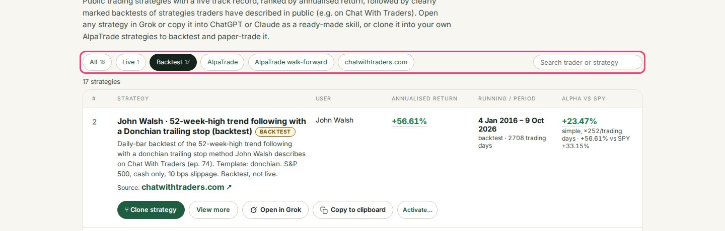
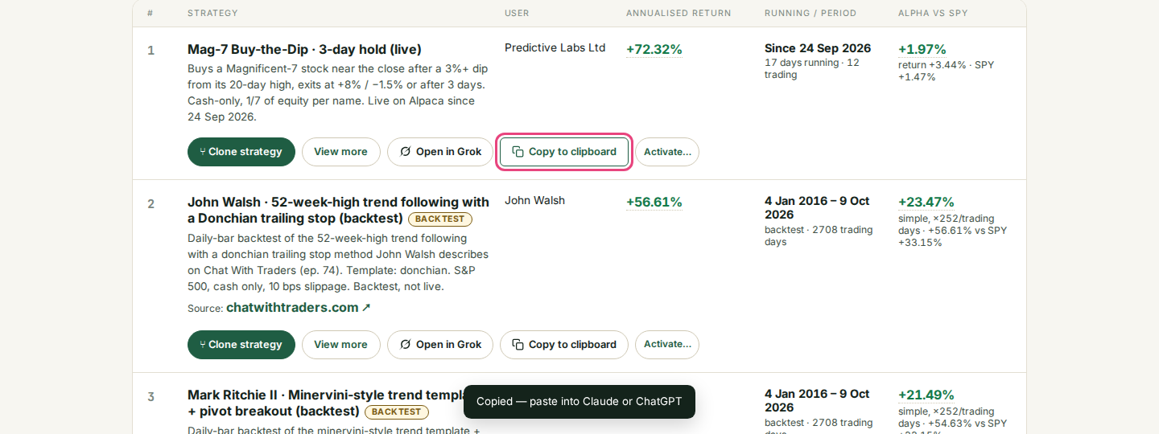
AlpaTrade
PART 2 · ADVANCED FEATURES
Leaderboard filters and Copy for ChatGPT / Claude
• Filter by All, Live, Backtest, AlpaTrade, AlpaTrade walk-forward or chatwithtraders.com, or search for a trader or strategy.
• Backtests carry a BACKTEST label. Only Live entries show a real track record.
• Open in Grok opens the strategy in Grok, ready to discuss.
• Copy to clipboard copies the strategy as a ready-made skill. Paste it into ChatGPT or Claude.
• View more opens the full strategy page.
AlpaTrade user guide · v0.40.1 · 12 October 2026 · © Predictive Labs Ltd 2026
14

Slide 15
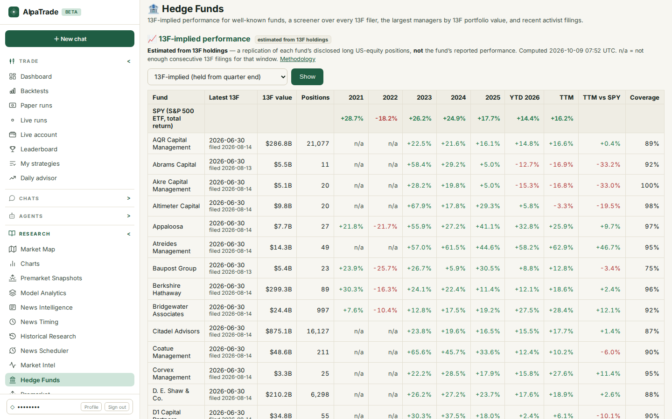
AlpaTrade
PART 2 · ADVANCED FEATURES
Hedge Funds
• See what well-known funds hold and how that portfolio performed.
• Returns are estimated from each fund's 13F filings (its disclosed long US stock positions). They are not the fund's reported results.
• Columns show each year since 2021, year to date, the last twelve months, the last twelve months vs SPY, and coverage.
• There is also a screener over every 13F filer, the largest managers and recent activist filings. Free for everyone once signed in.
AlpaTrade user guide · v0.40.1 · 12 October 2026 · © Predictive Labs Ltd 2026
15

Slide 16
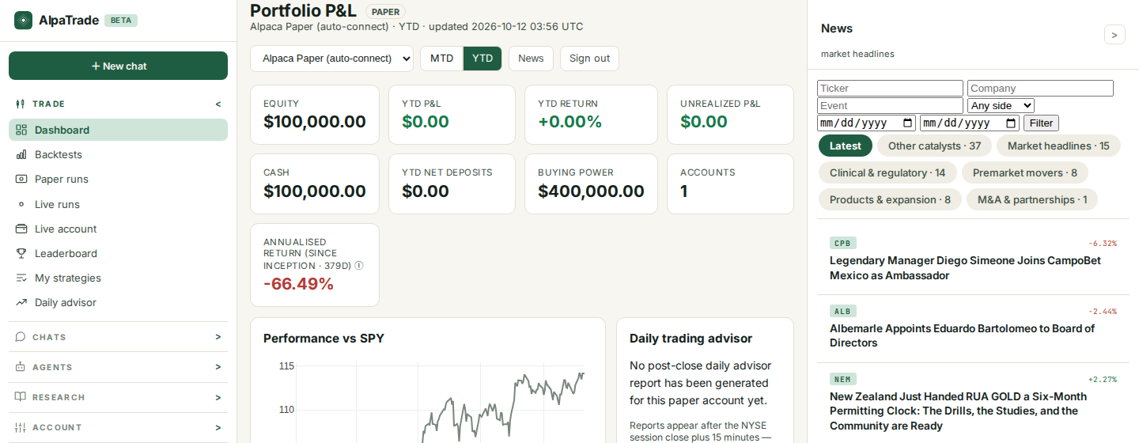
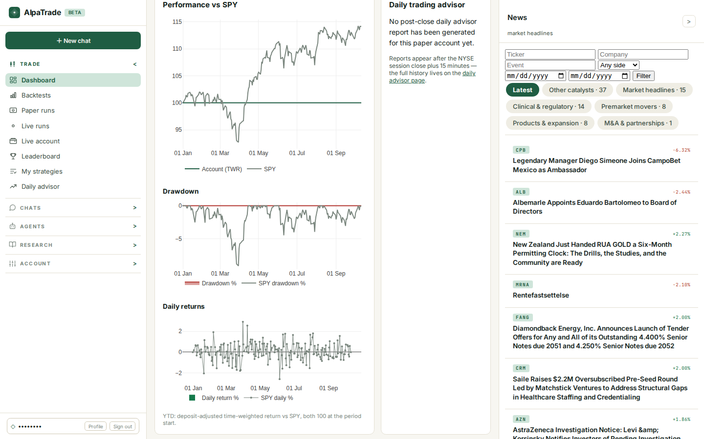
AlpaTrade
PART 2 · ADVANCED FEATURES
Dashboard: paper or live, MTD or YTD
• Choose an account (all accounts, a paper account or a live account) and a period: MTD or YTD.
• Tiles show equity, P&L, return, unrealised P&L, cash, net deposits, buying power and the annualised return since the account opened.
• Three charts: Performance vs SPY (both start at 100), Drawdown, and Daily returns vs SPY.
• Further down: Daily trading advisor, P&L contributors, strategy rankings, open positions and My strategies.
AlpaTrade user guide · v0.40.1 · 12 October 2026 · © Predictive Labs Ltd 2026
16

Slide 17
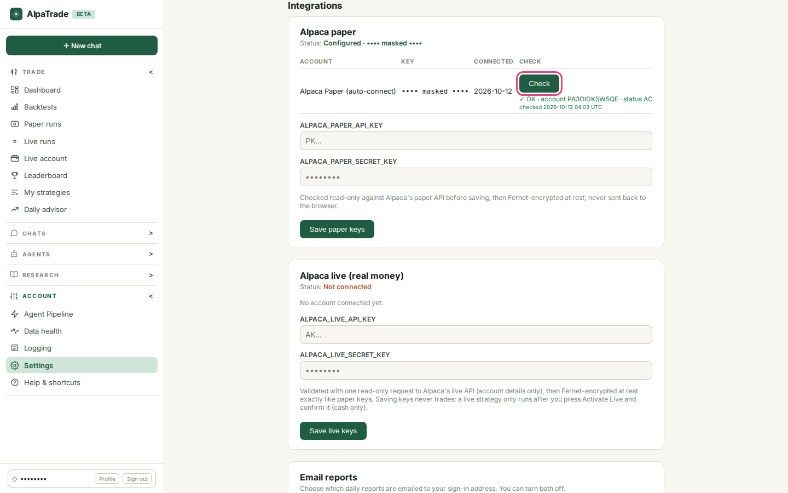
AlpaTrade
PART 2 · ADVANCED FEATURES
Settings > Integrations
• Alpaca paper and Alpaca live (real money) each have their own keys and status.
• Check sends one read-only request to Alpaca and shows OK with the account and its status.
• Keys are stored encrypted and never sent back to your browser. Saving keys never places a trade.
• A live strategy runs only after you press Activate Live and confirm.
• Email reports: choose which daily reports reach your sign-in address.
AlpaTrade user guide · v0.40.1 · 12 October 2026 · © Predictive Labs Ltd 2026
17

Slide 18
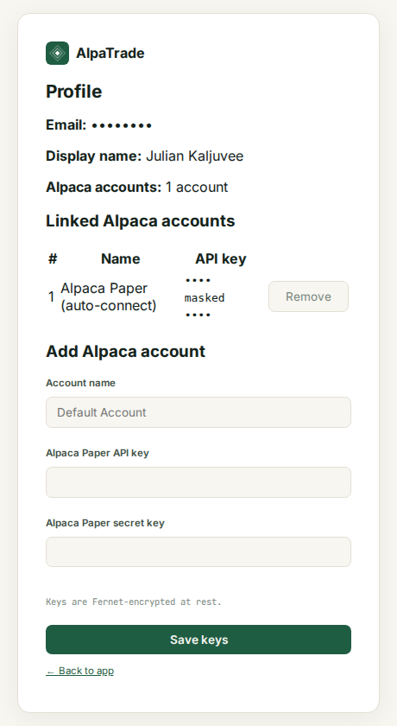
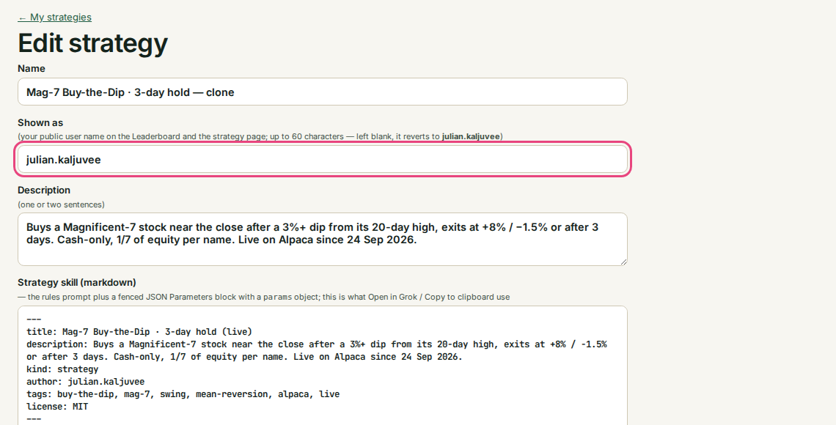
AlpaTrade
PART 2 · ADVANCED FEATURES
Profile and Shown as
• Profile shows your email, display name and linked Alpaca accounts, with keys masked. You can add another paper account or remove one.
• Shown as is the public name on the Leaderboard and the strategy page, up to 80 characters. Set it under My strategies > Edit.
• Tick Public to list a strategy on the Leaderboard. Leave it unticked to keep the strategy private.
AlpaTrade user guide · v0.40.1 · 12 October 2026 · © Predictive Labs Ltd 2026
18

Slide 19
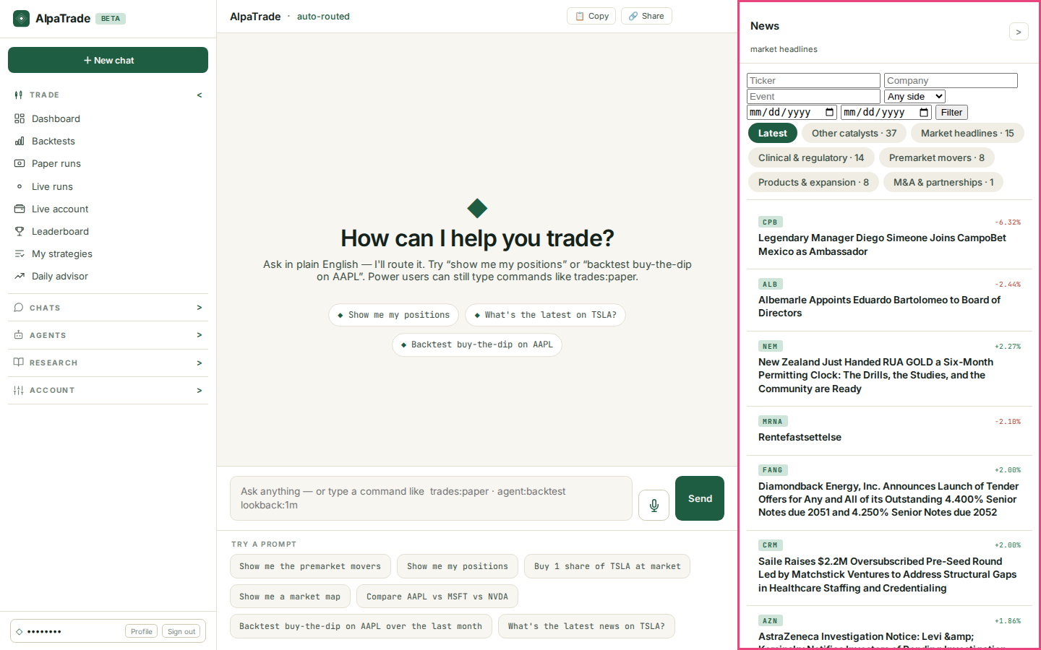
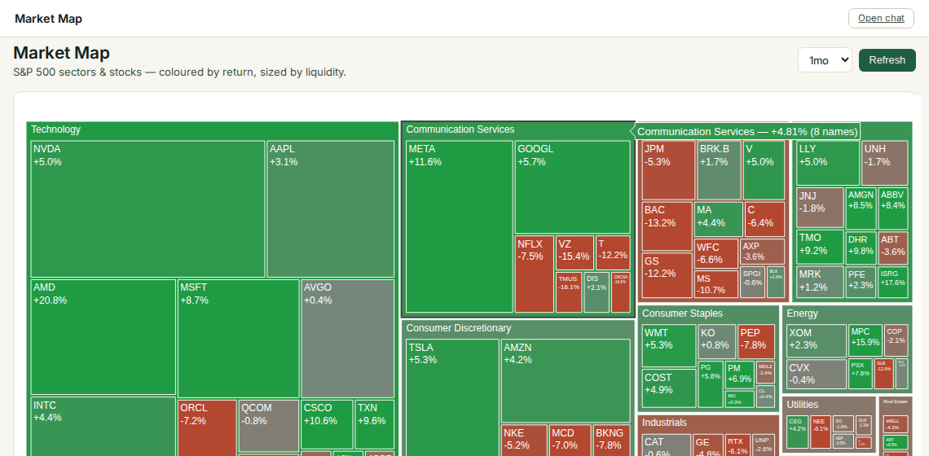
AlpaTrade
PART 2 · ADVANCED FEATURES
News and research
• The News panel sits to the right of the chat and the Dashboard. It shows the latest headlines with the ticker and its move, grouped by catalyst.
• Filter by ticker, company, event, direction or date. Close the panel with >.
• The Research menu adds Market Map (S&P 500 by sector, coloured by return), Charts, Premarket, Model Analytics, News Timing, Historical Research and Market Intel.
• You can also ask in the chat: What's the latest news on TSLA? or Show me a market map.
AlpaTrade user guide · v0.40.1 · 12 October 2026 · © Predictive Labs Ltd 2026
19

Slide 20
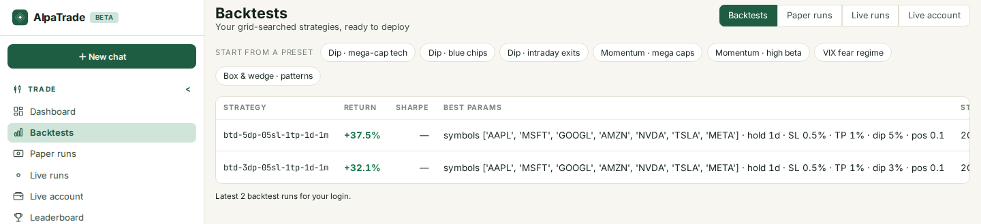
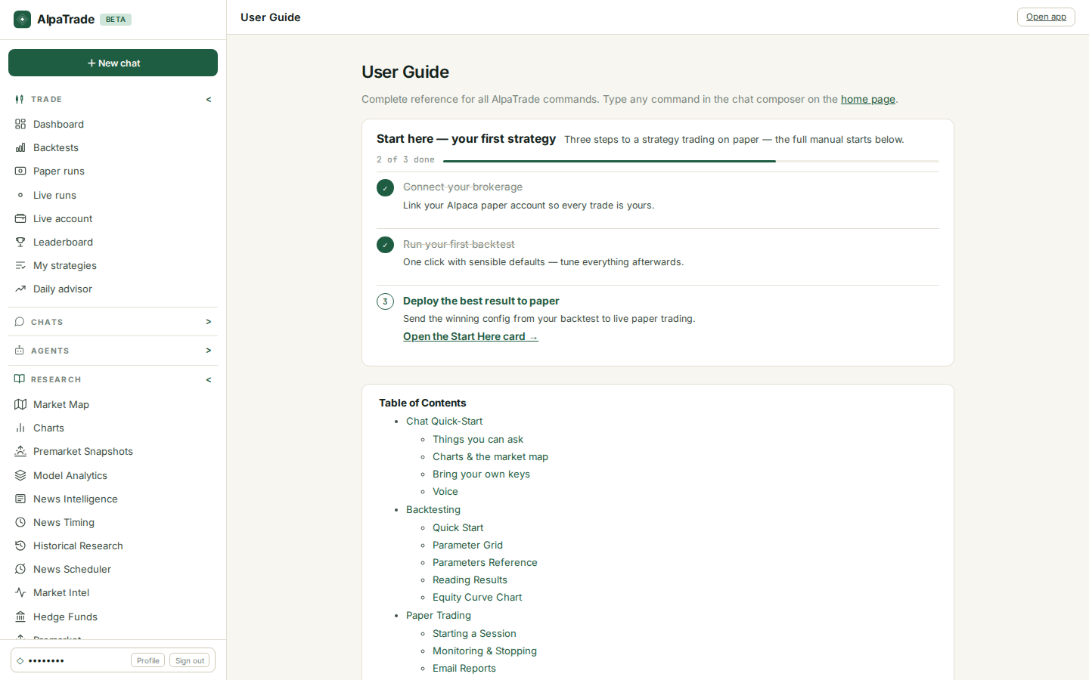
AlpaTrade
PART 2 · ADVANCED FEATURES
Runs, advisor, agents and help
• Backtests lists grid-searched runs that are ready to deploy. You can start from a preset such as Dip · mega-cap tech or Momentum.
• Paper runs and Live runs list your sessions. Live account is a read-only view of a linked live account.
• Daily advisor reviews your paper accounts each day, 15 minutes after the NYSE close.
• The Agents menu runs Backtest, Validate, Reconcile, Paper Trade or Full Cycle. Agent Pipeline shows the automated pipeline.
• Help & shortcuts holds the full command reference.
AlpaTrade user guide · v0.40.1 · 12 October 2026 · © Predictive Labs Ltd 2026
20

