Slide 1
Factorio for Universalbank
AI-native invoice financing · an international-investor SPV · UAE entry
A proposal by Consistente Ltd to build and operate a next-generation, white-label invoice-financing platform for Universalbank — more efficient than the incumbent, priced on volume alone, with an AI core, an international-investor SPV, and a route into the UAE.
Prepared by Consistente Ltd · Tallinn · info@consistente.tech · consistente.tech

Slide 2
EXECUTIVE SUMMARY
Three moves, one platform
• The gap. Every Uzbek bank rents its factoring product from OzPlanet or FinMakon — Universalbank included (OzPlanet cooperation agreement, Sept 2024). None owns the product, the customer relationship or the data.
• 1 · Own the platform. A white-label, AI-native platform Universalbank runs under its own brand — the bank owns the product, customers and data — priced on financed volume only.
• 2 · International capital. An SPV module lets global — and specifically Gulf — investors fund Uzbek receivables. OzPlanet and FinMakon take no foreign or retail money, so this is a clean, uncontested differentiator.
• 3 · UAE entry. A DIFC SPV and a phased Shariah programme (Murabaha → Wakala → Sukuk) to reach Dubai / DIFC Islamic capital.
• Decomposable & live today. Deploy origination first, add the investor / SPV layer later — and the chat-based loan triage and investor reporting are already running in the app.

Slide 3
THE OPPORTUNITY
Uzbekistan built the perfect rails for invoice finance
• SoliqOnline — the State Tax Committee's platform — has validated, timestamped and archived every B2B e-invoice in the country since January 2020.
• Didox connects 350,000+ organisations to it and integrates with 1C — a ready-made supplier base that already exchanges invoices electronically.
• Every invoice is government-verified and buyer-confirmed on official record — fraud and debtor-confirmation, factoring's hardest problems, are solved at source.
• The market is scaling fast: the CBU reports ~10.6 trillion soums (~$835M) factored in Jan–Sep 2025, about half of it digital — against a ~$2bn addressable market that is still lightly penetrated.

Slide 4
WHY NOW
The regulatory window is open
• Presidential Decree No. 106 (Aug 2024) mandated banks to offer factoring.
• ZRU-1058 (Apr 2025) amended the Civil Code to give factoring full legal force, and mandates automated API registration of the bank's collateral priority in the CBU registry — within about an hour of approval.
• No new licence is required: Universalbank's existing CBU licence covers this; Factorio operates as white-label technology under the bank's umbrella.
• No Uzbek bank has yet built a production-grade SoliqOnline factoring stack with an AI core — the first mover captures structural advantage.

Slide 5
THE INCUMBENTS
OzPlanet & FinMakon own the market — as aggregators
Dimension | OzPlanet | FinMakon | Factorio (Consistente)
Model | Aggregator; bank-set rates | Aggregator (Didox-backed) | White-label marketplace — bank owns it
Digital share (Q3 2025) | 56% of digital volume | 44% of digital volume | New entrant — builds share
Funding sources | Banks / MFOs only | Banks / factoring cos | Banks + investors + retail + SPV
Foreign / retail capital | No | No | Yes — SPV + marketplace
Bank owns product & data | No — OzPlanet does | No — FinMakon does | Yes — fully the bank's
AI core | Rule-based; nascent | Nascent | Grok chat triage + reporting, doc intelligence
Pricing to bank | Per-transaction commission | Per-transaction commission | Volume-only bps (no SaaS licence)
Universalbank already signed a cooperation agreement with OzPlanet (Sept 2024) — so it knows the model. The point of this proposal is not to rent a better aggregator, but to own the product outright. (Market data: CBU, Q3 2025.)

Slide 6
THE STRATEGIC GAP
No Uzbek bank owns its factoring product
• Today a bank connecting to OzPlanet or FinMakon is a funding partner on someone else's platform — the aggregator owns the brand, the customer relationship and the data.
• That is a strategic dependency: the bank cannot differentiate, cannot cross-sell off its own data, and cannot switch without losing the clients.
• Factorio flips this. Universalbank runs the platform under its own brand, owns all customer and transaction data, and can export and move it — no platform lock-in.
• Same government rails (SoliqOnline, CBU registry), same speed — but the bank owns the asset instead of renting the rails. That ownership is the real product.

Slide 7
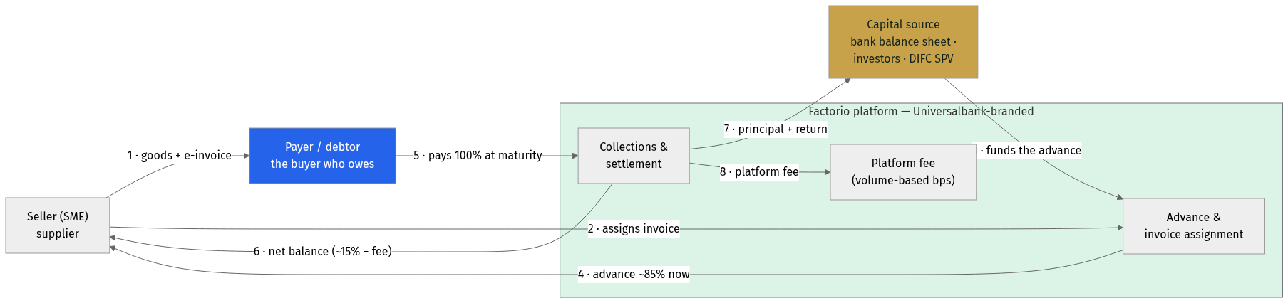
HOW IT WORKS
How the money moves — and who gets paid
• The payer (debtor) is the anchor: a specific, buyer-confirmed obligation on the SoliqOnline record.
• The platform advances ~85% now from the capital source (bank, investor or SPV); at maturity the payer settles 100% and the waterfall pays seller, capital and platform.
• Because the flow is identical regardless of who funds it, the capital layer is pluggable — bank first, investors/SPV later.
Money & payment flow — seller, payer (debtor), platform, capital

Slide 8
PILLAR 1 · A BETTER PLATFORM
AI at the core, not bolted on
• The same end-to-end factoring workflow — submit, verify, fund, settle — but with AI woven through triage, scoring, documents and reporting.
• Built on a lean, server-rendered stack (FastHTML + PostgreSQL) — fast to change, cheap to run, easy to white-label under the bank's brand.
• Trilingual by design (English · Oʻzbekcha · Russian); the AI answers in the user's language.
• The next three slides detail the AI, the credit-scoring engine, and the commercial model.

Slide 9
JOURNEY · BORROWER (ORIGINATION)
The seller's journey — sign-up to cash in 24–48h
• Manual bank involvement is a single approval click on a pre-populated screen; everything else is automated.
• The invoice is imported and verified from SoliqOnline; the debtor is scored; collateral is registered with the CBU in under 60 minutes.
• This is Module A — it stands alone and can go live first, funded entirely by the bank's balance sheet.
Origination: SoliqOnline import → AI triage → one-click approval → advance

Slide 10
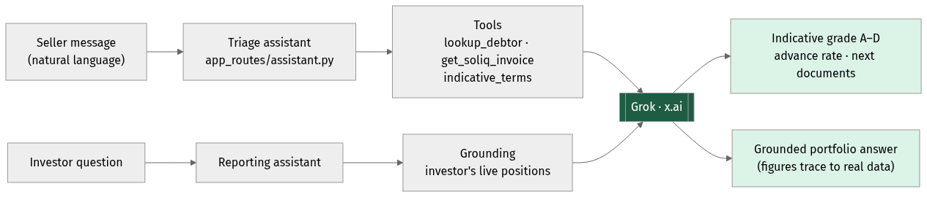
PILLAR 1 · AI
Two conversational surfaces, one Grok core
• Triage turns a seller's plain-language description into an indicative grade, advance rate and document list — in seconds.
• Reporting answers an investor's questions grounded in their own live positions — no invented figures.
• Grok scores and explains; a human always approves. Every AI decision is logged and auditable.
Chat-based loan triage and chat-based investor reporting

Slide 11
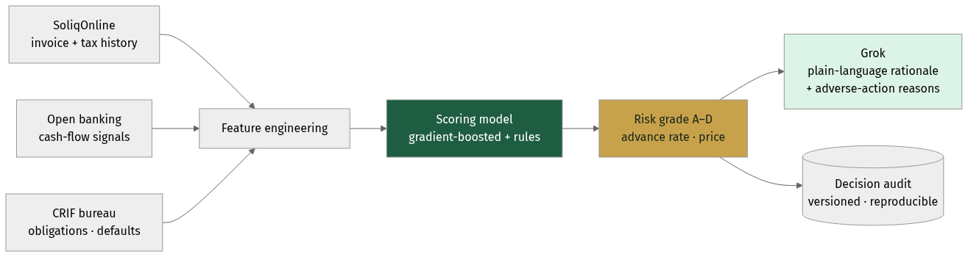
PILLAR 1 · CREDIT SCORING
Open-banking-style scoring, Uzbek edition
• The Plaid model is connect an account, read the cash flows, decide. In Uzbekistan the richest feed is SoliqOnline — verified invoices and tax-declared turnover — plus bank transaction data and the CRIF bureau.
• A model produces the grade, advance rate and price; Grok writes the plain-language rationale and adverse-action reasons.
• Every decision is versioned and reproducible — Consistente's core methodology, and what a regulator will ask for.
Plaid-style data fusion adapted to Uzbekistan's rails

Slide 12
ECONOMICS
What the bank earns on one invoice
Cash flow · $10,000 invoice · 85% · 60d · 5% | Amount | Direction | Day
Advance to seller (85%) | $8,500 | Platform → seller | Day 1
Payer (debtor) pays in full | $10,000 | Payer → collection | Day 60
Net balance released to seller | $1,500 | Platform → seller | Day 60
Discount income (gross) | $500 | Capital keeps | Day 60
Platform fee (volume-based) | ≈ $13 | Bank → Consistente | Day 60
Net income on the invoice | ≈ $487 | Capital keeps | Day 60
Annualised return on capital | ≈ 30% p.a. | — | —
Illustrative, per the standard SoliqOnline-verified structure. ~30% annualised on deployed capital compares with 22–28% on unsecured SME lending — at lower risk: the invoice is government-verified, the payer has confirmed the obligation, and the bank holds a registered CBU priority claim. Bank stays profitable to a ~4% default rate.

Slide 13
PILLAR 1 · COMMERCIAL MODEL
Volume-only pricing — aligned with the bank
Monthly financed volume | Platform fee (bps of financed volume)
Up to UZS 50 bn | 120 bps
UZS 50–200 bn | 90 bps
UZS 200–500 bn | 70 bps
Over UZS 500 bn | 55 bps
Illustrative. No SaaS licence, no per-seat, no setup fee — Consistente is paid only when the bank finances an invoice. Options on the table: a revenue-share alternative (a small % of the bank's discount income instead of bps), 12-month bank exclusivity in Uzbekistan, and a Year-3 deferred-equity option structured as new shares (non-dilutive, no board/veto rights). International SPV module: ~60 bps p.a. on invested AUM + a performance share above a hurdle. Final figures to be set with Universalbank.

Slide 14
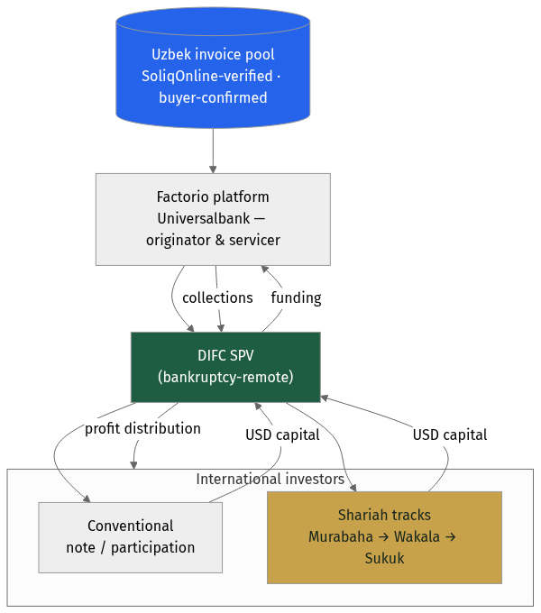
PILLAR 2 · INTERNATIONAL CAPITAL
An SPV that opens Uzbek receivables to the world
• Universalbank remains originator and servicer; a bankruptcy-remote SPV holds the investor-facing interest and channels foreign capital into the invoice pool.
• Two tracks off the same asset base: a conventional note/participation for institutional investors, and Shariah structures for Gulf capital.
• Investors get the same grounded, AI-assisted reporting — in their language — plus statements and a clean audit trail.
Invoice pool → Factorio → DIFC SPV → international investors

Slide 15
JOURNEY · INVESTOR
The investor's journey — onboarding to distribution
• Retail, institutional and Gulf investors onboard once (KYC / accreditation), then fund via the marketplace or the SPV.
• They hold positions with on-demand AI portfolio reporting; at maturity, principal + return are distributed automatically.
• This is Module B — it plugs onto the same origination engine later, without changing anything a seller or the bank does.
Investor: onboard → commit capital → hold with AI reporting → get paid

Slide 16
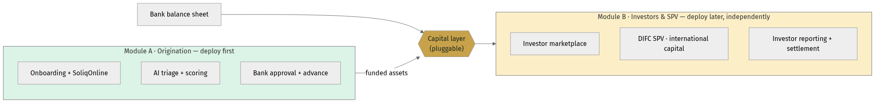
DELIVERY · DECOMPOSABILITY
Two modules — buy one, or both, in sequence
• Module A — Origination can be Universalbank's whole first phase: bank-funded factoring, live in weeks, immediately satisfying the Decree-106 mandate.
• Module B — Investors & SPV adds the marketplace and DIFC/international capital later, over the same engine, with no rework.
• The capital layer is the seam: swap or add funding sources without touching origination — de-risking the programme and the investment.
Origination (Module A) and Investors/SPV (Module B) are independently deployable

Slide 17
PILLAR 3 · UAE ENTRY
A phased Shariah programme for DIFC capital
Criterion | Murabaha SCF | Wakala Fund | Sukuk | Musharaka
Shariah purity | High | High | High | Highest
Complexity | Low | Low–Med | High | Medium
Time to market | Fastest | Fast | Slowest | Medium
Dubai investor appeal | Medium | High | Very high | High
Capital per deal | Small–Med | Medium | Large | Med–Large
Regulatory need | Fatwa only | Fatwa + fund | Fatwa + DFSA | Fatwa + fund
Best for | Pilot | Family offices | Institutional | Strategic partners
Recommended path: run them in sequence — Murabaha SCF pilot (M6–12) → Wakala fund → Sukuk. Each phase builds the track record that makes the next credible. All require an AAOIFI-accredited fatwa before deployment.

Slide 18
PILLAR 3 · WHY DUBAI / DIFC
The yield spread is the story
• Uzbek factoring yields of ~20–30% p.a. against Gulf Islamic money-market returns of ~4–6% — an exceptional spread for the risk, given SoliqOnline's structural protections.
• Short duration (30–90-day rolling receivables) is rare and highly demanded by Gulf liquidity managers.
• Uzbek receivables are uncorrelated with Gulf real estate, regional equities or oil — genuine diversification.
• DIFC (DFSA) and ADGM (FSRA) both have mature Islamic-finance frameworks and recognise SPV/Sukuk structures; the UAE's Federal Decree-Law No. 50 of 2022 codifies the contracts.

Slide 19
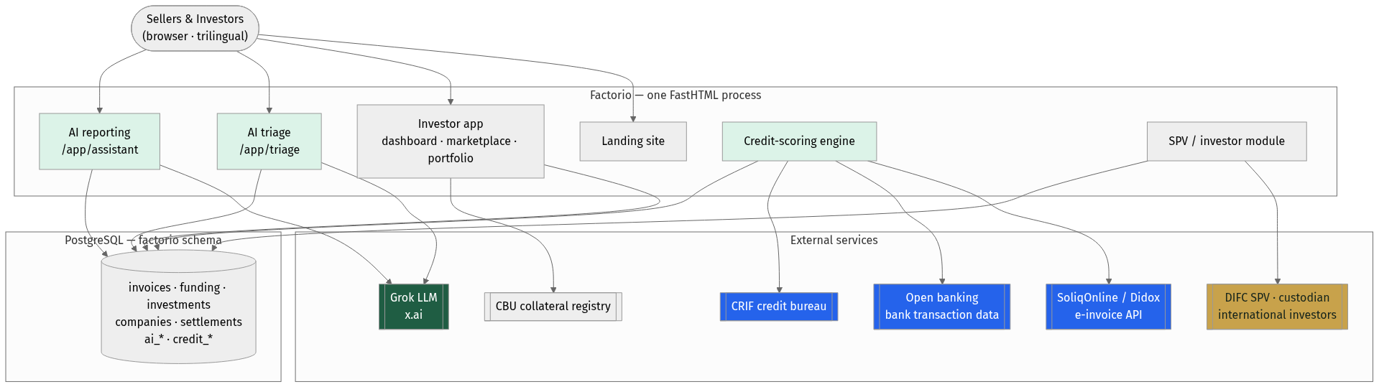
ARCHITECTURE
One process, AI-native, integration-ready
• A single FastHTML process serves the landing site, the investor app and the AI assistants; PostgreSQL holds the factoring and AI data.
• Clean integration seams to SoliqOnline/Didox, open banking, CRIF, the CBU registry, and the DIFC SPV / custodian.
• Grok (x.ai) is reached over an OpenAI-compatible interface — the model id is configuration, avoiding vendor lock-in.
Target system architecture with AI components highlighted

Slide 20
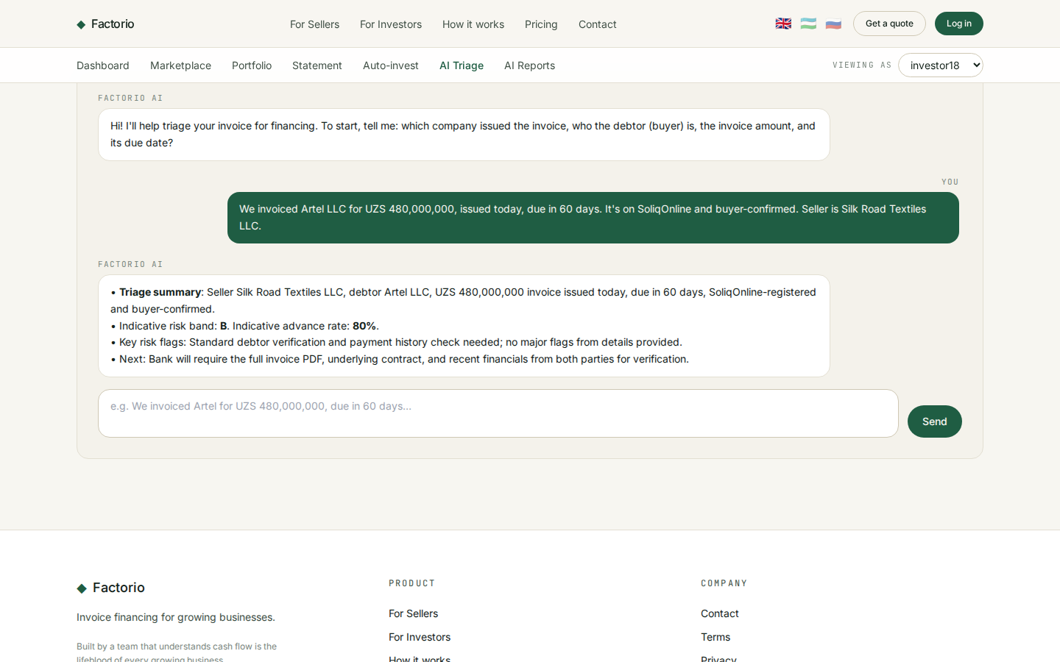
PROOF · WORKING TODAY
The AI is not a slide — it's shipped
• A seller describes an invoice in a sentence; the assistant returns an indicative risk band, advance rate and next-document list.
• Built on Grok (x.ai), trilingual, with graceful fallback and full audit logging — the same pattern extends to scoring and reporting.
Live chat-based invoice triage in the Factorio app

Slide 21
DELIVERY
From prototype to regional platform
• Phase 0 (now): AI triage + reporting prototype live.
• Phases 1–2 (M1–6): platform GA, SoliqOnline integration, open-banking scoring, volume pricing.
• Phases 3–4 (M6+): DIFC SPV and first international capital, then the Wakala → Sukuk sequence and regional scale.
Phased rollout — each phase funds the next

Slide 22
WHY CONSISTENTE
Production AI, delivered consistently
• Consistente Ltd (Tallinn, EU) builds production-grade AI for enterprises — with reproducible pipelines, versioned models and inspectable prompts, not black boxes.
• Precedents across financial services and regulated sectors: LSEG, DBRS Morningstar, ARM, Microsoft.
• Core capabilities map directly onto this project: document intelligence, applied forecasting/scoring, and agentic workflows with human review.
• EU-based, audit-first — the right profile for a bank building AI a regulator will scrutinise.

Slide 23
NEXT STEPS
What we propose to do first
• 1. Agree the white-label scope and the volume-based commercial terms.
• 2. Stand up a pilot on live SoliqOnline data; ship the platform GA with the AI triage and scoring engine.
• 3. In parallel, begin DIFC SPV and fatwa preparation so international capital can follow the operating book.
• Contact: Consistente Ltd · info@consistente.tech · consistente.tech

