Slide 1
LiquidRound
User Guide v0.4.0
AI-powered M&A, IPO readiness, and hedge fund intelligence
Predictive Labs Ltd

Slide 2
User Guide — AI ECM / IB Analyst Squad for M&A and IPO
Version 0.4.0 · Predictive Labs Ltd · Live at liquidround.ai
An AI-powered M&A, IPO readiness, and hedge fund intelligence platform.
23 specialist agents — buyer-led sourcing and diligence, seller-led positioning
and IPO readiness, and public markets intelligence — in one chat-first workspace.

Slide 3
What this platform is for
LiquidRound is the AI ECM / IB analyst squad — a chat-first workspace where
every question routes to the right specialist agent automatically.
• Buy-side: Find acquisition targets, run diligence, score matches, and draft IC memos.
• Sell-side: Prepare for sale (teasers / CIMs), identify buyers, and assess IPO readiness.
• Public markets: Explore SEC 13F institutional holdings, fund AUM rankings, and activist filings.
• BYOD: Upload your own pitch books, CIMs, and term sheets — agents read, cite, and draft from them.
The whole product answers one question: **"Who should we look at, what is it
worth, and what are the risks — ready for IC?"**

Slide 4
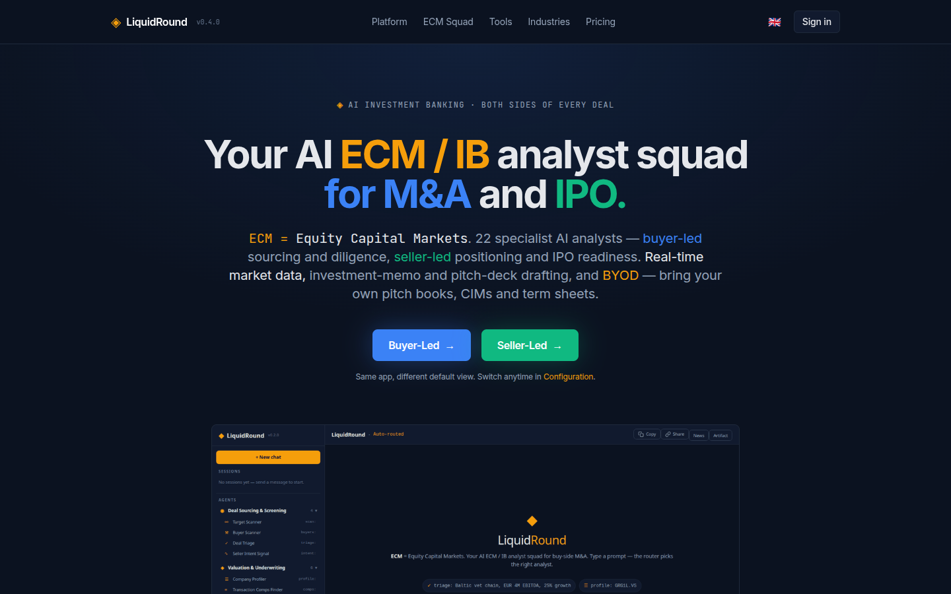
Getting started
Open liquidround.ai and choose your side:
• Buyer-Led — the app defaults to sourcing, diligence, and valuation agents.
• Seller-Led — the app defaults to positioning, teaser, and IPO readiness agents.
Sign in or register to save sessions, conversations, and pipelines. Guest users
can still use the full chat with in-memory sessions.

Slide 5
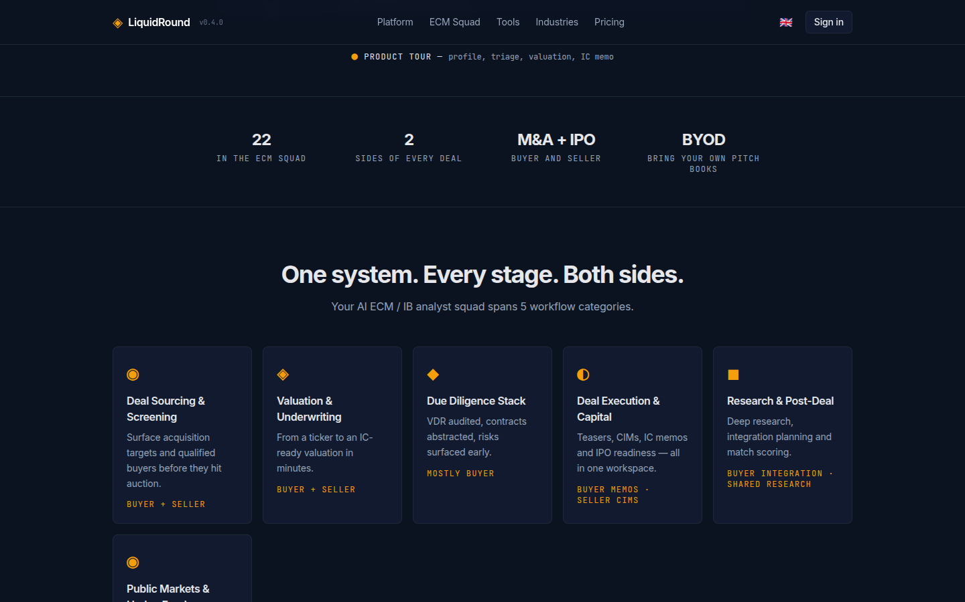
The platform — one system, every stage
Your ECM / IB analyst squad spans 6 workflow categories:
• Deal Sourcing & Screening (4 agents) — target scanning, buyer scanning, deal triage, seller intent
• Valuation & Underwriting (6 agents) — company profiling, DCF, comps, LTM, multiples, synergy
• Due Diligence Stack (5 agents) — VDR audit, contract abstraction, legal, operational, ESG
• Deal Execution & Capital (5 agents) — IC memo, teaser, bid strategy, IPO readiness, integration
• Research & Post-Deal (2 agents) — research analyst, match scorer
• Public Markets & Hedge Funds (1 agent) — SEC 13F holdings, fund AUM, activist filings

Slide 6
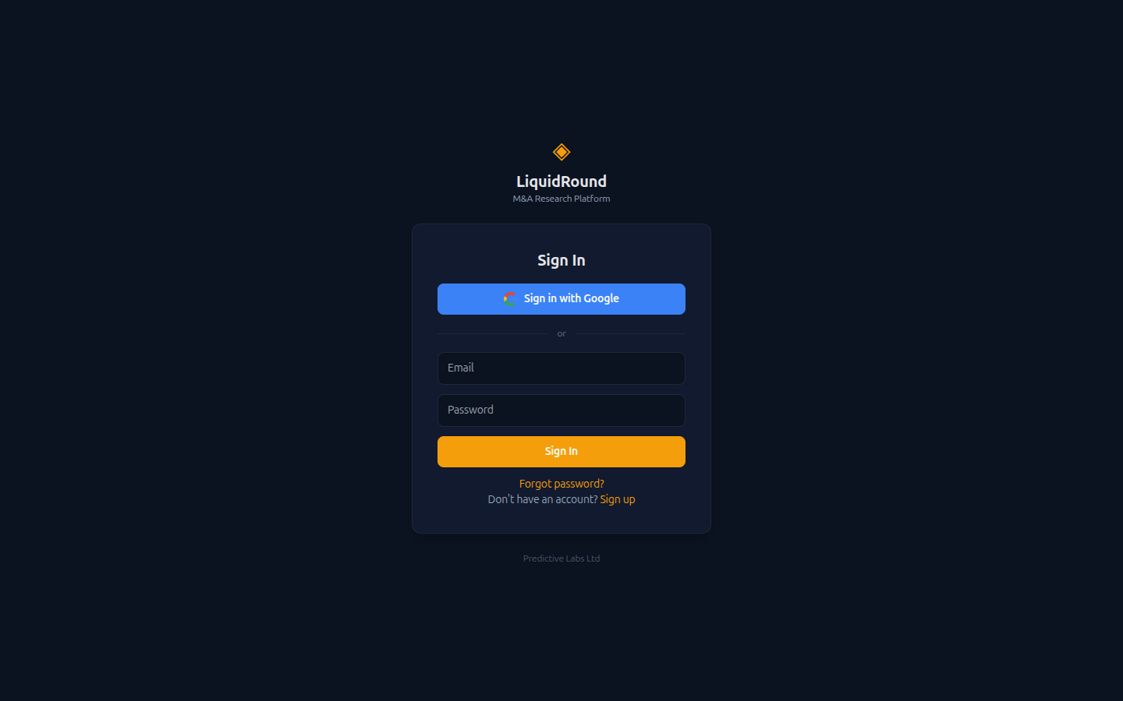
Sign in
Email + password or Sign in with Google. Registration is free. Signed-in users
get persistent conversations, share links, and saved pipelines.

Slide 7
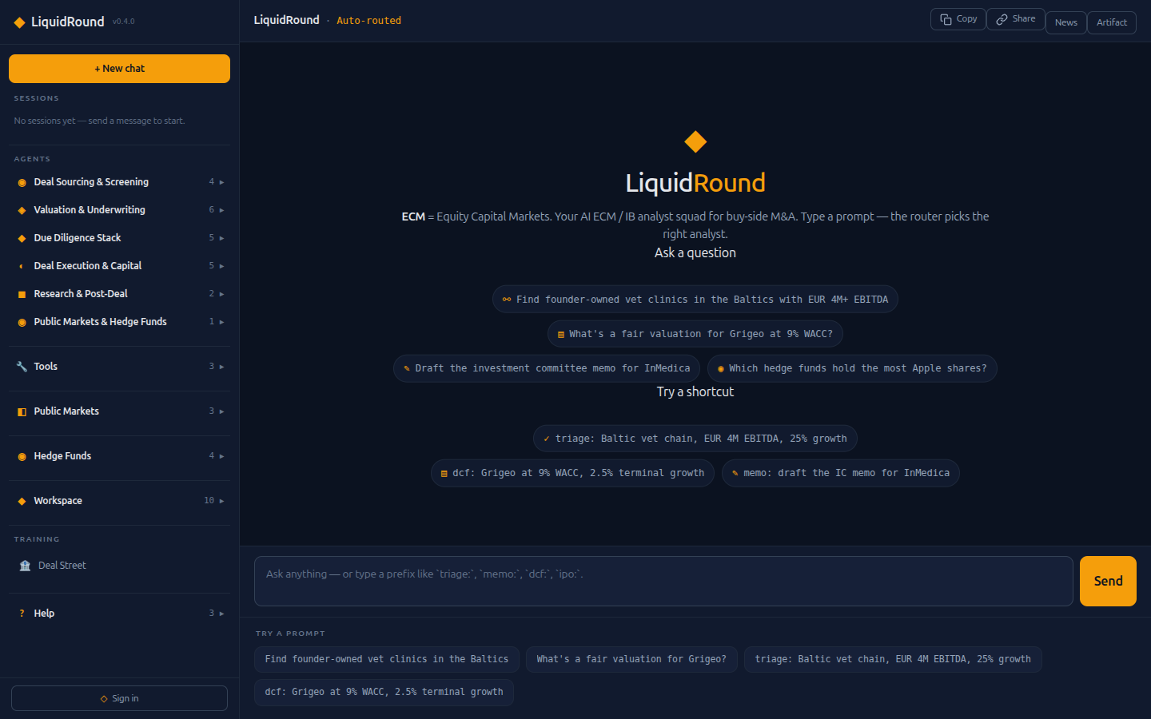
The chat interface — your primary workspace
The screen has three panes that stay consistent everywhere:
• Left — navigation: Sessions, Agents (6 categories), Tools, Public Markets, Hedge Funds, Workspace (10 pages), Training, Help.
• Centre — the chat: welcome hero with example prompts, message thread, and input bar.
• Right — the artifact canvas: News, Artifact tabs for agent-produced tables, charts, citations, and PDF previews.
Ask a question
Type a natural-language question — *"Find founder-owned vet clinics in the Baltics
with EUR 4M+ EBITDA"* — and the auto-router picks the best agent.
Try a shortcut
Use a prefix command to route directly to a specific agent:
| Prefix | Agent | What it does |
|--------|-------|-------------|
| profile: | Company Profiler | Look up a company by ticker |
| scan: | Target Scanner | Find acquisition targets |
| buyers: | Buyer Scanner | Identify strategic/financial buyers |
| triage: | Deal Triage | Quick deal screening |
| intent: | Seller Intent | Analyze seller motivation |
| dcf: | DCF Valuer | Discounted cash flow model |
| multi: | Multiples Valuer | EV/Revenue, EV/EBITDA comps |
| comps: | Comps Finder | Comparable transactions |
| ltm: | LTM Normalizer | Normalize trailing-twelve-month P&L |
| synergy: | Synergy Analyst | Revenue and cost synergy modelling |
| score | Match Scorer | 7-dimension buyer-target scoring |
| vdr: | VDR Auditor | Audit data room completeness |
| abstract: | Contract Abstractor | Extract key terms from contracts |
| legal: | Legal Reviewer | Open litigation and legal risk |
| ops: | Operational DD | Working capital and operations review |
| esg: | ESG Reviewer | Environmental, social, governance screening |
| memo: | IC Memo Writer | Draft an investment committee memo |
| teaser: | Teaser Designer | Blind teaser for sell-side |
| bid: | Bid Strategist | Cash/stock mix and offer structuring |
| ipo: | IPO Readiness | Assess public offering readiness |
| integrate: | Integration Planner | Post-merger 100-day plan |
| research: | Research Analyst | Deep web + semantic research |
| hedgefunds: | Hedge Fund Analyst | SEC 13F holdings, fund AUM, activist filings |

Slide 8
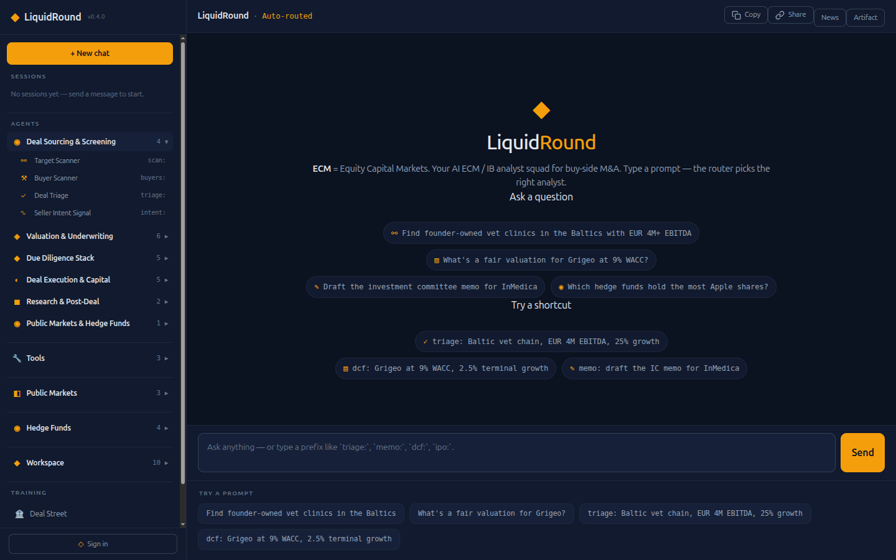
Agent browser — 23 specialists at a glance
Click any agent category in the left nav to expand it. Each agent shows its
name and prefix shortcut. Click an agent to fill the chat input with a sample
question — the router picks up automatically.
Each agent has its own system prompt and tool set. View and customize prompts in
Help → Instructions.

Slide 9
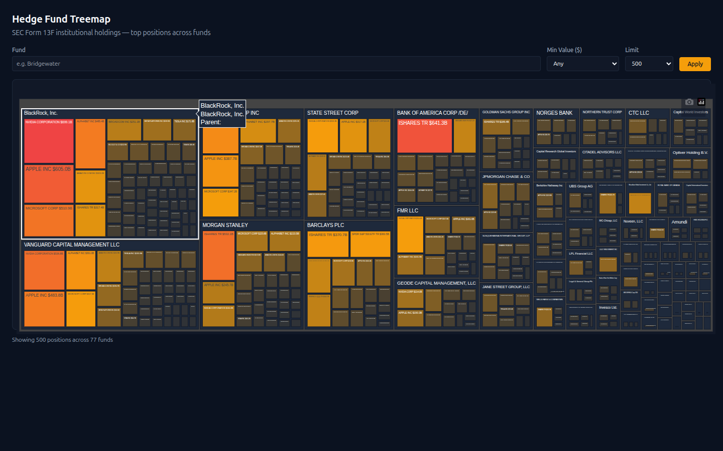
Hedge Fund Treemap
Interactive Plotly treemap at Hedge Funds → Fund Treemap showing SEC Form 13F
institutional holdings. Cell size is proportional to portfolio value.
Filter controls:
• Fund — search for a specific fund manager (e.g. "Bridgewater", "Vanguard")
• Min Value ($) — filter positions by minimum value ($1M, $10M, $100M, $1B)
• Limit — number of positions to display (200, 500, 1000)
Click Apply to refresh the treemap.
Chat commands
Click these in the left nav or type the prefix in chat:
• Top Holdings — hedgefunds: top funds by AUM
• Popular Securities — hedgefunds: most popular securities across all funds
• Activist Filings — hedgefunds: recent activist filings
• Fund Search — hedgefunds: search for Bridgewater
Data source
All hedge fund data comes from SEC Form 13F filings — mandatory quarterly
disclosures by institutional investment managers with over $100M in qualifying
assets. Approximately 10,000+ fund managers and 7 million+ holdings in
the database.

Slide 10
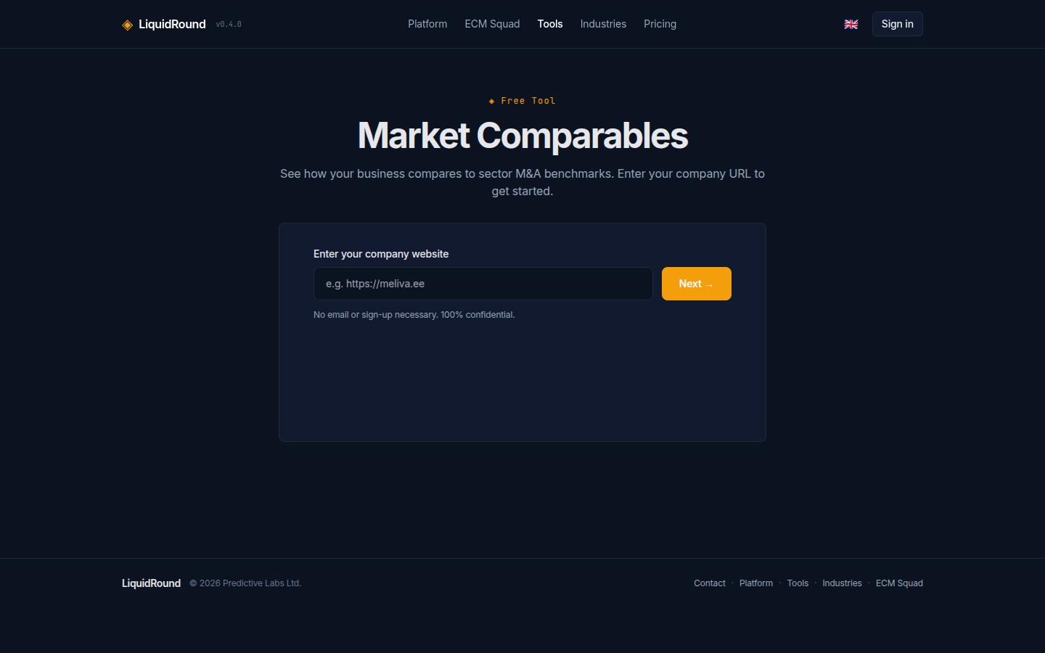
Free tools — no sign-in required
Market Comparables
Enter a company URL to get sector M&A benchmarks — EV/Revenue and EV/EBITDA
multiples compared to Damodaran sector averages.
Business Valuation
Enter a company URL and basic financials to get an indicative valuation range.
AI-generated value drivers (positive and negative) are included. Supports
human-friendly number input: 1M, 500k, 2.5B, or 1,000,000.
Find Buyers
Enter a company URL to identify potential strategic and financial buyers with
match scoring.
All three tools work by scraping the company website, identifying the sector, and
applying relevant multiples and buyer databases. Each ends with a **Book a
15-minute call** lead capture form.

Slide 11
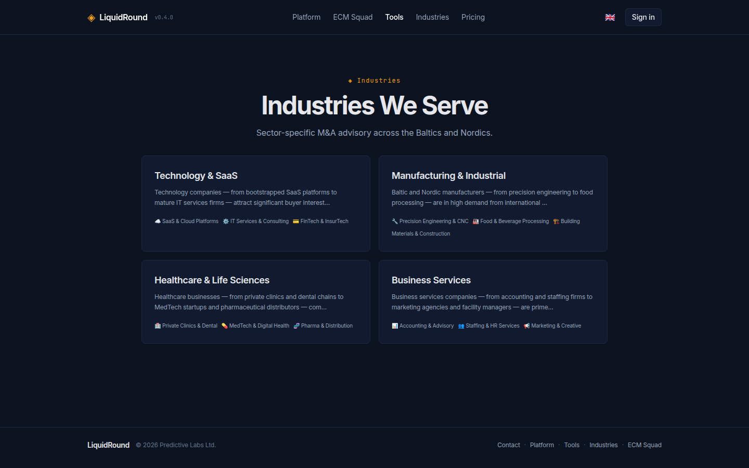
Industries
Sector-specific M&A advisory pages across the Baltics and Nordics. Each industry
page includes sector description, sub-sectors, advisor CTAs, and a "Find Buyers"
widget.

Slide 12
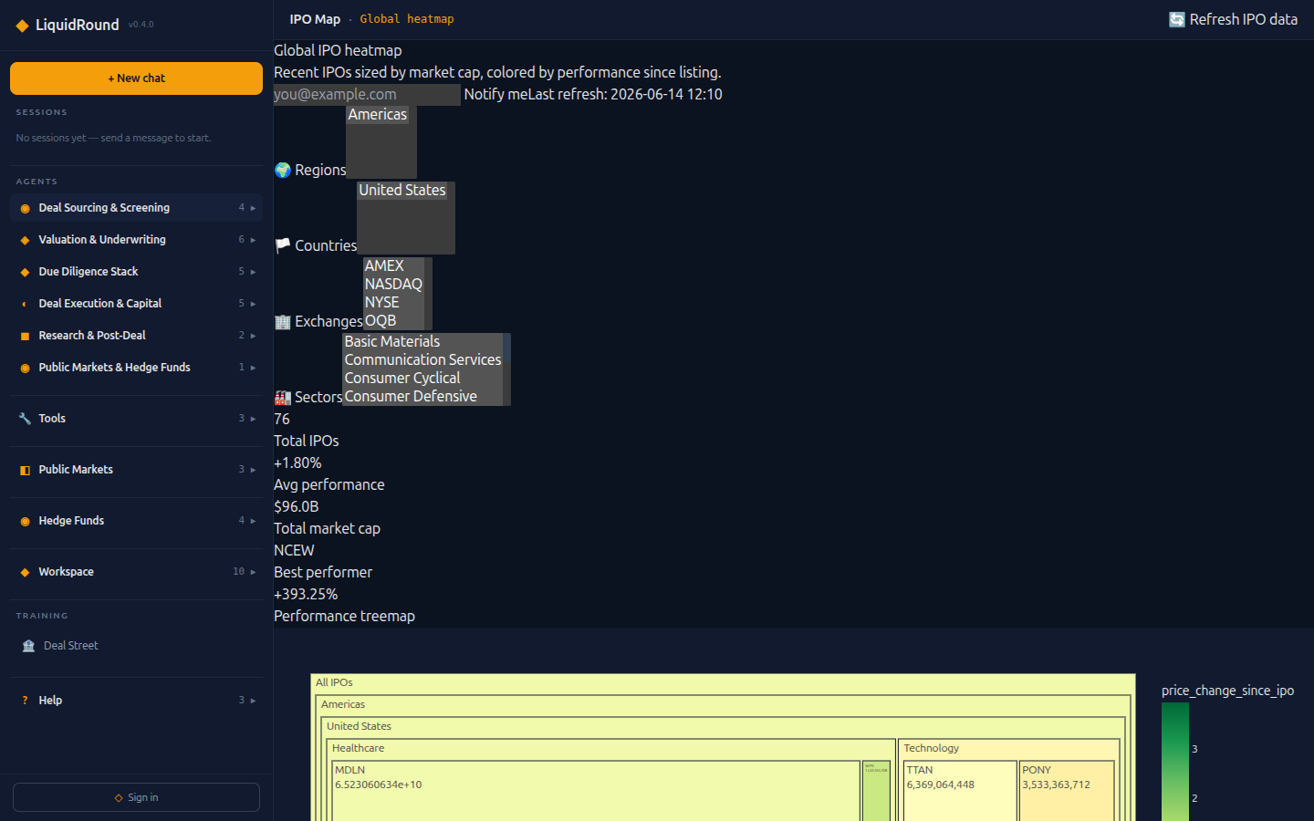
Public Markets
IPO Map
Global IPO heatmap — recent IPOs sized by market cap, colored by performance since
listing. Filter by region, country, exchange, and sector. KPIs: total IPOs, average
performance, total market cap, best performer.
IPO Pipeline
Track private mega-caps and upcoming US IPOs from the NASDAQ calendar. Bar chart
by sector, with company details including round, valuation, and description.
Prospectus
Browse and analyze IPO prospectus documents.

Slide 13
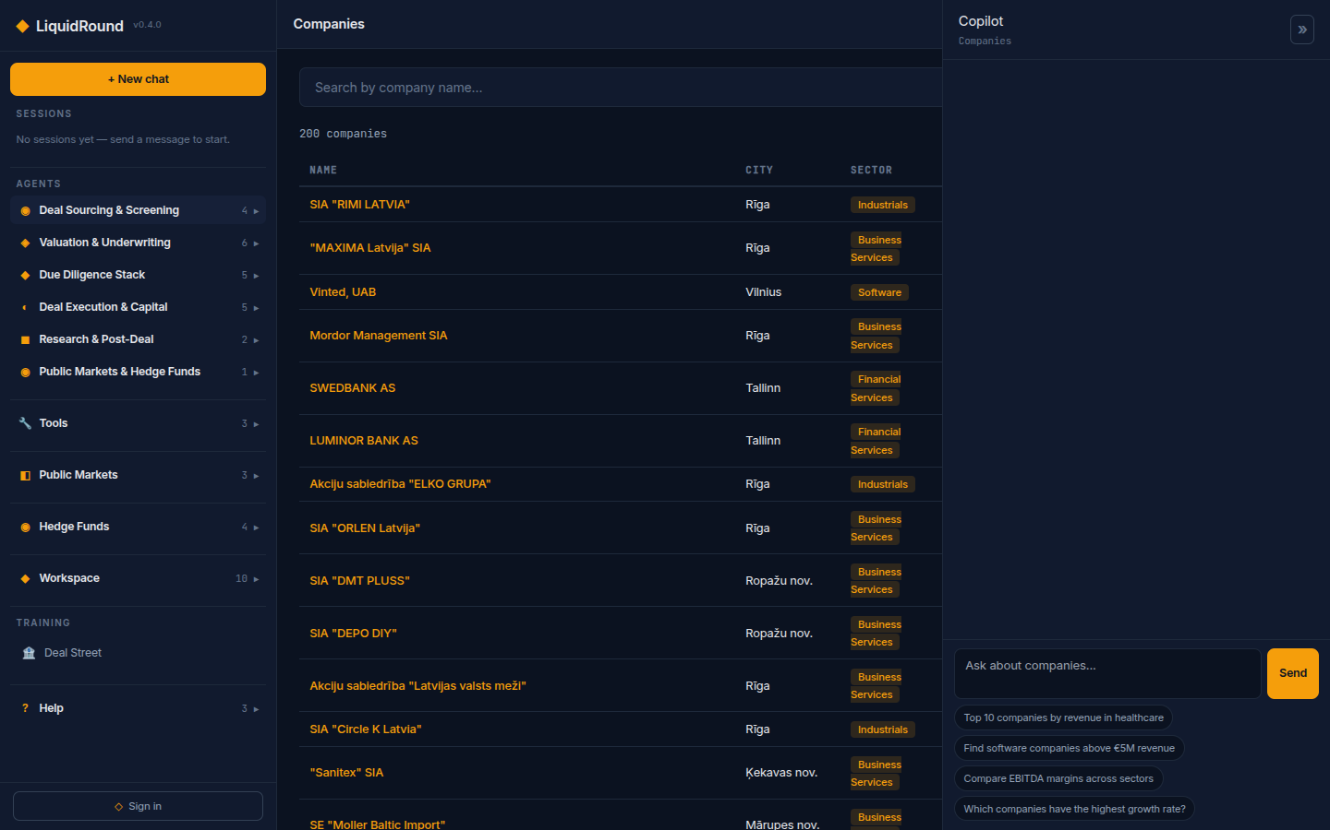
Workspace pages
Companies
Search the company database by name, sector, or geography. Click a company to see
its full profile with financials, description, and deal brief.
Pipelines
Track your deal pipeline — add targets or buyers, set deal stages, and monitor
progress. Requires sign-in.
Daily Deals
AI-curated daily digest of M&A-relevant companies. Each company gets a deal angle,
investment thesis, and sector comps. The featured company gets a deep dive with
company overview, deal context, and a bottom-line recommendation.
Delivered as a styled email — opt in via your profile preferences.
Valuation Simulator
Interactive valuation simulator with 4 methods: EV/Revenue multiples, EV/EBITDA
multiples, DCF (WACC + equity bridge), and combined view. Enter your financials
and adjust assumptions in real time.
Analytics
Text-to-SQL analytics — ask questions in plain English and get charts + tables
from the database.
Data Room
Upload and manage deal documents organized by company. Supports PDF, DOCX, XLSX,
PPTX, CSV, and image files. Drag-and-drop or use the upload button.
Documents
Browse uploaded documents. Extract key terms or score documents against buyer
criteria.
Deal History
View your workflow history with charts showing deal types, timeline, and status
distribution.
Instructions
View and customize agent system prompts to tailor AI behavior to your firm's
standards.

Slide 14
Exports
• Excel (XLSX) — when an agent produces a table, click Download XLSX for a formatted spreadsheet with styled headers.
• Word (DOCX) — IC memos, teasers, and other markdown content export as Word documents via Download DOCX.
• PDF — IC memos produce a PDF preview in the right pane. Company cards can also be downloaded as branded PDFs.

Slide 15
Configuration
• Currency — switch between EUR, GBP, and USD in Configuration.
• Role — set your default view to Buyer, Seller, or Both. Affects which agents and suggestions appear first.
• Number input — all financial inputs support human-friendly shortcuts: 1M, 35.5k, 2B, 1,000,000.

Slide 16
Keyboard shortcuts
• Enter — send message
• Shift+Enter — new line in message

Slide 17
Tips
• Use the Copy button to copy all chat messages to clipboard.
• Use the Share button to generate a shareable link for your session.
• The News tab in the right pane shows live M&A news.
• The Artifact tab shows agent-produced tables, charts, and citations.
• Upload documents via the paperclip button or drag-and-drop.
• All collapsible nav sections can be expanded by clicking the section header.

Slide 18
Quick reference
Navigation
• *Agents* — 6 categories, 23 specialists · *Tools* — Market Comps, Find Buyers, Valuation
• *Public Markets* — IPO Map, IPO Pipeline, Prospectus
• *Hedge Funds* — Fund Treemap, Top Holdings, Popular Securities, Activist Filings
• *Workspace* — Companies, Pipelines, Daily Deals, Valuation, Analytics, Data Room, Documents, Deal History, Exports, Instructions
• *Help* — Profile, Help page, Keyboard shortcuts
Prefix commands: profile: · scan: · buyers: · triage: · intent: · dcf: · multi: · comps: · ltm: · synergy: · score · vdr: · abstract: · legal: · ops: · esg: · memo: · teaser: · bid: · ipo: · integrate: · research: · hedgefunds:
LiquidRound v0.4.0 — Predictive Labs Ltd

