Slide 1
LiquidRound AI Platform Demo
M&A · IPO · Public Markets · Investor Relations
31 specialist agents · 7 categories · chat-first workspace
Predictive Labs Ltd · 20260728T063115Z

Slide 2
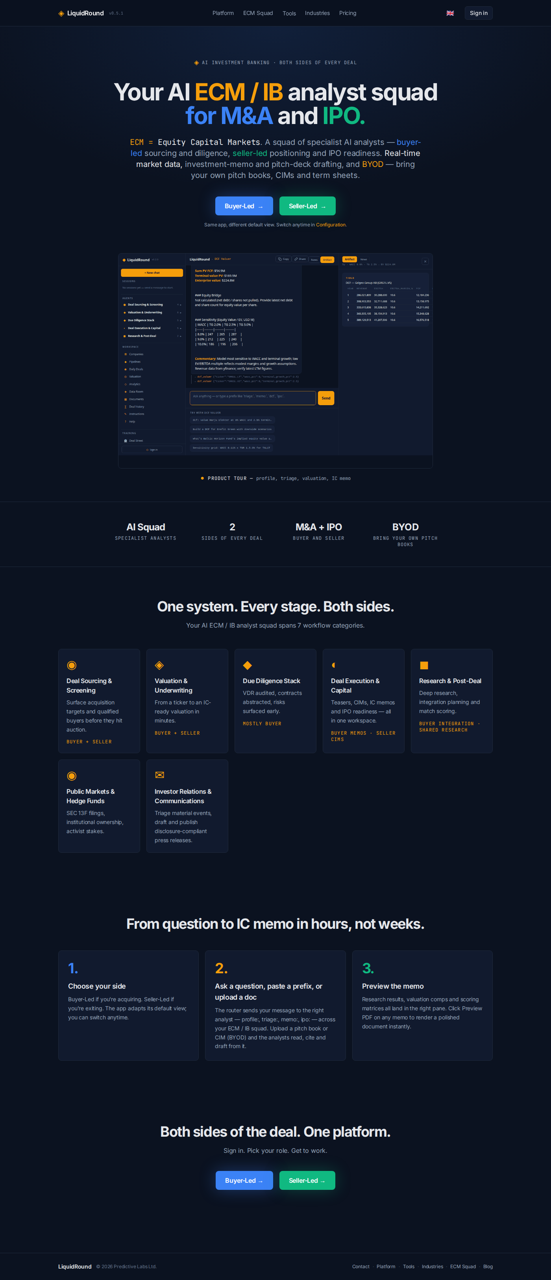
Demo at a glance
1. Open the three-pane workspace — show automatic agent routing.
2. Run a company profile or deep-research prompt in the chat.
3. Expand Investor Relations → create a researched press release.
4. Triage a material event with ir-triage: — disclosure go/no-go.
5. Export the draft to Markdown, Word, and PDF → save to Data Room.
6. Run ir-publish: to finalize into a wire-ready package.
7. Open Public Markets, Deal Radar, Analytics, and Skills.

Slide 3
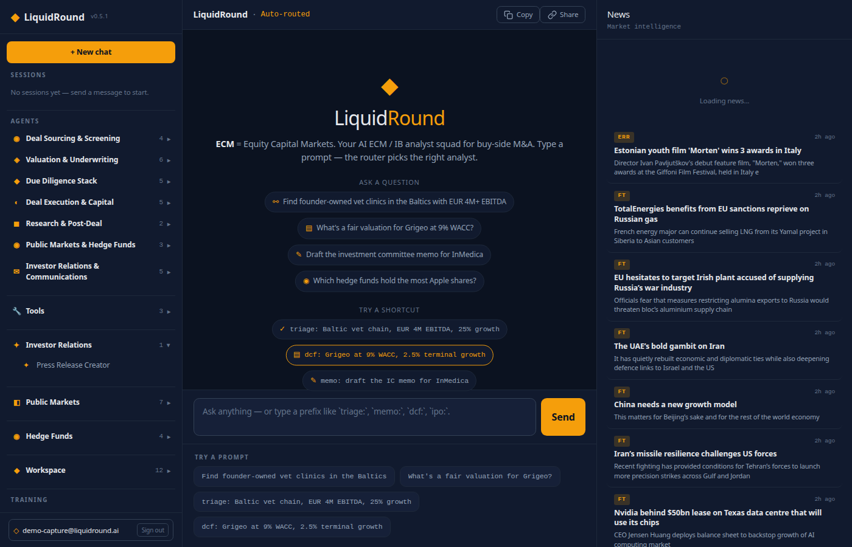
Getting started
Sign in at liquidround.ai — choose Buyer-Led or Seller-Led. Three panes: left (sessions, 31 agents, Tools, IR, Public Markets), centre (routed chat, workspace pages), right (live News feed).
On mobile, the left pane becomes a slide-in menu.

Slide 4
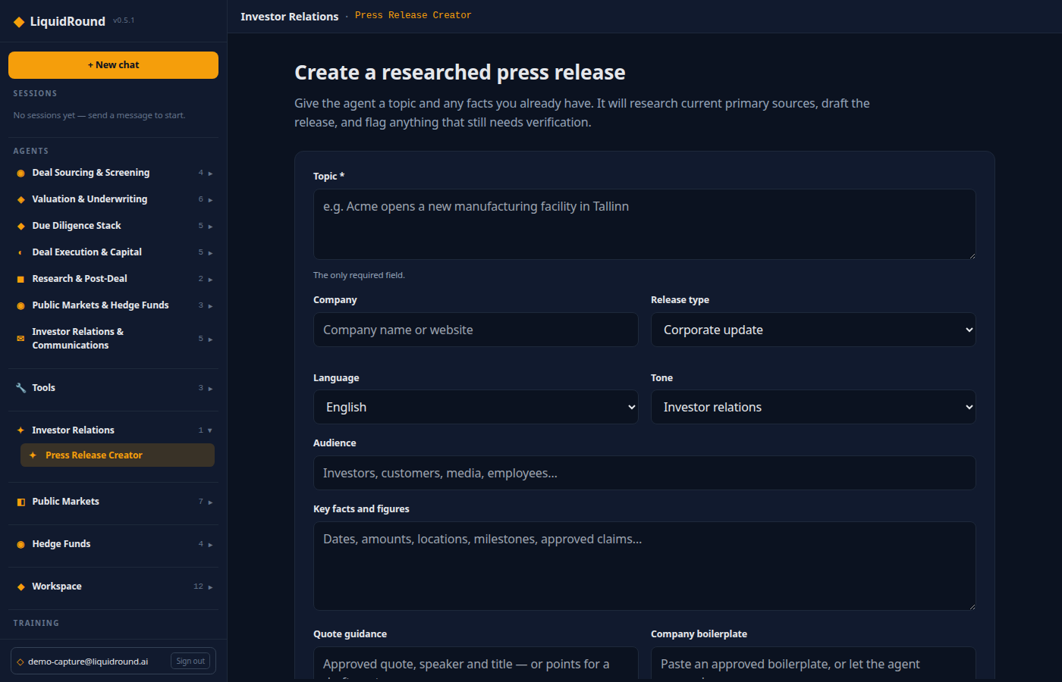
Investor Relations — Press Release Creator
Open Investor Relations → Press Release Creator at /app/investor-relations/press-release. Only Topic is required. The guided brief supports company, release type, language, tone, audience, key facts, quotes, boilerplate, contacts, and embargo.
Press Research and draft release — the workflow searches the web, sends evidence to the Press Release Writer, and returns editable Markdown with source notes.

Slide 5

Investor Relations — draft safeguards and exports
The writer produces a news-led headline, dateline, lead, supporting facts, attributed quotes, boilerplate, contacts, and source verification notes. Regulated announcements are flagged for legal review.
Output actions: Copy · Markdown · Word · PDF · Save to Data Room.

Slide 6
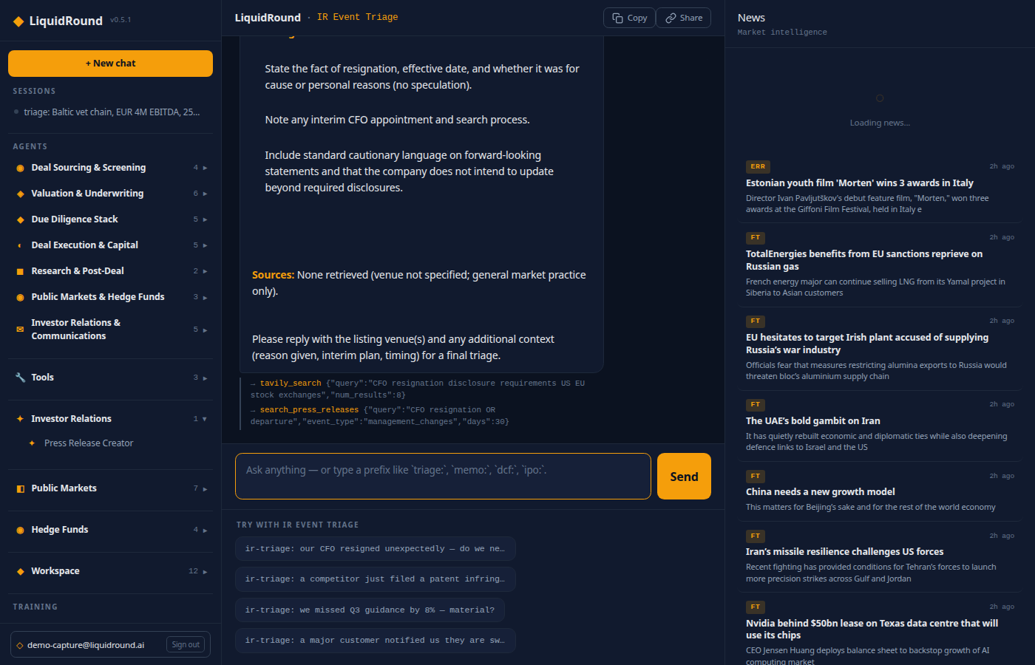
Investor Relations — the IR agent squad
Five agents cover the full disclosure lifecycle:
• IR Event Triage (ir-triage:) — materiality go/no-go under Reg FD, MAR, exchange rules.
• Press Release Writer (write-release:) — research and draft publication-ready releases.
• IR Compliance Reviewer (ir-compliance:) — Reg FD / MAR compliance check before publish.
• IR Publish Agent (ir-publish:) — approved draft → wire-ready package + checklist.
• IR Distribution Planner (ir-distribute:) — wire services, exchanges, investor lists, timing.

Slide 7
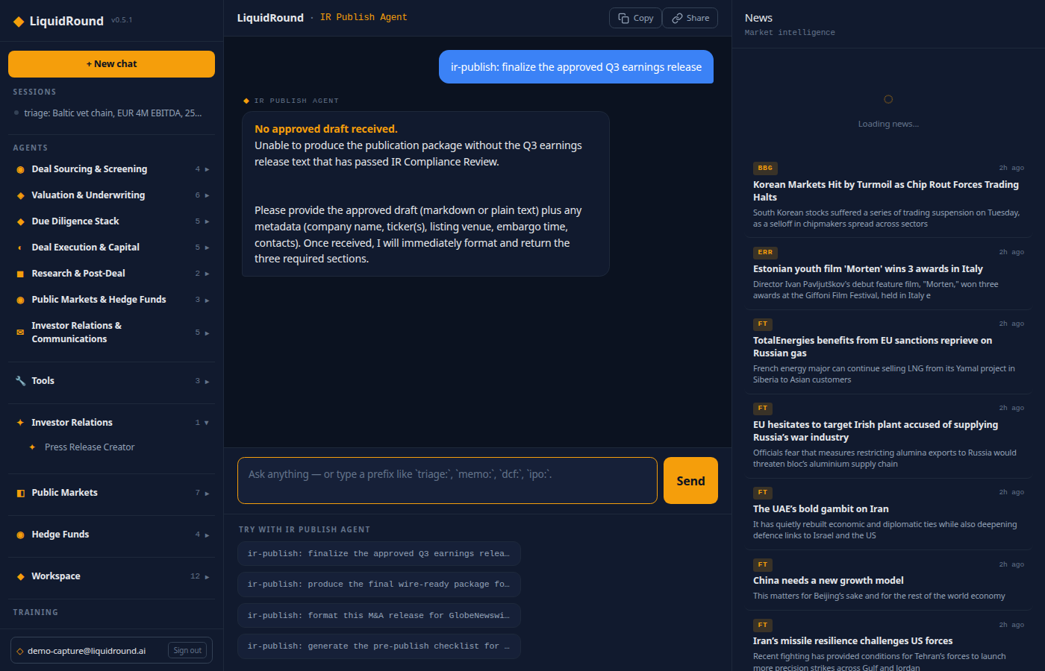
Investor Relations — publish and distribute
Run ir-publish: to take an approved draft and produce the final wire-ready package with exchange-compliant formatting and a pre-publish checklist. Then ir-distribute: plans wire-service routing, exchange notifications, and cross-timezone timing.
Demo prompts: ir-triage: CFO resigned, ir-compliance: check this draft, ir-publish: finalize Q3 earnings, ir-distribute: Nordic exchanges.

Slide 8
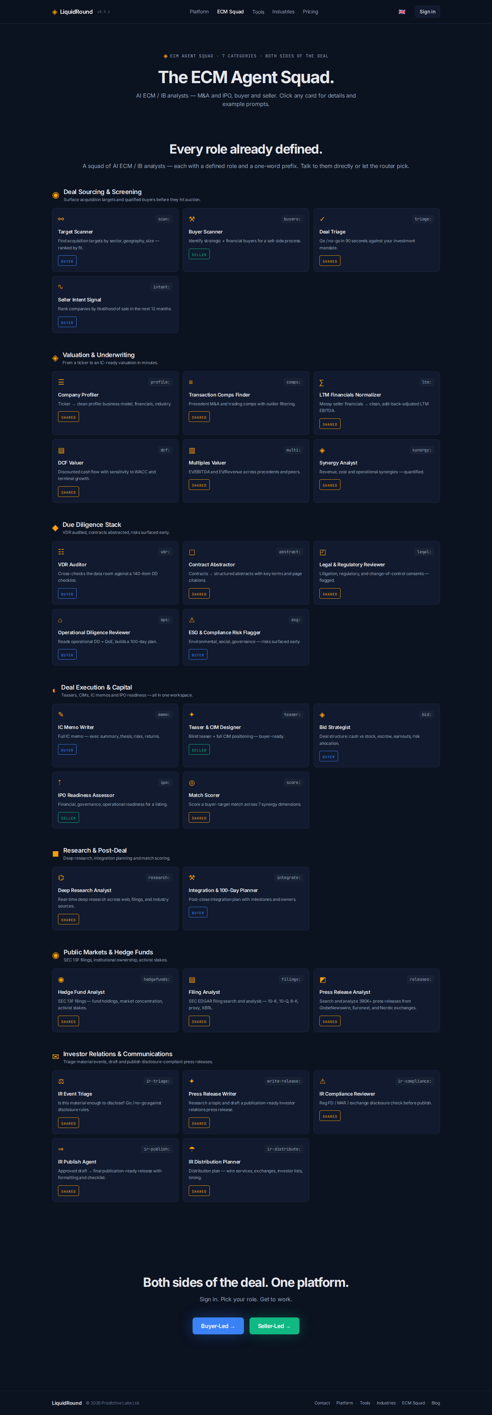
The 31-agent squad — sourcing and underwriting
Deal Sourcing (4): Target Scanner (scan:), Buyer Scanner (buyers:), Deal Triage (triage:), Seller Intent (intent:).
Valuation & Underwriting (6): Company Profiler (profile:), Comps Finder (comps:), LTM Normalizer (ltm:), DCF Valuer (dcf:), Multiples Valuer (multi:), Synergy Analyst (synergy:).

Slide 9
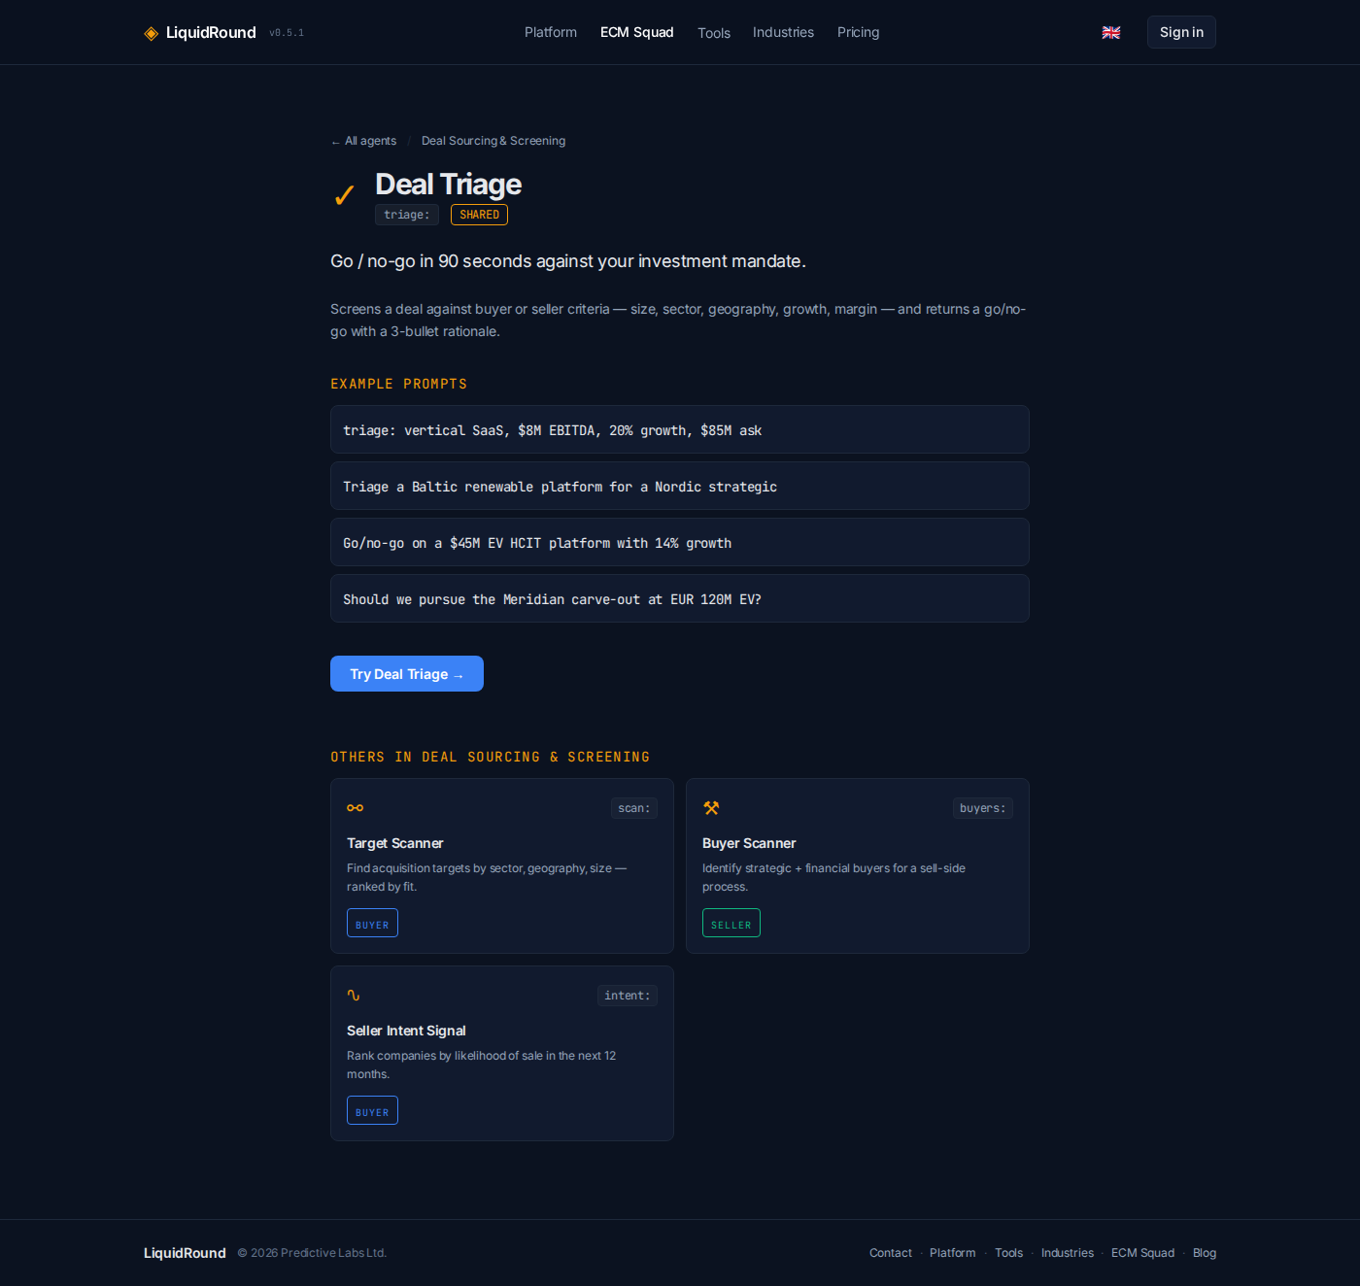
The 31-agent squad — diligence and capital
Due Diligence (5): VDR Auditor (vdr:), Contract Abstractor (abstract:), Legal Reviewer (legal:), Operational DD (ops:), ESG Flagger (esg:).
Deal Execution & Capital (5): IC Memo Writer (memo:), Teaser/CIM Designer (teaser:), Bid Strategist (bid:), IPO Readiness (ipo:), Match Scorer (score:).

Slide 10
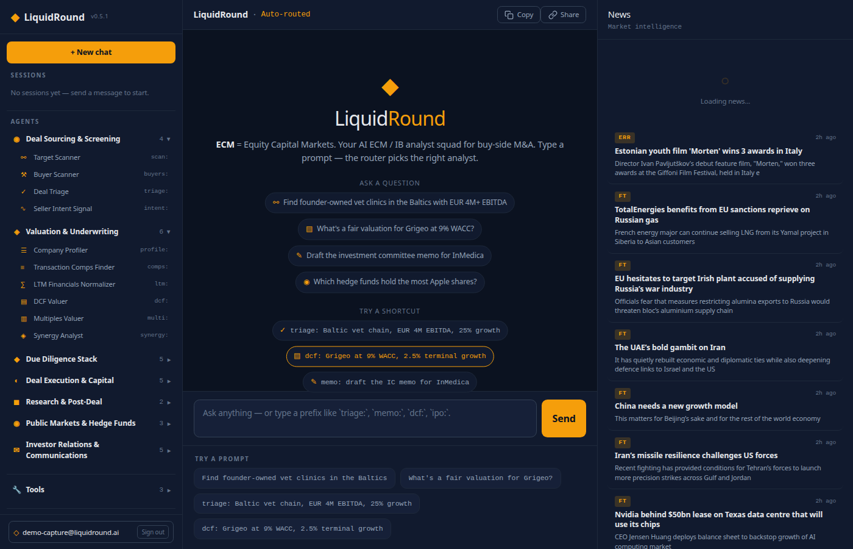
The 31-agent squad — research and public markets
Research & Post-Deal (2): Deep Research Analyst (research:), Integration Planner (integrate:).
Public Markets (4): Hedge Fund Analyst (hedgefunds:), Filing Analyst (filings:), Press Release Analyst (releases:), Reverse Merger Analyst (rto:).
Investor Relations (5): IR Triage, Press Release Writer, IR Compliance, IR Publish, IR Distribution.

Slide 11
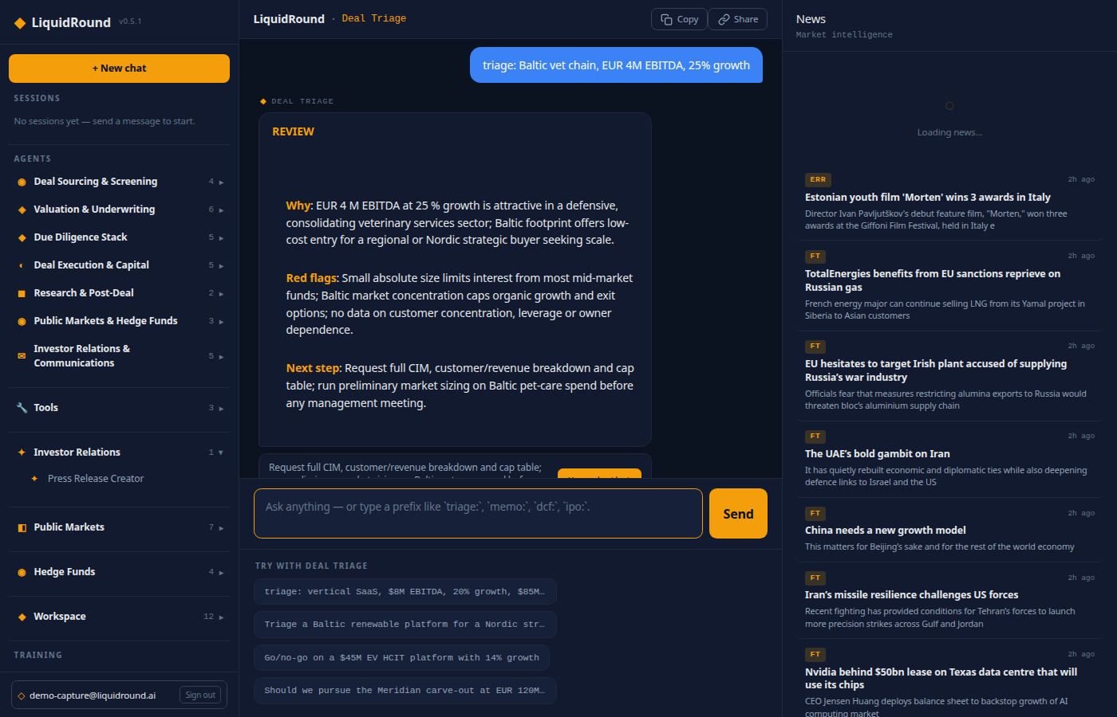
Chat, routing, and artifacts
Ask a natural-language question or use an agent prefix. The router picks the right agent; progress and tool calls stream live. Work products — profiles, tables, citations, charts — render inline. Use Copy and Share for session links.

Slide 12
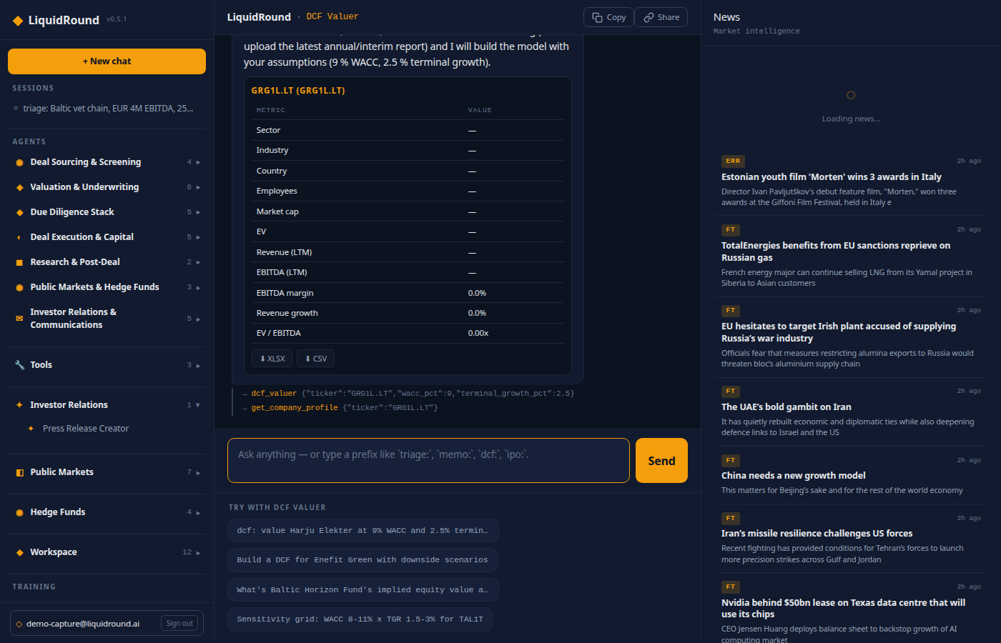
Chat — DCF and IC memo
DCF Valuer builds a five-year model with WACC and terminal-growth sensitivity. IC Memo Writer drafts a full investment-committee memo from workspace data.

Slide 13
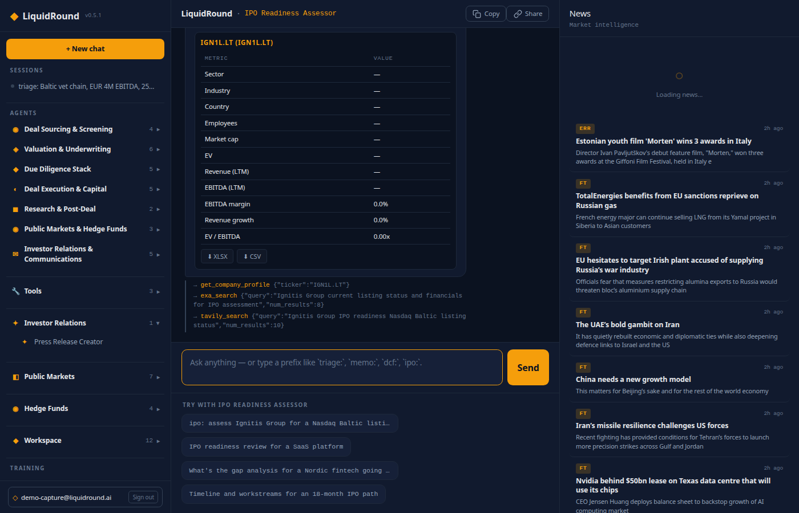
Chat — IPO readiness
IPO Readiness Assessor checks financial, governance, operational, and market readiness for a listing.

Slide 14
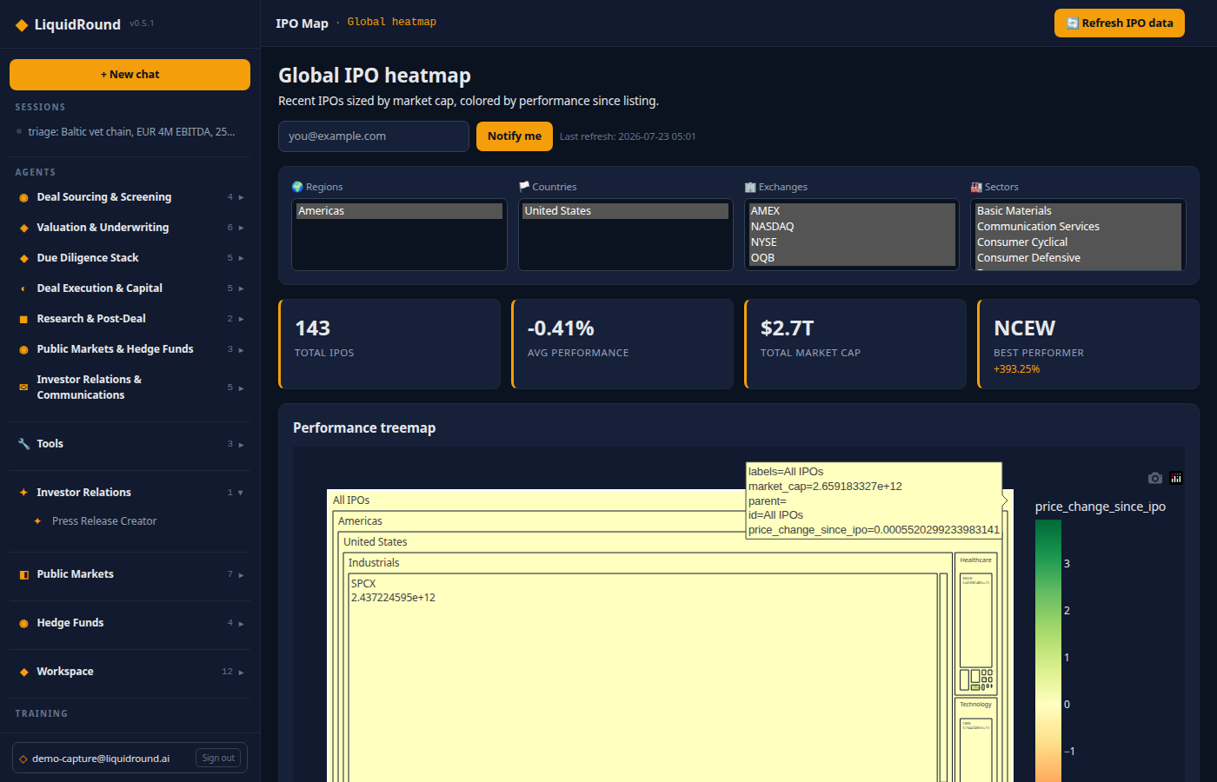
Public Markets — IPO Map and SPACs
The IPO Map shows recent listings sized by market cap, colored by performance. The SPAC Tracker covers searching, announced, completed, and liquidated SPACs with trust values and redemptions.

Slide 15
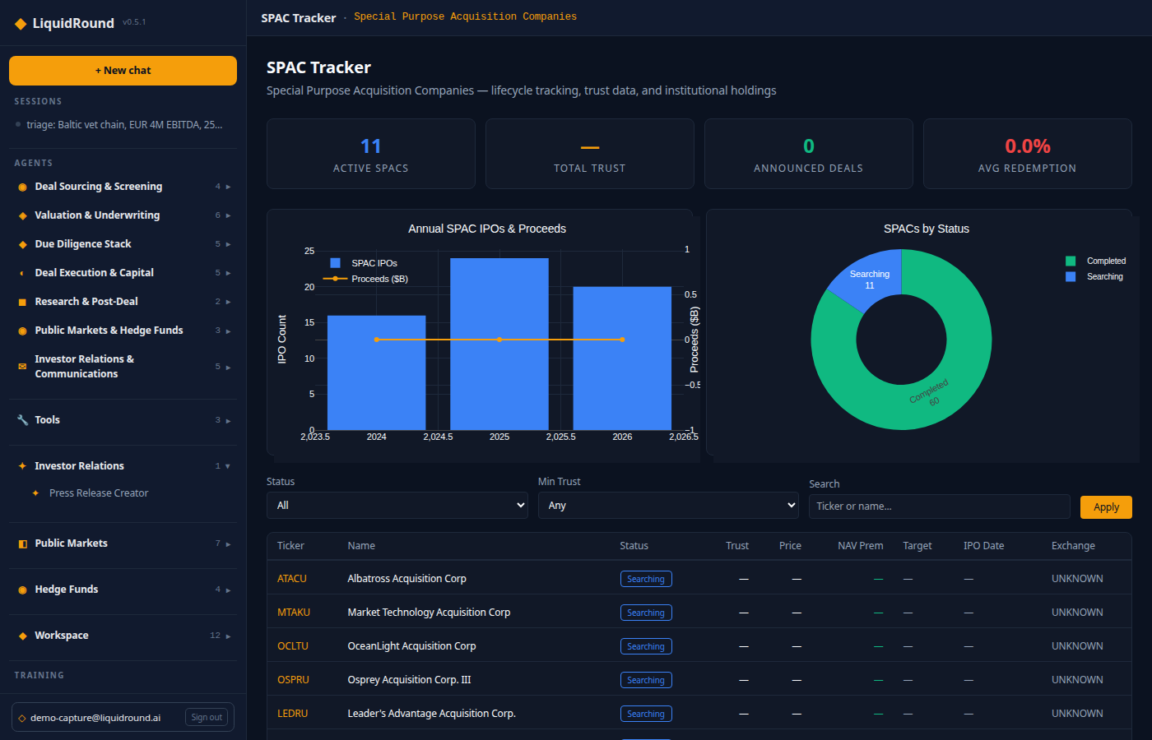
Public Markets — SPAC Tracker
Track SPAC lifecycle, trust values, redemptions, prices, targets, and institutional holders.

Slide 16
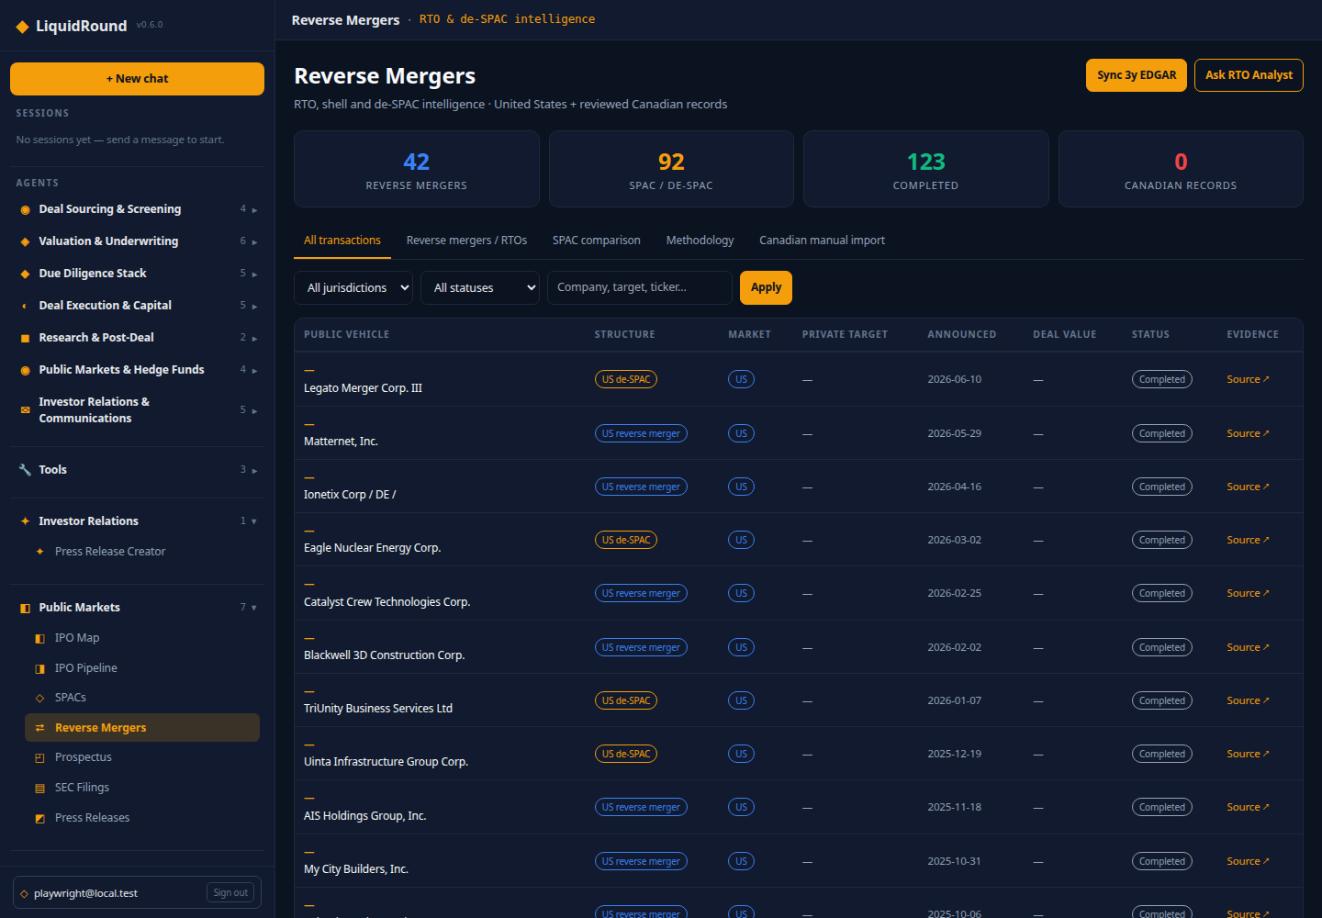
Public Markets — Reverse Mergers
Open Public Markets → Reverse Mergers at /app/reverse-mergers. Compare
traditional US reverse mergers, reviewed Canadian RTO/CPC records, and SPAC/de-SPAC
transactions in one normalized workspace. Filters cover jurisdiction, status, company,
target, structure, evidence, and deal value. Subtabs separate traditional reverse
mergers from the SPAC comparison and explain the classification methodology.
The three-year US monitor uses SEC EDGAR evidence, especially Form 8-K Items 1.01,
2.01, 5.01, 5.06, and 9.01. Canadian records are reviewed manual citations until a
licensed bulk source is connected; LiquidRound does not scrape or mirror SEDAR+.
Use rto: to ask the Reverse Merger Analyst.

Slide 17
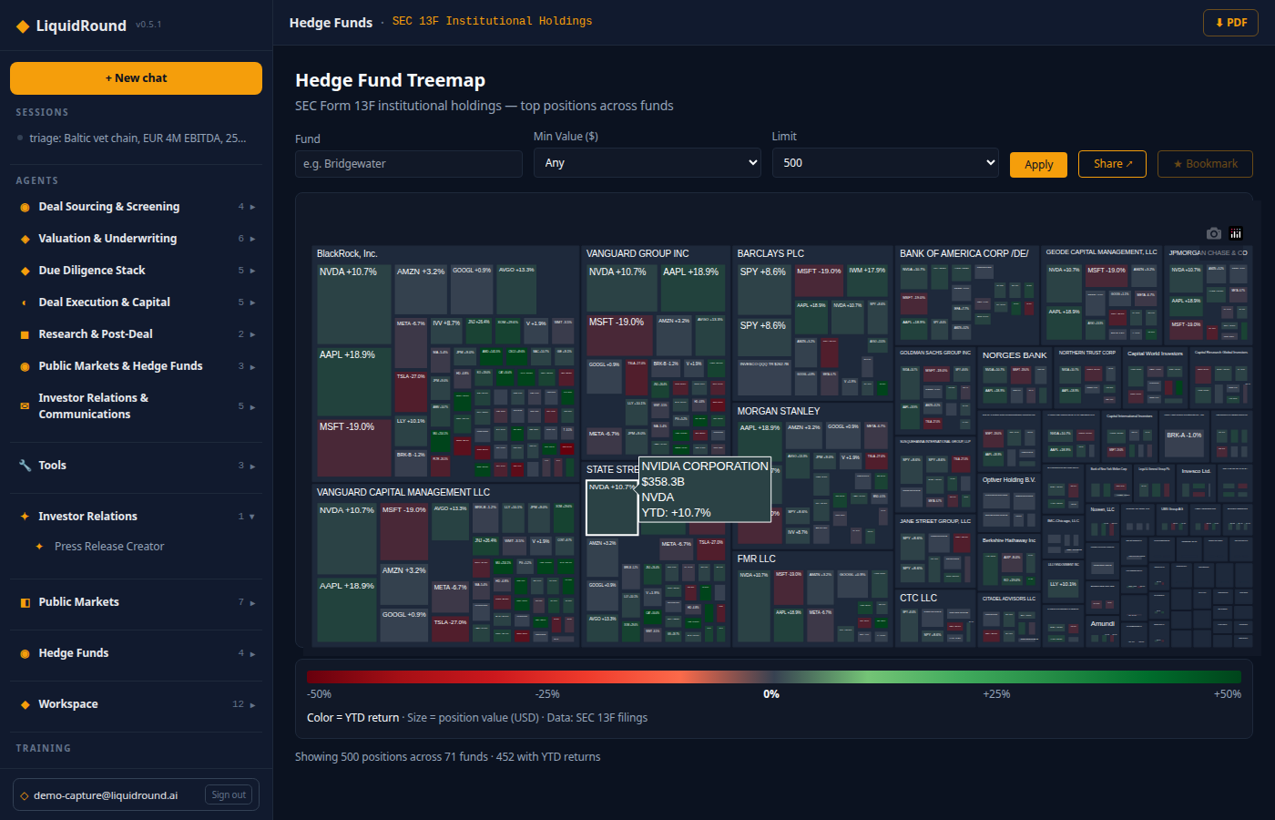
Hedge Fund Intelligence
The Fund Treemap visualizes SEC 13F positions by portfolio value. Search managers, set minimum positions, bookmark funds. Chat shortcuts surface top holdings, popular securities, concentration, and activist 13D/13G filings.

Slide 18
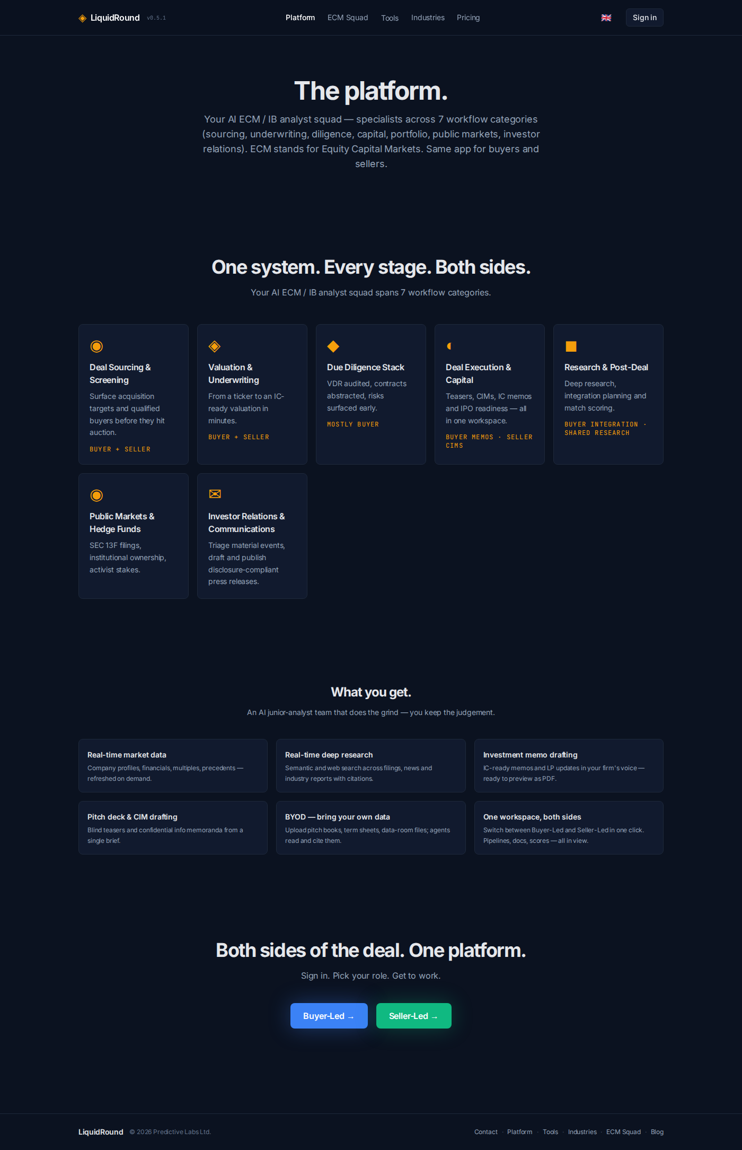
Free public tools
Three no-sign-in workflows: Market Comparables (benchmark transaction multiples), Find Buyers (score strategic and financial buyers), Business Valuation (sector multiples + value drivers). Fields accept shorthand like 1M, 500k, 2.5B.

Slide 19
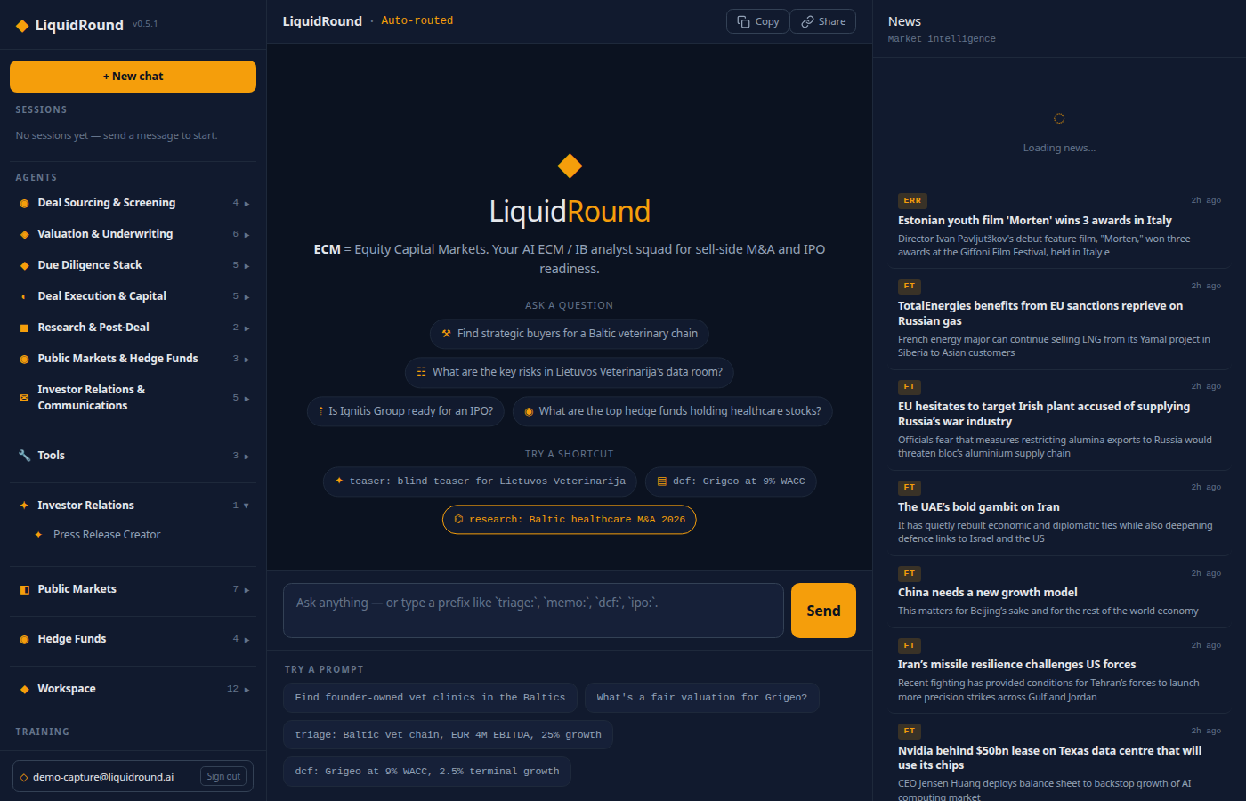
Workspace — companies and pipelines
Search companies by name, sector, geography. Open profiles, financials, deal briefs. Maintain target and buyer pipelines with drag-and-drop stages. Deal Radar ranks synergy pairs. Data Coverage syncs Estonian, Norwegian, and Danish sources.

Slide 20
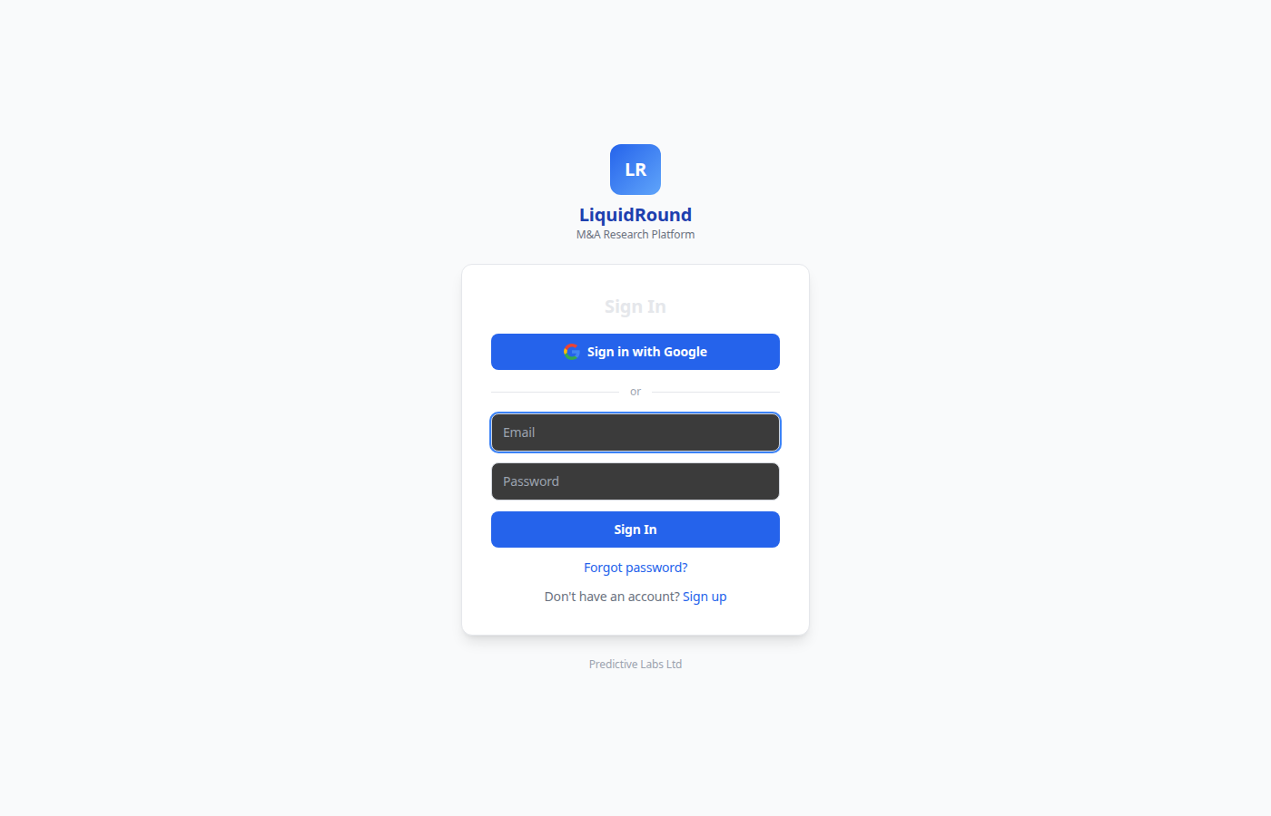
Workspace — valuation, analytics, data room
Valuation: EV/Revenue, EV/EBITDA, DCF with adjustable assumptions. Analytics: plain-language database queries with tables and charts. Data Room: upload, organize, and parse PDF/DOCX/XLSX/PPTX files. IR drafts saved from the Press Release Creator appear here.

Slide 21
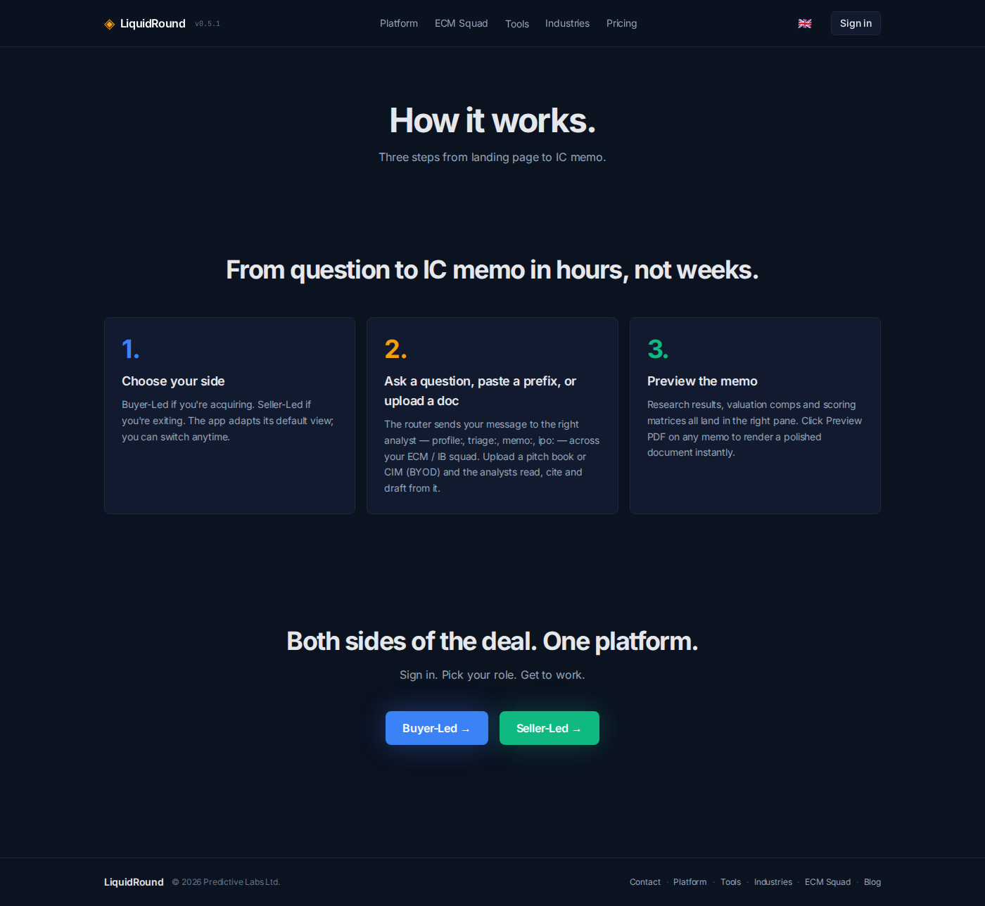
Skills
Open Workspace → Skills at /app/skills to review and edit the operating prompt for each agent. WYSIWYG and Markdown modes, version history, reverting. Saved changes clear the agent cache immediately.
IR skills: IR Event Triage, Press Release Writer, IR Compliance Reviewer, IR Publish Agent, IR Distribution Planner.

Slide 22
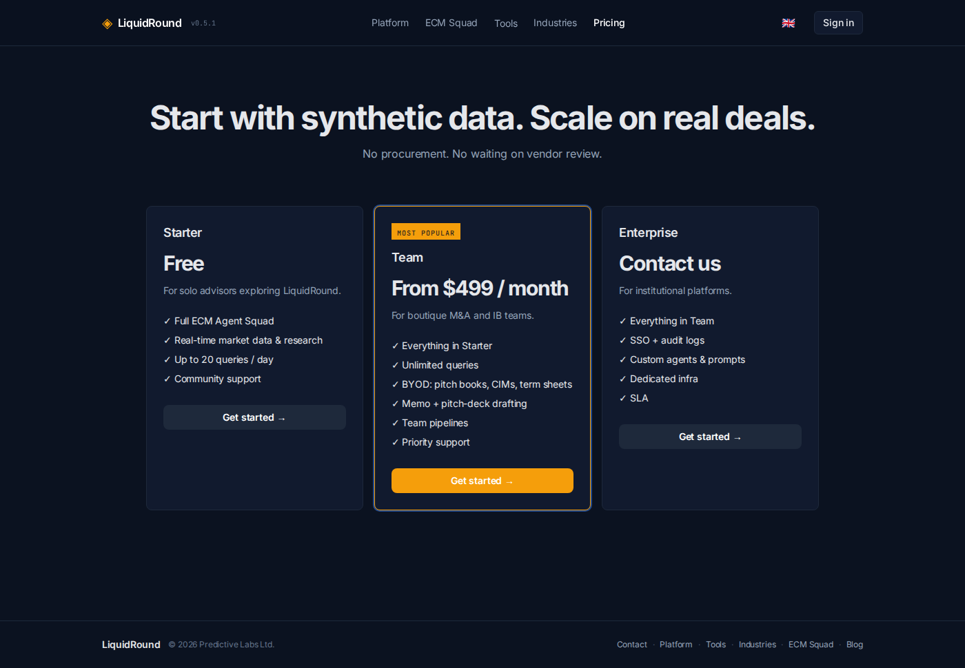
Exports, account, and training
Exports: XLSX, DOCX, branded PDF, CSV, press-release Markdown/Word/PDF. Account: profile, password, currency (EUR/GBP/USD), role, deal preferences, digest notifications. Training: Deal Street scenario-based RPG. Keyboard: Enter = send, Shift+Enter = newline.

Slide 23
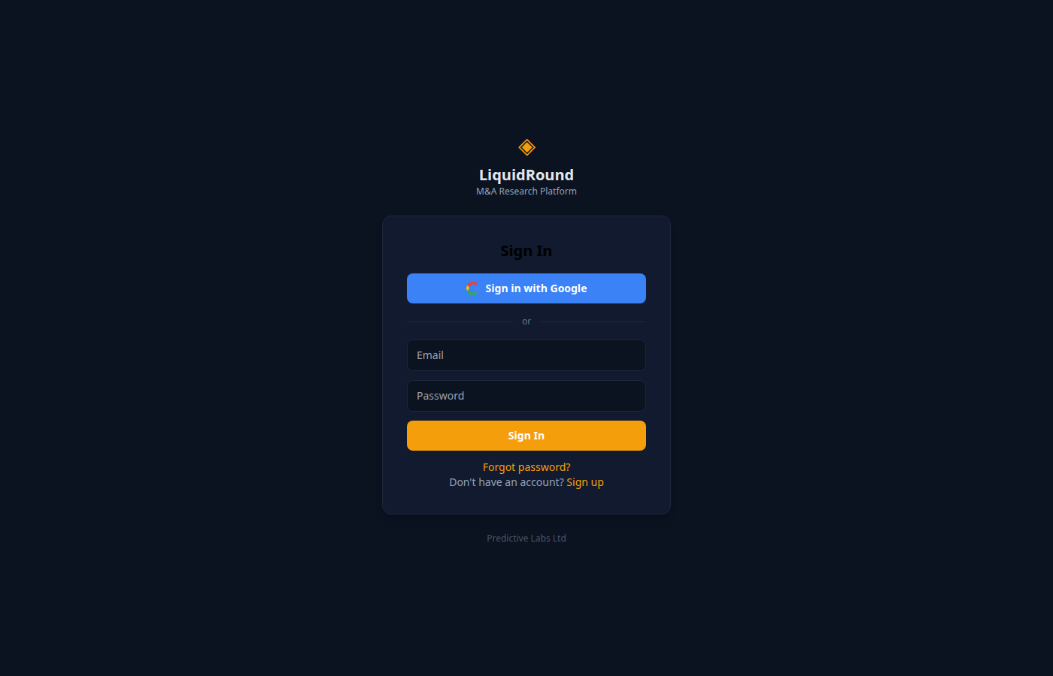
Demo checklist
1. Sign in → show persistence and Data Room.
2. IR Press Release Creator with a real company topic.
3. Review source notes and verification placeholders.
4. Export to Markdown, Word, PDF → save to Data Room.
5. ir-triage: on a hypothetical material event.
6. ir-publish: → wire-ready package + checklist.
7. Contrast releases: vs write-release:.
8. Open Skills → Press Release Writer skill.
9. Finish with a public-markets page.

Slide 24
Document control
Generated from platform state on 2026-07-28. Prior editions archived under docs/archive/. The regenerate-liquidround-demo skill archives, audits, refreshes, and produces timestamped MD + PDF + PPTX.
LiquidRound v0.6.0 — Predictive Labs Ltd

