Slide 1
Technology & AI-Driven Solutions
Products Roadmap & Platform Demo — FY2026 Q1
Ashland Hill Media Finance

Slide 2
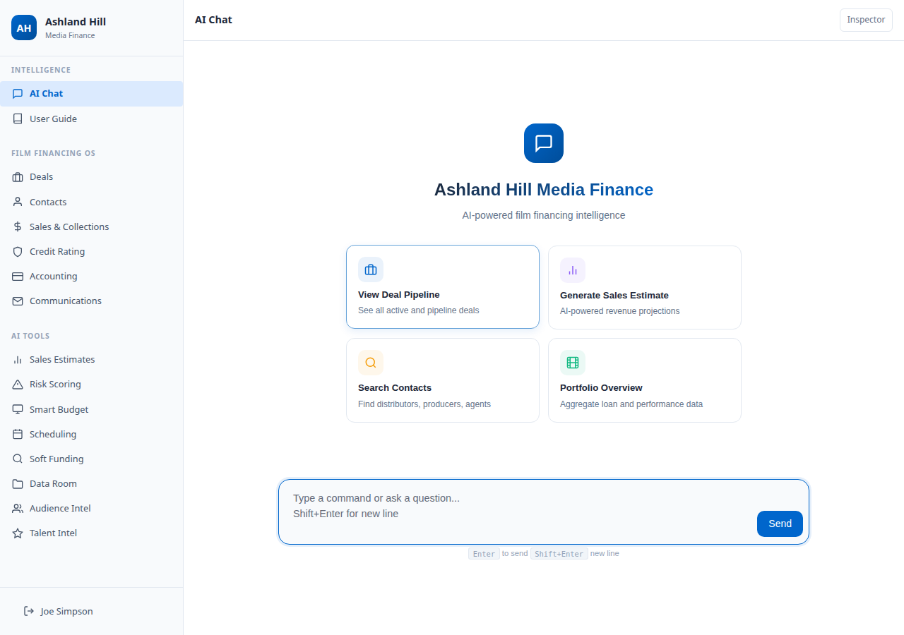
Platform Vision
From Single-Picture Lender to Integrated Media Platform
AHMF is a centralized, AI-driven operating system purpose-built for private credit and film finance.
Replaces fragmented spreadsheets and siloed workflows with a unified data architecture
9 product modules — all operational
AI-powered intelligence across the full financing lifecycle
Real-time portfolio visibility and deal management
Powered by LangGraph + XAI Grok-3 AI engine
Ashland Hill Media Finance — Private & Confidential

Slide 3
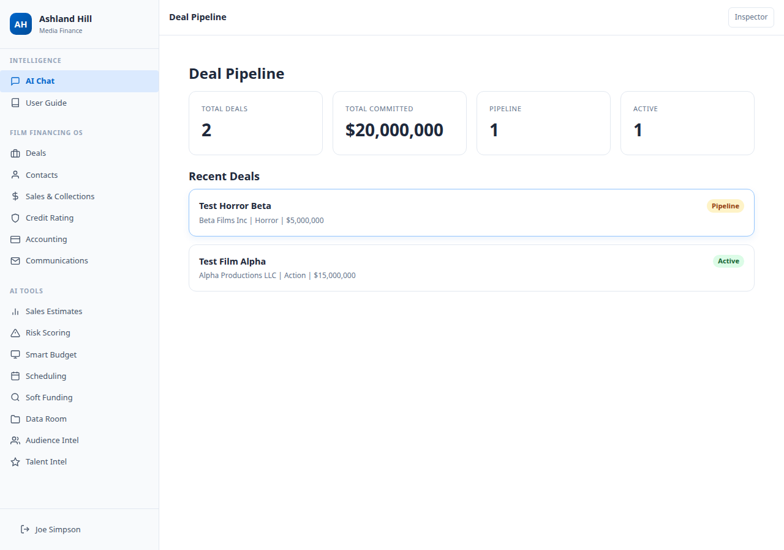
Film Financing Operating System
The core operating system — 6 fully operational modules
Deals — Pipeline dashboard, deal structuring, performance tracking
Contacts — Counterparty profiles, relationship mapping
Sales & Collections — Territory contracts, MG tracking, collection payments
Credit Rating — AI-powered counterparty scoring (AAA-CCC tiers)
Accounting — Transaction ledger, disbursements, repayments, net position
Communications — Deal-linked messages, tasks with deadlines, completion tracking
Ashland Hill Media Finance — Private & Confidential

Slide 4
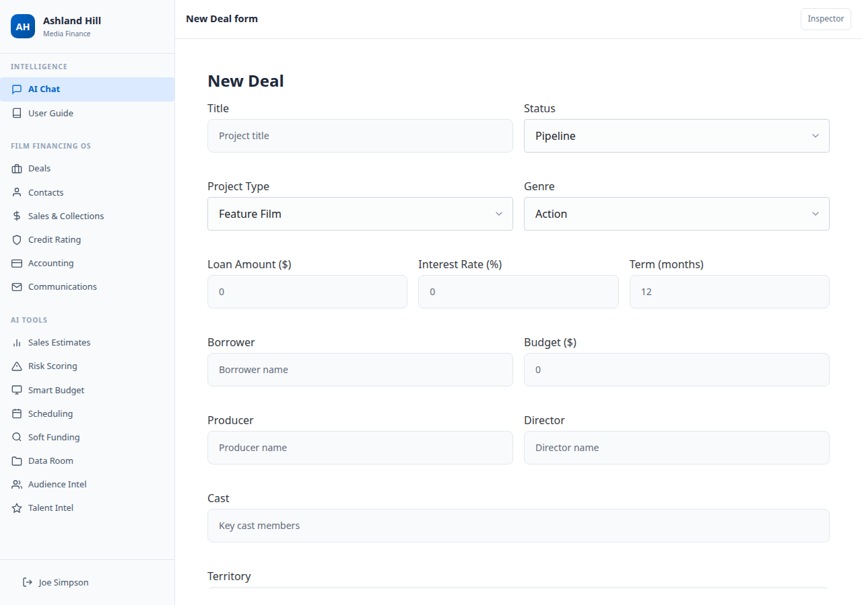
Deal Structuring
Comprehensive deal creation with all financing parameters
Title, genre, project type, status (Pipeline/Active/Closed)
Loan amount, interest rate, term in months
Budget, borrower, producer, director, cast
Territory and collateral type
Full audit trail with created_by tracking
Ashland Hill Media Finance — Private & Confidential

Slide 5
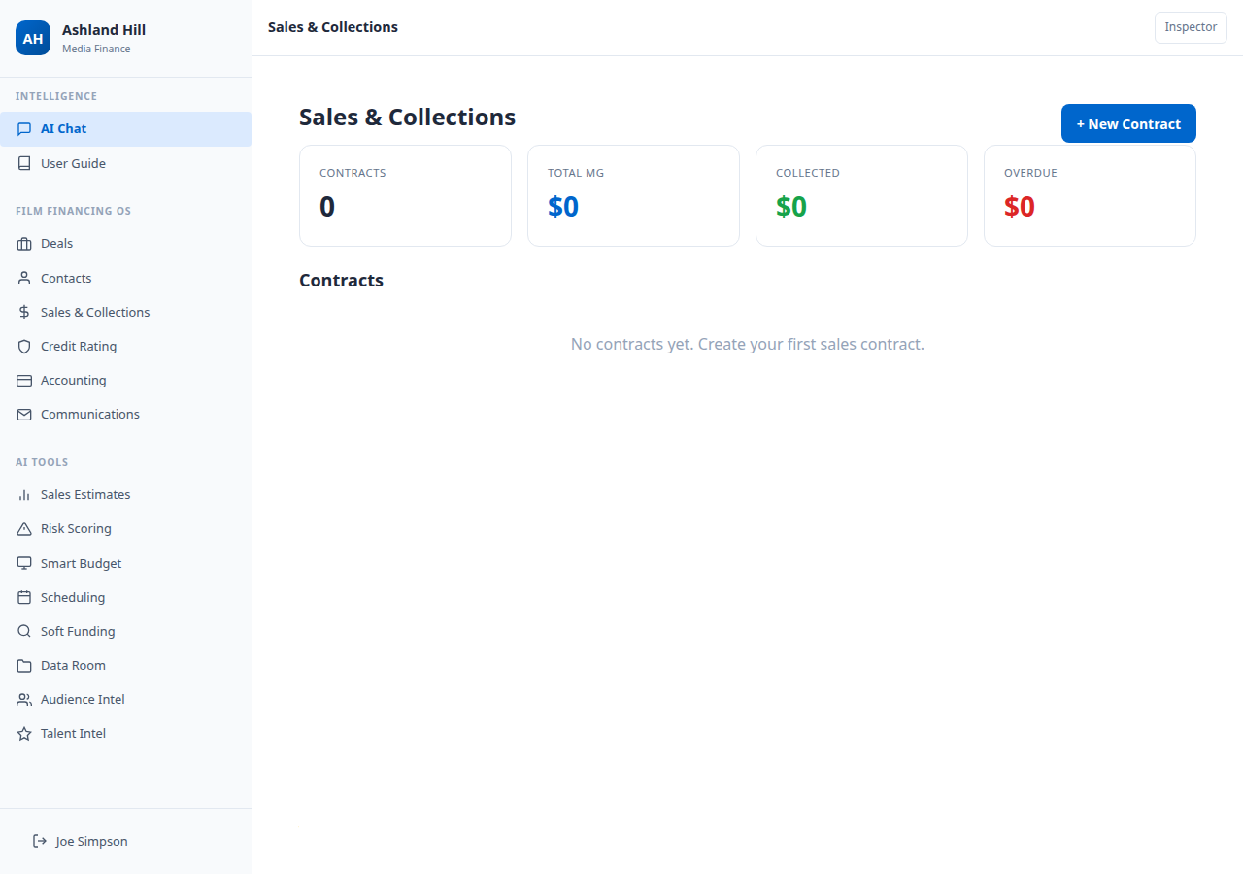
Sales & Collections
Territory-based revenue tracking and collateral monitoring
Sales contracts linked to deals and distributors
Territory-based MG (Minimum Guarantee) commitments
Collection payment recording with due dates
Status tracking: pending, received, overdue
Variance analysis: projected vs actual collections
Receivable flagging for delayed payments
Ashland Hill Media Finance — Private & Confidential

Slide 6
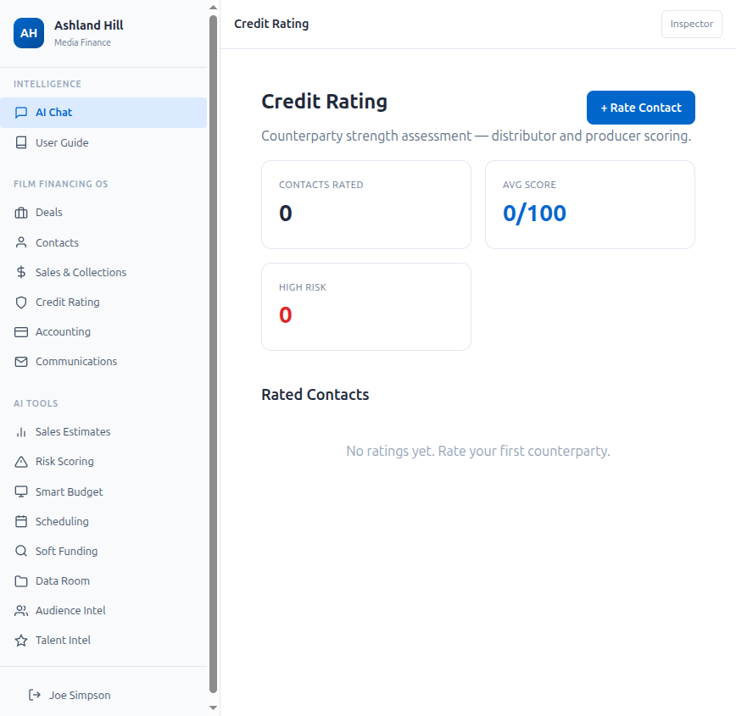
Credit Rating
AI-powered counterparty strength assessment
Select any distributor, producer, or sales agent
AI generates comprehensive credit profile:
Credit Score (0-100)
Payment Reliability (0-100)
Risk Tier (AAA through CCC)
Factor Analysis:
Track Record — historical deal performance
Financial Stability — company financials
Market Position — competitive standing
Payment History — on-time payment patterns
Ashland Hill Media Finance — Private & Confidential

Slide 7
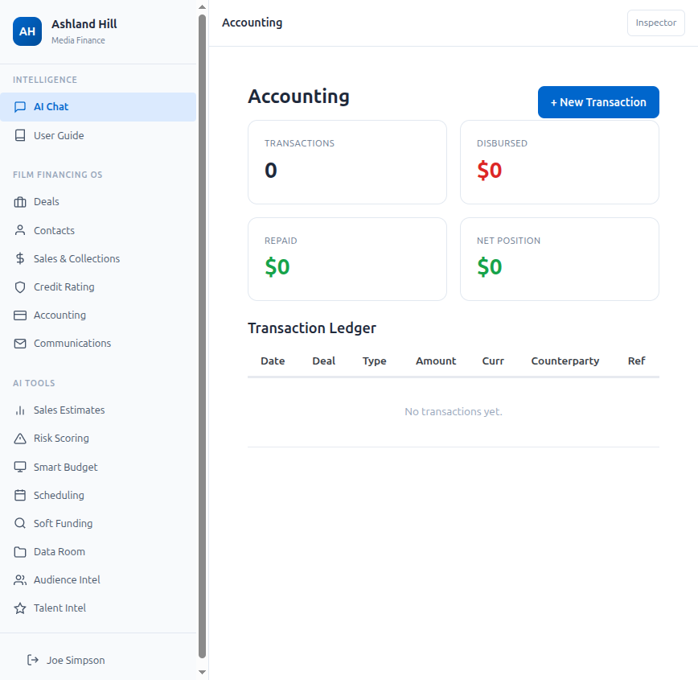
Accounting
Transaction-level financial integrity
Full transaction ledger across all deals
Transaction types: Disbursement, Repayment, Fee, Interest, Adjustment
Multi-currency support (USD, EUR, GBP, CAD, AUD, JPY, CNY)
Net position tracking (repaid + fees - disbursed)
Counterparty linking for audit trail
Reference notes per transaction
Ashland Hill Media Finance — Private & Confidential

Slide 8
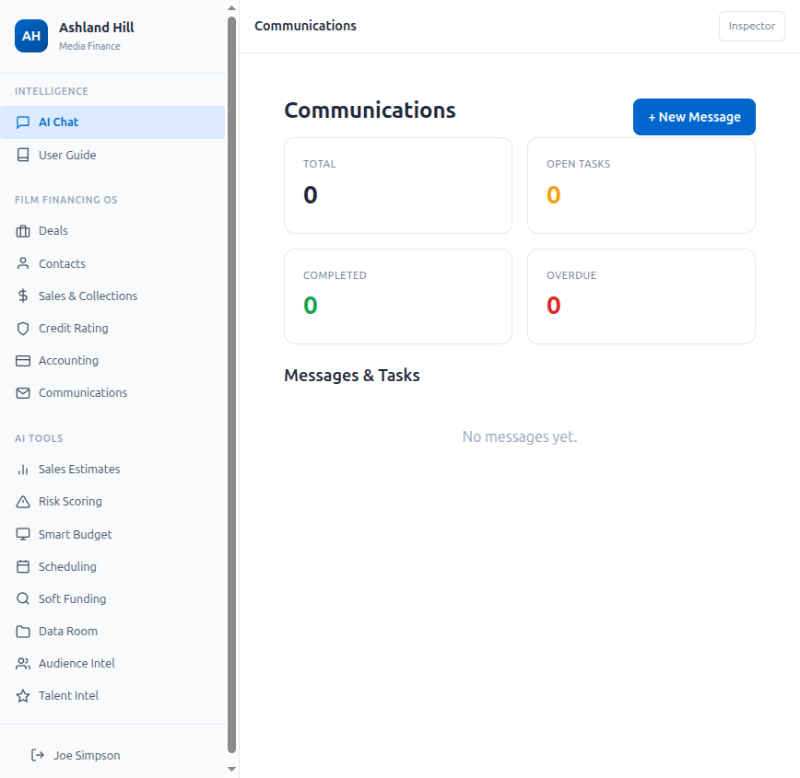
Communications
Execution control layer for deal teams
Deal-linked messages, tasks, and notifications
Task assignment with due dates and deadlines
Interactive checkboxes to mark task completion
Overdue task flagging for missed deadlines
Status dashboard: open tasks, completed, overdue
Full message history per deal
Ashland Hill Media Finance — Private & Confidential

Slide 9
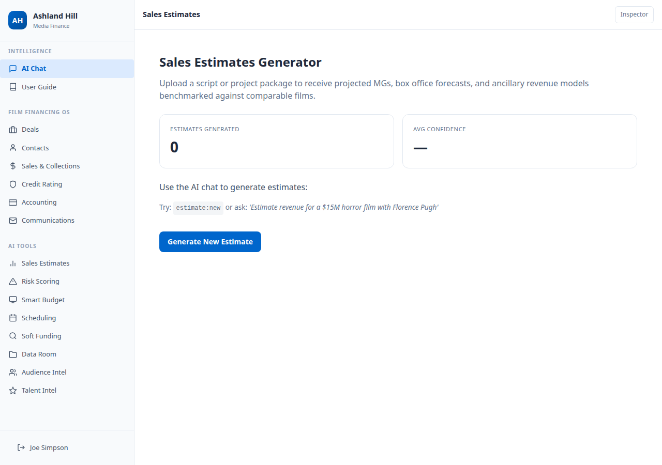
Sales Estimates Generator
Quantitative valuation intelligence for greenlight and collateral appraisal
Script ingestion with PDF parsing + metadata extraction
Genre + comp benchmarking via TMDB & OMDB databases
Territory-level MG projections
Box office forecasting (domestic + international)
Confidence score and model reliability rating
Comparable film analysis with budget, revenue, and cast data
Ashland Hill Media Finance — Private & Confidential

Slide 10
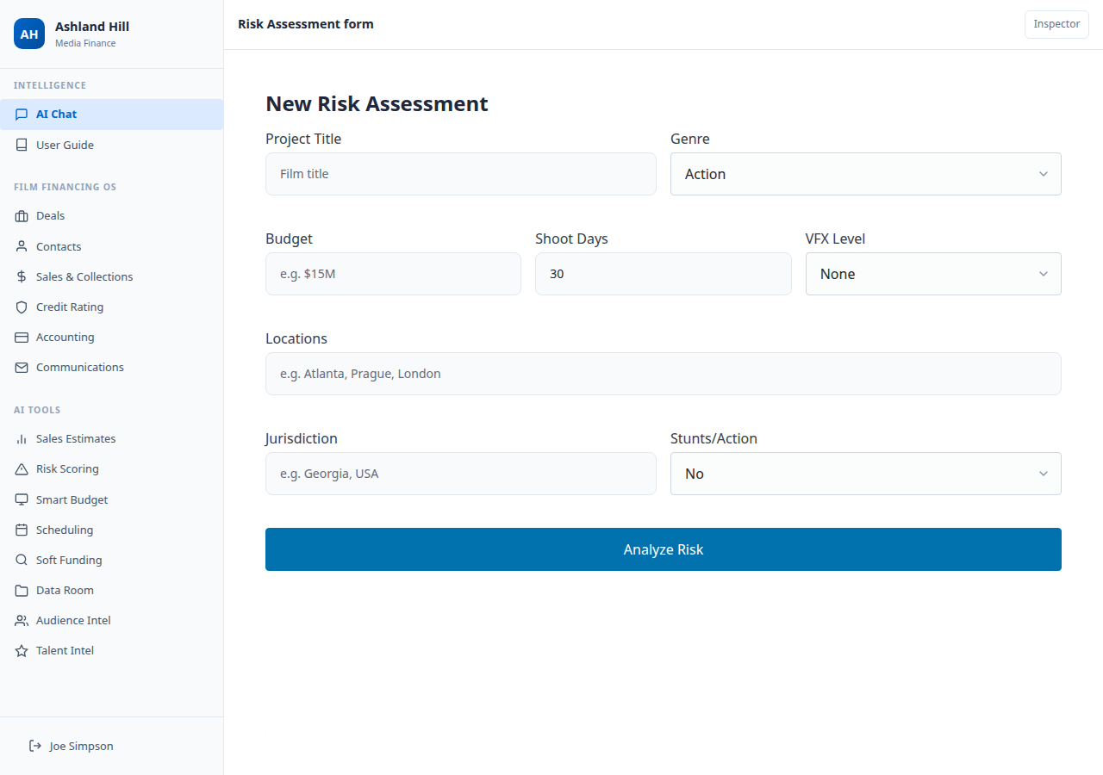
Production Risk Scoring
"Moody's for execution risk"
AI evaluates 6 risk dimensions on a 0-100 scale:
Script Complexity — locations, stunts, VFX density
Budget Feasibility — budget vs comparable films
Schedule Risk — shoot days vs scope
Jurisdictional Risk — labor laws, permits, stability
Crew/Talent Risk — availability, reliability, concentration
Completion Risk — on-time, on-budget probability
Output: Overall score, risk tier, mitigation recommendations
Ashland Hill Media Finance — Private & Confidential

Slide 11
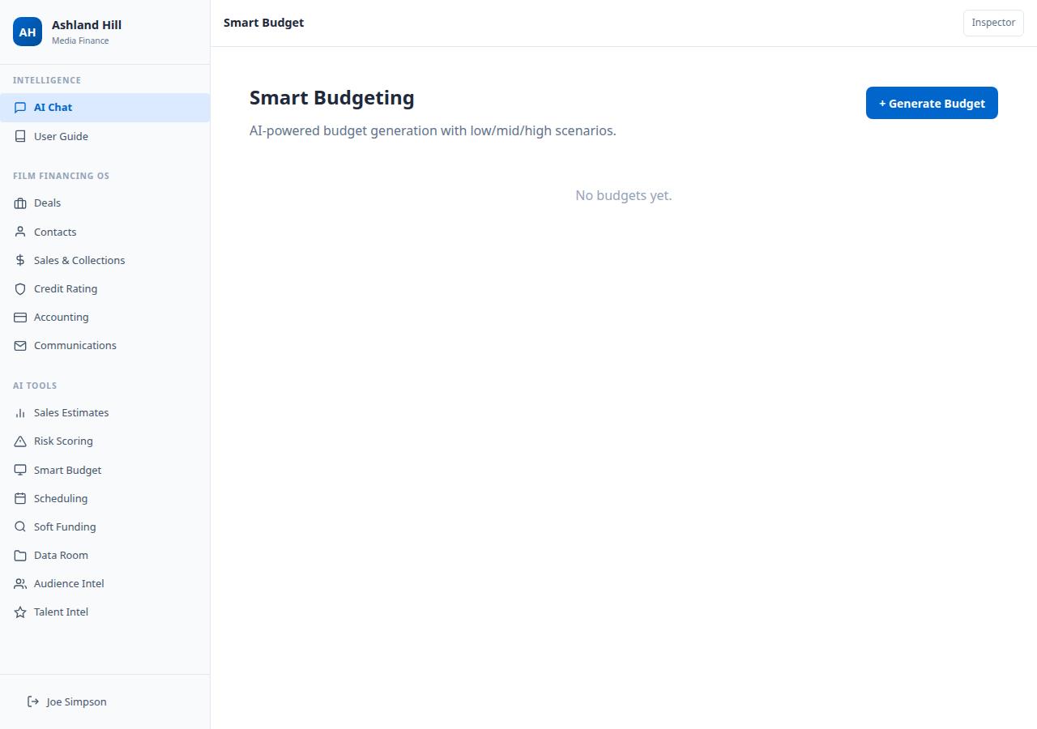
Smart Budgeting Tool
Generative budgeting logic + live cost intelligence
AI generates 3 scenarios: Low / Mid / High
8-12 detailed line items per scenario
Budget Categories:
Above-the-Line (talent, director, producer fees)
Below-the-Line Production (crew, equipment, locations)
Below-the-Line Post (editing, VFX, sound, music)
Insurance & Legal
Financing Costs
Contingency (typically 10%)
Ashland Hill Media Finance — Private & Confidential

Slide 12
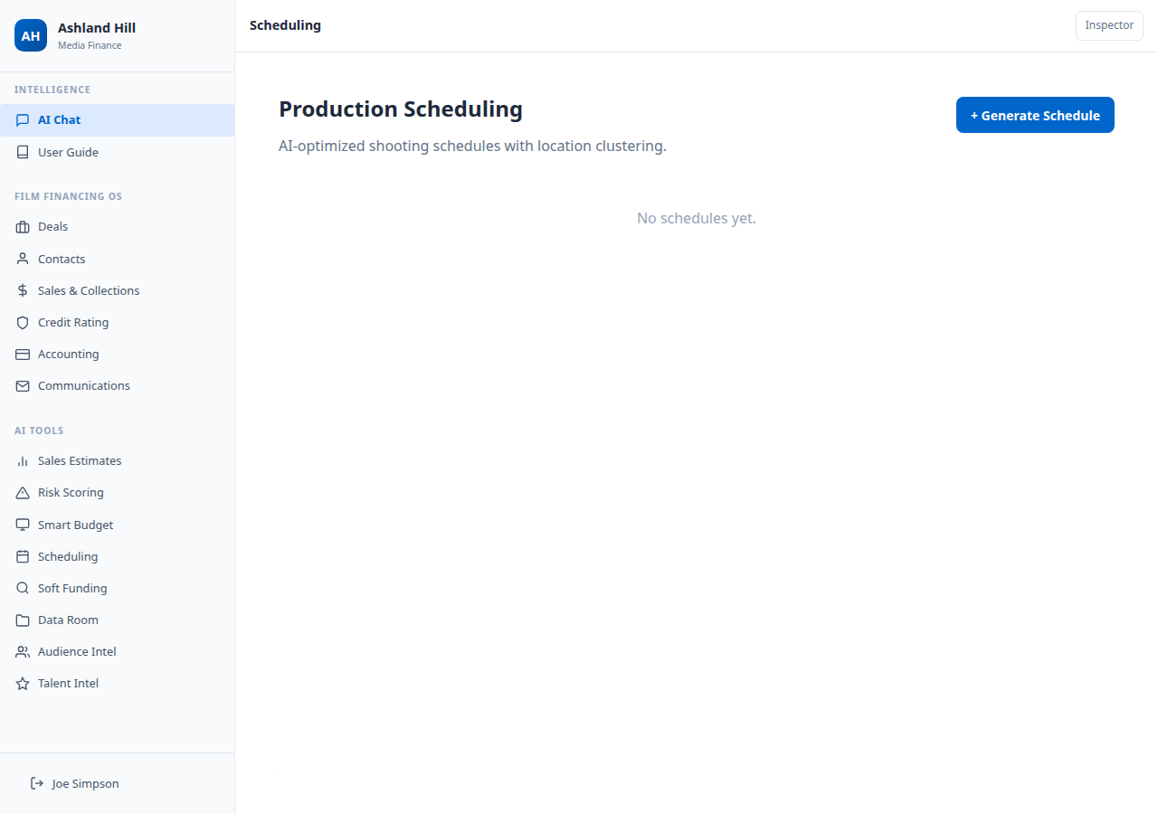
Automated Production Scheduling
Predictive production efficiency software
AI generates day-by-day shooting schedules
Location clustering optimization (minimize company moves)
Day/night scene grouping
Actor availability and labor law compliance
Bottleneck prediction
Scenario comparison (schedule A vs B)
Integration with budgeting tool
Ashland Hill Media Finance — Private & Confidential

Slide 13
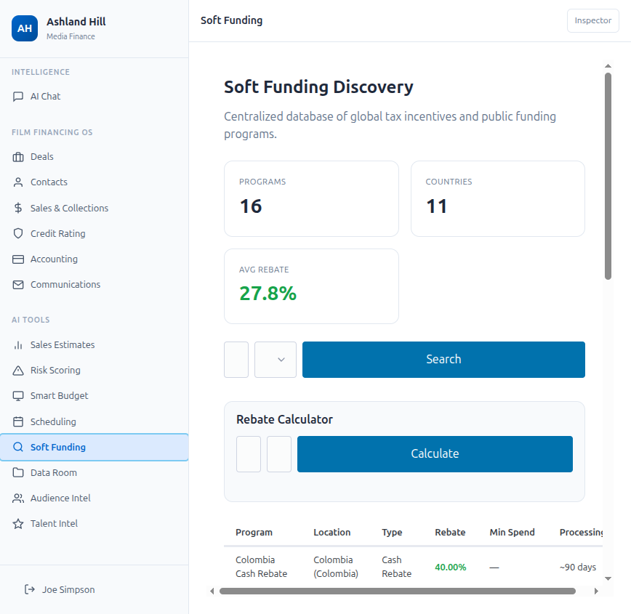
Soft Funding Discovery Engine
"Kayak for film incentives"
Database of 16+ global incentive programs
11 countries covered
Average rebate: 27.8%
Top Programs:
Colombia Cash Rebate — 40%
Ireland Section 481 — 32%
Georgia Tax Credit — 30%
Hungary Cash Rebate — 30%
Australia PDV Offset — 30%
Built-in rebate calculator and eligibility filters
Ashland Hill Media Finance — Private & Confidential

Slide 14
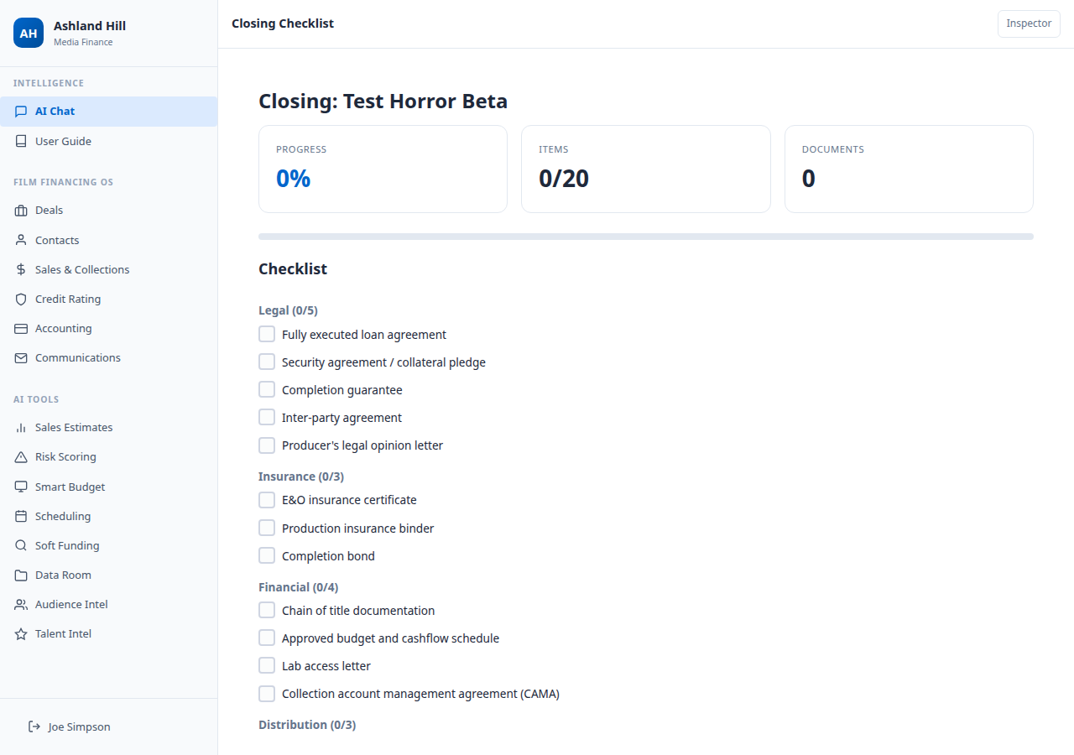
Deal Closing & Data Room
Infrastructure layer for streamlined closings
Auto-generated 20-item closing checklists
6 Categories:
Legal (5 items) — loan agreements, security, completion guarantee
Insurance (3 items) — E&O, production insurance, completion bond
Financial (4 items) — chain of title, budget, lab access, CAMA
Distribution (3 items) — agreements, delivery schedule, MG commitments
Tax Incentives (2 items) — applications, auditor opinion
Compliance (3 items) — KYC/AML, OFAC, board approval
Interactive checkbox tracking with progress bars
Ashland Hill Media Finance — Private & Confidential

Slide 15
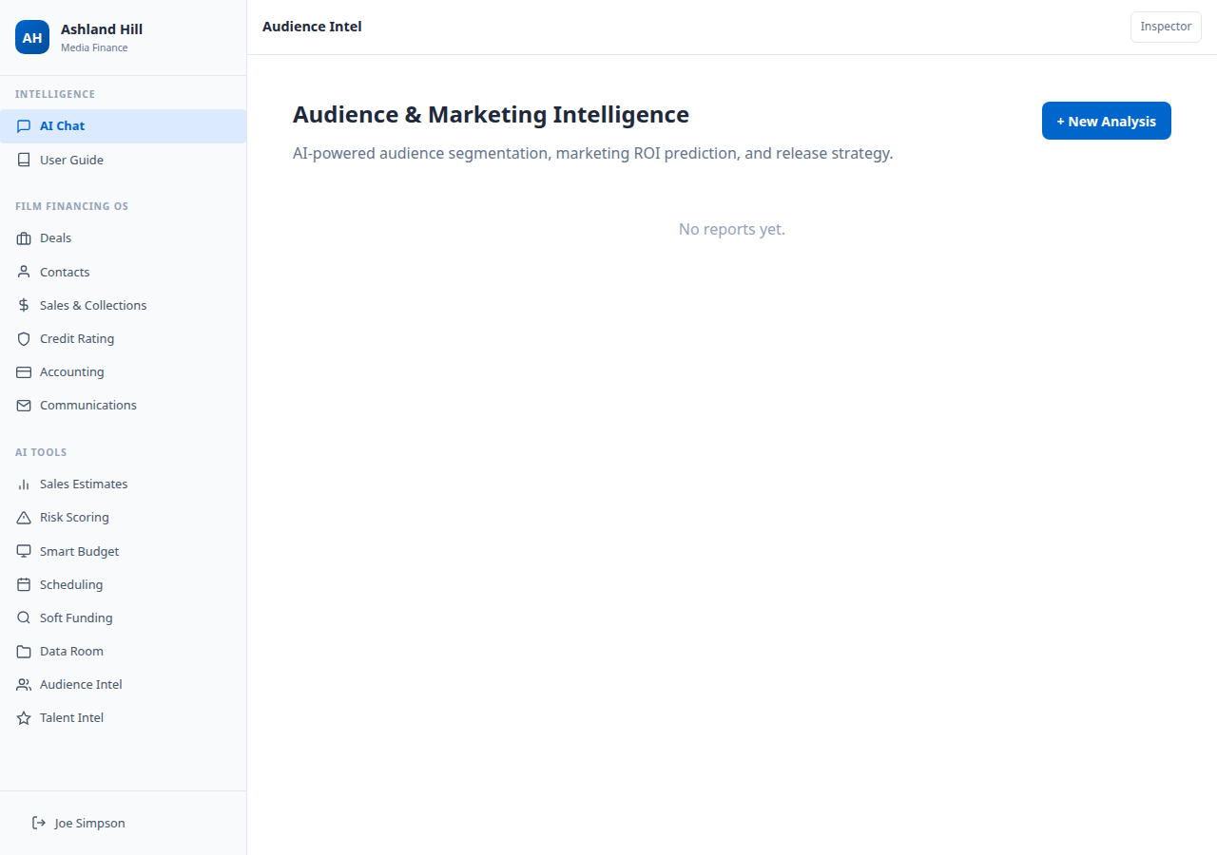
Audience & Marketing Intelligence
Campaign simulator meets audience heat map
AI-powered audience segmentation (3-5 segments)
Demographic + psychographic clustering with % share
Marketing channel allocation and spend estimates
Release window optimization
Platform strategy (theatrical, streaming, hybrid)
Festival positioning recommendations
Comparable film marketing analysis
Ashland Hill Media Finance — Private & Confidential

Slide 16
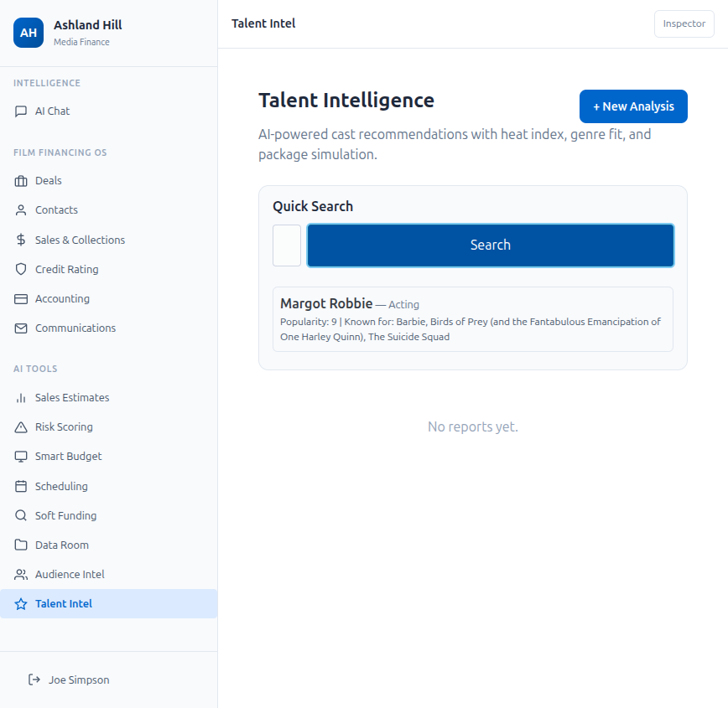
Talent Intelligence
Taste graph meets market intelligence
Live TMDB actor/director search with popularity data
AI cast recommendations scored on:
Heat Index (1-10) — current market popularity
Genre Fit (1-10) — alignment with project tone
Salary Tier — Low / Mid / High / Premium
International Sales Impact — Low / Mid / High
Package simulation: test cast combinations for projected revenue
Comparable role analysis from filmography data
Ashland Hill Media Finance — Private & Confidential

Slide 17
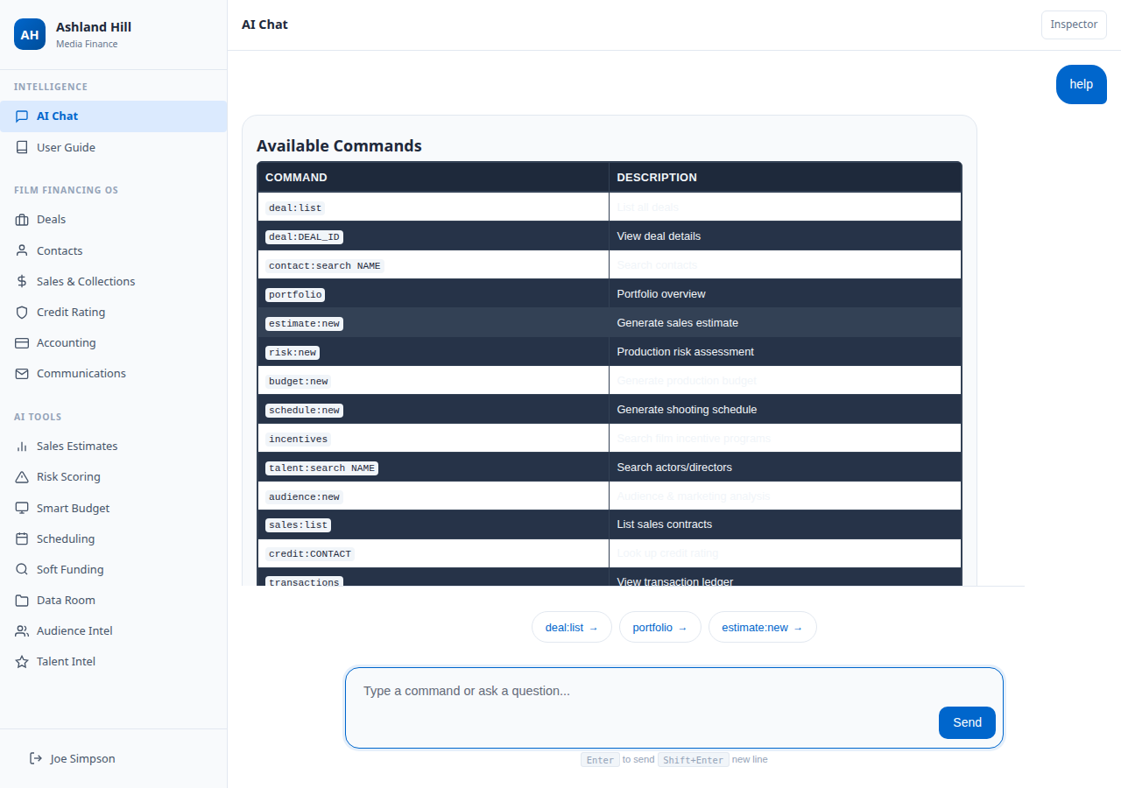
AI Chat — The Intelligence Layer
18 AI tools accessible via natural language or structured commands
deal:list / portfolio — Deal pipeline and portfolio analytics
contact:search / credit:NAME — Contacts and credit ratings
sales:list / transactions / messages — Financial operations
incentives — Search global film tax incentives
talent:search NAME — Look up actors/directors via TMDB
risk:new / budget:new / schedule:new — AI analysis tools
audience:new — Audience & marketing prediction
Or ask any question in natural language — AI routes to the right tool
Ashland Hill Media Finance — Private & Confidential

Slide 18
Technical Summary
Production-grade architecture
Frontend: FastHTML + HTMX (server-rendered, no React/JS frameworks)
AI Engine: LangGraph + XAI Grok-3 (18 structured tools)
Database: PostgreSQL (28 tables in ahmf schema)
Film Data: TMDB + OMDB APIs (budgets, revenue, cast, ratings)
Auth: Email/password + JWT session management
Deployment: Docker + Coolify (auto-deploy on git push)
Test Suite: 30 automated tests covering all modules
All 9 roadmap products fully operational — no placeholders
Ashland Hill Media Finance — Private & Confidential

Slide 19
Next Steps
Continued platform depth and integrations
Sales Estimate Pipeline: 5-node LangGraph pipeline (analyze > comps > territory > forecast > report)
PDF Script Ingestion: Upload screenplays for automated analysis
Closing Workflow Automation: Drawdown requests, digital signatures
Portfolio Analytics Dashboard: IRR tracking, collection monitoring, variance analysis
Investor Reporting: Automated LP/capital partner reports
Mobile Responsive: Tablet-optimized layout for on-the-go deal review
Ashland Hill Media Finance — Private & Confidential

Slide 20
Thank You
Joe Simpson — Managing Partner Simon Williams — Managing Partner Ashland Hill Media Finance
Ashland Hill Media Finance

