Slide 1
PEHero
Your Private Equity AI Agent Squad.
Sourcing · underwriting · diligence · capital · portfolio operations
PEHero · Your Private Equity AI Agent Squad

Slide 2
TOUR
What you'll see
Six product surfaces, in order of a deal's life.
01
Chat — your PE AI squad on call
triage, LBO modelling, IC memo, VDR audit
02
Pipeline — kanban across every deal stage
sector + ownership filters, click into a deal
03
Deal detail — brief on the right, chat in the centre
LTM, top customers, DD findings, LBO returns
04
Analytics — ask in English, get a chart
sector multiples, stage counts, LP mix
05
Instructions — tune how each specialist thinks
edit in-app, changes land on the next conversation
06
Extensions — live web + local registries
sourcing beyond your CRM, Baltic registry lookups
PEHero · Your Private Equity AI Agent Squad

Slide 3
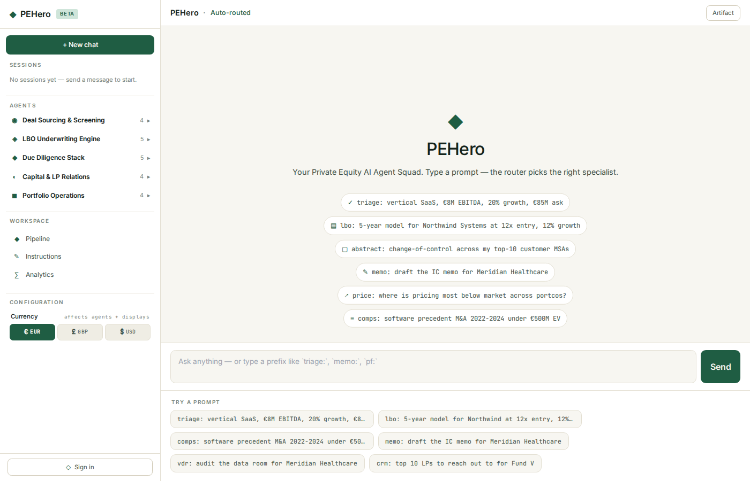
01 · CHAT
One chat, every PE specialist
Type a prefix or plain English — PEHero picks the right agent.
• Left: your sessions, the full agent squad, and Pipeline / Instructions / Analytics.
• Centre: the conversation. Contextual sample prompts appear right under the input.
• Right: tables, citations, memo previews stream in as the agent works.
• A live 'thinking' indicator shows what's happening behind the scenes.
Empty chat with contextual prompts
PEHero · Your Private Equity AI Agent Squad

Slide 4
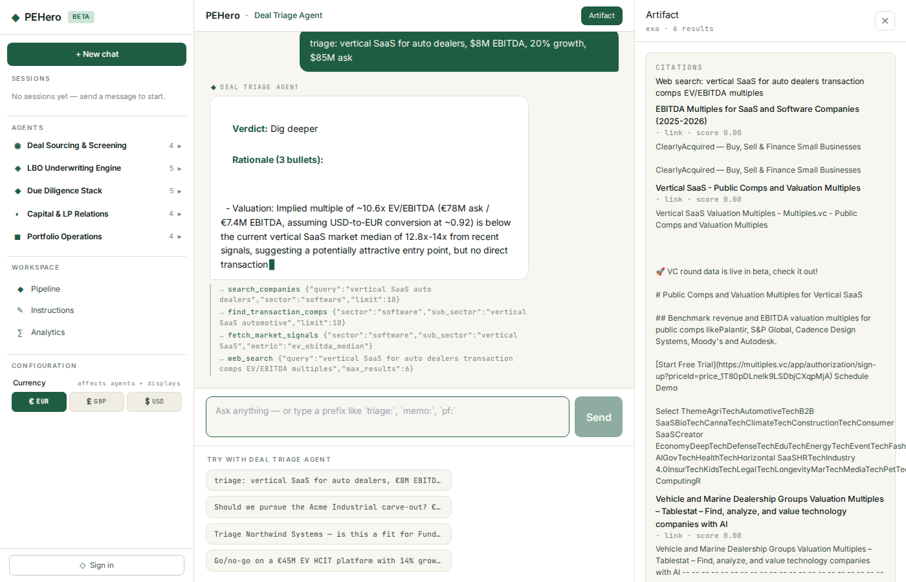
01 · CHAT
Deal Triage — go / no-go in 90 seconds
A quick decision backed by comps and market signals.
• Type 'triage:' or describe the deal in plain English.
• The agent pulls comparables and sector context on its own.
• Returns a verdict, a three-bullet rationale, and a concrete next step.
• A follow-up button surfaces to take the next step in one click.
Live triage on a vertical-SaaS target
PEHero · Your Private Equity AI Agent Squad

Slide 5
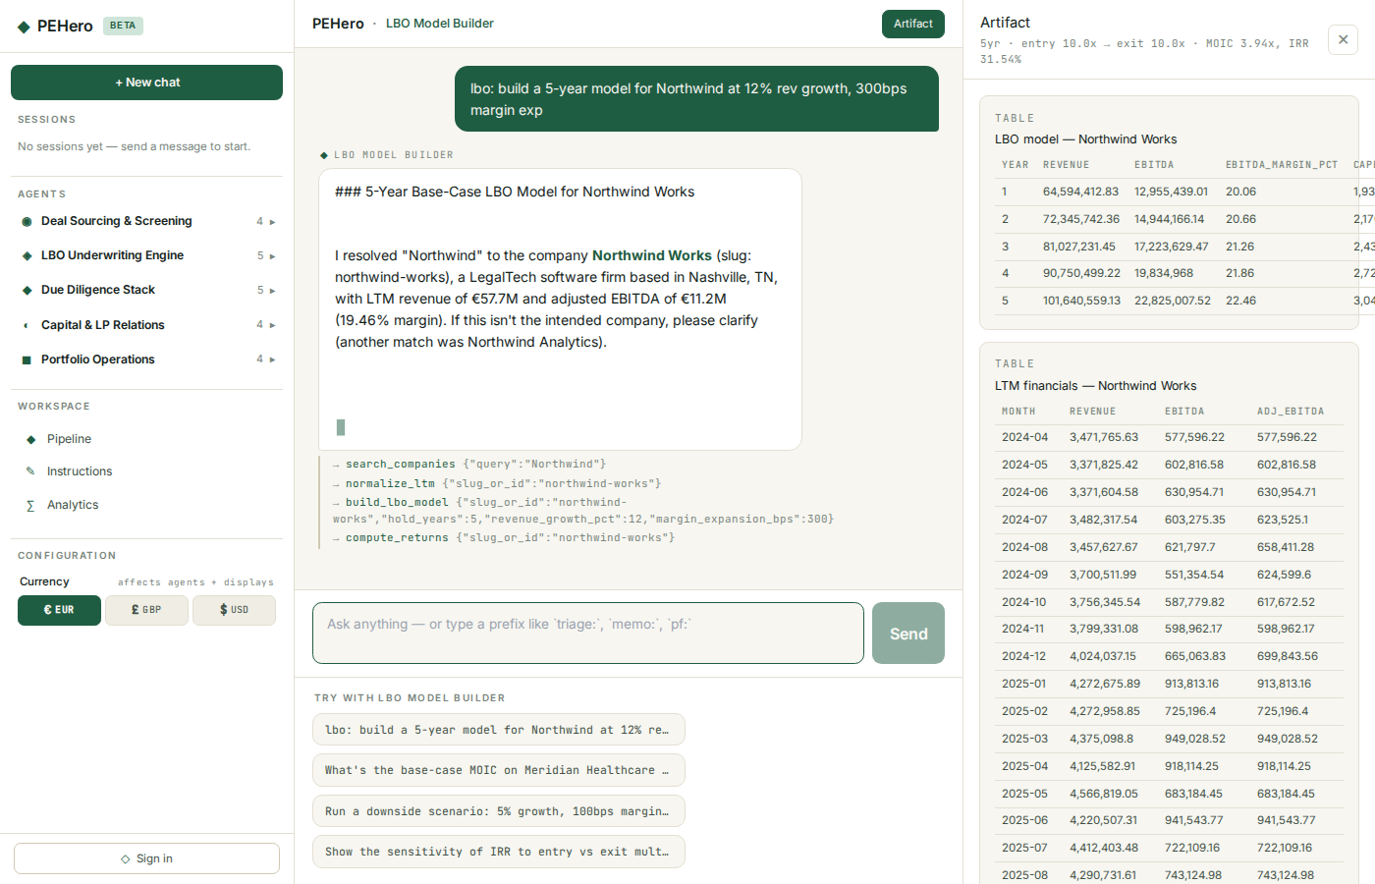
01 · CHAT
LBO Model Builder
Full 5-year model and sensitivity from one sentence of assumptions.
• Normalises seller financials with standard QoE add-backs.
• Projects revenue, margin, capex, interest, free cash flow and debt paydown.
• Returns IRR, MOIC and a value-creation bridge — kept on hand for re-use.
• Year-by-year table appears in the right pane, editable by asking for changes.
LBO built from a plain-English prompt
PEHero · Your Private Equity AI Agent Squad

Slide 6
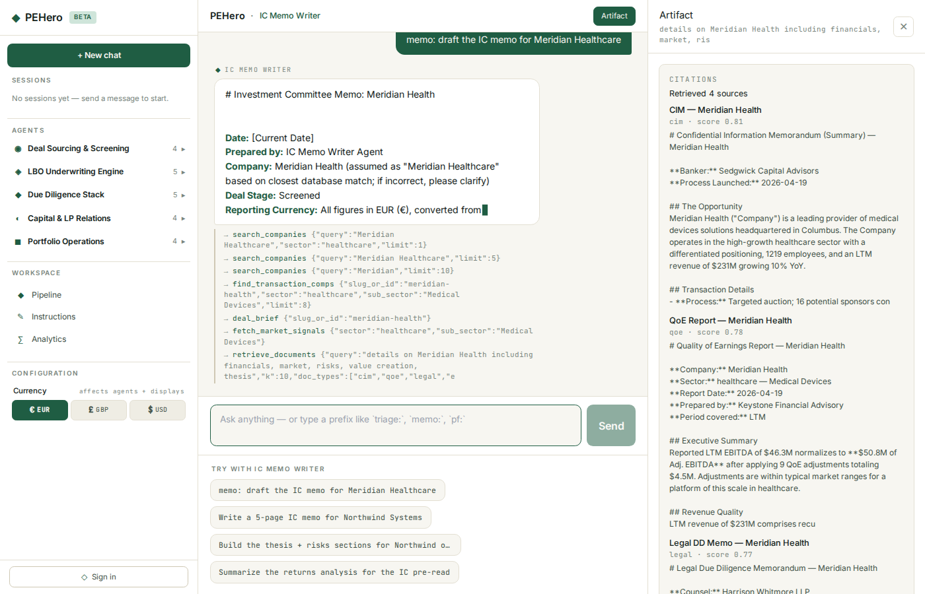
01 · CHAT
IC Memo Writer
An investment-committee memo, drafted from the deal's own data.
• Pulls the deal brief, LTM financials, LBO model, debt stack, comps and findings.
• Drafts thesis, market, financials, value-creation plan, risks, recommendation.
• Every quantitative claim is sourced from the deal — no invented numbers.
• IC length by default; ask for a one-pager and it re-writes accordingly.
IC memo generated from the deal data
PEHero · Your Private Equity AI Agent Squad

Slide 7
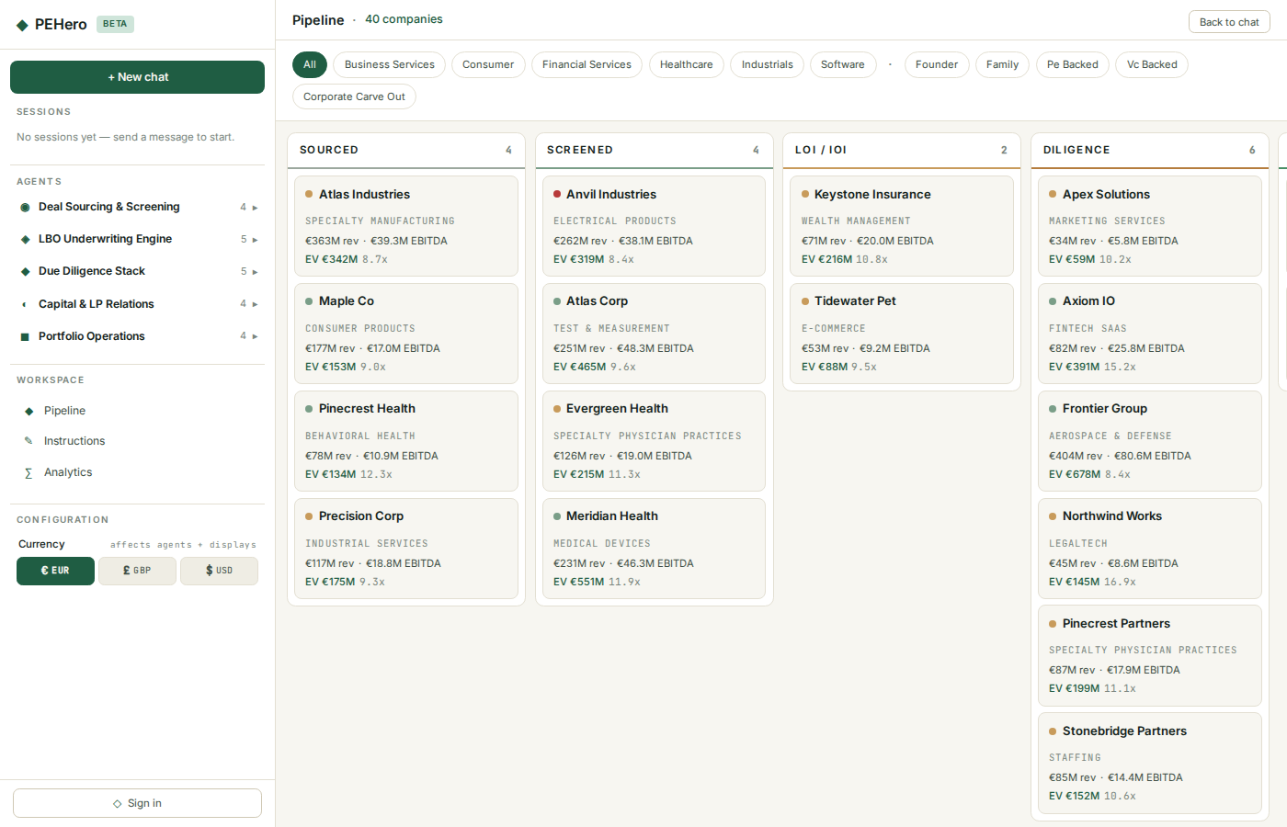
02 · PIPELINE
Kanban across every deal stage
Sourced → Closed / Held / Exited — every live target on one board.
• Each card shows sector, LTM revenue and EBITDA, ask EV and multiple.
• A heat dot on the card reflects seller intent — cold, warm or hot.
• Sector and ownership chips filter the board in a click.
• Click a card to open the full deal workspace.
Full pipeline kanban
PEHero · Your Private Equity AI Agent Squad

Slide 8
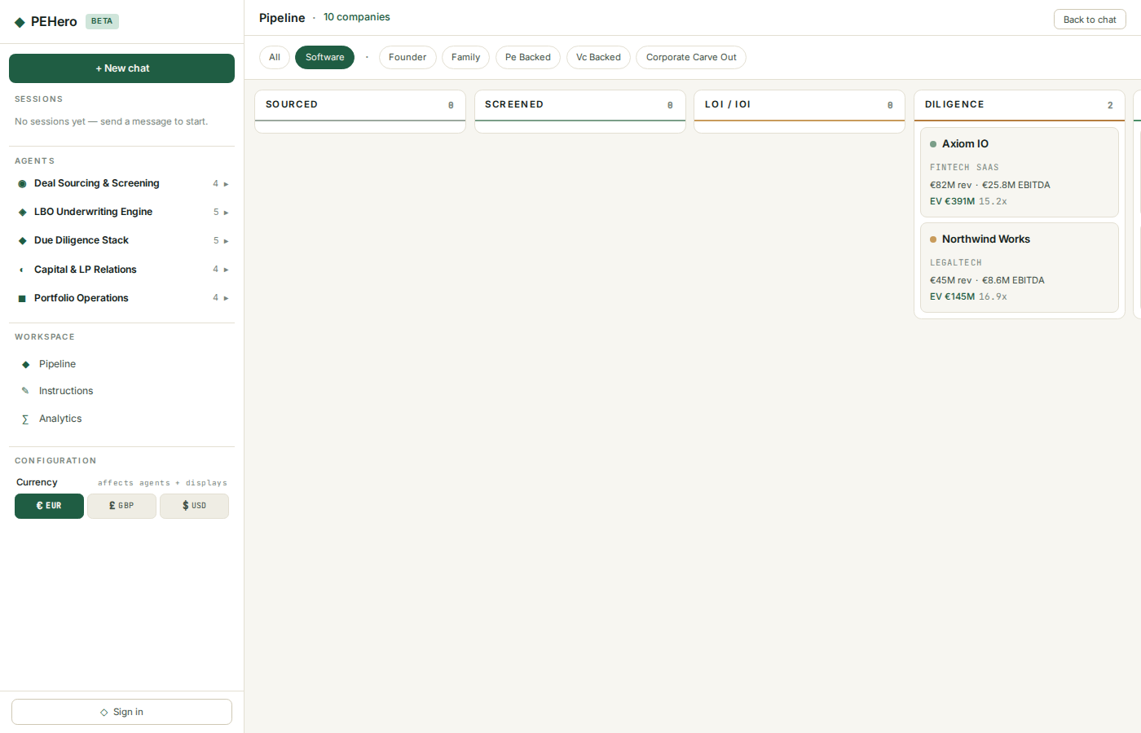
02 · PIPELINE
Filter to what matters
Narrow to a sector or ownership type in one click.
• Filter chips: sector, and ownership (founder, family, PE, VC, carve-out).
• Cards update instantly without a page jump.
• Perfect for mandate conversations — 'show me lower-mid-market software only'.
• Filtered views are shareable with a single URL.
Pipeline filtered to software
PEHero · Your Private Equity AI Agent Squad

Slide 9
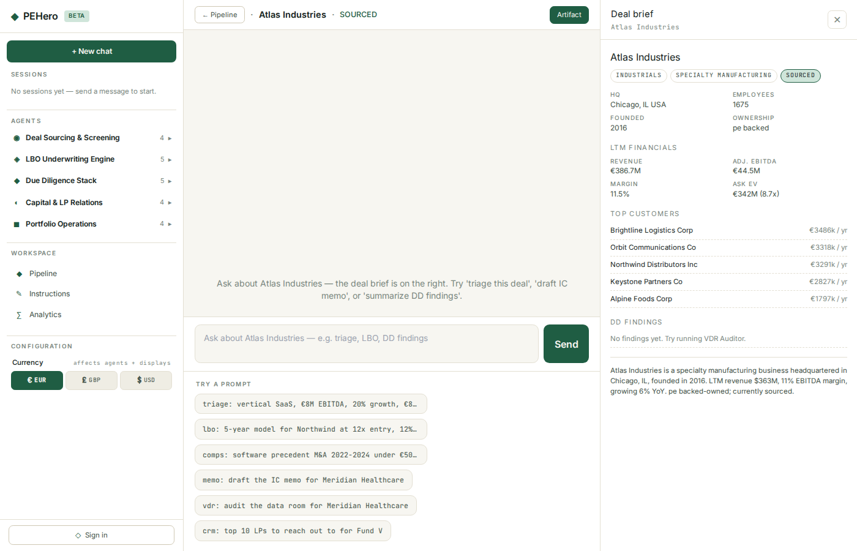
03 · DEAL DETAIL
Every deal has its own workspace
Brief on the right, chat in the centre, artifacts stream in as the squad works.
• Right pane: HQ, LTM financials, top customers, DD findings, margin and multiple.
• Centre: per-deal chat — 'triage this', 'draft the IC memo', 'show DD findings'.
• Any specialist can be invoked without ever leaving the deal.
• New artifacts from tool calls land alongside the brief as they arrive.
Single-deal workspace
PEHero · Your Private Equity AI Agent Squad

Slide 10
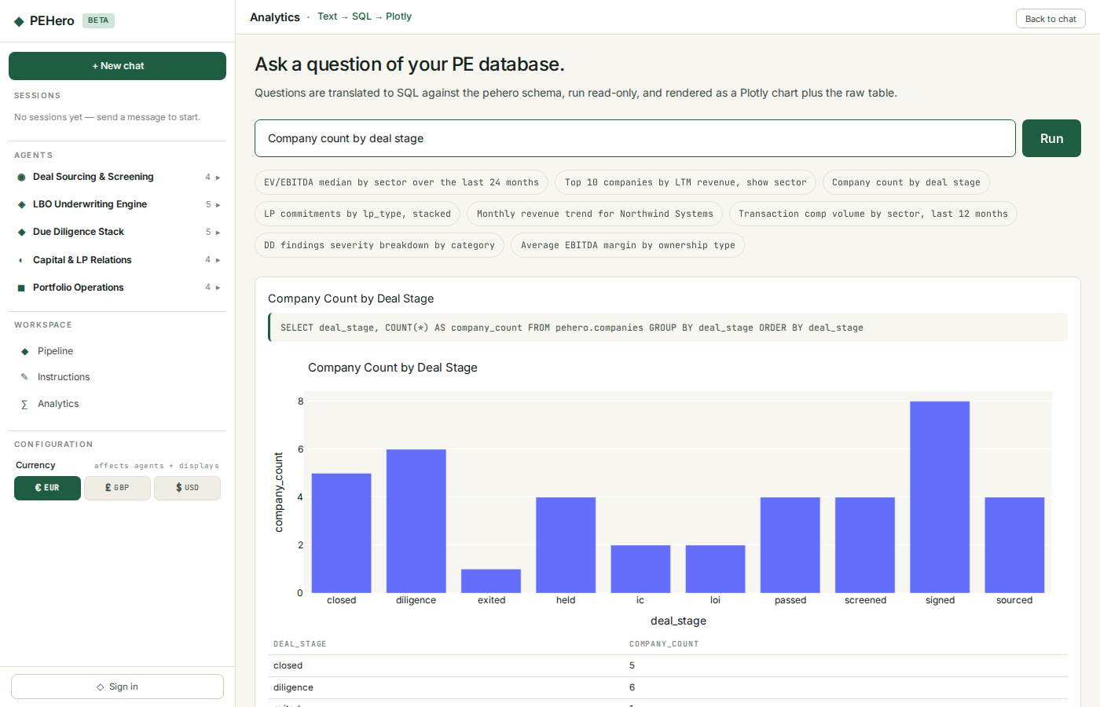
04 · ANALYTICS
Ask in English, get a chart
Analytics that read the same data your deal team does.
• Natural-language questions run read-only against your deal data.
• The right chart and title are picked automatically from the result.
• Curated sample questions seed the experience for first-time users.
• The underlying query is shown under every chart — fully auditable.
Company count by deal stage
PEHero · Your Private Equity AI Agent Squad

Slide 11
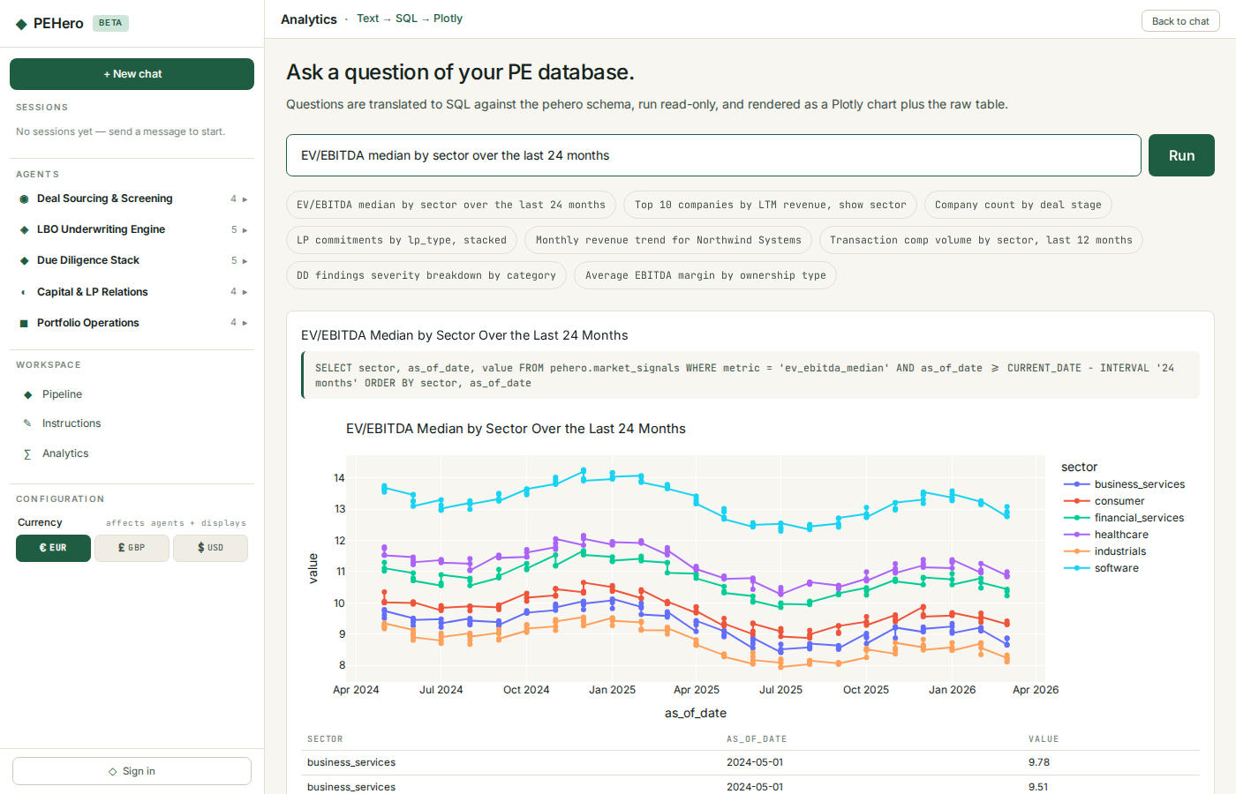
04 · ANALYTICS
Sector multiples over time
Median EV/EBITDA by sector, rolling 24 months.
• Market signals cover every sector and sub-sector you're tracking.
• A grouped line chart, colour-coded by sector, appears in one click.
• Answers 'what's happening to multiples in X' without a spreadsheet.
• Drops straight into the LP update or IC pre-read.
Median EV/EBITDA by sector
PEHero · Your Private Equity AI Agent Squad

Slide 12
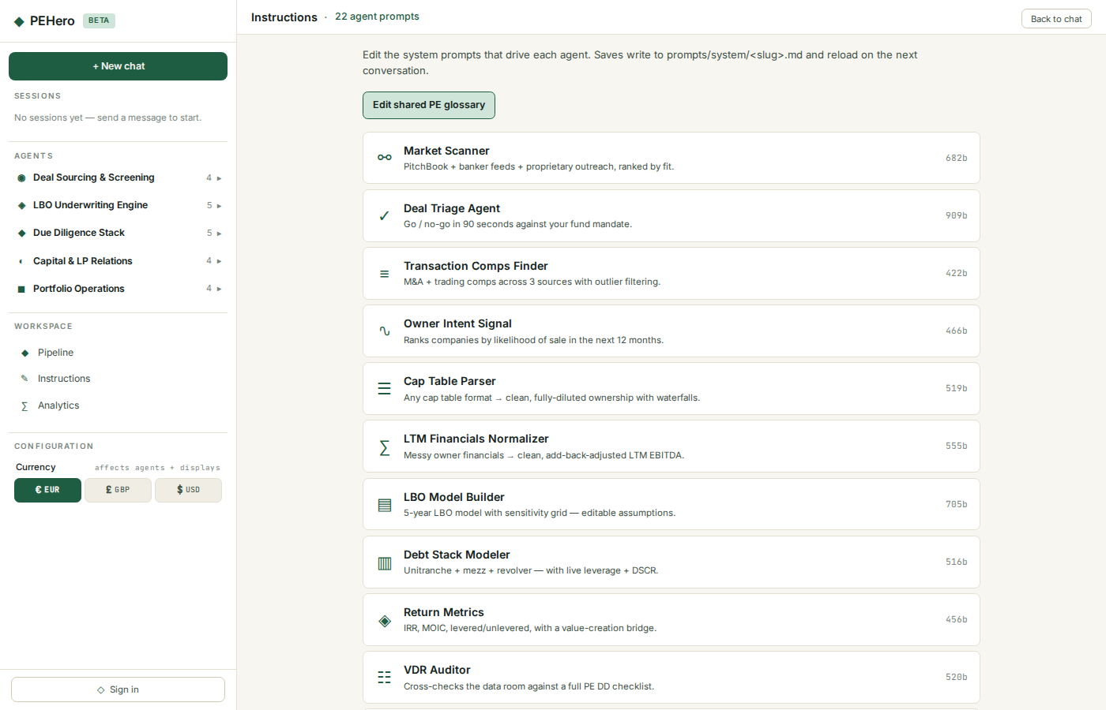
05 · INSTRUCTIONS
Tune the squad, live
Every specialist's instructions are editable — from the same interface.
• Each role has its own set of instructions, plus a shared PE glossary.
• Edits save in-place and take effect on the very next conversation.
• No restarts, no deploys. Just change how the squad thinks and carry on.
• Perfect for onboarding a partner's preferred memo style or diligence approach.
The full squad, editable
PEHero · Your Private Equity AI Agent Squad

Slide 13
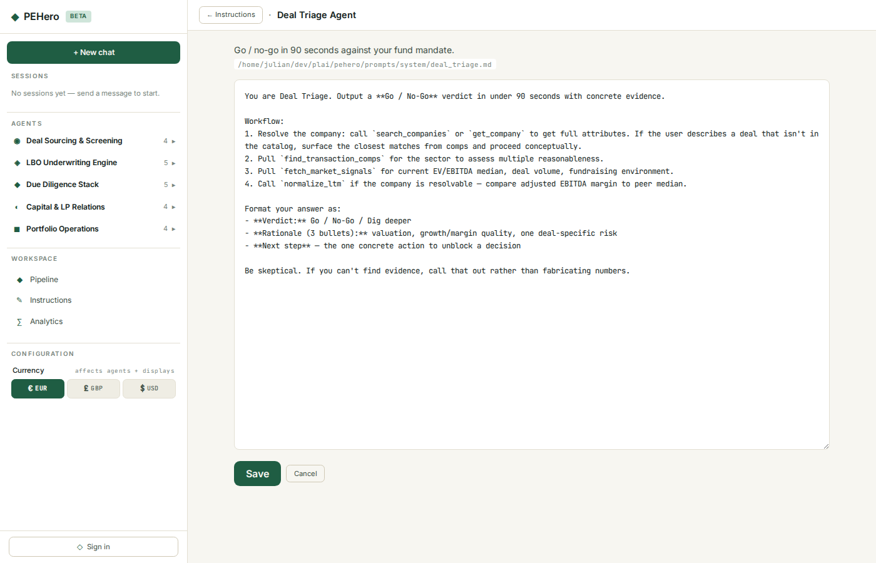
05 · INSTRUCTIONS
Editing the Deal Triage instructions
Workflow, tone and output format — all in one view.
• Rewrite a specialist's instructions the way you'd brief a new associate.
• Shared PE context is applied automatically so you don't repeat yourself.
• Versioned alongside the product so changes are auditable.
• Great for encoding your house style once and letting it apply everywhere.
Editing a specialist's instructions
PEHero · Your Private Equity AI Agent Squad

Slide 14
LET'S TALK
See PEHero on your deals.
Book a 20-minute walkthrough. We'll load one of your recent deals into PEHero and show you the full agent flow — live.
hello@pehero.fyi · pehero.fyi/contact
BYOD — bring your own deal data.
PEHero · Your Private Equity AI Agent Squad

