Slide 1
Applied Analytics and Predictive Modeling Spring 2020
Lecture-6
Lydia Manikonda
manikl@rpi.edu
Some of the slides adapted from Intro to Data Mining Tan et al. 2nd edition

Slide 2
Today’s agenda
Building a decision tree
Case Study presentations
KNN algorithm
Project description

Slide 3
Decision Tree

Slide 4
Computing Information Gain after Splitting
Information Gain
Parent Node, p is split into k partitions; n_{i} is number of records in partition i
Choose the split that achieves most reduction (maximizes GAIN)
Used in ID3 and C4.5 decision tree algorithms

Slide 5
Class exercise
Example from Han & Kamber Data Mining: Concepts and Techniques

Slide 6
Attribute Selection by Information Gain Computation
Class P: buys_computer = “yes”
Class N: buys_computer = “no”
I(p, n) = I(9, 5) =0.940
Compute the entropy for age:
means “age <=30” has 5 out of 14 samples, with 2 yes’es and 3 no’s. Hence
Similarly,

Slide 7
Output: A Decision Tree for “buys_computer”
age?
<=30
overcast
>40
30..40
student?
yes
credit rating?
no
yes
excellent
fair
no
yes
no
yes

Slide 8
Case Study-2 Presentations
Groups 3,4,9

Slide 9
K-Nearest Neighbor Algorithm
Adapted from Intro to Data Mining, Tan et al., 2nd edition.

Slide 10
Nearest Neighbor Classifiers
Basic idea:
If it walks like a duck, quacks like a duck, then it’s probably a duck
Compute Distance
Test Record
Training Records
Choose k of the “nearest” records

Slide 11
Nearest-Neighbor Classifiers
Requires three things
The set of labeled records
Distance metric to compute distance between records
The value of k, the number of nearest neighbors to retrieve
To classify an unknown record:
Compute distance to other training records
Identify k nearest neighbors
Use class labels of nearest neighbors to determine the class label of unknown record (e.g., by taking majority vote)

Slide 12
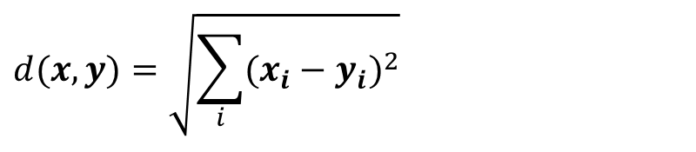
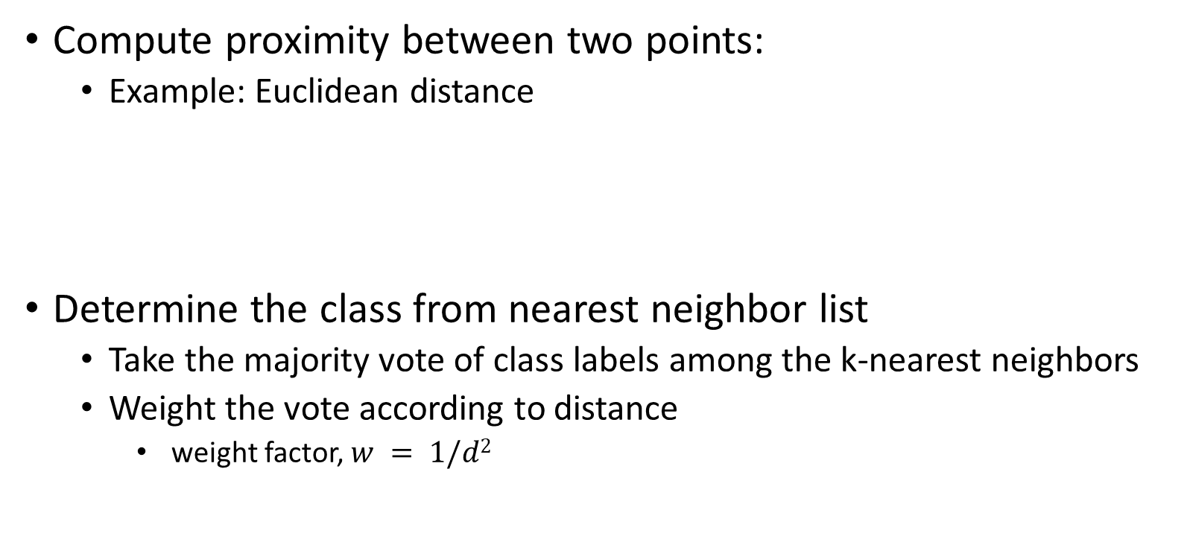
Nearest Neighbor Classification
Compute proximity between two points:
Example: Euclidean distance
Determine the class from nearest neighbor list
Take the majority vote of class labels among the k-nearest neighbors
Weight the vote according to distance
weight factor, $w = 1/d2$
$$d(x,y)=\sqrt{\sum_{i}{(x_{i}−y_{i})^{2}}}$$

Slide 13
Nearest Neighbor Classification…
Choosing the value of k:
If k is too small, sensitive to noise points
If k is too large, neighborhood may include points from other classes

Slide 14
Nearest Neighbor Classification…
Choice of proximity measure matters
For documents, cosine is better than correlation or Euclidean
1 1 1 1 1 1 1 1 1 1 1 0
0 0 0 0 0 0 0 0 0 0 0 1
vs
0 1 1 1 1 1 1 1 1 1 1 1
1 0 0 0 0 0 0 0 0 0 0 0
Euclidean distance = 1.4142 for both pairs

Slide 15
Nearest Neighbor Classification…
Data preprocessing is often required
Attributes may have to be scaled to prevent distance measures from being dominated by one of the attributes
Example:
height of a person may vary from 1.5m to 1.8m
weight of a person may vary from 90lb to 300lb
income of a person may vary from $10K to $1M
Time series are often standardized to have 0 means a standard deviation of 1

Slide 16
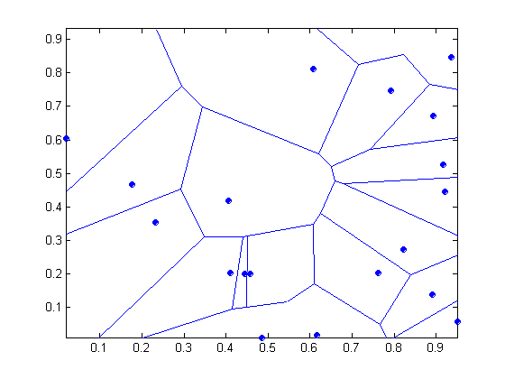
Nearest-neighbor classifiers
Nearest neighbor classifiers are local classifiers
They can produce decision boundaries of arbitrary shapes.
1-nn decision boundary is a Voronoi Diagram

Slide 17
Nearest Neighbor Classification…
How to handle missing values in training and test sets?
Proximity computations normally require the presence of all attributes
Some approaches use the subset of attributes present in two instances
This may not produce good results since it effectively uses different proximity measures for each pair of instances
Thus, proximities are not comparable

Slide 18
Nearest Neighbor Classification…
Handling irrelevant and redundant attributes
Irrelevant attributes add noise to the proximity measure
Redundant attributes bias the proximity measure towards certain attributes
Can use variable selection or dimensionality reduction to address irrelevant and redundant attributes

Slide 19
Improving KNN Efficiency
Avoid having to compute distance to all objects in the training set
Multi-dimensional access methods (k-d trees)
Fast approximate similarity search
Locality Sensitive Hashing (LSH)
Condensing
Determine a smaller set of objects that give the same performance
Editing
Remove objects to improve efficiency

Slide 20
Python Notebook
Exercises

Slide 21
Project Description

Slide 22
Dataset
We are working with goal-oriented subreddits.
Goal-oriented subreddits – Subreddits that are aimed towards helping users achieve their personal goals.
In this case all of them are related to health.
/r/stopsmoking
/r/stopdrinking
/r/c25k
/r/loseit

Slide 23
Tasks to-do
Phase-1 (due: 03/23/2020):
Choose the data atleast from 2 subreddits – You can select all the data from 4 subreddits or choose 2 or 3 subreddits (depends on the task you are planning to do)
Conduct preliminary analysis
How are these subreddits different from each other in terms of posting behavior, post size, engagement level (if you can measure), types of content being posted
How many unique users are posting and how are the users behaving in terms of average number of posts they are making on each subreddit, how long of posts they are making, how long did they join the group (just count from when they made a 1st post in the subreddit), etc.
Present any visualizations related to this or any other aspects that you can think of
Are there any overlapping set of users? If so, how is their behavior across these subreddits?
What are the 1 task ( or max 2 tasks if you are interested) that you want to do? Provide a brief outline and you don’t have to finish solving this task for this deadline

Slide 24
Tasks to-do
What are the tasks that you can do with this data?
Build a prediction algorithm to detect truthful vs fake posts/users
Classifying a user as an expert (who already achieved the goal but hanging around the subreddit to support other users) or a non-expert (someone who is working towards the goal)
Build a classifier to detect hate speech or trolls on these forums, if any.
Can you use these posts to build a rough financial portfolio of users?
Can you think of any unsupervised learning approach to provide aggregate analysis of various aspects latently present in the dataset?
Or can you use any pretrained classifiers to see if this data is biased in any way?
[Anything else that you can think of and share with me before you start working on it seriously..]

Slide 25
Tasks to-do
Phase-2 (due: 04/13 and 04/20 during project presentations for feedback; Final report due on 04/27):
Based on the classification model you are building, present all the details on why you chose this task; why is this an important aspect with regard to this dataset; how is your solution helping solve the task at hand?
Clearly define your task and create a dummy example to show details.
For classification purposes, since there is no ground truth data given here, you are expected to build the training data and testing data. Your training data doesn’t have to be perfect but try your best.

Slide 26

If you don’t like this project, here is an option
https://sites.google.com/view/icwsm2020datachallenge/home
Working towards a publication

