Slide 1
Applied Analytics and Predictive Modeling Spring 2020
Lecture-5
Lydia Manikonda
manikl@rpi.edu
Some of the slides adapted from Intro to Data Mining Tan et al. 2nd edition

Slide 2
Today’s agenda
Data Quality
Linear and Logistic Regression
Decision Trees
Case Study

Slide 3
Data Quality
Poor data quality negatively affects many data processing efforts
“The most important point is that poor data quality is an unfolding disaster.
Poor data quality costs the typical company at least ten percent (10%) of revenue; twenty percent (20%) is probably a better estimate.”
Thomas C. Redman, DM Review, August 2004
Data mining example: a classification model for detecting people who are loan risks is built using poor data
Some credit-worthy candidates are denied loans
More loans are given to individuals that default

Slide 4
Data Quality …
What kinds of data quality problems?
How can we detect problems with the data?
What can we do about these problems?
Examples of data quality problems:
Noise and outliers
Missing values
Duplicate data
Wrong data

Slide 5
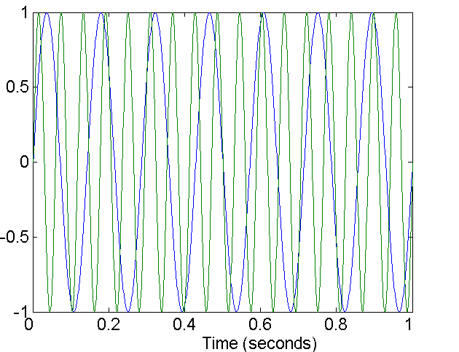
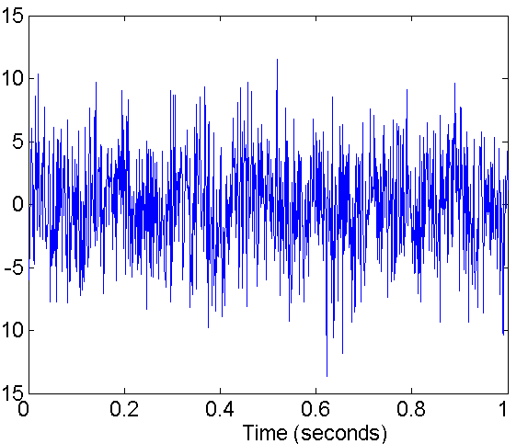
Noise
For objects, noise is an extraneous object
For attributes, noise refers to modification of original values
Examples: distortion of a person’s voice when talking on a poor phone and “snow” on television screen
Two Sine Waves
Two Sine Waves + Noise

Slide 6
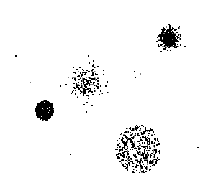
Outliers
Outliers are data objects with characteristics that are considerably different than most of the other data objects in the data set
Case 1: Outliers are noise that interferes with data analysis
Case 2: Outliers are the goal of our analysis
Credit card fraud
Intrusion detection
Causes?

Slide 7
Missing Values
Reasons for missing values
Information is not collected (e.g., people decline to give their age and weight)
Attributes may not be applicable to all cases (e.g., annual income is not applicable to children)
Handling missing values
Eliminate data objects or variables
Estimate missing values
Example: time series of temperature
Example: census results
Ignore the missing value during analysis

Slide 8
Missing Values …
Missing completely at random (MCAR)
Missingness of a value is independent of attributes
Fill in values based on the attribute
Analysis may be unbiased overall
Missing at Random (MAR)
Missingness is related to other variables
Fill in values based other values
Almost always produces a bias in the analysis
Missing Not at Random (MNAR)
Missingness is related to unobserved measurements
Informative or non-ignorable missingness
Not possible to know the situation from the data

Slide 9
Duplicate Data
Data set may include data objects that are duplicates, or almost duplicates of one another
Major issue when merging data from heterogeneous sources
Examples:
Same person with multiple email addresses
Data cleaning
Process of dealing with duplicate data issues
When should duplicate data not be removed?

Slide 10
Similarity and Dissimilarity Measures
Similarity measure
Numerical measure of how alike two data objects are.
Is higher when objects are more alike.
Often falls in the range [0,1]
Dissimilarity measure
Numerical measure of how different two data objects are
Lower when objects are more alike
Minimum dissimilarity is often 0
Upper limit varies
Proximity refers to a similarity or dissimilarity

Slide 11
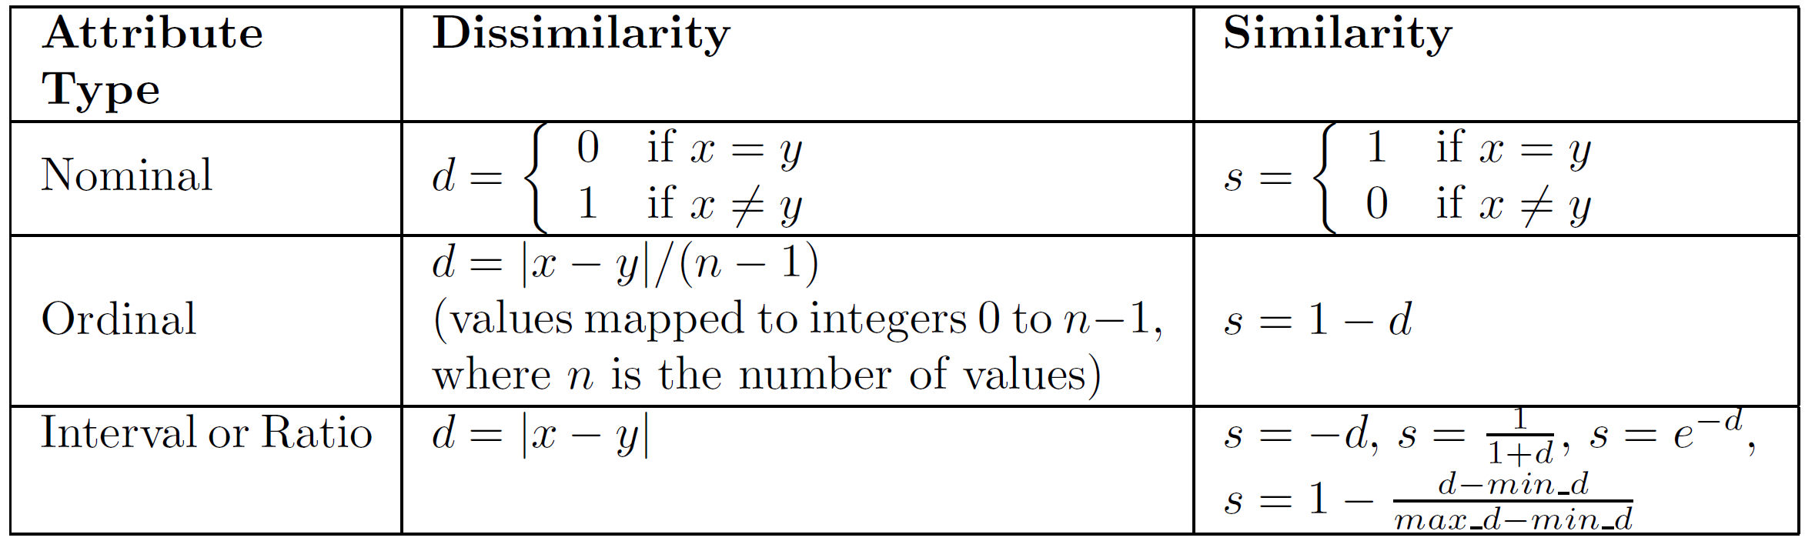
Similarity/Dissimilarity for Simple Attributes
The following table shows the similarity and dissimilarity between two objects, x and y, with respect to a single, simple attribute.

Slide 12
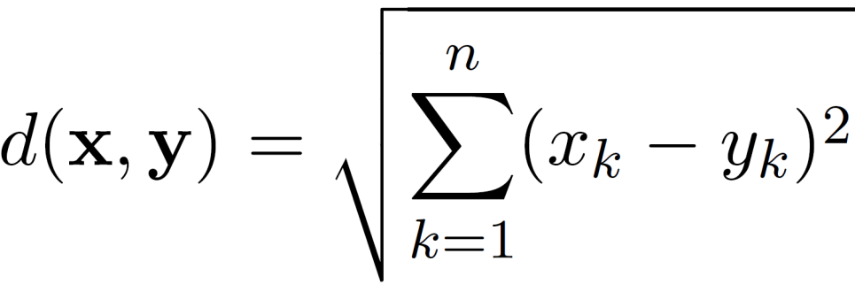
Euclidean Distance
Euclidean Distance
where n is the number of dimensions (attributes) and x_{k} and y_{k} are, respectively, the k^{th} attributes (components) or data objects x and y.
Standardization is necessary, if scales differ.

Slide 13
Euclidean Distance
Distance Matrix

Slide 14
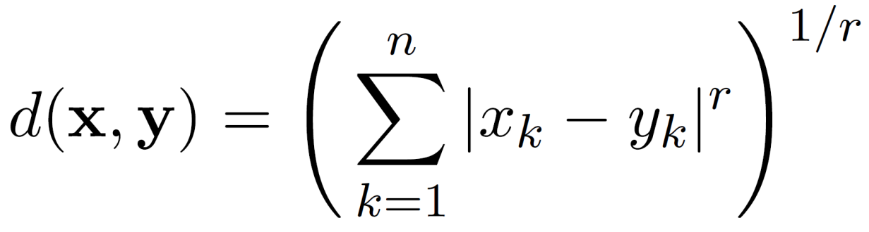
Minkowski Distance
Minkowski Distance is a generalization of Euclidean Distance
Where r is a parameter, n is the number of dimensions (attributes) and x_{k} and y_{k} are, respectively, the k^{th} attributes (components) or data objects x and y.

Slide 15
Minkowski Distance: Examples
r = 1. City block (Manhattan, taxicab, L₁ norm) distance.
A common example of this is the Hamming distance, which is just the number of bits that are different between two binary vectors
r = 2. Euclidean distance
r → ∞. “supremum” (L_{max} norm, L∞ norm) distance.
This is the maximum difference between any component of the vectors
Do not confuse r with n, i.e., all these distances are defined for all dimensions.

Slide 16
Minkowski Distance
Distance Matrix

Slide 17
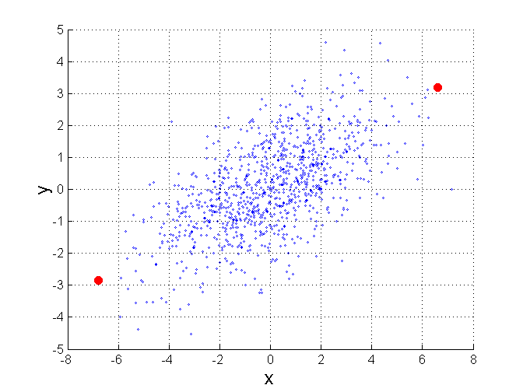
Mahalanobis Distance
$$mahalanobis\left(x,y\right)={ (x−y)}^{T}Ʃ^{−1}(x−y)$$
Σ is the covariance matrix
For red points, the Euclidean distance is 14.7, Mahalanobis distance is 6.

Slide 18
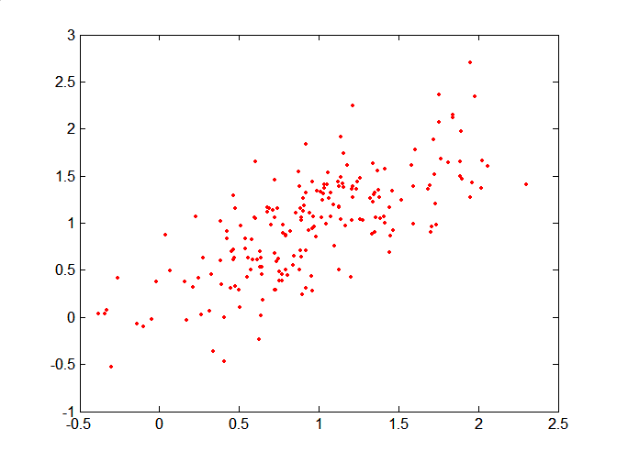
Mahalanobis Distance
Covariance Matrix:
C
B
A: (0.5, 0.5)
B: (0, 1)
C: (1.5, 1.5)
Mahal(A,B) = 5
Mahal(A,C) = 4
A

Slide 19
Common Properties of a Distance
Distances, such as the Euclidean distance, have some well known properties.
d(x, y) ≥ 0 for all x and y and d(x, y) = 0 only if x = y. (Positive definiteness)
d(x, y) = d(y, x) for all x and y. (Symmetry)
d(x, z) ≤ d(x, y) + d(y, z) for all points x, y, and z. (Triangle Inequality)
where d(x, y) is the distance (dissimilarity) between points (data objects), x and y.
A distance that satisfies these properties is a metric

Slide 20
Common Properties of a Similarity
Similarities, also have some well known properties.
s(x, y) = 1 (or maximum similarity) only if x = y.
s(x, y) = s(y, x) for all x and y. (Symmetry)
where s(x, y) is the similarity between points (data objects), x and y.

Slide 21
Similarity Between Binary Vectors
Common situation is that objects, p and q, have only binary attributes
Compute similarities using the following quantities
f₀₁ = the number of attributes where p was 0 and q was 1
f₁₀ = the number of attributes where p was 1 and q was 0
f₀₀ = the number of attributes where p was 0 and q was 0
f₁₁ = the number of attributes where p was 1 and q was 1
Simple Matching and Jaccard Coefficients
SMC = number of matches / number of attributes
= (f₁₁ + f₀₀) / (f₀₁ + f₁₀ + f₁₁ + f₀₀)
J = number of 11 matches / number of non-zero attributes
= (f₁₁) / (f₀₁ + f₁₀ + f₁₁)

Slide 22
SMC versus Jaccard: Example
x = 1 0 0 0 0 0 0 0 0 0
y = 0 0 0 0 0 0 1 0 0 1
f₀₁ = 2 (the number of attributes where p was 0 and q was 1)
f₁₀ = 1 (the number of attributes where p was 1 and q was 0)
f₀₀ = 7 (the number of attributes where p was 0 and q was 0)
f₁₁ = 0 (the number of attributes where p was 1 and q was 1)
SMC = (f₁₁ + f₀₀) / (f₀₁ + f₁₀ + f₁₁ + f₀₀)
= (0+7) / (2+1+0+7) = 0.7
J = (f₁₁) / (f₀₁ + f₁₀ + f₁₁) = 0 / (2 + 1 + 0) = 0

Slide 23
Cosine Similarity
If d₁ and d₂ are two document vectors, then
cos( d₁, d₂ ) = <d₁,d₂> / ||d₁|| ||d₂|| ,
where <d₁,d₂> indicates inner product or vector dot product of vectors, d₁ and d_{2,} and || d || is the length of vector d.
Example:
d₁ = 3 2 0 5 0 0 0 2 0 0
d₂ = 1 0 0 0 0 0 0 1 0 2
<d₁, d2> = 3*1 + 2*0 + 0*0 + 5*0 + 0*0 + 0*0 + 0*0 + 2*1 + 0*0 + 0*2 = 5
| d₁ || = (3*3+2*2+0*0+5*5+0*0+0*0+0*0+2*2+0*0+0*0)^{0.5} = (42) ^{0.5} = 6.481
|| d₂ || = (1*1+0*0+0*0+0*0+0*0+0*0+0*0+1*1+0*0+2*2) ^{0.5} = (6) ^{0.5} = 2.449
cos(d₁, d₂ ) = 0.3150

Slide 24
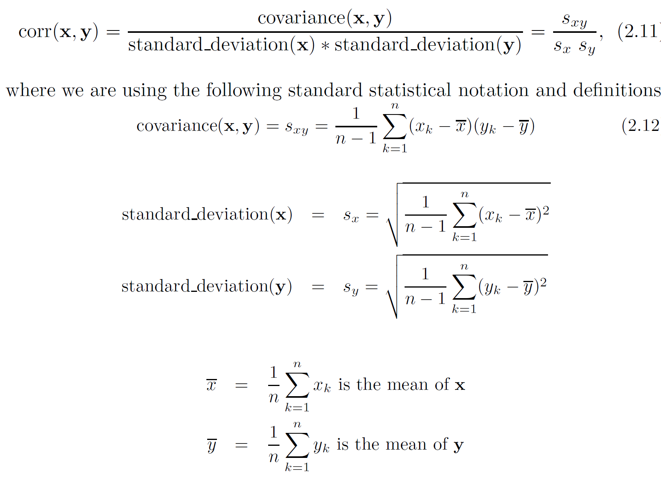
Correlation measures the linear relationship between objects

Slide 25
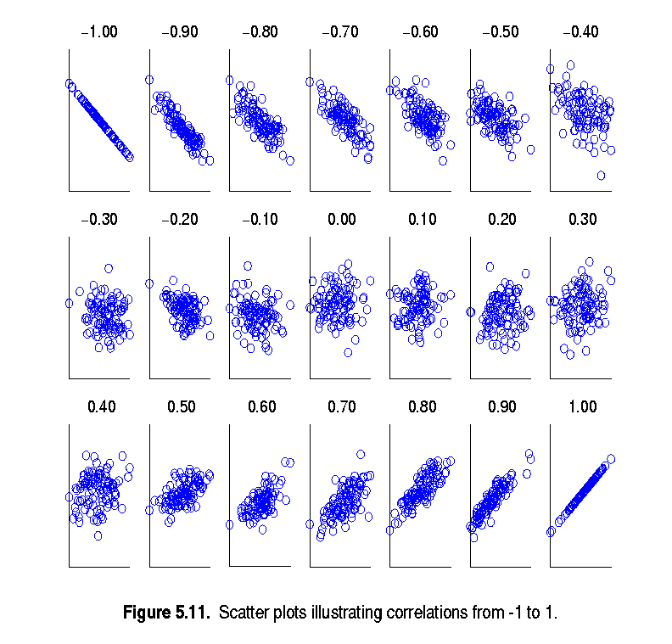
Visually Evaluating Correlation
Scatter plots showing the similarity from –1 to 1.

Slide 26
Information Based Measures
Information theory is a well-developed and fundamental disciple with broad applications
Some similarity measures are based on information theory
Mutual information in various versions
Maximal Information Coefficient (MIC) and related measures
General and can handle non-linear relationships
Can be complicated and time intensive to compute

Slide 27
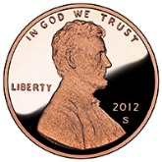


Information and Probability
Information relates to possible outcomes of an event
transmission of a message, flip of a coin, or measurement of a piece of data
The more certain an outcome, the less information that it contains and vice-versa
For example, if a coin has two heads, then an outcome of heads provides no information
More quantitatively, the information is related the probability of an outcome
The smaller the probability of an outcome, the more information it provides and vice-versa
Entropy is the commonly used measure

Slide 28
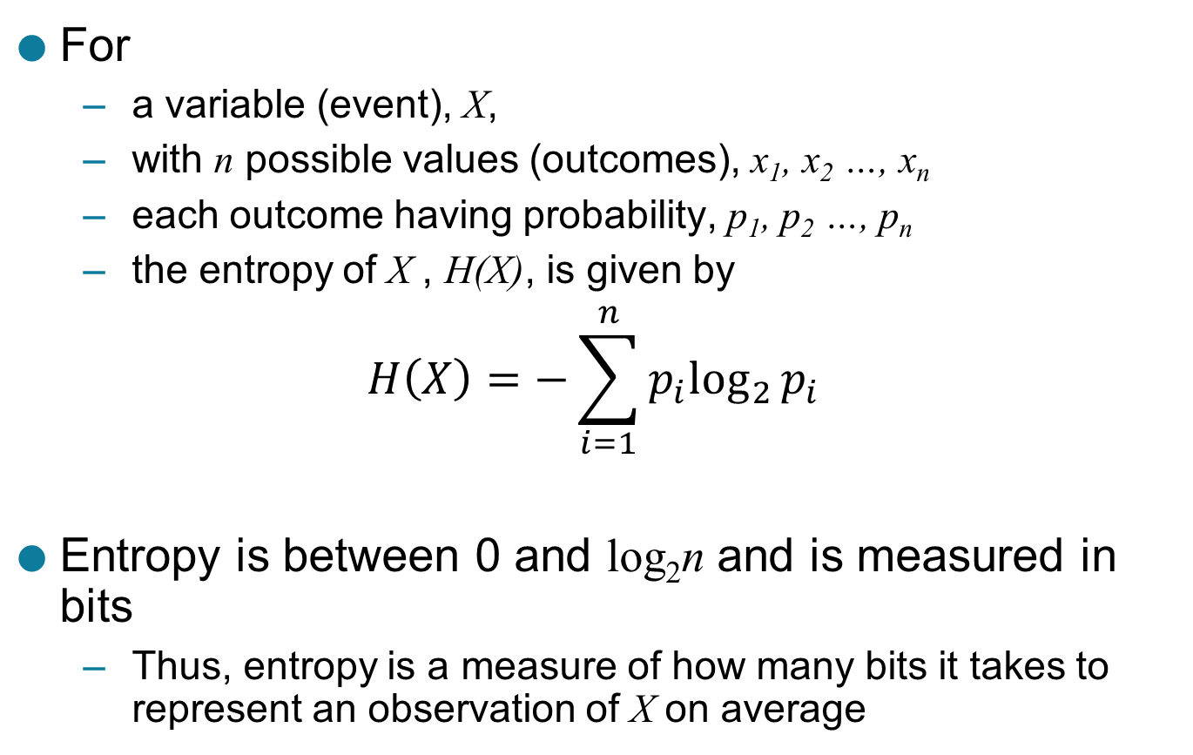
Entropy
For
a variable (event), X,
with n possible values (outcomes), x₁, x₂ …, x_{n}
each outcome having probability, p₁, p₂ …, p_{n}
the entropy of X , H(X), is given by
$$H\left(X\right)=−\sum_{i=1}^{n}{{p_{i}log}_{2}{p_{i}}}$$
Entropy is between 0 and log₂n and is measured in bits
Thus, entropy is a measure of how many bits it takes to represent an observation of X on average

Slide 29
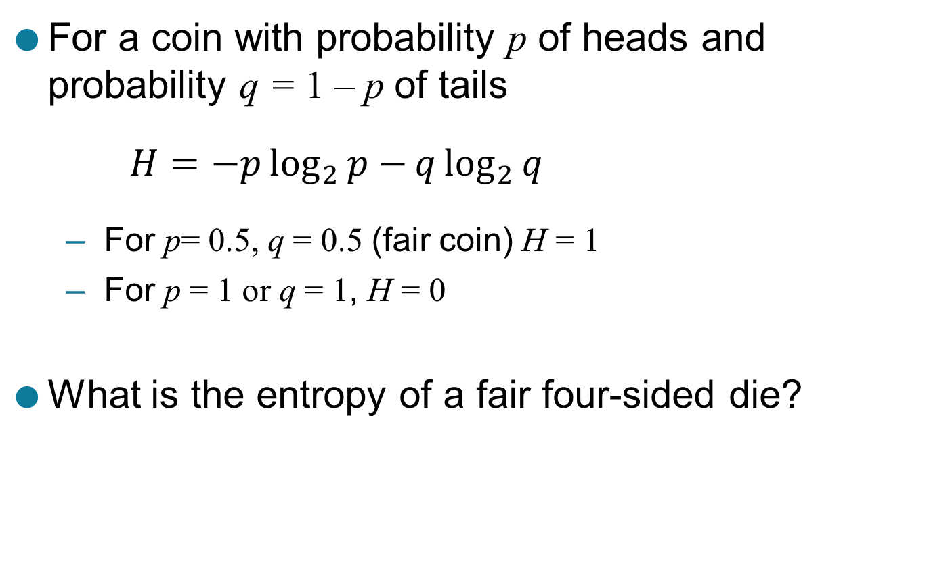
Entropy Examples
For a coin with probability p of heads and probability q = 1 – p of tails
$$H=−p\log_{2}{p−}q\log_{2}{q}$$
For p= 0.5, q = 0.5 (fair coin) H = 1
For p = 1 or q = 1, H = 0
What is the entropy of a fair four-sided die?

Slide 30
Entropy for Sample Data: Example
Hair Color | Count | p | -plog₂p
Black | 75 | 0.75 | 0.3113
Brown | 15 | 0.15 | 0.4105
Blond | 5 | 0.05 | 0.2161
Red | 0 | 0.00 | 0
Other | 5 | 0.05 | 0.2161
Total | 100 | 1.0 | 1.1540

Slide 31
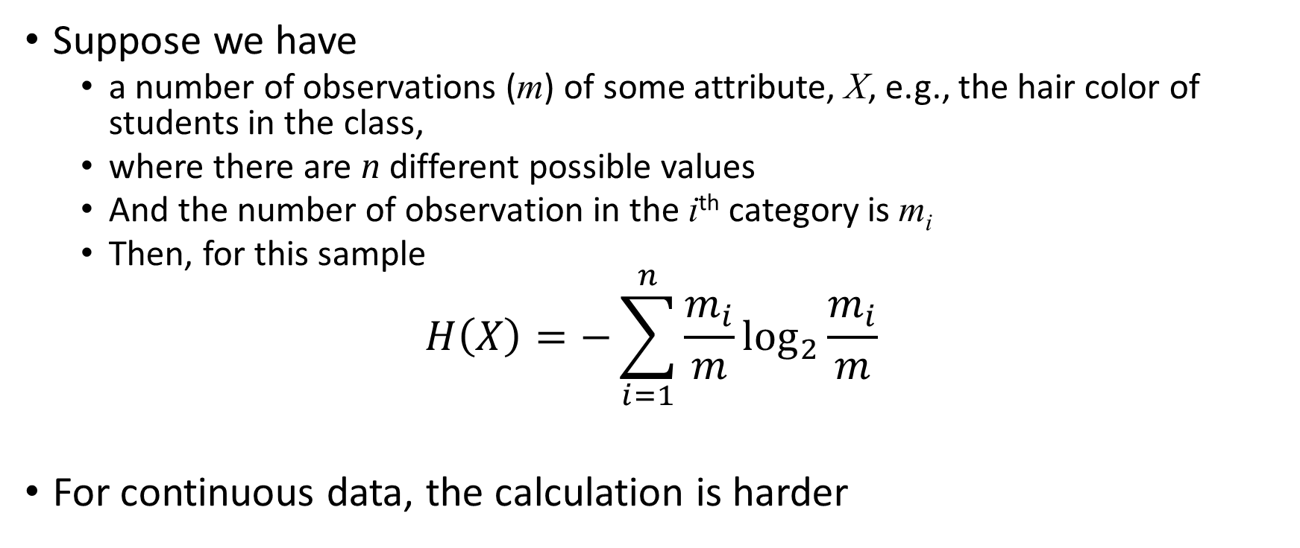
Entropy for Sample Data
Suppose we have
a number of observations (m) of some attribute, X, e.g., the hair color of students in the class,
where there are n different possible values
And the number of observation in the i^{th} category is m_{i}
Then, for this sample
$$H\left(X\right)=−\sum_{i=1}^{n}{{\frac{m_{i}}{m}log}_{2}{\frac{m_{i}}{m}}}$$
For continuous data, the calculation is harder

Slide 32
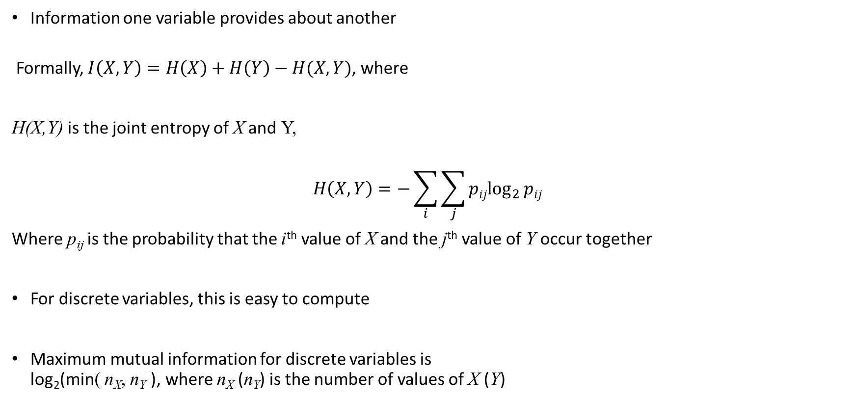
Mutual Information
Information one variable provides about another
Formally, $I\left(X,Y\right)=H\left(X\right)+H\left(Y\right)−H(X,Y)$, where
H(X,Y) is the joint entropy of X and Y,
$$H\left(X,Y\right)=−\sum_{i}{\sum_{j}{{pijlog}_{2}{pij}}}$$
Where p_{ij} is the probability that the i^{th} value of X and the j^{th} value of Y occur together
For discrete variables, this is easy to compute
Maximum mutual information for discrete variables is log₂(min( n_{X}, n_{Y} ), where n_{X} (n_{Y}) is the number of values of X (Y)

Slide 33
Mutual Information Example
Student Status | Count | p | -plog₂p
Undergrad | 45 | 0.45 | 0.5184
Grad | 55 | 0.55 | 0.4744
Total | 100 | 1.00 | 0.9928
Student Status | Grade | Count | p | -plog₂p
Undergrad | A | 5 | 0.05 | 0.2161
Undergrad | B | 30 | 0.30 | 0.5211
Undergrad | C | 10 | 0.10 | 0.3322
Grad | A | 30 | 0.30 | 0.5211
Grad | B | 20 | 0.20 | 0.4644
Grad | C | 5 | 0.05 | 0.2161
Total |  | 100 | 1.00 | 2.2710
Grade | Count | p | -plog₂p
A | 35 | 0.35 | 0.5301
B | 50 | 0.50 | 0.5000
C | 15 | 0.15 | 0.4105
Total | 100 | 1.00 | 1.4406
Mutual information of Student Status and Grade = 0.9928 + 1.4406 - 2.2710 = 0.1624

Slide 34
Density
Measures the degree to which data objects are close to each other in a specified area
The notion of density is closely related to that of proximity
Concept of density is typically used for clustering and anomaly detection
Examples:
Euclidean density
Euclidean density = number of points per unit volume
Probability density
Estimate what the distribution of the data looks like
Graph-based density
Connectivity

Slide 35
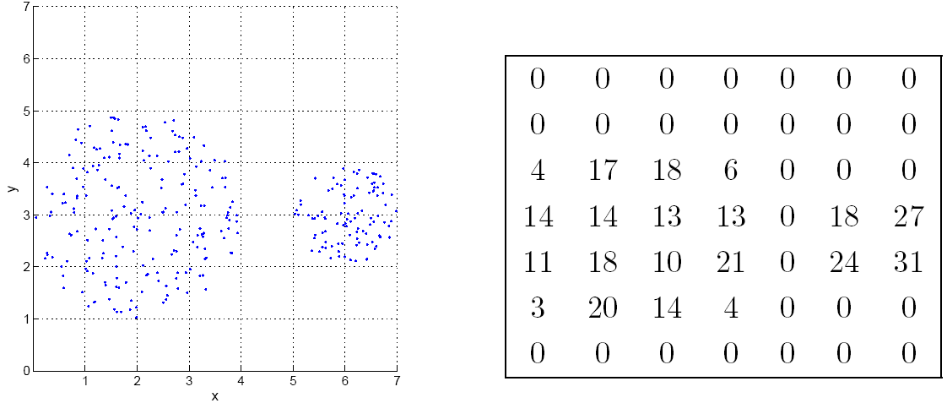
Euclidean Density: Grid-based Approach
Simplest approach is to divide region into a number of rectangular cells of equal volume and define density as # of points the cell contains
Grid-based density. Counts for each cell.

Slide 36
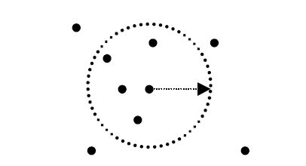
Euclidean Density: Center-Based
Euclidean density is the number of points within a specified radius of the point
Illustration of center-based density.

Slide 37
Linear Regression

Slide 38
Linear Regression
The technique is used to predict the value of one variable (the dependent variable - y) based on the value of other variables (independent variables x₁, x₂,…x_{k}) where is the error.

Slide 39
Modeling
The first order linear model
y = dependent variable
x = independent variable
β₀ = y-intercept
β₁ = slope of the line
= error variable
β₀ and β₁ are unknown,
therefore, are estimated
from the data.
y
Rise
β₁ = Rise/Run
β₀
Run
x
Notes:
a y-intercept or vertical intercept is a point where the graph of a function or relation intersects the y-axis of the coordinate system.
When x = 0, the corresponding y-value is the y-intercept

Slide 40
Estimating the coefficients
The estimates are determined by
drawing a sample from the population of interest,
calculating sample statistics.
producing a straight line that cuts into the data.
y
w
The question is:
Which straight line fits best?
w
w
w
w
w w w w
w
w w
w w
w
x

Slide 41
The best line is the one that minimizes the sum of squared vertical differences between the points and the line.
Sum of squared differences =
(2 - 1)² +
(4 - 2)² +
(1.5 - 3)² +
(3.2 - 4)² = 6.89
Sum of squared differences =
(2 -2.5)² +
(4 - 2.5)² +
(1.5 - 2.5)² +
(3.2 - 2.5)² = 3.99
Let us compare two lines
4
(2,4)
w
The second line is horizontal
3
w
(4,3.2)
2.5
The smaller the sum of squared differences the better the fit of the
line to the data.
2
w
(1,2)
(3,1.5)
w
1
1
2
3
4

Slide 42
To calculate the estimates of the coefficients
that minimize the differences between the data
points and the line, use the formulas:
The regression equation that estimates
the equation of the first order linear model
is:

Slide 43
Relationship between odometer reading and a used car’s selling price.
A car dealer wants to find the relationship between the odometer reading and the selling price of used cars.
A random sample of 100 cars is selected, and the data recorded.
Find the regression line.
Independent variable x
Dependent variable y

Slide 44
Solution to calculate b₀ and b₁ we need to calculate several statistics first;
where n = 100.

Slide 45
Decision Trees

Slide 46
Example of a Decision Tree
categorical
categorical
continuous
class
Splitting Attributes
Home Owner
Yes
No
NO
MarSt
Single, Divorced
Married
Income
NO
< 80K
> 80K
NO
YES
Training Data
Model: Decision Tree

Slide 47
Another Example of Decision Tree
categorical
categorical
continuous
class
Single, Divorced
MarSt
Married
NO
Home Owner
Yes
No
NO
Income
< 80K
> 80K
NO
YES
There could be more than one tree that fits the same data!

Slide 48
Apply Model to Test Data
Start from the root of tree.
Test Data
Home Owner
Yes
No
NO
MarSt
Single, Divorced
Married
Income
NO
< 80K
> 80K
NO
YES

Slide 49
Apply Model to Test Data
Test Data
Home Owner
Yes
No
NO
MarSt
Single, Divorced
Married
Income
NO
< 80K
> 80K
NO
YES

Slide 50
Apply Model to Test Data
Test Data
Home Owner
Yes
No
NO
MarSt
Single, Divorced
Married
Income
NO
< 80K
> 80K
NO
YES

Slide 51
Apply Model to Test Data
Test Data
Home Owner
Yes
No
NO
MarSt
Single, Divorced
Married
Income
NO
< 80K
> 80K
NO
YES

Slide 52
Apply Model to Test Data
Test Data
Home Owner
Yes
No
NO
MarSt
Single, Divorced
Married
Income
NO
< 80K
> 80K
NO
YES

Slide 53
Apply Model to Test Data
Home Owner
Test Data
Yes
No
NO
MarSt
Single, Divorced
Married
Income
NO
< 80K
> 80K
Assign Defaulted to “No”
NO
YES

Slide 54
Decision Tree Classification Task
Decision Tree

Slide 55
Decision Tree Induction
Many Algorithms:
Hunt’s Algorithm (one of the earliest)
CART
ID3, C4.5
SLIQ,SPRINT

Slide 56
General Structure of the Hunt‘s algorithm
Let D_{t} be the set of training records that reach a node t
General Procedure:
If D_{t} contains records that belong the same class y_{t}, then t is a leaf node labeled as y
If D_{t} contains records that belong to more than one class, use an attribute test to split the data into smaller subsets. Recursively apply the procedure to each subset.
D_{t}
?

Slide 57
Hunt’s algorithm

Slide 58
Hunt’s algorithm

Slide 59
Hunt’s algorithm

Slide 60
Hunt’s algorithm

Slide 61
Design Issues of Decision Tree Induction
How should training records be split?
Method for specifying test condition
depending on attribute types
Measure for evaluating the goodness of a test condition
How should the splitting procedure stop?
Stop splitting if all the records belong to the same class or have identical attribute values
Early termination

Slide 62
Methods for Expressing Test Conditions
Depends on attribute types
Binary
Nominal
Ordinal
Continuous
Depends on number of ways to split
2-way split
Multi-way split

Slide 63
Test Condition for Nominal Attributes
Multi-way split:
Use as many partitions as distinct values.
Binary split:
Divides values into two subsets

Slide 64
Test Condition for Ordinal Attributes
Multi-way split:
Use as many partitions as distinct values.
Binary split:
Divides values into two subsets
Preserve order property among attribute values
This grouping violates order property

Slide 65
Test Condition for Continuous Attributes

Slide 66
Splitting Based on Continuous Attributes
Different ways of handling
Discretization to form an ordinal categorical attribute
Ranges can be found by equal interval bucketing, equal frequency bucketing (percentiles), or clustering.
Static – discretize once at the beginning
Dynamic – repeat at each node
Binary Decision: (A < v) or (A ≥ v)
consider all possible splits and finds the best cut
can be more compute intensive

Slide 67
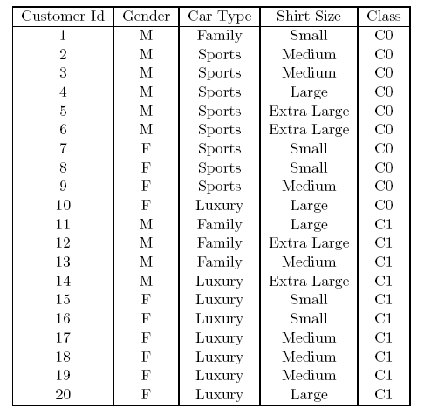
How to determine the best split
Before Splitting: 10 records of class 0, 10 records of class 1
Which test condition is the best?

Slide 68
How to determine the best split
Greedy approach:
Nodes with purer class distribution are preferred
Need a measure of node impurity:
High degree of impurity
Low degree of impurity

Slide 69
Measures of Node Impurity
Gini Index
Entropy
Misclassification error

Slide 70
Finding the best split
Compute impurity measure (P) before splitting
Compute impurity measure (M) after splitting
Compute impurity measure of each child node
M is the weighted impurity of children
Choose the attribute test condition that produces the highest gain or equivalently, lowest impurity measure after splitting (M)
Gain = P – M

Slide 71
Measure of Impurity: Entropy
Entropy at a given node t:
(NOTE: p( j | t) is the relative frequency of class j at node t).
Maximum (log n_{c}) when records are equally distributed among all classes implying least information
Minimum (0.0) when all records belong to one class, implying most information
Entropy based computations are quite similar to the GINI index computations

Slide 72
Computing Entropy of a Single Node
P(C1) = 0/6 = 0 P(C2) = 6/6 = 1
Entropy = – 0 log 0 – 1 log 1 = – 0 – 0 = 0
P(C1) = 1/6 P(C2) = 5/6
Entropy = – (1/6) log₂ (1/6) – (5/6) log₂ (5/6) = 0.65
P(C1) = 2/6 P(C2) = 4/6
Entropy = – (2/6) log₂ (2/6) – (4/6) log₂ (4/6) = 0.92

Slide 73
Computing Information Gain after Splitting
Information Gain
Parent Node, p is split into k partitions; n_{i} is number of records in partition i
Choose the split that achieves most reduction (maximizes GAIN)
Used in ID3 and C4.5 decision tree algorithms

Slide 74
Class exercise
Example from Han & Kamber Data Mining: Concepts and Techniques

Slide 75
Attribute Selection by Information Gain Computation
Class P: buys_computer = “yes”
Class N: buys_computer = “no”
I(p, n) = I(9, 5) =0.940
Compute the entropy for age:
means “age <=30” has 5 out of 14 samples, with 2 yes’es and 3 no’s. Hence
Similarly,

Slide 76
Output: A Decision Tree for “buys_computer”
age?
<=30
overcast
>40
30..40
student?
yes
credit rating?
no
yes
excellent
fair
no
yes
no
yes

Slide 77
Algorithm for Decision Tree Induction
Basic algorithm (a greedy algorithm)
Tree is constructed in a top-down recursive divide-and-conquer manner
At start, all the training examples are at the root
Attributes are categorical (if continuous-valued, they are discretized in advance)
Examples are partitioned recursively based on selected attributes
Test attributes are selected on the basis of a heuristic or statistical measure (e.g., information gain)
Conditions for stopping partitioning
All samples for a given node belong to the same class
There are no remaining attributes for further partitioning – majority voting is employed for classifying the leaf
There are no samples left

Slide 78
Other Attribute Selection Measures
Gini index (CART, IBM IntelligentMiner)
All attributes are assumed continuous-valued
Assume there exist several possible split values for each attribute
May need other tools, such as clustering, to get the possible split values
Can be modified for categorical attributes

Slide 79
GINI Index (IBM IntelligentMiner)
If a data set T contains examples from n classes, gini index, gini(T) is defined as
where p_{j} is the relative frequency of class j in T.
If a data set T is split into two subsets T₁ and T₂ with sizes N₁ and N₂ respectively, the gini index of the split data contains examples from n classes, the gini index gini(T) is defined as
The attribute provides the smallest gini_{split}(T) is chosen to split the node (need to enumerate all possible splitting points for each attribute).

