Slide 1
Applied Analytics and Predictive Modeling Spring 2020
Lecture-4
Lydia Manikonda
manikl@rpi.edu
Some of the slides adapted from Intro to Data Mining Tan et al. 2nd edition

Slide 2
Today’s agenda
Class Presentations – Groups 1, 2 and 10
Data Quality
Linear Regression

Slide 3
Presentations of Case Study-1
`

Slide 4
Data Quality
Poor data quality negatively affects many data processing efforts
“The most important point is that poor data quality is an unfolding disaster.
Poor data quality costs the typical company at least ten percent (10%) of revenue; twenty percent (20%) is probably a better estimate.”
Thomas C. Redman, DM Review, August 2004
Data mining example: a classification model for detecting people who are loan risks is built using poor data
Some credit-worthy candidates are denied loans
More loans are given to individuals that default

Slide 5
Data Quality …
What kinds of data quality problems?
How can we detect problems with the data?
What can we do about these problems?
Examples of data quality problems:
Noise and outliers
Missing values
Duplicate data
Wrong data

Slide 6
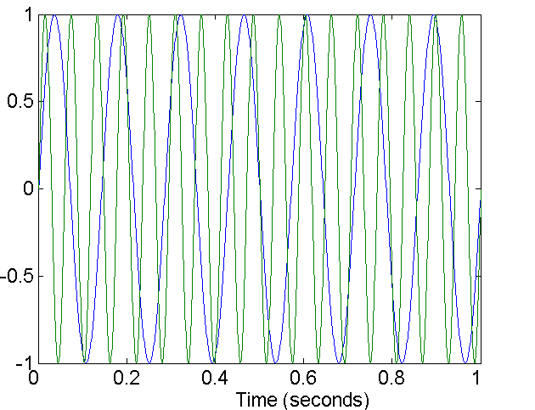
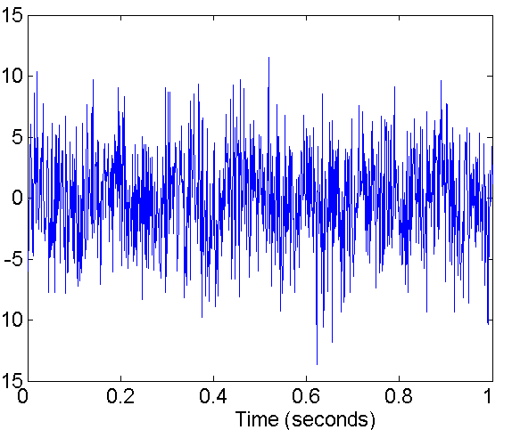
Noise
For objects, noise is an extraneous object
For attributes, noise refers to modification of original values
Examples: distortion of a person’s voice when talking on a poor phone and “snow” on television screen
Two Sine Waves
Two Sine Waves + Noise

Slide 7
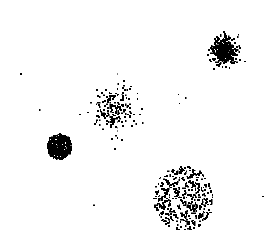
Outliers
Outliers are data objects with characteristics that are considerably different than most of the other data objects in the data set
Case 1: Outliers are noise that interferes with data analysis
Case 2: Outliers are the goal of our analysis
Credit card fraud
Intrusion detection
Causes?

Slide 8
Missing Values
Reasons for missing values
Information is not collected (e.g., people decline to give their age and weight)
Attributes may not be applicable to all cases (e.g., annual income is not applicable to children)
Handling missing values
Eliminate data objects or variables
Estimate missing values
Example: time series of temperature
Example: census results
Ignore the missing value during analysis

Slide 9
Missing Values …
Missing completely at random (MCAR)
Missingness of a value is independent of attributes
Fill in values based on the attribute
Analysis may be unbiased overall
Missing at Random (MAR)
Missingness is related to other variables
Fill in values based other values
Almost always produces a bias in the analysis
Missing Not at Random (MNAR)
Missingness is related to unobserved measurements
Informative or non-ignorable missingness
Not possible to know the situation from the data

Slide 10
Duplicate Data
Data set may include data objects that are duplicates, or almost duplicates of one another
Major issue when merging data from heterogeneous sources
Examples:
Same person with multiple email addresses
Data cleaning
Process of dealing with duplicate data issues
When should duplicate data not be removed?

Slide 11
Similarity and Dissimilarity Measures
Similarity measure
Numerical measure of how alike two data objects are.
Is higher when objects are more alike.
Often falls in the range [0,1]
Dissimilarity measure
Numerical measure of how different two data objects are
Lower when objects are more alike
Minimum dissimilarity is often 0
Upper limit varies
Proximity refers to a similarity or dissimilarity

Slide 12
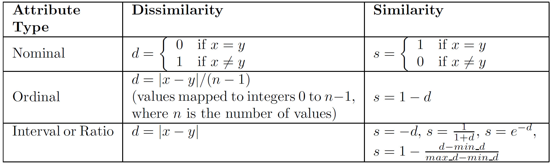
Similarity/Dissimilarity for Simple Attributes
The following table shows the similarity and dissimilarity between two objects, x and y, with respect to a single, simple attribute.

Slide 13
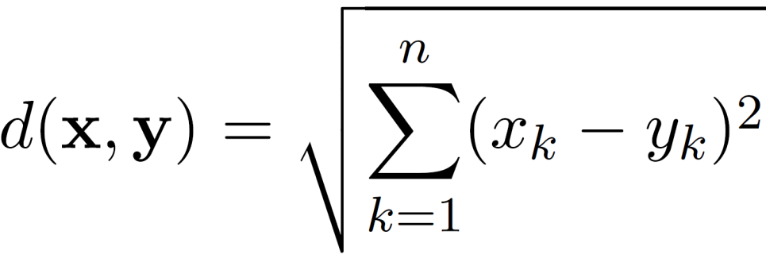
Euclidean Distance
Euclidean Distance
where n is the number of dimensions (attributes) and x_{k} and y_{k} are, respectively, the k^{th} attributes (components) or data objects x and y.
Standardization is necessary, if scales differ.

Slide 14
Euclidean Distance
Distance Matrix

Slide 15
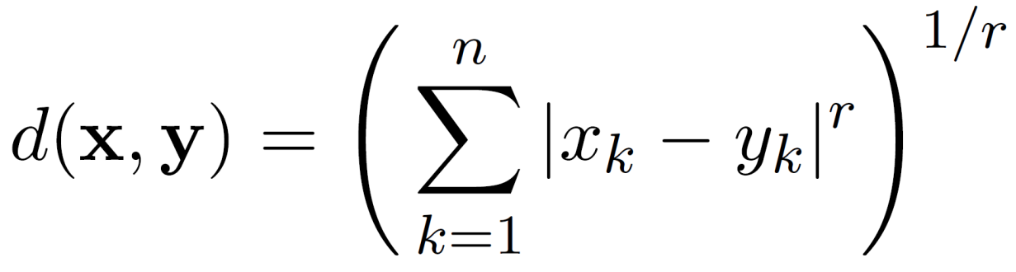
Minkowski Distance
Minkowski Distance is a generalization of Euclidean Distance
Where r is a parameter, n is the number of dimensions (attributes) and x_{k} and y_{k} are, respectively, the k^{th} attributes (components) or data objects x and y.

Slide 16
Minkowski Distance: Examples
r = 1. City block (Manhattan, taxicab, L₁ norm) distance.
A common example of this is the Hamming distance, which is just the number of bits that are different between two binary vectors
r = 2. Euclidean distance
r → ∞. “supremum” (L_{max} norm, L∞ norm) distance.
This is the maximum difference between any component of the vectors
Do not confuse r with n, i.e., all these distances are defined for all numbers of dimensions.

Slide 17
Minkowski Distance
Distance Matrix

Slide 18
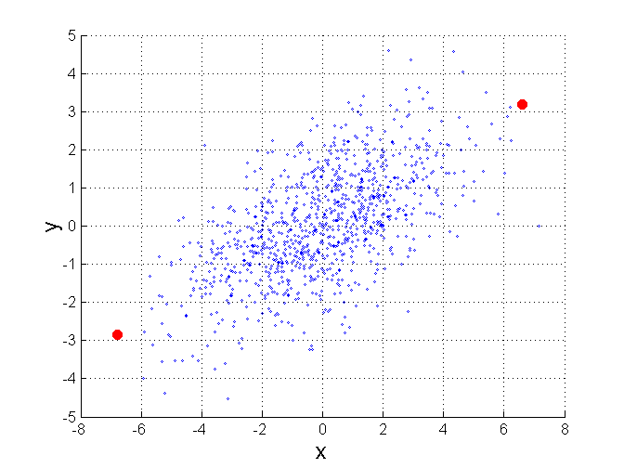
Mahalanobis Distance
$$mahalanobis\left(x,y\right)={ (x−y)}^{T}Ʃ^{−1}(x−y)$$
Σ is the covariance matrix
For red points, the Euclidean distance is 14.7, Mahalanobis distance is 6.

Slide 19
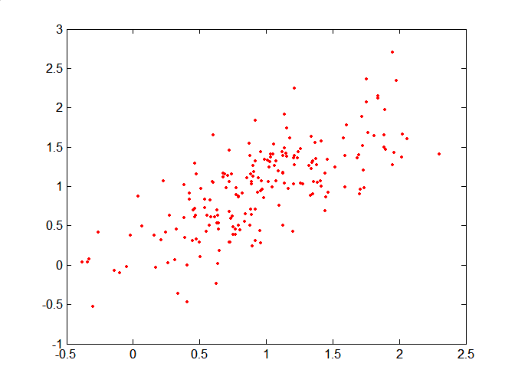
Mahalanobis Distance
Covariance Matrix:
C
B
A: (0.5, 0.5)
B: (0, 1)
C: (1.5, 1.5)
Mahal(A,B) = 5
Mahal(A,C) = 4
A

Slide 20
Common Properties of a Distance
Distances, such as the Euclidean distance, have some well known properties.
d(x, y) ≥ 0 for all x and y and d(x, y) = 0 only if x = y. (Positive definiteness)
d(x, y) = d(y, x) for all x and y. (Symmetry)
d(x, z) ≤ d(x, y) + d(y, z) for all points x, y, and z. (Triangle Inequality)
where d(x, y) is the distance (dissimilarity) between points (data objects), x and y.
A distance that satisfies these properties is a metric

Slide 21
Common Properties of a Similarity
Similarities, also have some well known properties.
s(x, y) = 1 (or maximum similarity) only if x = y.
s(x, y) = s(y, x) for all x and y. (Symmetry)
where s(x, y) is the similarity between points (data objects), x and y.

Slide 22
Similarity Between Binary Vectors
Common situation is that objects, p and q, have only binary attributes
Compute similarities using the following quantities
f₀₁ = the number of attributes where p was 0 and q was 1
f₁₀ = the number of attributes where p was 1 and q was 0
f₀₀ = the number of attributes where p was 0 and q was 0
f₁₁ = the number of attributes where p was 1 and q was 1
Simple Matching and Jaccard Coefficients
SMC = number of matches / number of attributes
= (f₁₁ + f₀₀) / (f₀₁ + f₁₀ + f₁₁ + f₀₀)
J = number of 11 matches / number of non-zero attributes
= (f₁₁) / (f₀₁ + f₁₀ + f₁₁)

Slide 23
SMC versus Jaccard: Example
x = 1 0 0 0 0 0 0 0 0 0
y = 0 0 0 0 0 0 1 0 0 1
f₀₁ = 2 (the number of attributes where p was 0 and q was 1)
f₁₀ = 1 (the number of attributes where p was 1 and q was 0)
f₀₀ = 7 (the number of attributes where p was 0 and q was 0)
f₁₁ = 0 (the number of attributes where p was 1 and q was 1)
SMC = (f₁₁ + f₀₀) / (f₀₁ + f₁₀ + f₁₁ + f₀₀)
= (0+7) / (2+1+0+7) = 0.7
J = (f₁₁) / (f₀₁ + f₁₀ + f₁₁) = 0 / (2 + 1 + 0) = 0

Slide 24
Cosine Similarity
If d₁ and d₂ are two document vectors, then
cos( d₁, d₂ ) = <d₁,d₂> / ||d₁|| ||d₂|| ,
where <d₁,d₂> indicates inner product or vector dot product of vectors, d₁ and d_{2,} and || d || is the length of vector d.
Example:
d₁ = 3 2 0 5 0 0 0 2 0 0
d₂ = 1 0 0 0 0 0 0 1 0 2
<d₁, d2> = 3*1 + 2*0 + 0*0 + 5*0 + 0*0 + 0*0 + 0*0 + 2*1 + 0*0 + 0*2 = 5
| d₁ || = (3*3+2*2+0*0+5*5+0*0+0*0+0*0+2*2+0*0+0*0)^{0.5} = (42) ^{0.5} = 6.481
|| d₂ || = (1*1+0*0+0*0+0*0+0*0+0*0+0*0+1*1+0*0+2*2) ^{0.5} = (6) ^{0.5} = 2.449
cos(d₁, d₂ ) = 0.3150

Slide 25
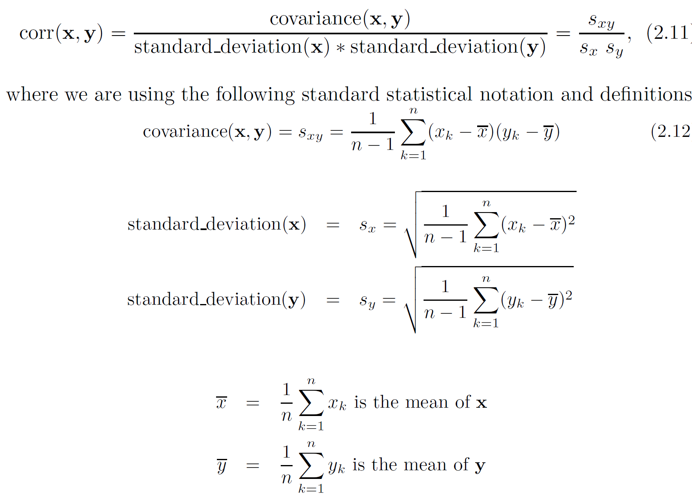
Correlation measures the linear relationship between objects

Slide 26
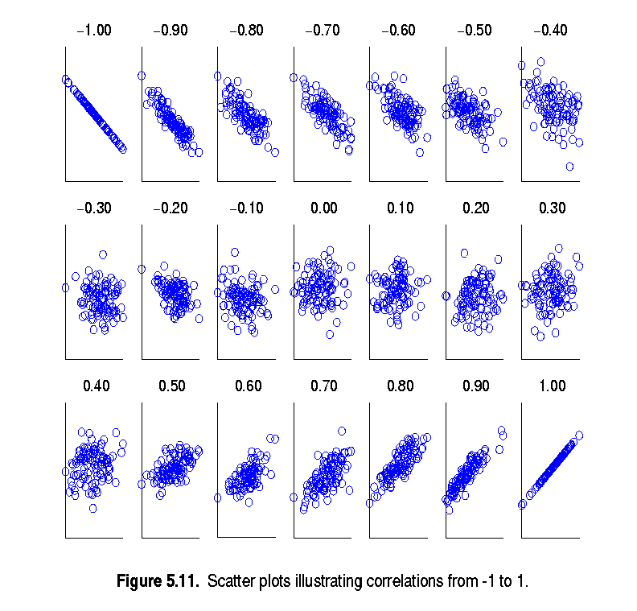
Visually Evaluating Correlation
Scatter plots showing the similarity from –1 to 1.

Slide 27
Information Based Measures
Information theory is a well-developed and fundamental disciple with broad applications
Some similarity measures are based on information theory
Mutual information in various versions
Maximal Information Coefficient (MIC) and related measures
General and can handle non-linear relationships
Can be complicated and time intensive to compute

Slide 28
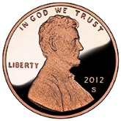


Information and Probability
Information relates to possible outcomes of an event
transmission of a message, flip of a coin, or measurement of a piece of data
The more certain an outcome, the less information that it contains and vice-versa
For example, if a coin has two heads, then an outcome of heads provides no information
More quantitatively, the information is related the probability of an outcome
The smaller the probability of an outcome, the more information it provides and vice-versa
Entropy is the commonly used measure

Slide 29
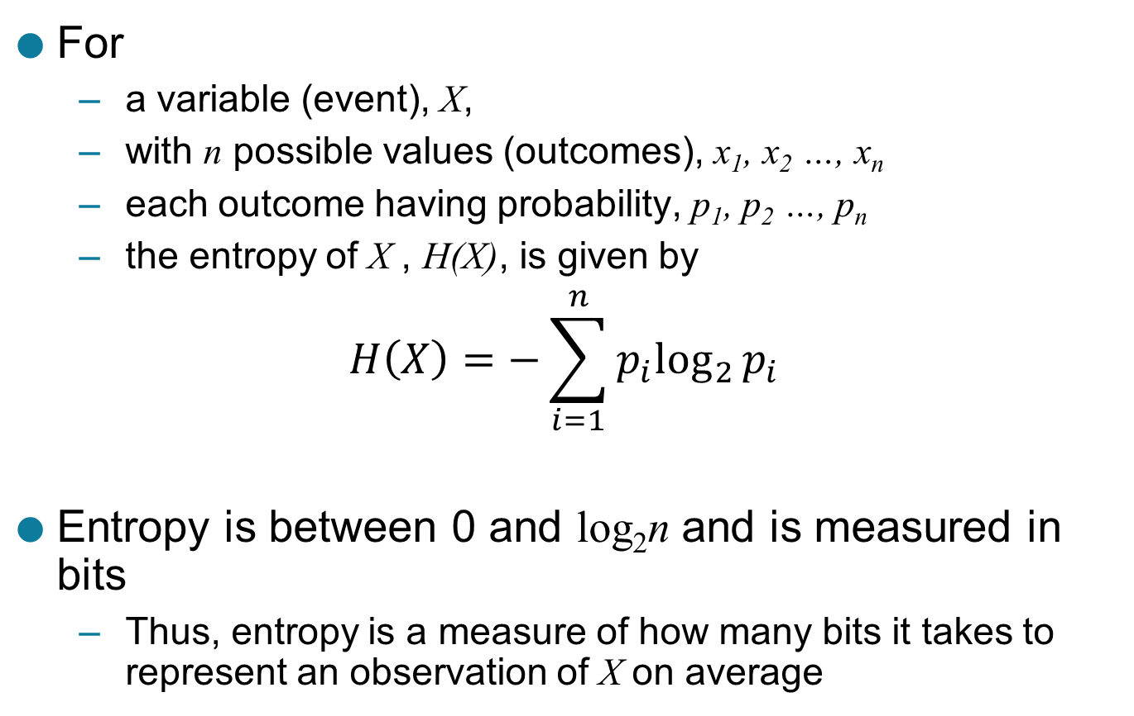
Entropy
For
a variable (event), X,
with n possible values (outcomes), x₁, x₂ …, x_{n}
each outcome having probability, p₁, p₂ …, p_{n}
the entropy of X , H(X), is given by
$$H\left(X\right)=−\sum_{i=1}^{n}{{p_{i}log}_{2}{p_{i}}}$$
Entropy is between 0 and log₂n and is measured in bits
Thus, entropy is a measure of how many bits it takes to represent an observation of X on average

Slide 30
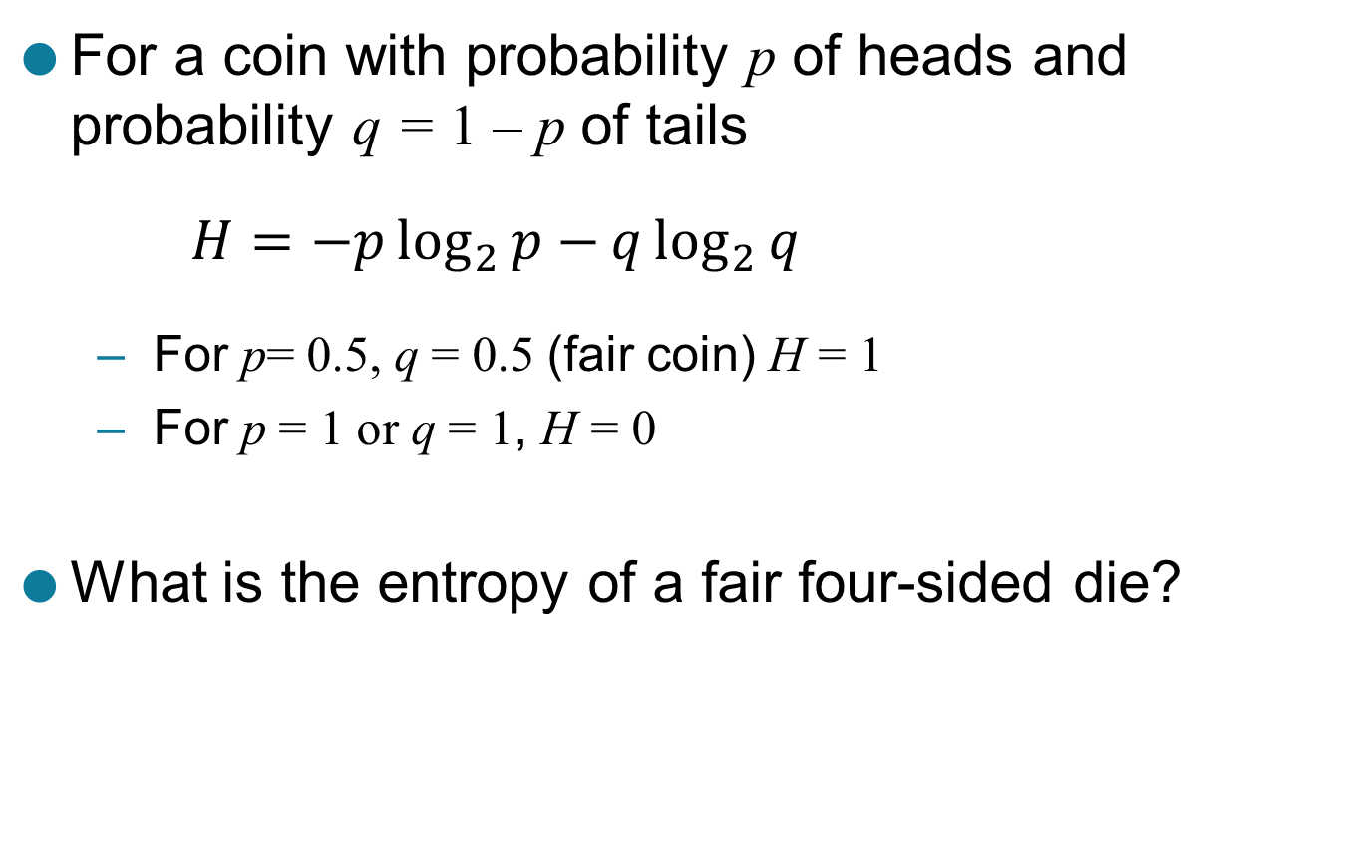
Entropy Examples
For a coin with probability p of heads and probability q = 1 – p of tails
$$H=−p\log_{2}{p−}q\log_{2}{q}$$
For p= 0.5, q = 0.5 (fair coin) H = 1
For p = 1 or q = 1, H = 0
What is the entropy of a fair four-sided die?

Slide 31
Entropy for Sample Data: Example
Hair Color | Count | p | -plog₂p
Black | 75 | 0.75 | 0.3113
Brown | 15 | 0.15 | 0.4105
Blond | 5 | 0.05 | 0.2161
Red | 0 | 0.00 | 0
Other | 5 | 0.05 | 0.2161
Total | 100 | 1.0 | 1.1540

Slide 32
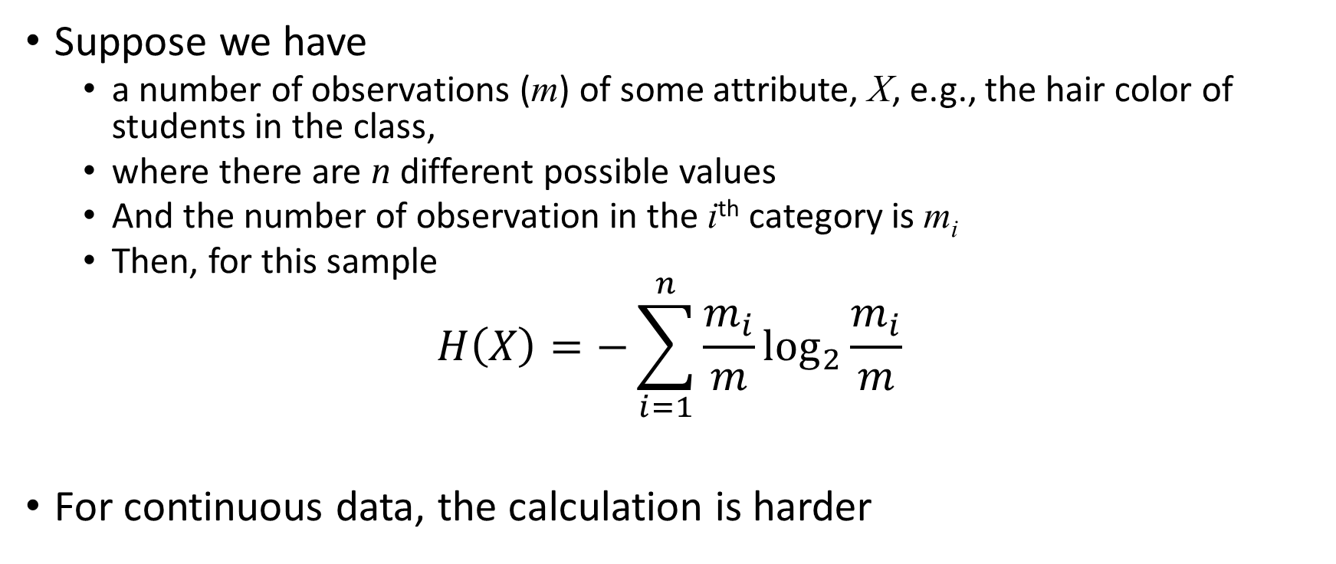
Entropy for Sample Data
Suppose we have
a number of observations (m) of some attribute, X, e.g., the hair color of students in the class,
where there are n different possible values
And the number of observation in the i^{th} category is m_{i}
Then, for this sample
$$H\left(X\right)=−\sum_{i=1}^{n}{{\frac{m_{i}}{m}log}_{2}{\frac{m_{i}}{m}}}$$
For continuous data, the calculation is harder

Slide 33
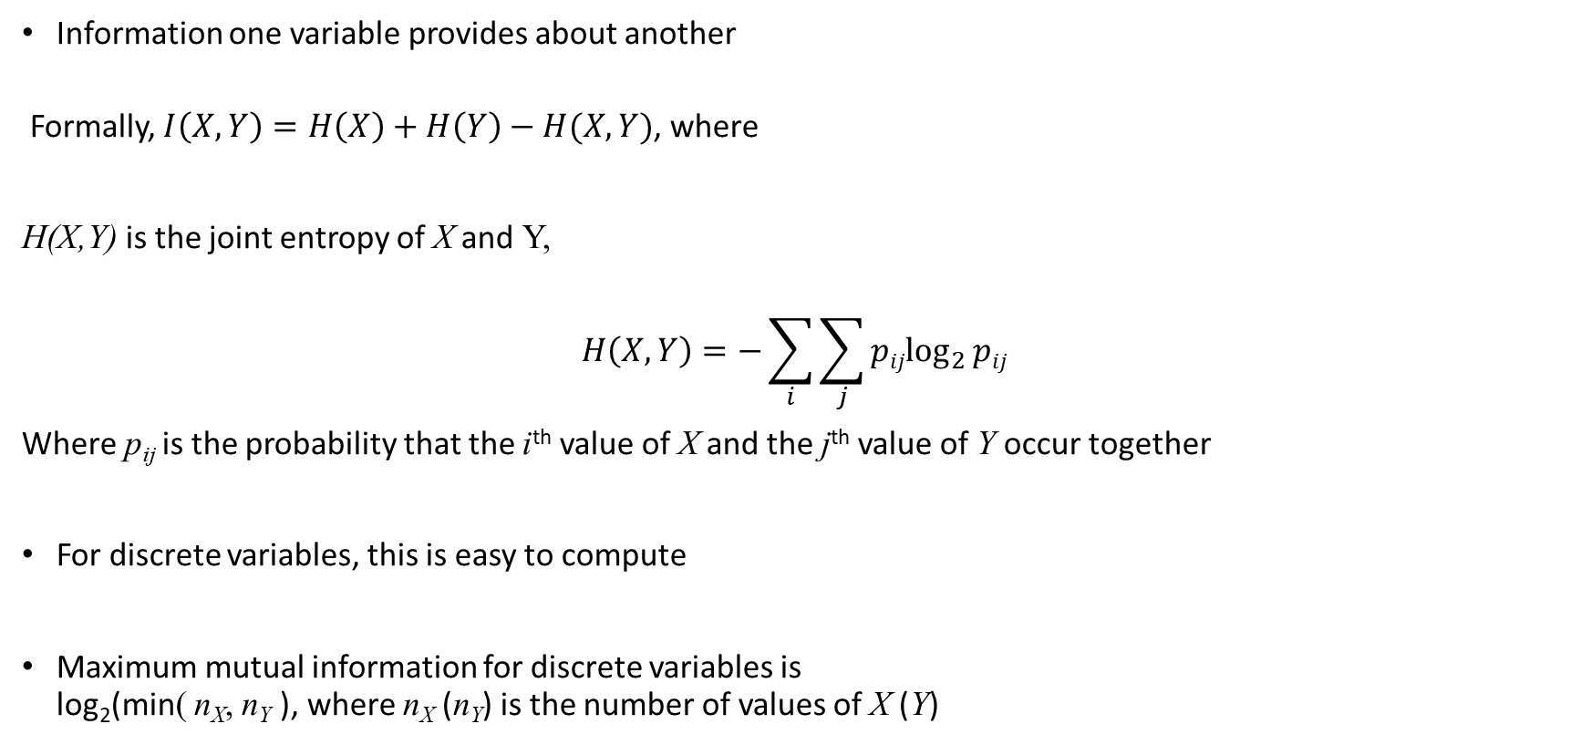
Mutual Information
Information one variable provides about another
Formally, $I\left(X,Y\right)=H\left(X\right)+H\left(Y\right)−H(X,Y)$, where
H(X,Y) is the joint entropy of X and Y,
$$H\left(X,Y\right)=−\sum_{i}{\sum_{j}{{pijlog}_{2}{pij}}}$$
Where p_{ij} is the probability that the i^{th} value of X and the j^{th} value of Y occur together
For discrete variables, this is easy to compute
Maximum mutual information for discrete variables is log₂(min( n_{X}, n_{Y} ), where n_{X} (n_{Y}) is the number of values of X (Y)

Slide 34
Mutual Information Example
Student Status | Count | p | -plog₂p
Undergrad | 45 | 0.45 | 0.5184
Grad | 55 | 0.55 | 0.4744
Total | 100 | 1.00 | 0.9928
Student Status | Grade | Count | p | -plog₂p
Undergrad | A | 5 | 0.05 | 0.2161
Undergrad | B | 30 | 0.30 | 0.5211
Undergrad | C | 10 | 0.10 | 0.3322
Grad | A | 30 | 0.30 | 0.5211
Grad | B | 20 | 0.20 | 0.4644
Grad | C | 5 | 0.05 | 0.2161
Total |  | 100 | 1.00 | 2.2710
Grade | Count | p | -plog₂p
A | 35 | 0.35 | 0.5301
B | 50 | 0.50 | 0.5000
C | 15 | 0.15 | 0.4105
Total | 100 | 1.00 | 1.4406
Mutual information of Student Status and Grade = 0.9928 + 1.4406 - 2.2710 = 0.1624

Slide 35
Density
Measures the degree to which data objects are close to each other in a specified area
The notion of density is closely related to that of proximity
Concept of density is typically used for clustering and anomaly detection
Examples:
Euclidean density
Euclidean density = number of points per unit volume
Probability density
Estimate what the distribution of the data looks like
Graph-based density
Connectivity

Slide 36
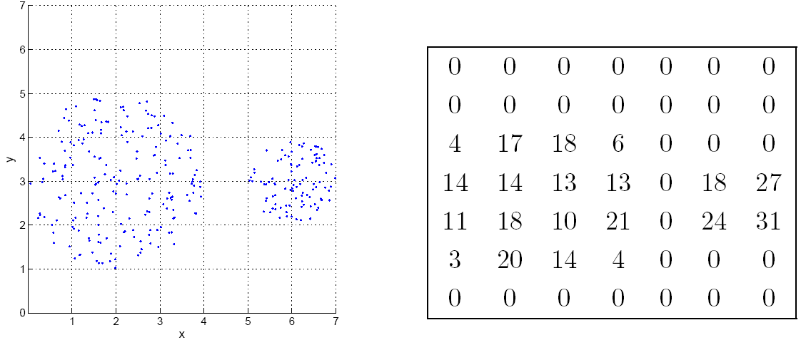
Euclidean Density: Grid-based Approach
Simplest approach is to divide region into a number of rectangular cells of equal volume and define density as # of points the cell contains
Grid-based density. Counts for each cell.

Slide 37
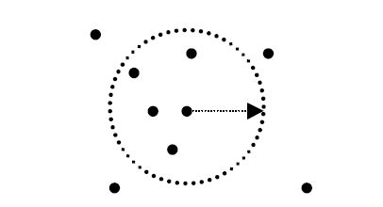
Euclidean Density: Center-Based
Euclidean density is the number of points within a specified radius of the point
Illustration of center-based density.

Slide 38
Linear Regression

Slide 39
Linear Regression
The technique is used to predict the value of one variable (the dependent variable - y) based on the value of other variables (independent variables x₁, x₂,…x_{k})

Slide 40
Modeling
The first order linear model
y = dependent variable
x = independent variable
β₀ = y-intercept
β₁ = slope of the line
= error variable
β₀ and β₁ are unknown,
therefore, are estimated
from the data.
y
Rise
β₁ = Rise/Run
β₀
Run
x

Slide 41
Estimating the coefficients
The estimates are determined by
drawing a sample from the population of interest,
calculating sample statistics.
producing a straight line that cuts into the data.
y
w
The question is:
Which straight line fits best?
w
w
w
w
w w w w
w
w w
w w
w
x

Slide 42
The best line is the one that minimizes the sum of squared vertical differences between the points and the line.
Sum of squared differences =
(2 - 1)² +
(4 - 2)² +
(1.5 - 3)² +
(3.2 - 4)² = 6.89
Sum of squared differences =
(2 -2.5)² +
(4 - 2.5)² +
(1.5 - 2.5)² +
(3.2 - 2.5)² = 3.99
Let us compare two lines
4
(2,4)
w
The second line is horizontal
3
w
(4,3.2)
2.5
2
w
(1,2)
(3,1.5)
The smaller the sum of
squared differences
the better the fit of the
line to the data.
w
1
1
2
3
4

Slide 43
To calculate the estimates of the coefficients
that minimize the differences between the data
points and the line, use the formulas:
The regression equation that estimates
the equation of the first order linear model
is:

Slide 44
Relationship between odometer reading and a used car’s selling price.
A car dealer wants to find the relationship between the odometer reading and the selling price of used cars.
A random sample of 100 cars is selected, and the data recorded.
Find the regression line.
Independent variable x
Dependent variable y

Slide 45
Solution to calculate b₀ and b₁ we need to calculate several statistics first;
where n = 100.

