Slide 1
Applied Analytics and Predictive Modeling Spring 2020
Lecture-3
Lydia Manikonda
manikl@rpi.edu
Some of the slides adapted from Intro to Data Mining Tan et al. 2nd edition

Slide 2
Today’s agenda
Data Preprocessing
Dimensionality Reduction
Including class exercises
Case study-1

Slide 3
Overview

Slide 4
What is data?
Attributes
Collection of data objects and their attributes
According to Tan et al.,
An attribute is a property or characteristic of an object
Also known as variable, field, characteristic, dimension, or feature
A collection of attributes describe an object
Also known as tuple, record, point, case, sample, etc.
Objects

Slide 5
More views of data
Data may have parts
The different parts of data may have relationships
More generally, data may have structure
Data can be incomplete

Slide 6
Attribute values
Attribute values are numbers or symbols assigned to an attribute for a particular object
Distinction between attributes and attribute values
Same attribute can be mapped to different attribute values
Example: Height can be measured in feet or meters
Different attributes can be mapped to the same set of values
Example: Attribute values for ID and age are integers
But properties of attribute values can be different

Slide 7
Types of Attributes
Nominal
Examples: ID numbers, zip codes, eye color
Ordinal
Examples: Rankings (expertise level on a scale of 1-10), grades, height {tall, medium, short}
Interval
Examples: Calendar dates, temperature in Celsius or Fahrenheit
Ratio
Examples: Temperature in Kelvin, length, time, counts

Slide 8
Discrete and Continuous attributes
Discrete Attribute:
Has only a finite or countably infinite set of values
Examples: zip codes, counts, or the set of words in a collection of documents
Often represented as integer variables.
Note: binary attributes are a special case of discrete attributes
Continuous Attribute:
Has real numbers as attribute values
Examples: temperature, height, or weight.
Practically, real values can only be measured and represented using a finite number of digits.
Continuous attributes are typically represented as floating-point variables.

Slide 9
Types of datasets
Record
Data Matrix
Document Data
Transaction Data
Graph
World Wide Web
Molecular Structures
Ordered
Spatial Data
Temporal Data
Sequential Data
Genetic Sequence Data

Slide 10
Important characteristics of data
Dimensionality (number of attributes)
High dimensional data brings a number of challenges
Sparsity
Only presence counts
Resolution
Patterns depend on the scale
Size
Type of analysis may depend on size of data

Slide 11
Record data
Data that consists of a collection of records, each of which consists of a fixed set of attributes

Slide 12
Document data
Each document becomes a ‘term’ vector
Each term is a component (attribute) of the vector
The value of each component is the number of times the corresponding term occurs in the document.

Slide 13
Transaction data
A special type of record data, where
Each record (transaction) involves a set of items.
For example, consider a grocery store. The set of products purchased by a customer during one shopping trip constitute a transaction, while the individual products that were purchased are the items.

Slide 14
Graph Data
Examples: Generic graph, a molecule, and webpages
Benzene Molecule: C6H6

Slide 15
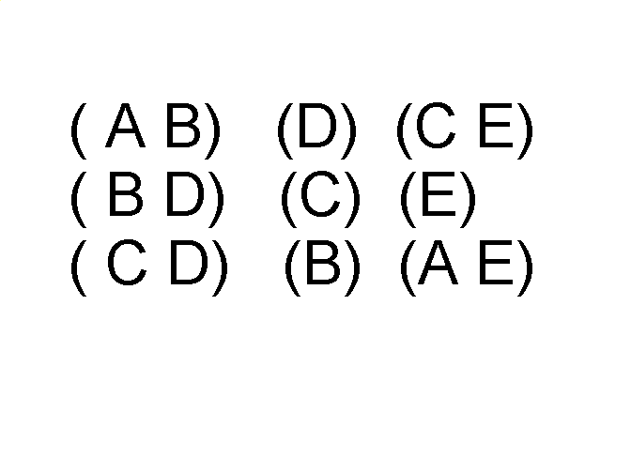
Ordered Data
Items/Events
Sequences of transactions
An element of the sequence

Slide 16
Ordered Data
Genomic sequence data

Slide 17
Ordered Data
Spatio-temporal data
Average Monthly Temperature of land and ocean

Slide 18
Examples
ID numbers
Nominal, ordinal, or interval?
Number of cylinders in an automobile engine
Nominal, ordinal, or ratio?
Biased Scale
Interval or Ratio

Slide 19
Data Preprocessing
Aggregation
Sampling
Dimensionality Reduction
Feature subset selection
Feature creation
Discretization and Binarization
Attribute Transformation

Slide 20
Aggregation
Combining two or more attributes (or objects) into a single attribute (or object)
Purpose
Data reduction
Reduce the number of attributes or objects
Change of scale
Cities aggregated into regions, states, countries, etc.
Days aggregated into weeks, months, or years
More “stable” data
Aggregated data tends to have less variability

Slide 21
Example: Precipitation in Australia
This example is based on precipitation in Australia from the period 1982 to 1993.
The next slide shows
A histogram for the standard deviation of average monthly precipitation for 3,030 0.5◦ by 0.5◦ grid cells in Australia, and
A histogram for the standard deviation of the average yearly precipitation for the same locations.
The average yearly precipitation has less variability than the average monthly precipitation.
All precipitation measurements (and their standard deviations) are in centimeters.

Slide 22
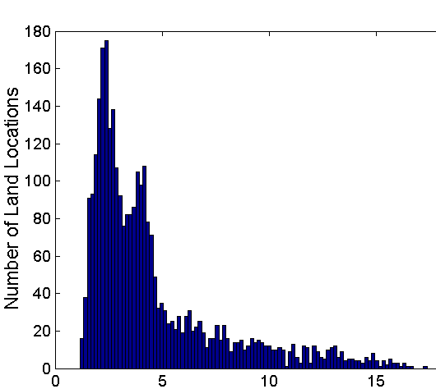
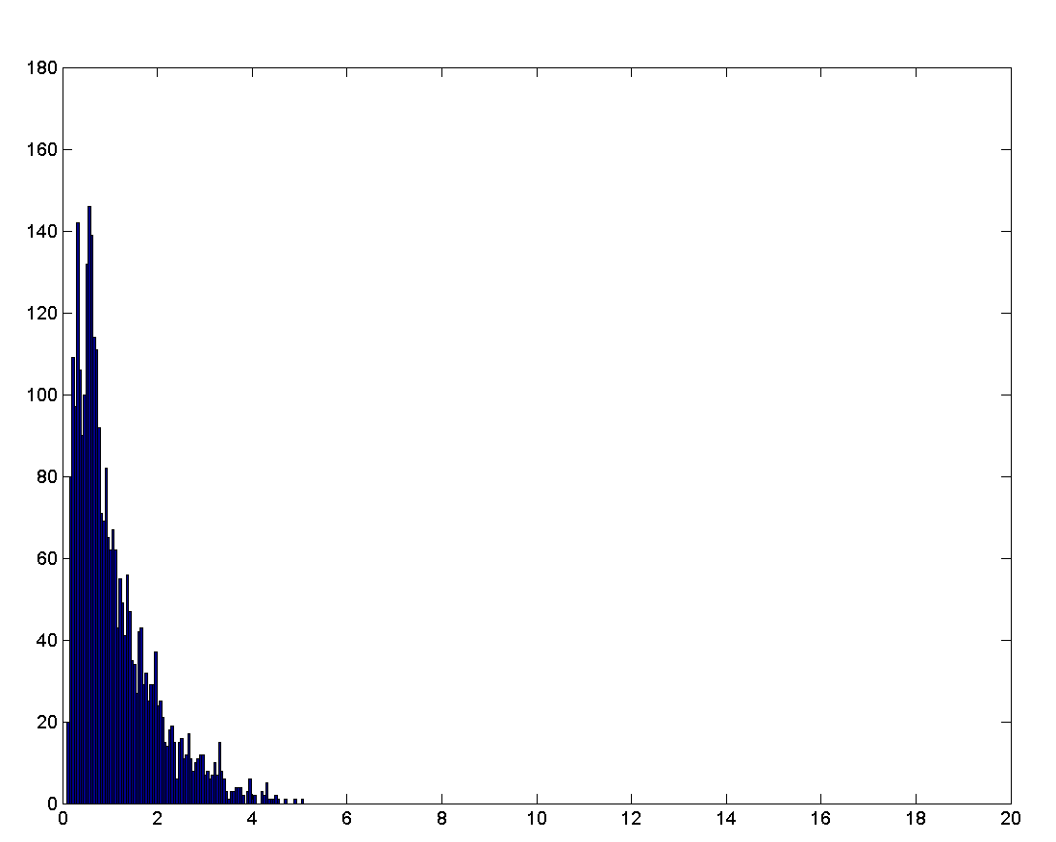
Example: Precipitation in Australia..
Variation of precipitation in Australia
Standard Deviation of Average Monthly Precipitation
Standard Deviation of Average Yearly Precipitation

Slide 23
Sampling
Sampling is the main technique employed for data reduction.
It is often used for both the preliminary investigation of the data and the final data analysis.
Statisticians often sample because obtaining the entire set of data of interest is too expensive or time consuming.
Sampling is typically used in data mining because processing the entire set of data of interest is too expensive or time consuming.

Slide 24
Sampling
The key principle for effective sampling is the following:
Using a sample will work almost as well as using the entire data set, if the sample is representative
A sample is representative if it has approximately the same properties (of interest) as the original set of data

Slide 25

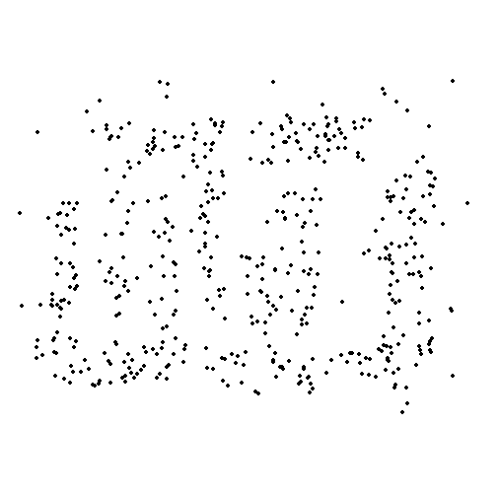
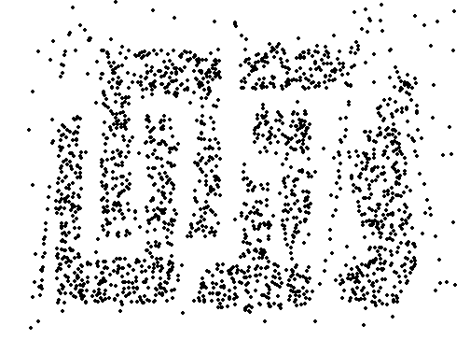
Sample size
8000 points 2000 Points 500 Points

Slide 26
Types of Sampling
Simple Random Sampling
There is an equal probability of selecting any particular item
Sampling without replacement
As each item is selected, it is removed from the population
Sampling with replacement
Objects are not removed from the population as they are selected for the sample.
In sampling with replacement, the same object can be picked up more than once
Stratified sampling
Split the data into several partitions; then draw random samples from each partition

Slide 27
Curse of dimensionality
When dimensionality increases, data becomes increasingly sparse in the space that it occupies

Slide 28
Dimensionality Reduction
Purpose:
Avoid curse of dimensionality
Reduce amount of time and memory required by data mining algorithms
Allow data to be more easily visualized
May help to eliminate irrelevant features or reduce noise
Techniques
Principal Components Analysis (PCA)
Singular Value Decomposition
Others: supervised and non-linear techniques

Slide 29
Feature subset Selection
Another way to reduce dimensionality of data
Redundant features
Duplicate much or all of the information contained in one or more other attributes
Example: purchase price of a product and the amount of sales tax paid
Irrelevant features
Contain no information that is useful for the data mining task at hand
Example: students' ID is often irrelevant to the task of predicting students' GPA
Many techniques developed, especially for classification

Slide 30
Feature Creation
Create new attributes that can capture the important information in a data set much more efficiently than the original attributes
Three general methodologies:
Feature extraction
Example: extracting edges from images
Feature construction
Example: dividing mass by volume to get density
Mapping data to new space
Example: Fourier and wavelet analysis

Slide 31
Discretization
Discretization is the process of converting a continuous attribute into an ordinal attribute
A potentially infinite number of values are mapped into a small number of categories
Discretization is commonly used in classification
Many classification algorithms work best if both the independent and dependent variables have only a few values

Slide 32
Binarization
Binarization maps a continuous or categorical attribute into one or more binary variables
Typically used for association analysis
Often convert a continuous attribute to a categorical attribute and then convert a categorical attribute to a set of binary attributes
Association analysis needs asymmetric binary attributes
Examples: eye color and height measured as {low, medium, high}

Slide 33
Attribute Transformation
An attribute transform is a function that maps the entire set of values of a given attribute to a new set of replacement values such that each old value can be identified with one of the new values
Simple functions: x^{k}, log(x), e^{x}, |x|
Normalization
Refers to various techniques to adjust to differences among attributes in terms of frequency of occurrence, mean, variance, range
Take out unwanted, common signal, e.g., seasonality
In statistics, standardization refers to subtracting off the means and dividing by the standard deviation

Slide 34
Exercises-1

Slide 35
Principal Component Analysis
Dimensionality Reduction

Slide 36
Eigenvalues and Eigenvectors
The eigenvector is a vector whose direction will not be affected by a linear transformation.
Hence eigenvectors represents the direction of largest variance of data while the eigenvalue decides the magnitude of this variance in those directions.
Notes:
Eigenvalues are a special set of scalars associated with a linear system of equations (i.e., a matrix equation) that are sometimes also known as characteristic roots, characteristic values

Slide 37
Computing eigenvalues and eigenvectors
Let A be a linear transformation represented by a matrix A
If there is a vector X ∈ R ≠ 0 such that AX=λX

Slide 38
LDA
Step-1: Standardize the data
To normalize the variances of data attributes
Avoids biased results
For any attribute, one way to do is to subtract the mean and divide by standard deviation
Step-2: Covariance matrix computation
How are the attributes related to each other
Matrix is symmetric with diagonal values are variances
Step-3: Compute Eigenvalues and Eigenvectors (that are principal components)
principal components represent the directions of the data that explain a maximal amount of variance
10-dimensional data gives you 10 principal components
1st component has the maximum information followed by 2nd component and so on.
Notes:
Cov(X, Y) = Σ ( X_{i} - X ) ( Y_{i} - Y ) / N
if positive then : the two variables increase or decrease together (correlated)
if negative then : One increases when the other decreases (Inversely correlated)

Slide 39
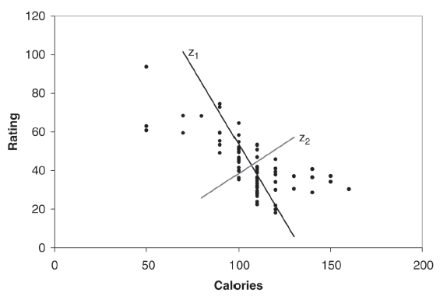
Using linear combinations to redistribute the variability
Z1 and Z2 are two linear combinations
Z1 has the highest variation or spread of values
Z2 has the lowest variation

Slide 40
Exercises-2

Slide 41
Case Study-1

