Slide 1
Applied Analytics & Predictive Modeling Spring 2020
Lecture-1
Lydia Manikonda
manikl@rpi.edu

Slide 2
Agenda
Course logistics
Instructor Info
Syllabus
----------------------------------------------------------------------------------------------
Introduction to Data Mining
Python basics
Colab – Jupyter notebook environment

Slide 3
Course Logistics
Lectures: Every Monday 3 pm to 5:50 pm
Location: SAGE 2715
Website: https://predictivemodeling.github.io/
Piazza for course-related discussions.

Slide 4
Instructor
Assistant Professor in Lally School of Management
PhD in Computer Science
AI & Machine Learning with a focus on Social Media Analytics
Office hours: Thursday 2 pm to 4 pm
Location: PITTS 1212

Slide 5
Syllabus
Python basics
Data cleaning and pre-processing
Data analysis including dimensionality reduction
Logistic regression
Decision trees
K-Nearest Neighbor algorithm
Association rules, Market basket analysis
Cluster analysis including NLP applications
…

Slide 6
Overview of Data Mining

Slide 7
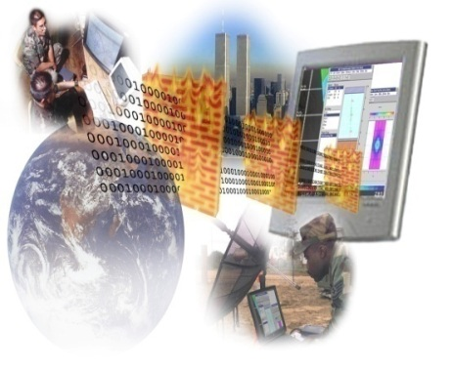

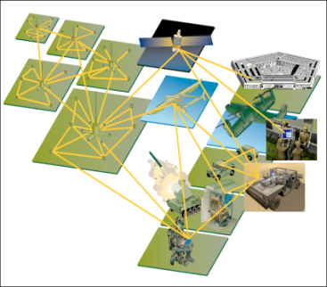
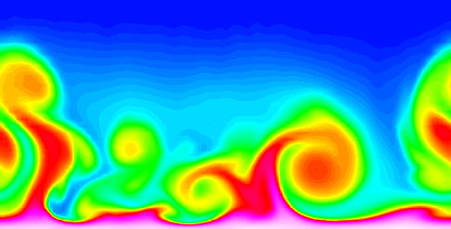
Large-Scale Data is Everywhere
There has been enormous data growth in both commercial and scientific databases due to advances in data generation and collection technologies
New mantra
Gather whatever data you can whenever and wherever possible.
Expectations
Gathered data will have value either for the purpose collected or for a purpose not envisioned.
E-Commerce
Cyber Security
Traffic Patterns
Social Networking: Twitter
Sensor Networks
Computational Simulations

Slide 8




Why Data Mining? Commercial Viewpoint
Lots of data is being collected and warehoused
Web data
Yahoo has Peta Bytes of web data
Facebook has billions of active users
purchases at department/ grocery stores, e-commerce
Amazon handles millions of visits/day
Bank/Credit Card transactions
Computers have become cheaper and more powerful
Competitive Pressure is Strong
Provide better, customized services for an edge (e.g. in Customer Relationship Management)

Slide 9
What is Data Mining?
Many Definitions
Non-trivial extraction of implicit, previously unknown and potentially useful information from data
Exploration & analysis, by automatic or semi-automatic means, of large quantities of data in order to discover meaningful patterns

Slide 10
What is NOT Data Mining?
What is not Data Mining?
Look up phone number in phone directory
Query a Web search engine for information about “Amazon”
What is Data Mining?
Certain names are more prevalent in certain US locations (O’Brien, O’Rourke, O’Reilly… in Boston area)
Group together similar documents returned by search engine according to their context (e.g., Amazon rainforest, Amazon.com)

Slide 11

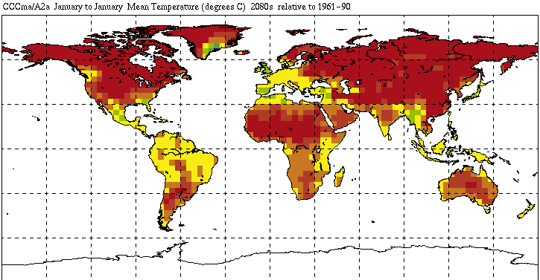

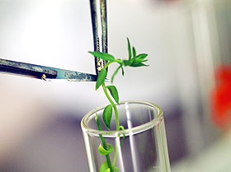
Great Opportunities to solve Society’s Major Problems
Improving health care and reducing costs
Predicting the impact of climate change
Finding alternative/ green energy sources
Reducing hunger and poverty by
increasing agriculture production

Slide 12
Python fundamentals
Basics, loops, conditionals, functions, packages

Slide 13
Basics
Language introduction, setup, variables, data structures

Slide 14
Python Language Introduction
General-purpose, high level programming language.
Designed by Guido Van Rossum in 1991
Main emphasis on
Code readability
Simple syntax
2 major versions – Python 2 and Python 3

Slide 15
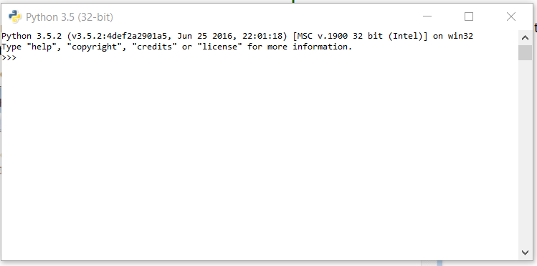
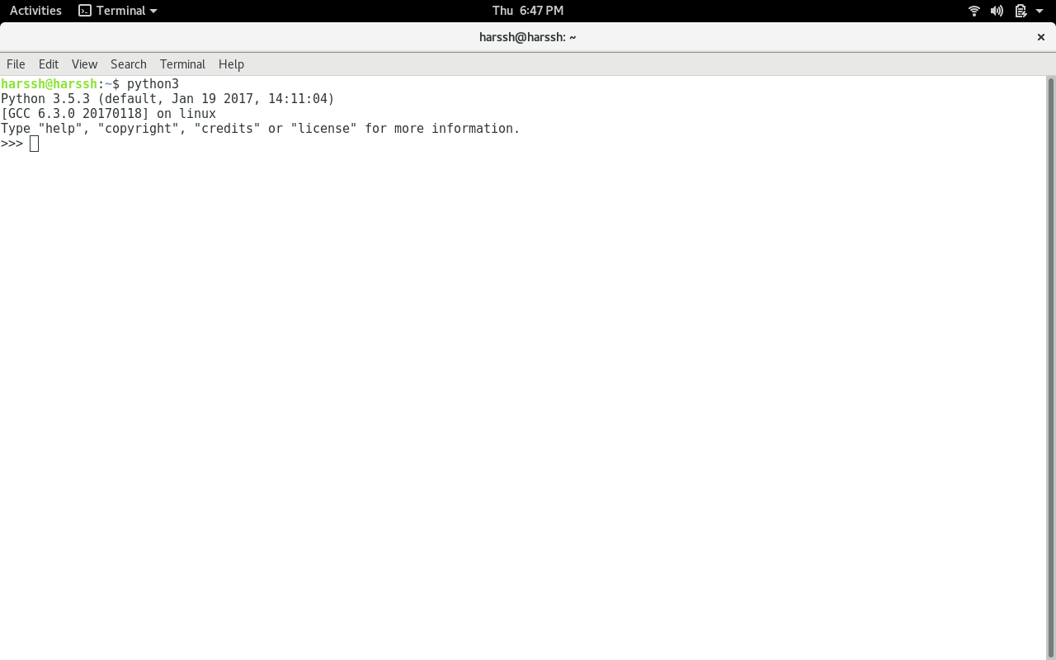
Finding an interpreter
Windows
Unix/Linux

Slide 16
First program in Python
>> #Begins -- Comments
>> print(“Hello World”)
>> #Ends – Comments
# is used for single line comment in Python
""" this is a comment """ is used for multi line comments

Slide 17
Variables and Data Structures
In programming languages such as C, C++ or C#, you need to declare the type of variables exclusively.
Data types can be int, float, char, String, etc.
Python – take a variable and the value assigned to it automatically tells the data type.
>> myVar = 2 #int
>> print(myVar)
>> myVar2 = 2.5 #float
>> print(myVar2)
>> myVar3 = “Hello World!” #string
>> print(myVar3)
Notes:
type(myVar)

Slide 18
Data Structures
Create a variable and assign any value you want!
Python has 4 types of inbuilt data structures
List
Dictionary
Tuple
Set

Slide 19
List
Most basic data structure in Python programming language.
Mutable data structure
Elements of this list can be altered after creating the data structure
append() – used to add elements in the list
insert() – used to add elements in the list at a certain index till the last element

Slide 20
List
append()
insert()
>> #Create an empty list
>> list1=[]
>> #Append elements to the list
>> list1.append(2)
>> list1.append(4.5)
>> list1.append(“four”)
>> print(list1)
>> list1 = [1, 2, 3, 4, 5]
>> list1.insert(5, 10)
>> print(list1)
>> list1.insert(1,10)
>> list1.insert(8,20)
>> print(list1)

Slide 21
Example – Mixing append(), insert() and remove()
>> list1=[1,2,3,4,5]
>> list1.insert(5,12)
>> list1.insert(1,14)
>> print(list1) # [1, 14, 2, 3, 4, 5, 12]
>> list1.insert(8,20)
>> print(list1) # [1, 14, 2, 3, 4, 5, 12, 20]
>> list1.append(11)
>> print(list1) # [1, 14, 2, 3, 4, 5, 12, 20, 11]
>> list1.pop(5) #removes the element at index 5; if only pop() – removes the last element
>> print(list1)

Slide 22
List – Exercise
Create a list of size 5 containing 10,20,30,40,50 – one at a time by using the method insert().
Print the list.
Remove element from index ‘3’ and print the list.
Remove the last element and print the list.

Slide 23
Dictionary
An unordered collection of data values in Python.
It is used to store data values like a map.
Unlike other Data Types that hold only single value as an element, Dictionary holds <key:value> pair.
Dictionary values can be of any datatype – can be duplicated no repeated keys.

Slide 24
Dictionary
>> diction1={}
>> print(diction1)
>> diction1 = {1: ‘First’, 2: ‘Python’, 3: ‘Dictionary’}
>> print(diction1)
>> diction1 = {1: ‘First’, 2: [1,2,3,4]}
>> print(diction1)

Slide 25
Dictionary
>> diction1={}
>> diction1[0]=2
>> diction1[1]=4
>> diction1[2]=“Hello”
>> diction1[“3”]=“It is possible”

Slide 26
Dictionary – Exercise
Create a dictionary (d1) of size 10 where the keys are from 1 to 10 and their associated values are twice the key value.
For example, d1[3]=6 because the key is 3 and the value is twice the value of key which is 2*3.

Slide 27
Tuple
Tuple is a collection of Python objects much like a list.
The sequence of values stored in a tuple can be of any type, and they are indexed by integers.
The important difference between a list and a tuple is that tuples are immutable.

Slide 28
Tuple
>> tuple1=()
>> print(tuple1)
>> tuple1=(1,2,3,4,5)
>> print(tuple1)
>> tuple1=(‘hello’, ‘world’)
>> print(tuple1)

Slide 29
Tuple
>> list1=[1,2,3,4,5]
>> list1[1]=3
>> print(list1)
>> list1=[7,6,5,4,3,2,1,0]
>> print(list1)
>> mytuple=(0,1,2,3,4,5,6,7)
>> print(mytuple) >> mytuple[1]=3
Concatenate tuples
>> Tuple1 = (0, 1, 2, 3)
>> Tuple2 = (‘hello’, ‘world’)
>> Tuple3 = Tuple1 + Tuple2
>> print(Tuple3)

Slide 30
Tuple – Exercise
Create a tuple t1 that contains 1,2,3,4
Create a tuple t2 that contains ‘I’, ‘love’, ‘analytics’
Concatenate t1 and t2 to form t3 and print t3.

Slide 31
Set
Set is an unordered collection of data type that is iterable, mutable and has no duplicate elements.
Highly optimized method compared to list because it is very easy to check whether an element is present or not.

Slide 32
Set
>> set1 = set()
>> print(set1)
>> set1 = set(“Predictive”)
>> print(set1)
>> s1=“Predictive”
>> set1 = set(s1)
>> print(set1)
>> set1=set([“I”, “love”, “analytics”])
>> print(set1)

Slide 33
Set – Exercise
S1=“Predictive”
Create a set that has only one element which is S1. In other words, create a set that is {“Predictive”}.

Slide 34
Take input from the user
input() function is used to take input from the user
>> # Python program to get input from user
>> name = input("Enter the course name: ")
>> # user entered the name ‘PredictiveModel' >> print("I registered for ", name)

Slide 35
User input – Exercise
Taking 2 integers as input from the user and print their product.
>> num1 = int(input("Enter num1: "))
>> num2 = int(input("Enter num2: "))
>> num3 = num1 * num2
>> print("Product is: ", num3)
Notes:
num1 = int(input("Enter num1: "))
num2 = int(input("Enter num2: "))
num3 = num1 * num2
print("Product is: ", num3)

Slide 36
Loops

Slide 37
Loops in Python
For
While
for iterator_var in sequence: statements(s)
while expression: statement(s)

Slide 38
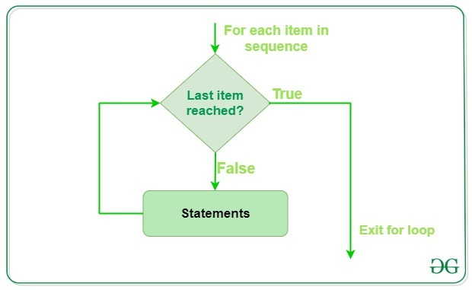
for

Slide 39
for
>> print("List Iteration")
>> list1 = [“hello", “world”]
>> for i in list1:
print(i)
>> for i in range(0,10,1):
print(i)
>> for letter in ‘predictiveanalytics': if letter == 'e' or letter == 's': continue print('Current Letter :', letter)

Slide 40
for loop -- Example
Given a list l1= [1,2,3,4,5,6,7,8,9,10], print only the even numbers using a for loop.

Slide 41
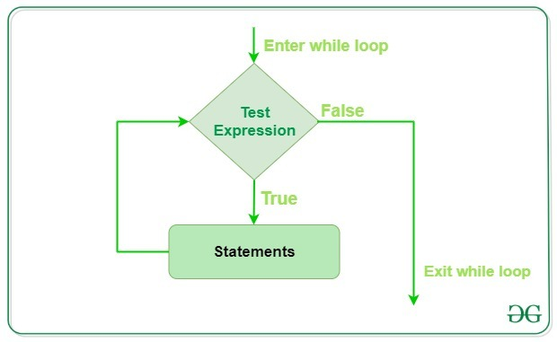
while

Slide 42
while
>> count = 0
>> while (count < 3):
count = count + 1
print("Hello world!")

Slide 43
While
>> i = 0
>> a = ‘predictiveanalytics'
>> while i < len(a):
if a[i] == 'e' or a[i] == 's': i += 1 continue
print('Current Letter :', a[i]) i += 1

Slide 44
while loop – Example
Given a list l1= [1,2,3,4,5,6,7,8,9,10], print only the odd numbers using a while loop.

Slide 45
Conditionals

Slide 46
if-else-if
>> num1 = 4
>> if(num1%2 == 0):
print("Num1 is even")
>> elif(num1%2==1):
print("Num1 is odd")
>> else:
print(“It never comes to this section")

Slide 47
Functions

Slide 48
Functions
Set of statements that take inputs and perform certain computations
>> def FindEven( x ):
if (x % 2 == 0): print "even" else: print "odd"
>> FindEven (2)
>> FindEven (3)

Slide 49
Lambda Functions – Anonymous functions
lambda arguments: expression
>> def cube(y): return y*y*y; >> g = lambda x: x*x*x
>> print(g(7)) >> print(cube(5))

Slide 50
Example – Intersection of 2 lists
>> def ArrIntersect(a1, a2): result = list(filter(lambda x: x in arr1, arr2)) print ("Intersection : ",result)
>> arr1 = [1, 3, 4, 5, 7] >> arr2 = [2, 3, 5, 6]
>> ArrIntersect (arr1,arr2)
Notes:
filter() function in Python takes in a function and a list as arguments

Slide 51
Functions examples
Write a function Square that takes an integer argument and outputs the square value of this argument. For example, if the input is 3, output should be 9.
y = 8 z = lambda x : x * y print z(6)
Notes:
lambdas are concise functions and thus, result = 6 * 8

Slide 52
Revising all the concepts – Exercises
Given a list of keywords, create a dictionary of the keywords and their frequencies as the values in an ascending order of the frequencies.
Input: Keywords = [‘hello’, ‘I’, ‘am’, ‘fine’, ‘but’, ‘fine’, ‘is’, ‘fine’, ’hello’, ‘to’, ‘you’, ‘fine’]
Dictionary: {‘hello’: 2, ‘I’:1, ‘am’:1, ‘fine’:4, ‘but’:1, ‘is’:1, ‘to’:1, ‘you’:1 }
Sorted dictionary: { ‘I’:1, ‘am’:1, ‘but’:1, ‘is’:1, ‘to’:1, ‘you’:1‘, hello’: 2, ‘fine’:4}

Slide 53
Write a code to split a list into a list of lists of size 3. l1 = [‘hello’, ‘hi’, ’hey’, ‘howdy’, ‘hola’, ‘greetings’, ‘bonjour’, ‘good day’, ‘welcome’]
→ [[‘hello’, ‘hi’, ’hey’], [‘howdy’, ‘hola’, ‘greetings’], [‘bonjour’, ‘good day’, ‘welcome’]]

Slide 54
Packages
3 different packages that we will use in this class

Slide 55
Packages – Pandas
Data handling

Slide 56
Data Frame
>> import pandas as pd
# list of strings >> lst = [‘I’, ‘am’, ‘excited’, ‘for’, ‘the’, ‘spring’, ‘semester’]
# Calling DataFrame constructor on list >> df = pd.DataFrame(lst) >> print(df)

Slide 57
Packages – Numpy
Numerical computations

Slide 58
Packages – Seaborn
Visualizations

