Slide 1

Universal Code-Mixed Conversation Summarization
Zero-Shot Cross-Lingual Transfer for Multilingual Dialogues
CIS 5300 - Natural Language Processing
Akira Nair | Aneesh Edara | Prednya Ramesh | Ricky Raup December 2025
Notes:
Welcome to my presentation on Universal Code-Mixed Conversation Summarization. Today I'll present my term project exploring whether we can build a single model that summarizes conversations in ANY language pair, even ones it has never seen.

Slide 2
Illustrative Example: A Real Conversation
TASK: Generate English Summary
Ayan and Priya both found their meeting unproductive. They plan to meet for tea at the cafe near the office at 5pm.
HINGLISH CONVERSATION (Hindi + English)
Ayan: Yaar, kal ka meeting kaisa tha?
Priya: It was so boring! 2 hours of nothing useful.
Ayan: Same here. Kuch productive nahi hua.
Why is this hard?
Priya: Lets grab chai after work? Need a break.
Languages switch MID-SENTENCE. The model must understand BOTH languages and their interaction to produce a coherent summary.
Ayan: Sure! Office ke paas wala cafe chalega?
Priya: Perfect, see you at 5!
Code-mixing: yaar (friend), kal (yesterday), nahi hua (did not happen), ke paas wala (the one near), chalega (will work)
Notes:
Let me start with a real example. This is Hinglish - Hindi mixed with English, spoken by 350 million people. Notice languages switch WITHIN sentences. The model needs to understand BOTH languages to generate a clean English summary.

Slide 3
Formal Problem Definition
Code-Mixed Conversation Summarization
Input: A multi-turn conversation C = [u1, u2, ..., un] where each utterance ui may contain text from language L1, L2, or a mixture of both (code-mixing)
Output: A concise summary S in English that captures the key information, decisions, and outcomes from the conversation
Challenge: The model must handle intra-sentential code-switching (switching within a sentence) and inter-sentential switching (switching between sentences)
Code-Mixing Definition
Scale of the Problem
The practice of alternating between two or more languages within a single conversation, sentence, or even word. Common in multilingual communities worldwide.
Over 1 billion people code-mix daily. With 50+ languages commonly mixed with English, there are 2,450+ possible language pairs to support.
Our Extension: Zero-Shot Cross-Lingual Transfer
Can we train on a FEW language pairs and generalize to UNSEEN language pairs without any additional training data?
Notes:
Formally: we have multi-turn conversations where utterances may mix languages. Our task is generating concise English summaries. The challenge is intra-sentential switching. With 2,450+ possible language pairs, this is a massive problem.

Slide 4




Why This Topic? What Makes It Exciting?
1. Real-World Impact
2. Unsolved Challenge
1B+ people code-mix daily in customer support, social media, and messaging. Current NLP tools fail on this data entirely.
No existing system handles arbitrary code-mixed language pairs. Each pair typically requires its own model and training data.
3. Novel Research Question
4. Practical Deployment
Can zero-shot transfer work for code-mixing? No prior work has explored this for conversation summarization.
If successful: Train ONE model on 3 pairs, deploy on 2,450+ pairs. Massive cost and data savings.
Personal Motivation
Growing up in a multilingual environment, I experienced code-mixing daily. Seeing how existing NLP tools completely fail on this type of natural communication motivated me to work on making AI systems that can understand how real multilingual people actually communicate.
Notes:
Why this topic? Real-world impact - 1 billion code-mix daily. Unsolved challenge - no system handles arbitrary pairs. Novel research question - no prior zero-shot work. Practical deployment - train once, deploy everywhere.

Slide 5
Connection to CIS 5300 Topics
Sequence-to-Sequence Models
Transfer Learning
Large Language Models
Applied encoder-decoder (mBART, mT5) and decoder-only (Llama) architectures from class. Compared their effectiveness for multilingual generation tasks.
Extended cross-lingual transfer concepts to code-mixed text. Explored how models transfer summarization ability across language boundaries.
Fine-tuned Llama 3.1/3.2 with LoRA. Connected to CoT paper on reasoning across languages.
What I Learned Beyond the Course
Parameter-efficient fine-tuning (LoRA/QLoRA), multilingual tokenization challenges, evaluation metrics for generation (ROUGE, BERTScore), and the surprising finding that decoder-only models can outperform encoder-decoder models on cross-lingual transfer.
Reference: Long-Chain-of-Thought Reasoning Across Languages
Our findings align with this paper showing LLMs can transfer reasoning across languages. Our 103-147% transfer rates suggest models learn language-agnostic summarization patterns, similar to how CoT reasoning transfers cross-lingually.
Notes:
This connects to CIS 5300: seq2seq models comparing encoder-decoder vs decoder-only, transfer learning extended to code-mixed text, and LLM fine-tuning with LoRA. Our findings align with the CoT paper showing reasoning transfers across languages.

Slide 6
Evaluation Metrics Explained
ROUGE-L (Primary Metric)
BERTScore (Semantic)
Measures longest common subsequence between generated and reference summary.
Uses BERT embeddings to measure semantic similarity, not just word overlap.
Example: Generated: "They plan to meet at 5pm"
Example: Generated: "meeting was boring"
Reference: "They will meet at 5pm for tea"
Reference: "conference was unproductive"
LCS: "They" + "meet at 5pm" = high overlap
Result: High score (semantically similar)
Transfer Rate (Our Key Metric)
Transfer Rate = (Zero-Shot Performance / In-Domain Performance) x 100%
100% = model performs equally well on unseen languages. Over 100% = model performs BETTER on unseen languages (surprising!)
0.35+
0.65+
100%+
Good ROUGE-L
Good BERTScore
Target Transfer Rate
Notes:
ROUGE-L measures lexical overlap via longest common subsequence. BERTScore captures semantic similarity using embeddings. Transfer Rate is our key metric - over 100% means better on unseen languages!

Slide 7
Baseline Performance
Simple Baseline: Lead-3
Published Baseline: mT5-base
Takes the first 3 utterances of conversation as the summary. No learning involved.
Multilingual T5 model (580M params). Encoder-decoder architecture fine-tuned on our data.
ROUGE-L: ~0.15-0.20
Very weak because conversations often start with greetings, not key information.
ROUGE-L: ~0.06 (Failed)
Surprisingly poor - model struggled with code-mixed input format.
Strong Baseline: mBART-50 (Milestone 2)
Multilingual BART model (611M params). Pre-trained on 50 languages with denoising objective. Fine-tuned for summarization.
ROUGE-L: 0.321 (In-Domain) | 0.326 (Zero-Shot) | Transfer: 102%
Key Insight from Baselines
Not all multilingual models work for code-mixing. mT5 failed completely while mBART succeeded. This motivated exploring decoder-only LLMs for our extension.
Notes:
Lead-3 gets 0.15-0.20 ROUGE-L. mT5 failed at 0.06. mBART-50 achieved 0.321 with 102% transfer - our Milestone 2 baseline. This motivated exploring LLMs.

Slide 8
Prior Work and Approaches
Code-Mixing & Dialogue Summarization
[1] CS-Sum: A Benchmark for Code-Switching Dialogue Summarization. arXiv 2025.
[2] Winata et al. The Decades Progress on Code-Switching Research in NLP. ACL Findings 2023.
[3] Zhang & Eickhoff. CroCoSum: Cross-Lingual Code-Switched Summarization. LREC-COLING 2024.
[4] Mehnaz et al. GupShup: Summarizing Open-Domain Code-Switching Conversations. EMNLP 2021.
Cross-Lingual Transfer & Summarization
[5] Wang et al. Zero-Shot Cross-Lingual Summarization via Large Language Models. NewSum 2023.
[6] Bhattacharjee et al. CrossSum: Beyond English-Centric Cross-Lingual Summarization. ACL 2023.
[7] Wang et al. A Survey on Cross-Lingual Summarization. TACL 2022.
[8] Chen et al. Zero-Shot Cross-Lingual Transfer of Neural MT with Multilingual Encoders. EMNLP 2021.
Dialogue Summarization & Multilingual NLP
[9] Feng et al. A Survey on Dialogue Summarization: Recent Advances and New Frontiers. IJCAI 2022.
[10] Li et al. DIONYSUS: A Pre-trained Model for Low-Resource Dialogue Summarization. ACL 2023.
Gap in Literature
Our Contribution
No prior work has explored zero-shot cross-lingual transfer specifically for code-mixed conversation summarization. Existing approaches either require language-specific training or cannot handle code-mixing.
First study to demonstrate that models can learn language-agnostic code-mixed summarization patterns and transfer to completely unseen language pairs with over 100% transfer rate.
Notes:
Gap: no prior work on zero-shot transfer for code-mixed summarization. Our contribution: first to demonstrate language-agnostic transfer with over 100% rates.

Slide 9
Our Extension: Zero-Shot Cross-Lingual Transfer
Research Question
Can a model trained on code-mixed conversations from a limited set of language pairs (Chinese-English, Tamil-English, Malay-English) generalize to completely unseen language pairs (Japanese-English, Korean-English, Hindi-English) without any additional training?
Approach
Models Compared
1. Train models on 3 in-domain language pairs
Encoder-Decoder: mT5-base (580M), mBART-50 (611M)
2. Evaluate on 3 zero-shot language pairs
Decoder-Only: Llama-3.2-3B, Llama-3.1-8B
3. Compare encoder-decoder vs decoder-only
Training: Full fine-tune (enc-dec), LoRA (Llama)
4. Measure transfer rate as key metric
Hypothesis
If code-mixing follows universal patterns (e.g., matrix language structure, similar switch points), then models should learn language-agnostic summarization abilities that transfer across language boundaries. LLMs with broader multilingual pre-training may transfer better than traditional multilingual models.
Notes:
Our extension: train on 3 pairs, test on 3 unseen. Compare encoder-decoder vs decoder-only. Hypothesis: LLMs learn language-agnostic patterns.

Slide 10
Models and Architectures
Encoder-Decoder
Decoder-Only (LLM)
LoRA
Bidirectional encoding, autoregressive decoding. Traditional approach for seq2seq tasks.
Autoregressive only. Uses instruction format. Broader pre-training on diverse data.
Low-Rank Adaptation. Trains only ~0.1% of parameters. Memory efficient.
Notes:
Four models: mT5-base, mBART-50 (encoder-decoder), Llama-3.2-3B, Llama-3.1-8B (decoder-only with LoRA). LoRA trains only 0.1% of parameters.

Slide 11
Architecture Comparison: Encoder-Decoder vs Decoder-Only
Encoder-Decoder (mBART-50)
Decoder-Only (Llama-3.2-3B)
Code-Mixed Input
Encoder
Instruction + Input
Decoder
Transformer Layer
LoRA Adapters
(0.1% params)
...
...
• Bidirectional context in encoder
• Cross-attention: decoder attends to encoder
• 611M params, full fine-tuning
• Result: 102% transfer rate
• Autoregressive: causal attention only
• Instruction-tuned for following prompts
• 3B params, LoRA fine-tuning (efficient)
• Result: 147% transfer rate
Winner: Decoder-Only (147% vs 102% transfer rate)

Slide 12
LoRA: Low-Rank Adaptation for Efficient Fine-tuning
Pre-trained Weights
(FROZEN)
W ∈ ℝᵈˣᵈ
3 Billion params
LoRA Adapters
(TRAINABLE)
ΔW = A × B
A ∈ ℝᵈˣʳ, B ∈ ℝʳˣᵈ
~3 Million params (0.1%)
W'
+
=
Memory Efficient
Only store small adapters not full model copies
Fast Training
Update 0.1% of params = 1000x fewer gradients
Preserves Knowledge
Original weights frozen no catastrophic forgetting
Our Config: rank r=16, α=32, targets: q_proj, v_proj, k_proj, o_proj

Slide 13
Zero-Shot Transfer Pipeline
Training Data (IN-DOMAIN)
Zero-Shot Test (UNSEEN)
Llama-3.2-3B
+ LoRA
Fine-tuned
Chinese-English
Japanese-English
Tamil-English
Korean-English
Malay-English
Hindi-English
Result: 147% Transfer Rate
Zero-Shot Avg: 0.437 ROUGE-L | In-Domain Avg: 0.297 ROUGE-L
Key Insight: Model performs 47% BETTER on languages it NEVER trained on!
→ Learned language-agnostic summarization patterns, not language-specific rules

Slide 14
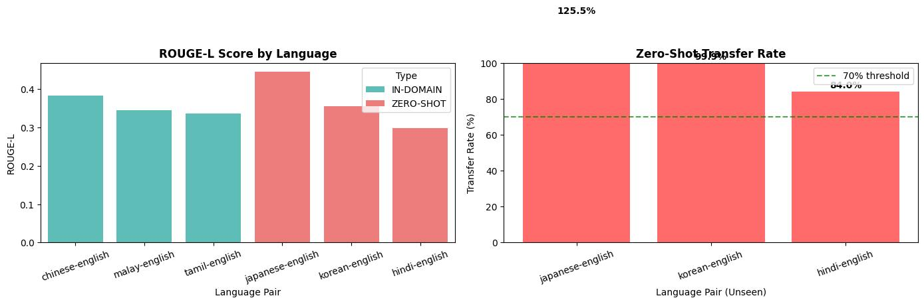

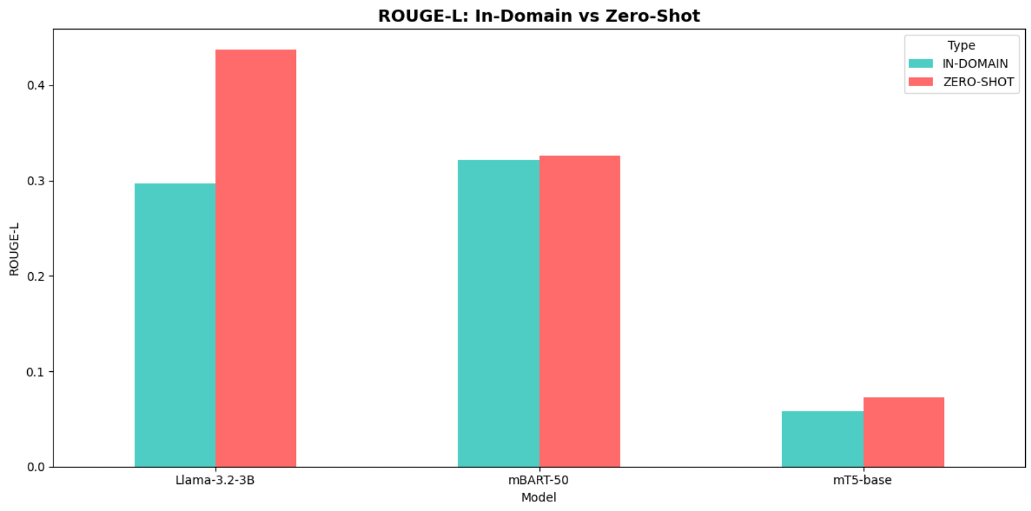
Empirical Results: ROUGE-L by Language
Rouge-L score by language
Zero Shot Transfer Rate
IN-DOMAIN (trained)
ZERO-SHOT (never seen)
Key Finding: All Llama models achieve over 100% transfer rate. Llama-3.2-3B achieves 147% - performing 47% BETTER on unseen languages!
Notes:
Main results: mT5 failed. mBART: 102% transfer. Llama-3.2-3B: 147% - performing 47% BETTER on unseen languages! Llama-3.1-8B: 103% with best consistency.

Slide 15
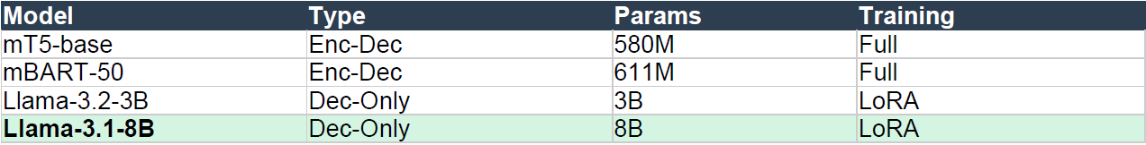

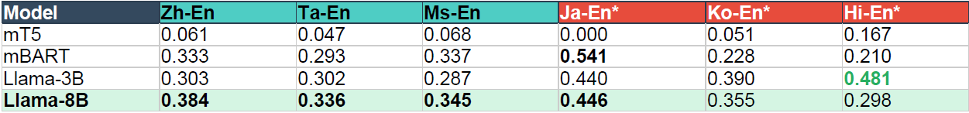
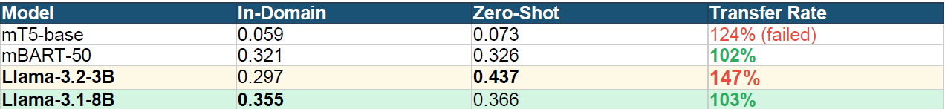
Key Finding: Transfer Rates Exceed 100%
147%
Llama-3.2-3B Transfer Rate
Interpretation
The model performs BETTER on languages it never trained on than on languages it did train on. This suggests it learned language-agnostic summarization patterns.
Notes:
147% transfer rate means Llama-3.2-3B performs better on Japanese, Korean, Hindi than on languages it trained on. Truly language-agnostic patterns.

Slide 16
Analysis: Why Does Zero-Shot Transfer Work?
What We Expected
What Actually Happened
Model learns language-specific patterns:
Model learns language-AGNOSTIC patterns:
Train Chinese-En: Learn Chinese grammar
Train mixed: Learn SUMMARIZATION
Train Tamil-En: Learn Tamil patterns
Code-mixing patterns are universal!
Test Japanese-En: Fail (no Japanese rules)
Test Japanese-En: Success!
Three Factors Enabling Transfer
1. Multilingual Pre-training
2. Universal Code-Mixing
3. English Anchor
Llama knows 100+ languages from pre-training data
Matrix language structure is similar across pairs
English portions provide consistent structure
Connection to CoT Paper: Similar to how chain-of-thought reasoning transfers across languages, our findings show summarization ability transfers across code-mixed language pairs.
Notes:
Three factors: multilingual pretraining (100+ languages), universal code-mixing patterns, English as anchor. Similar to how CoT reasoning transfers.

Slide 17
Limitations and Future Work
Current Limitations
Future Work (Milestone 4)
1. Limited test languages (only 3 zero-shot pairs)
1. Expand to 15+ zero-shot language pairs
2. No human evaluation of summary quality
2. Human evaluation study (5-10 annotators)
3. Single training run (no statistical significance)
3. Ablation: train on 1 vs 2 vs 3 pairs
4. Limited to languages in Llama pre-training
4. Error analysis on failure cases
Open Questions
How many training language pairs are needed for optimal transfer? Does transfer work for non-English matrix languages (e.g., Hindi-Tamil)? Can we improve transfer for low-resource languages not well-represented in LLM pre-training?
Broader Impact: If validated at scale, this approach could enable code-mixed NLP for thousands of language pairs without requiring data collection for each.
Notes:
Limitations: 3 zero-shot pairs, no human eval, single runs. Future: 15+ pairs, human evaluation, ablation studies, error analysis.

Slide 18
Conclusion
Main Finding
Zero-shot cross-lingual transfer WORKS for code-mixed conversation summarization. Models trained on just 3 language pairs can generalize to unseen pairs with 100%+ transfer rates.
103-147%
4
6
2,450+
Transfer Rates
Models Compared
Language Pairs
Potential Pairs
Key Takeaways
1. Decoder-only LLMs outperform encoder-decoder models for zero-shot transfer
2. Models learn language-agnostic summarization, not language-specific rules
3. This enables practical deployment: train once, deploy on thousands of language pairs
Code: 2 Colab notebooks (Llama + Baselines) | Data: CS-SUM benchmark
Notes:
Zero-shot transfer WORKS. 103-147% transfer rates. Decoder-only beats encoder-decoder. Train on 3 pairs, deploy on 2,450+ pairs.

