Slide 1

PredSea
The AI First Mate that knows the sea before you leave the dock.
Conversational AI & High-Resolution Marine Intelligence for the Western Mediterranean
Seed Round · Palma de Mallorca · July 2026
Prepared for Invision Club Deal

Slide 2
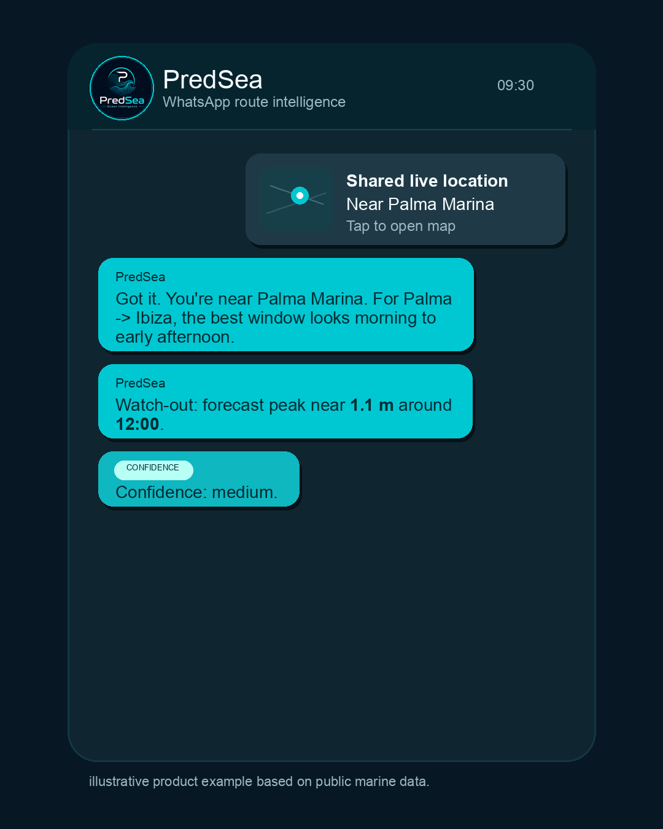
PROBLEM → SOLUTION
Captains need an answer, not more data.
THE PROBLEM
App fatigue. Multiple weather consoles and tide charts, just to reach one go/no-go decision.
Coarse models. ~25km global grids miss the nearshore physics that actually change a passage.
THE SOLUTION
Zero friction. A phone number replaces an app — no install, no account.
Reasoning, not telemetry. A direct recommendation against your vessel's own safety envelope.
Fleet mode. One query briefs an entire charter fleet — which boat should delay, and why.
PredSea · Seed Round · Confidential
2

Slide 3
TECHNOLOGY
A real physics stack, built to be independent.
Four layers, each independently upgradeable — no single third-party dependency the whole product relies on.
01
02
03
04
Atmospheric model — WRF
Ocean & wave model — PredSea 1km
Live observational correction
AI reasoning layer
Own-compiled WRF, nested to 3km over the Western Med, run daily on GCP Spot VMs. Genuinely ours, not a repackaged feed.
Our own-compiled coupled wave & current solver (SWAN, CROCO, NEMO), run daily at 1km resolution over the Western Med — fully in-house, replacing third-party regional licensing.
Hourly bias-checking against SOCIB buoys, coastal radar, gliders and Puertos del Estado gauges.
A custom, in-house agent turns natural language into spatial-temporal queries and replies in captain-grade language.
Every layer is fully owned and operated in-house — no single third-party model dependency. Next: continuous accuracy benchmarking against SOCIB and Puertos del Estado buoys as the fleet scales.
3

Slide 4
MARKET OPPORTUNITY
A basin we can already map, hull by hull.
TAM
SAM
SOM
Global marine nav & weather software
Western Med charter & coastal-commercial users
Charter fleets, skippers & sailing schools
~$1.2B → ~$2.5B by early 2030s
Spain · France · Italy — Gibraltar Strait to Sicily
Across the Western Med
Directional industry estimate
Current modelling & registry coverage
Live pilot beachhead
Charted Western Med infrastructure (our own registry)
Geographic split — 2,955 destinations
PredSea · Seed Round · Confidential
4

Slide 5
BUSINESS MODEL
Two paying markets — B2C captains, B2B fleets.
Co-Captain
B2C
Fleet & Enterprise
B2B
€49
Custom
/ vessel / month
fleet / enterprise pricing
Individual captains & yacht owners
Hourly high-res forecast, 5-day horizon
WhatsApp daily brief + hazard alerts
Vessel-specific comfort profiles
Charter fleet operators & yacht managers
Centralized multi-vessel console
Fuel-waste & pathing audits
Priority onboarding & support
High-margin secondary streams
Developer API (marine hardware makers) · Event & regatta forecasts · Data & forecast licensing (insurers, ports, research)
PredSea · Seed Round · Confidential
5

Slide 6
GO-TO-MARKET
Charter fleets first, distributed through the show circuit.
Charter fleet managers. One relationship lands 15-40 vessels at once. 25+ years of Med captaincy gives direct, warm access.
Product-led distribution. A phone number replaces an app-store funnel — lower CAC, organic word-of-mouth.
Non-dilutive tracks. Horizon Europe, CDTI, ESA BIC Spain and ENISA (Spain) run alongside the raise to extend runway.
2026 Boat show circuit
Year 1: attend only · Year 2+: exhibit via Balearic Marine Cluster / yachting-venture partnerships
SEP
Monaco Yacht Show
Monaco
OCT
Barcelona Boat Show
Spain
OCT
METSTRADE
Netherlands
OCT
Genoa Int'l Boat Show
Italy
NOV
Fort Lauderdale Show
USA
LONG-TERM VISION
The Western Med is the beachhead, not the ceiling: our pilot already spans Gibraltar Strait to Sicily; further basins (Canary Islands, North Sea, a counter-seasonal Caribbean) follow once this basin's coverage and metrics are proven.
PredSea · Seed Round · Confidential
6

Slide 7
TRACTION
Past the build phase — live in a real pilot.
✓
Live pilot with an initial cohort of yacht captains across the Western Med, delivered end-to-end on WhatsApp.
✓
Live hazards endpoint merging official AEMET alerts with statistical anomaly detection.
✓
Daily automated WRF regional model runs on GCP Spot VMs, feeding a production FastAPI service.
✓
Institutional data partnership with SOCIB — deep-sea buoy, coastal radar and glider telemetry.
✓
Fully separated, IAM-isolated test and production environments with a documented deploy/rollback process.
✓
Own-compiled SWAN / CROCO / NEMO wave-and-current solver, run daily at 1km resolution over the Western Med.
PredSea · Seed Round · Confidential
7

Slide 8
COMPETITIVE LANDSCAPE
Not a better map — a different delivery model.
Dimension
Global incumbents
PredSea
Onboarding
App download, account setup, logins
Zero — start chatting on WhatsApp
Experience
Complex dashboards; captain interprets raw layers
AI-driven briefing with a direct recommendation
Forecast source
Repackaged global models (~25km grids)
Own WRF (3km) + own 1km wave/current model + live buoy calibration
Validation
No real-time bias correction disclosed
Hourly bias pipeline; own solver validation is a near-term milestone
Distribution
Paid app-install marketing, high drop-off
Word-of-mouth inside captain & fleet networks
PredSea · Seed Round · Confidential
8

Slide 9
TEAM
Four founders. One signed agreement.
CS
KW
MB
GW
Charles Santana
Kobus Wentzel
Matt Bullamore
Graham Wilkinson
Co-Founder & Technical Lead
Co-Founder & Software / AI
Co-Founder & Product / Marketing
Co-Founder & Maritime Advisor
PhD in climate/oceanography. Designs the coupled models, data pipelines and API stack. Previously co-founded Kultrip.
Leads software engineering and AI architecture, including conversational-platform integration and routing.
Leads product and the conversational infrastructure behind WhatsApp; drives AI-leveraged acquisition.
25+ years as a professional superyacht captain across the Western Med. Key charter-network relationships.
Equal 25% equity in PredSea and in the founders' separate Consultancy practice under a signed Founders' Memorandum of Agreement, IP assigned to the Company with one disclosed carve-out — formal incorporation in progress.
PredSea · Seed Round · Confidential
9

Slide 10
FINANCIAL PROJECTIONS
Beachhead to regional scale in three years.
Target growth plan, not measured traction. See Business Plan §7.5/§13.2/§13.2b.
Metric
Year 1
Year 2
Year 3
Contracted vessels (year-end)
100
1,050
5,200
Exit ARR (year-end vessels × €49 × 12)
€58,800
€617,400
€3,057,600
PredSea billed revenue (in-year)
€20,874
€282,240
€1,587,600
Consultancy revenue
€22,500
€60,000
€90,000
Total billed revenue
€43,374
€342,240
€1,677,600
Operating costs
€316,000
€386,000
€640,400
EBITDA
(€272,626)
(€43,760)
€1,037,200
Exit ARR ÷ operating costs
0.19x
1.60x
4.77x
€49/vessel/month held flat · 85%+ B2B SaaS gross margin target on PredSea revenue. Consultancy revenue is separate client work from the founders' Consultancy practice, unrelated to PredSea's SaaS product, and is not SaaS-multiple-eligible — shown separately for transparency.
PredSea · Seed Round · Confidential
10

Slide 11
THE ASK & EXIT
A scoped raise, built toward a strategic exit.
6-month scenario
12-month scenario
€158,000
€316,000
11.6% investor equity post-money
20.8% investor equity post-money
€1.2M pre-money · €1.358M post-money
€1.2M pre-money · €1.516M post-money
Use of funds: founder salaries, cloud compute, AI tooling, marketing and the boat-show circuit.
Targeting exit within 3.5–4 years
Marine hardware & electronics
Big tech & climate-tech platforms
Marine software & shipping
A turn-key conversational layer for commodity chartplotters.
A GCP-native regional environmental-intelligence feed.
Proprietary coastal wave/current modeling for fleet-management platforms.
PredSea · Seed Round · Confidential
11

Slide 12
Let's talk.
predsea.com
Charles Santana · Co-Founder & Technical Lead
charles@predsea.com
PredSea Systems · Est. 2025 · Palma de Mallorca · 39°34'N · 02°39'E

