Slide 1
Clojure
By-
Akash Raghavendra (G41868923)
Preeti Das (G46780640)
Vardh (G24531843)
Vivek Kanikanti (G49807161)
Yagnamithra Vallabhaneni (G47022483)

Slide 2
Names
Names in Clojure are symbols that can refer to values, functions, or other entities.
Can be declared inside namespaces, which are containers for grouping related code. Helps in organizing code and avoiding naming conflicts.

Slide 3
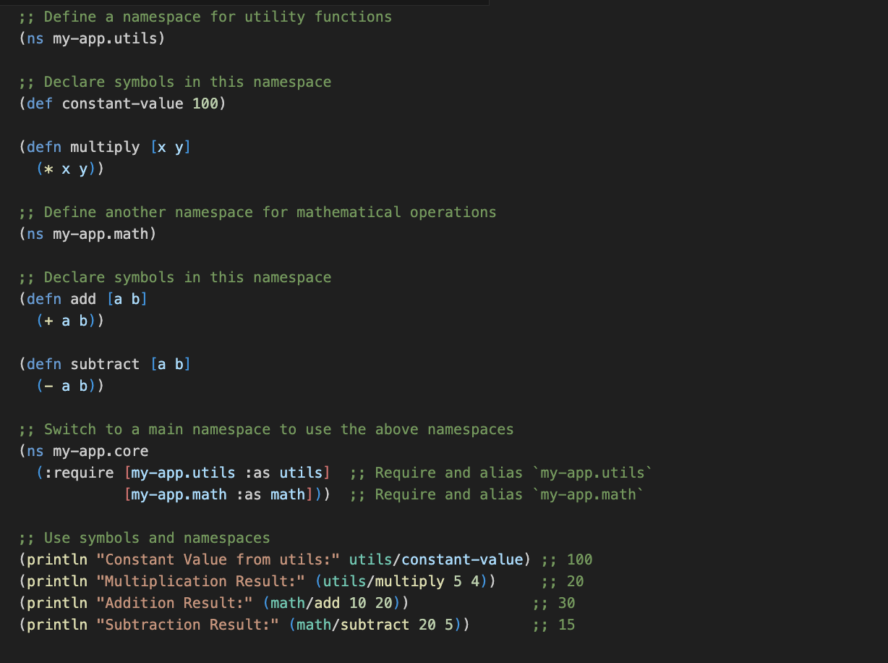
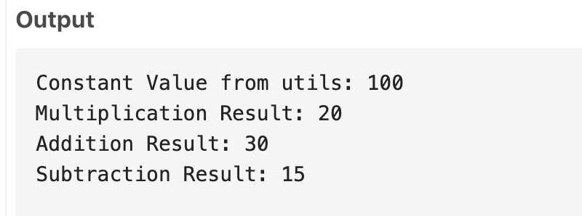
Example:

Slide 4
Binding
Process of associating a symbol with a value or function. Clojure supports 3 types of bindings:
Global - Throughout the program, use def to globally associate a symbol with a value or function.
Local - Uses let to create temporary associations that are only valid inside that block and have a restricted scope.
Dynamic (through metadata like ‘dynamic’ and the special form ‘binding’) - Temporarily overrides a global binding within a specific thread context using ^:dynamic and binding.
Notes:
Binding and Scopes go hand in hand. Binding is the process of associating a symbol with a value or function.
3 types: global usually defined through def
Variables and the values bonded can be accessed throughout the program.
Immutable by default but can be updated by using the def keyword again
Local – binds the variable to a value in a given block and can be only used within the block.
Dynamic – allows for temporary thread local bindings of global variables

Slide 5
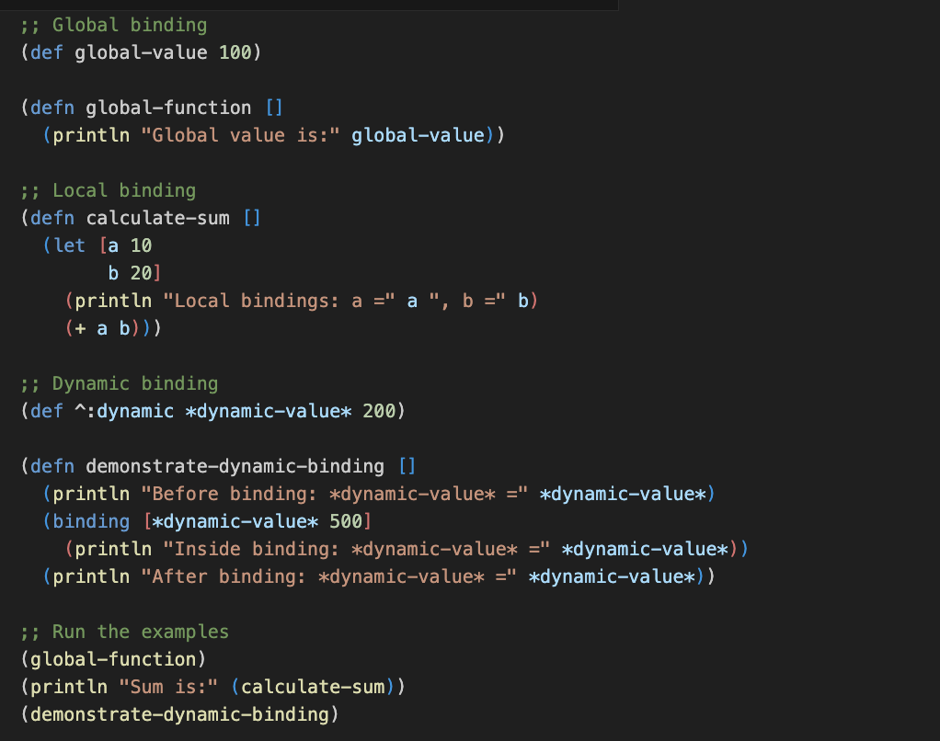
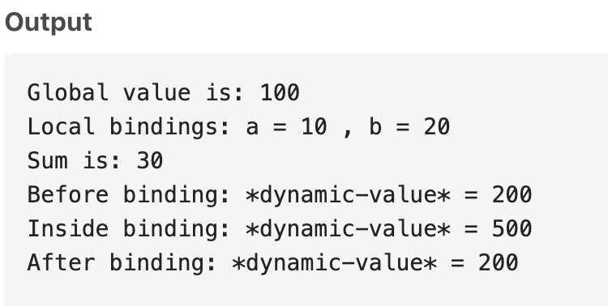
Example:

Slide 6
Scope
Defines where a binding is valid or accessible:
Lexical (also called static):The scope is determined at compile time based on the code structure and does not change during execution, ensuring predictable and consistent behavior.
Global:A binding is accessible throughout the entire namespace and can be used anywhere in the program unless shadowed by a local binding
Dynamic:A binding is temporarily valid during the execution of a specific block of code using binding.
Notes:
Clojure primarily uses lexical scope (also called static scope), which means that the scope of a variable is determined by the structure of the code (where it's defined) rather than by the program's runtime behavior. Variables defined in a let or as function arguments are only available in the block where they are defined.
Global scope refers to symbols that are bound globally using def. These are accessible throughout the entire program (in the current namespace) unless shadowed by local bindings.
Clojure also supports dynamic scope, where bindings can be temporarily overridden using binding. Dynamic scope is typically used with dynamic variables, which can be re-bound in a local context but revert to their original value afterward.

Slide 7
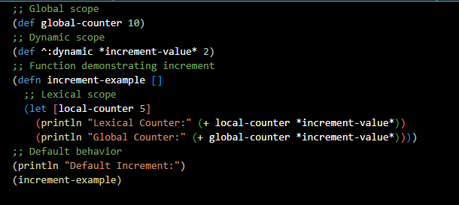
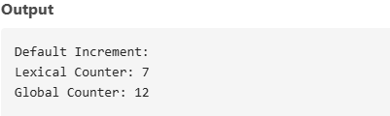
Example:

Slide 8
Expressions
Clojure expressions are the fundamental units of computation in the Clojure programming language, where every piece of code evaluates to a value, eliminating the distinction between statements and expressions found in other languages. As an expression-based language, Clojure employs prefix notation, with operators and functions preceding their arguments, and uses Lisp syntax to represent both code and data as lists. Clojure features a REPL (Read-Eval-Print Loop) for interactive coding, enabling real-time evaluation and testing of expressions.

Slide 9
Types of Clojure Expressions
Arithmetic Expressions – Performs mathematical operations like addition, subtraction, multiplication and division.
Function Expressions – Defines reusable blocks of logic that can accept arguments and return results.
Conditional Expressions – This enables decision-making constructs like if, cond, & case.
Logical Expressions – This performs Boolean expressions like and, or, and not.
Data Structure Expressions - Work with immutable data structures such as sets, maps, vectors, and lists in Clojure.
Looping and Recursion Expressions - Use features like loop, recur, and higher-order functions to manage iteration and recursive reasoning.
Let Expressions - For temporary scope, bind local variables inside a code block.
Macro Expressions - Allow code transformation and compile-time logic using user-defined macros

Slide 10
Clojure Assignment Statements
Clojure assignment statements are constructs for binding values to symbols in the Clojure programming language, emphasizing immutability. They utilize def for global variable definitions, allowing the creation of symbols that are bound to values. Local bindings are created with let, which provides temporary variables within a specific scope. Clojure also supports dynamic variables using binding, enabling temporary re-bindings. Overall, Clojure's design encourages immutability, making it necessary to use constructs like atom, ref, or agent for mutable state management.

Slide 11
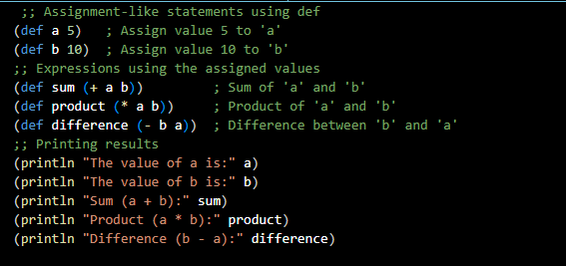
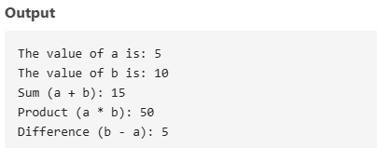
Example:

Slide 12
Data Types
The Data types present are numbers, characters, strings, keywords, symbols, lists, vectors, maps, sets, functions, nil.
Some features which help Clojure data types to stand out are -
Immutable Data Structure
Heterogenous collections
Functional Programming
Dynamic Typing
Promotes Lazy sequences

Slide 13
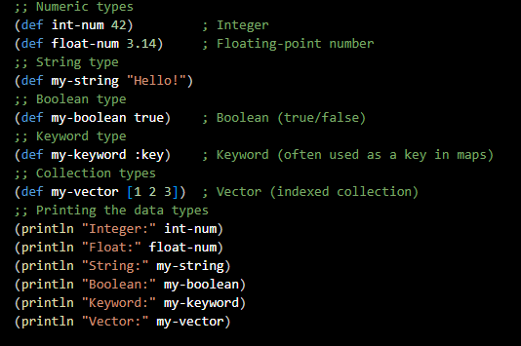
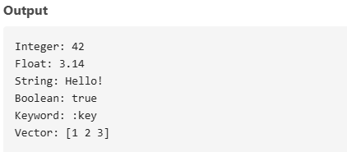
Example:

Slide 14
Support for OO Programming
Clojure is primarily considered as Functional Programming language , but it runs on the Java Virtual Machine (JVM) which allows it to interoperate with java, an OO Programming. It provides mechanisms that allow developers to incorporate OO principles when its necessary.
Features That shows Clojure Support to OO Programming-
1.Interoperability with Java
Clojure can instantiate and use java objects directly. It’s possible because clojure runs on the JVM and can call any Java method or interact with java libraries.

Slide 15
2.Protocols and Polymorphism
Clojure introduces protocols which are similar to interfaces in OO languages like Java.
3.Records for Encapsulation
Clojure supports records, which allow you to define data structures with fields and methods. It’s much like defining a class in OO programming.
4.Multimethods for Polymorphism
Clojure provides multi-methods, which are flexible way of achieving polymorphism.

Slide 16
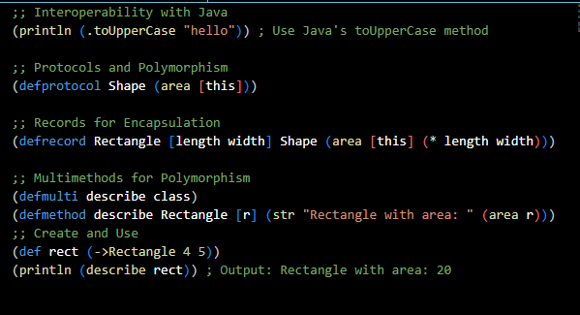
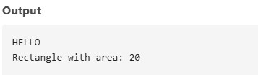
Example:

Slide 17
Functional Programming
Functional programming is a programming paradigm that uses functions to build programs.
Some features which make Clojure an excellent functional programming language are –
Rich set of higher order functions
First class functions
Seamless interoperability with JAVA
Homoiconicity

Slide 18
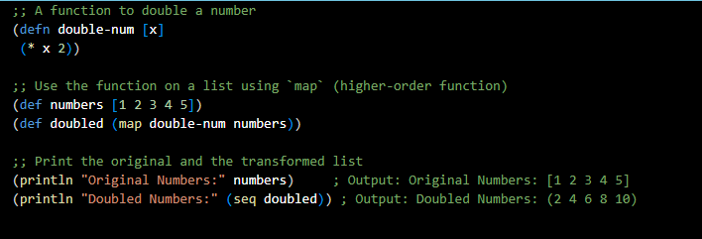
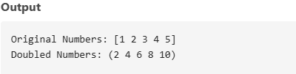
Example:

Slide 19
Concurrency
Concurrency (handling multiple tasks at once) in Clojure is achieved through four features provided by the language:
Atoms: For changing a single piece of data safely.
Refs: For coordinating changes to multiple things together.
Agents: For doing things in the background without waiting for them.
Futures: For running tasks that you don’t need right away but can check on later.
Notes:
Atoms are for situations where you want to change one piece of data safely, even when many parts of your program are trying to change it at the same time. When you use swap!, Clojure locks the atom temporarily so only one thread can update it. Other threads have to wait until the first one finishes, so there's no risk of them overwriting each other. In simple terms, swap! keeps changes to an atom safe.
Refs are for when you need to change several pieces of data together. Think of it like a "transaction" in a bank: either all changes happen, or none happen. This ensures everything stays in sync.
Agents are for tasks that don't need to happen right away. You tell an agent to do something, and it works on it in the background without making you wait.
A future is like asking someone to work on something, and then you check on it later. It runs a task in the background and you can get the result when it’s ready.

Slide 20
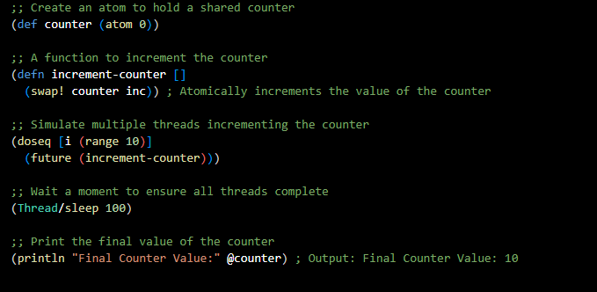

Example:

Slide 21
Exception Handling
Clojure uses Java’s system to handle errors:
try: The block where you put the code that might throw an error.
catch: This block catches and handles the error if it happens.
finally: Code that runs no matter what (whether there was an error or not), often for cleaning things up.
throw: You can use this to throw (create) a new error.
Notes:
When things go wrong in your code (like dividing by zero or calling a function incorrectly), Clojure uses Java’s system to handle errors. You can try to run some code and catch any errors that happen along the way.

Slide 22
Event Handling
For desktop apps, use Java libraries like Swing to respond to button clicks or other actions.
For web apps, ClojureScript (and re-frame) lets you handle events like button clicks, form submissions, etc.
Notes:
Clojure can use Java libraries for building user interfaces. For example, Java Swing is a toolkit for making windows, buttons, and other UI elements. You can use Swing to handle button clicks.
If you're building web apps, ClojureScript (which compiles to JavaScript) can handle browser events like button clicks or form submissions. Re-frame is a framework in ClojureScript that makes managing events and app state easy.

Slide 23
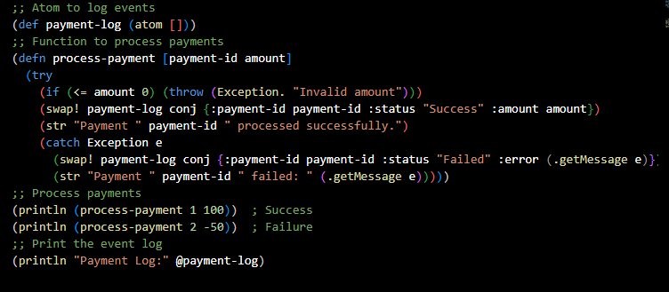
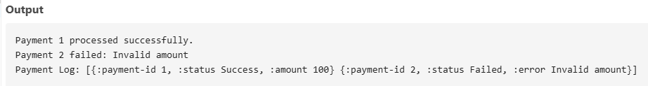
Example:

Slide 24
Real-World Applications
WALMART - used for backend services and data processing
NETFLIX – used in their recommendation engine and data processing pipelines
ADOBE – employs clojure in parts of its product offerings
TARGET – implements clojure in analytics and backend applications
CIRCLECI – used clojure in its CI/CD platform
METABASE – a popular BI tool built using clojure
FOURSQUARE – used clojure for real time processing of data

Slide 25
Project Title- Algorithm Visualizer

Slide 26
Objective
The objective of this project is to develop an interactive visualizer that vividly illustrates the inner workings of various computer science algorithms. By providing a dynamic and user-friendly interface, the visualizer will allow users to explore algorithms step by step, showcasing the calculations, transformations, and logic behind their operation in real time.
Each algorithm will be broken down into its fundamental components, enabling users to observe how inputs are processed, decisions are made, and outputs are generated. The tool aims to demystify complex concepts, making them accessible to learners, educators, and professionals alike. Through visual and interactive representation, users will gain deeper insights into algorithmic processes, fostering a more intuitive understanding of how these solutions are designed and applied in the real world.
This project aspires to be an invaluable resource for those seeking to enhance their grasp of algorithms, bridging the gap between theoretical knowledge and practical application.

Slide 27
Project Implementation
The working and visualization of each algorithm are defined in separate functions all encapsulated under one namespace.
The main function acts as a user interface consisting of function calls each referencing the respective algorithm.
When the project is executed the user is displayed a menu of various sorting, searching, and graph algorithms.
The user is then prompted to choose from one of the displayed algorithms.
Depending on the algorithm, the user inputs either an array of integers or a source node that is a character.
A visualization is shown displaying each step of the chosen algorithm in the terminal

Slide 28
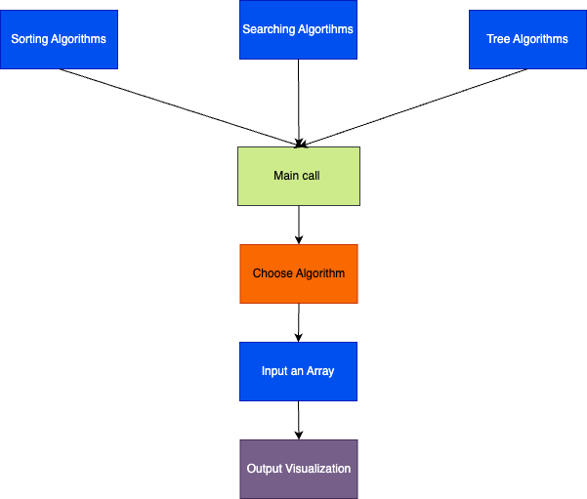
Project Structure

Slide 29
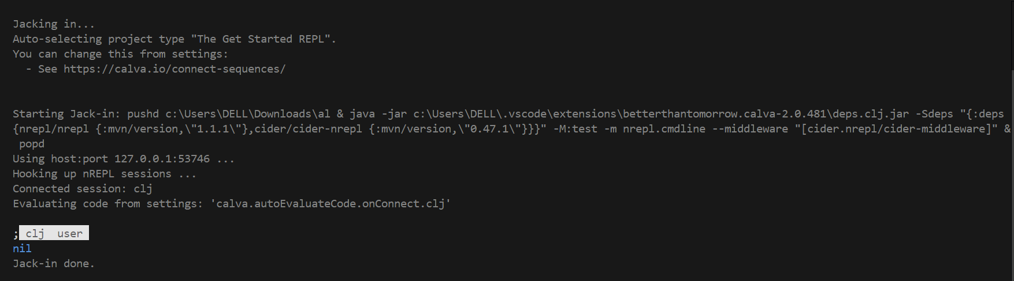
Project Implementation
Connecting to the REPL(Read-Eval-Print-Loop) Environment.

Slide 30
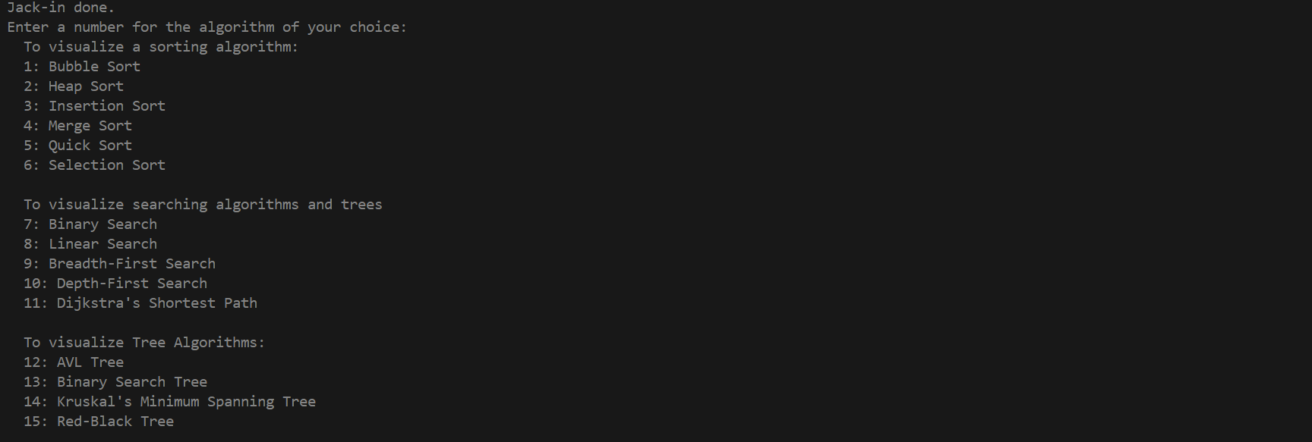
Project Implementation
Algorithm Visualizer Menu.

Slide 31
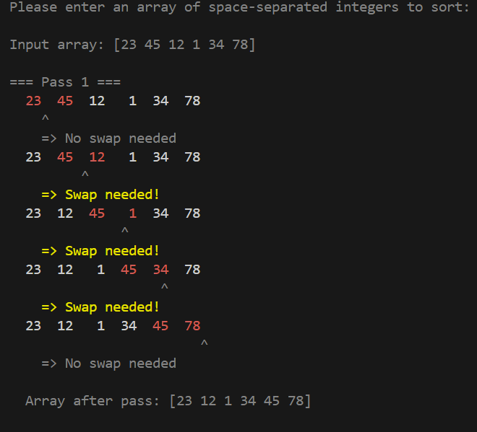
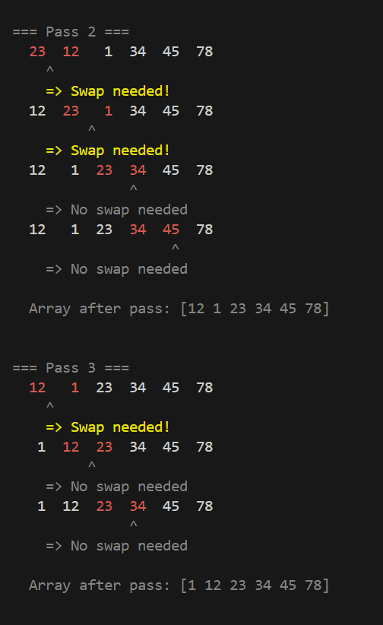
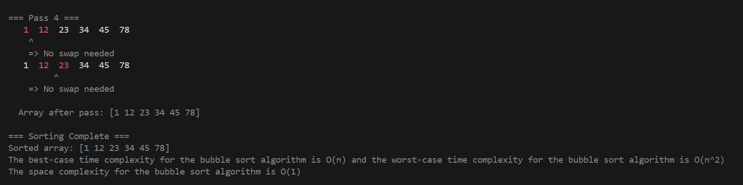
Project Implementation
Example visualization of an algorithm (Bubble Sort).

Slide 32
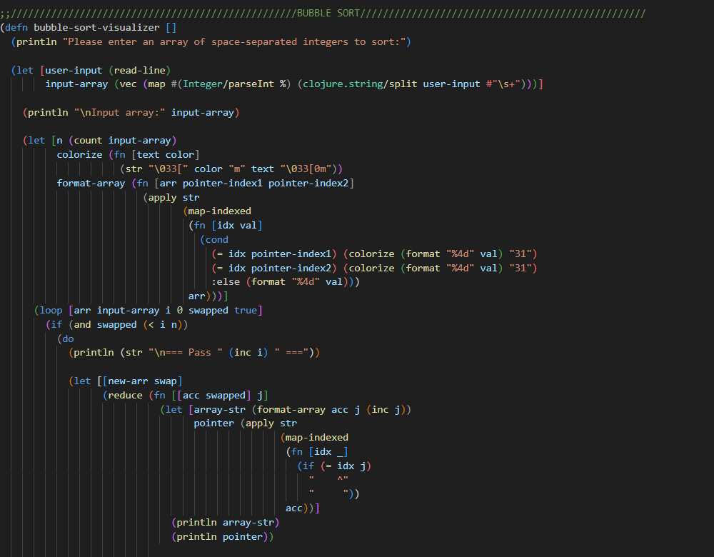
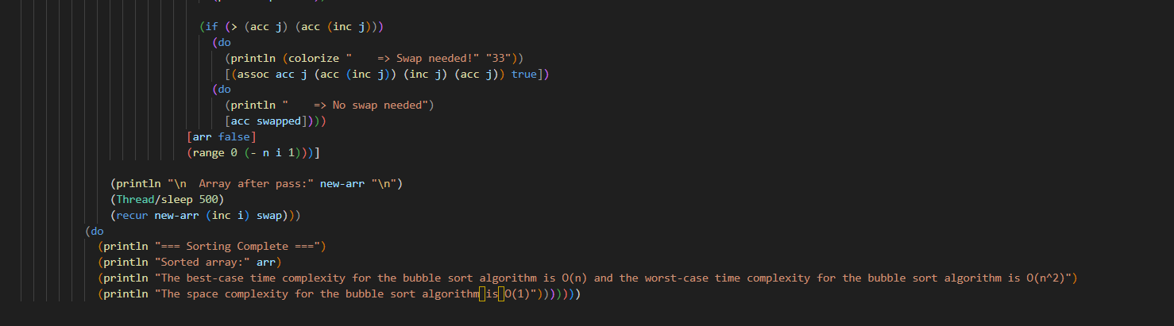
Project Implementation
Code snippet of the working algorithm defined in a function.

Slide 33
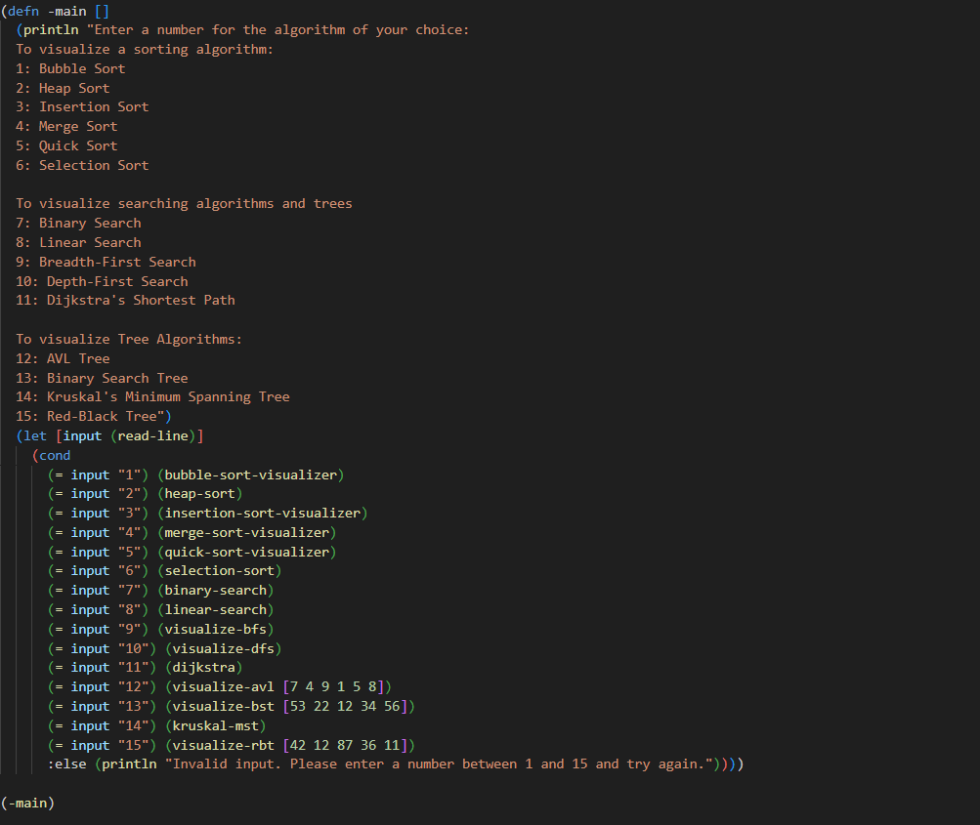
Project Implementation
Code snippet of the main function.

Slide 34
Features
Multiple Algorithm Visualizations: Shows the working of a variety of algorithms.
Step-by-Step Execution: Shows a detailed execution of each algorithm.
User Input Functionality: Allows the user to input an array of integers.
Dynamic Visualization: Displays a pointer depicting which part of the array is modified in each step.
Algorithm Complexity Analysis: Provides the best-case and the worst-case time complexity as well as the space complexity of the chosen algorithm.

Slide 35
Technology
Programming Language: Clojure, a modern dialect of Lisp, is used as the programming language for the Algorithm Analyzer. Its functional programming paradigm and focus on immutability make it a robust choice for computationally intensive tasks such as algorithm analysis.
Development Environment: The Algorithm Analyzer is developed in Visual Studio Code using the Calva extension, which provides a tailored environment for Clojure programming.
Output: The output of the Algorithm Analyzer is showcased in a terminal environment, reflecting a minimalist yet effective approach to presenting algorithm insights.

Slide 36
Constraints
Input Data: The algorithm takes only one type of input, an array of space-separated integers. Therefore, there is no flexibility when feeding data to the program.
Real-time Interaction: There is a lack of real-time interactability as each algorithm is implemented entirely and can’t be altered in between once the algorithm starts running.
Time Delays: Execution is delayed due to the integration of Clojure with the IDE.
Terminal-Based Visualization: There is a limit to the visualization capabilities because the terminal of the IDE is used to display the end product.

Slide 37
Project Applications
As an Educational Tool for Teaching: Visualizing algorithms like sorting, searching, or graph traversal helps students better understand the underlying processes. Improves engagement and retention by providing interactive, visual explanations of complex algorithms.
As an Algorithm Optimization and Debugging Tool: Developers can use an algorithm visualizer to simulate different algorithms on specific data sets, helping them identify inefficiencies or bugs in their implementations.
As a Data Structure Visualization Tool for Researchers: Visualize complex data structures (like trees, heaps, and graphs) in real-time, making it easier to understand how these structures behave under various conditions.

Slide 38
Data Structure Exploration: Allows users to visualize how algorithms interact with data structures such as arrays, stacks, queues, trees, and graphs.
Corporate Training Programs: Used in employee training to explain algorithmic logic and efficiency, helping professionals understand complex systems and improve problem-solving skills.

Slide 39
Project Github Repo- https://github.com/pree1609/CSCI_6221_Clojure

Slide 40
Thank You!

