Slide 1
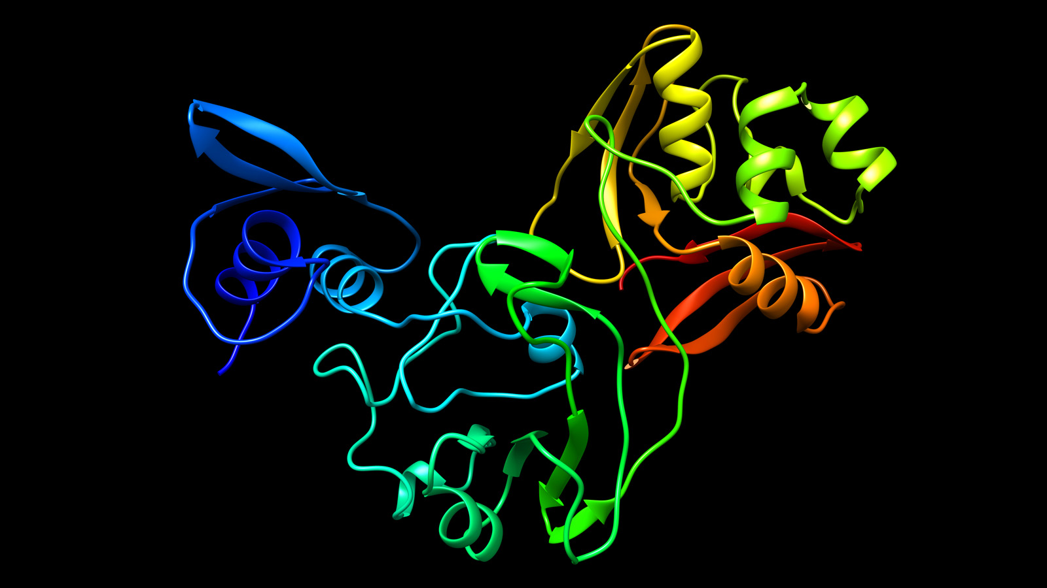
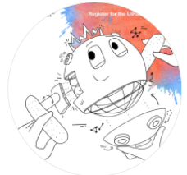
UiPath HyperHack 20.10 Product Release
Tiara : Chatbot for corona vaccine enrollment
#ConversationalRPA

Slide 2


Individual
Category 4: Chatbots
Dr. Preethi Harris
Sri Ramakrishna Engineering College
Problem Statement
A chatbot in combination with RPA for conversation-based vaccine enrollment of citizens

Slide 3
Problem Statement
A chatbot in combination with RPA for conversation-based citizen vaccine enrollment of citizens

Slide 4
Introduction
This pandemic continues to surge after having claimed approximately 3 million lives
To be successful in bringing the situation under control, vaccine for the citizens could be a solution
As the WHO statement, the goal of every country should be to immunize atleast 20% of their population by the end of 2021
However WHO has expressed deep concern of Corona vaccine unavailability to Health, Frontline workers and citizens with previous ailments
It is confirmed that the Corona vaccine dosage might exceed 1.5 Billion in India

Slide 5
Solution
Corona vaccine with promising results of trials for realistic solution to the deadly virus
Fostering structural reforms in building robust healthcare conversation through the combination of Chatbot and UiPath Robotic Process Automation
A hypothetical scenario for Corona vaccine enrollment in phased manner based on:
Profession
Previous Health ailments
Triggering RPA Process from chat

Slide 6
Druid
Conversation Flow
Connector
Integration
Connector action
Application
UiPath Ochestrator
UiPath Studio
Robot

Slide 7
Screenshots
Druid-Chatbot
UiPath Ochestrator-Queue
UiPath Studio

Slide 8
Technologies Used
UiPath Studio
UiPath Ochestrator
UiPath Assistant
DRUID Chatbot Platform

Slide 9
Applications
Improved vaccine enrollment service 24/7
Increased citizen engagement for enrollment through AI-based conversation
Faster and relevant responses for citizen interaction

Slide 10
References
https://preeharris.community.druidplatform.com/docs/Content/1_Druid%20ChatBot%20Platform/Druid%20ChatBot%20Platform.htm
https://communityevents.uipath.com/events/details/uipath-hackathons-presents-druid-chatbot-configuration-training/
https://forum.uipath.com

Slide 11


