Slide 1
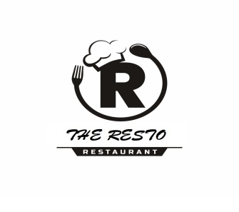
The Resto Food delivery website
Submitted To: Submitted by: Mr. Jagbir Singh Preekshit Dahiya
2019214

Slide 2
Abstract
It is a food delivery website for a specially designed for the restaurant “The Resto” .
It has a simple and responsive design.
Menu driven, understandable, and user friendly interface which is compatible to use.
This restaurant has its specialty in Indian foods.
Provide attractive offers on different meals.

Slide 3
Introduction
This website is made to provide the service of online food ordering and delivery to the customers of the restaurant named “The Resto”.
It contain various web-pages serving various purposes(Home, Menu, Offers, Login, Contact and About Us).
Its home page also contain the special meals of the restaurant providing extra attraction to the customers.
It is made to attract the customers rather than to distribute the customers which enhance the business much effectively.

Slide 4
Objectives of Project
This website is made with the objective to provide Food delivery system for the specific restaurant named “The Resto”.
With this platform users can easily order for their foods without much difficulty.
Rather than focusing on general and combined business it focuses on specific one.
It is made to attract the customers rather than to distribute for customers which enhances the business much effectively.

Slide 5
Technology
In this project , REACT JS which is a free and open-source front-end JavaScript library, is used to develop the user-interface. React JS features in importing and exporting files, routing etc. To design the UI of this project, further CSS concepts are used.
Further this platform is made responsive by the use of BOOTSTRAP.
This project provides Backend support with NODE JS AND EXPRESS JS which is an open source server environment. Node JS allows you to run JavaScript on the server. Further it uses MONGO DB database to save data from the website.

Slide 6
IMPLEMENTATION
User Interface:
It contains components like Navbar, Home, Cards, Footer, Menu, Login, Registration, Offers,
Contact and About Us.
Server:
It contains components like Index (which includes main backend programming) and Models
(which defines schema and models of the database).

Slide 7
RESULT & DISCUSSION
This project proved good for me as it provided practical knowledge of not only programming in Full stack but also on web based application and on some extent Windows Application and Mongo DB Server, and also about all handling procedure related with project. The following work can be done in this project further:
• Search engine optimization can be used for providing better search facility.
• Recommendations can be made to the customers by using artificial intelligence.
• User history can be stored and used for giving better suggestions.
• More payment options can be used for better usage of the website.
• Order tracking facility can also be added to provide user satisfaction.

Slide 8
Future scope
This website has a great scope in Restaurant market where it only focuses on single motive to attract customers.
Its objective to not distribute customers make more beneficial for business in this field. With decrease in distribution of customers it can focus only on one goal to increase the number of customers.
With this platform users can easily order for their foods without much difficulty. Rather than focusing on general and combined business it focuses on specific one.

Slide 9
References
https://getbootstrap.com/
https://nodejs.org/en
https://pixabay.com/photos/
https://www.istockphoto.com/
https://icons8.com/icons
https://www.w3schools.com/Css/
https://michalsnik.github.io/aos/

Slide 10
Thank You
Queries?

