Slide 1


TUTORIALS WEBSITE
Presented by: Preekshit Dahiya, Anupam and Ankit

Slide 2
Table of contents
Title and Objective.
Technology Used.
Introduction.
Features and Scope.
User Interface.
New Innovations
Conclusion.

Slide 3

Title:
ExamPreparations.com
This project is made with the objective to provide the tutorials for each subject of each semester in I K Gujral Punjab technical University. With this system students can easily learn and get study material from this website
according to their subjects.

Slide 4
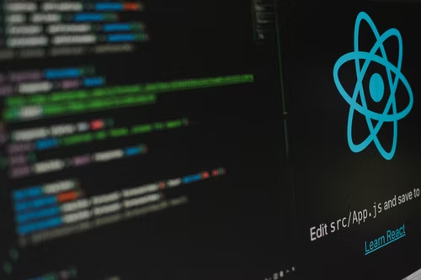
Technology Used
REACT JS
In this project ,react js which is a free and
open-source front-end JavaScript library
is used to develop user-interface. React Js
features like importing and exporting files,
routing etc. To design the ui of this project,
further CSS concepts are used.

Slide 5
INTRODUCTION
ExamPreparations.com is a website that can be used to provide tutorials to
students of I K Gujral Punjab Technical University.
This system contains tutorials of different subject which make it easy for students to get the study material for their examinations.
This system also provides exciting events like ideathon, code like ninja, expert talks etc.
Further it also gives the forms to contact and join us.

Slide 6
Features and Scope
The main features of this project are as follows:
Simple and one click navigation menu.
The scope of this project is as follows:
Can give study assistance for exam preparations.
Specially designed for I K Gujral Punjab Technical University students.
Five sections-navbar, tutorials, events, contact form, footer.
Forms to contact and join us.
Provide Study material according to subjects.
Easy and compatible to use.
User friendly interface.

Slide 7
USER INTERFACE

Slide 8
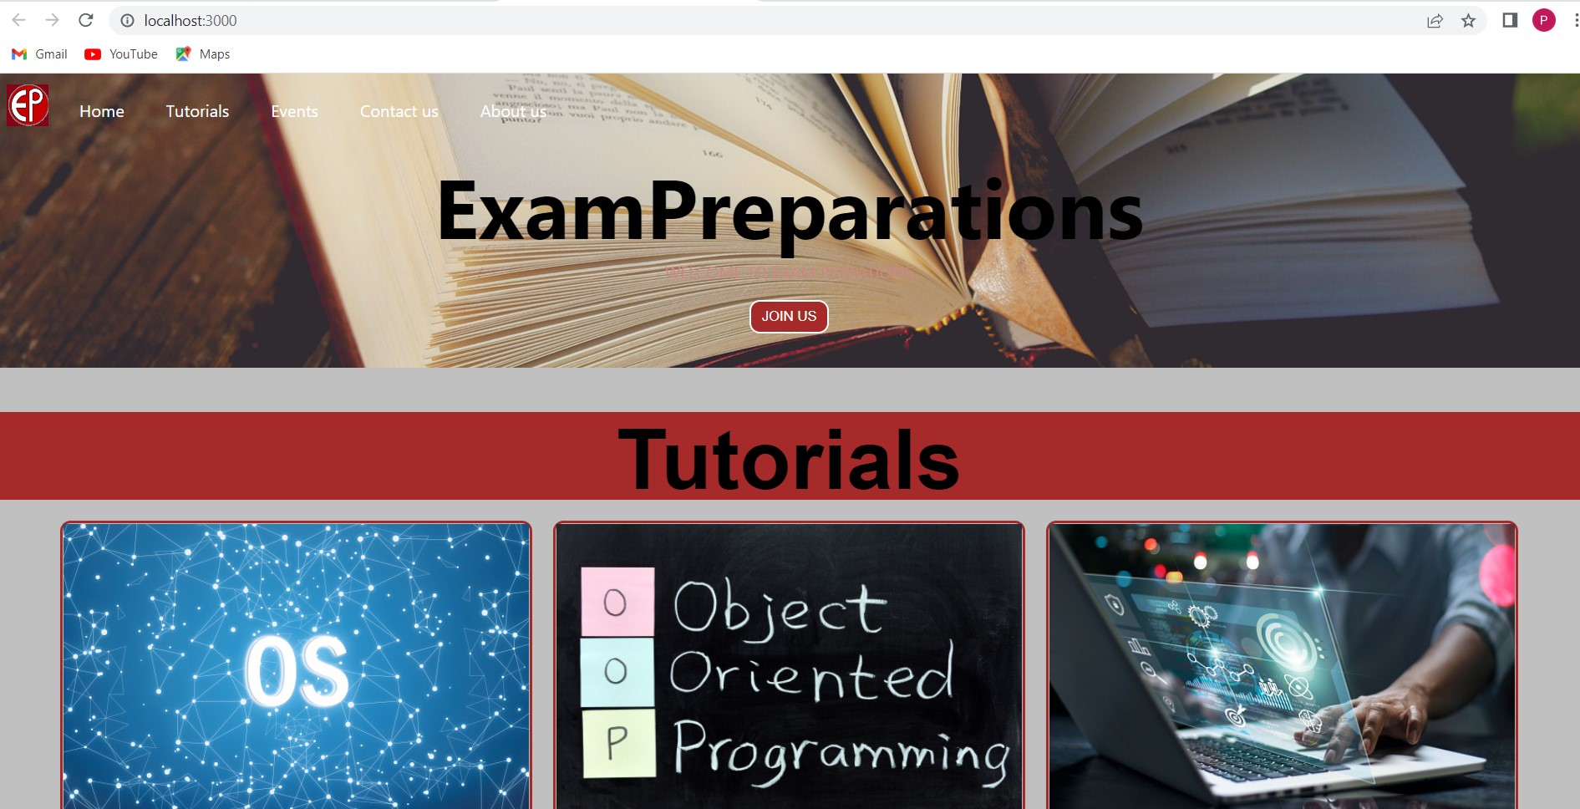
This is the Home page.

Slide 9
New Innovations Following are the new innovations that can be added in this this system to make it more effective.
We can make website more lucrative.
We can provide video assistance as well.
Also we sort the tutorials according to courses and departments.

Slide 10
Conclusion
ExamPreparations.com is the tutorials website which is both simple and user friendly. It is especially designed in accordance with PTU syllabus. With this website students can easily get study material for their exams.

Slide 11
THANKYOU

