Slide 1
Algorithm Design and Analysis
NMU - Week 1_1

Slide 2
Agenda
Course outline
ADT revisit
Introduction to Algorithm

Slide 3
Course Contents
Introduction to Algorithm (2 units)
Problem-Solving Technique (2 units)
Time complexity and Algorithm Efficiency (1 units)
Space complexity (1 units)
Brute Force (1 units)
Divide and Conquer + Recurrence Analysis (2 units)
Revision + Project 1 (2 units)
Total 11 units (28th Oct – 12th )

Slide 4
Course communication
CAMT moodle site
Algorithm Analysis and Design

Slide 5
Programming language
Java programing
VS code

Slide 6
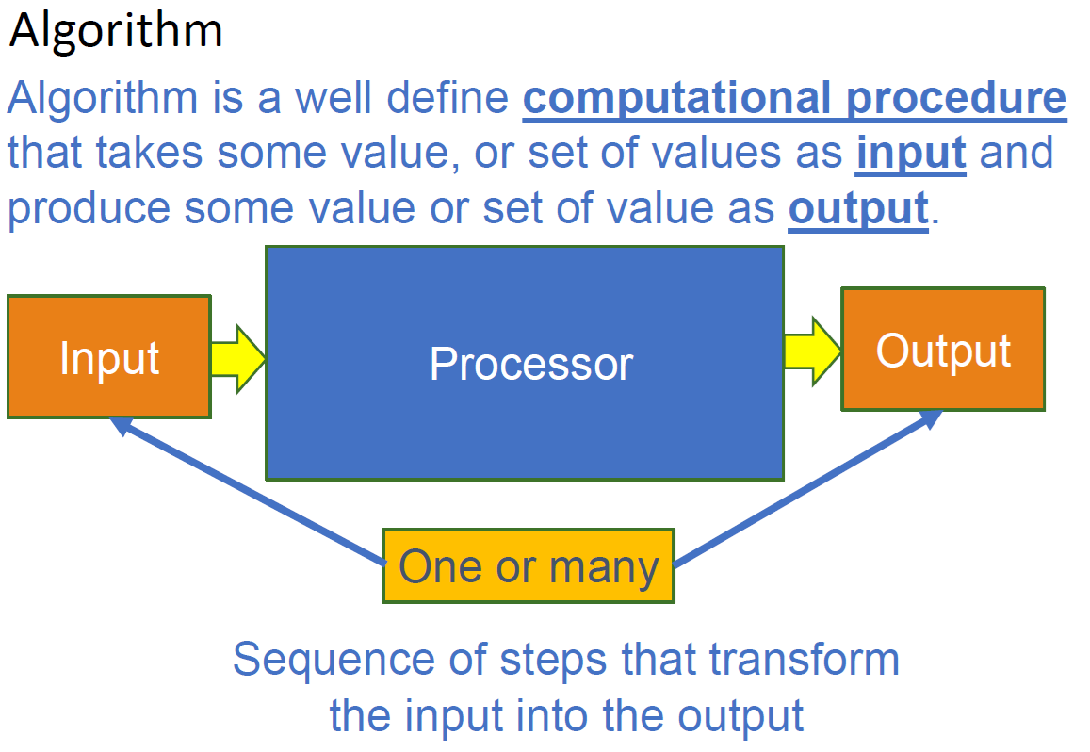
Introduction to Algorithm

Slide 7
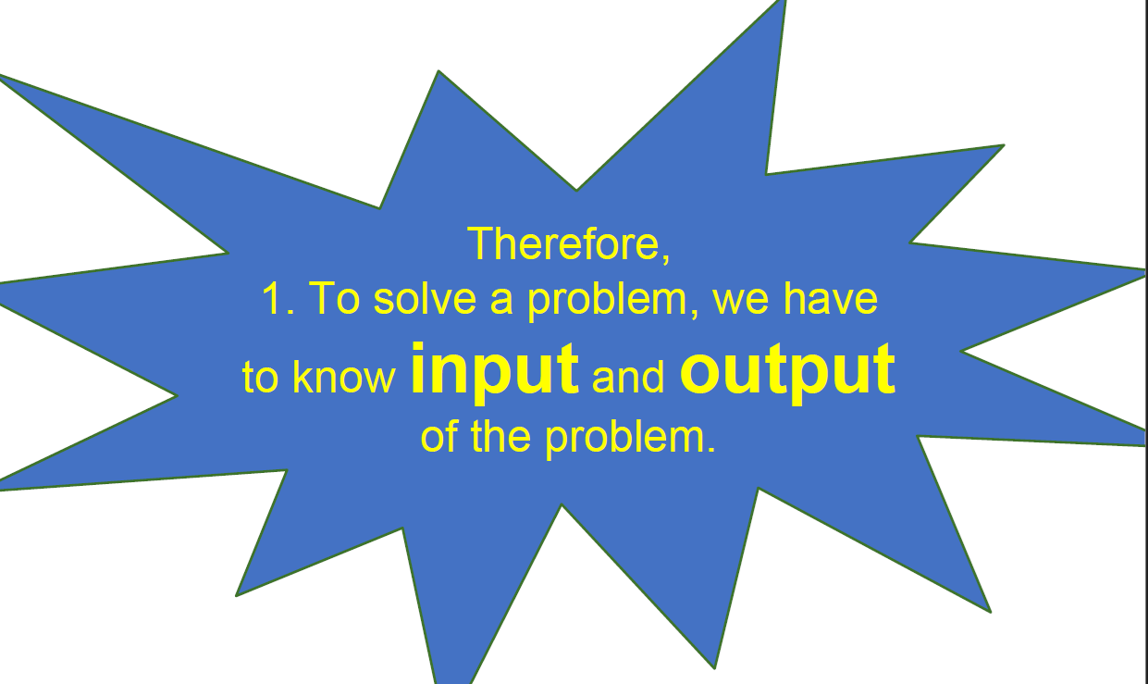
Introduction to Algorithm

Slide 8
Why study algorithms?
Important for all other branches of computer science related.
Time and space
Large data
Play a key role in modern tech. innovation
AI, ML, Blockchain
Novel solution in healthcare, tourism, logistics fields.
Provide novel “lens” on process outside computer science and tech.
scheduling tasks, navigating routes, to analyzing social networks
Challenging & fun
Improve coding performance
Problem solving skills

Slide 9
Why do we analyze an algorithm?
Classify problems and algorithms by difficulty
Predict performance, compare algorithms, tuning params.
Better understand and improve implementations and algorithms.

Slide 10
What are input and output?
2+5=?
(((2*5)+20)-(7+8)) =?
Find the average age of students in Algorithm class
Sorting problem
Also, you need to know the conditions of the problem

Slide 11
Sorting problem
SORTING PROBLEM
Input: A sequence of n number(a1,a2,…,an)
Output: A permutation(reordering)(a1’,a2’,…,an’)of the input sequence such that a1’≤a2’≤…≤an’
EX: give nan input(5,4,1,3,2), a sorting algorithm return the output(1,2,3,4,5)
The input sequence,(5,4,1,3,2),is called an instance of the sorting problem.
An INSTANCE OF A PROBLEM consists of the input needed to compute the solution of the problem.

Slide 12
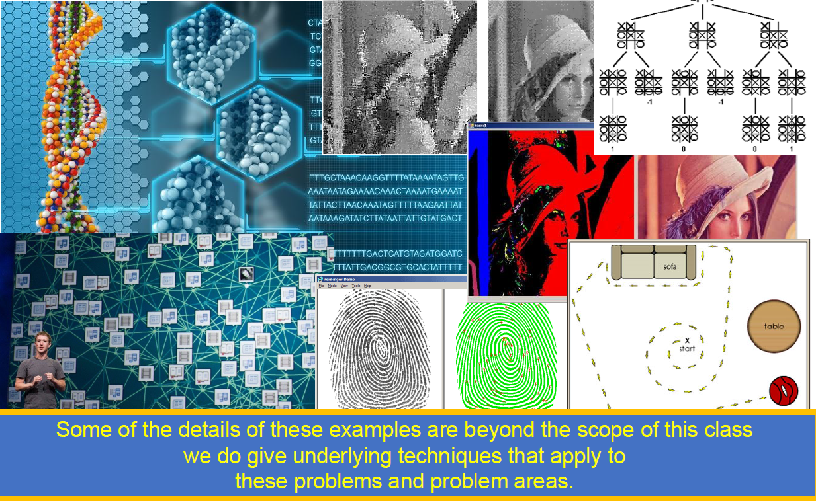
What kinds of problems are solved by algorithms?

Slide 13
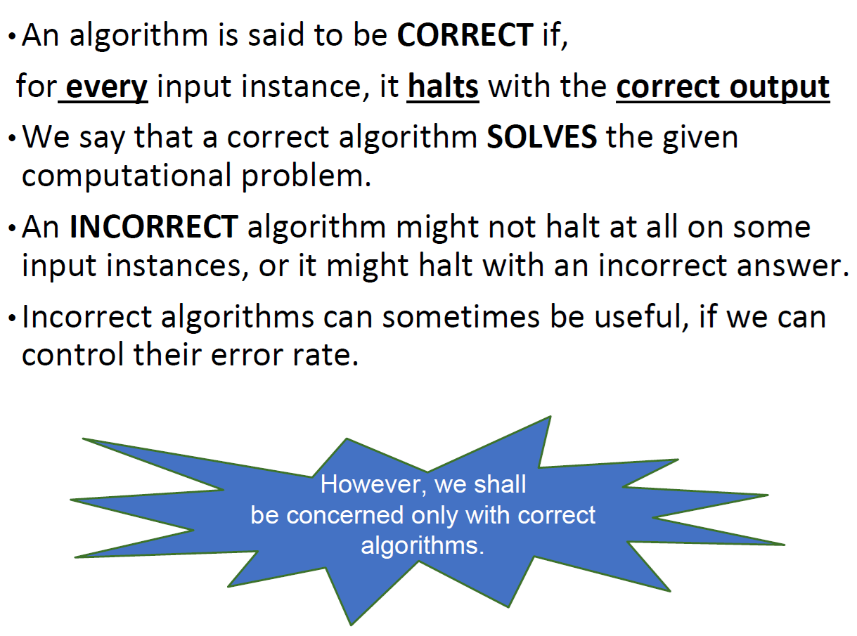

Slide 14
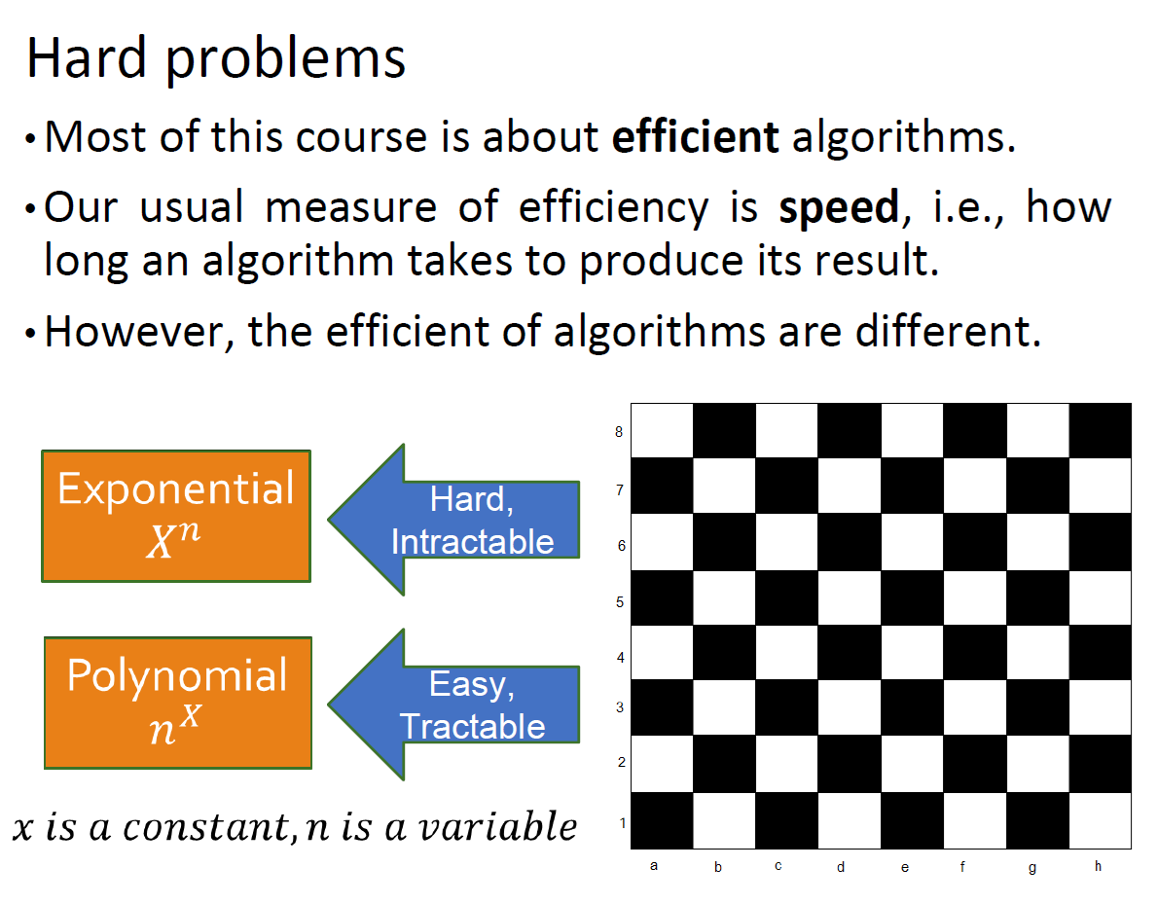

Slide 15
You have learnt inADT
How to find MaxValue
Selection sort, bubble sort, InsertionSort
Binary search
Recursion principle(Factorial)
BigO
Stack-Queue–Tower of Hanoi
Linklist, ArrayList
Binary Tree, Breadth First Search, Depth first search

Slide 16
Quick Sort
A popular and efficient sorting algorithm that uses the divide-and-conquer strategy.
Developed by Tony Hoare in 1959 and is widely used because of its performance in practical scenarios.

Slide 17
Steps of Quicksort:
Choose a Pivot: Select an element from the array as the pivot. This could be the first element, last element, middle element, or even a random element (the choice of pivot affects performance but doesn't change the correctness).
Partitioning the Array:
Compare each element of the array with the pivot.
Rearrange the elements so that all elements less than the pivot are moved to the left of the pivot and all elements greater than the pivot are moved to the right.
Recursion: Apply quicksort recursively to the left and right subarrays (elements smaller and larger than the pivot).
Combine: Since the array is sorted in-place during partitioning, no merging step is required. Once the recursive calls finish, the entire array will be sorted.

Slide 18
Merge Sort
Highly efficient sorting algorithm that uses a divide-and-conquer approach.
Partition the Array: Rearrange the array elements so that elements less than the pivot are on the left side, and elements greater than the pivot are on the right side. The pivot element will be placed in its correct sorted position in this process.
Recursively Apply Quick Sort: Apply the same process (choose a pivot, partition the array) to the left and right sub-arrays until the entire array is sorted.

