Slide 1
Algorithm Design and Analysis
NMU - Week 1_2

Slide 2
Agenda
Class Activity 1: Rat and Poisonous Milk Bottles
Class Activity 2: 25 horse Race

Slide 3
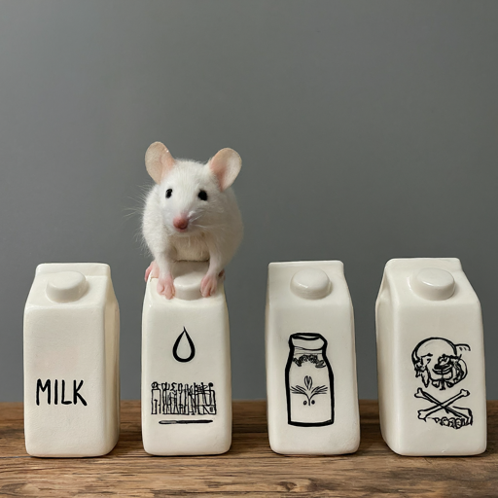
Class Activity 1: Rat and Poisonous Milk Bottles
You have 4 bottles of milk.
One of them is poisonous while the other 3 are non-poisonous.
There is a rat which dies exactly after 10 hours of drinking the poisoned bottle.
You have a clock that measures time only in hours.
Suggest an optimal strategy to identify the poisoned bottle within 24 hours.

Slide 4
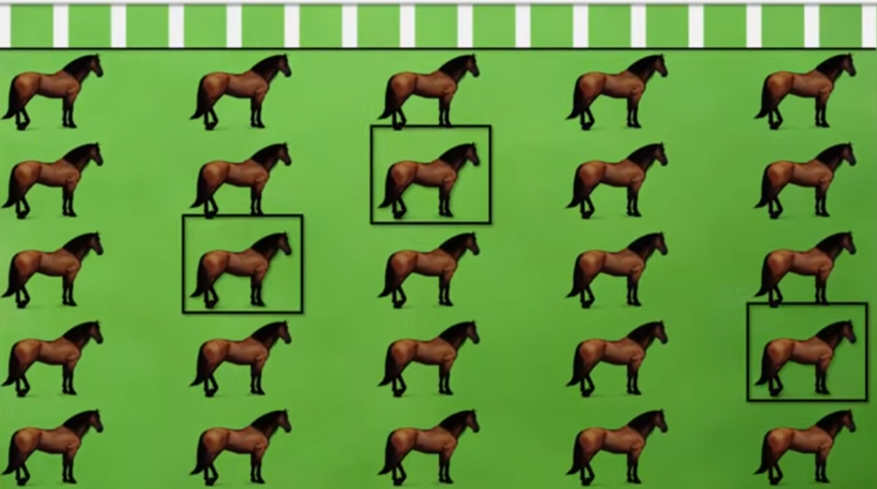
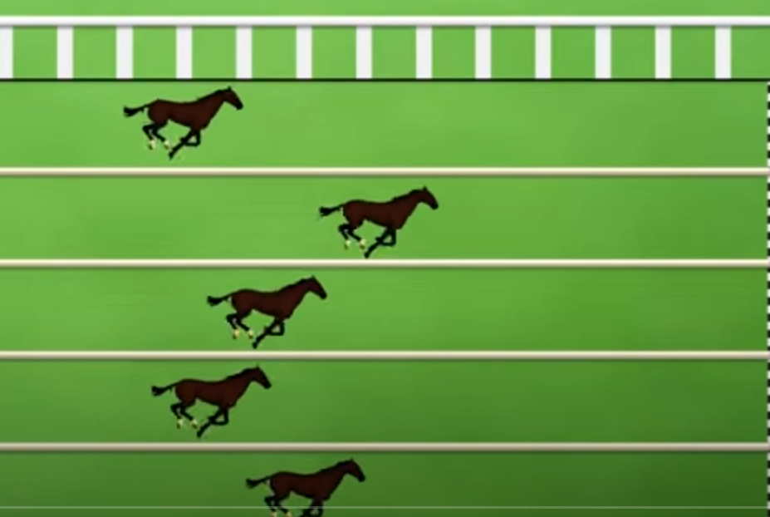
25 horse Race

Slide 5
Class Activity 2
Question:
From 25 horses, determine the three fastest
Only 5 horses can run at any one time.
You only know the order of the result
How many races that you have to arrange to find the 3 fastest horses?
Submit:
What are input/output/conditions?
Propose an algorithm to solve the problem? Please Explain + Show Example how our algorithm solve the problem.

