Slide 1

Click to hear the team explain
🌐 Live App: https://app-hazel-eight-24.vercel.app

Slide 2
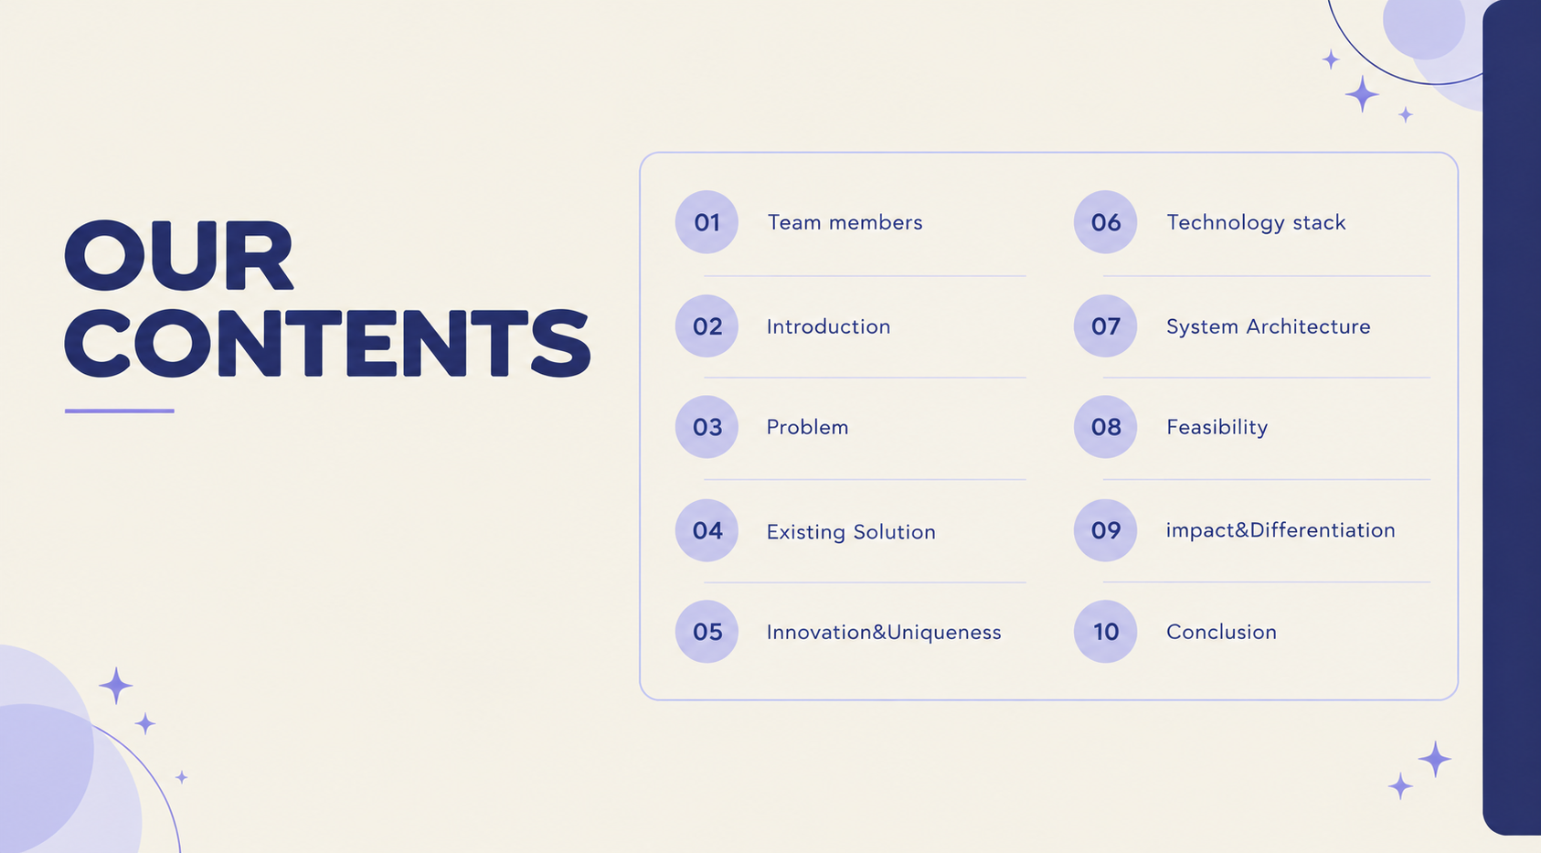
Click to hear the team explain

Slide 3
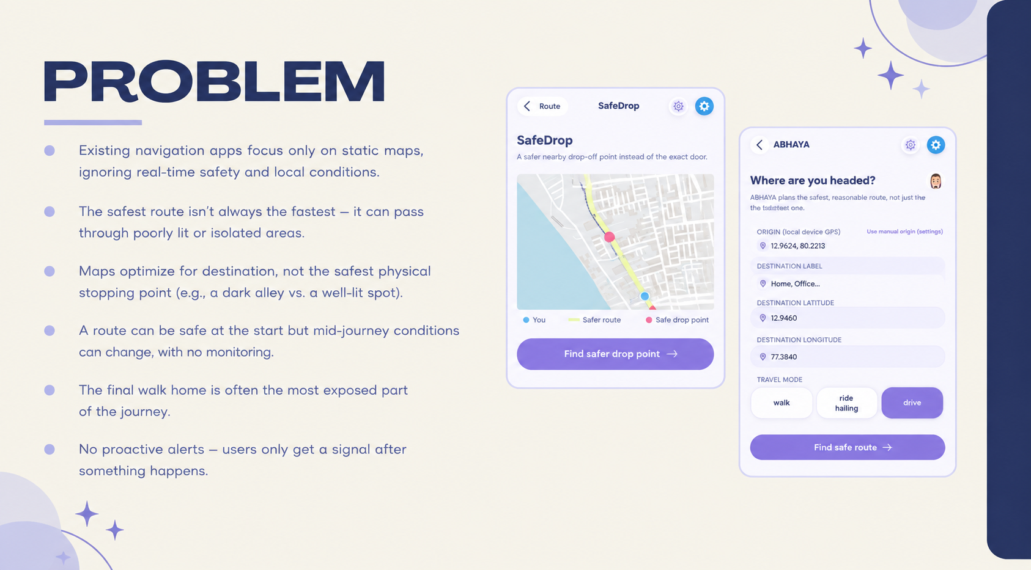
Click to hear the team explain

Slide 4
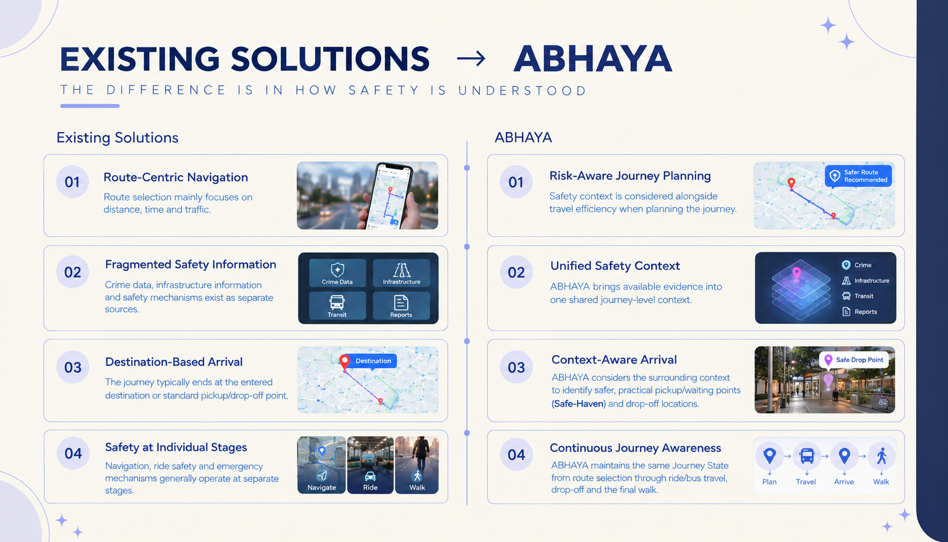
Click to hear the team explain

Slide 5
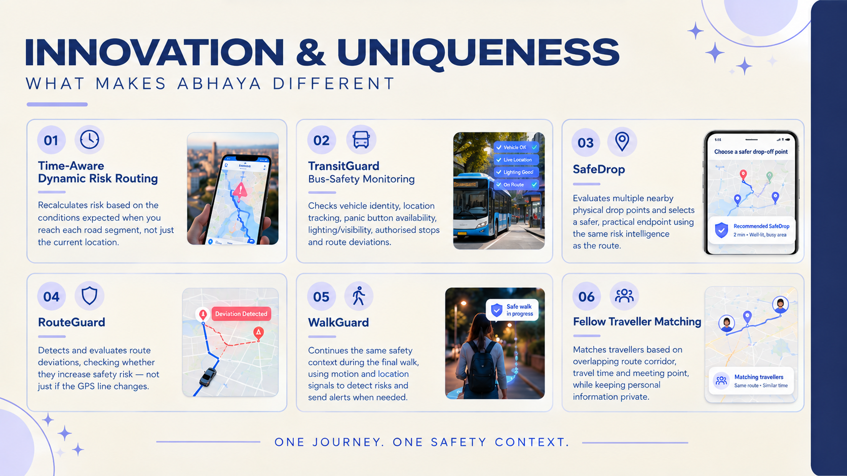
Click to hear the team explain

Slide 6

Click to hear the team explain

Slide 7
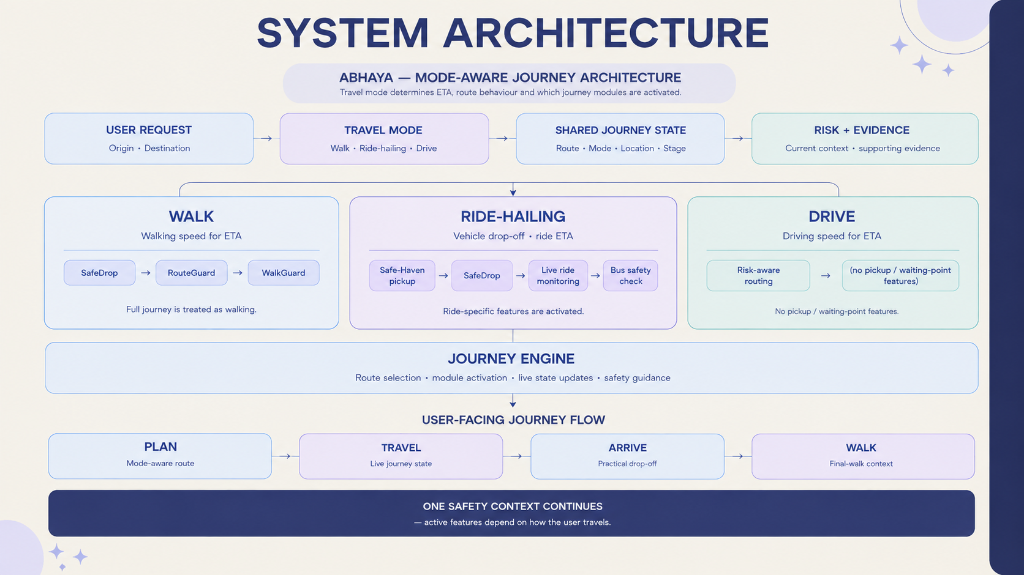
Click to hear the team explain

Slide 8

Click to hear the team explain

Slide 9

Click to hear the team explain

Slide 10

🌐 Live App: https://app-hazel-eight-24.vercel.app

