Slide 1
Python Music Player
Preet Gajjar, Manit Rachh, Raj Patel

Slide 2
Index
01
02
03
04
Modules Used
Setting Basic App
Basic Functions
Play time function

Slide 3
Index
05
06
07
08
Album Cover Function
Play, Pause & Stopping Functions
Next & Previous
Song Functions
Slider & Volume
Functions

Slide 4
Index
09
10
11
12
Tkinter List Box & CTk Frames
CTk Image & Buttons
CTk Switch & Menu
Tkinter Label & CTk Sliders

Slide 5
01
Modules Used

Slide 6
Modules Used
List of modules used in the Music Player:-
Customtkinter: Used to set the appearance mode, default color theme, various frames, various controlling buttons, button images, switches, and sliders.
Pygame: It is used to load and play songs, to stop the currently played song, to play the next/previous song from your playlist, to pause and resume the playing song, with the volume slider, one can adjust the volume.
Tkinter: Tkinter is mainly used to extend the capabilities of app like adding the list box where all songs appear, menu bar to add/delete song, label for time elapsed and cover image.
Time: Synchronizing the audio playback, updating the progress bar, and displaying the elapsed time and current time.
Mutagen: Allows the program to handle and play MP3 audio files, This is used to get the total length of the song which is playing currently.

Slide 7
Continued:-
Imagetk: Allows to dynamically load and display the album covers associated with the currently playing songs, providing a more engaging and aesthetically pleasing user interface, also allows to get and remove the album cover. Additionally used to display icon in the form of buttons.

Slide 8
02
Setting up basic app

Slide 9
Creating main app window
from tkinter import *
import customtkinter
import pygame
from tkinter import filedialog
import time
from mutagen.mp3 import MP3
from PIL import Image, ImageTk
import tkinter
root = customtkinter.CTk()
root.title('Music Player')
root.geometry('920x450')
root.resizable(width=FALSE, height=FALSE)
customtkinter.set_appearance_mode('system’)
customtkinter.set_default_color_theme('blue’)
pygame.mixer.init()
The CTk class forms the basis of any CustomTkinter program. It creates the main app window. An app is started by calling the ‘.mainloop()’ method.
When you set the appearance mode to "system", the current mode is read from the operating system. If the appearance mode of the operating system changes, the program will adapt .By default all colors are set by the color theme. Currently we set the theme to "blue".
Also initializing the ‘pygame’ mixer for audio playback

Slide 10
03
Basic Functions

Slide 11
Adding Songs
def add_song():
song = filedialog.askopenfilename(initialdir='music/', title='Chose A Song', filetypes=(("mp3 Files", "*.mp3"), ))
song = song.replace("C:/Python Project/musicplayer-main/music/", "")
song = song.replace(".mp3", "")
song_box.insert(END, song)
The file dialog opens a window for selecting the songs from the file manager to be inserted into song box.
Initially the ‘music/’ directory is opened and accepts only ‘.mp3’ types of file.
The directory and extension is stripped from the song name to load in song box by replace method.
The song name is inserted into the list box(song box) by insert method.

Slide 12
Adding Multiple Songs
def add_many_song():
songs = filedialog.askopenfilenames(initialdir='music/', title='Chose A Song', filetypes=(("mp3 Files", "*.mp3"), ))
for song in songs:
song = song.replace("C:/Python Project/musicplayer-main/music/", "")
song = song.replace(".mp3", "")
song_box.insert(END, song)
It is similar to the adding songs function the only difference is this does same thing for many song at a time by the ‘filedialog.askopenfilenames’ function.
The file dialog allows to select many song from file manager while earlier it only restricts to one song at a time.
The for loop is used to strip the directory and extension from every song selected and then inserted in the list box(song box)

Slide 13
Deleting Songs
def delete_song():
stop()
song_box.delete(ANCHOR)
pygame.mixer.music.stop()
remove_album_cover()
Delete song function deletes the song from the list box(song box).
When the song is deleted the pygame stops the music from playing and also the album cover of the song which was playing is also removed.

Slide 14
Deleting Multiple Songs
def delete_all_songs():
stop()
song_box.delete(0,END)
pygame.mixer.music.stop()
remove_album_cover()
Similar to the Delete song function the difference is it deletes all the songs from the index 0 to the last index denoted by END.
The pygame also stops the music and the album cover is also removed.

Slide 15
Save and delete songs from file
def sd_songs_to_file():
if save_switch.get()==1:
songs = song_box.get(0, END)
with open('selected_songs.txt', 'w') as file:
for song in songs:
file.write(song + '\n')
else:
with open('selected_songs.txt', 'w') as file:
pass
If the save switch if toggles to True/ On the sd_songs_to_file function is executed.
The songs currently in the list box(song box) is stored in the tuple ‘songs’ .
The file ‘selected_songs’ is opened in ‘w’ mode and for each value of tuple the song name is written in the file using write method.
If the ‘save_switch’ is False the content of the file is cleared.

Slide 16
Load songs logic
def load_songs_from_file():
try:
with open('selected_songs.txt', 'r') as file:
songs = file.readlines()
for song in songs:
song = song.strip()
song_box.insert(END, song)
save_switch.select()
except FileNotFoundError:
pass
root.bind('<Shift-Escape>', lambda event: delete_all_songs_saved() if save_switch.get() == 1 else sd_songs_to_file())
This function loads the song in the list box if the ‘save_switch’ was turned on when closing the app previously.
The song’s which are stored in the file are loaded using opening the file in ‘r’ mode and using the ‘readlines’ method, the song is stripped with the newline character and is inserted into the list box.
The hotkey is assigned to delete all songs and delete saved songs from file using the delete_all_song_saved fn.

Slide 17
Deleting all songs with save logic
def delete_all_songs_saved():
stop()
song_box.delete(0,END)
pygame.mixer.music.stop()
remove_album_cover()
save_switch.toggle()
When the hotkey ‘Shift-Esc’ is pressed and the ‘save_switch’ is turned on the, all the song’s in the list box are deleted.
The pygame stops the music, the album cover is removed and the ‘save_switch’ is set to false using ‘toggle’ method.

Slide 18
04
Play time function

Slide 19
Play time function
current_time = pygame.mixer.music.get_pos()/1000
converted_current_time = time.strftime('%M:%S', time.gmtime(current_time))
song_mut = MP3(song)
song_length = song_mut.info.length
converted_song_length = time.strftime('%M:%S', time.gmtime(song_length))
if int(my_slider.get()) == int(song_length):
statu_bar.config(text=f'{converted_song_length}/{converted_song_length}')
if switch.get()==1:
next_song()
The current time is calculated by the pygame.mixer.music.get_pos().
The function returns the current time in the song in terms of millisecond which is divided by 1000 to get the time in second.
The mutagen contains MP3 class which is used to get the total length of the song which is returned in the seconds.
The shrfttime function is used convert the seconds to the minute:second format.

Slide 20
Continued..
The slider for the music is returns to the current time of song using the get() method.
If the slider position is same as the total length the time status bar is set to total length of total length. Additionally if the autoplay switch is set to 1 (i.e. True) then next_song() function is called which plays the next song in the playlist.

Slide 21
Continued..
elif paused:
pass
elif(int(my_slider.get()) == int(current_time)):
slider_position = int(song_length)
my_slider.configure(to=slider_position)
my_slider.set(int(current_time))
else:
slider_position = int(song_length)
my_slider.configure(to=slider_position)
my_slider.set(int(my_slider.get()))
converted_current_time = time.strftime('%M:%S', time.gmtime(my_slider.get())) statu_bar.config(text=f'{converted_current_time}/{converted_song_length}’)
next_time = int(my_slider.get())+1
my_slider.set(next_time)
statu_bar.after(1000, play_time)
If the song is paused there will be a pass condition which will not update anything the time status bar and the slider position will not be updated and will stand still.
If the position of the slider is same as the current time which is the case when the song is playing the slider position attribute ‘to’ is set to total length of song and the current position of slider is set to the current time.
In normal play this same thing happens along with config of time status bar.

Slide 22
05
Album Cover Functions

Slide 23
Function to Get & Remove Album Cover
image_current_path=song_box.get(ACTIVE)
image_current_path=f'C:/Python Project/musicplayer-main/img/{image_current_path}.jpg'
image1 = Image.open(image_current_path)
image2=image1.resize((170, 170))
global load
load = ImageTk.PhotoImage(image2)
label1.configure(image=load)
label1.grid(row=0, column=0)
image_current_path=f'C:/Python Project/musicplayer-main/img/Transparent.png'
image1 = Image.open(image_current_path)
image2=image1.resize((170, 170))
load = ImageTk.PhotoImage(image2)
label1.configure(image=load)
label1.image=load
The get album cover is invoked through play function, next_song function and the previous_song function.
The get_album_cover is based on pillow (PIL), Image and ImageTk module.
The module PIL consist of Image and ImageTk module which is used to load the image in the label (text line).
.open function is used to open the image and the .PhotoImage is used to load the image in any variable (here load).

Slide 24
Continued..
The remove album cover is invoked when deleting one or all song, deleting all the songs saved, and stopping the song.
The function opens a transparent image and loads it to the label .

Slide 25
06
Playing & Stopping Function

Slide 26
Playing the Selected Song
def play():
my_slider.set(0)
song = song_box.get(ACTIVE)
song = f'C:/Python Project/'musicplayer-main/music/{song}.mp3
pygame.mixer.music.load(song)
pygame.mixer.music.play(loops=0)
#call the paly_time fn to get current time
play_time()
get_album_cover()
The play function is used to play the select song in the song box(i.e. List Box).
The active selected song is returned by the .get() method of list box.
The .get() method returns only the name as the path and extension was stripped out when storing song.
The path and extension is added to the song name using the ‘f’ string and is loaded by pygame.mixer.music.load function, and played. The play_time and album cover is invoked too.

Slide 27
Stopping the Selected Song
def stop():
statu_bar.config(text=’’)
my_slider.set(0)
pygame.mixer.music.stop()
song_box.select_clear(ACTIVE)
statu_bar.config(text=’’)
remove_album_cover()
The stop function clears the time status bar.
The slider is set to 0 and the pygame.mixer.music.stop function stops the song from playing.
The list box selectin is cleared out and the album cover is also removed by invoking the remove album cover function.

Slide 28
07
Next & Previous
Song Functions

Slide 29
Playing the Next Song
def next_song():
statu_bar.config(text='')
my_slider.set(0)
next_one = song_box.curselection()
next_one = next_one[0]+1
if (switch.get()==1 and next_one == song_box.size()):
next_one = 0
song = song_box.get(next_one)
song = f'C:/Python Project/musicplayer-main/music/{song}.mp3'
pygame.mixer.music.load(song)
pygame.mixer.music.play(loops=0)
song_box.selection_clear(0,END)
song_box.activate(next_one) song_box.selection_set(next_one, last=None)
get_album_cover()
The function Next Song first sets the statusbar to empty and song slider to 0.
song_box.curselection() returns a tuple for the current index of the song playing from listbox and is assigned to next_one.
The next one is incremented by one pointing to the next song in the list box.
In the first case , if the autoplay switch is set to one i.e. True and the next_one is equal to size of song box then the current song will be return and will be loaded and played.

Slide 30
Continued..
else:
song = song_box.get(next_one)
song = f'C:/Python Project/musicplayer-main/music/{song}.mp3’
pygame.mixer.music.load(song)
pygame.mixer.music.play(loops=0)
#clear active song in frame
song_box.selection_clear(0,END)
#activate next song in frame
song_box.activate(next_one)
#set active bar to next song
song_box.selection_set(next_one, last=None)
get_album_cover()
The previous case was for the song wich was at the last of song box in that case, the first song of the song box was played automatically.
In Else case, the next song is selected, loaded and played.
In both the cases, the selection of current song is cleared and the next song is selected and activated.

Slide 31
Playing the Previous Song
def previous_song():
statu_bar.config(text='')
my_slider.set(0)
next_one = song_box.curselection()
next_one = next_one[0]-1
song = song_box.get(next_one)
song = f'/Users/manit/Documents2/musicplayer-main/music/{song}.mp3'
pygame.mixer.music.load(song)
pygame.mixer.music.play(loops=0)
The pervious song function plays the pervious song in the song box.
First the status bar is set to empty and the song slider is set to 0.
Using the ‘song_box.curseselection’ method the index of current song in the form is returned and stored in variable next_one.
The element at index 0 of next_one is added to 1, which ideally means that the index of next song in the song box is selected.

Slide 32
Continued..
song_box.selection_clear(0,END)
song_box.activate(next_one)
song_box.selection_set(next_one, last=None)
get_album_cover()
The next_one is passed to the ‘.get’ method in the song box which returns the name of song from the song box.
The name of song is added to file path using the f string.
The pgame mixer is used to load and play song, and the current selection of song in the song box is cleared and set to the next one and the next one is also activated.

Slide 33
08
Slider & Volume
Functions

Slide 34
Slider & Volume Function
def slide(x):
song = song_box.get(ACTIVE)
song = f'C:/Python Project/musicplayer-main/music/{song}.mp3'
pygame.mixer.music.load(song)
pygame.mixer.music.play(loops=0, start=int(my_slider.get()))
def volume(x):
pygame.mixer.music.set_volume(volume_slider.get())
The slide function is to skip to any length in the song. The slide function need to make at least one parameter so here ‘x’ is passed but it is not used.
The active song is selected from the song box and is added to it path and is loaded.
When playing two parameters are passed one is loop which is set to 0, and second is the start which means the Strat position in the song which is set the position of slider which is in float and converted into integer.

Slide 35
Continued..
The volume function sets the volume of the music.
The volume of music is set using ‘pygame.mixer.set_volume’ function. The function accepts one argument that is level of volume.
The volume is accepted in range between 0-1 i.e. the music can have max volume of 1 and least volume of 0.
The volume can be in a long float with a long precision.
The volume is determined by the position of the volume slider which is ideally set at 1 so the volume is also set at 1 which is highest.
When the position of the volume slider is changed the ‘.get’ method is used to get the current position of slider.

Slide 36
09
Tkinter
List Box & CTk Frames

Slide 37
List Box & Frames
song_box = Listbox(master_frame, bg='#aab0b5', fg='black', width=60)
song_box.grid(row=0, column=0, pady=20,padx=20)
master_frame=customtkinter.CTkFrame(master=root)
Master_frame.pack(pady=20)
controls_frame=customtkinter.CTkFrame(master=
master_frame,width=350, height=200, fg_color='transparent')
controls_frame.grid(row=1, column=0, pady=20, padx=10)
volume_frame=customtkinter.CTkFrame(master=master_frame, fg_color='transparent')
Volume_frame.grid(row=0,column=1,padx=(0,10),pady=10)
album_frame=customtkinter.CTkFrame(master=master_frame, width=175, height=170, bg_color='#aab0b5', fg_color='#aab0b5')
album_frame.grid(row=0, column=2,padx=(0,10),pady=10)
The song box is a list box which is class in the tkinter module. It created a visible box which consist of various elements here song names.
Th ‘.grid’ method is used to position the song box in the window.
The ‘master_frame’ is used to create a frame which can consist of n number of widgets in them.
The frame is ideally used to easy positioning the widgets.
The master fame is packed to the window with a padding y of 20 pixels.
The song box, controls frame, volume frame, and album frame are in the master frame. The master frame itself is in root i.e. window.

Slide 38
10
CTk Image
& Buttons

Slide 39
CTk Images
back_btn_img=customtkinter.CTkImage(light_image=Image.open('images/back50.png'),dark_image=Image.open('images/back50.png'),size=(50,50))
forward_btn_img=customtkinter.CTkImage(light_image=Image.open('images/forward50.png'),dark_image=Image.open('images/forward50.png'),size=(50,50))
play_btn_img=customtkinter.CTkImage(light_image=Image.open('images/play50.png'),dark_image=Image.open('images/play50.png'),size=(50,50))
pause_btn_img=customtkinter.CTkImage(light_image=Image.open('images/pause50.png'),dark_image=Image.open('images/pause50.png'),size=(50,50))
stop_btn_img=customtkinter.CTkImage(light_image=Image.open('images/stop50.png'),dark_image=Image.open('images/stop50.png'),size=(50,50))
The CTk images is used in the icons of the buttons of play, pause, next, previos and stop.
The Image module in Pillow is used to open the image and is loaded using the CTk image
Class.
The ‘.png’ images are used to have a transparent background.
The same images are set for light and dark mode of system and is sized to 50x50 pixels.

Slide 40
Buttons
back_button = customtkinter.CTkButton(controls_frame, text='',border_width=0,width=70,command=previous_song,image=back_btn_img,fg_color='transparent')
back_button.grid(row=0, column=0)
forward_button = customtkinter.CTkButton(controls_frame, text='',border_width=0,width=70,command=next_song,image=forward_btn_img,fg_color='transparent')
forward_button.grid(row=0, column=1, padx=10)
play_button = customtkinter.CTkButton(controls_frame, text='',border_width=0,width=70,command=play,image=play_btn_img,fg_color='transparent')
play_button.grid(row=0, column=2,padx=10)
pause_buttton = customtkinter.CTkButton(controls_frame, text='',border_width=0,width=70,command=lambda:pause(paused),image=pause_btn_img,fg_color='transparent')
pause_buttton.grid(row=0, column=3,padx=10)
The buttons are used to invoke the functions play, paused, stop, next_song and previous song.
The CTkButton class is used for a button.
There are few attributes the button which are:
Master: which is the frame or root we need the button to appear in.
Width: which is the width of the button.
Command: Which is the function to execute when the button is clicked by the user.
Image: The image is the icon which is to be loaded which we have stored while using CTk images.
Fg_color: The fore ground color is set to transparent here which means the fore ground will be transparent.

Slide 41
11
CTk Switch
& Menu

Slide 42
CTk Switch
switch = customtkinter.CTkSwitch(master_frame, text="Autoplay", onvalue=True, offvalue=False)
switch.grid(row=1, column=1)
save_switch =customtkinter.CTkSwitch(master_frame, text="Save Playlist", onvalue=True, offvalue=False, command=sd_songs_to_file)
save_switch.grid(row=2, column=1, pady=(0,20))
The Ctk switch is used here for autoplay and to save the songs in the song box.
The ‘switch’ is for the autoplay. The switch is given with some attributes they are:
Master: Which frame the switch is present. Here ‘master_frame’.
Text: The text which we want to display.
Onvalue: which is the value the switch will be set to when it is on.
Offvalue: which is the value the switch will be set to off.
Command: The command is the function to execute when the switch is toggled either to on or off the function will be executed

Slide 43
Menu
my_menu = Menu(root, background='#1f6aa5', fg='#ffffff')
root.config(menu=my_menu)
add_song_menu = Menu(my_menu,bg="#1f6aa5", fg="#ffffff")
my_menu.add_cascade(label='AddSongs',menu=
add_song_menu)
add_song_menu.add_command(label='Add one song to playlist', command=add_song)
add_song_menu.add_command(label='Add Many song to playlist', command=add_many_song)
remove_song_menu = Menu(my_menu,bg="#1f6aa5", fg="#ffffff")
my_menu.add_cascade(label="Remove Songs", menu=remove_song_menu)
The Menu is a class in module Tkinter which makes a menu bar the ‘my_menu’.
The menu bar ‘my_menu’ is the master menu here and is added with sub menu using ‘.add_cascade’ method.
The sub menu which is added is the ‘add_song_menu’ and ‘remove_song_menu’ these two menu are further divided into commands ‘add one song’ and ‘add many song’ using ‘.add_command’ method, And delete one song and many song in the same way.
When clicked on any command it will invoke the corresponding command given for each.

Slide 44
12
Tkinter
Label & CTk
Sliders

Slide 45
Tkinter Label & CTk Sliders
statu_bar = Label(root, text='', anchor=E, bg='#1f6aa5', fg="#ffffff")
statu_bar.pack(fill=X, side=BOTTOM, ipady=2)
my_slider = customtkinter.CTkSlider(master_frame, from_=0, to=100, orientation=HORIZONTAL, command=slide, width=360,fg_color='#4c4c4c')
my_slider.set(0)
my_slider.grid(row=2, column=0, pady=10)
volume_slider=customtkinter.CTkSlider(volume_frame, from_=0, to=1, orientation=VERTICAL, command=volume, height=120,fg_color='#4c4c4c')
volume_slider.set(1)
volume_slider.pack()
label1 = tkinter.Label(album_frame)
The status bar is the bottom bar which displays the time enlapsed.
The status bar is a label which is class in the Tkinter module.
The label is just a text with some attributes.
The attributes given here are:
Master: Where the label is present. Here ‘root’ i.e. main window.
Text: which is initially set to empty.
Anchor: Which is the relative position if the text in the area which is set to ‘East’ here.
Bg & Fg: Which is the background and foreground color.

Slide 46
Continued..
My_slider is the song slider. The CTk class is set with some attributes which are:
Master: Where the slider is present. Here ‘master_frame’ .
From & To: Which is the maximum and minimum position of the slide. The minimum is 0 and the maximum is 100 ideally.
Orientation: The here orientation is set to Horizontal.
Command: command is the function to execute here it is slide .
Width: The width here set is 360.
Fg_color: Which is the foreground color.
Same goes with the volume slider the difference is the to is set to 1. Which is from 0 to 1, as the volume is accepted by the pygame mixer is between 0 and 1.
And the command is set to volume function and is set to 1 and while the song slider is ideally set to zero which indicates the song is starting from 00:00.

Slide 47
Images

Slide 48
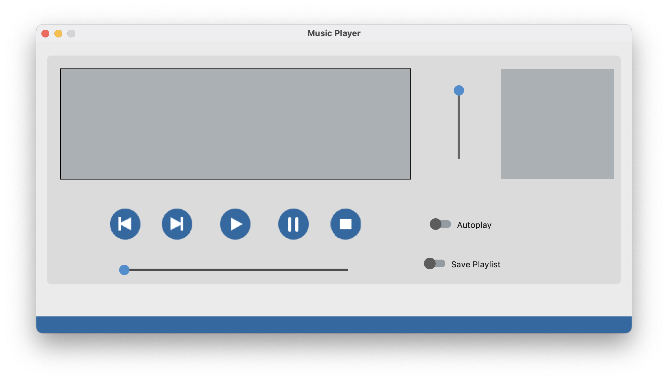
Light Mode set same as the system

Slide 49
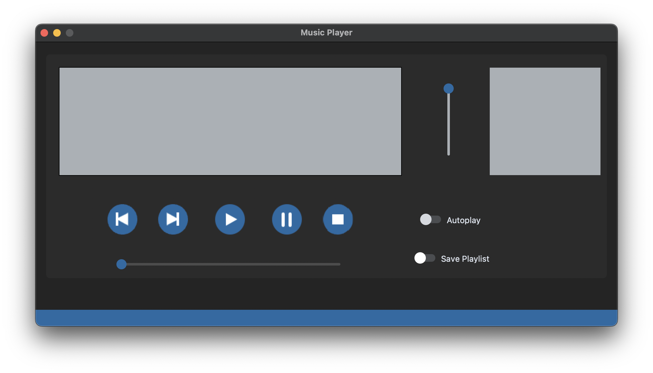
Dark Mode set same as the system

Slide 50
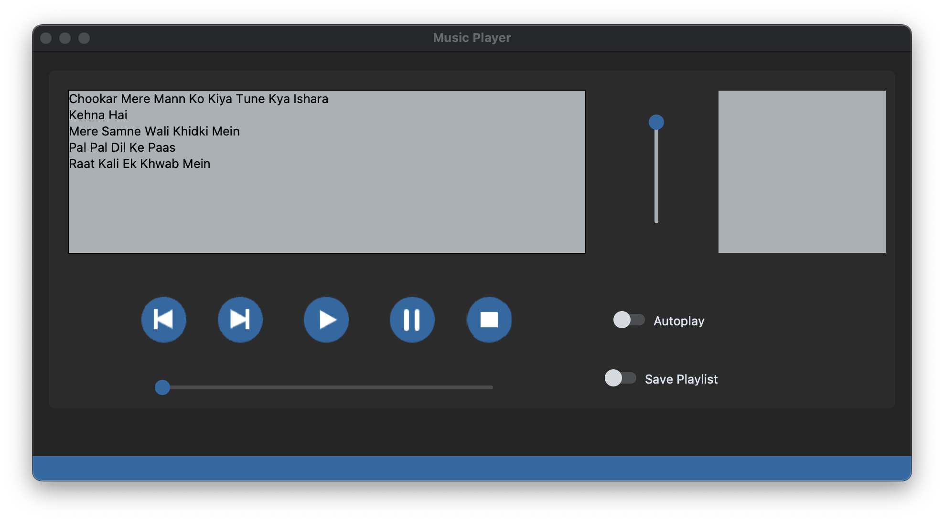
Adding Song

Slide 51
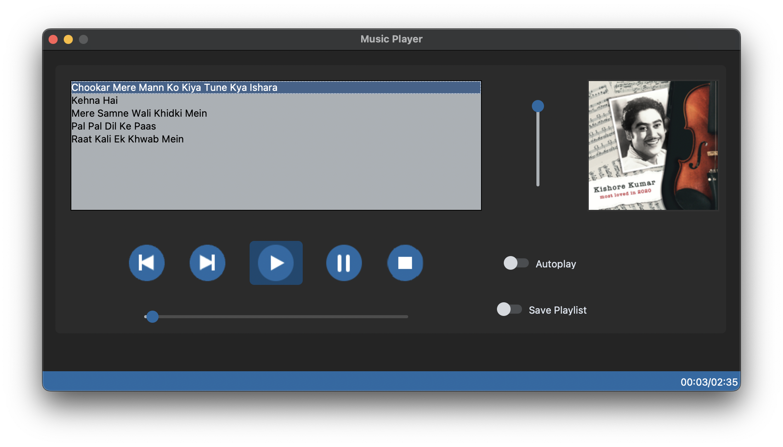
Playing the song

Slide 52
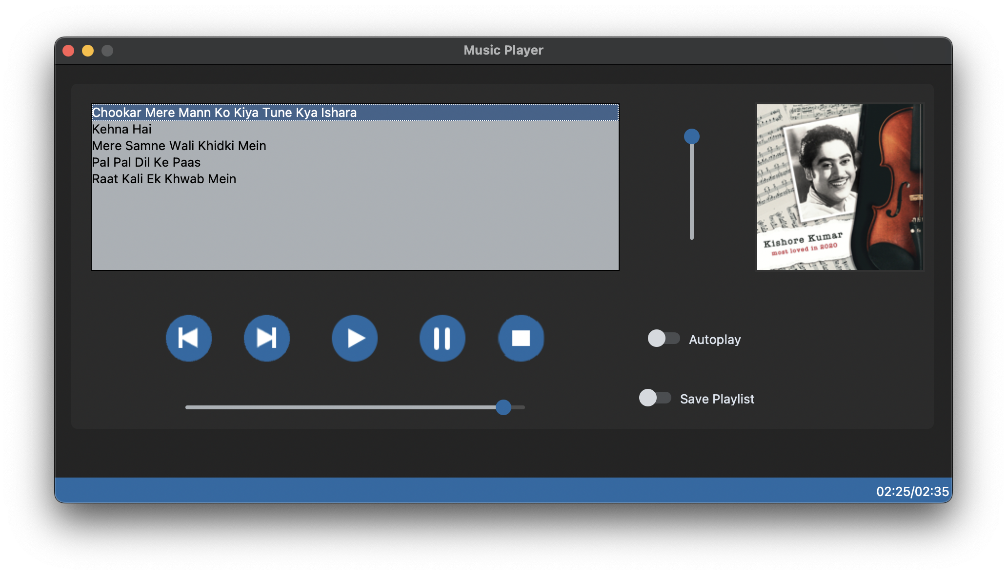
Skipping song ahead

Slide 53
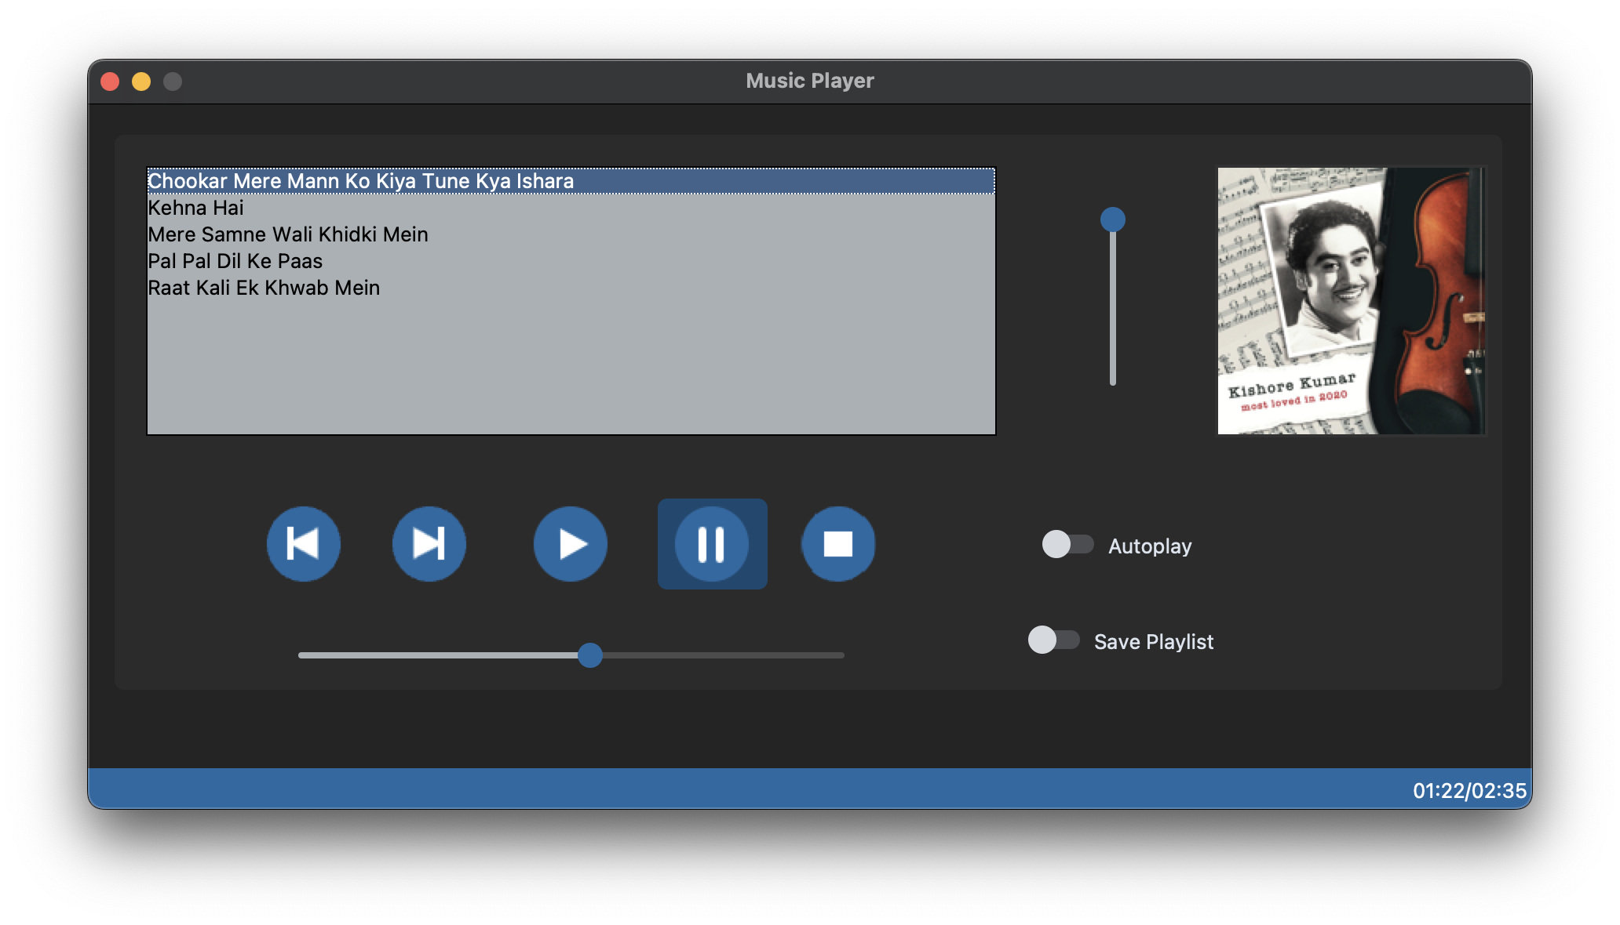
Pause/Unpause song

Slide 54
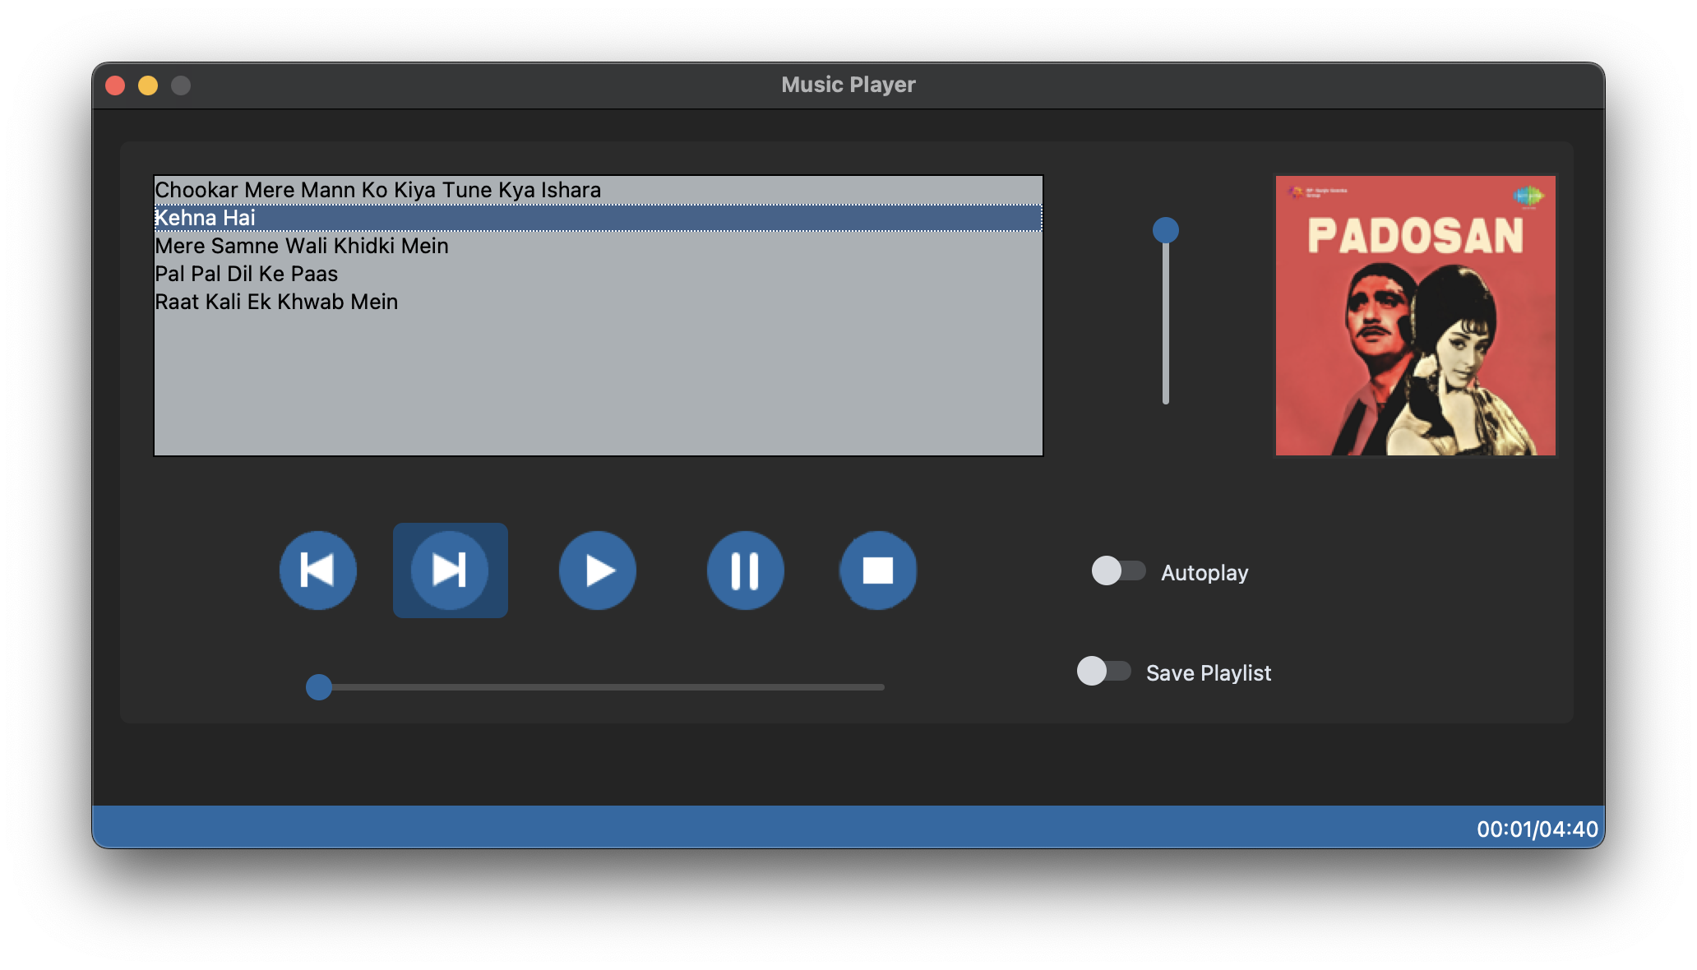
Next song

Slide 55
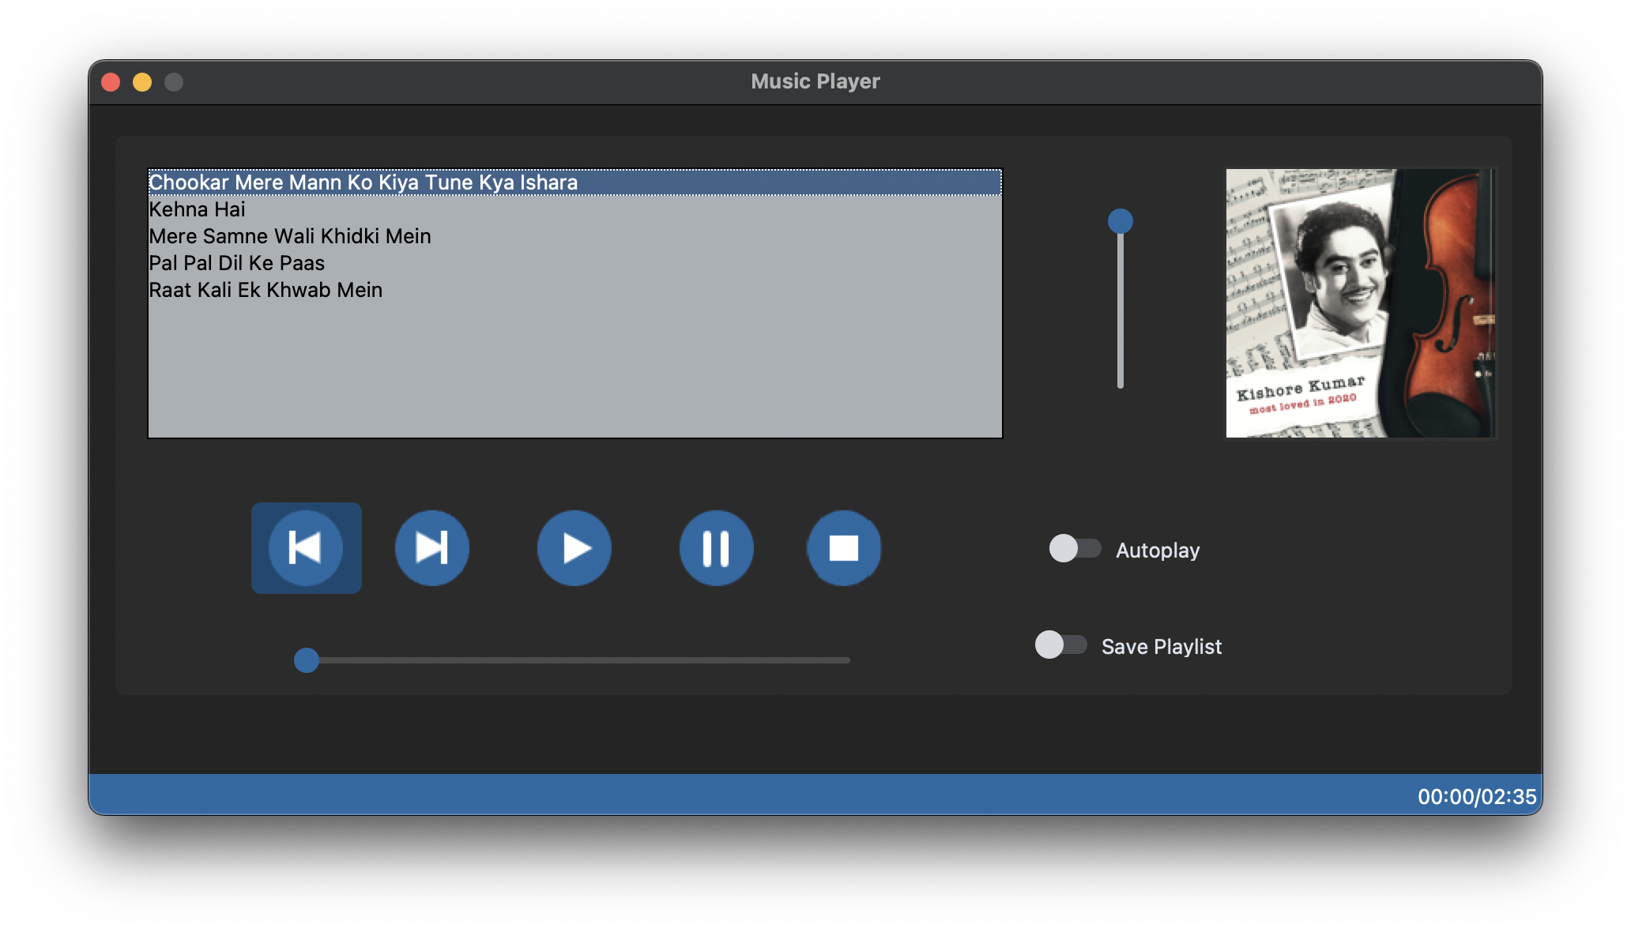
Previous song

Slide 56
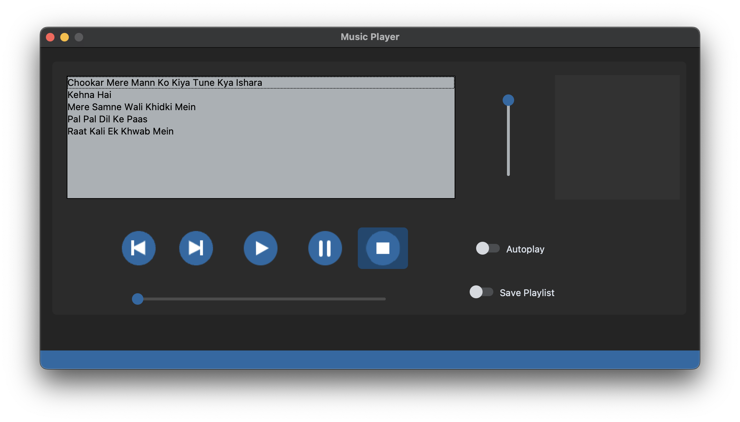
Stop song

Slide 57

Autoplay

Slide 58

Saving Songs

Slide 59
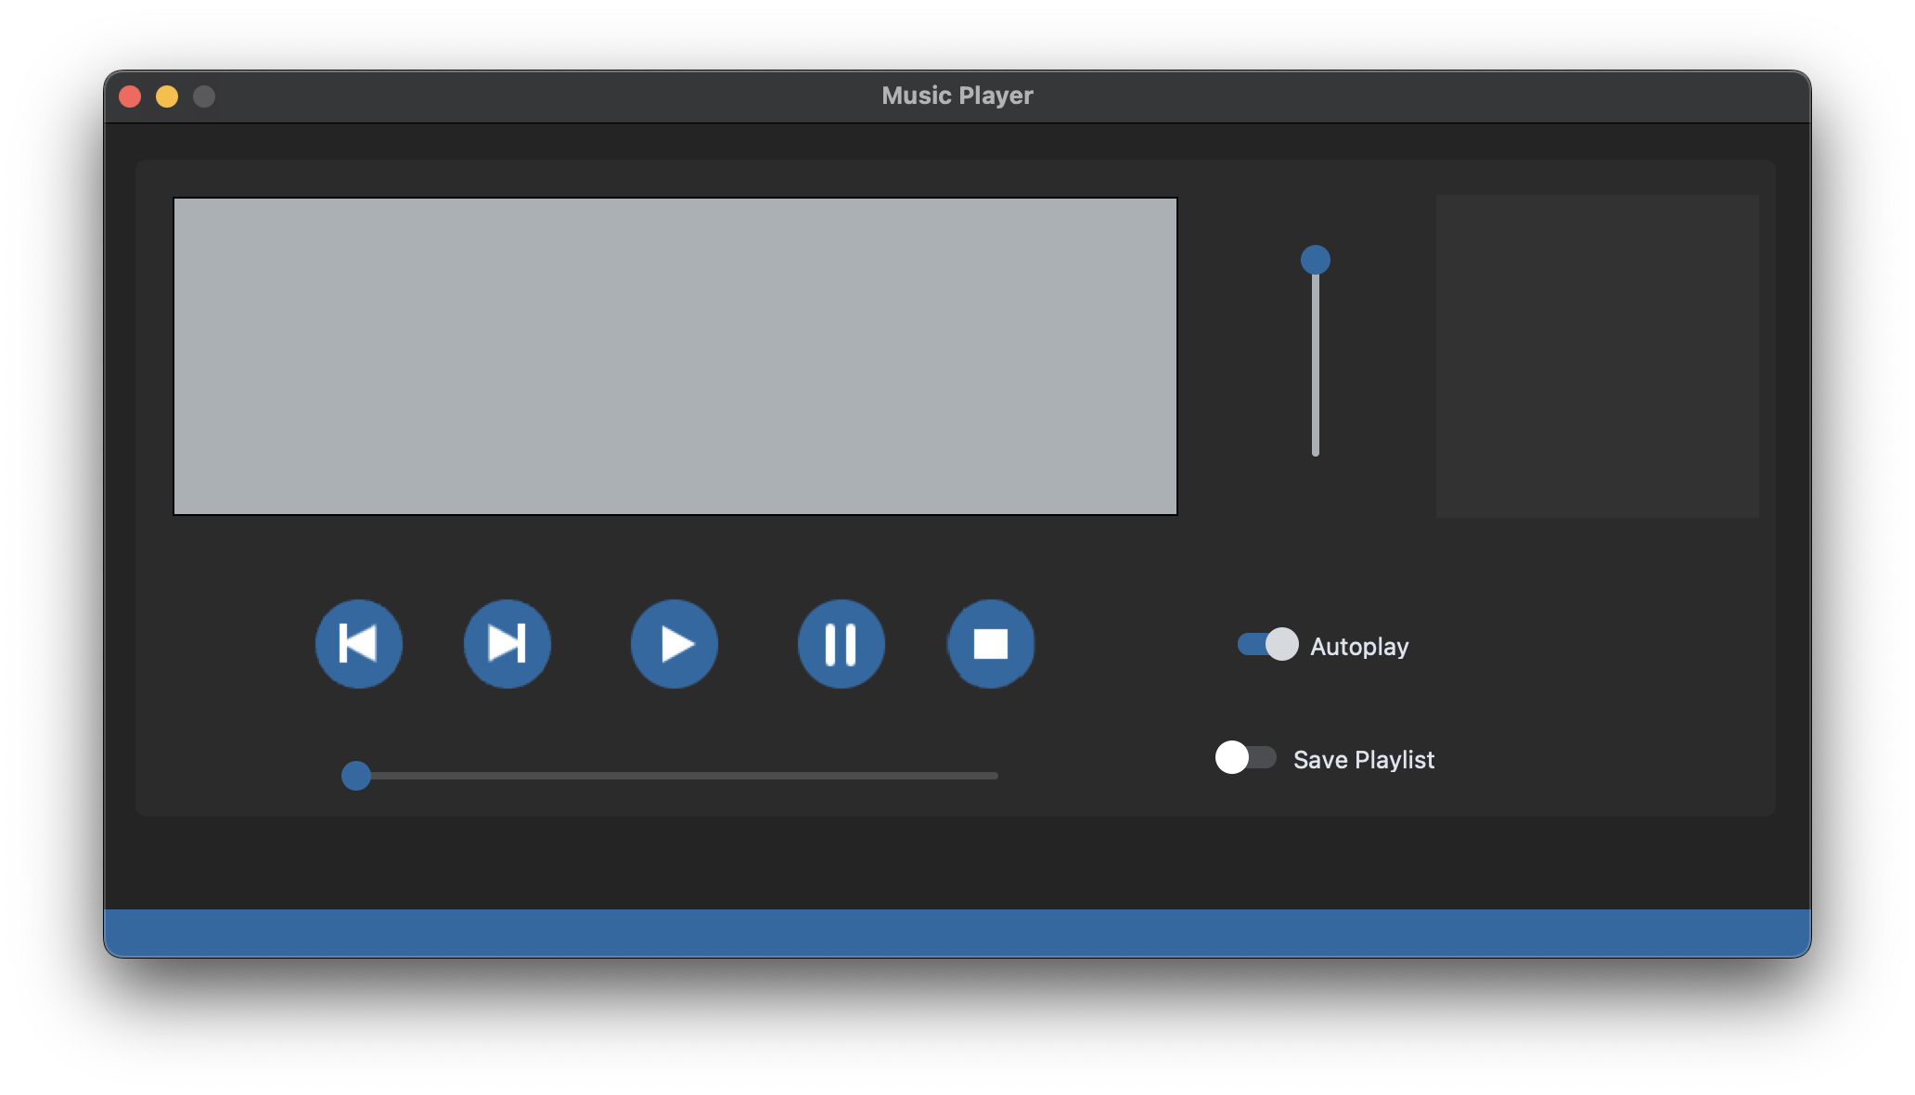
Shortcut SHIFT+ESC

Slide 60
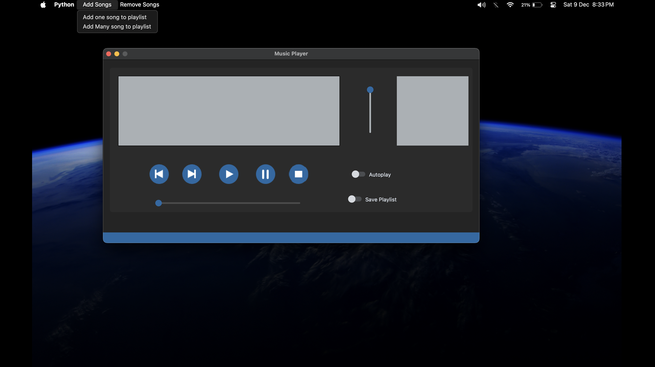
Menubar Add Songs command

Slide 61
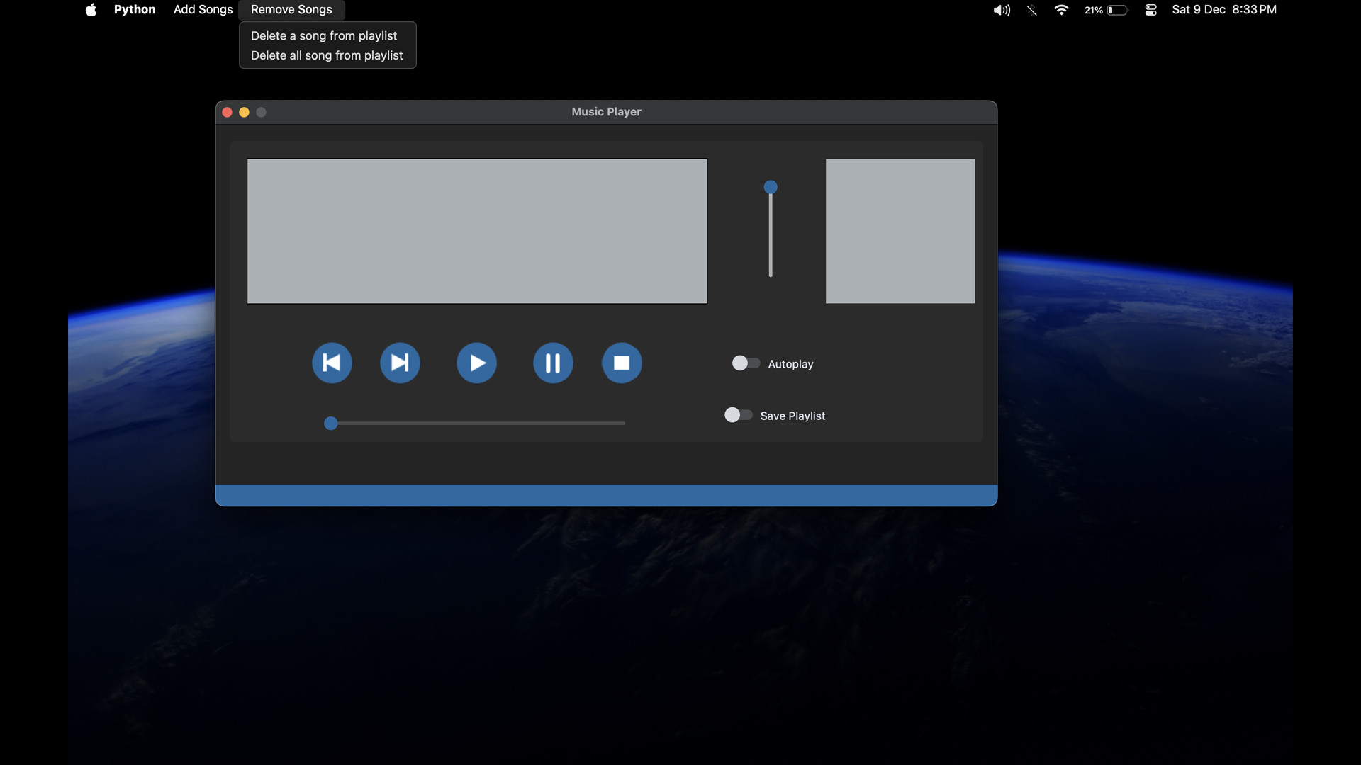
Menubar Delete Songs command

Slide 62
Thanks!

