Slide 1

whatsapp
CHAT ANALYSIS
SOFTWARE GROUP PROJECY-V (CS452)
1 9 D C S 0 8 5 - P A T E L D E V
1 9 D C S 0 8 3 - P A T E L D A k S H
UNIT TEST - 1

Slide 2
table of
CONTENT
1 . I NTRODUCTION
3 . PROPOSED SYSTEM AND SCOPE
2 . BACKGROUND THEORY
4 . REQUIREMENTS
6 . PROJECT PLANNING
5 . HARWARE AND SOFT REQ
Page 02 of 10

Slide 3
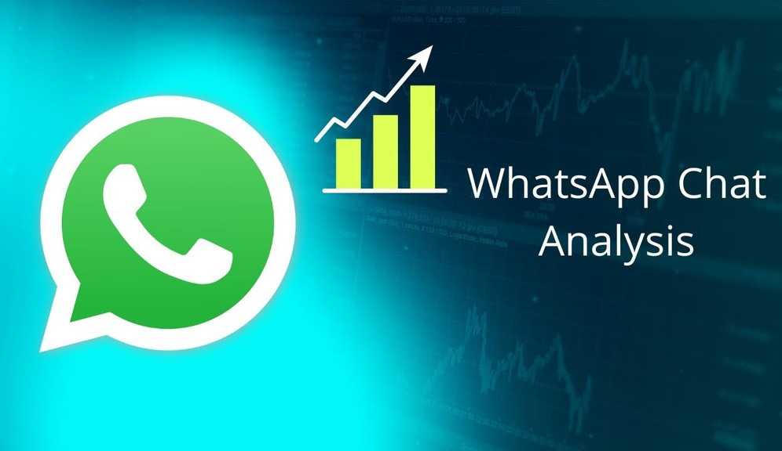
Introduction
Page 03 of 10
WhatsApp chat Analyzer is an analyzing tool for the WhatsApp chats. The chat files can be exported from WhatsApp and it generates various plots and graphs showing, number of messages or emojis or images sent by a person, most active member in the group etc. It helps us to have a better understanding of our WhatsApp chats. This system is based on data analysis and pre-processing
DATA ANALYSIS

Slide 4
Background
Page 04 of 10
THEORY
Data analysis is a process for acquiring raw data and transforming it into useful information for decision-making by users. This project provides a basic statistical analysis WhatsApp chat. Following are the analysis made :
To find total messages, total words, total media and links shared in the WhatsApp chat
To find the most active people in the group.
To find the most used emojis in the group.
To find the busiest day and least busy in a month.
To find the most frequently and commonly used words in the group.
To find the frequency of chat in every day and month.

Slide 5
Proposed
Page 05 of 10
SYSTEM
Data pre-processing is the initial part of the project, it is to understand the implementation and usage of various python inbuilt modules. These various modules provide better user understandability and code representation. The following libraries are used such as NumPy, pandas, matplotlib, sys, re, emoji, seaborn etc. It analyses the data and gives top statistics like total messages, total media, links, images shared, graphs showing the activity map weekly and monthly, monthly timeline, daily timeline, mostly busy users, chart most common words used, emojis used.

Slide 6
REQUIREMENT GATHERING TECHNIQUES
Page 06 of 10
MAIN IDEA CHOOSING TOPIC REFERENCE
YOUTUBE
Referred different projects checked resources required Analysis was the preference
RESEARCH
tried to find best projects by: research papers
youtube diff websites
WEBSITES
took reference on the project through :
Git hub
Research papers on the topic

Slide 7
Hardware & Software
REQUIREMENTS
HARDWARE
Mostly for creating and maintaining the data and preparing it you need a pc/laptop which supports latest applications and a good wifi connection.
Page 07 of 10
SOFTWARE
We can use software applications like jupiter notebook , google chrome etc. You will also require statistical programming skills
Also you can use any web browser instead of google chrome.

Slide 8
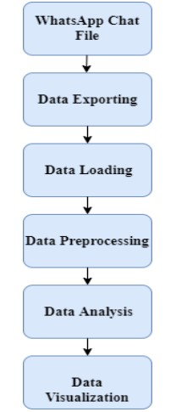
Project
PLANING
Page 08 of 10
Steps to Export chat:
Open WhatsApp chat for a group ->click on the menu ->click on more- ->select export chat->choose without media.
Working of WhatsApp chat analysis.
Initially open WhatsApp chat analyzer web page.
Select Date format.
Upload the exported chat file.
Analyzing of data is done by trained model
Preprocessing of data is done by trained model.
Select overall or single person analysis
Trained model shows analysis it includes top statistics, word cloud, activity map, monthly timeline, daily timeline, emoji analysis.

Slide 9
References
PRESENTATION: HTTPS:// WWW. CANVA. COM/
TOPIC REFERENCE : HTTPS:// WWW. YOUTUBE. COM/ WATCH? V=KCRETGOTIFU& AB_CHANNEL=MCKAYJOHNS
G I THUB: HTTPS:// G I THUB. COM/
RESEARCH PAPER :
HTTPS:// WWW. I RJMETS. COM/ UPLOADEDFILES/ PAPER// I SSUE_ 5 _MAY_ 2022 / 22029 / F I NAL/ F I N_IRJMETS 1651575 263 . PDF
Page 09 of 10

Slide 10
thankyou
Page 10 of 10
TO ALL
19DCS085 19DCS083

