Slide 1

ADMISSION ANALYSIS on mimic iii

Slide 2

1. Problem Statement
2. Project Objectives
3. Dataset Information
4. Dataset
5. Data exploration and Visualizations
7. Challenges
Why Admission analysis
8.References
6. Why Machine Learning ?
Contents

Slide 3

Why admission analysis
In this contemporary era each hospital is facing some problem.
Each hospital admission/entry records of patients contains tremendous amount of knowledge.
With the help data analysis and machine learning we can analyze this data and solve many problem. we can give them best solution of their problem so they can optimize their work for better performance.
By using machine learning we can predict that patient will visit the hospital in future or not.

Slide 4
Problem Statement
Identify the factor that can be cause for patient death not only this but try to improve hospital / healthcare infrastructure from the ground.

Slide 5
Data set
Database source : physionet.org
We work on 2 dataset of MIMIC III
Admission
Notesevent

Slide 6

analysis
on
admission data (EDA)

Slide 7
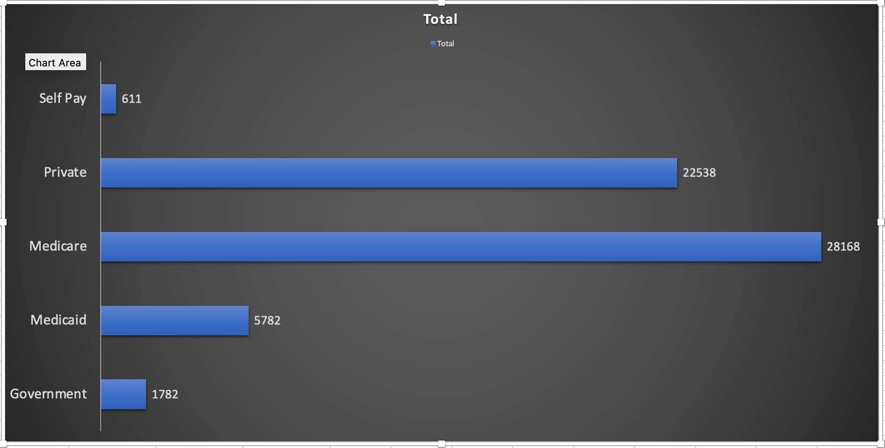
Patient admitted have which Insurance ?

Slide 8
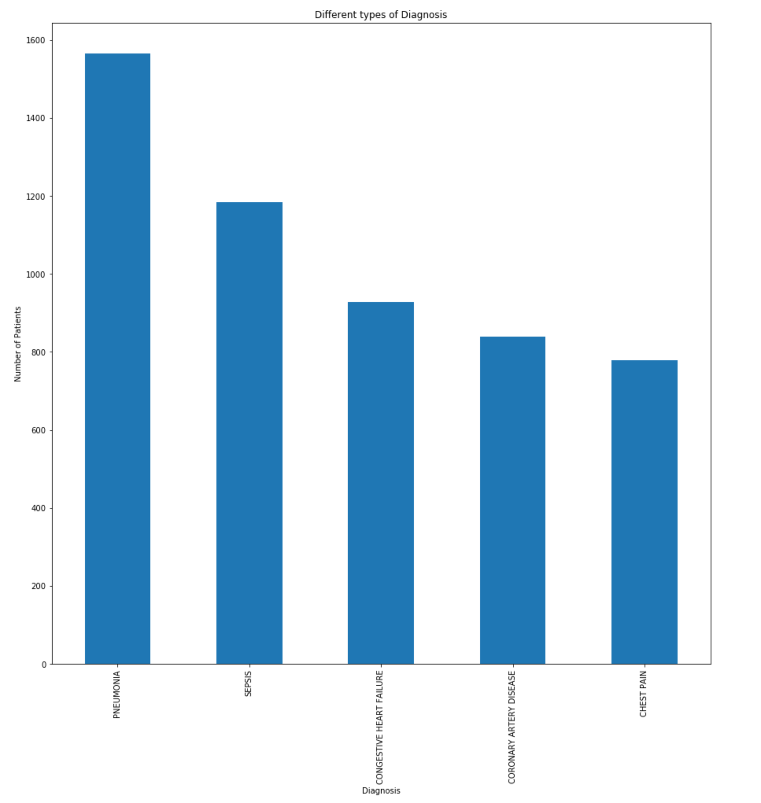
PATIENT DIAGNOSIS WITH DISIEASE

Slide 9
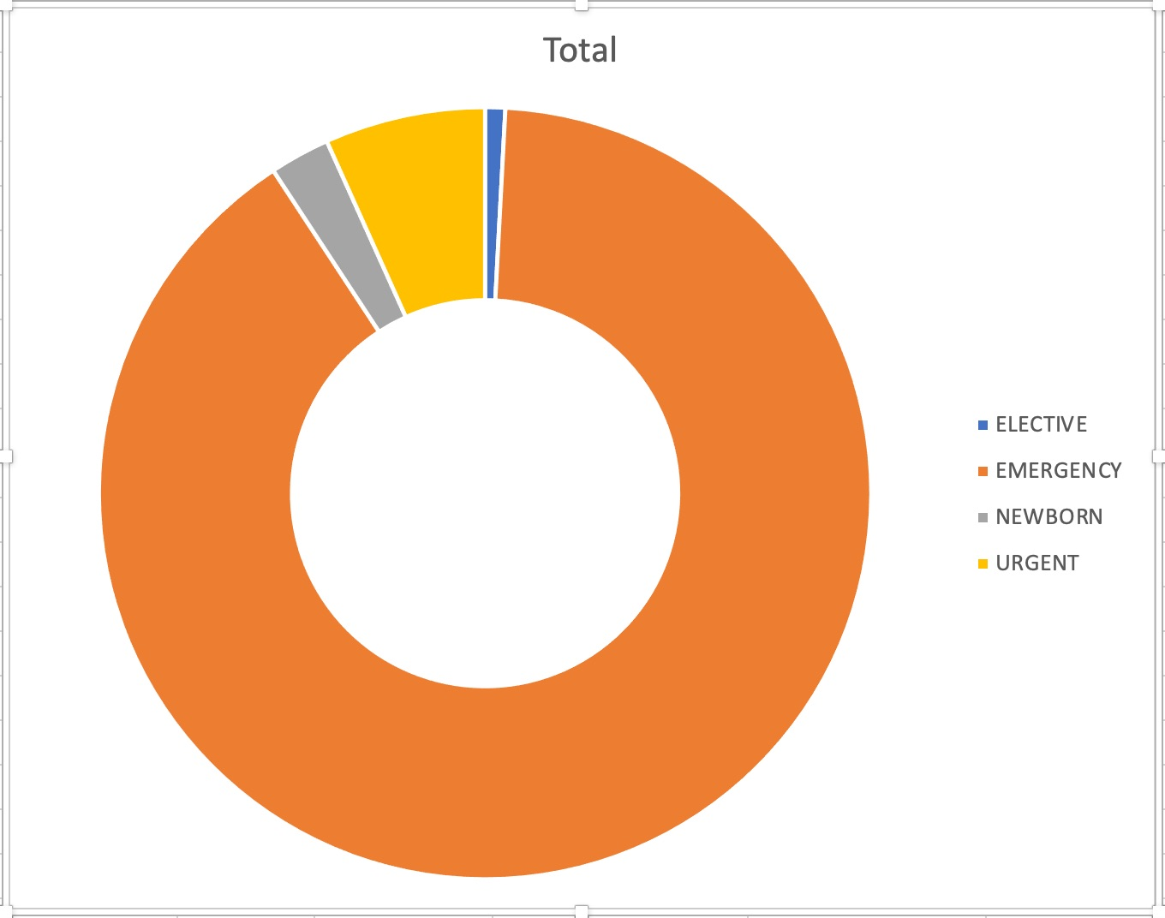
Which Admission_type have more patient ?

Slide 10
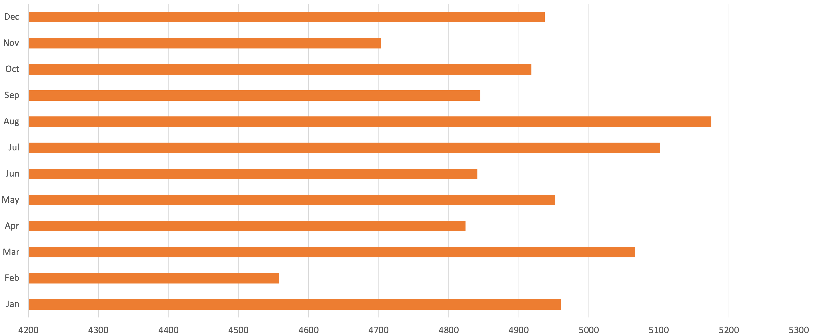
Patient admitted in hospital month wise

Slide 11
Patients died in admitted location

Slide 12
Average length of stay in hospital

Slide 13
DEATH RATE BY DIAGNOSIS

Slide 14
LENGTH OF STAY BY DISEASE

Slide 15
Machine Learning
We applied machine learning to predict the readmission rate of patient that are admitted in the emergency/urgent section.
To do that we combine notesevent dataset with the admission dataset.

Slide 16
Machine Learning cont.
How we do it
We going to predict readmission rate based on discharge SUMMARY that is present in the notesevent file.
What we use
We use logistic regression model
Natural language processing (To understand text better)
We combine both dataset files

Slide 17

Model performance

Slide 18
Logistic regression model
Model Accuracy on Testing data : 72%
Model accuracy on validation data is : 71%
F1 score is : 73%

Slide 19
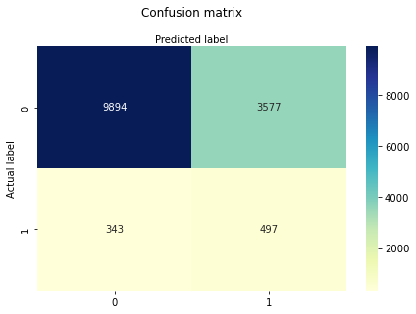
Confusion matrix

Slide 20
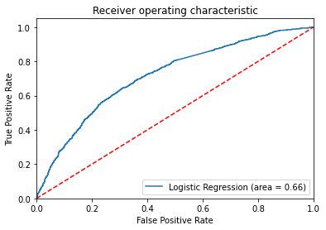
ROC curve
ROC SCORE IS 71%

Slide 21
Conclusion
More patient died by PNEUMONIA and SEPSIS . So, hospital / Healthcare organization should higher more experience doctors and more powerful/Higher dosage medicine.
Increase staff in HMO/REFRELL and SICK and Emergency department and Thoracic Dissection.

Slide 22


