Slide 1

MAULANA AZAD NATIONAL INSTITUTE OF TECHNOLOGY
BHOPAL,INDIA, 462003
Computer Science and Engineering Department
Face Mask Detection Using CNN
Minor Project
Semester - V & VI
Under the Guidance of
<Faculty name>
DEPARTMENT OF COMPUTER SCIENCE AND ENGINEERING
Session: <current session>

Slide 2
Under the Guidance of
Dr. R. K. Pateriya
DEPARTMENT OF COMPUTER SCIENCE AND
ENGINEERING
Submitted by : | Scholar No.
Preetam Patel | 181112247
Anubhav goyal | 181112248
Parth Sourav | 1811122305
Vatsal rastogi | 181112239.

Slide 3
Abstract :
COVID-19 pandemic has rapidly affected our day-to-day life disrupting world trade and movements. Wearing a protective face mask has become a new normal. In the near future, many public service providers will ask the customers to wear masks correctly to avail of their services. Therefore, face mask detection has become a crucial task to help global society.
This work presents a simplified approach to achieve this purpose using some basic Machine Learning packages like Keras, OpenCV and Scikit-Learn.
The proposed method detects the face from the image correctly and then identifies if it has a mask on it or not
.
As a surveillance task performer, it can also detect a face along with a mask in motion. The method attains avg accuracy up to 94.77% respectively on dataset. We explore optimized values of parameters using the Sequential Convolutional Neural Network model to detect the presence of masks correctly without causing over-fitting.
Keywords:
Computer Vision , Face Detection, Image;
Tracking; COVID-19; Face Masks; Safety

Slide 4

FACE MASK DETECTION USING CNN

Slide 5

Detecting if an image contains a person wearing a mask or not is a simple classification problem. We have to classify the images between 2 discrete classes: The ones that contain a face mask and the ones that do not.
Defining the problem:
Solution of Problem :
A Convolutional Neural Network, also known as CNN or
ConvNet, is a class of neural networks that specializes in
processing data that has a grid-like topology, such as an image.
Application of CNN:
1.Object Detection 2. Face Classification
3.Object Classification 4. Object Recognition

Slide 6
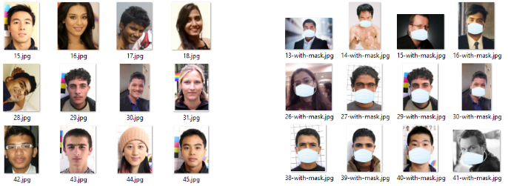
Dataset
I found a dataset containing faces with and without masks online.
It contains 2076 images. 1690 images show people with face masks and 310 images show people without face masks.

Slide 7
Image classification and CNNs
A bit of theoretical background first. Convolutional Neural Networks (CNN) are neural networks most commonly used to analyze images. A CNN receives an image as an input in the form of a 3D matrix.
CNNs consist of the following sequential module( contain layers):
Input Layer
Hidden Layer
Output layer :)Each Layer hase two main part 1. Convolution 2. Pooling

Slide 8
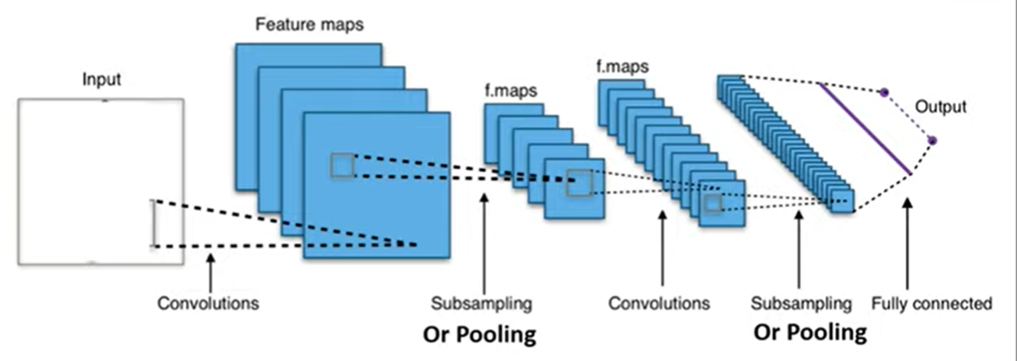
Convolutional Neural Network Architecture

Slide 9
Convolution
Convolution operation is an element-wise matrix multiplication operation.
Convolutional layers are the layers where filters are applied to the original image, or to other feature maps in a deep CNN. This is where most of the user-specified parameters are in the network. The most important parameters are the number of kernels and the size of the kernels.The output of this operation is the final convoluted image.

Slide 10
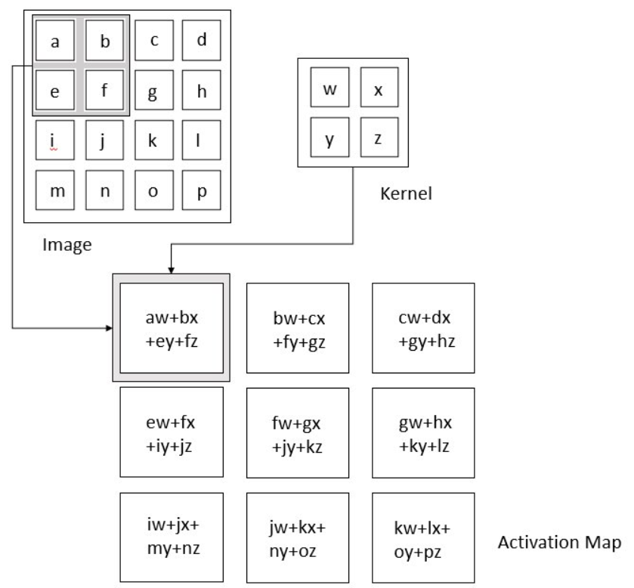
Convolution Operation

Slide 11
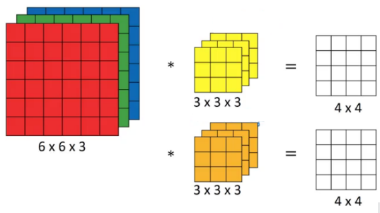
Problem Behind Convolution
There are primarily two disadvantages here:
1. Every time we apply a convolutional operation, the size of the image shrinks
2. Pixels present in the corner of the image are used only a few number of times during convolution as compared to the central pixels. Hence, we do not focus too much on the corners since that can lead to information loss

Slide 12
PADDING
To overcome these issues, we can pad the image with an additional border, i.e., we add one pixel all around the edges:
Input: n X n
Padding: p
Filter size: f X f
Output: (n+2p-f+1) X (n+2p-f+1)
There are two common choices for padding:
Valid: output will be (n-f+1) X (n-f+1)
Same: output size of my image = n X n
Get Value of p from equation :
n+2p-f+1 = n
p = (f - 1)/2

Slide 13
Pooling
It does so to reduce processing time and the computing power needed.
During this process, it preserves the most important feature information. There are several methods that can be used for pooling.
The most common ones are Max pooling and Average pooling.

Slide 14
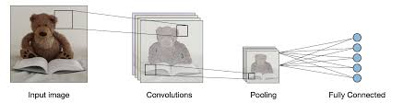
POOLING

Slide 15
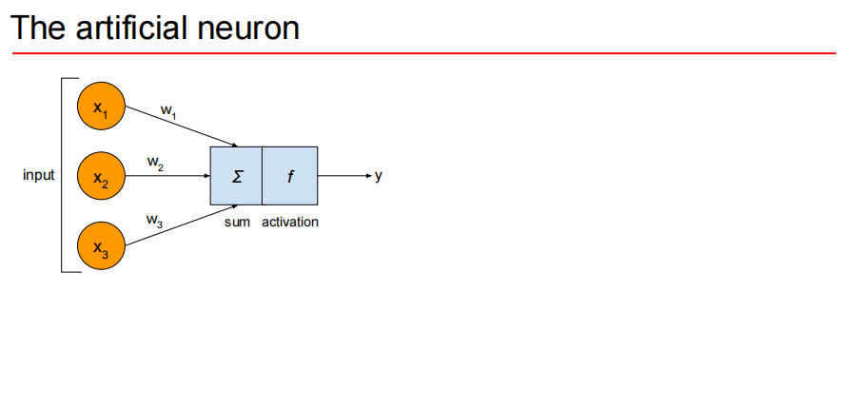
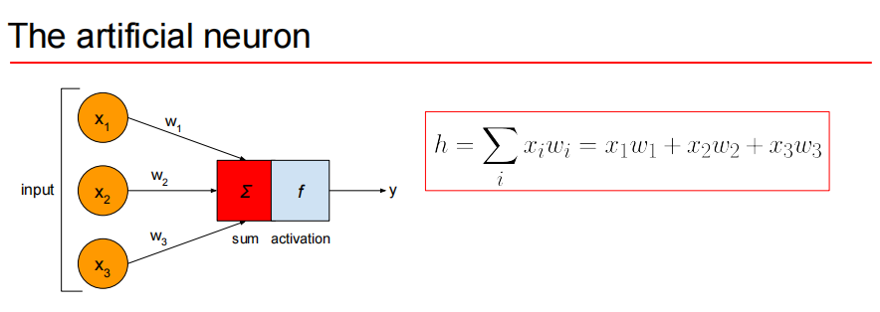

Slide 16
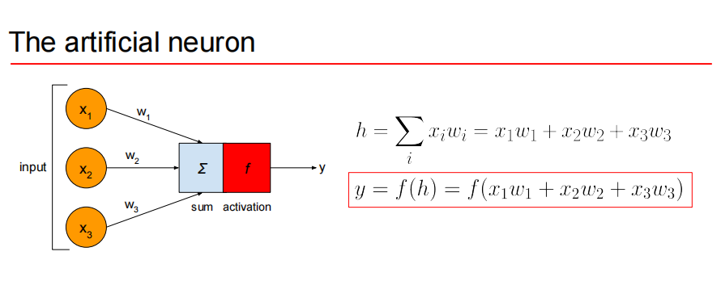
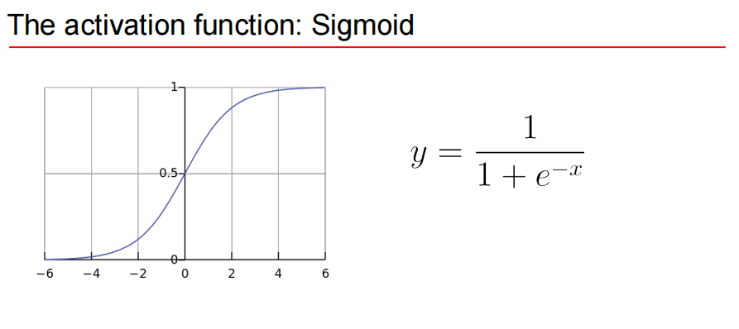

Slide 17
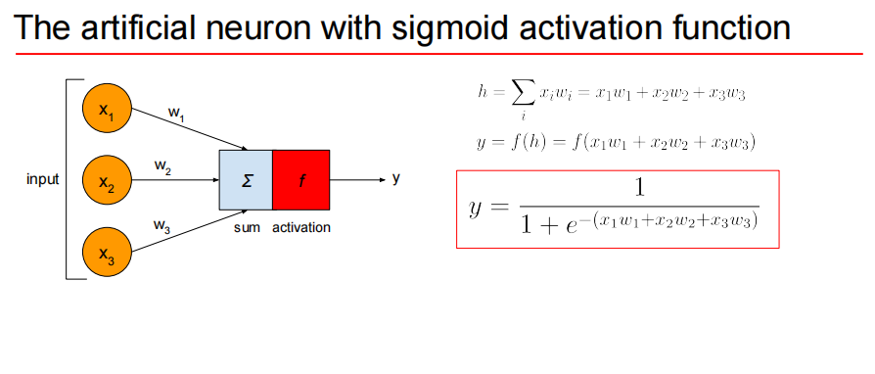

Slide 18
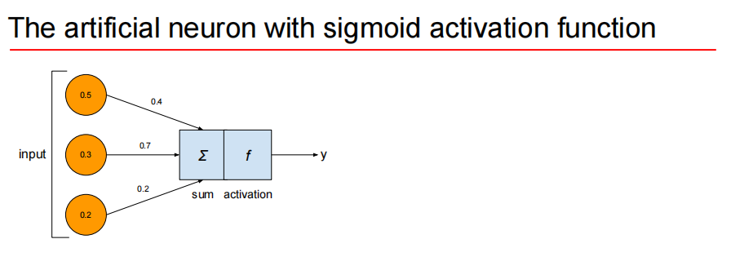
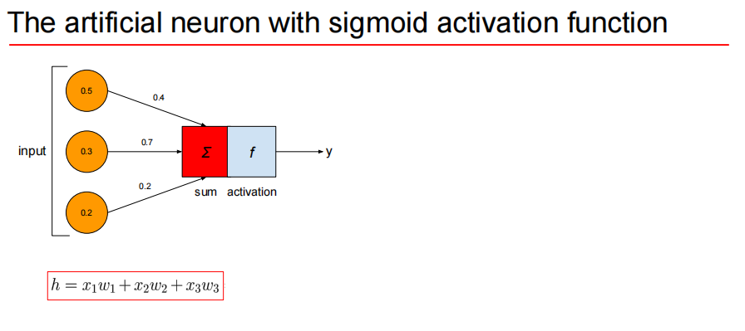
The artificial neuron with sigmoid activation function0.50.40.7inputyΣf0.30.2activationsum0.2

Slide 19
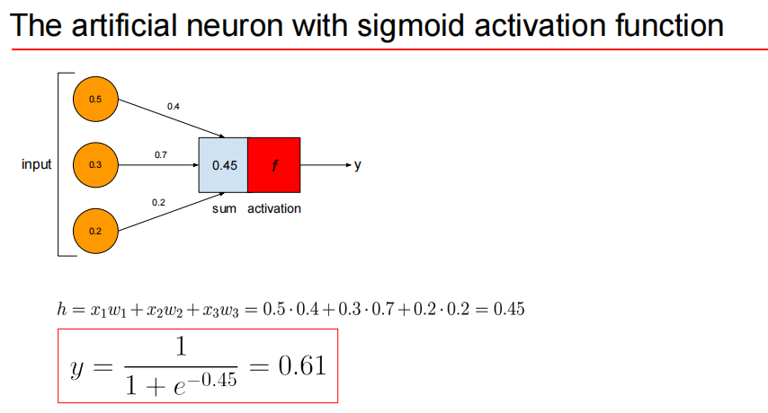

Slide 20



Activation Function
1. Softmax Function
2. Sigmoid Function
3. Rectified Linear Unit (ReLU) Function

Slide 21
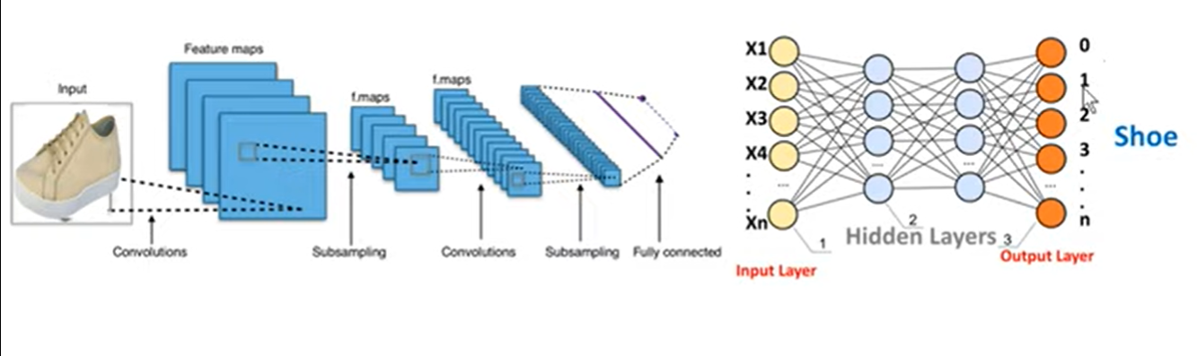
Neural Network Architecture

Slide 22
Face mask detection :
I used Tensorflow and Keras to create the CNN that classifies the images as with or without mask.
First, we need to randomly split the dataset in separate train / test sets. We do so with the following function:
We then call it twice (one for the images that contain a mask and one of the images that do not) with a train / test split of 80% (80% used for training and 20% for test).

Slide 23
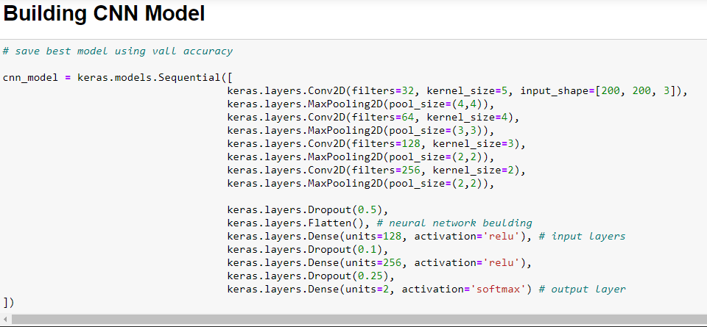
The model
The definition of the model is presented below:

Slide 24
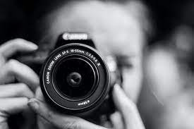
IMAGE CAPTURING AND PROCESSING

Slide 25
Libraries for Image Processing
import cv2
import os
from keras.models import load_model
from keras.preprocessing.image import load_img, img_to_array
import numpy as np

Slide 26
DETECTING FACE FROM IMAGE
1. Load Cascade classifier for face detection.
2. Load Image .
3. convert to Gray Scale
4. Get coordinate of object(face).
5. plot rectangle around the around face.
My Harcascaded File is :)
haarcascade_frontalface_default.xml

Slide 27
DETECTING FACE FROM VIDEO
1. Load Cascade classifier for face detection.
2. Start Web Camera.
3. Select frame (Image) for detection of face.
4. convert frame(Image) to Gray Scale.
5. Get coordinate of object(face).
6. plot rectangle around the around face on frame.
My Harcascaded File is :)
haarcascade_frontalface_default.xml

Slide 28
Making Image Compatible For Model
1. Load the Image.
2. Add one more dimension to image.
3. Convert to an array
4. provide to Model

Slide 29
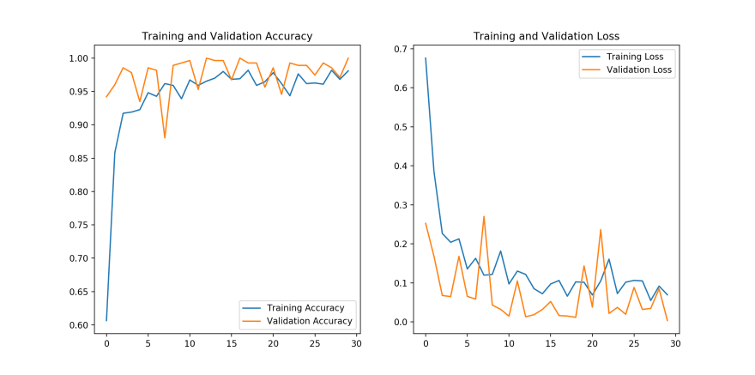
Benchmarks
The learning curves (training and validation accuracy and loss) of the model are the following for 30 epochs of training:

Slide 30
THANK YOU

