Slide 1

EE746: Neuromorphic Engineering
Robot Path Planning Using SNN
Jayesh Choudhary Preetam Pinnada Srisht Fateh Singh
170070038 170070042 170070056
Notes:
The most fundamental part of Robot Path Planning is to get a sense of direction and position. For this project, we replicate one method to find the directions using the spiking neural network as proposed in the paper: A Spiking Neuron Model of Head-Direction Cells for Robot Orientation by Thomas, Loic, Christian and Angelo. We also propose a method to find the position in a 2D space.

Slide 2
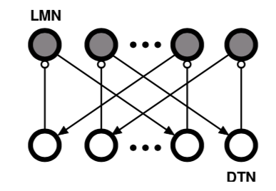


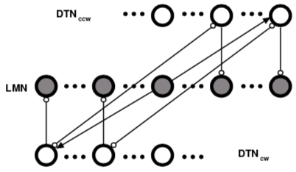

Implementation of Head Direction Cells
Notes:
Sense of direction is crucial for both biological and artificial systems involving navigation. Extracellular recordings from freely-moving rats suggest that Head directional cells perform a very crucial role in this. An HD cell has a unique preferred direction for which it discharges maximally. We try to mimic the network implemented in the reference paper. The network comprises of an attractor network and an integrator network composed of 1000 lateral mammillary nucleus abbreviated as LMN and 1000 dorsal tegmental nucleus or DTN which comprises of 500 neurons for clockwise direction and 500 for anticlockwise direction. Each of these neurons have a unique preferred angle uniformly distributed between 0 to 360 degrees for which it discharges maximally. LMN projects excitatory connections to DTN. DTN projects inhibitory connections to LMN. Also, there are lateral connections between DTNcw and DTNccw to induce unbalanced cell activity between DTNcw and DTNccw. The weights of these connections are shown in the slides. This unbalanced cell activity is responsible for change in peak firing proportional to omega. By integrating the angular velocity of time, the direction of the head is found out.

Slide 3
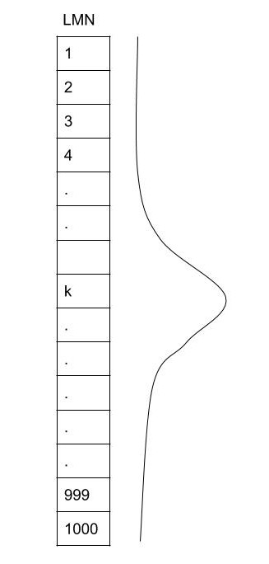
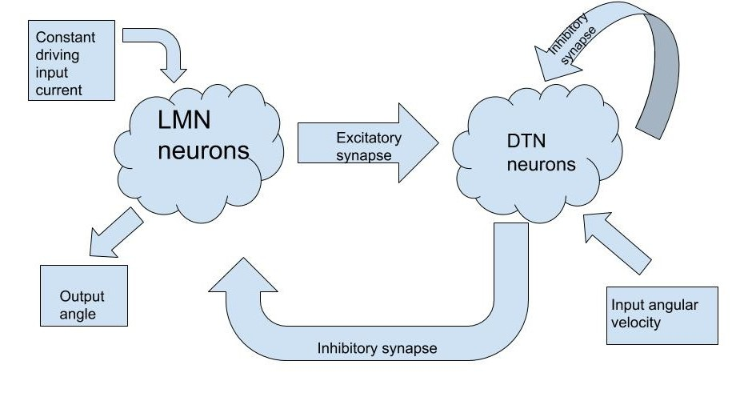
Intuitive understanding of paper
Fig 1
Fig.2
Notes:
Fig.1 shows the gaussian profile of the weights as the prefered angle of the postsynaptic neuron changes with respect to the presynaptic neuron. The magnitude of weights decreases as the difference of prefered angles in a synapse increases. The neural system consists of two parts namely the attractor network and the integrator network. To understand the attractor network, assume a zero angular velocity. The LMN neurons with dominating input current will excite the DTN neurons with some phase difference in a gaussian profile which will further inhibit the LMN neurons. Here the phase means the prefered angle. Thus, the LMN neurons are inhibiting some of its own neurons via DTN neurons. This works like a negative feedback. During the steady state, only some cluster of LMN around a particular angle will keep on firing.
When the input angular velocity is non-zero, it perturbs the system thus shifting the dominant firing of LMN neurons. This velocity of shift is proportional to the amount of perturbation or the angular velocity. Thus, the output firing of LMN neurons keeps on shifting.

Slide 4
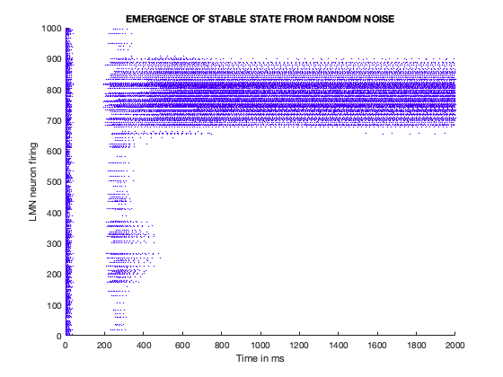
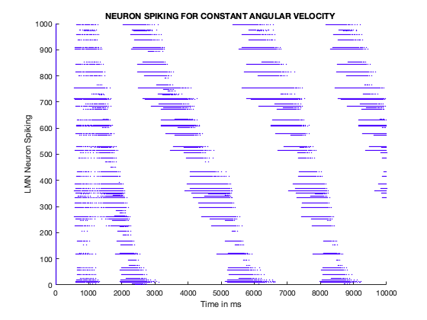
Obtained Results
Notes:
Two major observations from the paper are shown in this slide. The figure on the left is for the case when no angular velocity is applied. Here we can see that initially all the neurons fire, then for few 100 ms, none of them fires. This oscillation continues. Finally, a stable state emerges from random noise due to attractor model dynamics after a transitory period characterised by the oscillation activity. In the absence of external stimuli, the HD population activity profile settles down to a self-sustained state in which only a subpopulation of cells with similar preferred directions discharges tonically.
The figure on the right is for the case when constant angular velocity is provided. Transitory period is seen here as well. We can see that after the transitory period, as time progresses, there is shift in firing of neuron. The neurons corresponds to angle 0 to 360 degrees and so the final angle is modulo 360 degrees and hence the spikes are discontinuous as in the figure. This implies that with our SNN model, we can find the direction for a given angular velocity.

Slide 5
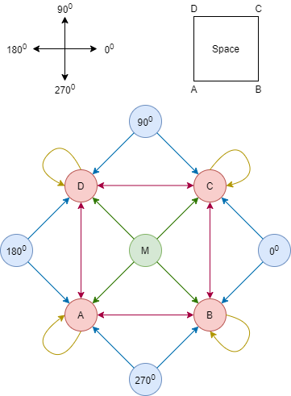
Our proposed method for navigation in 2D-Space
1
2
Notes:
So far we’ve seen how to identify the direction of a bot, but an equally important task is to be able to determine the relative position in space. So now I’ll be explaining our proposed method to determine the position of a robot in a 2D space. We divide the 2D space into a square grid, and identify at which of these lattice points is the bot located at any given instance. For our implementation purposes, we limited these positions in space to four corners of a square. This idea can be scaled using symmetry to encompass a larger 2D space.
The neural network contains the following 9 neurons -
4 position neurons (viz. A,B,C,D) each corresponding to one of four corners of a square. These neurons fire in a mutually exclusive manner. At any instance the position of the robot is inferred from the neuron that’s firing.
4 direction neurons (viz. 0, 90, 180, 270) each indicating the direction of the robot w.r.t. a predetermined baseline. These neurons again fire in a mutually exclusive manner. At any instance the direction of the robot is inferred from the neuron that’s firing.
1 motor neurons (M). M fires when the robot makes a move. A move is defined as a transition from one corner of a square to another. Movement only along the edges of the square are permitted.
All the neurons are modelled as LIF neurons and all synapses in the network are of the same type. The architecture is described in Fig. 5. The motor neuron excites every position neuron. Since one can arrive at a particular corner of a square only in two directions, the angle neurons excite position neurons accordingly. For example, one can reach B from A in 0⁰ direction and from C in 270⁰ direction, therefore only 0⁰ and 270⁰ direction neurons excite the position neuron B. If this is to be extended to a larger space with greater number of lattice points, in such a case just like the motor neuron, every direction neuron would excite every other position neuron.
Neuronal dynamics during navigation from a corner to the adjacent would play out as follows. Without any loss of generality, consider the robot starting at corner A and facing corner B, i.e. neurons A & 0⁰ are firing at the moment. A change in position from A to B is seen as (A AND 0⁰ AND M) together charging neuron B. When the B fires, it indicates the change in robots position. The firing of neuron B is sustained through a self-excitation indicated in amber colored arrows in Fig. 5. When B is being charged, simultaneously (A AND 0⁰ AND M) inhibits the neuron A. The notion of “AND” is taken from [4]. This way mutually exclusiveness is achieved in position neuron firing patterns.

Slide 6
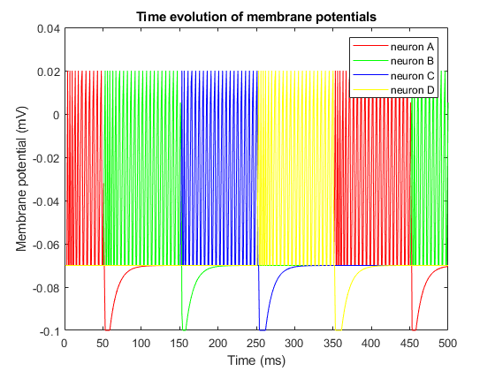
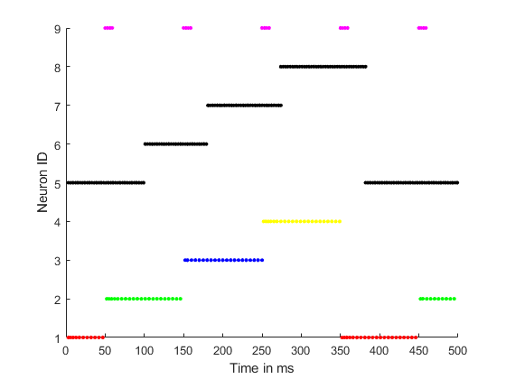
Simulation Results of our proposed method
1
2
3
Notes:
The neurons used in this expt consist of LIF neurons refractory period of 2ms. The results of this experiment are shown in Fig. 6 and in Fig. 7. It is evident from the firing patterns of position neurons A(red), B(green), C(blue), D(yellow) in these figures, that the bot is able to correctly identify it’s position as it visits the four corners of a square.

Slide 7
https://drive.google.com/drive/folders/1qDMpNVgZ8bpjn9sGDrztesGtAc4SA-1j?usp=sharing : Link for all the audio files

