Slide 1
Spatial Localization using RNNs and Analysis of Emerging Firing Patterns
BTP Stage-1
By
Preetam Pinnada, 170070042
Supervisor:
Prof. Udayan Ganguly

Slide 2
Questions
How do humans understand and navigate through an environment?
How can it help in designing a spatial localization system for artificial agents?
What does it tell us about brain development?

Slide 3
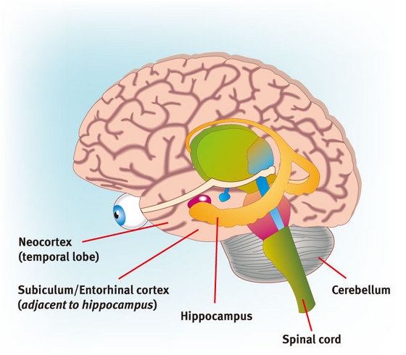
Hippocampus Entorhinal Cortex Neocortex
Source: https://www.riken.jp/medialibrary/riken/research/rikenresearch/figures/low_2725.jpg

Slide 4
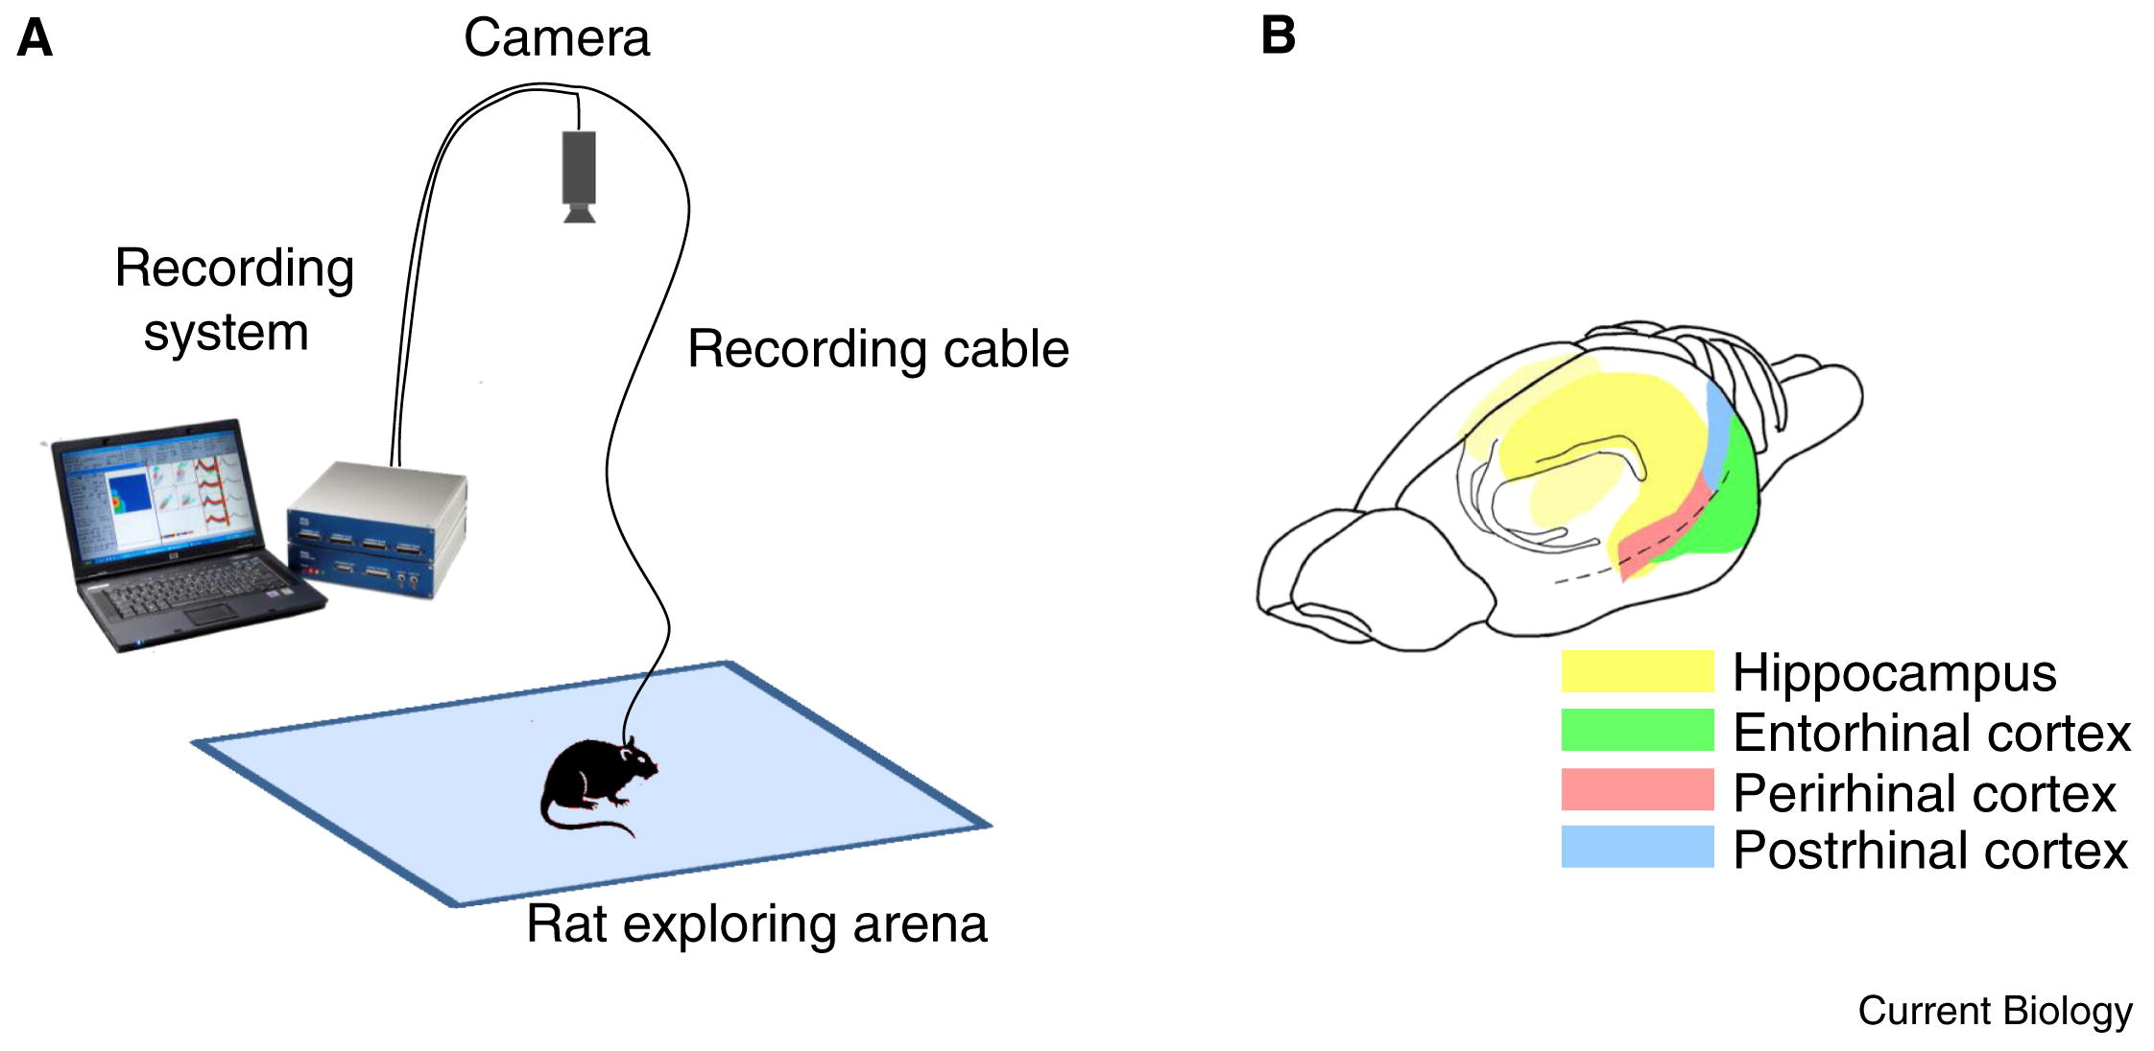
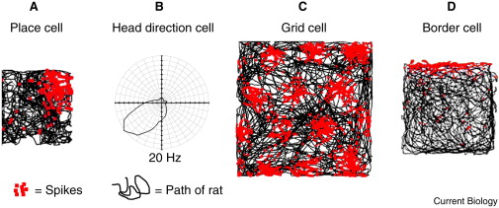
Interesting Firings Patterns
Sources:
https://ars.els-cdn.com/content/image/1-s2.0-S0960982212012079-gr1_lrg.jpg
https://ars.els-cdn.com/content/image/1-s2.0-S0960982212012079-gr2.jpg

Slide 5
Spatial Firing Patterns in RNNs
Christopher J. Cueva and Xue-Xin Wei. Emergence of grid-like representations by training recurrent neural networks to perform spatial localization. ICLR 2018
Banino, A., Barry, C., Uria, B. et al. Vector-based navigation using grid-like representations in artificial agents. Nature 557, 429–433 (2018).

Slide 6
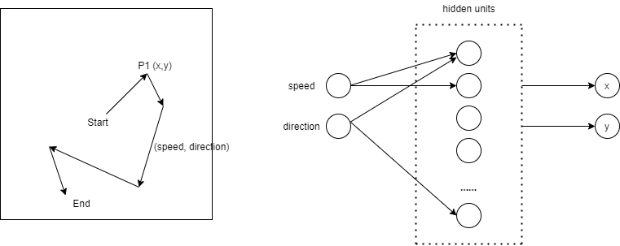
Setup

Slide 7
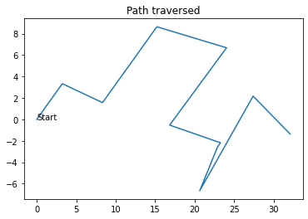
Data

Slide 8
Model Details

Slide 9
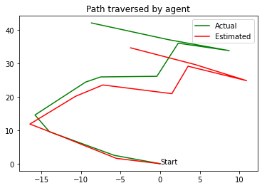
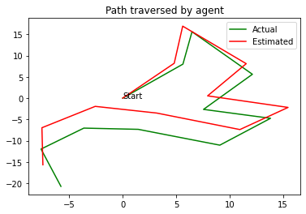
Results

Slide 10
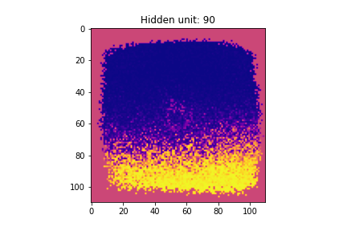
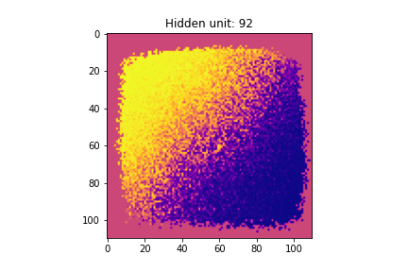
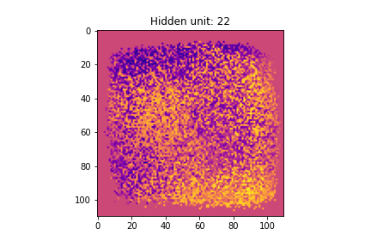
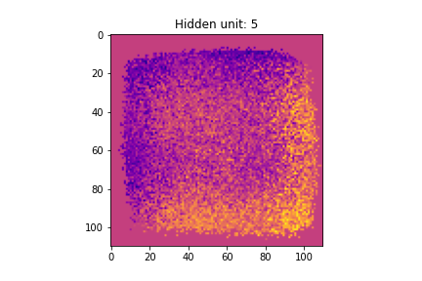
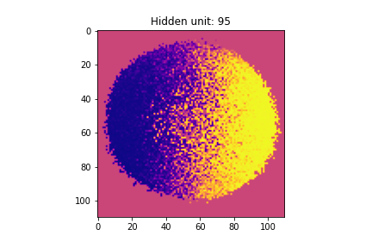
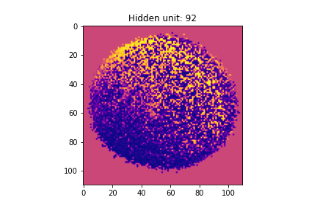
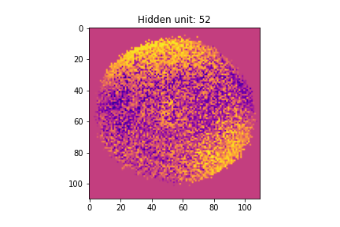
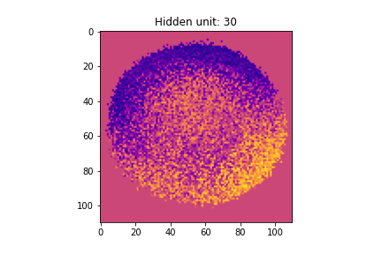
Firing Patterns

Slide 11
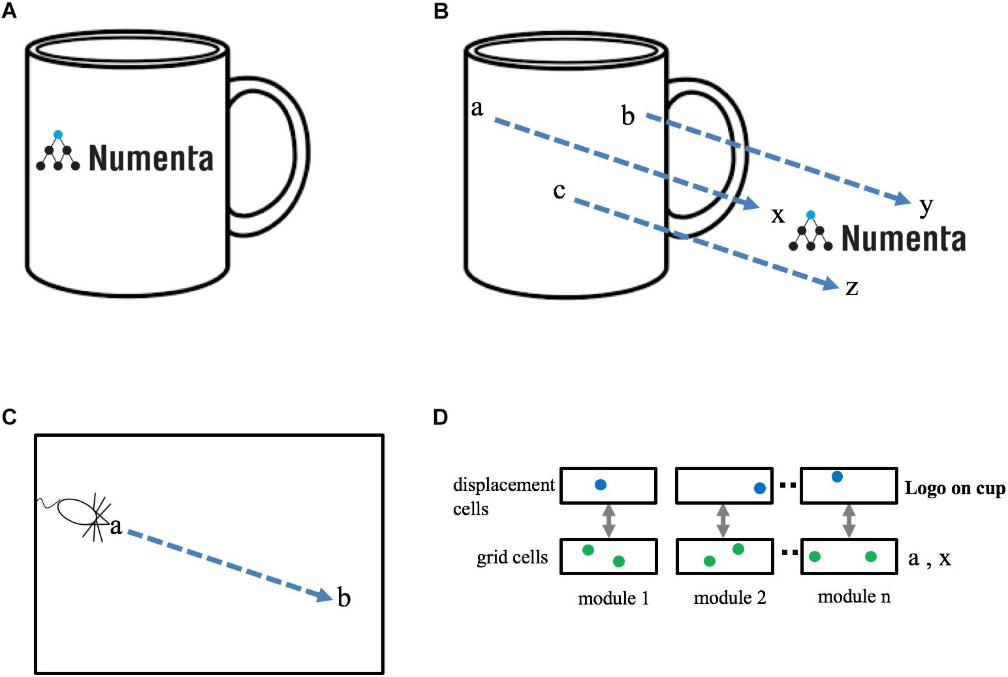
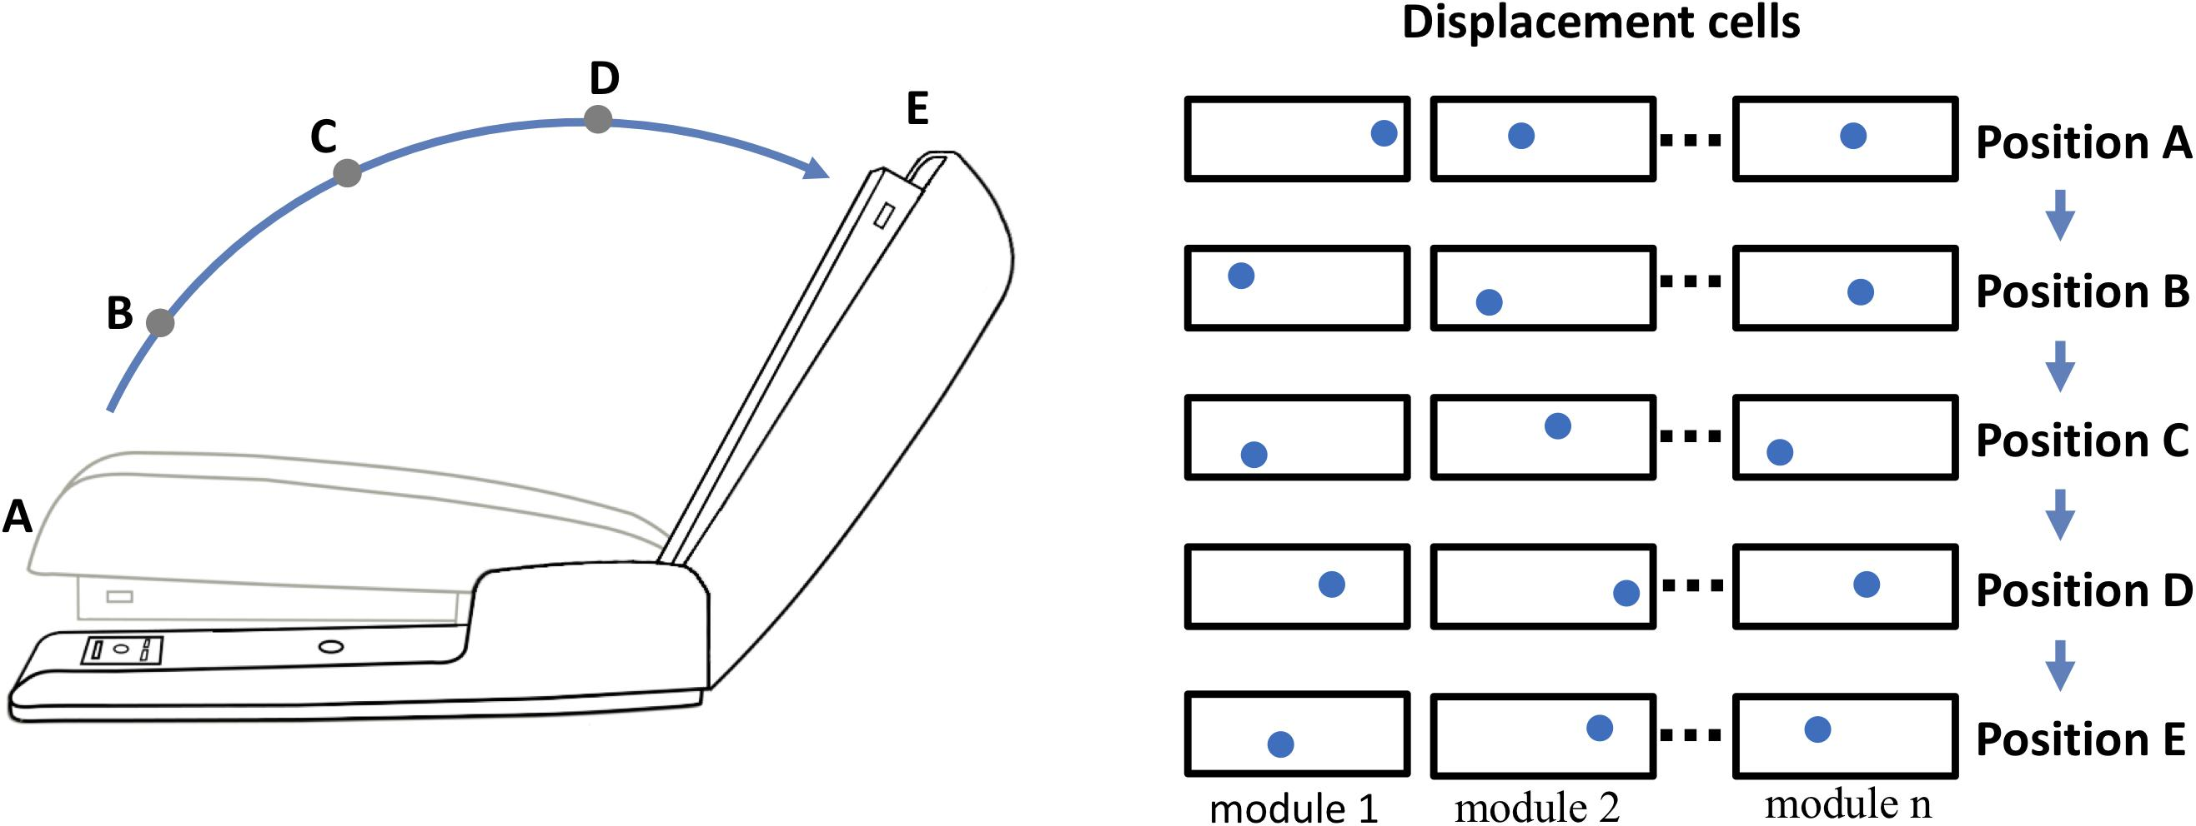
What’s with Grid Cells in Neocortex?
Hawkins Jeff, Lewis Marcus, Klukas Mirko, Purdy Scott, Ahmad Subutai.
A Framework for Intelligence and Cortical Function Based on Grid Cells in the Neocortex.
Frontiers in Neural Circuits 2019. DOI=10.3389/fncir.2018.0012

Slide 12
Links
Report
Code (1 & 2)
Blogposts

Slide 13
Questions?

