Slide 1
Spatial Localization using SNNs
BTP Stage-2
By
Preetam Pinnada, 170070042
Supervisor:
Prof. Udayan Ganguly
Notes:
Hello, my name is Preetam. And I welcome you to my BTech thesis project presentation. This is the stage-2 review which is about spatial localization using SNNs.
This is in direct continuation to BTP-1. So to set the stage for the new audience, please allow me to briefly describe the work done in the previous semester.

Slide 2
Questions
How do humans understand and navigate through an environment?
How can it help in designing a spatial localization system for artificial agents?
What does it tell us about brain development?
Notes:
At the heart of this entire project lies the following questions that I asked myself.
How do humans understand and navigate through an environment?
How would it help in designing a spatial localisation system?
And what does it tell us about brain development?

Slide 3
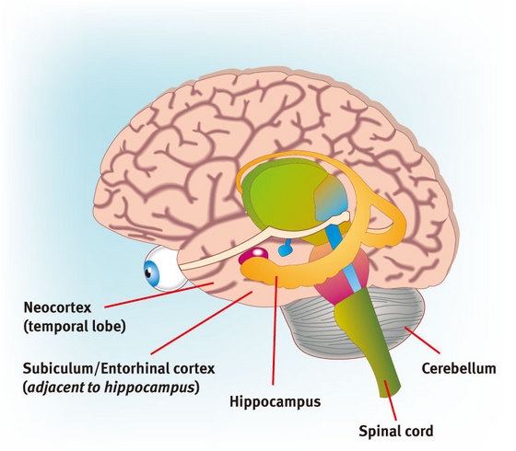
Hippocampus Entorhinal Cortex Neocortex
Source: https://www.riken.jp/medialibrary/riken/research/rikenresearch/figures/low_2725.jpg
Notes:
Regions of brain called hippocampus and entohinal cortex were found to play a crucial role in animal navigation.

Slide 4
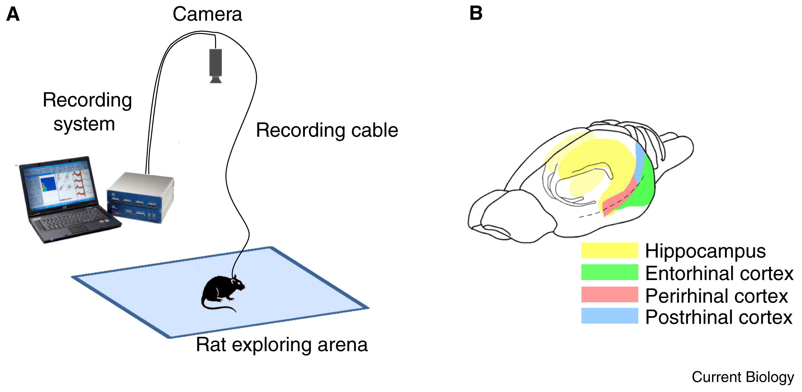
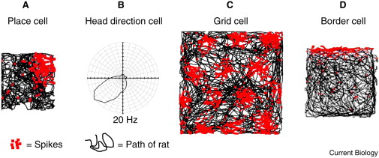
Interesting Firings Patterns
Sources:
https://ars.els-cdn.com/content/image/1-s2.0-S0960982212012079-gr1_lrg.jpg
https://ars.els-cdn.com/content/image/1-s2.0-S0960982212012079-gr2.jpg
Notes:
Back in the day scientists observered the firing patterns of different nerve cells in a rat brain as it explored a rectangular arena.
In the images on the right hand side, red coloured dots indicate spikes. For a particular nerve cell was found to spike only when the organism was at a particular place in the arena. They named it place cell. And similarly we have grid cells, border cells, etc.

Slide 5
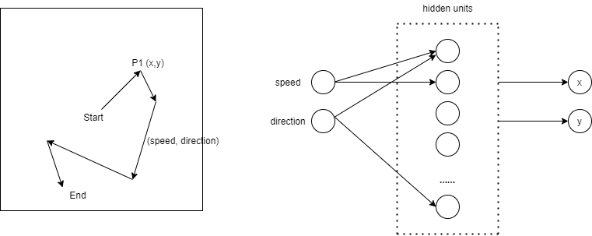
Setup
Notes:
Looking at all of this, I set out to train a neural network to perform path integration and observed its pattern.
Path integration is the ability of the organism to estimate its relative location from the start based on external cues (such as vision, motor neuron activity, head direction cells activity, etc)
In this current setup, I trained an RNN to estimate (x,y) coordinates at every time step based on (speed, direction) input

Slide 6
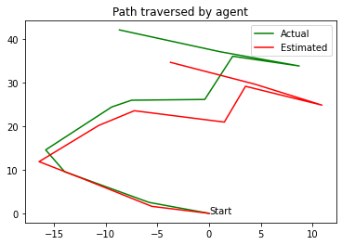
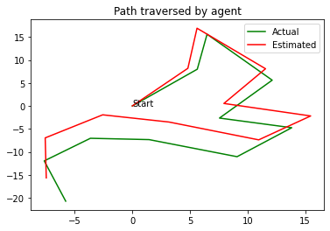
Results
Notes:
And here’s how the results turned out to be. The model got quite close to the estimating the path traversed by the agent.
To really understand this result, it is like closing your eyes and moving around in space and trying to estimate the your position relative to start based on you steps and turns.

Slide 7
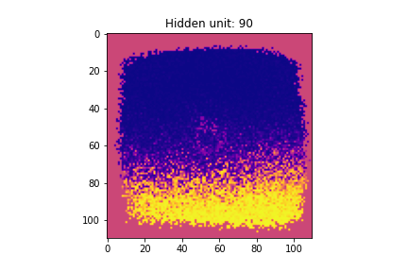
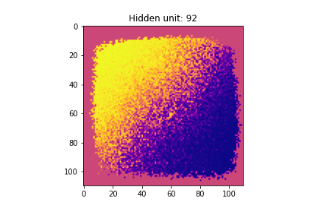
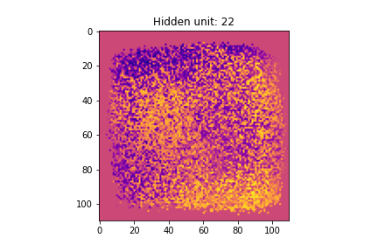
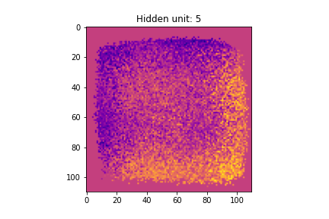
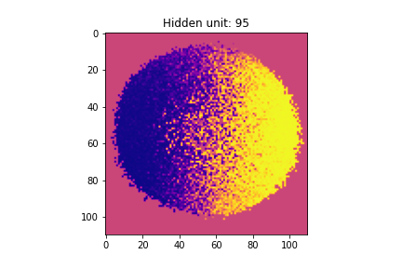
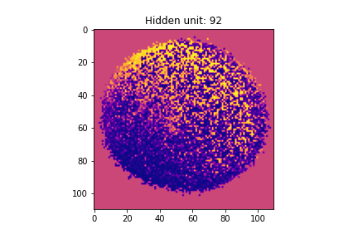
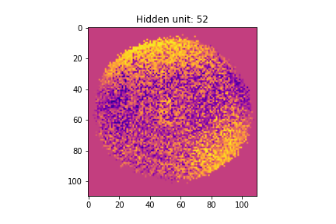
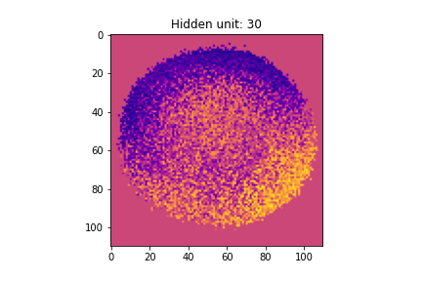
Firing Patterns
Notes:
These images depict activity of specific hidden units in the RNN. As can be seen, there’s striking resemblance in of these to the firing patterns observed in the animal brain. Also, the manner in which these patterns appeared as epochs of training passed by is also consistent with brain development studies.
So, to this end we have a model that perform spatial localisation.

Slide 8
New Questions
How to develop a brain-inspired navigation system for artificial agents?
How to perform path integration using spiking neural networks?
Notes:
With this done, in stage-2 I set to to pursue a larger goal and to pose a new set of questions.
How to develop a brain-inspired navigation system for artificial agents?
Note that the prev model was an artificial neural network, which.isn’t the way the brain works. Spiking neural netowrks mimic the function of the neurons present in brain and are energy efficient. They are also realisable using neuromorphic hardware. So if one day we were to build a physical robot with navigation capabilities at par with living organisms, it has to be with SNNs.
So the next question is –
How to perform path integration using spiking neural networks

Slide 9
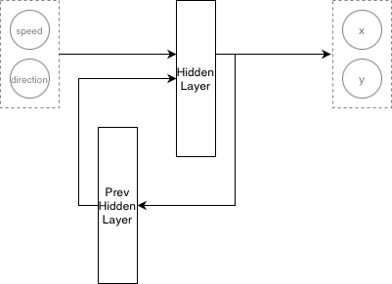
Transfer Learning
Notes:
Current literature has a mention a variety of methods to build spiking neural networks – notable of them being spike timing dependent plasticity (STDP), tandem learning, transfer learning.
But all the above procedures were explored and described only for translating CNNs but not RNNs. There’s very little work about building a recurrent spiking neural networks. Even if there is any, it only suggests an algorithm or a hybrid network i.e. a combination of artificial and spiking elements.
Since I already have a trained artificial neural network, I decided to take inspiration from transfer learning methods.
Training in artificial domain and usage in spiking domain.

Slide 10
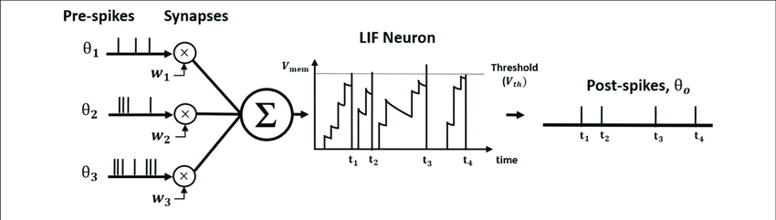
Elements: LIF Neuron & Synapse
Source: https://www.researchgate.net/figure/The-illustration-of-Leaky-Integrate-and-Fire-LIF-neuron-dynamics-The-pre-spikes-are_fig1_339574089
Notes:
Before we dive into model details, we have to understand the constituents of a spiking neural netwprk.
There are biologically inspired models of neurons and synapses. For this work I used the LIF neuron model.
(about the second equation)
Synapse..
Explain the diagram

Slide 11
Model Details
Notes:
This is the architecture of the SNN.

Slide 12
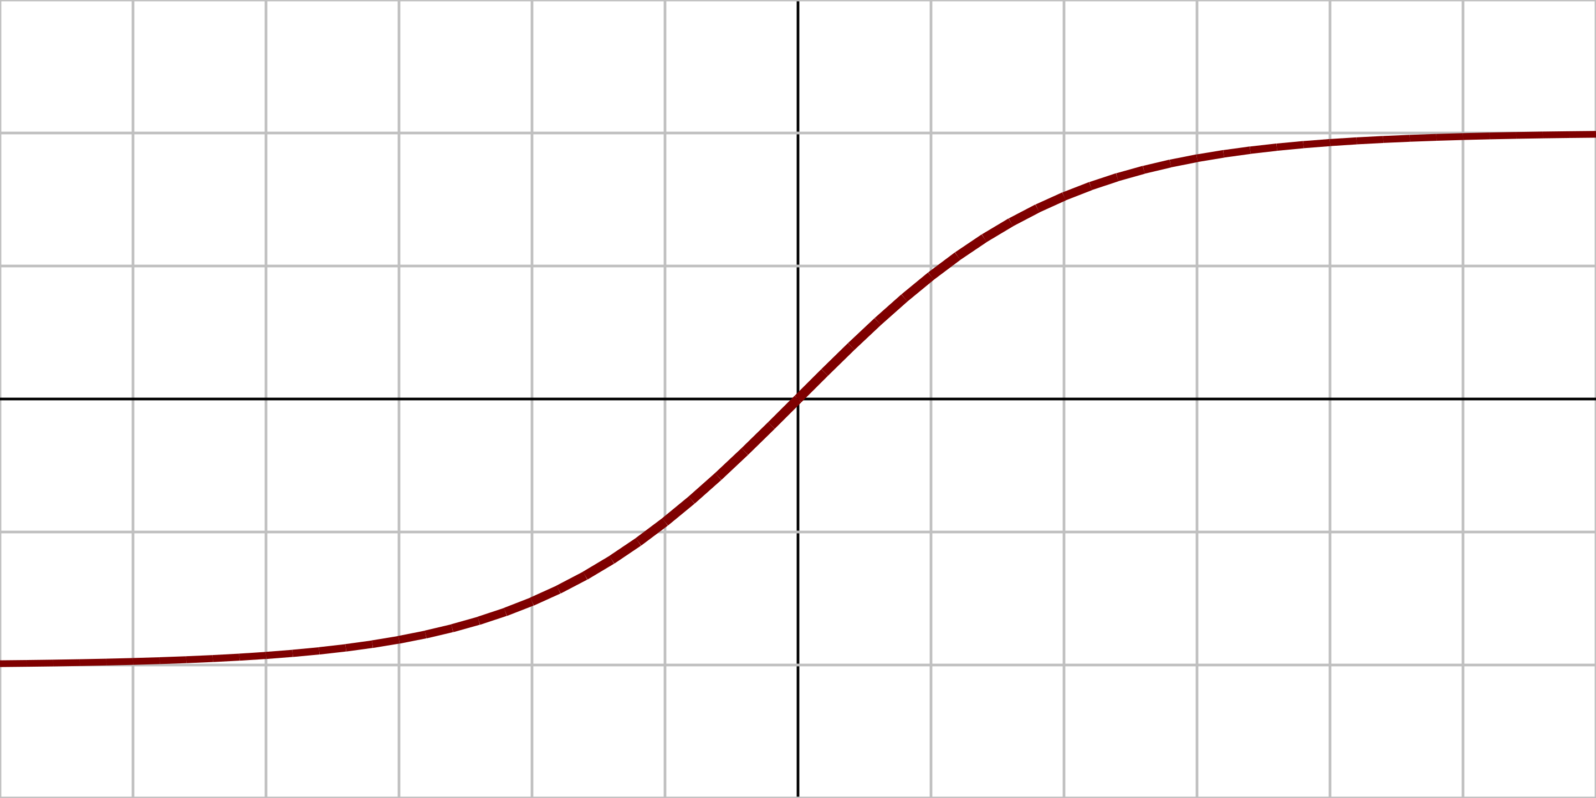
3 Key Ideas
Data pre-processing
Negative values shouldn’t be passed to LIF Neurons
Recurrent connections in SNN
Concept of input frames
Tanh activation in SNN
Playing with parameters of neuron model
Notes:
Following are three key ideas and insights from this work.
Different ways to manifest activation functions in spiking domain -
Play with parameters of neuron model
Use dynamic thresholds
Tanh vs ReLU -
Tanh suffers from vanishing gradient problem
But in recurrent networks Tanh is preferred to avoid blowing up
On recurrent connections -
Input display period (T) consisting of several time steps
Accuracy of rate coding increases with increasing T
Delay the hidden layer activity to prev hidden layer
Petty workarounds -
Hybrid networks
Libraries such as nengo introduce concepts of negative spikes that biologically not plausible
Due to these challenges and other external factors, as of date, the code implementation of the network is incomplete.

Slide 14
Future Work
Implementation on Loihi
Training RNN in spiking domain
Perform navigation tasks (integration with C.Elegans work)

Slide 15
Links
Report
BTP-1
Blogposts

Slide 16
Questions?

