Slide 1
ZERO SHOT LEARNING in SCENE GRAPH GENERATION
By SPURs
160050043 Sanchit Jain
160050042 Rupesh
160050032 Utkarsh Gupta
170070042 Preetam Pinnada

Slide 2
Problem Statement
Given an image, we have to generate SCENE Graph , a graph showing various objects in the image as nodes and relationship between then as edges in the graph.
Using knowledge of word embeddings as a good representation to word, we will find a map between the 2 object detected to the word embedding space through Fully Connected Neural Network and thereby predict the relationship between them.

Slide 3
Related Work
Visual Translation Embedding Network for Visual Relation Detection
Scene Graph Generation by Iterative Message Passing
Zero-Shot Learning - The Good, the Bad and the Ugly
Faster R-CNN: Towards Real-Time Object Detection with Region Proposal Networks
Visual Relationship Detection with Deep Structural Ranking

Slide 4
Key Ideas
Basic scheme of Scene Graph generation:
Classify Objects
Classify relationship between each pair of objects
Working in Embedding space:
Learn the transformation matrices from feature space to embedding space
Maximize dot product between target relationship and the predicted relationship

Slide 5
Problem Identified
This is trying to calculate the max over all relationship possible by making a vocabulary and this harmes the scalibility of the network.
To patch this problem, we are using the word embedding of relationship words in the training time and minimising the square distance with our target word embedding vector. As a result, our output of the network will be also an embedding vector , because that’s the way to minimise square loss. Making similar prediction. Same direction as well as norm.
At test time, we can use reverse mapping to find the closest word for a given vector output of network.

Slide 6
Datasets and Evaluation Plan
VG Dataset (Visual Genome)
VRD Dataset (Visual Relation Detection) → 4000 train;1000 test
Achieve similar results with the changed loss function and make test time predictions of some relationships not in the training data

Slide 7
Dataset description
VG Dataset description: (.json files except the the first)
Images (eg. image_id.jpg)
Images metadata: image id, url, width, height, coco_if, flickr_id
Region descriptions
Image_id
Regions: region_id, x, y, width, height, phrase, synsets
Questions and answers
Image_id
Qas: qa_id, question, answer, question_synsets

Slide 8
Objects
Image_id
Objects: object_id, x, y, w, h, name, synsets
Attributes: Image_id, Objects, Attributes
Relationships
Image_id
Relationship_id
Predicate
Subject: object_id, x, y, w, h, name
Object: object_id, x, y, w, h, name
Synsets
Region graphs
Image_id
Regions: region_id, objects, relationships
Scene graphs
Image_id
Objects
Relationships
Qa_to_region_mapping

Slide 9
Coding schematics
Libraries required
tensorflow-gpu==1.3.0(installed ) ; Cuda8 ; libcuDNN6
Already have the github implementation(Visual Translation Embedding Vtrance)
Vrd (visual relation detection) files with pretrained model
And embedding to top5 word precition using ANNOY https://github.com/RaRe-Technologies/gensim/blob/develop/docs/notebooks/annoytutorial.ipynb

Slide 10
Required computational source
Nvidia-smi
Have a 4GB nvidia geforce gtx 1050 Ti on one of the laptops
Btw already have a pre trained network for scene graph generation. Need to fine tune.
(As discussed in presentation we may need to train it fully which we have already described in obtained results in the last slide)

Slide 11
Work distribution and Timeline
8th April Run the github implementation
14th April Make necessary changes for Word2Vec in the implementation and store results
By 21st April Test on various embeddings like ELMO, GloVe,Gensim and report the best result out of these
Later time for extra spill overs

Slide 12
Additions after presentation
The pretrained model was not working.
We were able to train the model ourselves and got a test accuracy as 47.5% after training for 20 Hours (max going upto 51.9 %) (screen-shot on next page)
We ran the test results which we obtained the result as follows for the vrd dataset.
We are getting test accuracy of 45.9774633124 %(screen-shot attached)
Also VG dataset is being downloaded as of now

Slide 13
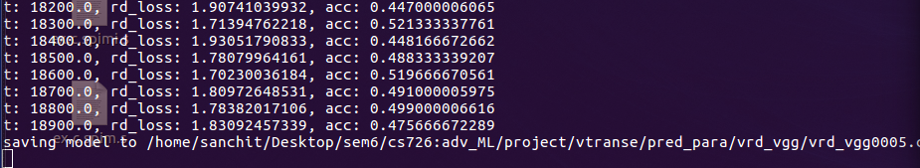
Training SS

Slide 14
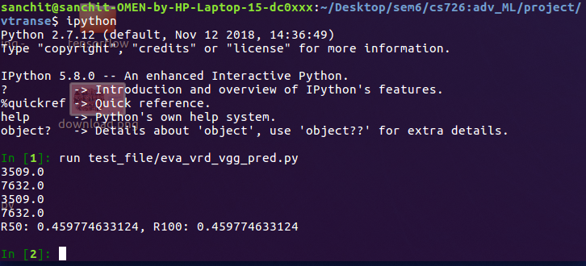
Testing SS

Slide 15
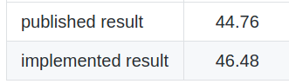
Accuracy Test time
Our run
R50 : 45.9 %
R100: 45.9%
Github post result (For R100)

Slide 16
Thank You

