Slide 1
Name of the Project - SNIPER
Submitted By :- Pritam Patel
Neha Kathar Satyapriya Nayak
Akash kumar Gouda Kanhu charan Das
Guided By :-
Prof. Bibhudendu Panda
Mr. Satyajit Appot Mr. Rajat Barik

Slide 2
PROJECT Development Step
FRONT END
BACKEND
API
DATABASE
ML

Slide 3
Working Strategies
Developed a dashboard using Angular Js – (Done by – Kanhu & Akash).
Backend Integration in python including Profit/Loss , Indicator ,Previous percentage value – (Done by – Neha).
Fetch the JSON Data using FastAPI.
Implementation of OOPS Concept.
Unit Testing – (Done by – Neha Kathar).

Slide 4
Design a Dataset into different Triangle Pattern structure using Machine
Learning and showing Entry , Exit and Stoploss – (Done by – Pritam Patel ).
Push the Code in GitHub Repository and Setup Jenkins –
(Done by – Satyapriya Naik).
Code Review and Documentation – (Pritam and Satyapriya).

Slide 5
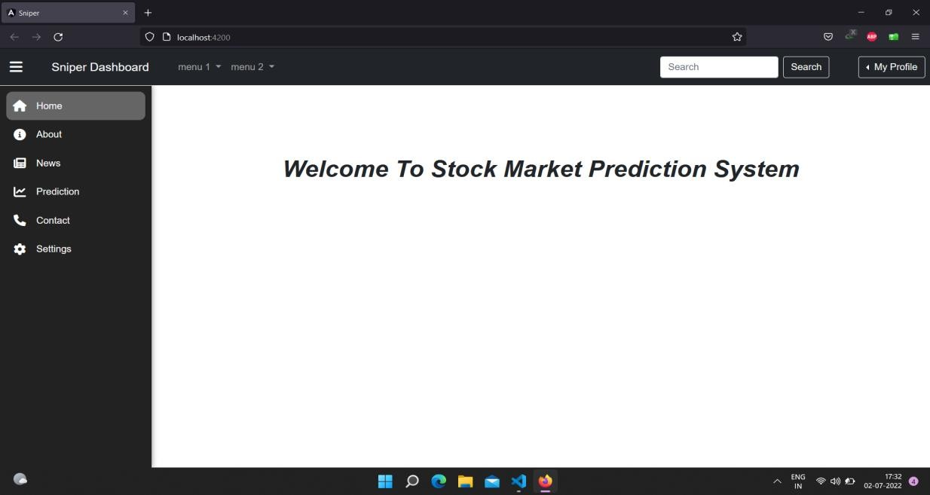
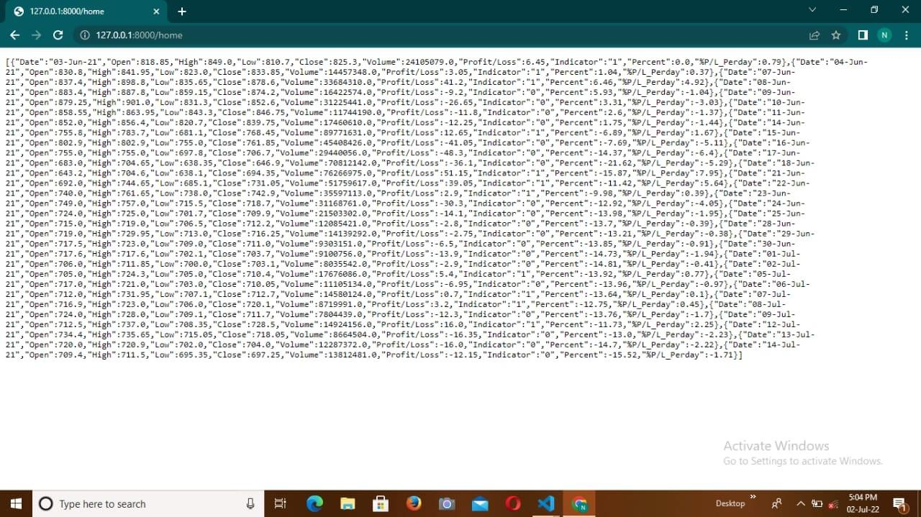
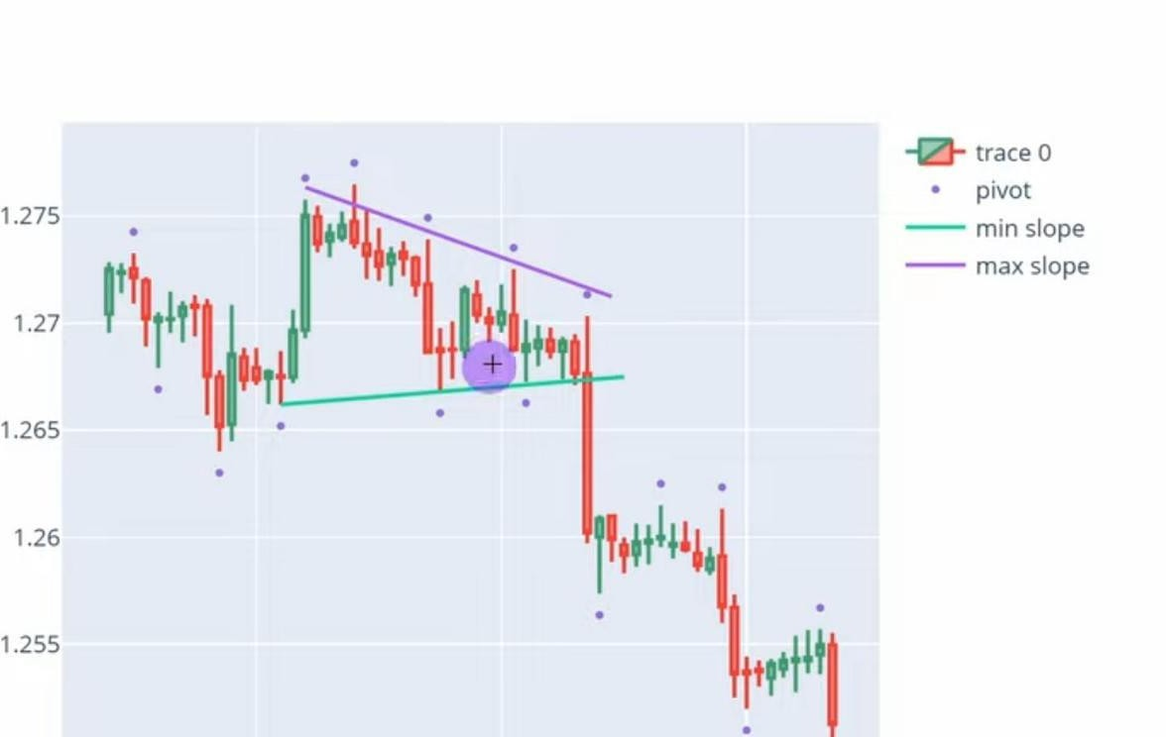
( UI Development )
( Stock Market Strategies JSON Data )
( Descendants Triangle Pattern For Analysis )

Slide 6
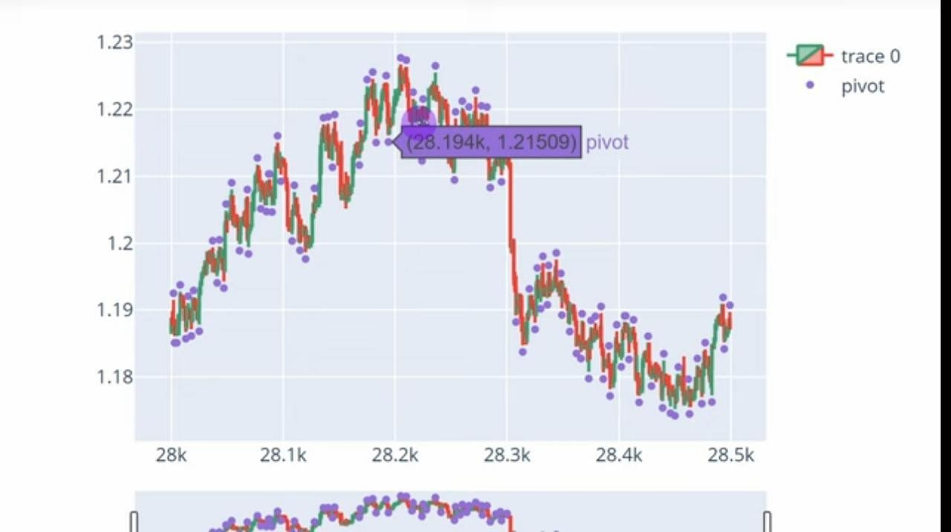
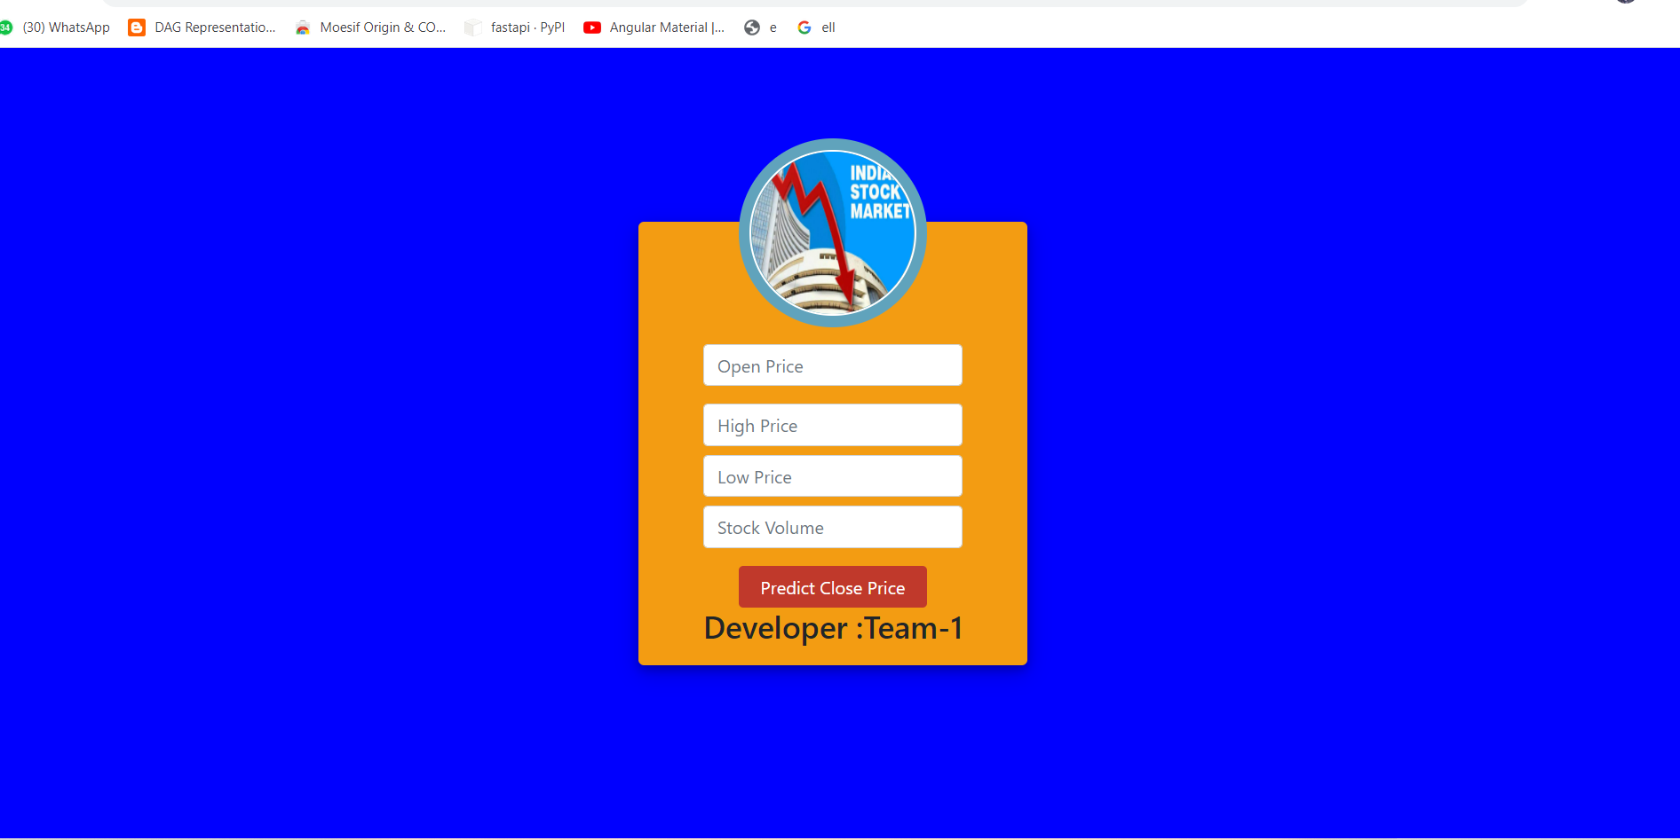
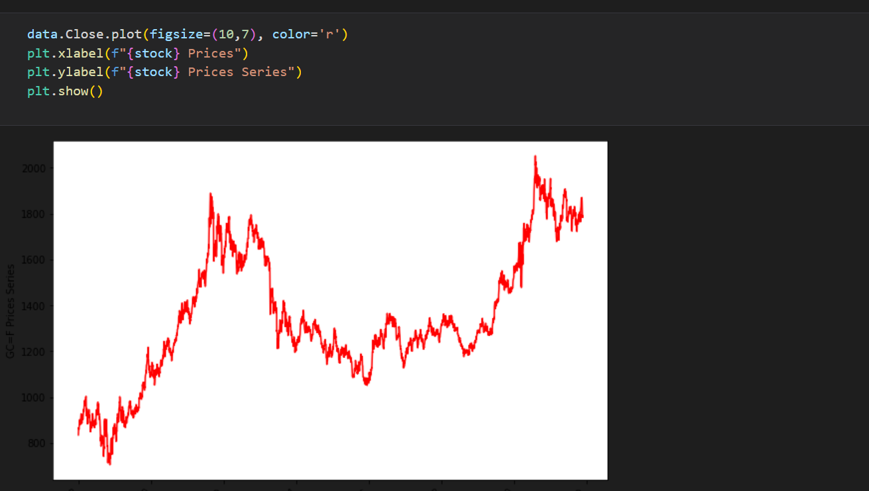
(Stock Market Predicator )
( Stock Visualization )

Slide 7

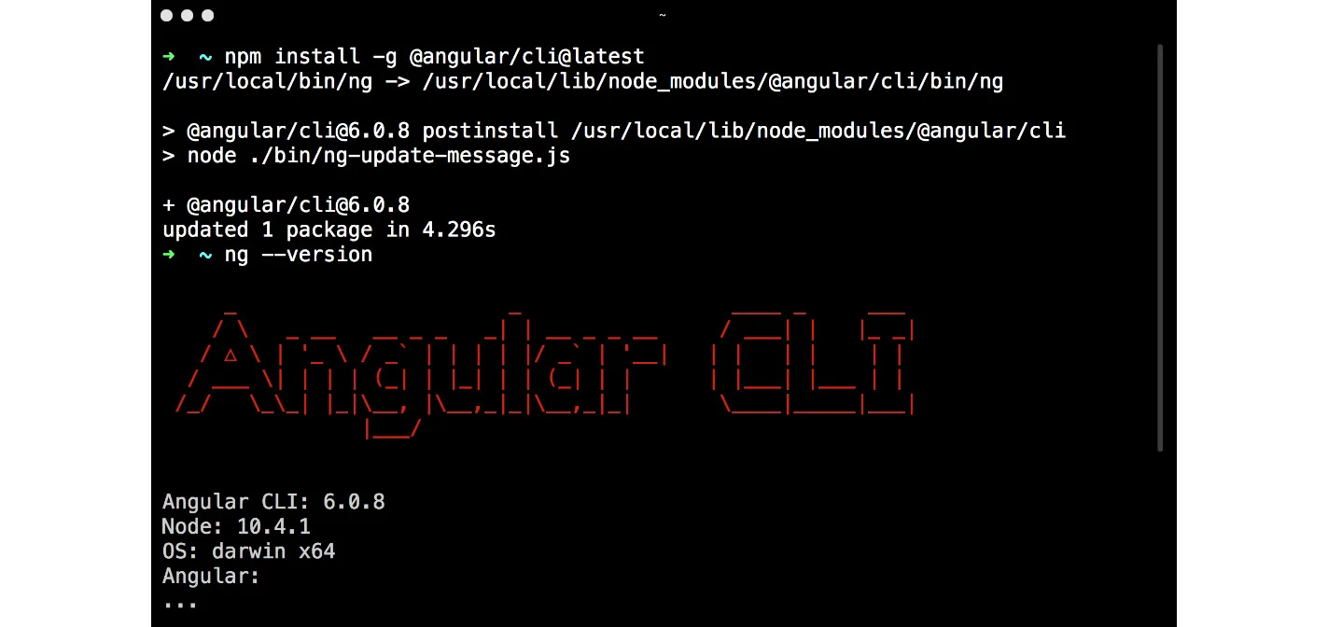
Project setup
Front-end
--npm install –g angular-cli
--ng new my-dream-app
--cd my app
--ng serve

Slide 8
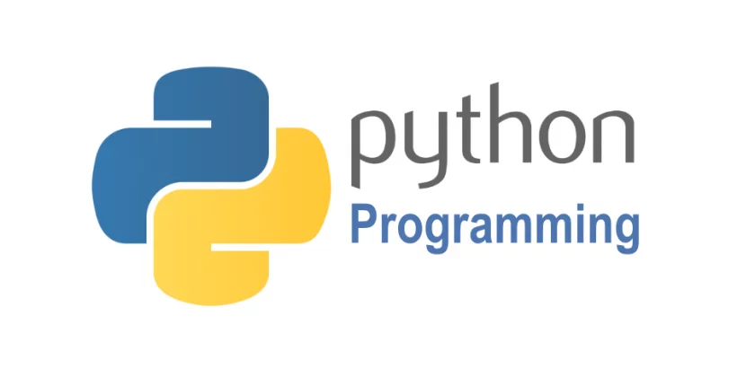
BACKEND
Python Module Environment
1.Pandas
2.Matplotlib
3. NumPy
4.Yfinance
5.Seaborn
6.Fastapi
7.Flask
8.util
Server :- uvicorn

Slide 9
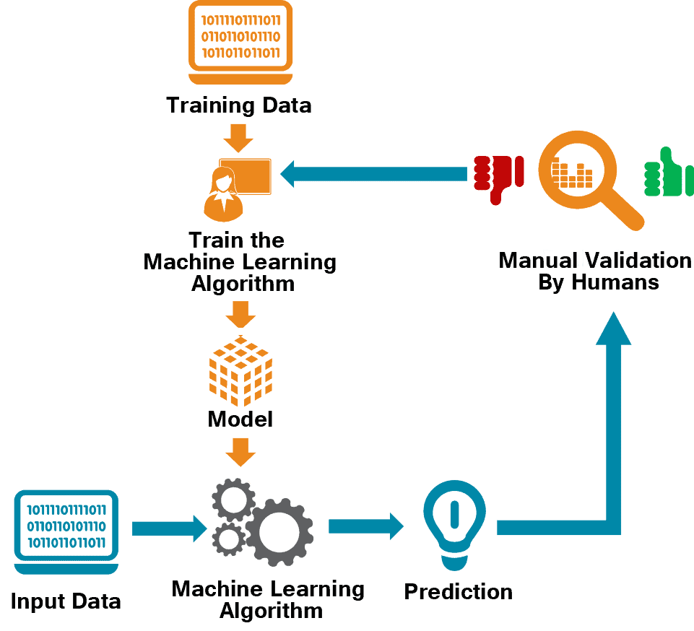
Machine learning
ML Algorithm
1.Lasso and Ridge Model
2.Support Vector Machine

Slide 10
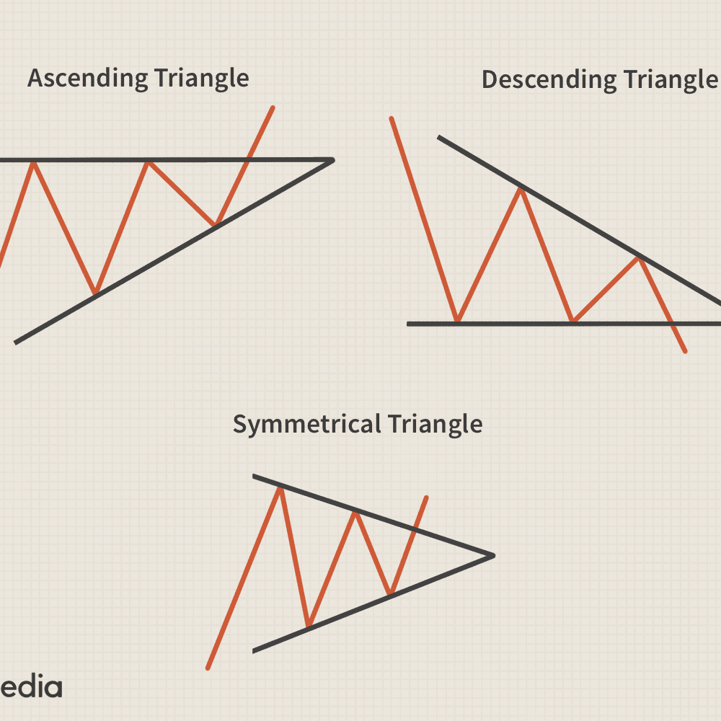
Pattern trading in ml
Ascending Triangle
Descending triangle
Symmetrical Triangle

Slide 11
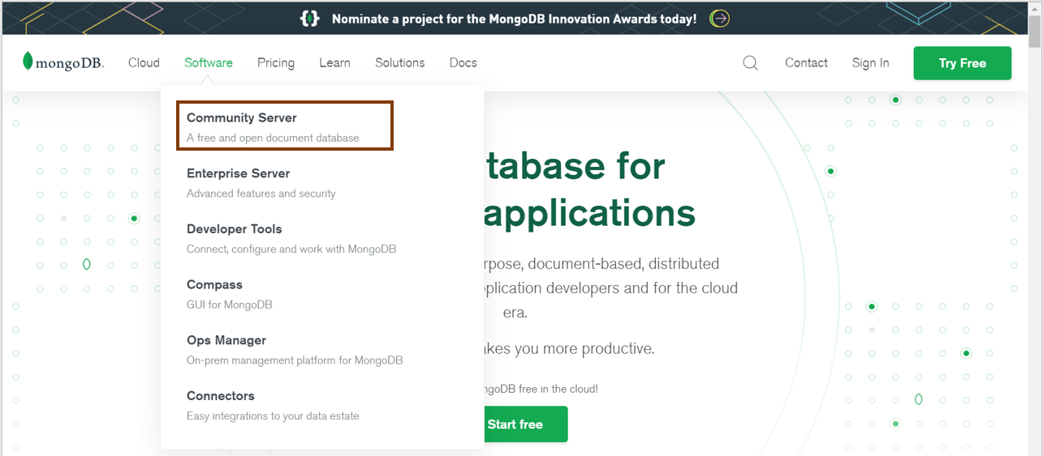
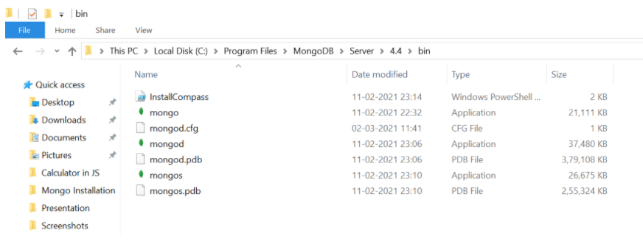
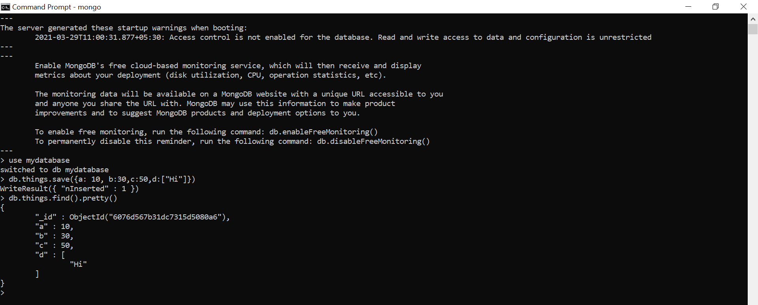
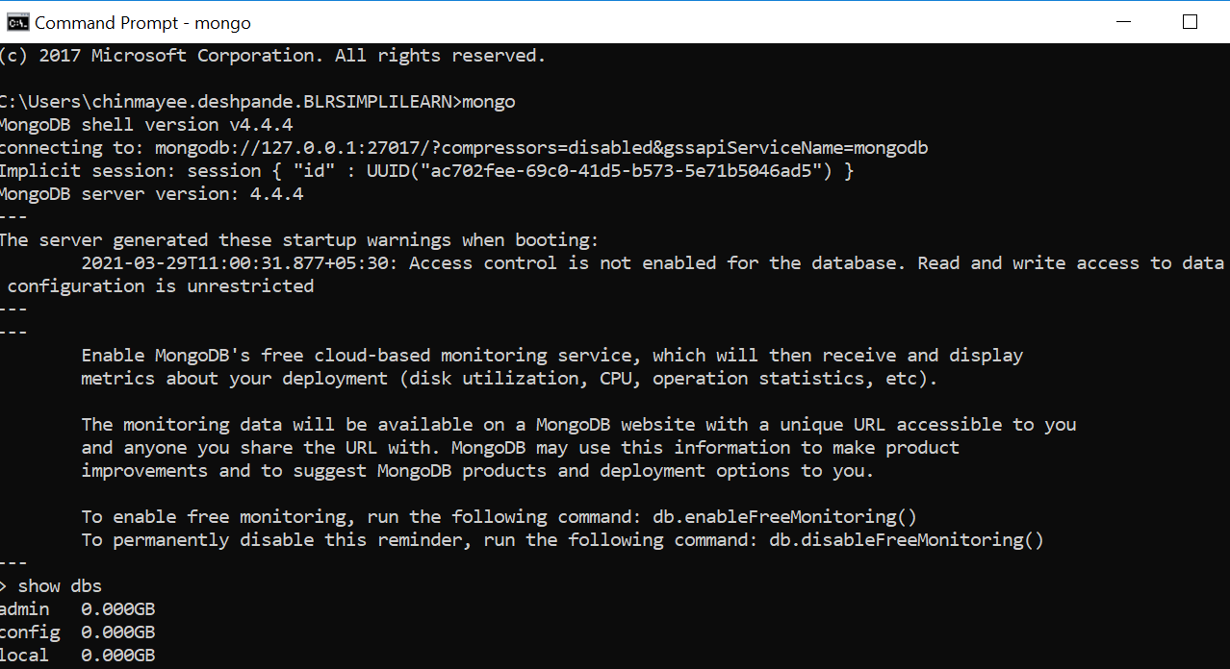
DATABASE:- MONGODB

