Slide 1
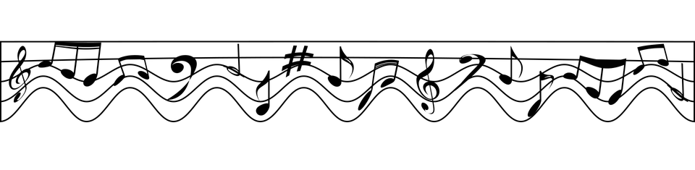
Investigating Audio Artificial Intelligence
Prepared by Aysha Araien, Preet Parmar, & Letian Ren

Slide 2

Overview
Introduction
Genre Classification
Methods, Results, Improvements
Recommendation System
Methods, Results, Improvements
Conclusion and Future Directions

Slide 3

Introduction
Spotify has transformed music listening since it launched in 2008. It currently offers 70 million tracks, including more than 3.2 million podcast titles to users for free [1].
Have you ever noticed a pattern to the “shuffle” features in-app such as similar BPM songs playing in succession or a song coming on by the same artist?
Our project will focus on investigating audio artificial intelligence by creating the following:
Genre classification system using Neural Network
Recommendation system for Music

Slide 4
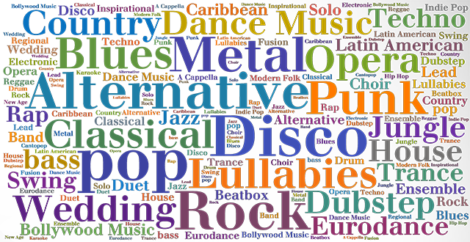
About the data
2 Datasets - Different Data
Neural Network
GTZAN dataset - widely used for audio classification
1000 audio files of 10 different genre songs
Further split into 10 samples per song -- 10000 samples
Recommendation System
Music dataset
Descriptive features about songs

Slide 5
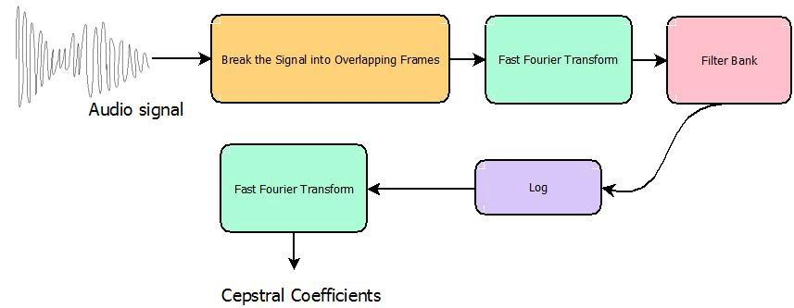
Genre Classification System - Methods
MFCC (melfrequency cepstrum coefficients) Features Used as Input
MFCC are extracted from audio signal
Very mathematically heavy to calculate, Librosa in Python calculates automatically

Slide 6
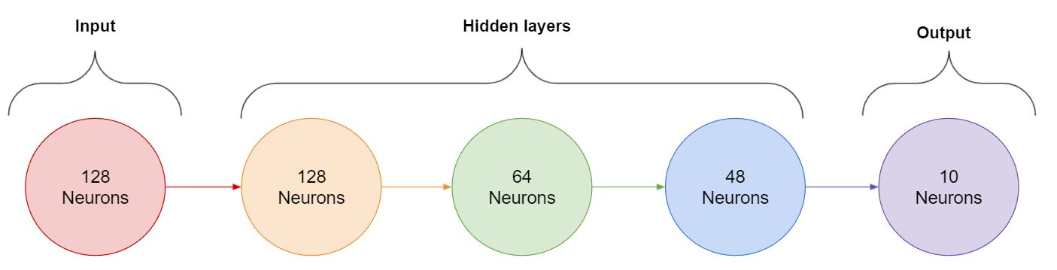
Genre Classification System - Methods
Neural Network architecture

Slide 7
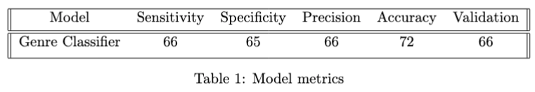
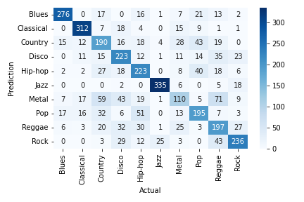
Genre Classification System - Results
Accuracy - 72%, Validation - 66%
Good performance
Number of classes
Small dataset size
Metal category - wrongly classified
Reggae - hard to classify
Blues & Classical - easily
classified

Slide 8

Genre Classification System - improvements and Limitations
More data needed to produce higher accuracy
FMA Data
Full songs were split into samples
There are nuances in the songs which could be lost
There is likely more optimal architecture than we used
Ran locally, could be improved by running remotely with more computational resources

Slide 9

Recommendation System - Methods
Features - fields in dataset
Topic, Lyrics, Artist Name, Genre
Preprocessing - NLP techniques
Lowercase all words, remove commas from features
Vectorize the data in features
Converting text to feature vectors
Model - cosine similarity using matrix of the features
Recommendations are generated based on which items are most similar to the input song

Slide 10
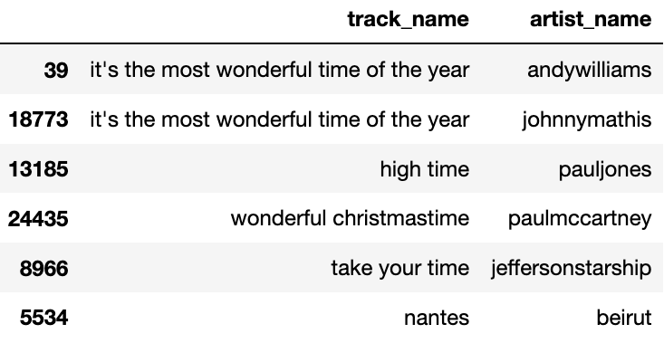
Recommendation System - Results
Hard to measure recommendation system performance
Do not have reference ‘similar songs’
Eye test - looks like it works
Most similar song is cover
High time has time in name
From the 60’s
‘Wonderful Christmas Time’
Holiday song

Slide 11


Recommendation System - improvements and Limitations
Currently does not have collaborative filtering
If they have listened to a song many times, and given it a positive rating, put it higher than other similar songs
Need to find a dataset with user ratings
More data needed with more descriptive fields

Slide 12

CONCLUSION and future directions
Overall the goals were accomplished - investigated Audio AI by building Genre Classification system and Recommendation system
Initial impression of the project - linked models
Genre already exists in datasets
Usefulness of each model
Music Genre Classifier could be used in a audio recognition project
Recommendation system could be used to fully develop a shuffle algorithm after adding collaborative filtering

Slide 13

Thank you! Any questions?

Slide 14
References
[1] About Spotify. (2021, November 17). Retrieved December 8, 2021, from https://newsroom.spotify.com/company-info/
[2] Moura, L. (2020, August 24). Music Dataset: Lyrics and Metadata from 1950 to 2019. Retrieved from https://data.mendeley.com/datasets/3t9vbwxgr5/2
[3] Olteanu, A. (2020, March 24). GTZAN Dataset - Music Genre Classification. Retrieved December 8, 2021, from https://www.kaggle.com/andradaolteanu/gtzan-dataset-music-genre-classification
[4] Nair, P. (2020, March 24). The Dummy’s Guide to MFCC. Retrieved December 8, 2021, from https://medium.com/prathena/the-dummys-guide-to-mfcc-aceab2450fd

Slide 15
References - Images
[1]https://pixabay.com/vectors/music-musical-notes-divider-5734436/
[2]https://freesvg.org/1529291246
[3]https://cdn.onlinewebfonts.com/svg/img_666.png
[4]https://cdn2.iconfinder.com/data/icons/digital-marketing-182/520/48_Analysis_Chart_Data-512.png
[5]https://i.pinimg.com/originals/09/2d/d9/092dd994351ee5eacf8149d978a4bd1c.png
[6] https://www.iconfinder.com/icons/1010381/audio_multimedia_music_note_sound_warning_icon
[7]https://cdn.icon-icons.com/icons2/1076/PNG/512/hierarchystructure_77889.png
[8]https://www.flaticon.com/free-icon/no-music_1661921
[9]http://cdn.onlinewebfonts.com/svg/img_41065.png
[10]http://cdn.onlinewebfonts.com/svg/img_41170.png
[11]https://www.flaticon.com/free-icon/music_2792342

