Slide 1
Predicting whether an order will be returned
Sumedh Shah Preet Jain
Notes:
DESCRIBE DATASET HERE

Slide 2
Key Takeaways
The best ML model for predicting order returns is Random-Forest Classifier
→ Has the highest recall score and the lowest number of false negatives in addition to other performance metrics.
It can predict 2836 orders to not be returned on the test set (total: 12807) with a recall score of 85.6%
An estimated price of $809, 463 will be returned with a precision score of 58.8%
Using this information the company can evaluate the following based on their business operations:
Locations of warehouses to cut costs of return
Decrease customer churn rate by finding which items are returned the most
Manage logistics like required inventory, man force, transportation
Improve product sales by using better marketing strategies

Slide 3
Performance Metrics
Recall
F1-score
Precision
Specificity
AUC score
Accuracy
(In terms of priority)
Notes:
Recall because we want to prevent false negatives
F1-score takes into account recall and precision
Precision reports the orders that will be returned
Specificity reports the orders that will not be returned
AUC score measures the extent of separability between the two classes
Accuracy computes the correct predictions

Slide 4
Best Model: Random-Forest Classifier
Random-Forest Classifier provides the best performance metrics (from training) in comparison to any of the other models
Recall: 0.856
F1-score: 0.697
Precision: 0.588
Specificity: 0.286
AUC score: 0.622
Accuracy: 0.596
Note: everytime the model is run, these metrics increase or decrease by minute amounts
Advantages:
Random-Forest classifier can be trained on categorical, ordinal or numerical features without any issues.
Disadvantages:
Random-Forest classifier takes a lot of computation time during training.

Slide 5
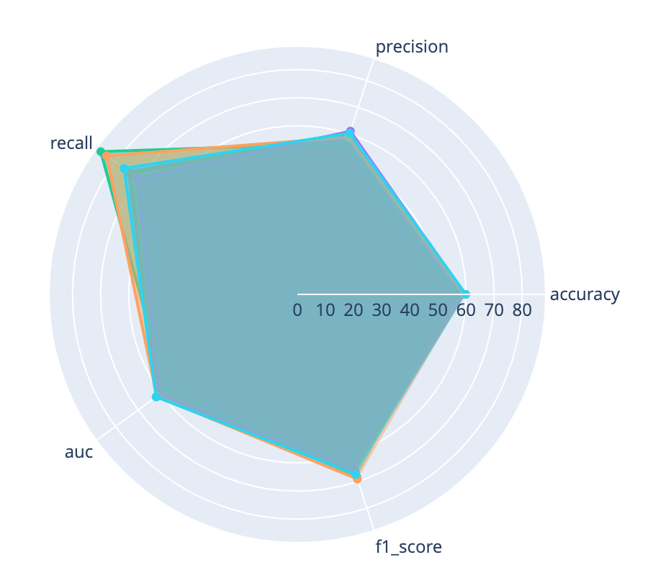
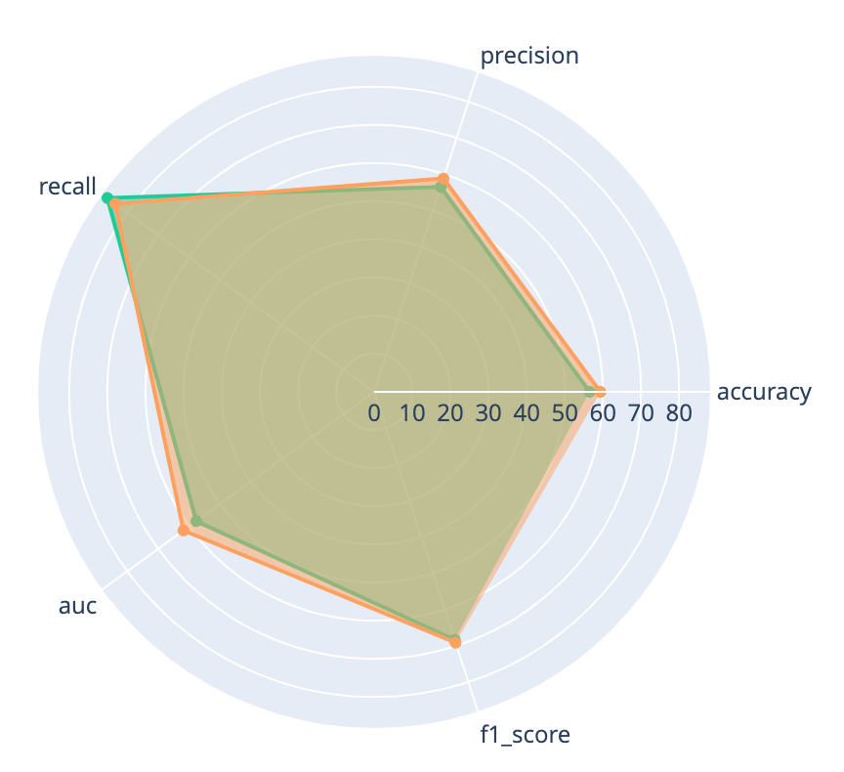
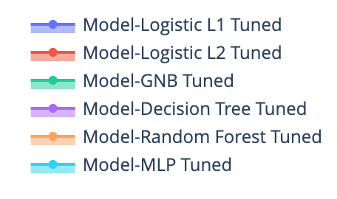
Gaussian Naive Bayes Model comes close to our best model
All models
GNB and RF only
Advantages:
Takes less time to train.
Disadvantages:
Makes the conditional independence assumption which makes the model more of a baseline model and also, the assumption might not hold true for the underlying data distribution.
GNB gives a higher recall score but because of the conditional independence assumption and lower metrics otherwise, was not selected

Slide 6
Best model performance metrics with complete training dataset
Recall: 0.831
F1-score: 0.0.692
Precision: 0.593
Specificity: 0.323
AUC score: 0.622
Accuracy: 0.599
The performance metric values reduce when the entire model is which is expected as additional data is being trained on

Slide 7
Data Preparation - Understanding
48.17% of the orders get returned
→ Signifies why predicting returns is important
→ Balanced Data
The company has 2656 different items and 155 different brands as part of their product offerings.
This data consists of 100000 orders.
The company has 37663 customers who are from 16 different states.

Slide 8
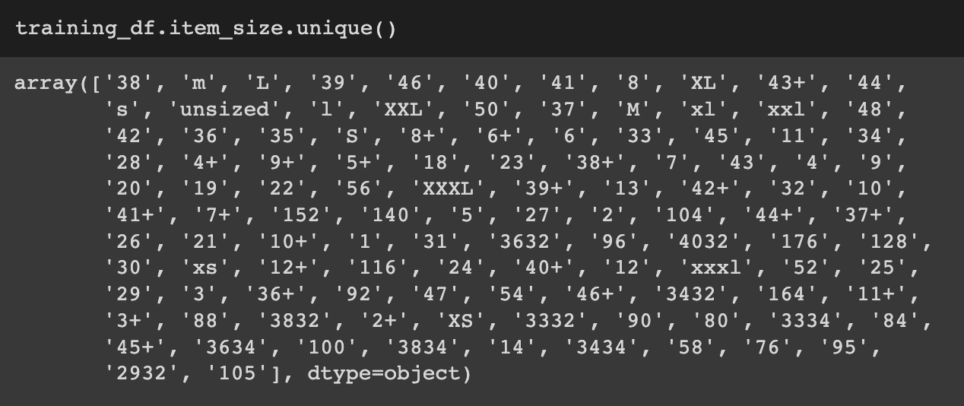
Data Preparation - Key Takeaways
The Original Dataset had the following issues which were dealt with:
Missing values.
Unimportant features.
Features that can be used to compute new features like gender.
Features like item_size had a mix of ordinal and numerical values.
Categorical features to like States that needed to be One-Hot Encoded.
item_size has a mix of ordinal and numerical values along with some outliers like ‘4032’ or ‘40+’

Slide 9
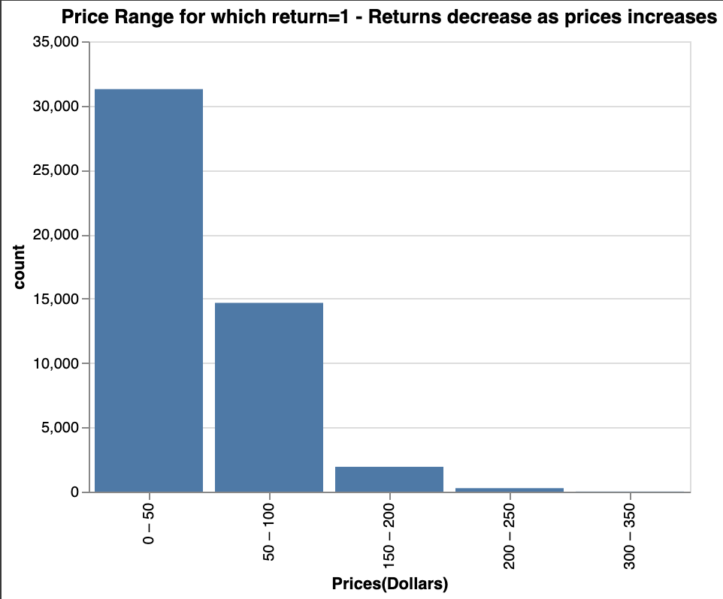
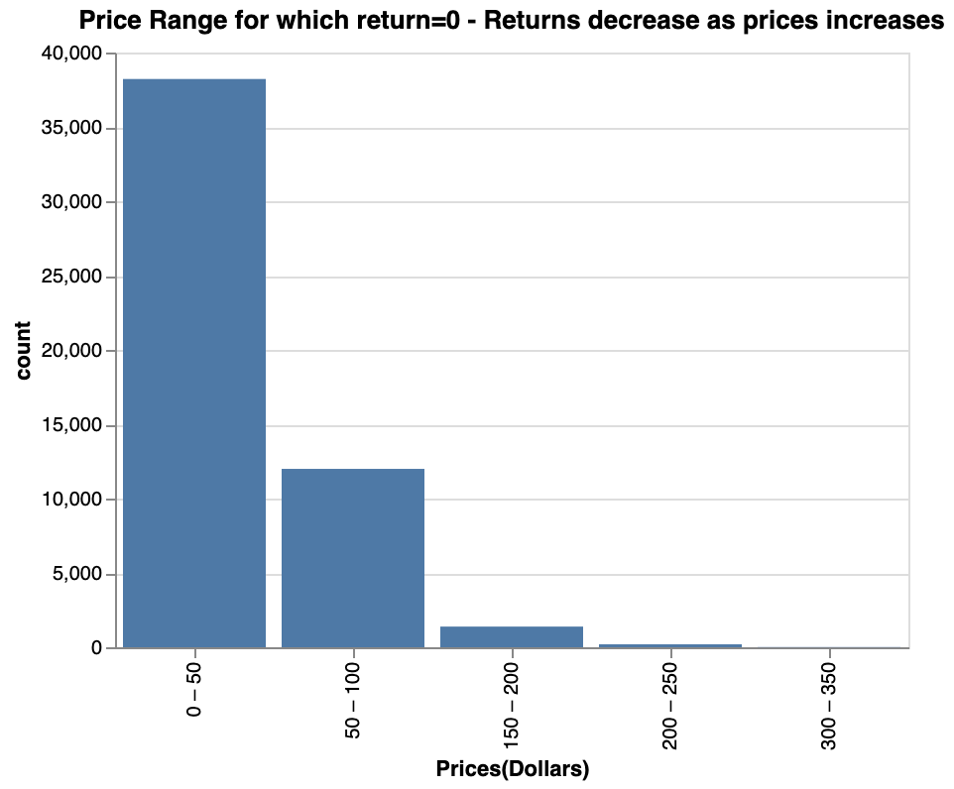
Data Preparation - Visualizations
Low-priced products are returned by count
The company sells more low-priced products in general

Slide 10
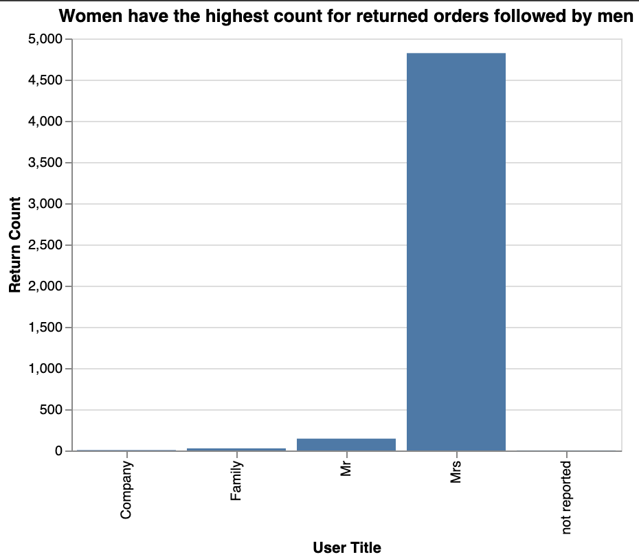

Slide 11
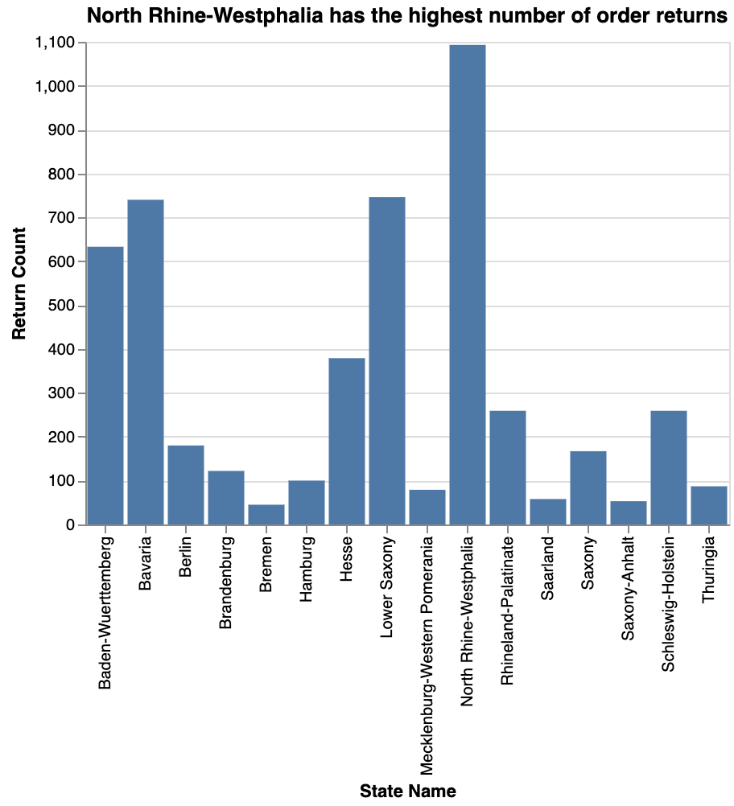

Slide 12
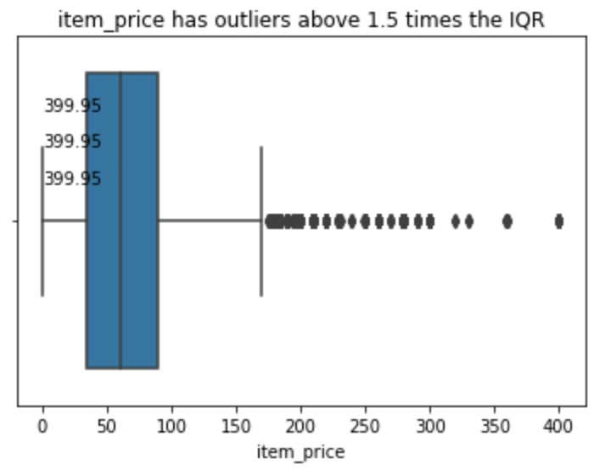

Slide 13
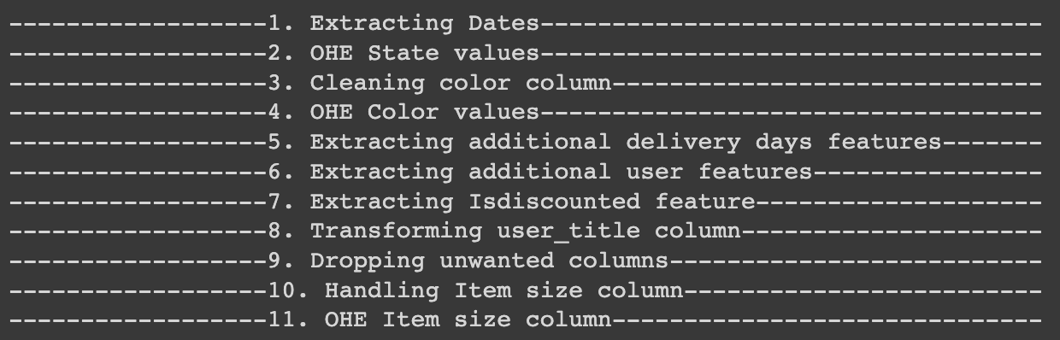
Data Cleaning Steps
Note: Days to delivery was computed in 5 but had missing values. Imputation failed to provide reasonable values and hence, those rows were dropped.
Feature scaling was performed after these rows were dropped

Slide 14
Model Training
Baseline Models Trained:
Dummy Classifier
Gaussian Naive Bayes Classifier
L1 Logistic Classifier
L2 Logistic Classifier
Decision Tree Classifier
Random-Forest Classifier
Multi-layer Perceptron
Except for Dummy Classifier all models were regularized to ensure that all the models are generalized and the test error is low.
Notes:
Performance measures of all models (baseline and regularized) can be found in the notebook

Slide 15
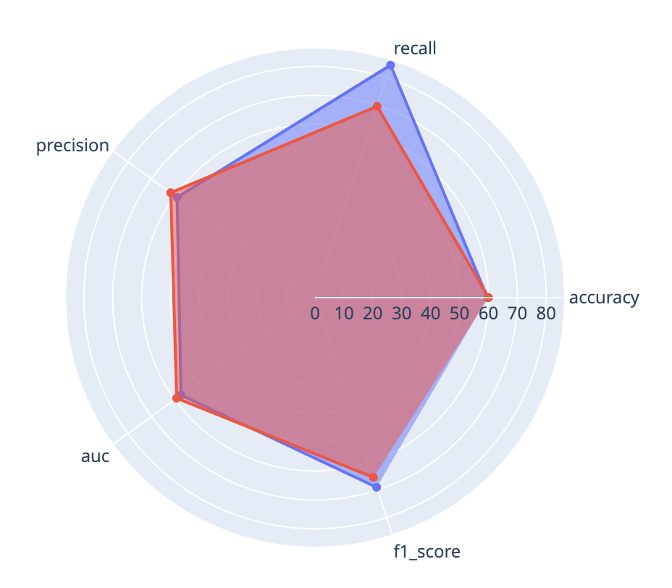

Baseline Model vs. Regularized Model
Random-Forest saw the highest change in performance metrics compared to any of the other models.

Slide 16
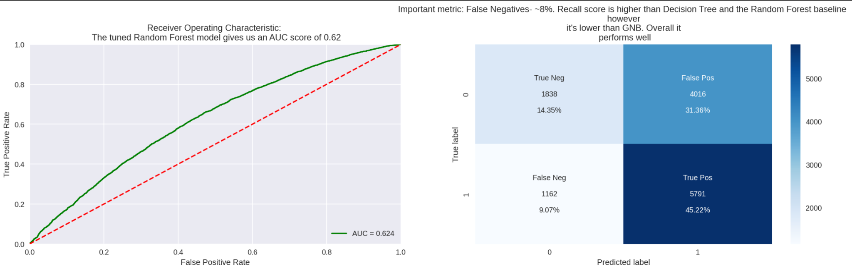
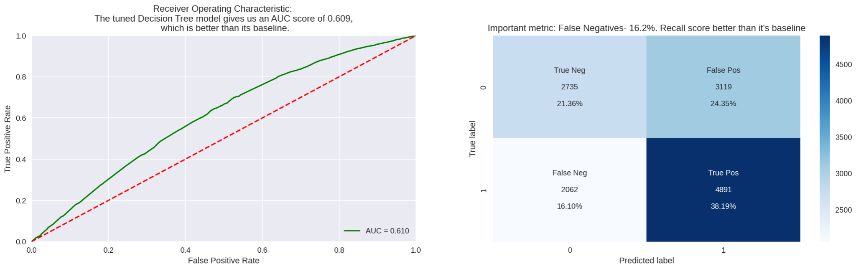
Confusion Matrix
Regularized Random-Forest
Regularized Decision Tree
Notes:
Key Takeaway: Random-Forest does a better job at reducing False negatives and increasing the AUC than decision trees.

Slide 17
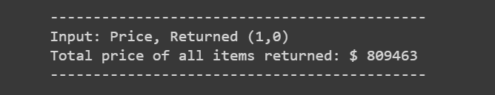
Estimated Savings with our best model on test data
$809, 463 is a significant amount of money in terms of orders being returned and the company having to manage this much inventory with items that are mostly low-priced.
This estimate serves as a success metric of our project

Slide 18
Conclusion
Predicting order returns is a challenging task when data is not collected in an appropriate way
The accuracy scores of all the models were less than 65% signifying that there might be some additional features (not recorded in the dataset) that would be important to predict the return. For ex. item_type
Random Forest Classifier does the best job in terms of performance metrics
While the price estimation is an estimate, it provides an outlook of what products are being returned and how the company can better manage its inventory
Future Scope
Testing error can be reduced by standardizing the item_size in a way that does not remove a bunch of rows.
The company should record the item_type and along with only numerical or only categorical item_sizes
Predict which items are likely to be returned or which customers are more likely to return

Slide 19
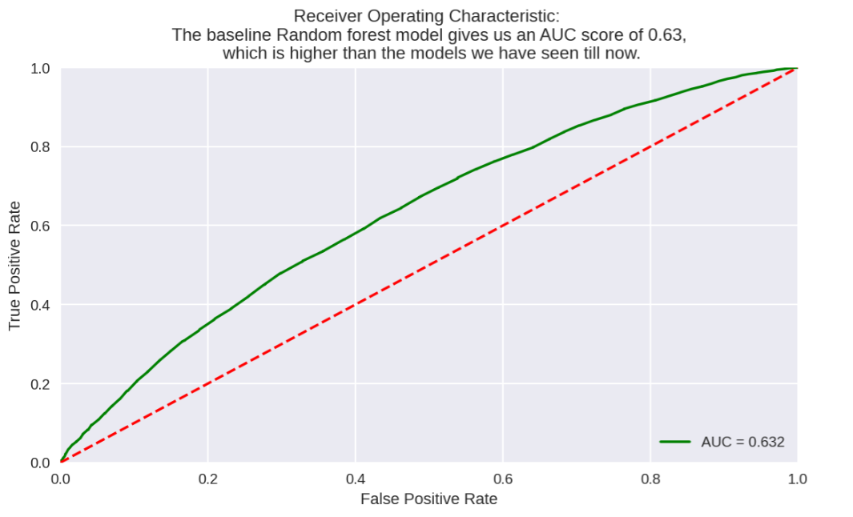
Appendix
Baseline Random-
Forest
Regularized Decision Tree
Regularized Random-
Forest

