Slide 1




SRMAP
MULTICLIENT SOCKET PROGRAMMING
USING JAVA

Slide 3


ABSTRACT
INTRODUCTION
MULTICLIENT SOCKET PROGRAMMING'S
TCP SOCKET
CONTENTS
WHAT IS MULTI SOCKET PROGRAMMING ?
ESTABLISHING CONNECTIONS
REAL LIFE APPLICATIONS
RESULTS
CONCLUSION
REFERENCES

Slide 4

Abstract
Multiclient socket programming involves creating a server application that is able to accept and manage connections from multiple clients simultaneously. This type of programming is commonly used in networked applications such as chat rooms, online gaming, and
other applications that require real-time communication
between multiple users. To implement multiclient sockets
programming in Java, the server application must create
a ServerSocket object and bind it to a port on the server
machine.

Slide 5
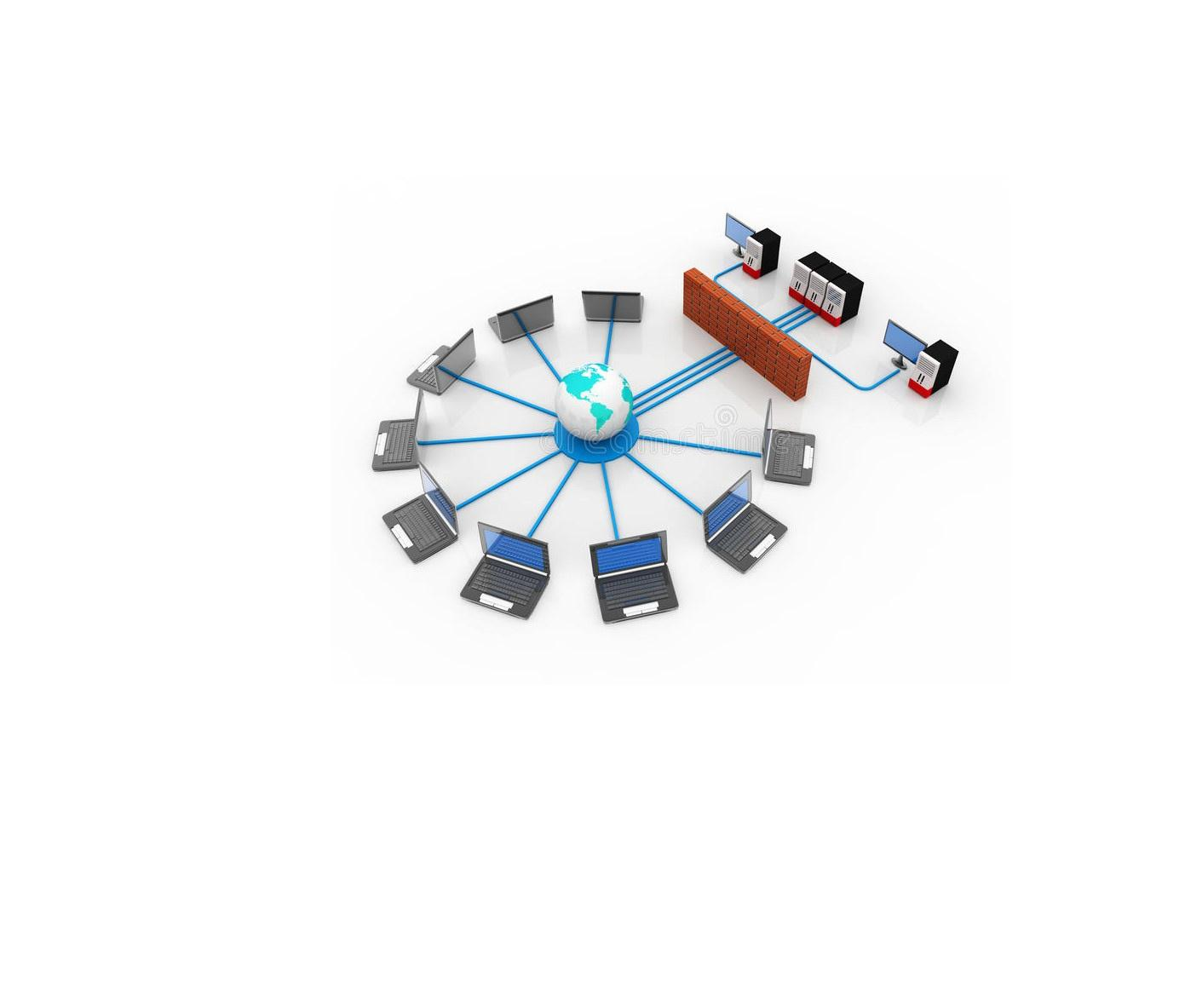

INTRODUCTION

Slide 6
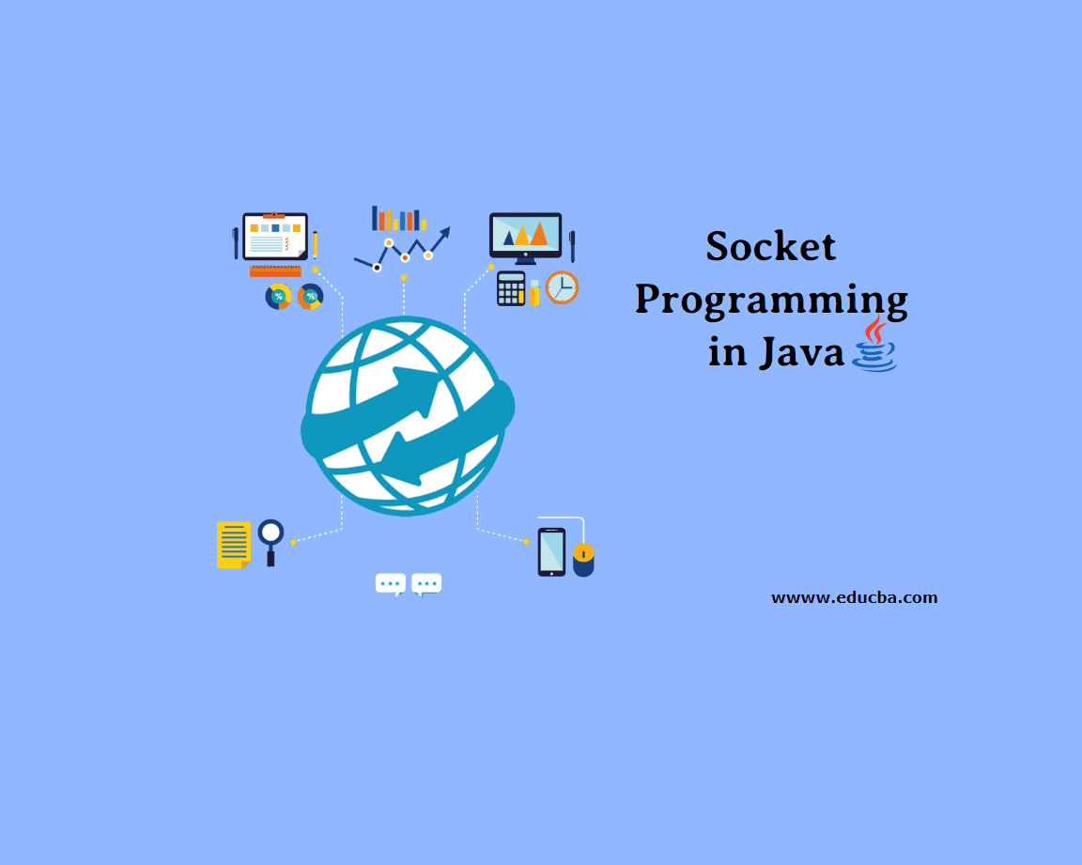
what is socket ?
In network programming, sockets are used to establish connections between processes on the same or different machines. A socket has a unique address, which consists of an IP address and a port number. The IP address identifies the machine on which the socket is running, while the port number identifies a specific application or process on that machine.

Slide 7

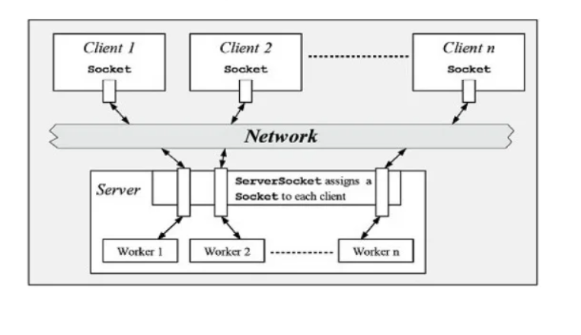
TCP SOCKET
TCP stands for Transmission Control Protocol.
TCP provides a connection oriented service, since it is based on connections between clients and servers. This means that a connection is established before processes can exchange data. It is also reliable because when a client sends data to a server, it requires an acknowledgement in return. If an acknowledgement is not received, the data has to wait for a longer period of time.

Slide 8
WHAT IS MULTI-CLIENT SOCKET PROGRAMMING ?
In network programming, a socket is a endpoint of a bidirectional interprocess communication flow across a computer network. Multiclient socket programming allows a server to accept Connections from multiple clients at the same time. This is achieved using the concept of "multiplexing", which allows the server to handle multiple client connections concurrently using a single socket.

Slide 9
ESTABLISHING CONNECTIONS
To create a multiclient socket program in Java, you will need to follow these steps:
1.Create a ServerSocket object and bind it to a port on the server machine.
2.Start listening for incoming client connections with the ServerSocket's accept() method.
3.For each client that connects, create a new Socket object to represent the connection.
4.Create input and output streams on the Socket to read from and write to the client.
5.Communicate with the client using the input and output streams.
6.Close the Socket and repeat the process for the next client that connects.

Slide 10
ESTABLISHING CONNECTIONS
To create a multiclient socket client in Java, you will need to follow these steps:
1.Create a Socket object and connect it to the server using the server's IP address and port number.
2.Create input and output streams on the Socket to read from and write to the server.
3.Communicate with the server using the input and output streams.
4.Close the Socket when you are finished.

Slide 11

REAL LIFE APPLICATIONS
Multiclient sockets are sockets that allow multiple computers to communicate with each other in real-time. There are many real-life applications for multiclient socket programming, such as the chat room in Microsoft's Chat Room software, or the email server in Yahoo Mail.
It can be used to create a networked game server that is able to accept and manage connections from multiple clients. It can facilitate the exchange of game data between the clients, and allow them to communicate in real-time via the internet.
It can be used to create a server application that is able to accept and manage connections from multiple clients. It can help to facilitate the exchange of data between the clients and allow them to work on the same document or project in real-time.
It is a powerful tool that is widely used in a variety of real-life applications. It can be used to create server applications that are able to accept and manage connections from multiple clients, and to facilitate the exchange of data between the different components of the system.

Slide 12
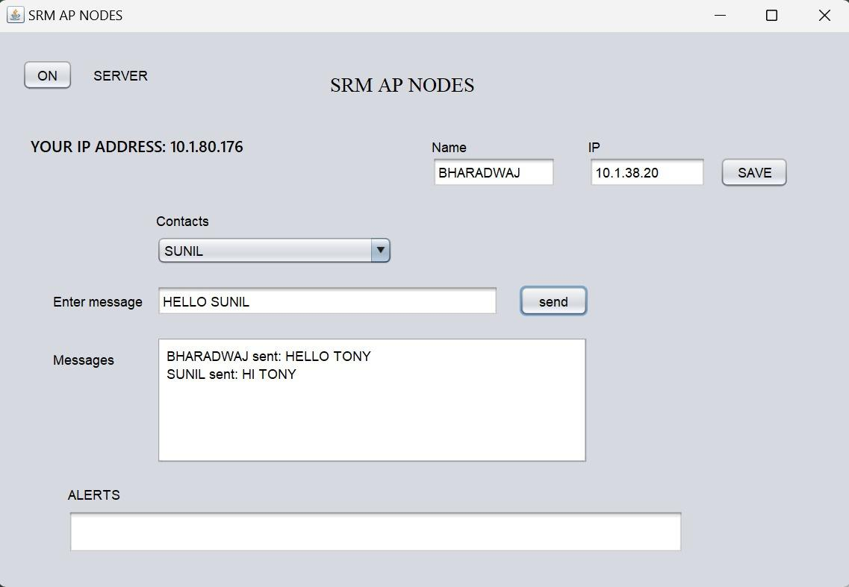
Results

Slide 13
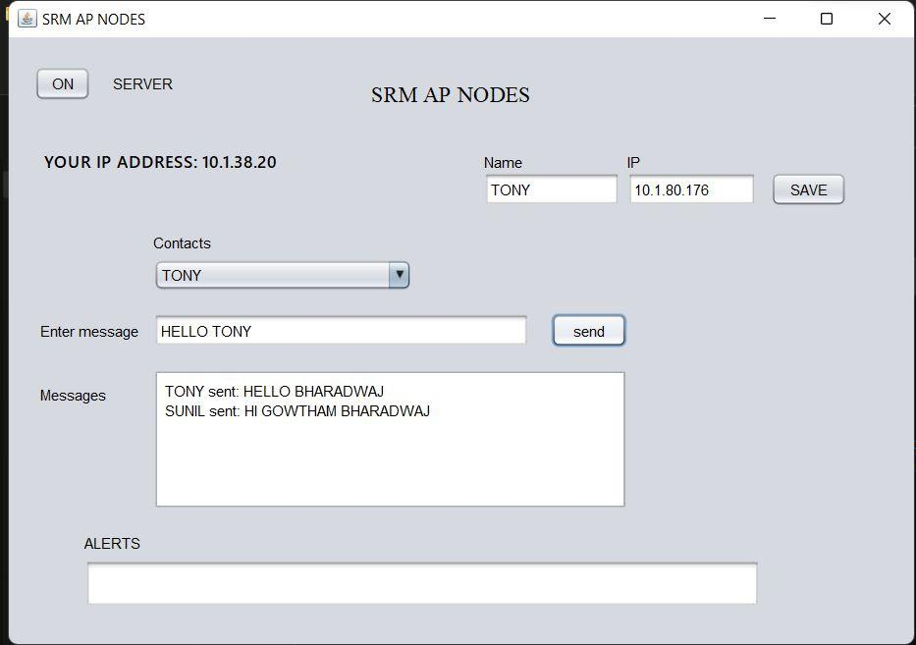

Slide 14
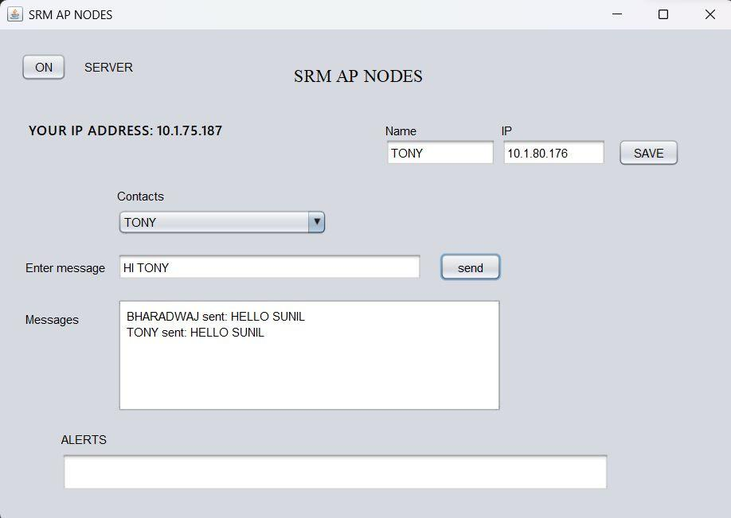

Slide 15
Conclusion
In multiclient socket programming, a server can accept connections from multiple clients simultaneously, allowing it to serve multiple clients concurrently. This is achieved by creating a separate thread for each client connection, allowing each client to be serviced independently. The most appropriate approach will depend on the specific requirements of the application and the resources available on the server.
Mixed socket programming can be a powerful tool for building robust and scalable networked applications, but it requires careful planning and design to ensure that it is implemented correctly. It is important to consider the scalability and reliability of the multiclient socket server when designing the application.

Slide 16
References
http://makemobiapps.blogspot.com/p/multiple-client-server-chat-programming.html
https://gyawaliamit.medium.com/multi-client-chat-server-using-sockets-and-threads-in-java-2d0b64cad4a7
https://www.slideshare.net/MohammedAbdallaYouss/java-socket-programming-75446299

Slide 17

THANK
YOU

