Slide 1
Task 1:
Expense Details For 6 Months
PRESENTED BY:
Aritra Bhattacharjee
RITAM DAS
PARTHA SADHU
PREETHAA DUTTA

Slide 2
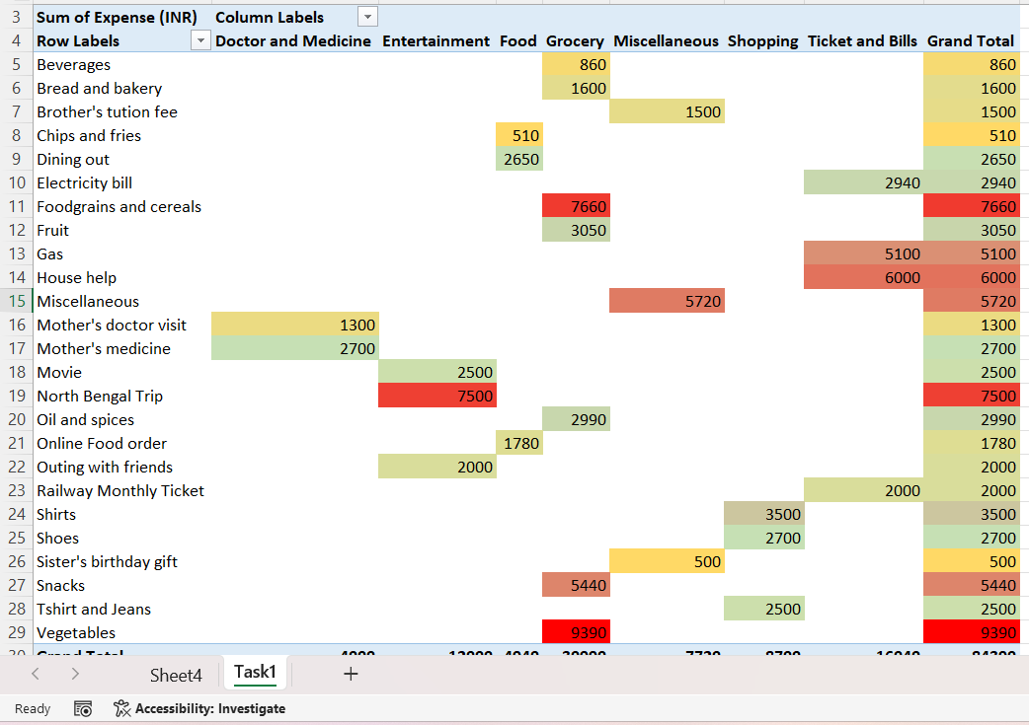
Q: 4) What amount is spent on each item of the categories with highest and 2nd highest expense amount (Pivot table). Visually represent the data with data bars (Conditional formatting)
Here in the pivot table the highest expense is marked in red color.
The second highest expense is marked in green color.
The lowest expense is marked in yellow color.

Slide 3
Thank You

