Slide 1

Project: Task 1
Expense Details For The Month Of June
Data Analytics Project

Slide 2



Presented By:
1. Ritam Das
2. Aritra Bhattarcharjee
3. Partha Sadhu
4. Preethaa Dutta

Slide 3
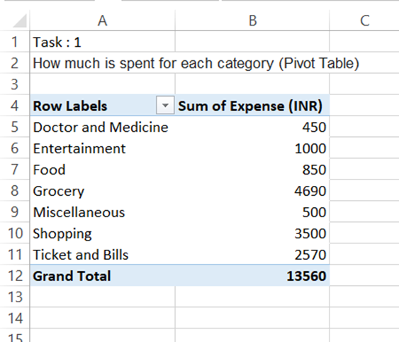
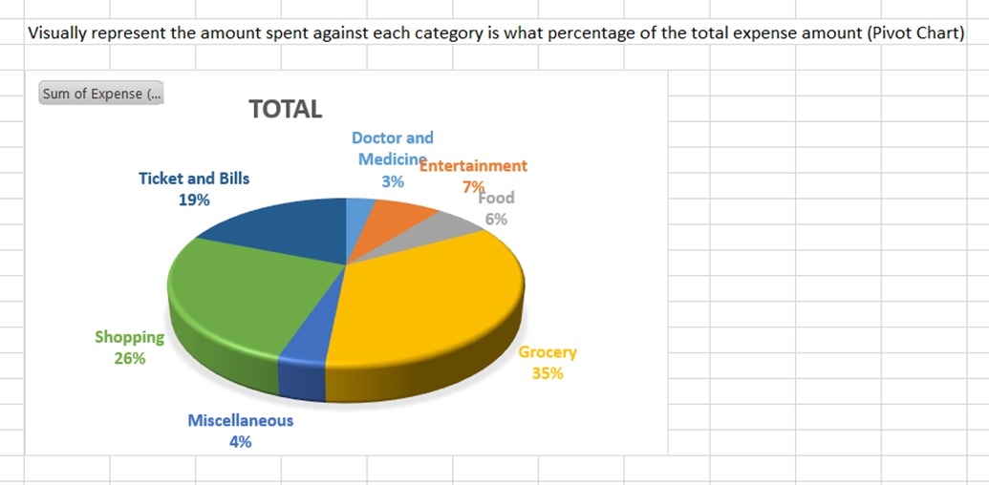
Question: 1
Insert Pivot Table:
Navigate to the Insert tab. Select PivotTable.
Select Data Range:
Select all the data range from the “Expense Details for the month of June” table
Configure PivotTable Fields:
Drag Category to Rows area.
Drag expense (INR) to Values area (ensure it sums the expenses).
Select PivotTable:
Click anywhere in the PivotTable.
Insert PivotChart:
Navigate to the Insert tab.
Select PivotChart.
Choose Pie Chart for visual representation.
Format Chart:
Show data labels.
Display percentages.

Slide 4

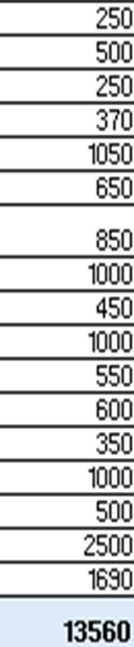
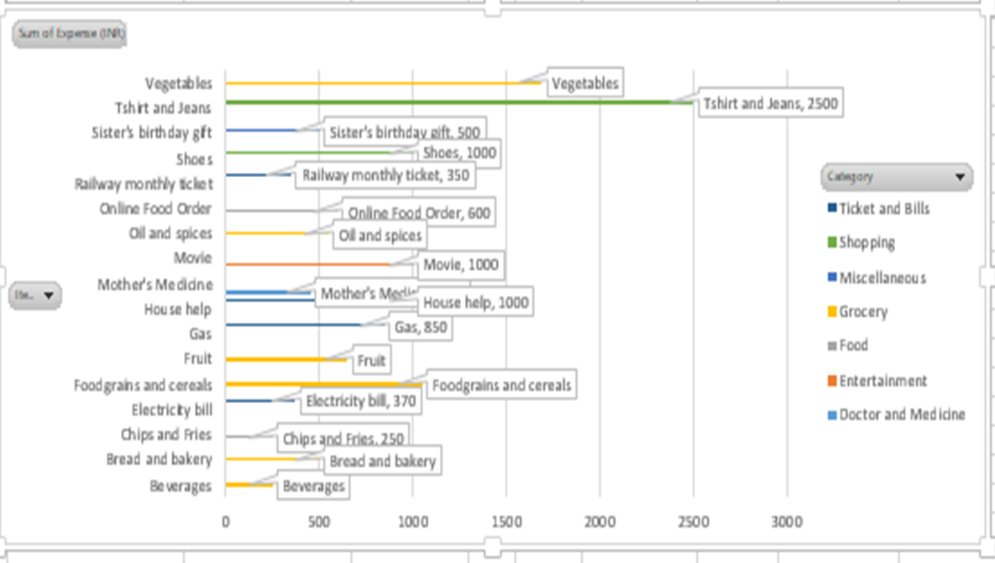
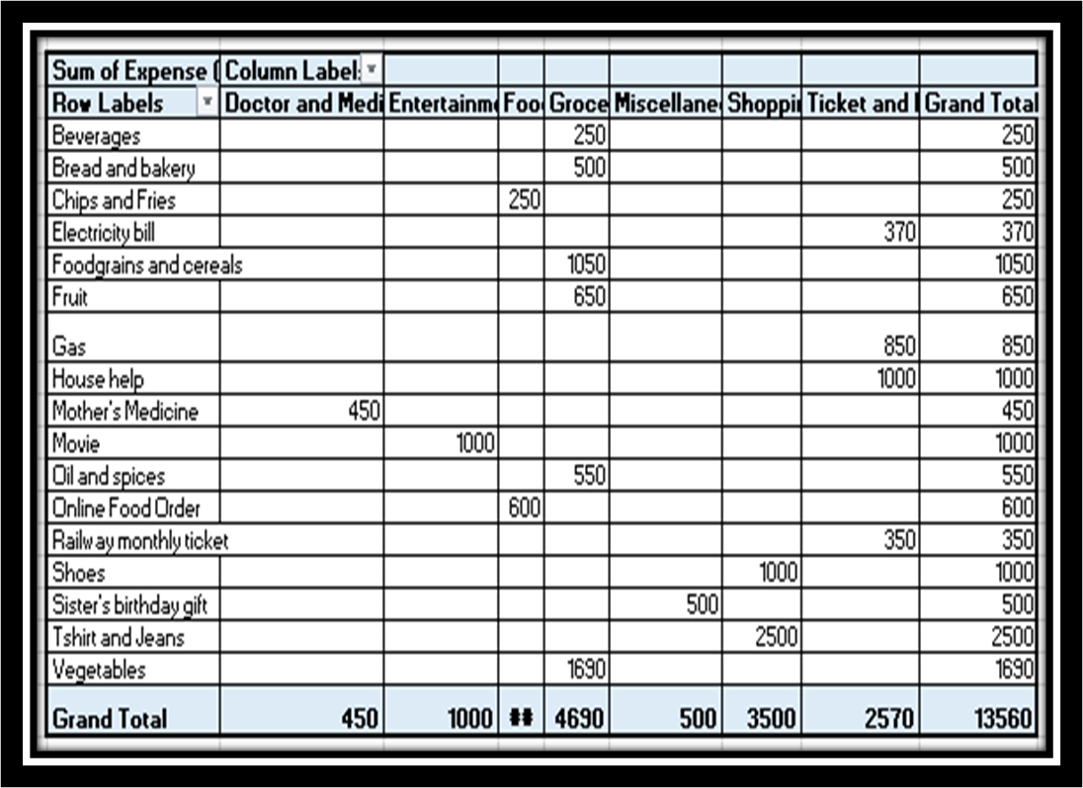
Question: 2
Beverages-
Bread and bakery-
Chips and fruits-
Electricity bills-
Foodgrains and cerials-
Fruit-
Gas-
House help-
Mother’s medicine-
Movie-
Oil and spices
Online food order-
Railway monthly ticket-
Shoe’s-
Sister’s birthday gift-
Tshirts and jeans-
Vegetables-
Grand total-
Pivot table on how much is Nitin spending on different items
Here we can see from the data that Nitin spending a bit much on Foodgrains and cerials, House help, Movie, ticket, and on his Sister’s birthday gift.

Slide 5

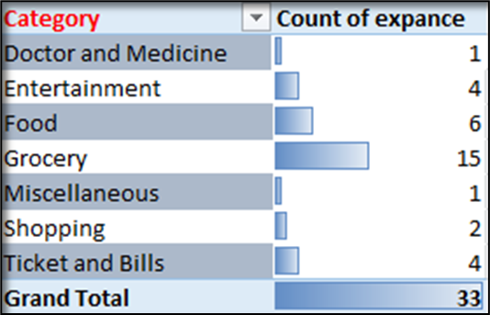

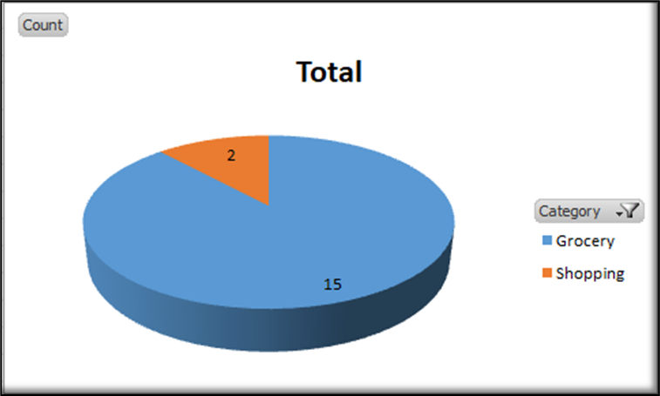
Question: 3
How many times money has been spent against different items of each category (Pivot Table)
Too much time expenses on Grocery
Filter the data to display the data for Grocery items and Shopping items
Grocery – 15
Shopping- 2

Slide 6

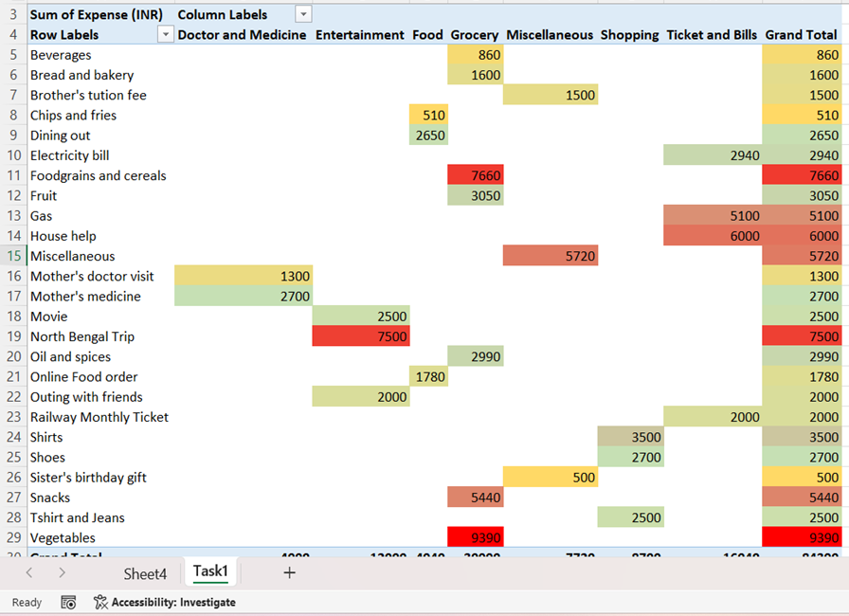

Question: 4
What amount is spent on each item of the categories with highest and 2nd highest expense amount (Pivot table). Visually represent the data with data bars (Conditional formatting)
In the pivot table the highest expense is marked in red color.
The second highest expense is marked in green color.
The lowest expense is marked in yellow color.

Slide 7


Thanks!
Do you have any question?

