Slide 1
Credit Card Transaction & Customer Report
Data Analysis Project

Slide 2


Created By -
Preethaa Dutta
Anudip ID: AF0404154
Sutanu Maity
Anudip ID: AF0406069

Slide 3


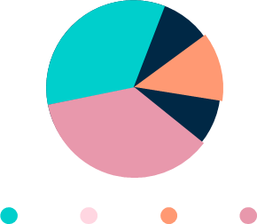
Objective:-
To develop a comprehensive credit card weekly dashboard that provides real-time insights into key performance matrices and trends, enabling stakeholders to monitor and analyze credit card operations effectively.

Slide 4
Steps for creating the project:-
Step 2
Step 4
Step 1
Step 3
Import data to SQL database
Design Dashboard & Insights
Data processing and DAX query
Export & share

Slide 5

DAX Queries:-
AgeGroup = SWITCH(
TRUE(),
'public cust_detail'[customer_age] < 30, "20-30",
'public cust_detail'[customer_age] >= 30 && 'public cust_detail'[customer_age] < 40, "30-40",
'public cust_detail'[customer_age] >= 40 && 'public cust_detail'[customer_age] < 50, "40-50",
'public cust_detail'[customer_age] >= 50 && 'public cust_detail'[customer_age] < 60, "50-60",
'public cust_detail'[customer_age] >= 60, "60+",
"unknown"
)
IncomeGroup = SWITCH(
TRUE(),
'public cust_detail'[income] < 35000, "Low",
'public cust_detail'[income] >= 35000 && 'public cust_detail'[income] <70000, "Med",
'public cust_detail'[income] >= 70000, "High",
"unknown"

Slide 6


DAX Queries:-
week_num2 = WEEKNUM('public cc_detail'[week_start_date])
Revenue = 'public cc_detail'[annual_fees] + 'public cc_detail'[total_trans_amt] + 'public cc_detail'[interest_earned]
Current_week_Reveneue = CALCULATE(
SUM('public cc_detail'[Revenue]),
FILTER(
ALL('public cc_detail'),
'public cc_detail'[week_num2] = MAX('public cc_detail'[week_num2])))
Previous_week_Reveneue = CALCULATE(
SUM('public cc_detail'[Revenue]),
FILTER(
ALL('public cc_detail'),
'public cc_detail'[week_num2] = MAX('public cc_detail'[week_num2])-1))

Slide 7
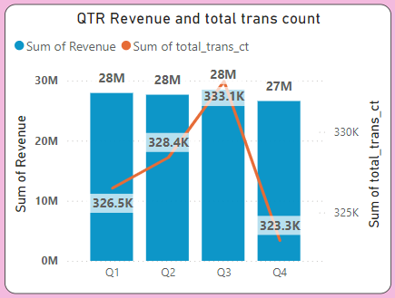
Project Insights:-
OVERVIEW YTD:
• Overall revenue is 57M
• Total interest is 8M
• Total transaction amount is 46M
• Male customers are contributing more in revenue 31M, female 26M
• Blue & Silver credit card are contributing to 93% of overall transactions
• TX, NY & CA is contributing to 68%
• Overall Activation rate is 57.5%
• Overall Delinquent rate is 6.06%

Slide 8
Project Insights:-
GENDER
Female
Revenue: 50.2M
Interest: 39.5M
Amount: 7.2M
Count: 646.7K
Revenue: 110.6M
Interest: 89.0M
Amount: 15.7M
Count: 1.3M
Male
Revenue: 60.4M
Interest: 49.5M
Amount: 8.5M
Count: 664.6K

Slide 9
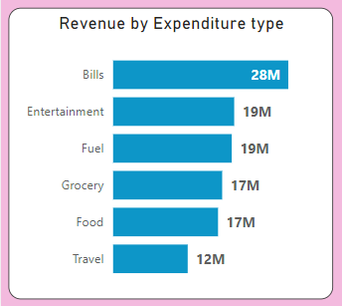

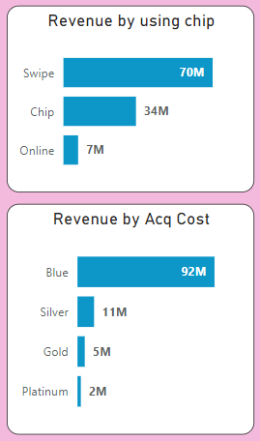

Credit Card Transaction Report

Slide 10
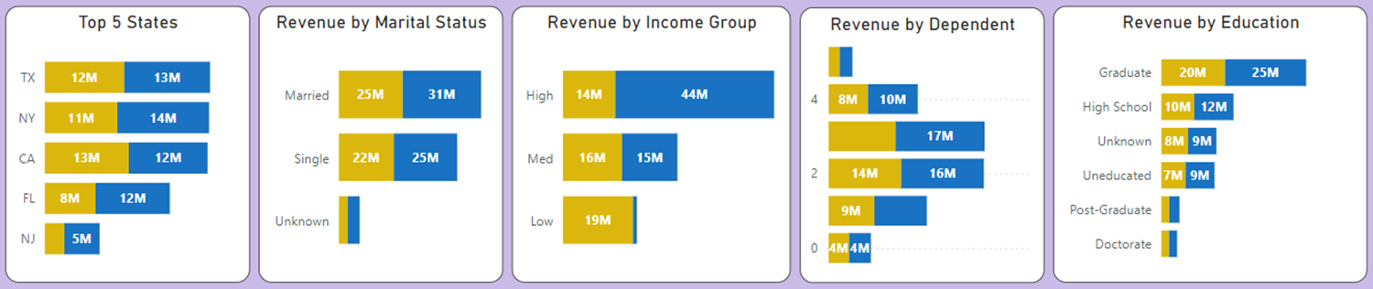

Credit Card Customer Report

Slide 11

Features:
The dashboard shows gender wise reports and charts.
The dashboard shows specific date wise reports and charts.
When new data is uploaded to database the dashboard updates as per the new data.

Slide 12

Thank You
Feel free to ask any question

