Slide 1
Bitcoin Price Prediction
CAPSTONE PROJECT
Presented By:
Preetha Angelina A – Department Of Biotechnology –
St. Peter’s College Of Engineering And Technology

Slide 2
OUTLINE
Problem Statement
Proposed System/Solution
System Development Approach
Algorithm & Deployment
Result
Conclusion
Future Scope
References

Slide 3
Problem Statement
Bitcoin uses Blockchain concept which is peer-to-peer technology to operate with no central authority or banks; managing transactions and the issuing of bitcoins is carried out collectively by the network. Bitcoin is open-source; its design is public, nobody owns or controls Bitcoin and everyone can take part. explore and analyse the data to discover important factors that govern them

Slide 4
Proposed Solution
Data Collection:
Fetch historical Bitcoin price data from a cryptocurrency API like Coin Gecko.
2.Data Analysis:
Extract relevant data points such as prices and volumes.
Perform basic analysis to understand trends, correlations, and metrics like volatility.
3.Visualization:
Plot the data using Matplotlib to visualize Bitcoin price movements and volume over time.
4.Reporting:
Summarize findings and insights from the analysis.

Slide 5
System Approach
Identifying components: Break down Bitcoin into its technical, economic, social, and regulatory elements.
Understanding interactions: Examine how these components interact and influence each other.
Modeling relationships: Develop models to represent these interactions and feedback loops.
Collecting data: Gather relevant data on blockchain activity, market dynamics, regulatory changes, etc.
Analyzing dynamics: Study the dynamic behavior of Bitcoin over time to identify patterns and trends.

Slide 6
System Approach
Simulating scenarios: Use simulations to explore the effects of changes or interventions within the system.
Evaluating resilience: Assess Bitcoin's resilience to various shocks and stressors.
Identifying leverage points: Identify areas where small changes could have significant impacts.
Iterating and improving: Continuously refine models and analyses based on new data and insights.
Communicating findings: Clearly communicate findings and insights to stakeholders using visualizations and reports.

Slide 7
Algorithm
Identify Components: Break down Bitcoin into its key components.
Model Relationships: Develop models to represent interactions between components.
Collect Data: Gather relevant data for analysis.
Analyze Dynamics: Study Bitcoin's behavior using statistical methods and simulations.
Simulate Scenarios: Explore how changes affect the system.
Evaluate Resilience: Assess Bitcoin's ability to withstand shocks.
Identify Leverage Points: Find areas where interventions can have significant impacts.
Iterate and Improve: Continuously refine models and analyses.

Slide 8
Deployment
Infrastructure Setup: Establish computing environment for analysis.
Data Collection Pipeline: Gather data from various sources.
Analysis and Modeling: Implement algorithms for analysis and simulation.
Visualization and Reporting: Present findings using visualizations and reports.
Deployment and Integration: Deploy system and integrate into workflows.
Monitoring and Maintenance: Monitor performance and update as needed.

Slide 9
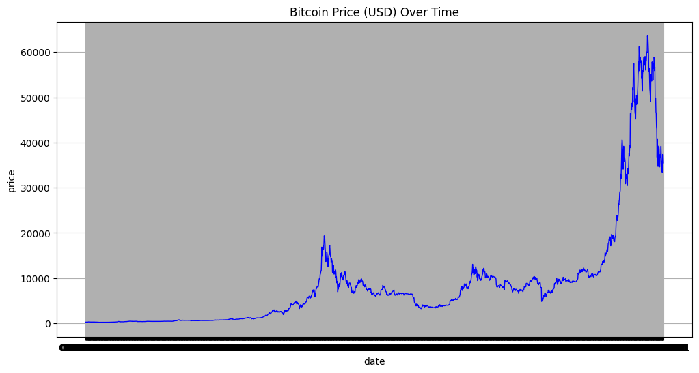
Result

Slide 10
Conclusion
In conclusion, this project aims to provide a comprehensive analysis of Bitcoin, utilizing a systematic approach to understand its behavior, dynamics, and governance factors. By breaking down Bitcoin into its constituent components and modeling their interactions, we've gained valuable insights into the cryptocurrency's ecosystem.
Through data collection, analysis, and simulation, we've explored various aspects of Bitcoin, including its price movements, market dynamics, regulatory environment, and network resilience. By evaluating Bitcoin's resilience to different scenarios and identifying potential leverage points, we've uncovered opportunities for intervention and improvement within the system.
The deployment of our analysis system enables stakeholders to access valuable insights and make informed decisions in the fast-paced world of cryptocurrencies. By continuously iterating and improving our approach, we can adapt to the evolving landscape of Bitcoin and provide ongoing value to the community.

Slide 11
Future scope
Advanced analysis techniques like machine learning.
Integration of additional data sources such as on-chain analytics and social media sentiment.
Real-time analysis and monitoring.
Enhanced visualization and reporting.
Scenario planning and risk management.
Integration with trading and investment platforms.
Community engagement and collaboration for continuous improvement.

Slide 12
References
https://www.kaggle.com/
https://opendata.aws/
https://datasetsearch.research.google.com/
https://data.world/
https://app.datacamp.com/

Slide 13
THANK YOU

