Slide 1
Superstore Sales Dashboard
Elevate Labs Internship – Task 4

Slide 2
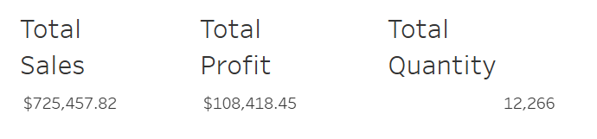
Key Metrics Overview
- Displays total sales, profit, and quantity for quick performance tracking.

Slide 3
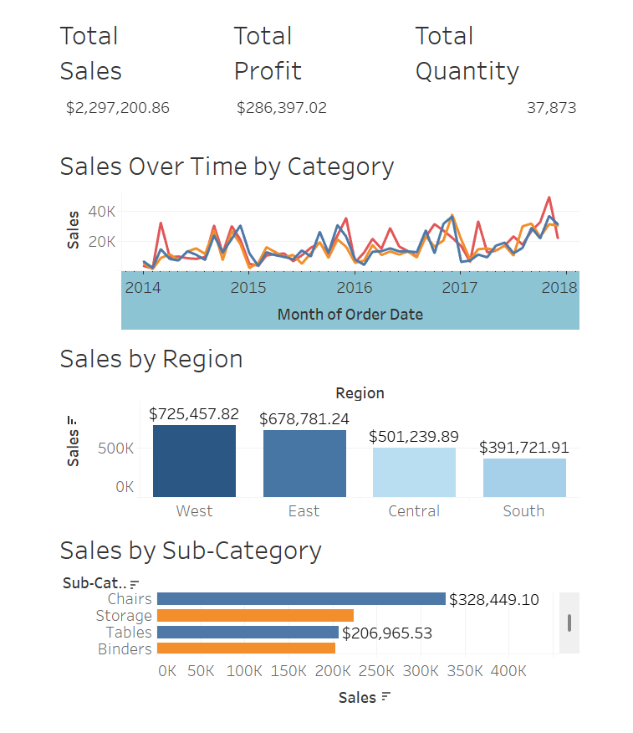
Dashboard Overview
• Sales trends over time by product category
• Regional performance with profitability view
• Top-performing sub-categories
• Interactive filtering via region and category

Slide 4
Key Insights
• West region generated the highest profit overall
• Technology category showed steady monthly growth
• Chairs and Phones are top-selling sub-categories
• Most sales occurred during Q4 (Oct–Dec)
• Office Supplies had lower profit margins despite high sales volume

Slide 5
Tools Used & Submission Info
• Tableau Desktop – For dashboard creation
• Sample Superstore Dataset (Excel) – Sales data source
• Google Slides – Presentation design
• GitHub – Submission hosting
Prepared by: Preetham
For: Elevate Labs Data Analyst Internship – Task 4

