Slide 1
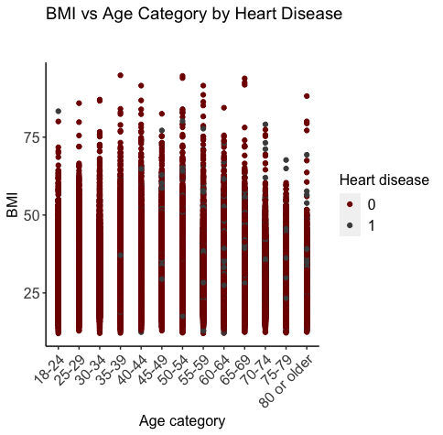
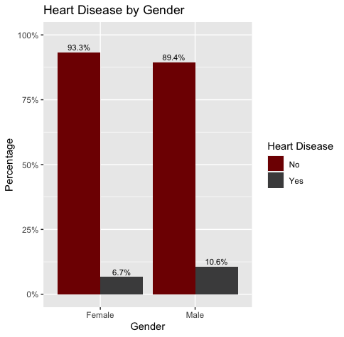
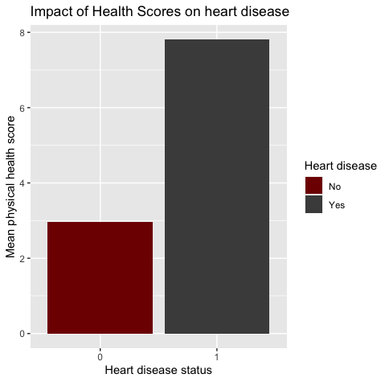
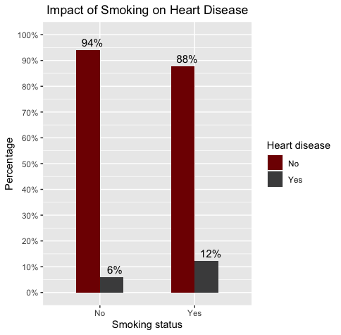
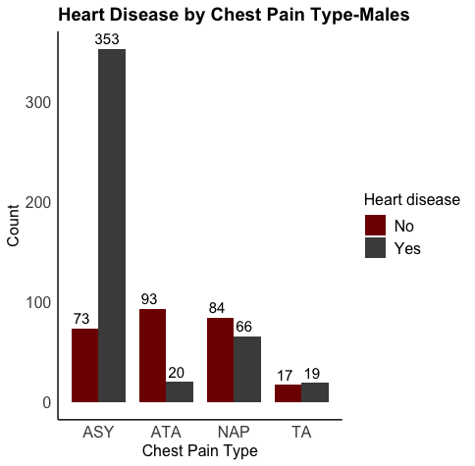
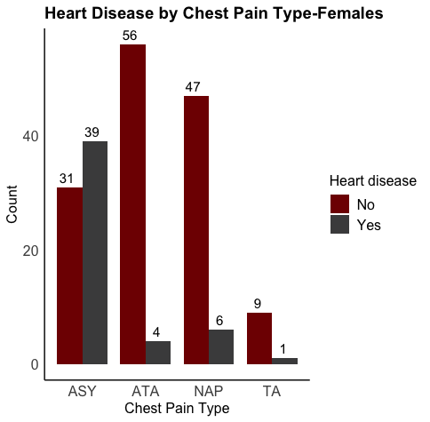








$$α$$
Abstract
$$ε$$
Visualizations
The Relationship Between Heart Disease and Lifestyle Factors
Heart disease is a significant cause of mortality and morbidity worldwide. This study aims to analyze a dataset of patient records to explore the relationship between various lifestyle factors and the likelihood of heart disease. Also, it examines the association between sex, chest pain type, cholesterol levels, blood pressure, and other factors with the presence or absence of heart disease. This analysis includes descriptive statistics, hypothesis testing, and R programming language data visualization. The results of this analysis will provide insights into the factors that contribute to heart disease and help identify high-risk patient populations.
$$β$$
Introduction
Heart disease is a leading cause of death and disability worldwide. According to the World Health Organization, an estimated 17.9 million people die annually from cardiovascular disease, accounting for 31% of all deaths globally. In the United States, heart disease is responsible for one in four deaths, making it the leading cause of mortality in the country. While several risk factors have been identified for heart disease, including age, sex, smoking, high cholesterol, high blood pressure, and diabetes, the complex interplay of these factors is not fully understood.
To better understand the relationship between risk factors and heart disease, we will analyze a dataset of patient records using statistical and machine learning techniques. Our analysis will focus on identifying the most significant risk factors for heart disease and understanding how these factors interact with each other.
Preetham Reddy V Information Visualization
Indiana University Bloomington
April 25, 2023
$$γ$$
Dataset Summary
This study analyzes two datasets, one with 18 columns and 319,795 rows containing various lifestyle factors and the other with 12 columns and 918 rows that provide more information on different medical parameters for predicting heart disease.
To gain a better understanding of the data, exploratory data analysis (EDA) was conducted. Additionally, two-sample t-tests were performed for numerical variables, and chi-square tests were used for categorical variables to determine the significance of each column concerning heart disease. The results of these tests helped identify the most significant predictors, which were then used to create visualizations using linear regression models.
$$ε$$
Results
BMI vs Age : This visualization gives insights on how BKI and Age causes the heart diseases
Heart Diseases by Gender: This visualization helps us understand the percentage status of heart diseases by gender
Impact of Health Score: This visualization helps us understand the impact of health score on heart disease
Impact of smoking: This visualization helps us understand the effect of smoking on heart diseases
Heart Diseases by Chest Pain: Last two visualizations analyzes the distribution of chest pain type by gender and status of heart disease
$$δ$$
Research Questions
References
$$θ$$
How do lifestyle factors such as BMI, smoking, alcohol drinking, physical activity, and sleep affect the development of heart disease?
Are there any trends among the medical parameters concerning demographics such as age and sex?
edesoriano. (September 2021). Heart Failure Prediction Dataset: https://www.kaggle.com/fedesoriano/heart-failure-prediction
Kamil Pytlak (January 2022). Personal Key Indicators of Heart Disease: https://www.kaggle.com/datasets/kamilpytlak/personal-key-indicators-of-heart-disease
Template reference: https://templatelab.com/research-posters/#google_vignette

