Slide 1






















SENTIMENTAL ANALYSIS PROJECT
❤️
🔥
😊
💯
👌
👎
🤚
😒

Slide 2

Introduction to
Sentimental Analysis

Slide 3

Definition of Sentimental Analysis
Sentiment analysis, often referred
to as opinion mining, utilizes natural
language processing and text analysis
techniques to classify sentiments
expressed in text as positive, negative, or neutral. It involves identifying
emotional tones in written
communications, providing crucial
insights for businesses & researchers.

Slide 4


Sentiment analysis has evolved significantly, originating from early text mining techniques to sophisticated machine learning models.The developments in computational linguistics and advancements in NLP algorithms have dramatically increased the accuracy of sentiment detection over the years.

Slide 5

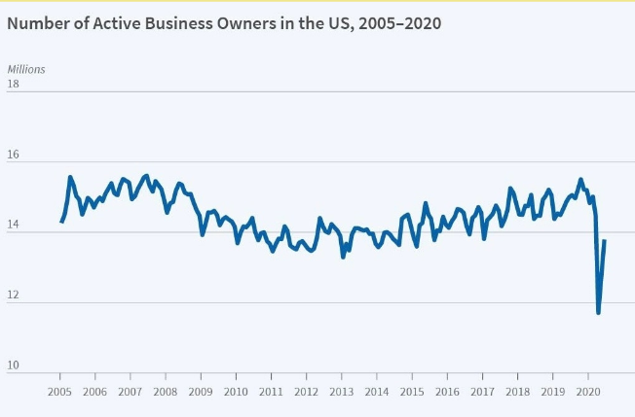
Sentiment analysis is essential for enhancing human-machine interaction by allowing computers to understand and respond to human emotions. Its significance extends to various NLP applications, including customer feedback, market analysis, and social media monitoring, ultimately improving user experience and strategic decision-making.

Slide 6


Slide 7

The methodology involves data collection from various sources, preprocessing the text for analysis, and utilizing machine learning techniques for sentiment prediction. The approach encompasses training and evaluating models to ensure accuracy in sentiment classification .

Slide 8
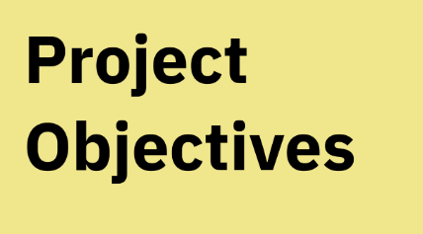

The primary objective is to implement a robust sentiment analysis model that can discern positive, negative, and neutral sentiments in text. This aims to improve customer feedback analysis for businesses, enhancing their understanding of consumer emotions and satisfaction.

Slide 9


The expected outcome is a fully functional sentiment
analysis model capable of accurately predicting
sentiments in real-time scenarios..
Anticipated results include increased customer
satisfaction through better understanding
of feedback and enhanced product/service
adjustments based on insights gained.

Slide 10

Design of the
Project

Slide 11

Overview of Project Design
The design of the project
encompasses several integral phases.
These include data collection,
preprocessing, feature extraction,
model selection, training, evaluation,
and deployment, ensuring a systematic
approach to building reliable sentiment
analysis framework.

Slide 12

Data Collection
&
Pre-Processing
Data collection involves gathering a dataset containing labeled examples of positive, neutral, and negative text. Preprocessing is crucial as it cleans and tokenizes the data while removing unnecessary characters, making it suitable for analysis .

Slide 13
Model Selection &
Architecture
Choosing the right model is vital for effective sentiment analysis. Popular architectures include Support Vector Machines, Random Forests, Recurrent Neural Networks, and Transformers like BERT, each with distinct advantages based on data characteristics .

Slide 14
Implementation of Sentimental
Analysis Model

Slide 15

Implementation Strategy
The implementation strategy encompasses a well-defined process starting from data collection to model deployment. Emphasis on preprocessing and feature extraction is crucial to ensure that the model comprehensively understands the sentiment .

Slide 16

Code Overview and Techniques
The implementation leverages libraries such as Pandas for data manipulation and Transformers for model architecture. Essential coding techniques include cleaning the text, extracting relevant features, and preparing data for model training .

Slide 17

Model Training Process
Model training involved utilizing a labeled dataset with positive, negative, and neutral sentiments. Techniques such as hyperparameter tuning and cross-validation were applied to optimize the model's performance.

Slide 18

Deployment of Sentimental Analysis Model
The trained model was successfully deployed using a Flask application, enabling real-time sentiment predictions. The deployment process included testing for performance and integrating user feedback mechanisms .

Slide 19
Conclusion & Future Scope

Slide 20

Summary
Model training involved utilizing a labeled dataset with positive, negative, and neutral sentiments. Techniques such as hyperparameter tuning and cross-validation were applied to optimize the model's performance.

Slide 21
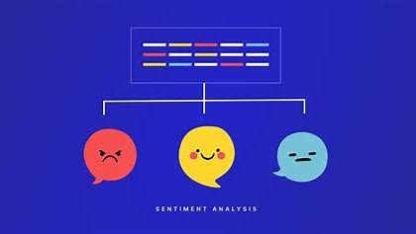
Real-World Applications
Sentiment analysis is increasingly adopted in sectors such as marketing, customer service, and finance. Businesses utilize it to gauge customer opinions from reviews and social media, allowing for tailored products and marketing strategies that align with consumer sentiments.

Slide 22
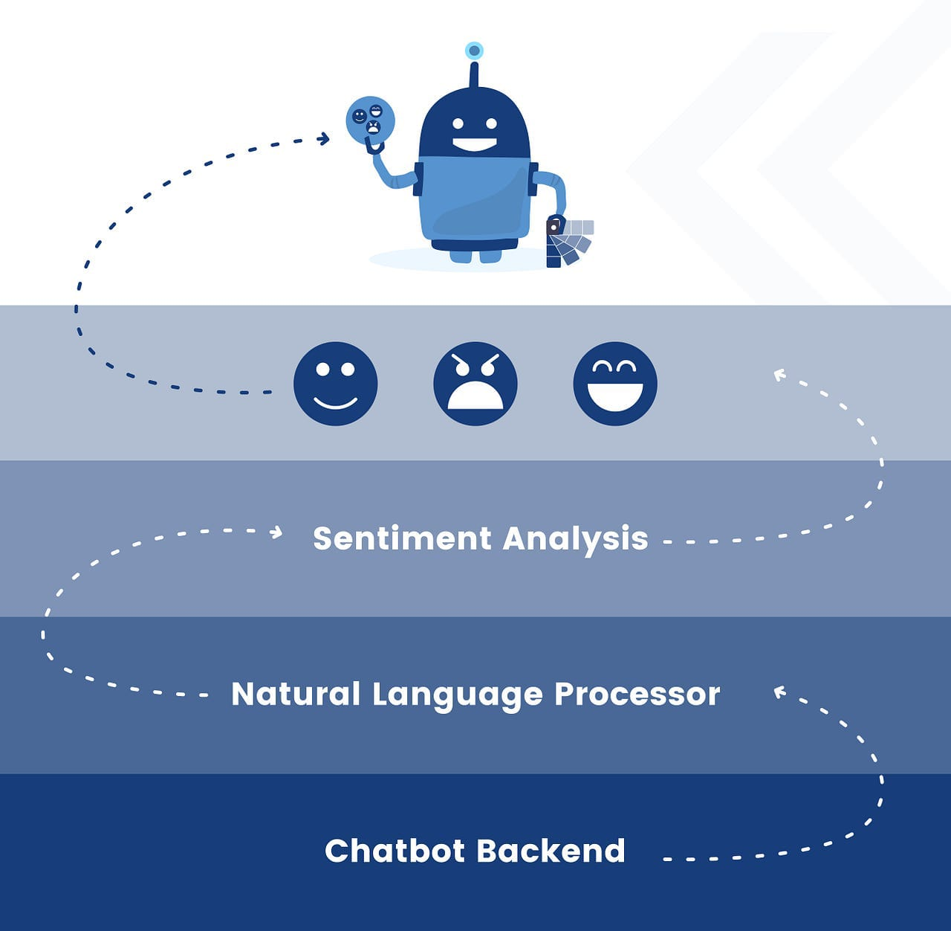
Integration with Other Technologies
Integrating sentiment analysis with Al systems such as chatbots and voice assistants could provide more personalized user experiences. Moreover, combining sentiment data with predictive analytics can inform product development and customer engagement strategies.

Slide 23
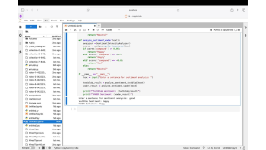
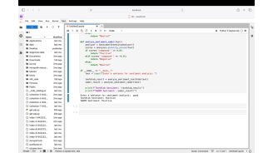
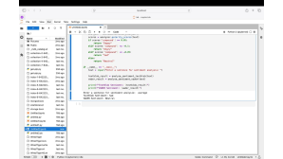
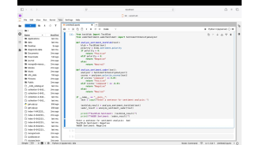
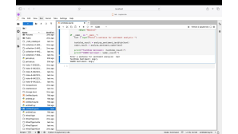
CODE
CODE EXECUTION
👎
😡
👍
😉
😂

Slide 24
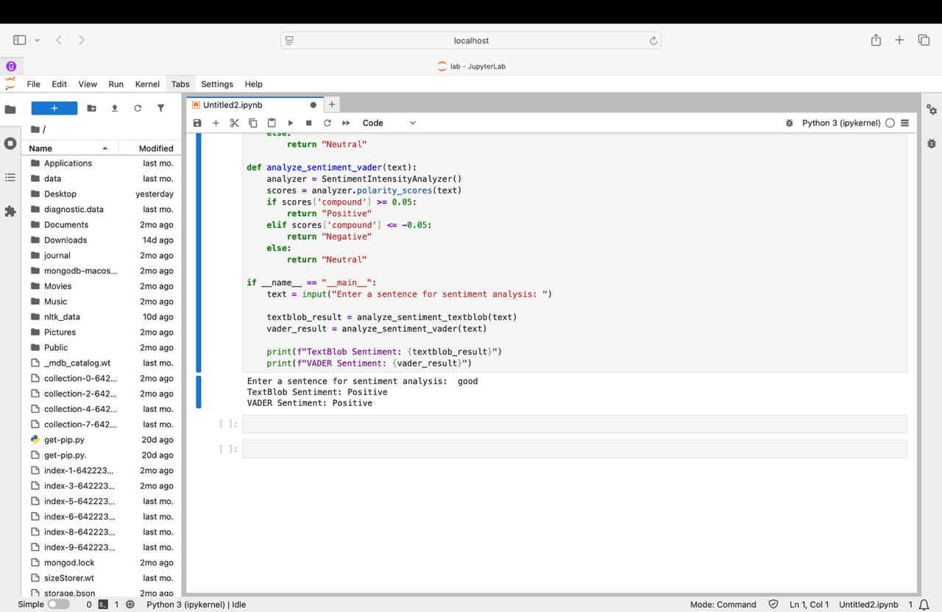

Slide 26
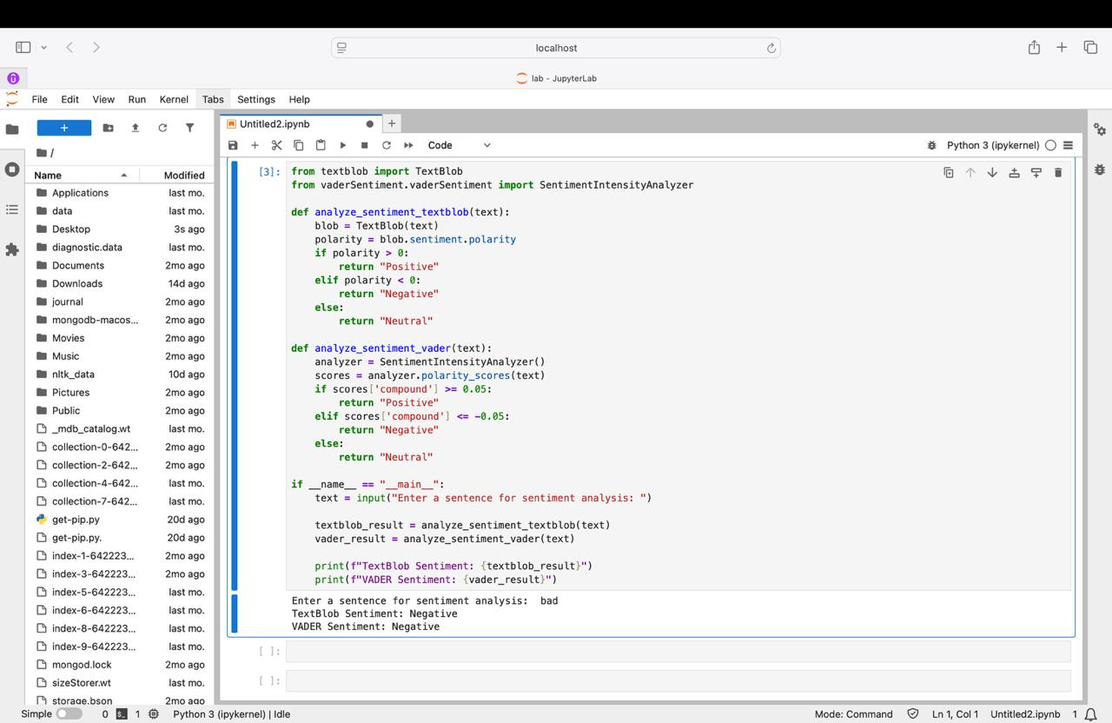

Slide 27
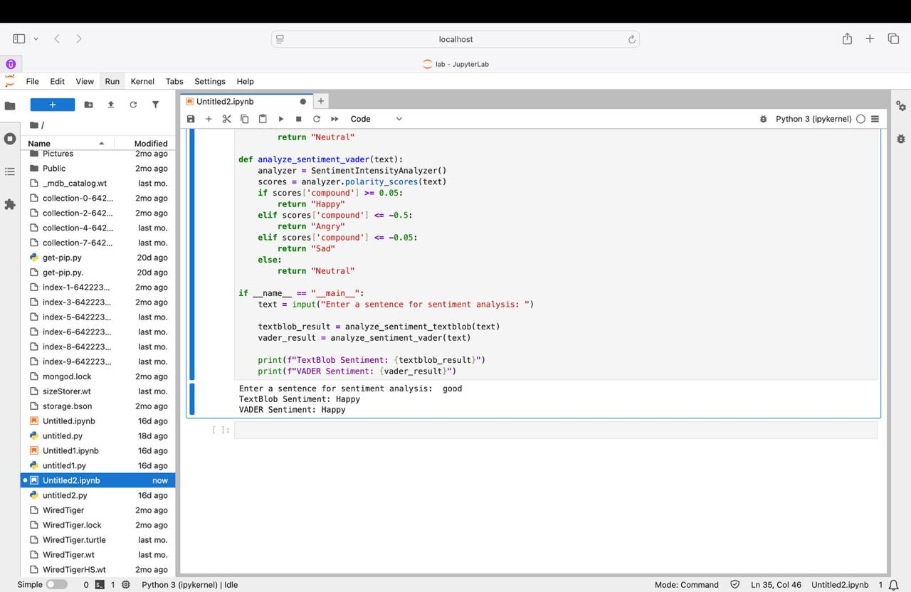

Slide 28
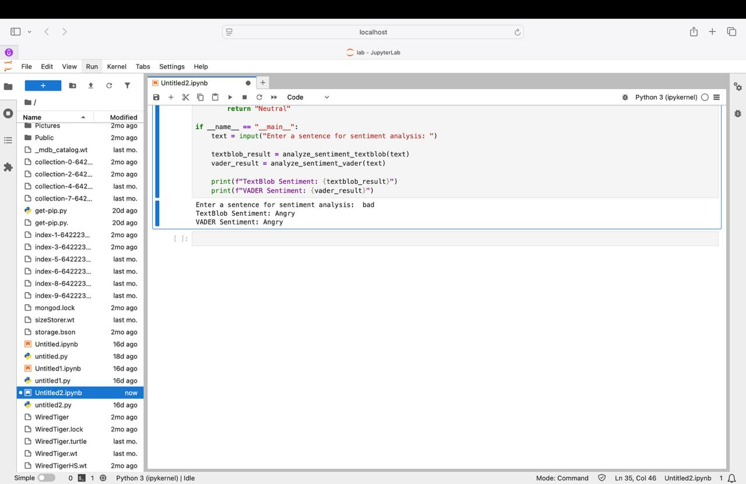

Slide 29
