Slide 1


Slide 2
What we offer
This app is specially designed to promote eCommerce technology to rural kirana owners.
VyaaparHub is a one stop solution for all rural retailers and provides consumer choice , all available at doorstep of kirana stores.
Some of the categories included in the website are : Grocery, Edible oils, Bakery, Health and hygiene, Cattle feeds products.

Slide 3
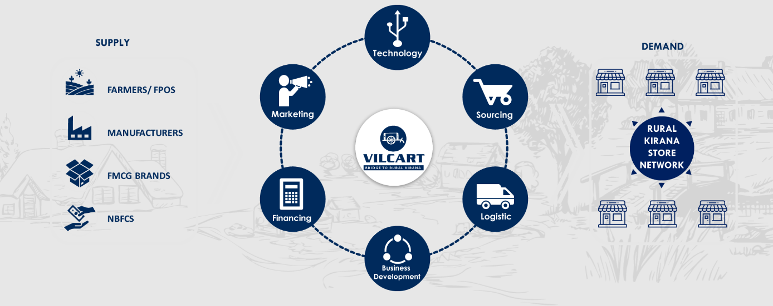
How we operate
VyaaparHub with its tech enabled rural to rural supply chain connects farmers, brands, manufactures directly to kirana store through our website.
VyaaparHub will be deep rooted in all parts of rural Karnataka.

Slide 4
impact
VyaaparHub with its technology takes care of all segments of rural such as kirana owners, local transport operators, rural small and medium sized enterprises.

Slide 5
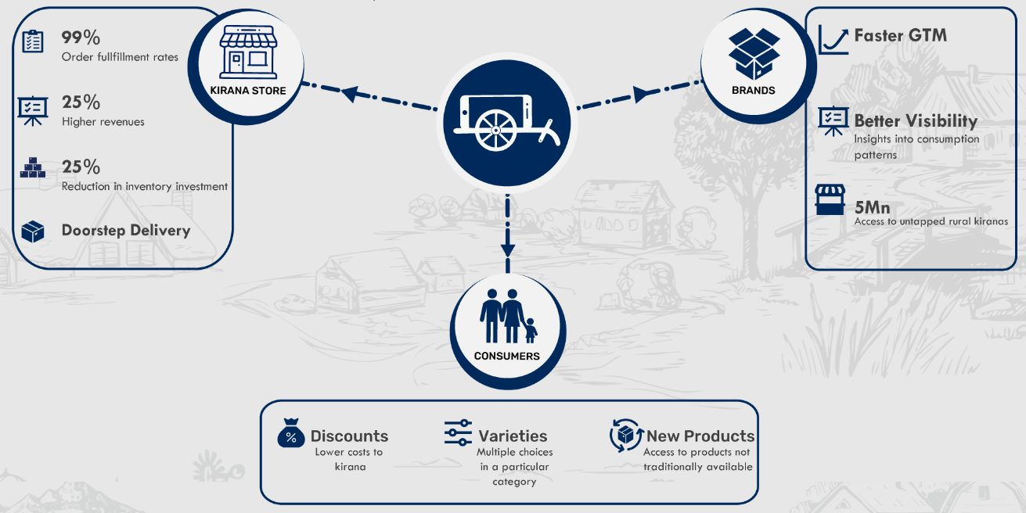
benefits
Partnering with VyaaparHub gives multiple financial benefits, Ease of doing business, better comfort, better reach to all Stakeholders in the rural retail.

