Slide 1

Innovating Healthcare Coordination through Data-Driven Strategies
TEAM MEMBERS
AV.AYYAPA REDDY BL.EN.U4CSE22008 G.KRISHNA KOUSIK BL.EN.U4CSE22023 MOHAMMAD AMAN SOHEL BL.EN.U4CSE20102
M.PREETHAM BL.EN.U4CSE20097

Slide 2
Introduction
A hospital management system is a crucial tool for effectively organizing and managing healthcare facilities.
Utilizing trees, graphs, linked lists, and queues can enhance the efficiency and accuracy of the system.
This presentation will delve into how these data structures can be applied in a hospital setting.

Slide 3
Importance of Trees in Hospital Management
Trees can be used to represent hierarchical structures within a hospital, such as departments, units, and staff levels.
By utilizing trees, administrators can easily navigate through different levels of the hospital organization.
This hierarchical representation helps in efficient decision-making and resource allocation.

Slide 4
Application of Graphs in Hospital Management
Graphs can model complex relationships between various entities in a hospital, such as doctors, patients, and medical procedures.
By using graphs, hospitals can optimize scheduling, resource allocation, and patient flow.
Graph algorithms can be applied to identify and address bottlenecks in the hospital system.

Slide 5
Utilizing Linked Lists for Patient Records
Linked lists can store and manage patient records efficiently, allowing for quick access and updates.
Each node in the linked list can represent a patient's information, including medical history, treatments, and appointments.
Linked lists provide a dynamic and flexible way to organize and track patient data in real-time.

Slide 6
Implementing Queues for Appointment Scheduling
Queues can be used to manage appointment scheduling, ensuring a fair and organized system.
Patients can be added to the queue based on their appointment requests, with priority given to urgent cases.
Queues help streamline the appointment process and minimize waiting times for patients.

Slide 7
Improving Resource Management with Trees
Trees can represent the hierarchy of hospital resources, such as medical equipment, medications, and staff.
By organizing resources in a tree structure, hospitals can optimize inventory management and allocation.
Tree traversal algorithms can be used to efficiently locate and track available resources within the hospital.

Slide 8
Enhancing Patient Care through Graph Analysis
Graphs can analyze patient data to identify patterns, trends, and correlations that can improve treatment outcomes.
By applying graph algorithms, hospitals can personalize patient care plans based on individual medical histories and conditions.
Graph visualization tools can help medical professionals make informed decisions and provide better patient care.
7

Slide 9
Streamlining Workflow with Linked Lists
Linked lists can track and manage workflow processes within the hospital, such as patient admissions, lab tests, and discharge procedures.
Each node in the linked list can represent a step in the workflow, ensuring a systematic and efficient progression.
Linked lists help streamline communication and coordination among different departments and staff members.

Slide 10
Optimizing Appointment Scheduling using Queues
Queues can prioritize and schedule patient appointments based on urgency, availability, and medical needs.
By implementing queues for appointment scheduling, hospitals can reduce no-shows, minimize wait times, and improve patient satisfaction.
Queue management algorithms can dynamically adjust appointment schedules to accommodate emergencies and unexpected changes.

Slide 11
Ensuring Data Integrity with Trees
Trees provide a structured and organized way to store and manage sensitive patient data, ensuring data integrity and security.
By utilizing tree data structures, hospitals can implement access control mechanisms to protect patient privacy and comply with regulations.
Tree-based data storage facilitates efficient data retrieval and analysis while maintaining data consistency and accuracy.

Slide 12
Analyzing Healthcare Trends with Graphs
Graphs can analyze healthcare trends, such as disease outbreaks, treatment effectiveness, and patient demographics.
By visualizing healthcare data using graphs, hospitals can identify emerging health issues, predict future trends, and allocate resources effectively.
Graph analytics can provide valuable insights for healthcare decision-makers to improve public health and patient outcomes.

Slide 13
Managing Patient Records with Linked Lists
Linked lists offer a dynamic and scalable solution for managing patient records, including medical histories, test results, and treatment plans.
Each node in the linked list can store specific patient information, allowing for easy retrieval and updates.
Linked lists can streamline the process of documenting and tracking patient care, ensuring continuity of treatment and accurate record-keeping.

Slide 14
Prioritizing Patient Care with Queues
Queues can prioritize patient care tasks, such as medication administration, lab tests, and surgical procedures, based on criticality and urgency.
By using queues to manage patient care tasks, hospitals can ensure timely and efficient delivery of healthcare services.
Queue-based scheduling helps healthcare providers focus on high-priority tasks and optimize patient outcomes.

Slide 15
Enhancing Decision-Making with Trees
Trees can represent decision trees in healthcare scenarios, helping medical professionals make informed choices based on patient conditions and treatment options.
By visualizing decision trees, hospitals can streamline the decision-making process and improve treatment outcomes.
Tree-based decision support systems can assist healthcare providers in selecting the most effective interventions and personalized care plans for patients.

Slide 16
Optimizing Resource Allocation using Graphs
Graphs can model resource allocation scenarios in hospitals, such as optimizing staff assignments, equipment utilization, and facility management.
By analyzing resource allocation graphs, hospitals can identify inefficiencies, reduce costs, and improve overall operational performance.
Graph algorithms can recommend optimal resource allocation strategies to maximize the use of hospital resources and enhance patient care.

Slide 17
Improving Workflow Efficiency with Linked Lists
Linked lists can streamline workflow processes in hospitals, such as patient admissions, discharge planning, and follow-up care.
Each node in the linked list can represent a workflow task, ensuring a systematic and coordinated approach to patient care.
Linked lists facilitate communication and collaboration among healthcare providers, enhancing workflow efficiency and patient satisfaction.

Slide 18
Enhancing Patient Experience through Queue Management
Queues can enhance the patient experience by reducing wait times, improving appointment scheduling, and prioritizing patient needs.
By optimizing queue management processes, hospitals can increase patient satisfaction, loyalty, and trust in the healthcare system.
Queue management systems can provide a seamless and pleasant experience for patients, enhancing their overall healthcare journey.

Slide 19
Ensuring Data Security with Trees
Trees can secure patient data by implementing encryption, access controls, and audit trails to protect sensitive information from unauthorized access.
By using tree data structures for data security, hospitals can comply with privacy regulations, such as HIPAA, GDPR, and HITECH.
Tree-based data security measures safeguard patient confidentiality, integrity, and availability, ensuring trust and confidence in the hospital's data management practices.

Slide 20
Forecasting Healthcare Needs with Graph Analytics
Graph analytics can forecast healthcare needs, such as predicting patient admissions, resource demands, and disease trends.
By leveraging graph analytics, hospitals can proactively plan for future healthcare challenges, allocate resources strategically, and improve operational efficiency.
Graph-based forecasting tools can empower healthcare administrators to make data-driven decisions and adapt to changing healthcare demands effectively.

Slide 21
Flow Chart
Login
Register
Online
Offline
Enter Symptoms
Select location and doctor
Predict Disease
Book appointment
Details to email

Slide 22
Conclusion
Implementing trees, graphs, linked lists, and queues in a hospital management system can enhance operational efficiency, patient care, and decision-making processes.
By utilizing these data structures effectively, hospitals can optimize resource allocation, streamline workflows, and improve overall healthcare outcomes.
Embracing innovative technologies and data structures in hospital management is essential for driving continuous improvement and delivering high-quality healthcare services.

Slide 23
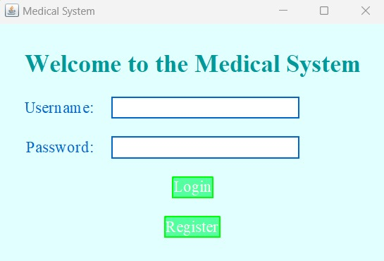
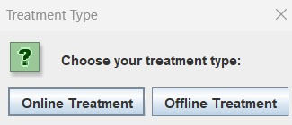
RESULTS
This figure shows the login page
where we need to login or register on the medical system if its user’s first time.
This figure is the HMS it shows the user two option online treatment and offline treatment

Slide 24
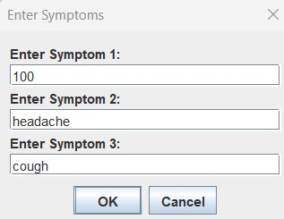
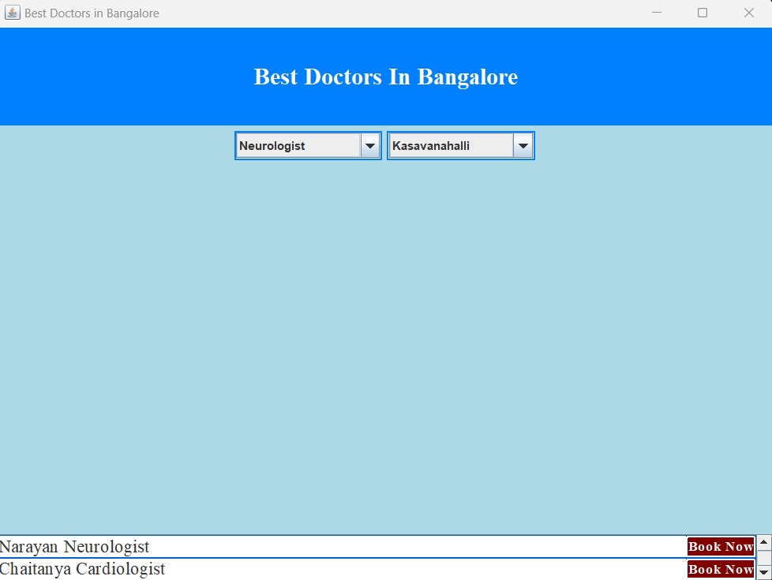
This figure shows that the online treatment. Where we need select the three symptoms
This figure shows that the offline treatment

Slide 25
THANK YOU

