Slide 1


Slide 2
Visualization
Data Modelling
Walmart sales Analysis Report
Forecasting sales and profit Report
Top 20% customer by sales
Customer insight analytical Report
Store performance Report
Inventory details Report
Sales and profit by shipping mode

Slide 3
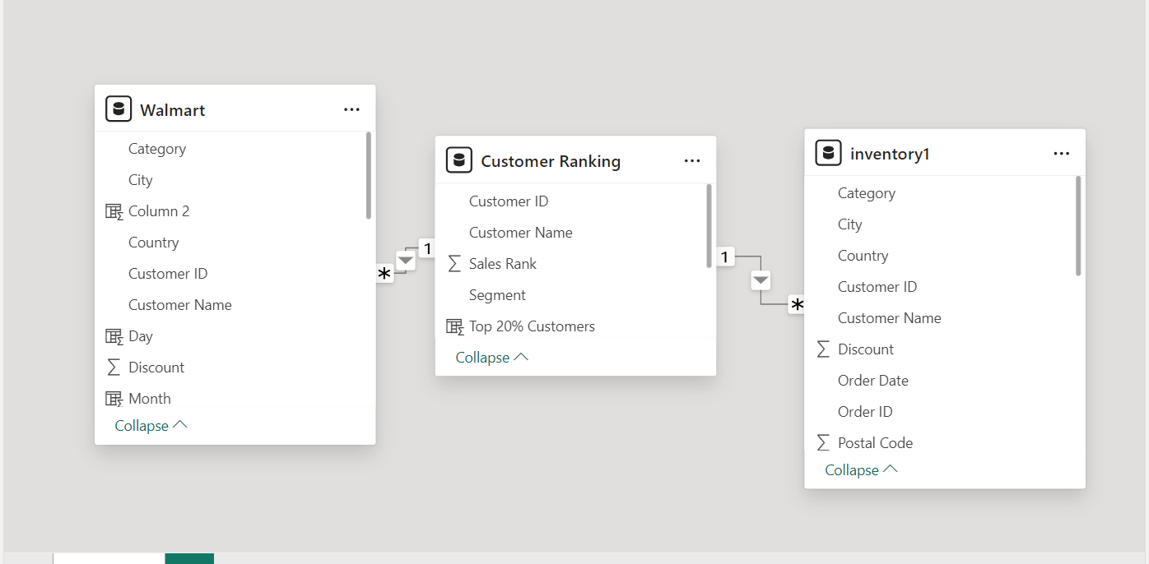
Data Modeling

Slide 4
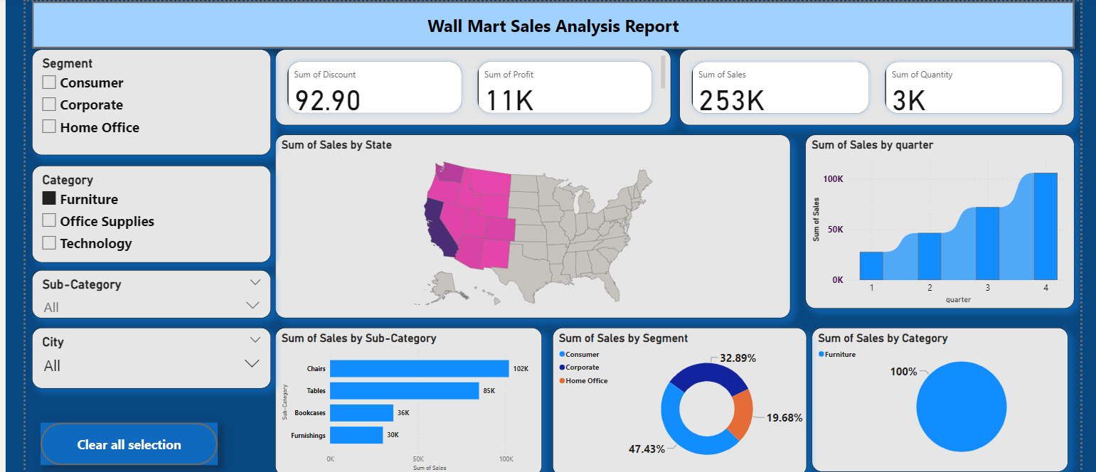
Walmart Sales Analysis report

Slide 5
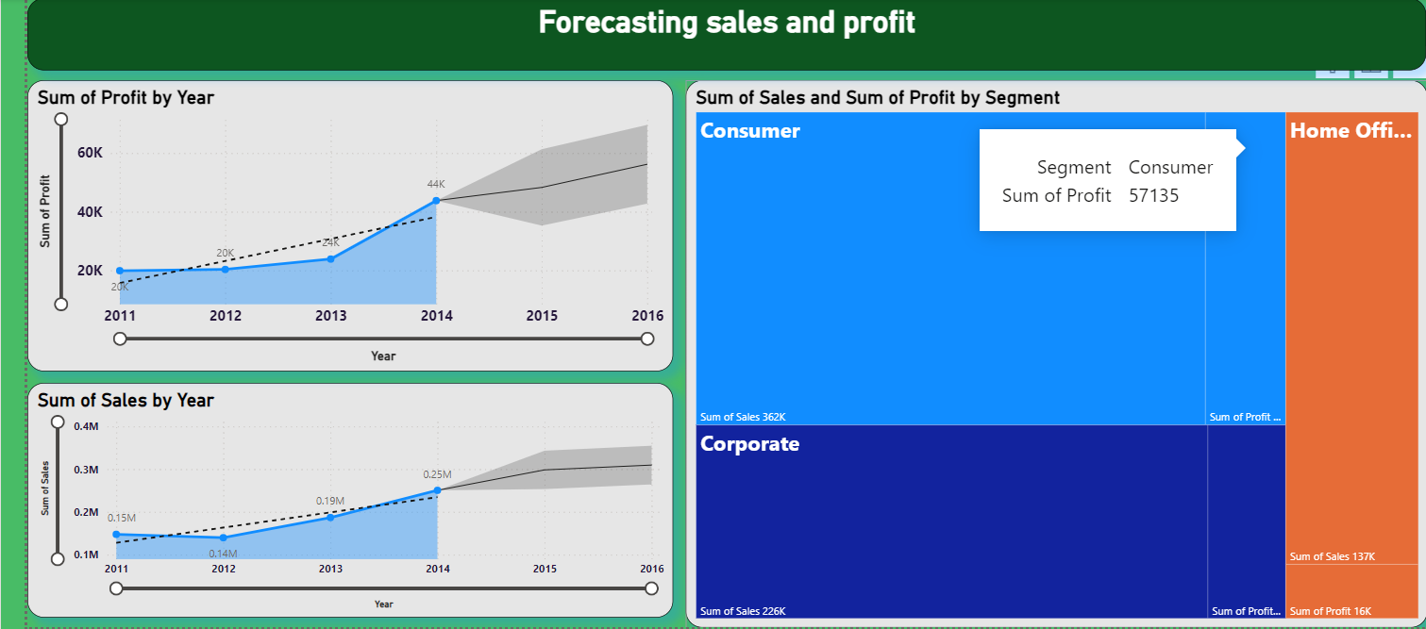
Forecasting sales and profit

Slide 6
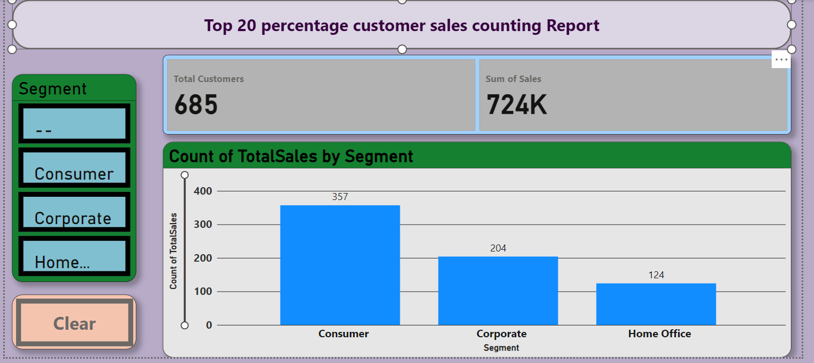
Top 20% customer by sales

Slide 7
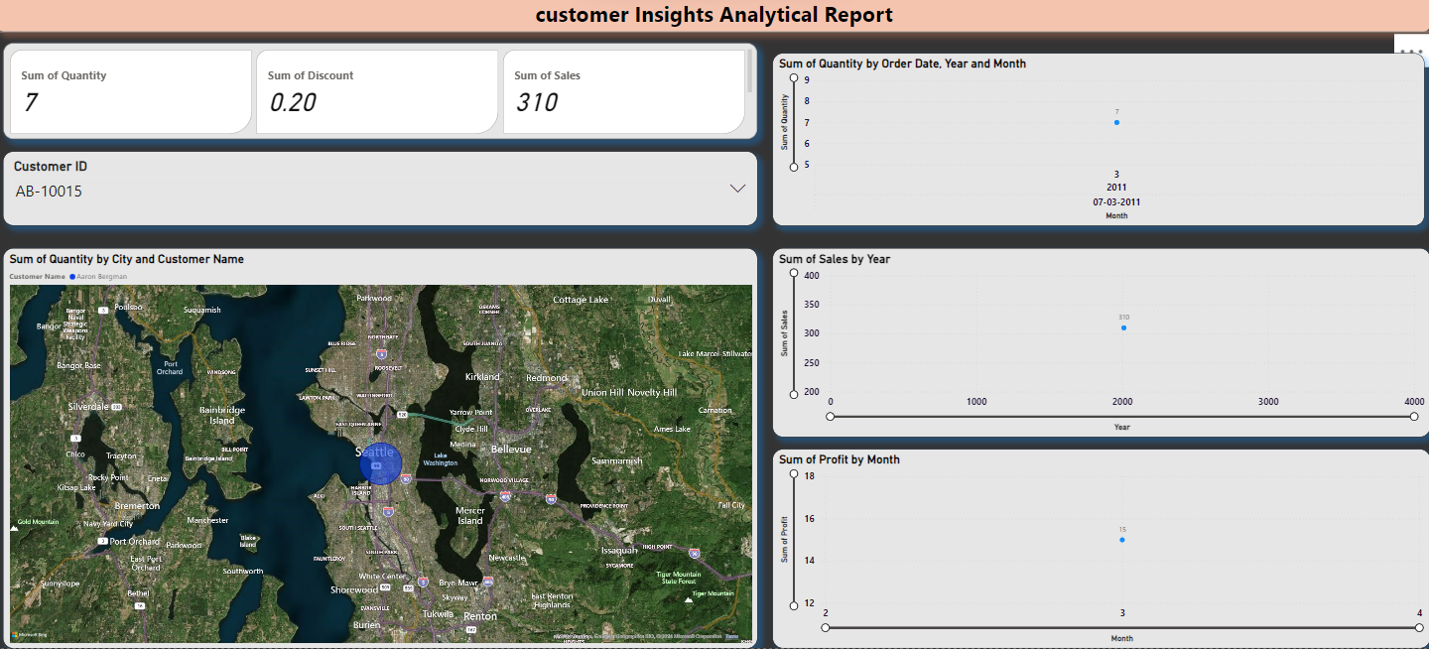
Customer insight analytical Report

Slide 8
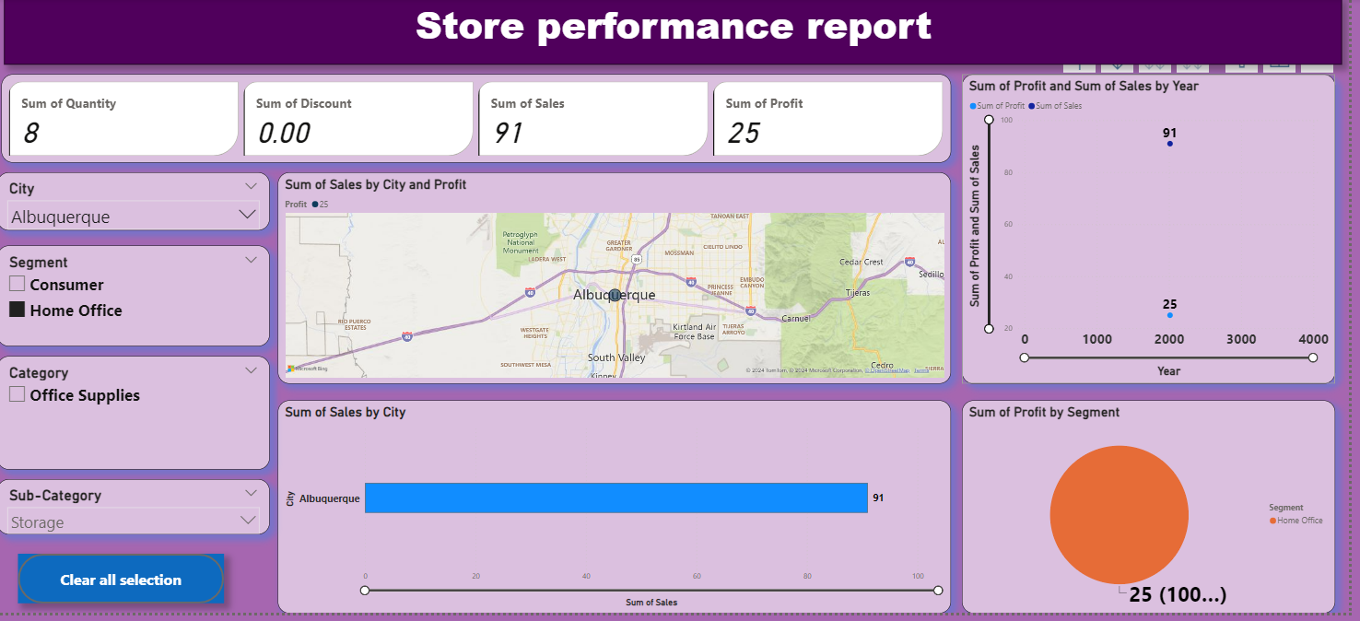
Store performance Report

Slide 9
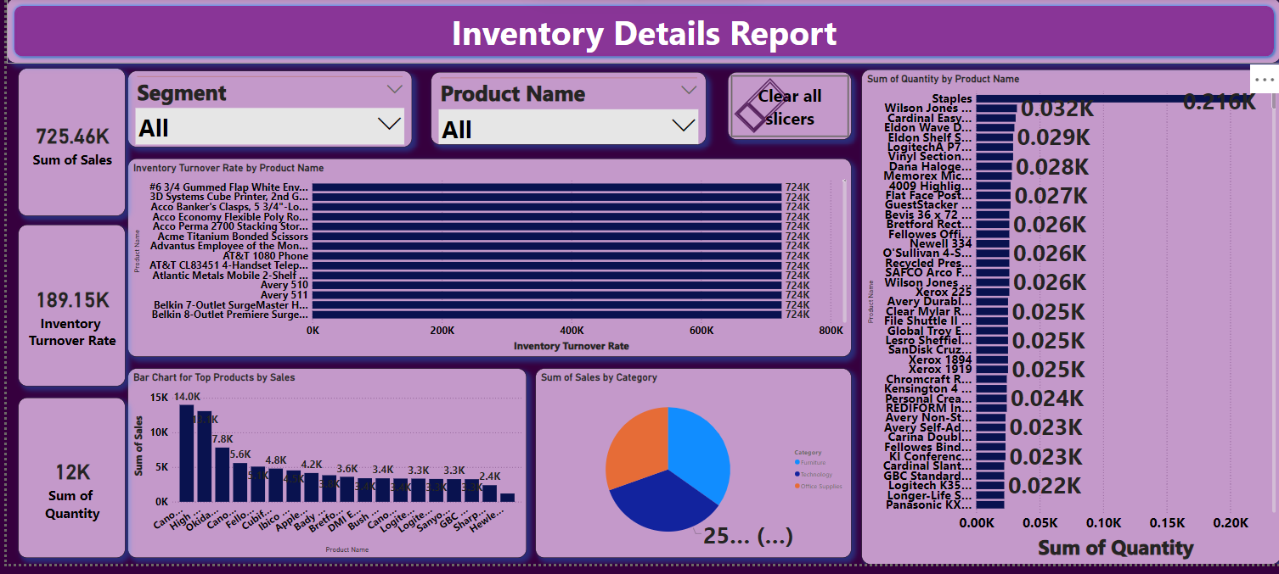
Inventory details Report

Slide 10
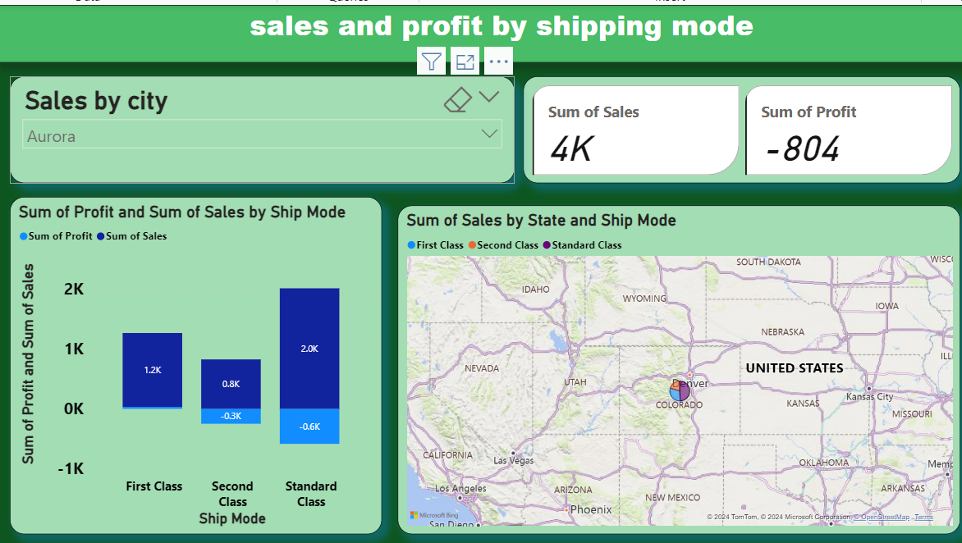
Sales and profit by shipping mode

Slide 11

Presented by
preetha(MB25)

