Slide 1
Car Rental System: Object-Oriented programming cs251
--------------

Slide 2
CONTENTS
Introduction
Main Transactions
Classes
Inheritance
Output
Future scope
Individual contribution

Slide 3
INTRODUCTION
The Car Rental System is designed to facilitate the efficient management of car rentals for customers.
It aims to provide a user-friendly interface for renting cars, selecting rental durations, and generating invoices.
The system automates various tasks involved in the rental process, enhancing customer experience and streamlining operations.

Slide 4
Main Transactions
1.Car Reservation:
Allows customers to browse available cars and reserve their preferred model.
Customers can view car features, select the desired car, and confirm the reservation.
2.Rental Duration Selection:
Enables customers to specify the duration for which they want to rent the car.
Customers can choose the start and end dates of the rental period, influencing the rental fee calculation.
3.Invoice Generation:
Automatically generates invoices for completed rental transactions.
Invoices include details such as customer information, car model, rental duration, and total rental fee.

Slide 5
Classes
Car Features:
Manages car attributes.
Displays car features to users.
Customer:
Stores customer information.
Facilitates rental transactions.
Rent:
Handles rental operations.
Calculates fees and generates invoices.
Welcome:
Displays a welcoming message.
Enhances user experience.

Slide 6
INHERITANCE DIAGRAM
welcome
carfeatures
rent
customer

Slide 7
INHERITANCE
Explanation and Key Points
Customer : Stores customer information. Rent inherits from Customer, extending functionality for rental operations.
Rent : Inherits from Customer, adding rental functionality like fee calculation and invoice generation.
Car Features : Manages car attributes independently, promoting code modularity.
Welcome : Provides a welcoming interface without inheritance, enhancing user experience.
Modularity : Encapsulates specific functionalities, facilitating code organization and maintenance.
Functionality Extension : Inheritance allows Rent to enhance rental operations while leveraging existing data management capabilities.

Slide 8





Rental process overview :
Step 1
Step 2
Step 3
Step 4
Step 5
Welcome message
User input
Rent calculation
Display car features
Invoice generation

Slide 9
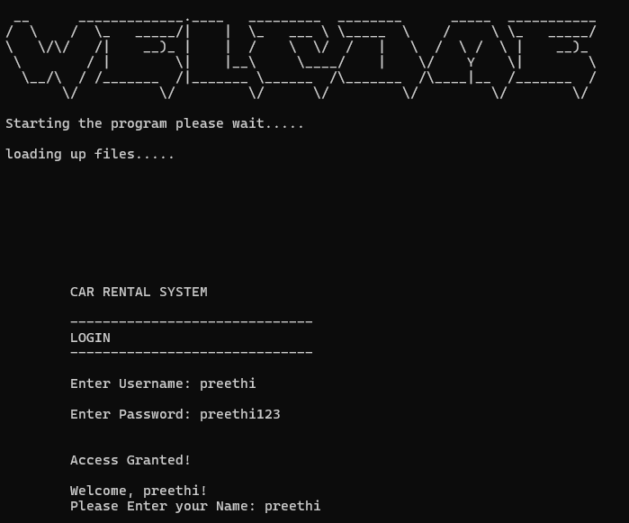
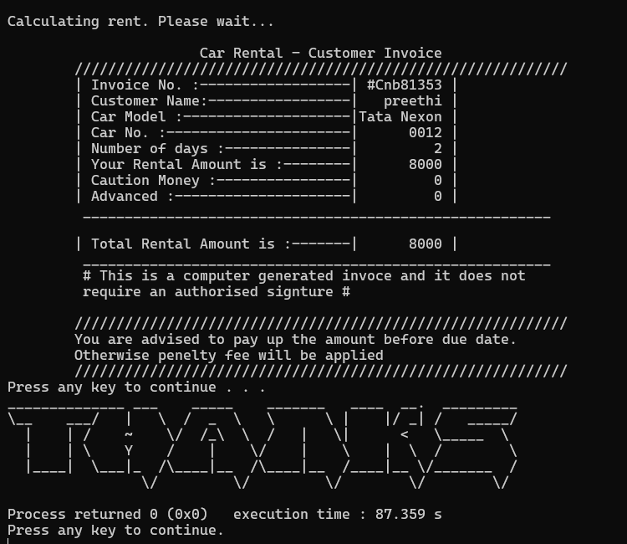
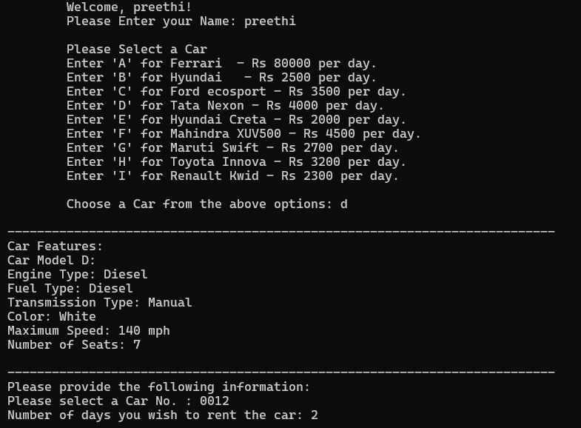
O
U
T
P
U
T

Slide 10
FUTURE SCOPE
01
02
03
Online Payments:
Enable easy online payments for rentals.
Simplify the rental process for customers.
Vehicle Tracking:
Track cars in real-time with GPS.
Improve how we manage our fleet.
More Choices:
Add new car types and rental options.
Offer flexibility to meet diverse needs.

Slide 11
FUTURE SCOPE
04
05
06
Better Experience:
Make the system more user-friendly.
Listen to feedback and make improvements.
Digital Prescence:
Be where our customers are online.
Reach more people and grow our business.
Smart Marketing:
Use creative ways to promote our service.
Engage customers through social media and ads.

Slide 12
Individual contributions
Krishnamurthi
Nithyasri
Akhila
Preethi
Rent class
Customer class
Car features
Welcome class
Handled rental operations, including fee calculation and invoice generation.
Managed customer information and facilitated rental transactions through data storage and retrieval.
Managed car attributes and provided a user-friendly display of car features.
Enhanced user experience with a welcoming message and introduction to the car rental system.

