Slide 1



EDGE AI HEALTH MONITORING SYSTEM USING FPGA
TEAM CARECRAFT
160123735156 - M.Keerthi Sri
160123735018 - P. Keerthi
160123735159 - N.Preethi
Department of Electronics and Communication Engineering
Chaitanya Bharathi Institute of Technology, Hyderabad

Slide 2
Problem Statement:
In today’s healthcare systems, continuous real-time monitoring of patient vitals is still limited, expensive, and often delayed.
Most existing solutions suffer from:
Delayed detection of critical conditions
Dependence on manual supervision
High-cost hospital monitoring systems
Limited ability to monitor multiple patients simultaneously
Reliance on software/cloud processing, causing latency
T

Slide 3
Why This Problem Matters:
Importance of Real-Time Monitoring
Healthcare emergencies require immediate response.
Statistics:
Heart disease causes 17.9 million deaths every year (WHO)
Many critical cases occur due to late detection of vital changes
If abnormal vital signs are detected early, emergency response can save lives.
Even a few seconds of delay in detecting abnormal conditions can lead to severe consequences.

Slide 4
Existing Design - Limitations
Wearable Devices | Depend on cloud processing
Hospital Monitors | Expensive and bulky
Manual Monitoring | High risk of human error
Software Systems | Slower response time
Most systems rely on software processing instead of hardware acceleration.

Slide 5
Proposed Solution:
Our Solution : We propose a
Real-Time FPGA-Based Health Monitoring System
The system continuously monitors:
Heart Rate
Blood Oxygen (SpO₂)
Blood Pressure
Body Temperature
The FPGA analyzes this data and:
Detects abnormal conditions
Generates alerts instantly
Displays results on monitoring dashboard

Slide 6
Objectives:
The goal of this project is to:
Develop a real-time health monitoring system
Use FPGA hardware acceleration for faster processing
Detect abnormal patient conditions instantly
Generate automatic alerts for critical situations
Visualize health data using dashboards

Slide 7
Project Claims :
Key Contributions of Our System
Our system introduces several improvements:
FPGA-based real-time processing
Parallel monitoring capability
Instant critical condition detection
Low latency alert system
Scalable architecture for hospitals
Hardware-based monitoring instead of software-only processing.

Slide 8
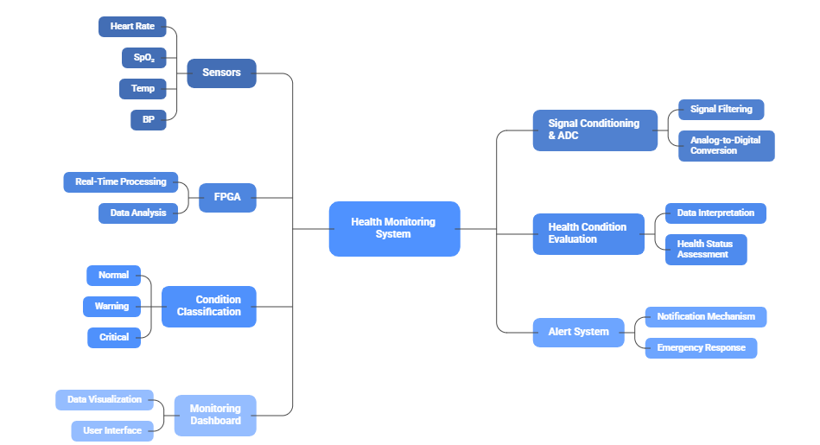
SYSTEM ARCHITECTURE

Slide 9
Methodology:
Data Acquisition: Collect real‑time patient vitals such as Heart Rate, SpO₂, Temperature, and Blood Pressure using sensors.
Signal Conversion: Convert analog sensor signals into digital data for processing.
FPGA Data Input: Feed the digital health data into the FPGA processing unit.
Real‑Time Processing: FPGA analyzes multiple parameters simultaneously using parallel hardware logic.
Health Evaluation: Sensor values are compared with predefined medical thresholds.
Condition Classification: Patient condition is categorized as Normal, Warning, or Critical.
Alert Generation: If abnormal conditions are detected, the system triggers instant alerts.
Dashboard Display: Processed health data and alerts are visualized on a monitoring dashboard for doctors or caregivers.

Slide 10
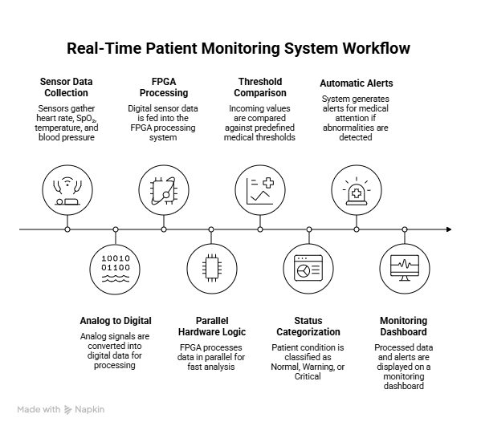

Slide 11
Tools & Technologies Used:
PROGRAMMING LANGUAGES & SOFTWARE TECHNOLOGIES:
1. Core Development Language: TypeScript
The foundation for type-safe, robust application logic.
2. Frontend Architecture: React Framework
Component-based UI for real-time health monitoring.
3. Modern Styling Engine: Tailwind CSS
Utility-first design for a responsive and professional interface.
4. Structural Foundation: HTML5 & CSS3
The standard building blocks for web-based applications.
5. Configuration & Metadata: JSON
Managing project dependencies and application settings.
6. Build System & Tooling: Vite
High-performance development and production bundling.
7. Specialized Libraries & Web APIs
Integrating Hardware (Web Serial), Voice (Web Audio), and Location (Geolocation).
Data Visualization with Recharts and Motion Animations.
Hardware tools:
Xilinx FPGA Board
Heart Rate Sensor (ECG / Pulse Sensor)
SpO₂ Sensor (Pulse Oximeter)
Temperature Sensor
Blood Pressure Sensor
Signal Conditioning / ADC Module
Display / Dashboard Interface
Simulation Platforms:
Verilog HDL
EDA Playground
EPWave Waveform Analyzer
Testbench-based signal simulation

Slide 12
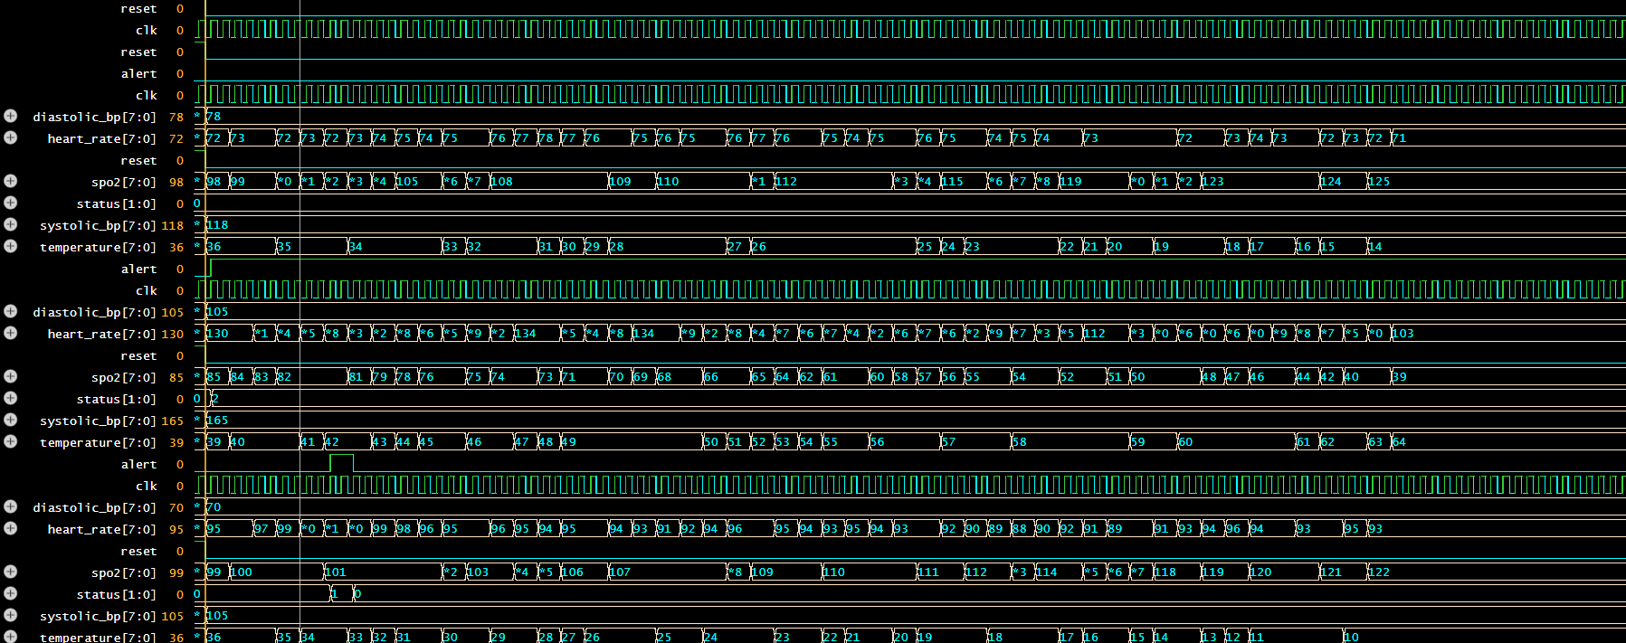
Software Simulations
Simulations of different cases in people

Slide 13

Software Simulations

Slide 14
WORK TO BE DONE
Integration of real biomedical sensors with the FPGA hardware
Implementation of the system on a physical FPGA board (Xilinx platform)
Development of a real-time monitoring dashboard interface
Testing the system with real patient data for accuracy validation
Optimization of FPGA design for low power and high efficiency
Expansion to support remote monitoring using IoT connectivity
Enhancement of system with AI-based health prediction (future scope)

Slide 15
Expected Outcomes:
* Development of a real-time health monitoring system using FPGA
* Accurate monitoring of vital parameters such as:
Heart Rate
SpO₂
Temperature
Blood Pressure
* Instant alert generation for abnormal health conditions
* Demonstration of parallel processing capability of FPGA for multi-patient monitoring
* Real-time waveform simulation showing dynamic physiological data
* Visualization of patient health status through a dashboard interface
* Reduced latency in detecting critical conditions compared to traditional systems
* Successful classification of patient conditions into:
Normal
Warning
Critical
Dept. of ECE

Slide 16
Conclusion:
This project presents a real-time FPGA-based health monitoring system capable of continuously tracking vital parameters such as heart rate, SpO₂, body temperature, and blood pressure. By utilizing the parallel processing capabilities of FPGA, the system ensures fast and efficient analysis of multiple parameters simultaneously with minimal latency. The implementation successfully classifies patient conditions into normal, warning, and critical states while generating instant alerts for abnormal situations. The simulation results demonstrate the system’s ability to handle dynamic, real-time data effectively. Overall, this project provides a scalable and reliable solution for modern healthcare monitoring, with strong potential for future integration into real-world medical systems.

