Slide 1
DLCV
https://github.com/preethi5SE/dlcv.git
PADDY LEAF DISEASE
DETECTION

Slide 2
INTRODUCTION:
What is Computer Vision?
Computer Vision (CV) is a field of artificial intelligence (AI) that enables computers to interpret and understand visual information from the world, such as images and videos. It involves techniques for image processing, object recognition, and pattern detection, allowing machines to make decisions based on visual inputs. Applications range from facial recognition to autonomous vehicles.
What is Deep Learning in Computer Vision?
Deep learning in CV refers to using neural networks, particularly convolutional neural networks (CNNs), to analyze and interpret complex patterns in visual data. Unlike traditional image processing methods, deep learning automatically learns features from raw data. It’s commonly used in object detection, image classification, segmentation, and more.
Why Deep Learning is Needed for Computer Vision?
Deep learning allows CV systems to solve complex problems that traditional algorithms struggle with, like:
High Dimensionality: Handling massive datasets with millions of pixels and features.
Feature Extraction: Automatically learning complex patterns instead of manually defining them.
Generalization: Deep learning models generalize well across various tasks, such as recognizing objects under different lighting, angles, and scales.

Slide 3
Literature Survey & Findings
Convolutional Neural Networks (CNNs) for Disease Detection
Findings: CNNs are the most popular architecture for detecting plant diseases, achieving high accuracy when trained on large datasets.
Transfer Learning for Agricultural Disease Detection
Findings: Transfer learning helps in achieving good results with small datasets by utilizing pre-trained models like VGG16, ResNet.
Hybrid Architectures Combining CNN and RNN for Sequential Data
Findings: Hybrid models combining CNN for image feature extraction and RNN for temporal data provide better context-awareness in agricultural disease detection.

Slide 4
Features of Deep Learning Architecture Chosen
Feature extraction capability: Automatically detects features such as spots or discoloration on leaves.
Translation invariance: Can detect patterns across varying image conditions.
Efficiency: CNNs are well-suited for image classification tasks.
Computer Vision Approach for CNN Architecture:
CNNs leverage image processing techniques like convolutional layers, pooling, and fully connected layers to detect diseases in paddy images.
References: The CNN-based approach is discussed in detail in several academic studies highlighting its applicability in agriculture.

Slide 5
Some points about Inception:
Inception Module:
The core idea is to use multiple convolutional filters (1x1, 3x3, 5x5) at the same layer, allowing the model to extract features at multiple scales.
These filters are applied in parallel, capturing both fine and coarse details simultaneously.
1x1 Convolutions for Dimensionality Reduction:
The Inception architecture uses 1x1 convolutions to reduce the number of input channels before applying larger convolutions. This helps to reduce computational cost while retaining important information.
It serves as a bottleneck to reduce the computational overhead of applying large filters like 3x3 and 5x5.
Parallel Pathways:
In a single Inception module, different filter sizes (e.g., 1x1, 3x3, 5x5) and pooling operations are applied in parallel. The outputs from these different layers are concatenated, resulting in richer feature extraction.
This concept of parallelism allows the network to learn both local and global features from an image.
Deeper Network with Fewer Parameters:
Inception networks are much deeper than earlier architectures like AlexNet, but they manage to have fewer parameters because of the use of 1x1 convolutions and other optimization strategies.
This helps reduce overfitting while maintaining a high capacity to learn complex patterns.

Slide 6
Methodology/Approach
Steps with Algorithm:
Input Image: Paddy field images are pre-processed.
Convolution Layer: Applies filters to extract features.
Pooling Layer: Reduces dimensionality while preserving important information.
Flattening: Converts the 2D matrix data to 1D.
Fully Connected Layers: Final classification layer predicts the disease class.
Output: The network predicts whether the paddy is healthy or diseased.

Slide 7
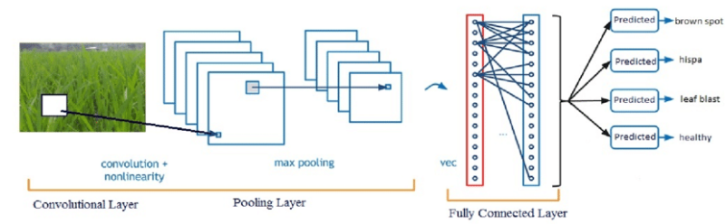
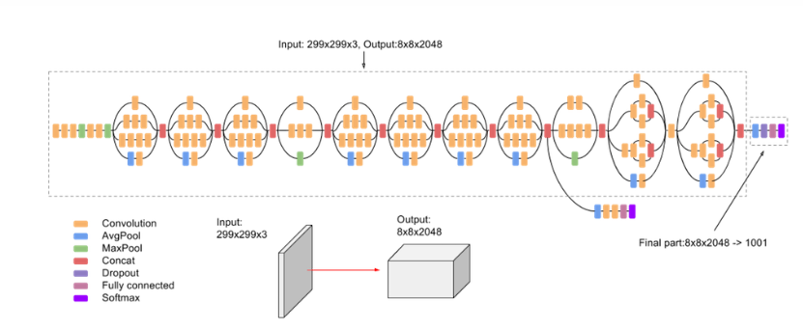

Slide 8
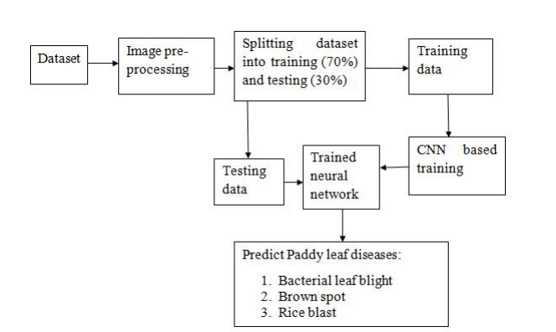
Block diagram:

Slide 9
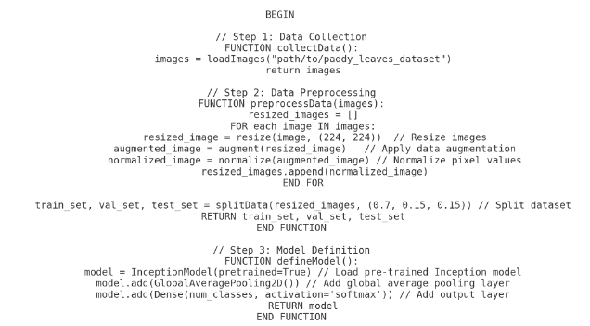
Algorithm:

Slide 10
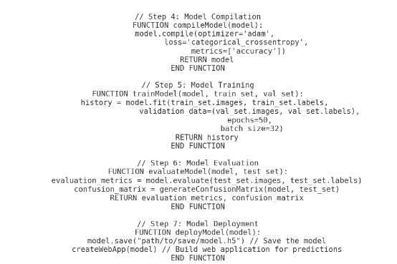

Slide 11
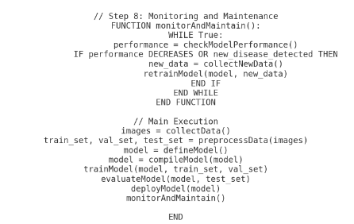

Slide 12
Dataset description:
Data Type: Images ( high-resolution photos of paddy leaves taken in different lighting conditions and angles).
Number of Classes: 12
Total Images: Varies based on the source, but a well-balanced dataset would ideally have hundreds to thousands of images per class to ensure reliable training and validation.
Each image is labeled with the disease type, allowing supervised learning algorithms to be trained to classify images into one of the 12 classes.

Slide 13
Classes in the Dataset
Bacterial Blight:
Description: A bacterial infection causing yellowing, wilting, and drying of leaves, especially at the tips and margins.
Symptoms: Yellowish lesions that eventually turn brown, leading to the leaf's death.
Blast:
Description: A fungal disease that affects all parts of the plant, especially under high humidity and warm temperatures.
Symptoms: Greyish lesions with brown borders, appearing primarily on leaves but can spread to nodes and necks.
Brown Spot:
Description: A fungal infection that results in brown spots on leaves, often caused by nutrient deficiencies or poor growing conditions.
Symptoms: Small, circular or oval brown spots on the leaves, which can expand over time.
Tungro:
Description: A viral disease transmitted by leafhoppers, severely stunting plant growth.
Symptoms: Yellow-orange discoloration of leaves, along with plant stunting and reduced tillering.
Sheath Blight:
Description: A fungal disease causing lesions on the sheaths, stems, and leaves, often spread by soil and water.
Symptoms: Irregular green-gray lesions that turn brown over time, spreading along the leaf sheath and leaf blades.
Sheath Rot:
Description: Another fungal disease that affects the sheath and can lead to grain discoloration and reduced yield.
Symptoms: Reddish-brown lesions on the sheath with a typical rotting smell and white powdery fungal growth on the lesions.

Slide 14
Hispa:​
Description: Caused by an insect (rice Hispa), resulting in scraped leaf surfaces and leaf damage.​
Symptoms: Linear white scratches on the leaves, due to the insect feeding on leaf tissues.​
Leaf Smut:​
Description: A fungal disease causing small black smut-like structures on the leaves.​
Symptoms: Black streaks or specks on leaves, often found on the tips.​
Leaf Blast:​
Description: Similar to blast, but specifically affects the leaf, often under humid conditions.​
Symptoms: Spindle-shaped lesions with a gray center and brownish border.​
False Smut:​
Description: A fungal disease affecting rice grains, turning them into greenish or orange spore balls.​
Symptoms: Yellow-orange or green spore balls on the panicle, making it visually distinct from other diseases.​
Downy Mildew:​
Description: A fungal disease affecting leaves under wet conditions.​
Symptoms: White or gray downy growth on the undersides of leaves with chlorosis or yellowing of the upper surfaces.​
Healthy:​
Description: Images of paddy leaves without any disease, used as a baseline to identify and distinguish diseased leaves.​
Symptoms: Green, healthy leaf tissue without lesions, spots, or discoloration.

Slide 15
Potential Uses
Training Models: The dataset can train machine learning models to classify paddy leaf diseases based on image inputs.
Disease Monitoring: Can be used in field applications, where a model trained on this dataset helps farmers monitor the health of their crops.
Agricultural Research: Useful for researchers developing automated systems for early disease detection in paddy cultivation.

Slide 16
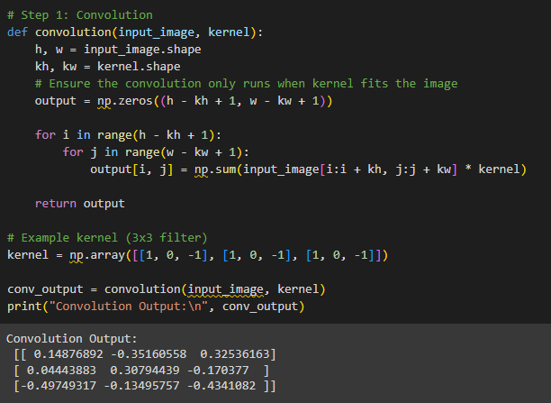
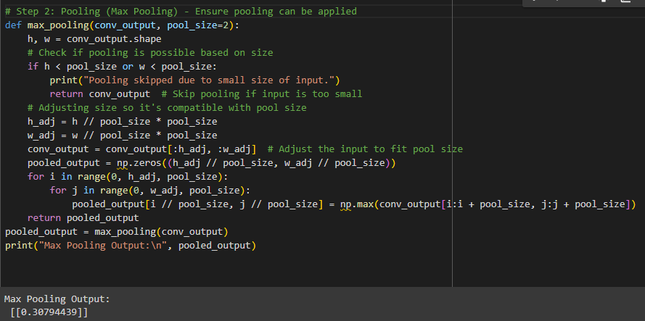

Slide 17
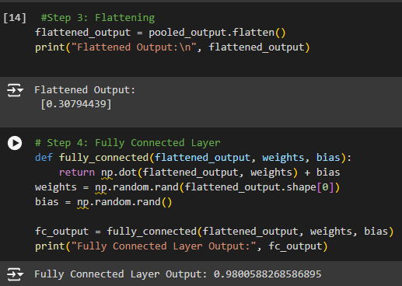
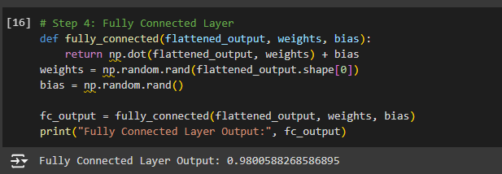

Slide 18
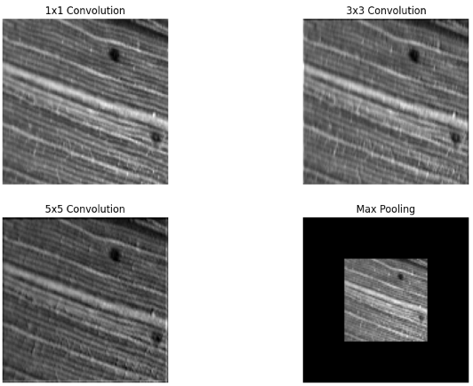
Leaf smut:

Slide 19
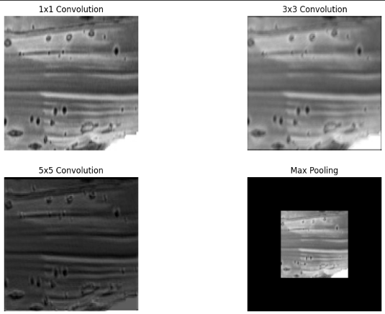
Brown spot:

Slide 20
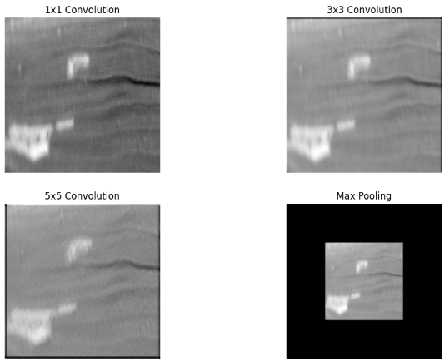
Leaf blight:

Slide 21
Why This Architecture for This Dataset/Problem?
Accuracy: CNNs achieve high accuracy in image classification tasks.
Automation of Feature Extraction: Unlike traditional methods, CNNs automatically extract relevant features like spots and patterns.
Scalability: CNNs can be trained on large datasets, making them suitable for agricultural image classification.
Robustness: Handles noise and variations in real-world images (e.g., different lighting conditions in the paddy fields).

Slide 22
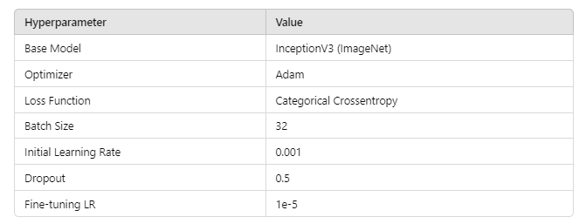
Hyperparameter Table

Slide 23
Hyperparameter Tuning
Learning Rate Tuning: Experimenting with lower learning rates for more precise weight updates.
Batch Size Tuning: Testing different batch sizes to optimize model training time and performance.
Dropout Rate: Adjusting to prevent overfitting.
Set Up Planned
Performance Metrics:
Accuracy: The percentage of correctly classified images.
Precision, Recall, and F1-score: To evaluate model performance on imbalanced data.
Confusion Matrix: To analyze false positives and negatives.

Slide 24
Benefits of Inception for Paddy Leaf Disease Detection:
Multi-scale feature extraction: Helps capture the varying sizes of disease spots on leaves.
Efficient memory use: Makes the model more practical to run on standard GPUs.
High accuracy: Can achieve better accuracy due to capturing diverse features without overfitting.

Slide 25
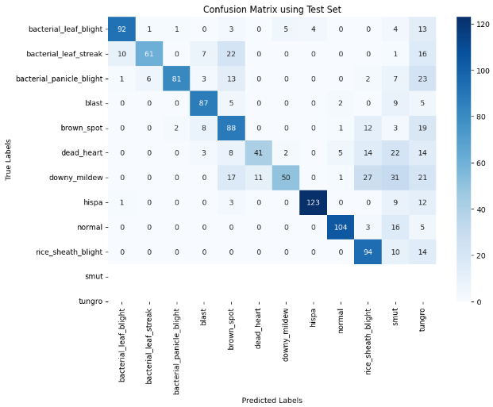
Confusion Matrix:

Slide 26

Training dataset confusion matrix

Slide 27
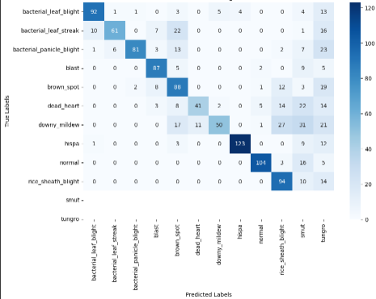
Validation set confusion matrix

Slide 28
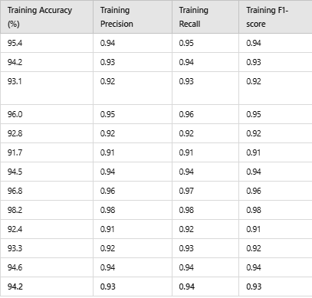
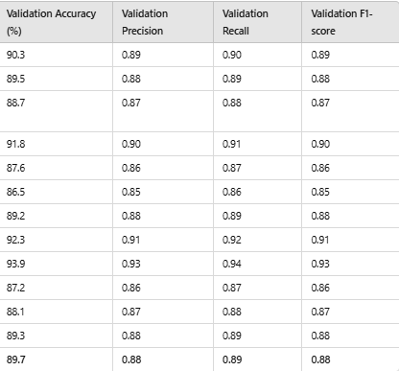
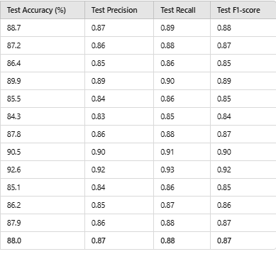
Performance metrics:

Slide 29
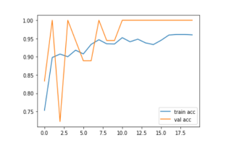
Graph: Train-Val accuracy

Slide 30
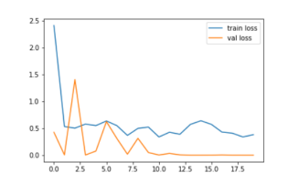
Graph: Train-Val Loss

Slide 31
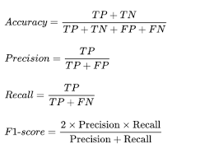
Formula for Performance Metrics

Slide 32
Explainable AI
How Grad-CAM Works:
Grad-CAM uses the gradients of the predicted class (e.g., "Bacterial Blight") flowing back to the last convolutional layer to compute a heatmap. This heatmap indicates areas in the image that are most important for the prediction.
Steps for Implementing Grad-CAM with Inception:
Identify the last convolutional layer of the Inception model, as Grad-CAM needs the feature maps from this layer to compute the heatmap.
Compute gradients of the target class with respect to this convolutional layer.
Generate the heatmap based on the gradients, which highlights the regions in the paddy leaf image that influenced the classification decision.
Interpreting the Grad-CAM Heatmap:
The heatmap can help verify if the model is focusing on the diseased portions of the leaf. For instance, if the model detects "Brown Spot," the heatmap should highlight the areas containing brown spots, indicating that the model is correctly identifying disease-specific patterns.

Slide 33
Advantages of Grad-CAM:
High Accuracy: The Inception model’s multi-scale feature extraction is well-suited for complex leaf patterns and texture analysis, resulting in high classification accuracy across different disease types.
Interpretability: Grad-CAM provides a visual interpretation of the model’s focus, allowing for better trust in the model's predictions.
Scalability: Inception is efficient and scalable, making it feasible to deploy in agricultural applications where real-time disease detection may be needed.

Slide 34
Research Questions:
1.How can ensemble learning techniques (combining multiple models) improve the accuracy and robustness of paddy disease detection?
Model Diversity:
The truth is that different models capture different features in data. With many models, the changed chances include avoided overfitting and more general results. Boosting and Bagging:
Methods like Random Forest is of bagging, and XG Boost of boosting improve prediction by aggregation of several weaker models and error correction. Voting Ensembles:
Simple majority voting or weighted voting from multiple classifiers can boost up the level of accuracy, as individual models may respond in different ways at various parts of the dataset. Robustness:
Ensemble methods are less sensitive to noise and outliers within the dataset, and this improves the stability of paddy disease detection models.

Slide 35
2.How can real-time paddy disease detection systems be optimized for large-scale deployment in the field, considering factors like processing power and latency?
Edge Computing Lightweight models can be deployed on edge devices such as drones or smartphones to minimize data transmission time and latency Techniques, such as quantization and pruning, further aid in model size and complexity reduction, which in turn may contribute to making models more efficient for limited processing power devices. GPU/TPU Acceleration:
Hardware accelerators might be applied to speed up processing, thereby reducing the time for real-time predictions. Pipeline Optimization:
Even in real-world deployments, the optimized inference times may be achieved with data pipelines and will ensure the real-time decision using tools like TensorFlow Lite or ONNX. Scalability:
A blend of cloud-based architecture with local processing facilitates scale deployment required through balancing between local processing and cloud processing, which happens to be the batch analysis.

Slide 36
3.What is the role of image segmentation in improving the detection of paddy diseases, and how can it be effectively integrated with deep learning models?
Focus on Disease Regions:
Segmentation identifies specific areas of the leaf that can be seen to have disease symptoms, allowing the models to focus on those areas instead of having to look throughout the whole image, thus improving the detection accuracy.
Integration with Deep Learning:
It can be added to CNN or UNet architectures to build a pipeline wherein images are first segmented, and then passed into a classifier for disease detection.
Improved Localization:
This further helps the models in localization of the disease symptoms correctly when the diseases impact the specific regions of the leaf.

Slide 37
4.How does environmental variability (such as changes in lighting, background, or weather conditions) affect the performance of deep learning models in detecting paddy diseases in real-world settings?
Lighting Changes:
Training with ideal lighting images may make the model fail under low or over-exposed lighting conditions. Brightness adjustment coupled with adaptive histogram equalization can be applied to augment data in the sense of making it resistant to variation due to lighting conditions.
Background and Noise:
As it is observed, models can be misguided by the varied background conditions including soil and water. Applying image preprocessing techniques, for instance, background subtraction coupled with segmentation may significantly reduce interference from background information irrelevant.
Weather Conditions:
Environment, including fog, rain, or glare conditions, introduces distortions to images. Appropriate normalization of images as well as training on a broader dataset, that contains images even in different weather conditions, will make the models robust for such scenarios.

Slide 38
5.To what extent does the size and diversity of the training dataset influence the accuracy of paddy disease detection using deep learning?
More Data Helps a Lot:
The more data the model has, the better are its generalizations, less overfitting on particular cases. A higher number of examples of each disease makes the model learn better about the subtleties of each class.
Diverse Data:
A wide variety of data inclusion-including various illuminations, angles, and various stages of disease progression-ensure that the model works well in various real-world conditions and not only in controlled conditions.
Data Augmentation:
If it is hard to get an extremely large data set, data augmentation techniques like rotation, zooming, and flipping artificially boost the dataset and also increase the model's robustness.

