Slide 1
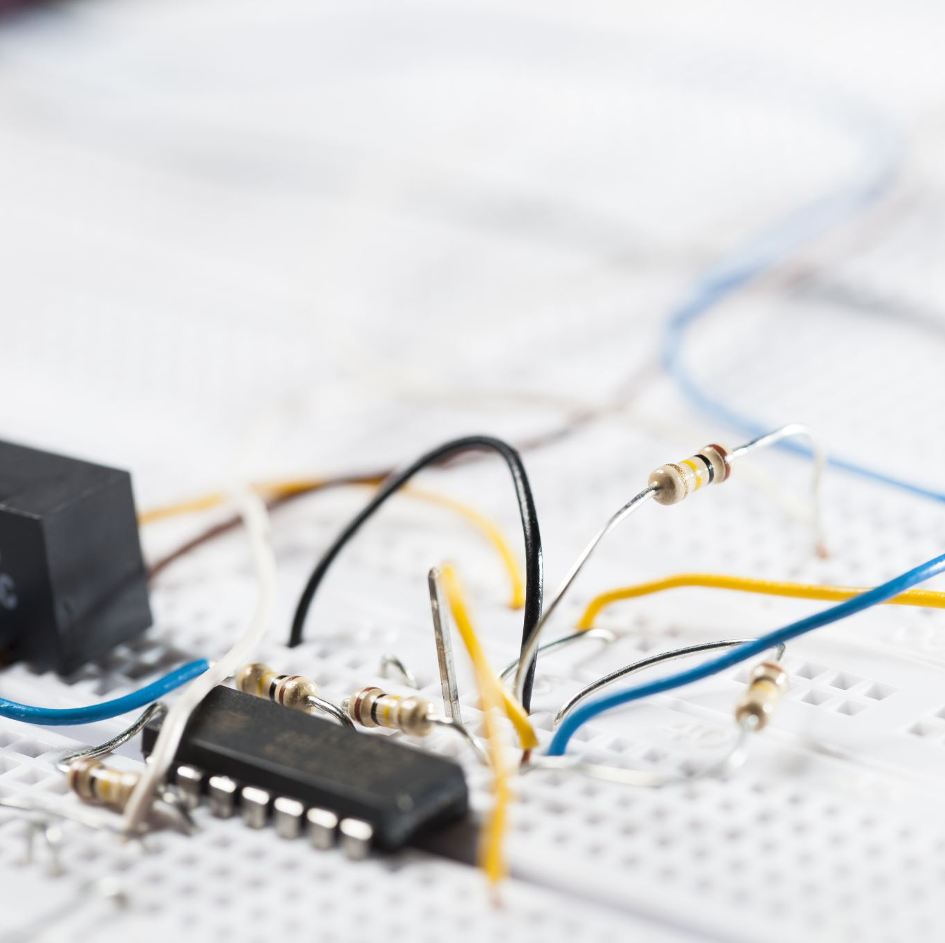
Face detection using ESP32, Python and OpenCV
Satya Divya Maddipudi
Preethi Billa
Niranjan Reddy Masapeta

Slide 2
Introduction
ESP32 is a low cost and low power microcontroller used to small to medium IoT projects.
ESP32 is the successor of highly successful ESP8266 microcontroller with increased CPU cores, faster Wi-Fi and higher clock frequency.
Face detection is one of the most important research areas in modern Machine Learning used in face recognition, facial biometric authentication, liveness detection and many more.

Slide 3
Project deliverables
Build a face detection model using Python and OpenCV library.
Connect a camera module to ESP32 microcontroller to stream video.
Using the face detection algorithm, detect faces in the stream generated by ESP32 camera

Slide 4
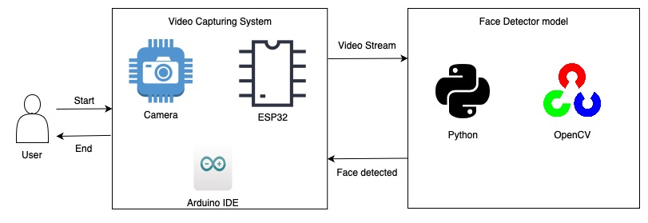
Project architecture

Slide 5
Project dependencies
ESP32 microcontroller
OV2640 Camera
Python
OpenCV
Arduino IDE

